Slide 1

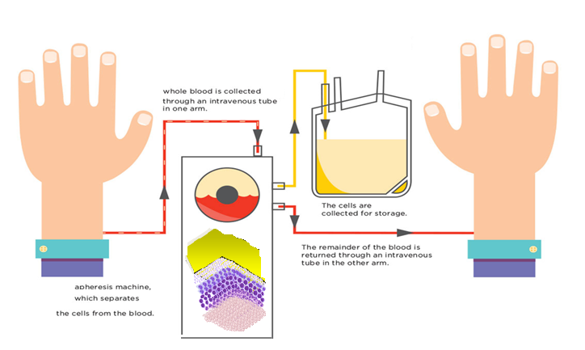


Overview of Therapeutic Apheresis
×
×
×
Dr. Mustafa CETIN

Slide 2

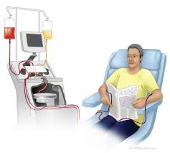
Definition &
Rationale For TA Procedures
Apheresis” is derived from the Greek word “Aphairesis”
which means “to separate,” “to take away by force,” or “to remove”
Moreover, it is used to treat many different clinical conditions.
It involves removal of some components from the blood
with or without replacement.

Slide 3
Technology (Apheresis Instrument Types)
×
×
×
Centrifugation
Column filtration
Column adsorption

Slide 4
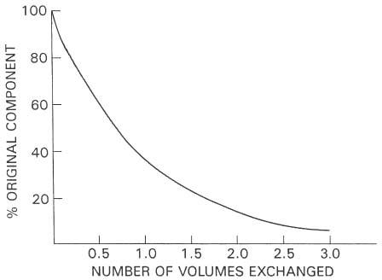
Plasma Volumes Exchanged
Therapeutic Apheresis
Disease Mediator
Removed, %
Choices of Replacement fluid
Albumin/HAS
Colloids – saline
Fresh Frozen Plasma (FFP)

Slide 5
Therapeutic Apheresis
Removes quickly a large volume of plasma and cellular comportments from circulation,
  I. Therapeutic Cellular Exchange
  Exchanging the disturbed cells in circulating blood,
  II. Therapeutic Plasma Exchange
  Removing the plasma disease mediators in circulating plasma,
    Pathologic antibodies ,
    Immune complexes,
    Cytokines,
    Paraproteins,
    Lipid- Cholesterol,

Slide 6
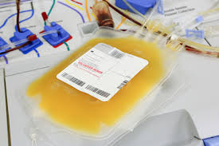
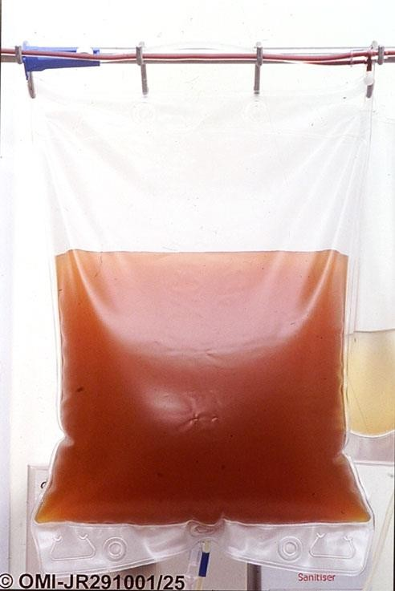
Therapeutic Cellular Exchange
Removal of:
  WBCs:
    Leukocytapheresis: in the setting of high WBC count in leukemia
    Peripheral stem cell collection
  Platelets:
    Thrombocytapheresis for thrombocytosis of myeloproliferative disorders
Exchange of:
  RBC: Erythrocytapheresis (sickle cell disease, malaria)
Modification of:
  WBC (with UV light): Photopheresis

Slide 7
Therapeutic Cellular Exchange
Rapid reduction of a greatly elevated number of cells from the intravascular space to decrease the risks associated with vascular stasis
According to the ASFA evidenced based guidelines, Cellular depletions are generally considered when:
  Leukocytosis: > 100,000/µL white blood cells (WBC)*
  Thrombocytosis: > 500,000 – 1,000,000 platelets*
  Erythrocytosis: > 60% hematocrit* or when the patient is symptomatic
Supportive therapy used in combination with drugs or chemotherapy

Slide 8
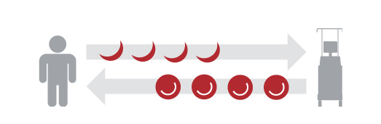
Therapeutic Cellular Exchange
Red Blood Cell Exchange
Known as automated exchange or exchange-transfusion
Defective RBC are removed and normal RBC are simultaneously infused
Can rapidly adjust the HCT% and HBS% concentration of the patient
Avoids fluid overload, increased viscosity, and iron overload associated with transfusions
Indications for Red Blood Cell Exchange
•Sickle cell disease
•Thalassemia
•Protozoal infections of red blood cells (RBCs)
•Incompatible transfusion
•Carbon monoxide poisoning

Slide 9
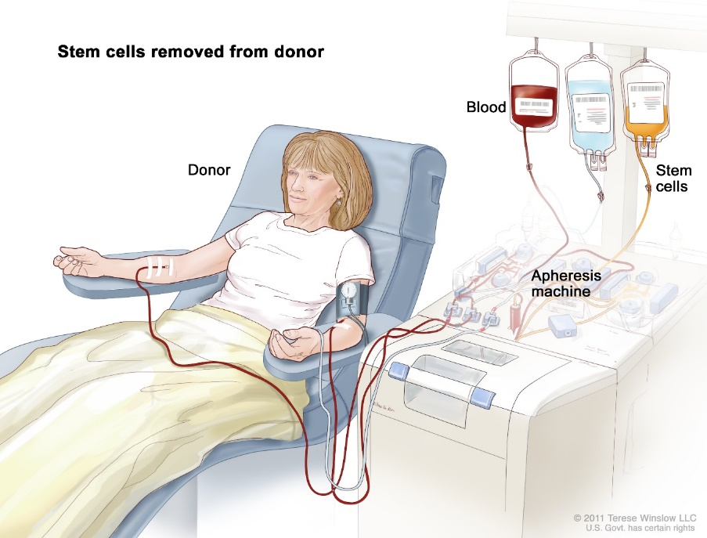
Stem Cell Harvest
Therapeutic Cellular Exchange
Autologous/ allogeneic
Primed prior to planned collection
Harvest is performed when CD34 count is high enough in peripheral blood
Aim to process 2.5 x total blood volume
Procedure time is within 3.5 to 5hrs
End target depends on the diagnosis, number of transplants, and rescues required

Slide 10
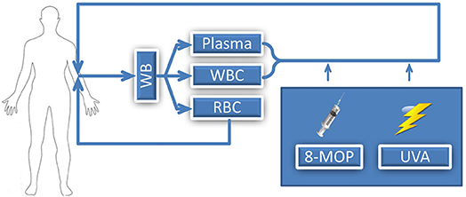
Extracorporeal Photopheresis (ECP)
Therapeutic Cellular Exchange
Photopheresis procedure
Therapeutic Applications
Malignancy
  CTCL,mycosis fungoides, Sezary syndrome
Graft Versus Host Disease
Solid organ transplant rejection
Autoimmune Disease
  PS sclerosis, SLE, RA, psoriatic arthritis
Suppress the abnormal immune response
Remove the causative factor
Relieve/eliminate symptoms

Slide 11
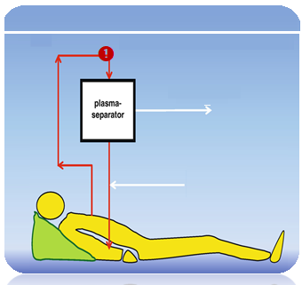
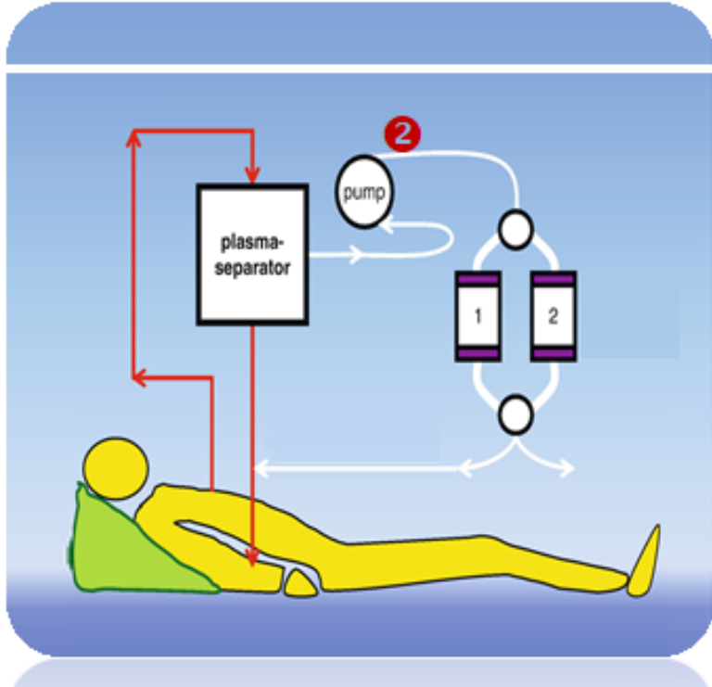
Therapeutic Plasma Exchange
Therapeutic Plasma Exchange
Removing the plasma disease mediators in the patient’s circulation
Plasma Exchange
Immune Adsorption
Plasma Exchange
  Alloantibodies,
  Autoimmune antibodies
  Antigen-antibody complexes
  Abnormal plasma proteins
  Very high cholesterol levels
  Plasma bound poisons or drugs
Endogen plasma
plasma
+ Ig G
Replacement fluids
* Albumin/HAS
* Colloids – saline
* Fresh Frozen Plasma
Adsorbed plasma
+ Ig G
It does not only remove abnormal plasma components (creatinine, urea, bilirubin, e.g.) but also replaces important plasma mediators (albumin, fibrinogen, electrolytes, bilirubin, e.g.) disturbed by disease : indirect homeostasis.

Slide 12
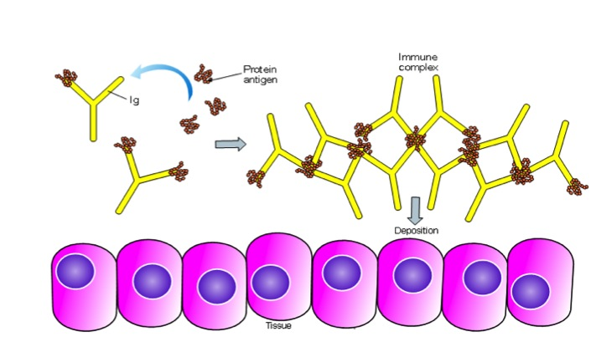
Autoimmune Disease
Therapeutic Plasma Exchange
Autoimmune disease occurs when an immune response is triggered inappropriately against self antigens
Against the self cells include:
Self Antibodies > inflammatory effects: (Fever, Pain, Swelling)
Self Immune complexes > an antibody and an antigen combination (entrapped in blood vessels, kidneys, or joints > Vasculitis, Nephritis, Arthritis)
Subsequently, the body self cells are destroyed by own antibodies and immune complexes
FDA approved for treatment of refractory ITP and rheumatoid arthritis
Clearance of antigen by normal immune processes does not occur and can result in a sustained immune response and chronic injury to tissues

Slide 13
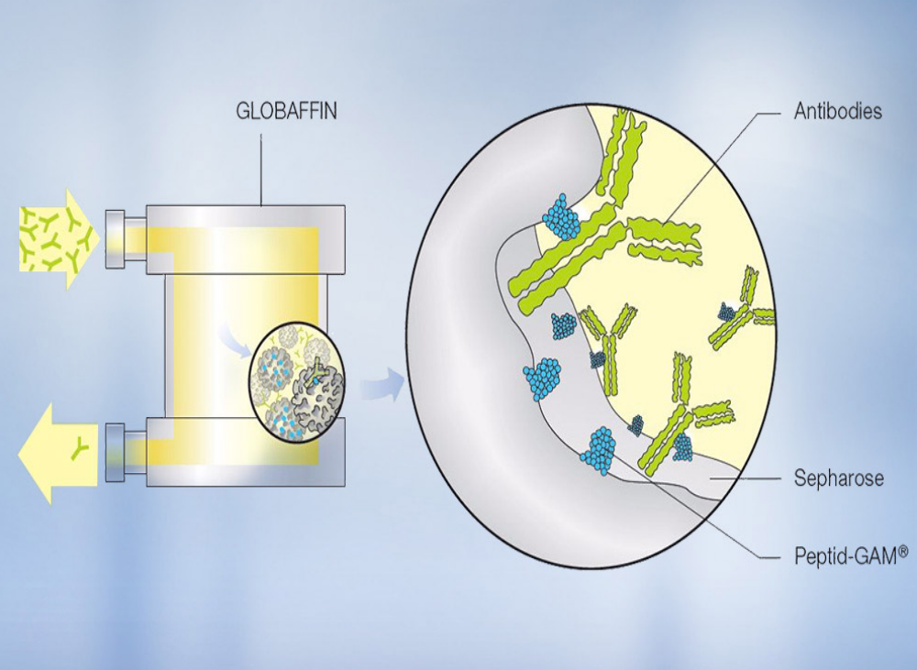
Guillain Barre Syndrome
Chronic ID polyneuropathy
Myasthenia gravis
Goodpasture’s
Post-transfusion purpura
Refsum’s disease
Therapeutic Plasma Exchange
Antibodies & Immune-complex Apheresis

Slide 14
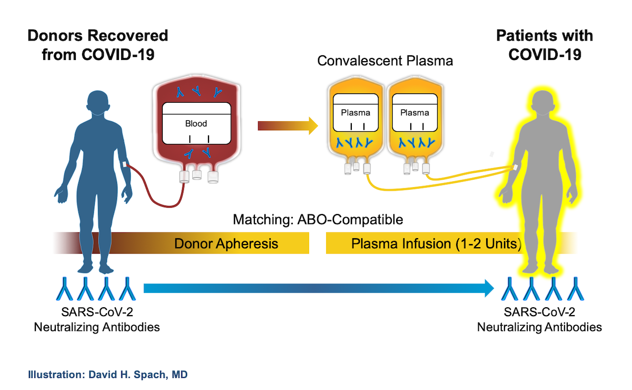
Therapeutic Plasma Exchange
Apheresis Antibodies

Slide 15
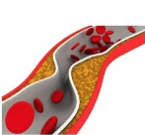
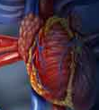
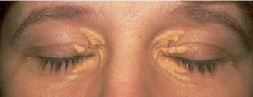
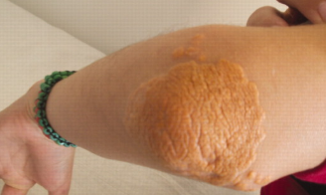
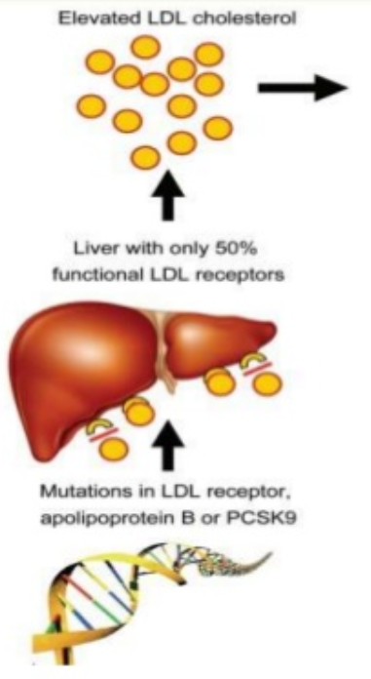
Lipid Apheresis
Therapeutic Plasma Exchange
LDL apheresis is performed for homozygotes or those with analogous phenotypes such as compound heterozygotes if the patient has been treated with diet and pharmacotherapy and if LDL-C remains above the following cut-points:
●LDL-C ≥160 mg/dL in children (age less than 18 years) with established atherosclerotic CVD.
●LDL-C ≥250 mg/dL in children without established atherosclerotic CVD
●LDL-C ≥160 to 190 mg/dL in adults with established CVD
●LDL-C ≥190 mg/dL in adults without established CVD.

Slide 16
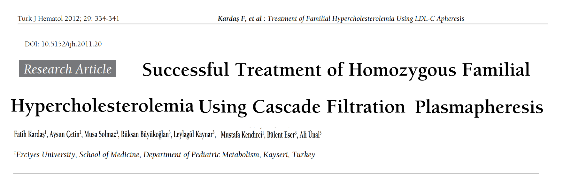
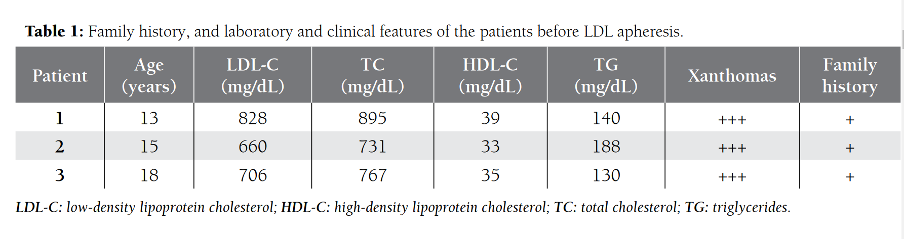
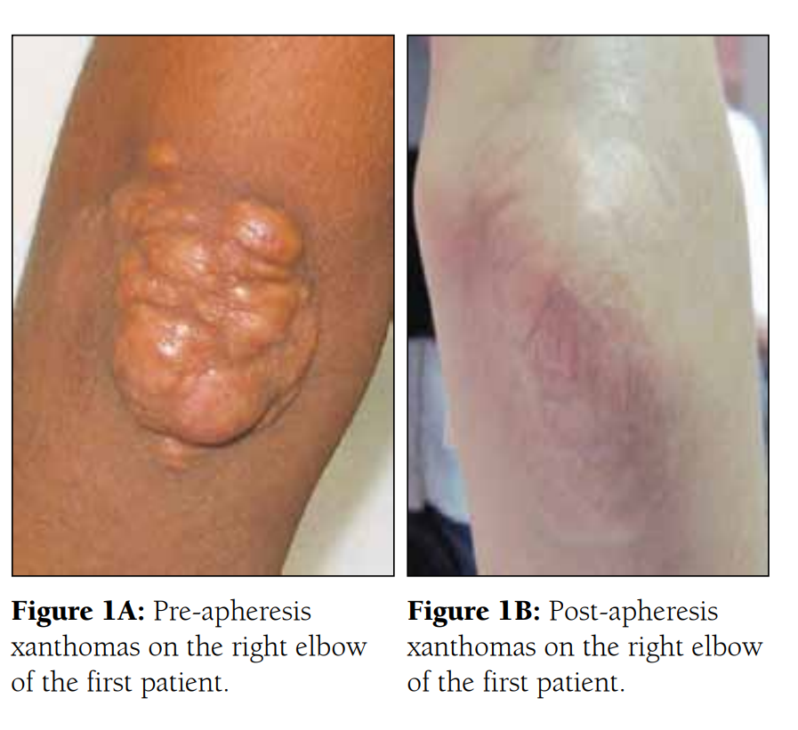
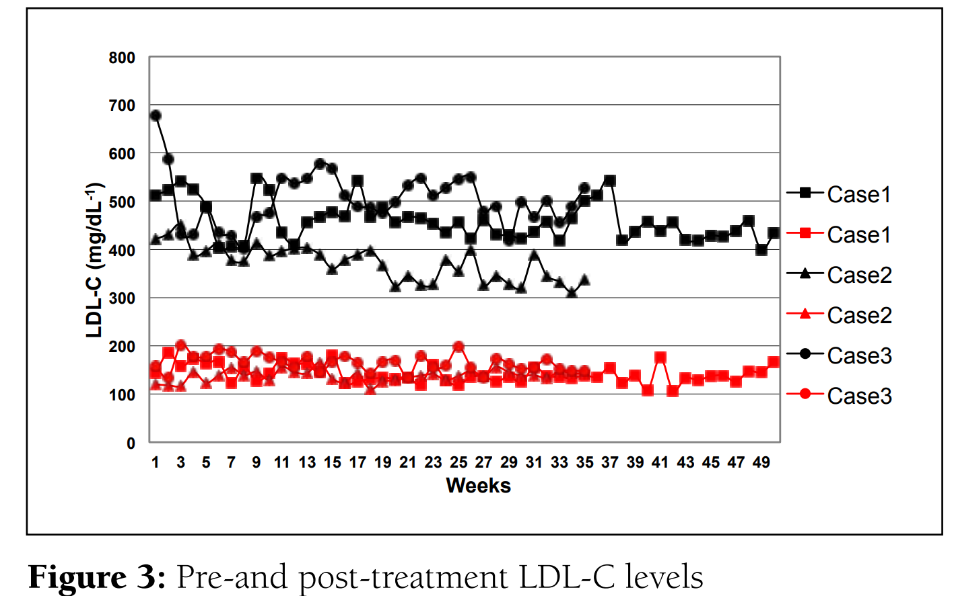
Therapeutic Plasma Exchange

Slide 17
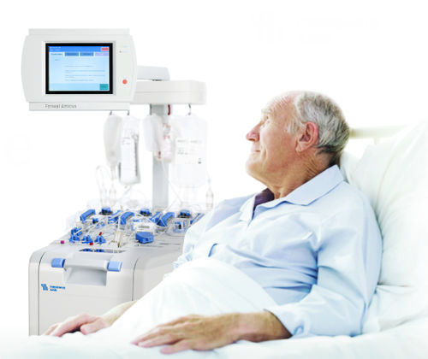
Drugs and Poisons reportedly removed by PEX
Therapeutic Plasma Exchange
Basiliximab
Ceftriaxone
Chloramphenicol
Ceftazidime
Cisplatin
Diltiazem
IFN-alpha
Palivizumab
Proxyphene
Propanolol
Rituximab
Tobramycin
Verapamil
Vincristine

Slide 18
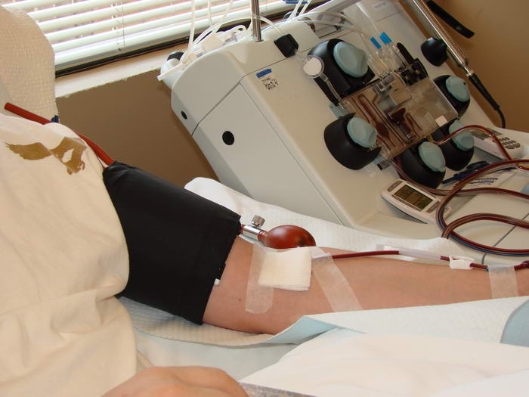
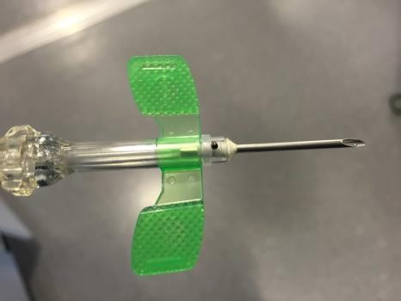
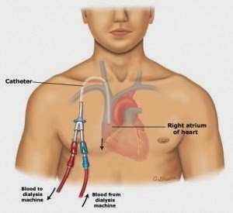
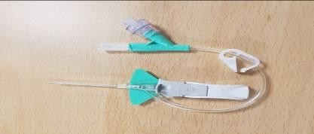
Vascular Access
Therapeutic Apheresis
Adults:
Peripheral ➔16-18g needle
Dual Lumen CVC ➔ 16-18g cannula Hickman + needle Femoral Vascath
Pediatrics:
Dual Lumen CVC
Hickman line
Hickman + cannula Femoral Vascath

Slide 19
Potential Side Effects
Therapeutic Apheresis
Overall rate 4-5%, higher with the first procedure
Types of adverse reactions
  Transfusion reactions
  Citrate toxicity
  Hypotension/Vasovagal
  Access related complications
    Infection, Hematoma, Pneumothorax, etc
Death is usuallyrare due to underlying disease
  Reported to be 1-2 per 10,000 in the French Registry.
  0 cases reported in >20,000 cases reported to the Swedish registry.

Slide 20
Treatment Frequency
Therapeutic Apheresis
Acute disease
Rapidly progressive
Requires frequent treatments (every 24 to 48 hours, sometimes every 12 hours)
Chronic disease
Slowly progressive
Requires less frequent treatments (weekly or monthly)

Slide 21
Indication Categories
Therapeutic Apheresis
Category I: First line therapy – proven to be effective
Category II: Adjunct therapy – proven to be beneficial in some instances
Category III: May be- evidence conflicting but there is some suggestion of benefit, can be considered if conventional therapy is failing
Category IV: Lack of evidence that therapeutic apheresis is beneficial, anecdotal experiences have been discouraging

Slide 22
Indications Cell Exchange
Others:
Therapeutic Apheresis
Other Categories
Category I
  Sickle cell disease :
    Acute chest syndrome
    Stroke: prevention and treatment
    Persistent priapism
    Intractable pain crisis
  Protozoa infections: malaria, babesia
  Pre-op exchange for sickle cell patients
  Rh - young female who received Rh+ RBCs
  Progressive MS
  Polymyositis
  Dermatomyositis
  Hyperleukocytosis
  Thrombocytosis
  Extra Corporeal Photopheresis

Slide 23
Indications for TPE
Therapeutic Apheresis
Other Categories
Category I
Rheumatoid arthritis
Major ABO incompatible marrow transplant
Presensitization to solid organ graft
Cryoglobulinemia
ITP
Aplastic anemia
Autoimmune hemolytic anemia
Hemolytic uremic syndrome
Hyperviscosity/multiple myeloma
Guillain Barre Syndrome
Chronic ID polyneuropathy
Myasthenia gravis
Goodpasture’s
Post-transfusion purpura
Refsum’s disease
TTP
Familial hypercholesterolemia
Sezary Syndrome

Slide 24
Specialties covered
Therapeutic Apheresis
Demand for our services

Slide 25
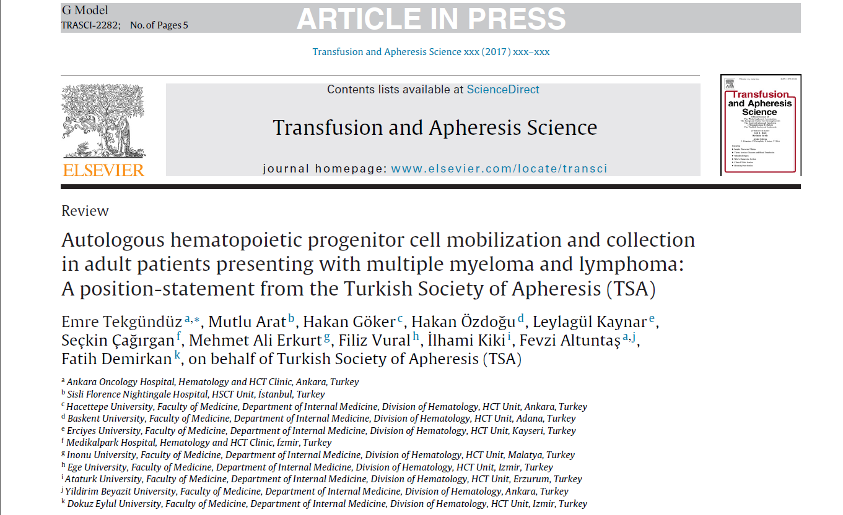
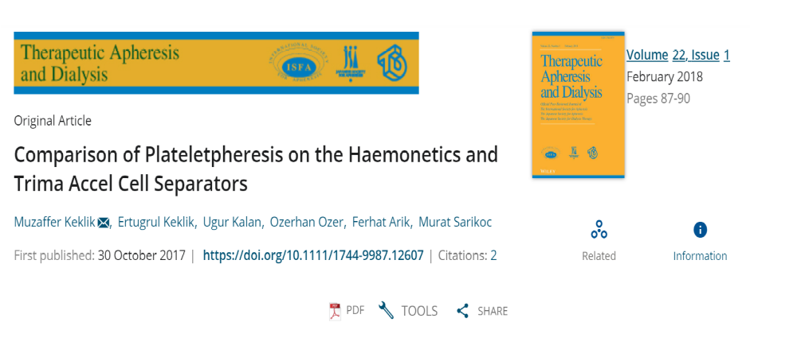
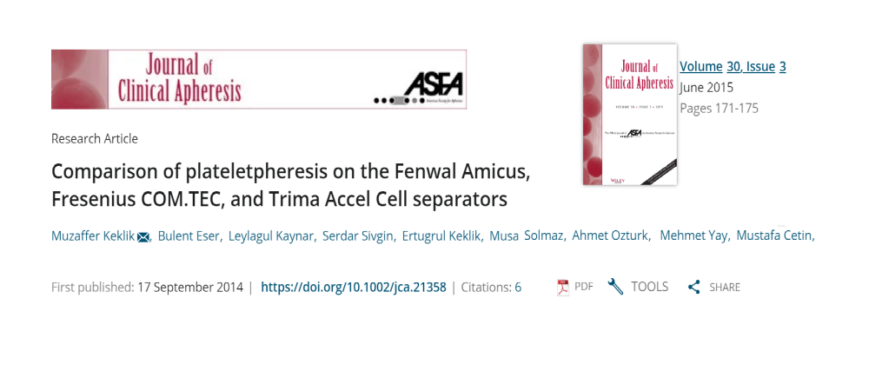
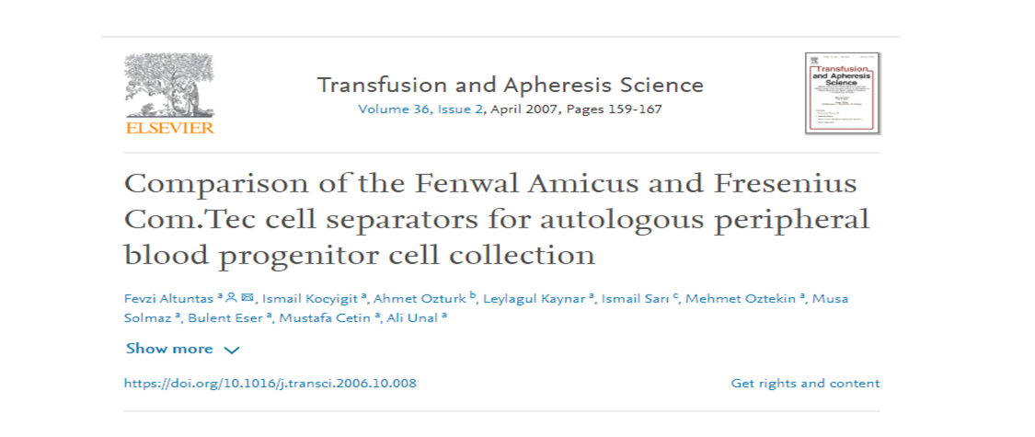
Demand for our services

Slide 26
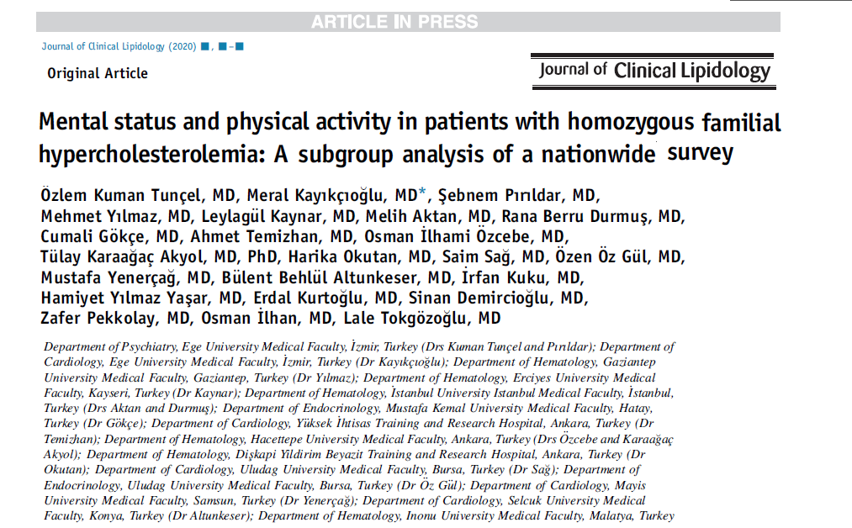
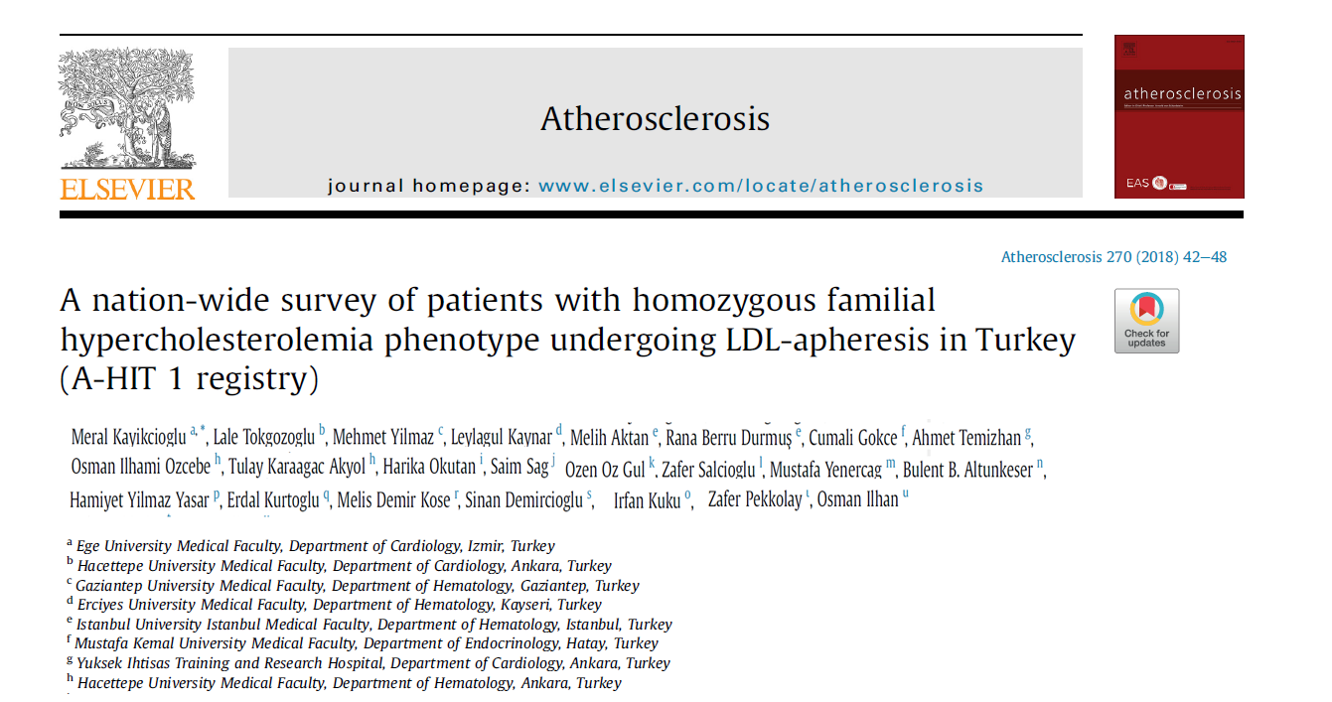
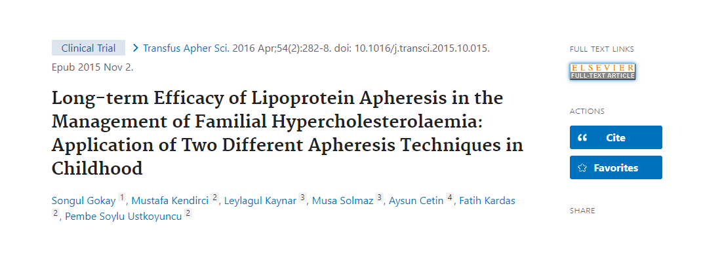
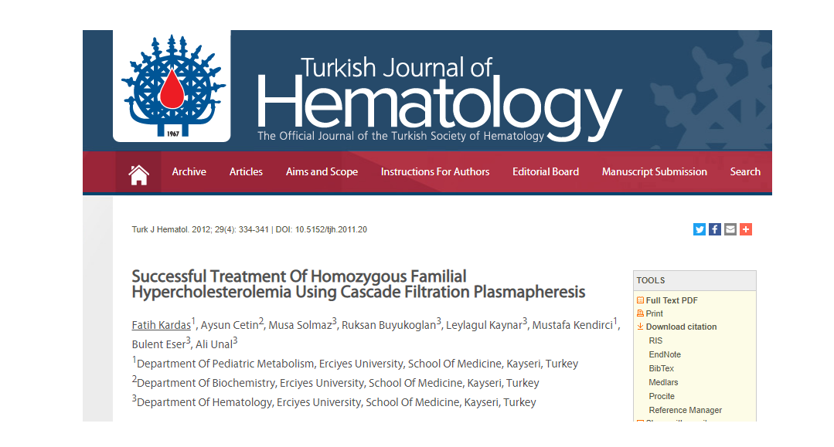
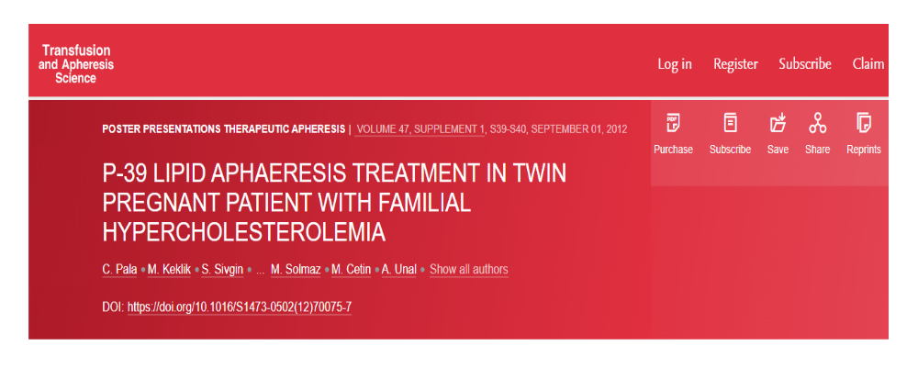
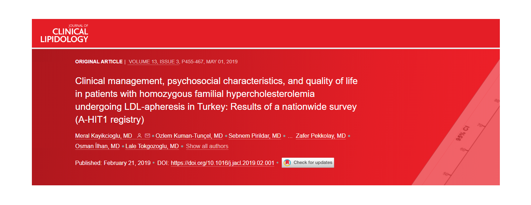
Demand for our services

Slide 27
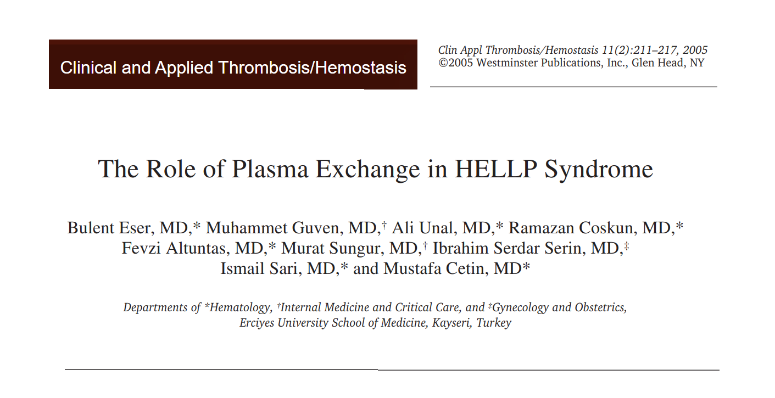
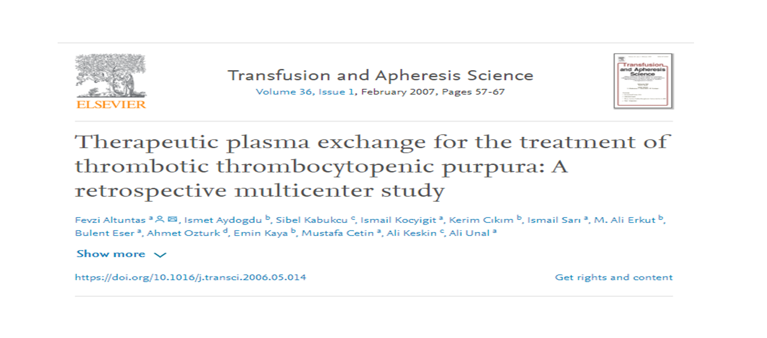
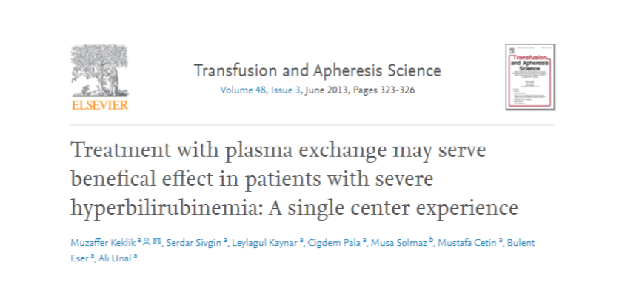
Demand for our services

Slide 28
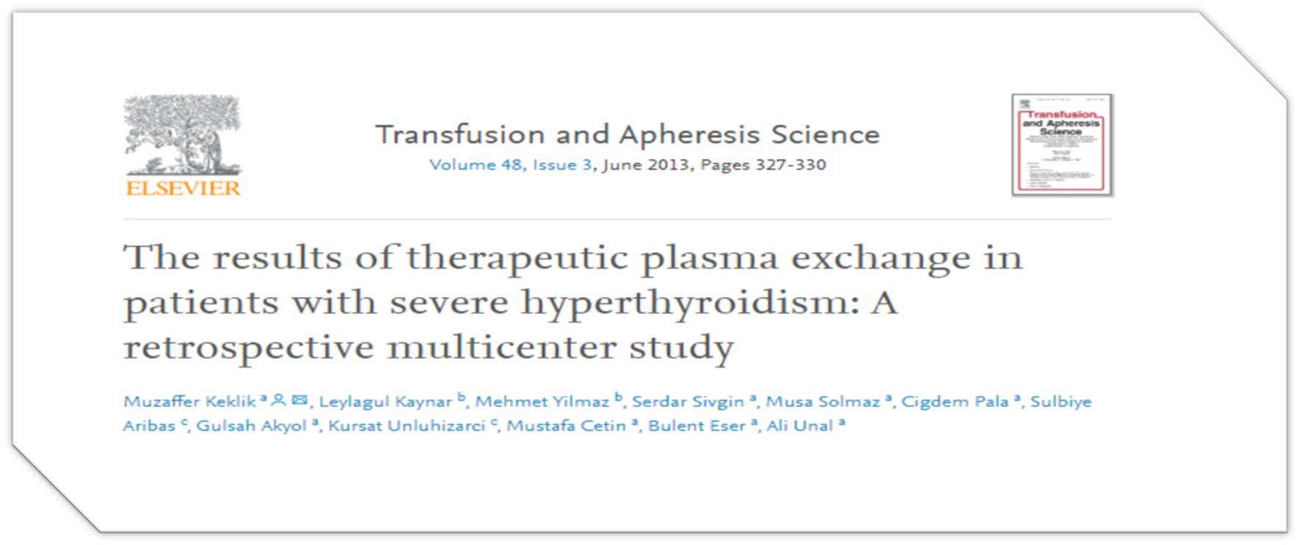
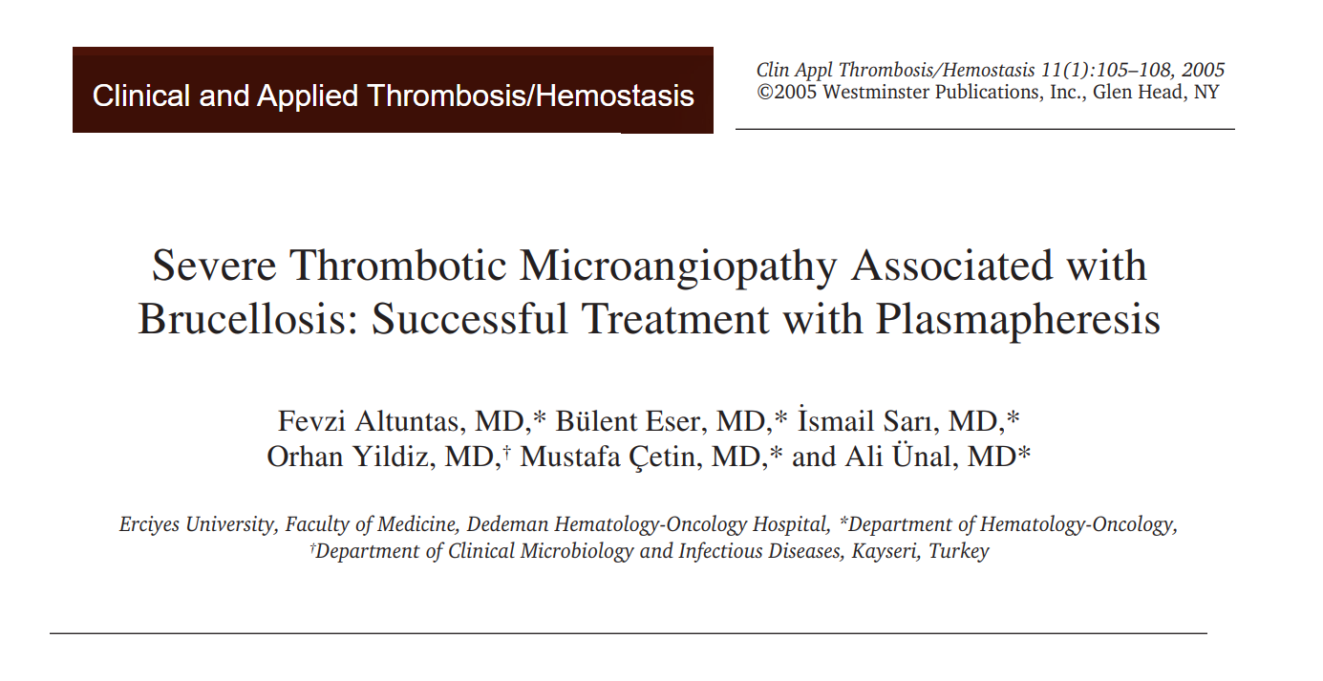
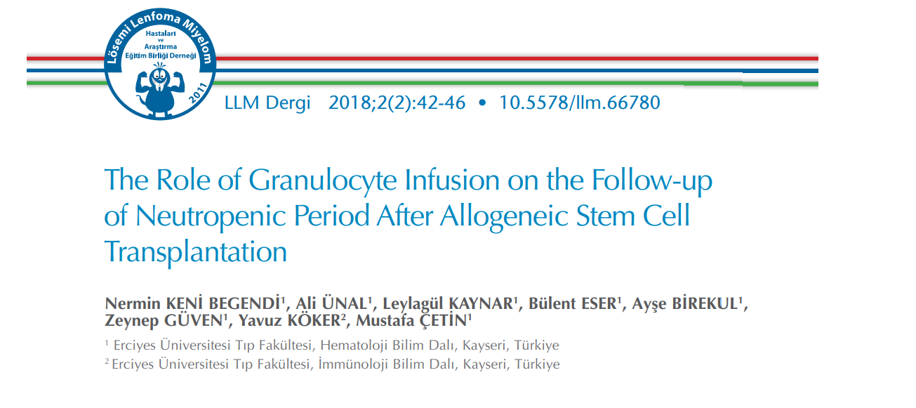
Demand for our services

Slide 29
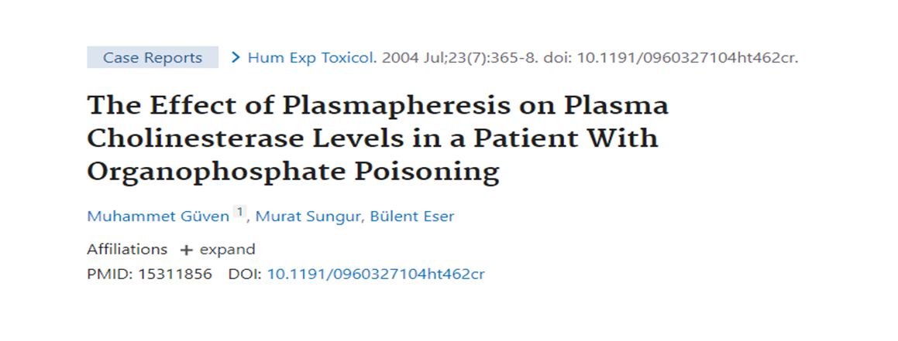
Demand for our services

Slide 30
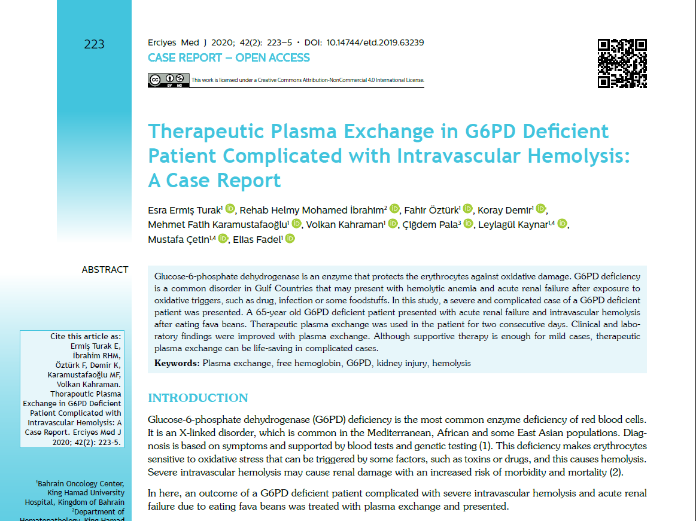
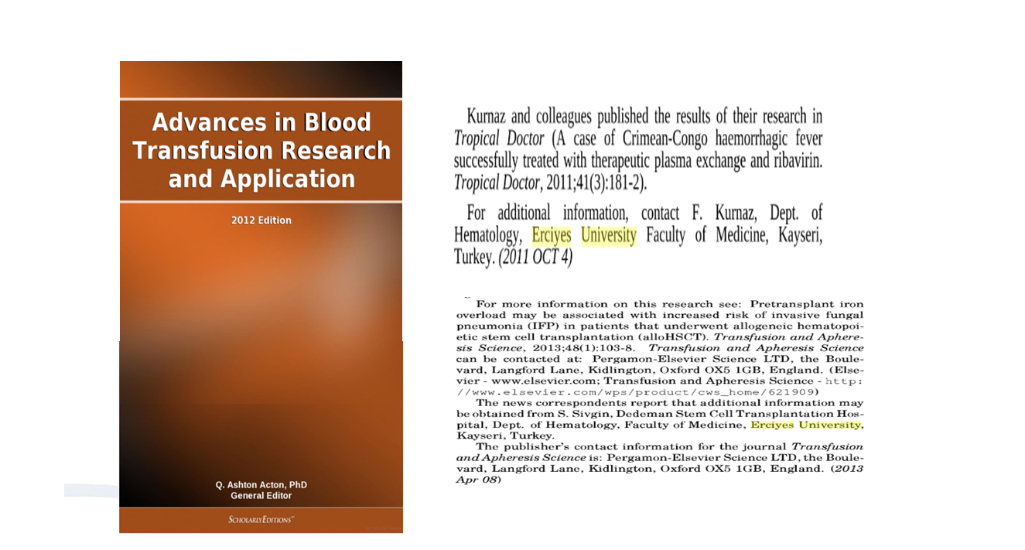
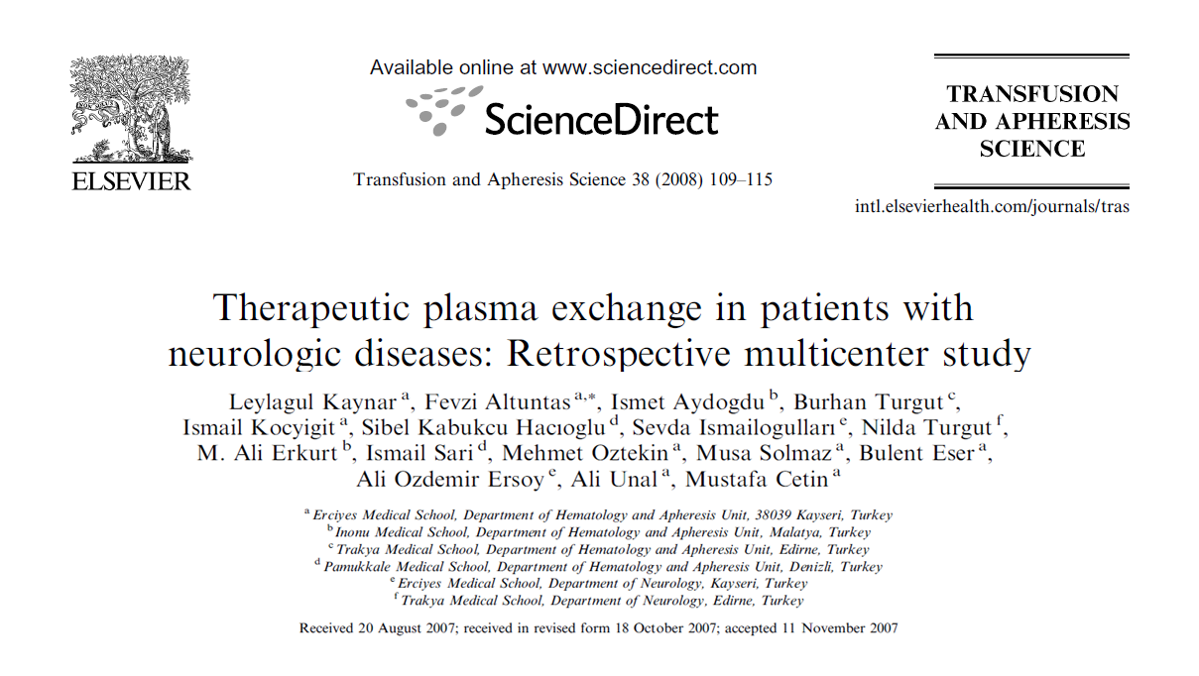
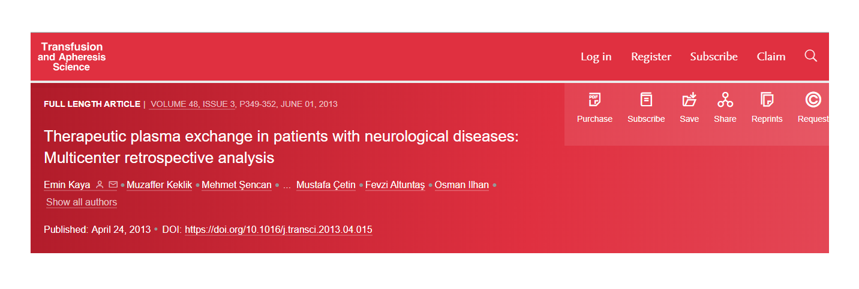
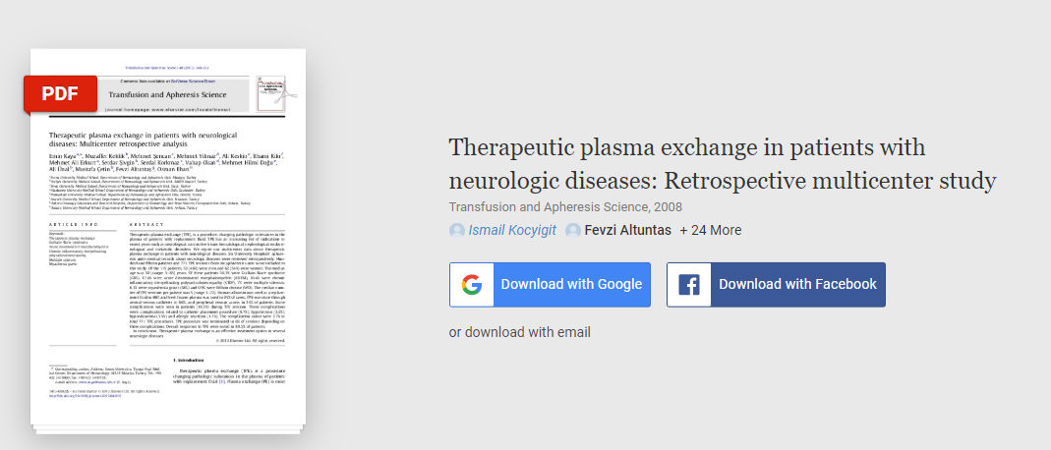
Demand for our services

Slide 31
Demand for our services
How to Request an Apheresis Procedure ?
Medical Indication
Call Apheresis Unit
Evaluation & Approval & Consent
Process
Finalisation and Report

Slide 32
Demand for our services
Questions?

