Slide 1
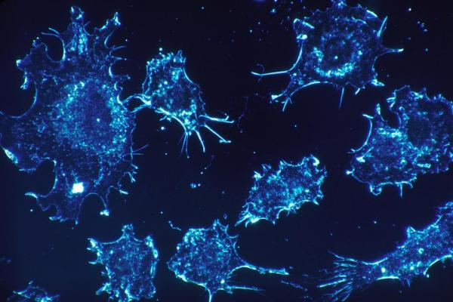
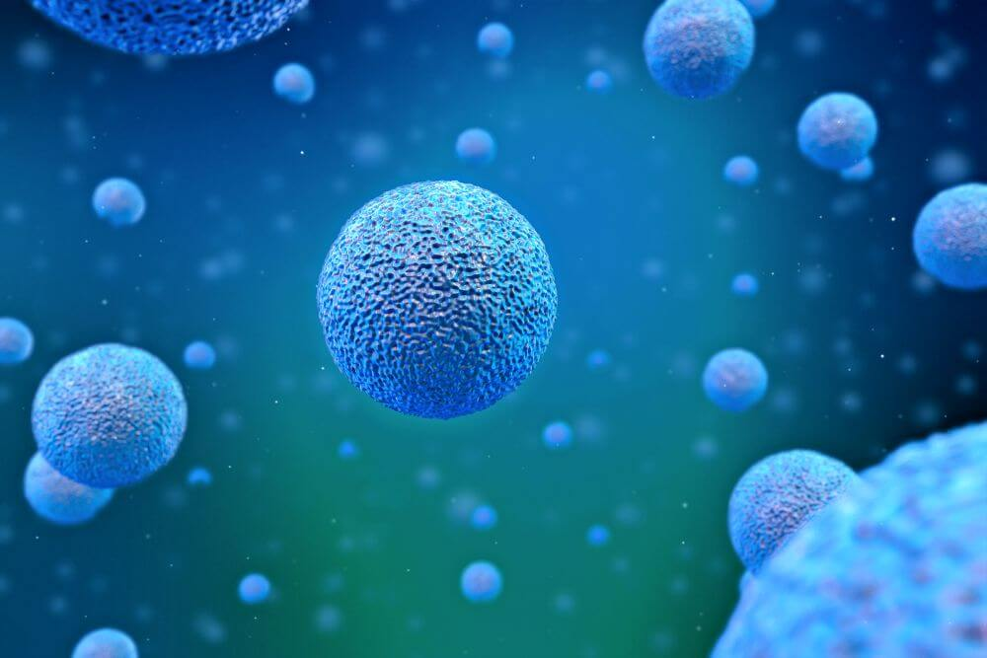
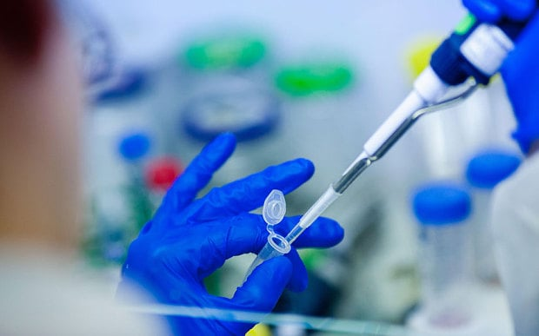
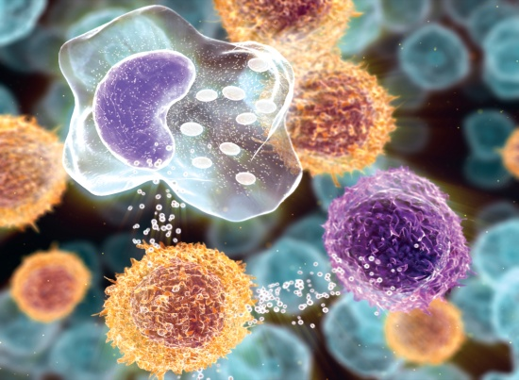

Hematopoetic Stem Cell Transplantation;
From A…..to ……Z
Mustafa CETIN, MD May , 2017
Erciyes University BMT Center

Slide 2

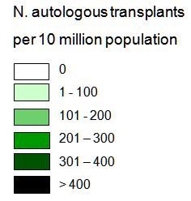
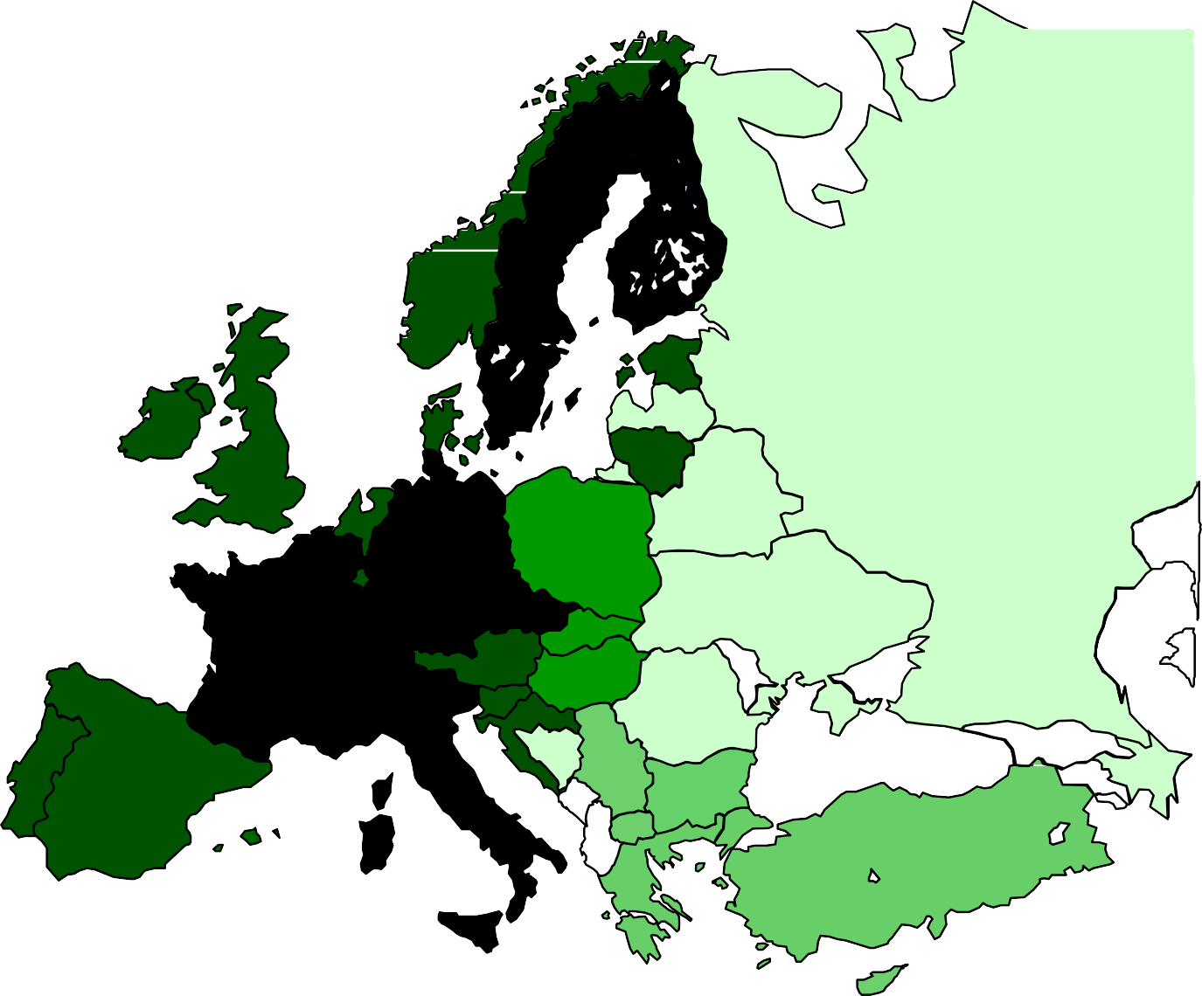
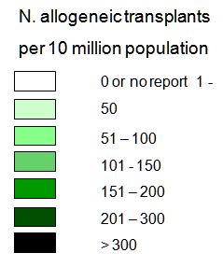
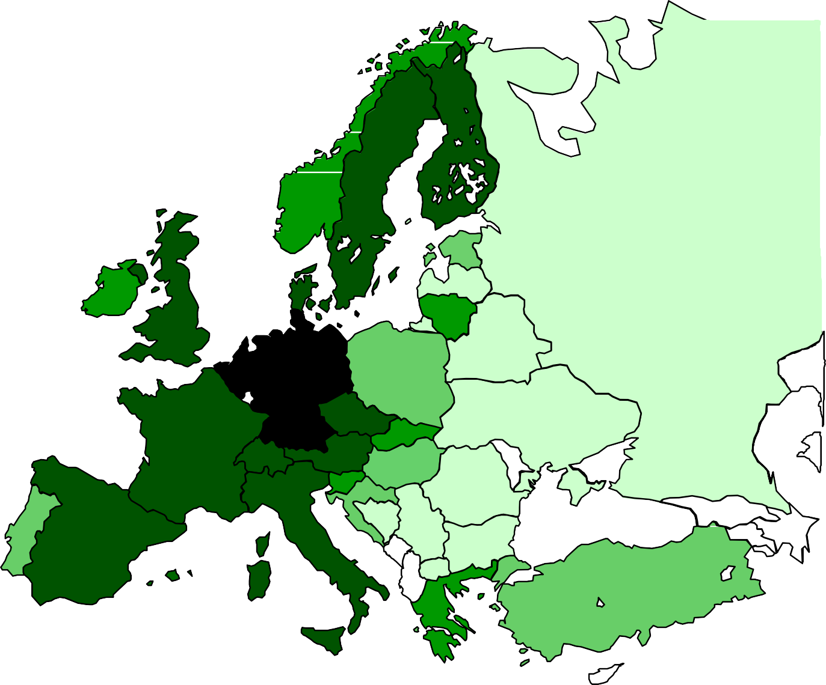
HSCT - rates in Europe
JR. Passweg, H. Baldomero et al, Bone Marrow Transplantation (2015) 50, 476–482

Slide 3
Hemapoetic Stem Cell
Transplantation Endications
Endications for HSCT: Current Practice in EUROPA
Allo-HSCT and Auto-HSCT in Hematologic Malignancies
  Acute leukemias
  Aplastic anemia
  Myeloproliferative disorders
  Multiple myeloma
  Lymphomas / Chronic lymphocytic leukemia
Allo-HSCT and Auto-HSCT in Benign Diseases
Allo-HSCT and Auto-HSCT in Solid Tumors

Slide 4
Main Indications
EBMT Activity Survey
Allogeneic 1st HSCT
Autologous 1st HSCT
Indications
Total
 | Leukemia | 10690 | 500 | 11190
 | Lymphoma | 1678 | 7880 | 9558
 | Plasma Cell disorder | 606 | 9794 | 10400
 | Bone marrow failure | 772 | 1 | 773
 | Solid tumor | 60 | 1483 | 1543
 | Non-malignant disorders | 1024 | 178 | 1202
 | Other | 120 | 23 | 143
 | Total 1st Transplants | 14950 | 19859 | 34809

Slide 5
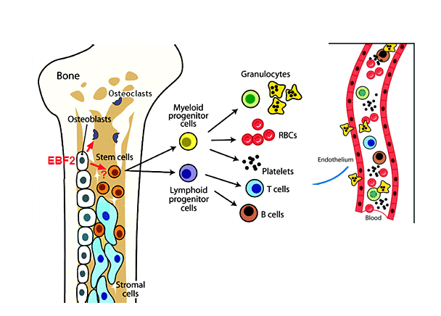
What are the Hematopoetic Stem Cells?
(HSCs)

Slide 6
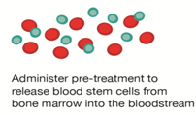




Restoration of patient’s own hematopoetic tissue in the…. autologous setting (The correction of HDC-induced aplasia) to eradicate chemosensitive tumor
Autologous HSC Transplant Procedure
Mobilisation
Conditioning
Apheresis
HSC Infusion
Aplastic Phase
RECOVERY
  Note: At least, 2 × 106/kg CD34 cells are required for successful engraftment in autologous transplant :

Slide 7
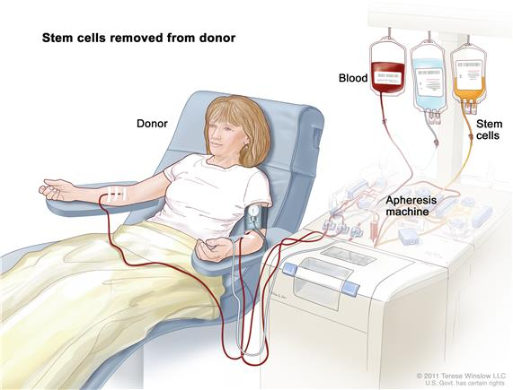
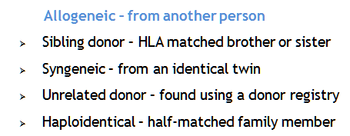
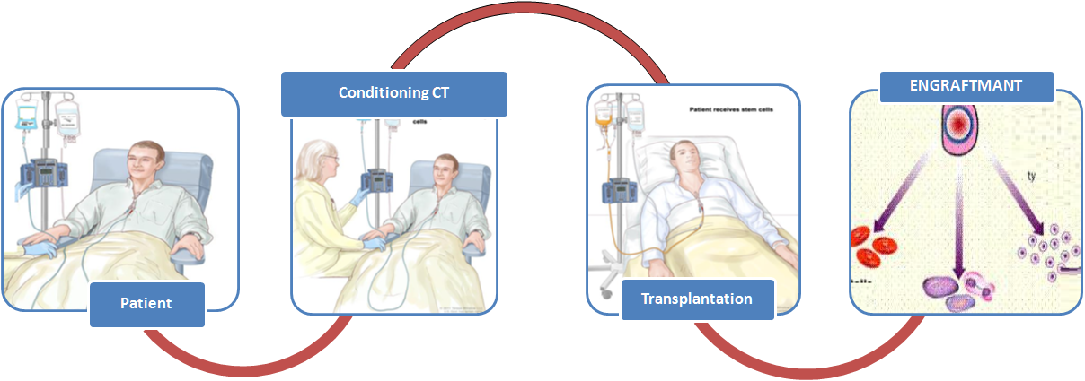
Allogenic Haematopoietic Stem Cell Transplantation
Installation of new hematopoietic tissue in the…. allogeneic setting (chimerism)
  to develop alloreactivity (GVL) against malignant disorders
  to correct functional defects observed in inherited or acquired non- malignant disorders
Donor Apheresis
  ***Note: At least, 3 × 106/kg CD34 cells are required for successful engraftment in allogeneic transplant :
Notes:
+A procedure in which a person receives blood-forming stem cells (cells from which all blood cells develop) from a genetically similar, but not identical, donor. This is often a sister or brother, but could be an unrelated donor.
Stem cell transplant (Step 1). Blood is taken from a vein in the arm of the donor. The patient or another person may be the donor. The blood flows through a machine that removes the stem cells. Then the blood is returned to the donor through a vein in the other arm.
Stem cell transplant (Step 2). The patient receives chemotherapy to kill blood-forming cells. The patient may receive radiation therapy (not shown).
Stem cell transplant (Step 3). The patient receives stem cells through a catheter placed into a blood vessel in the chest.

Slide 8

Factors determining HSCT outcome
Pretransplantation
Transplantatıon
Posttransplantation
DISEASE STATUS
Type of Disease
Indication status
Remission status
(Suitable BM)
Prior treatments
PATIENT
Clinical Elgibility Criterias
EBMT risk score (Age,PS,etc)
Comorbidity index
GvHD PROPHYLAXIS
Pharmacological
T-cell Depletion
CONDITIONING
Myeloablative & RIC
Organ Toxicity
STEM CELL SOURCE/DOSE
Bone Marrow
Peripheral Blood / UCB
IMMUNE RECONSTITUTION
Infections GvHD
GVT effect
DONOR STATUS (IDEAL GRAFT)
HLA matched
HLA mismatched Haploidentical
D/R sex combinations
ABO, CMV serostatus,…
Notes:
As increase the number of risk factor and comorbidities, the patients obtain low response rate and lon

Slide 9
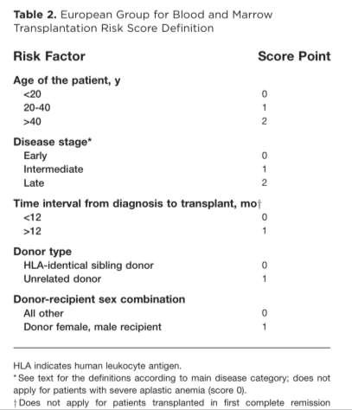
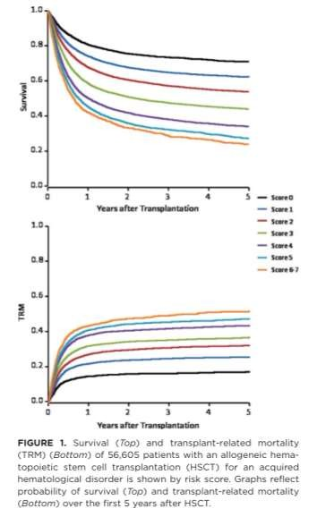
EBMT risk index
Hematopoietic cell transplantation
A Gratwohl et al. Cancer 2009

Slide 10
Today Topics
  Donor selection
    Donor Screening & Identification
  Source of Stem Cells
    Stem Cell Mobilization
    Stem Cell Collection
    Stem Cell processing
  Conditioning Regimen
  Stem Cell Infusion
  Engraftment (allograft /Chemerism)
  Prophilaxis (GVHD, infection,VOD )
  Early & Late Effects (Control)

Slide 11
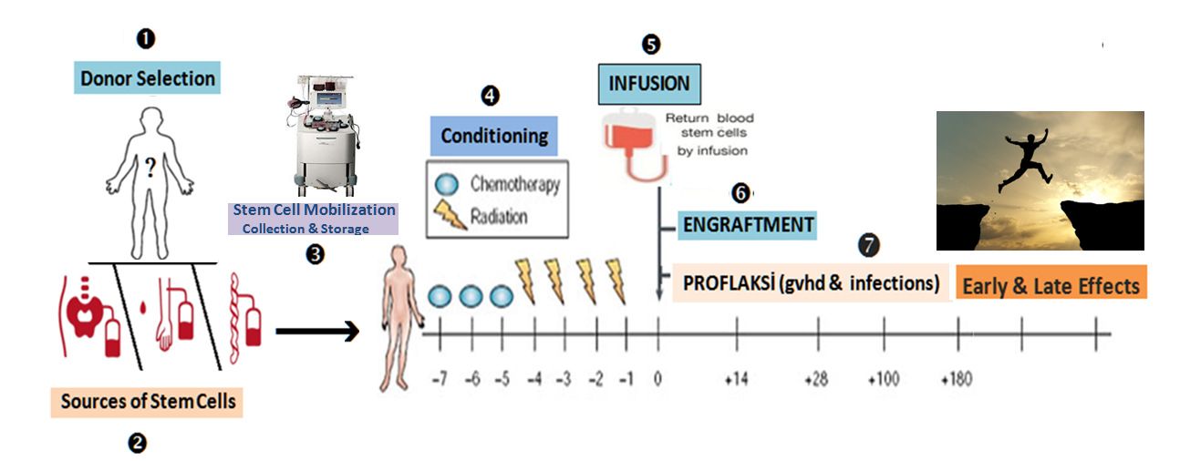

Allogeneic SCT is a complex procedure
34

Slide 12
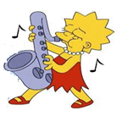


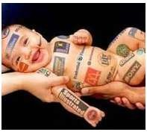
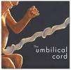

❶ Donor Selection
Stem Cell Donor AVAILABILITY
HLA-identical sibling
  First choice
Unrelated donor
Cord blood
Other related donor
  Haploidentical
1/3 patients in population
>29 million donors worldwide
• ~700 000 cords
• Inevitable ?
Notes:
Lisa Kız9
BART
Maggie (küçük kız)
Homer
(baba)

Slide 13
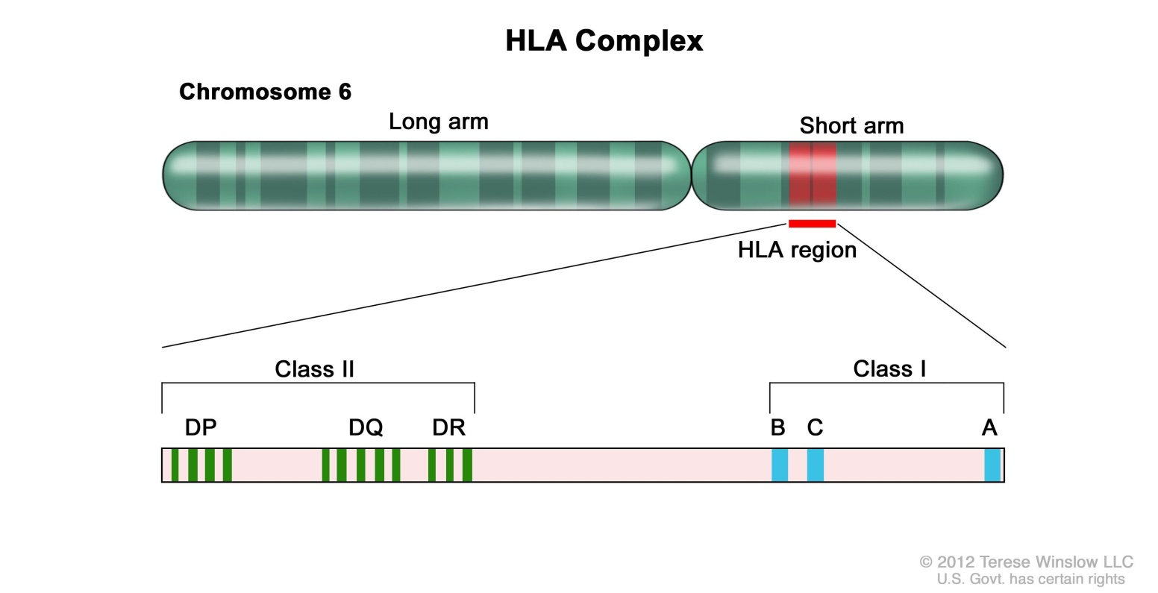
Why is HLA so important?
❶ Donor Selection
Human Leukocyte Antigen
One of the most gene- dense regions of the genome
Discovered: in mice (1937), humans (1954)
HLA is in the MHC on Chr6:
HLA is a protein – or marker – found on most cells in your body.
Notes:
First requirement for TX

Slide 14
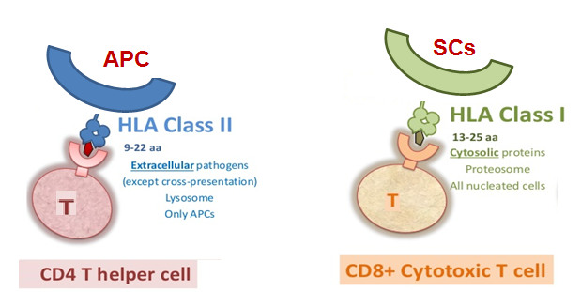
The Major Histocompatibility Complex & Antigen recognition
❶ Donor Selection
MHC
HLA, present peptides to T cells, thus allowing elimination of foreign particles and recognition of self or non-self
SO, If donor proteins are presented to the host T CELL , (HVG,Rejection)
If host proteins are presented Donor T CELL (GVHD, GVT effect)

Slide 15


❶ Donor Selection
The HLA Family
A1 A2
A3 A26
B8 B44
B7 B14
DR7 DR5
DR7 DR8
A1 A3
A1 A26
A2 A3
B8
B7
B8 B14
B44 B7
Half of our HLA markers are inherited from our mother and half from our father
DR7 DR7
DR7 DR8
DR5 DR7
Each brother and sister has a 25%, or 1 in 4, chance of matching you,
Notes:
Half of your HLA markers are inherited from your mother and half from your father.. It is highly unlikely that other family members will match you. Under very rare circumstances, family members other than siblings may be tested.
.
,

Slide 16
❶ Donor Selection
The HLA Family
A1 A2
A3 A26
B8 B44
B7 B14
DR7 DR5
DR7 DR8
A1 A3
A1 A26
A2 A3
A1 A3
B8
B7
B8 B14
B44 B7
B8 B7
DR7 DR7
DR7 DR8
DR5 DR7
DR7
DR7
HLA A, B, DR (6/6) sibling
HLA matched
Unfortunately, there is only a 25-percent chance of a sibling match
Notes:
Each brother and sister has a 25%, or 1 in 4, chance of matching each-other

Slide 17
❶ Donor Selection
The HLA Family
A1 A2
A3 A26
B8 B44
B7 B14
DR7 DR5
DR7 DR8
(10/10) unrelated donor
A1 A3
B8
B7
A1 A3
A1 A26
A2 A3
DR7
DR7
DP3 DP8
B8
B7
B8 B14
B44 B7
DQ11 DQ3
DR7 DR7
DR7 DR8
DR5 DR7
DP3 DP8
DQ11 DQ3

Slide 18
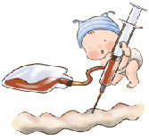
❶ Donor Selection
The HLA Family
(5/10) Haploidentical family donor
90-95 percent chance from family
A1 A2
A3 A26
B8 B44
B7 B14
DR7 DR5
DR7 DR8
DP3
DP8
DQ11
DQ3
A1 A3
A1 A26
A2 A3
B8
B7
B8 B14
B44 B7
( <2 , M.M.) Cord Blood donor
DR7 DR7
DR7 DR8
DR5 DR7
DP3 DP8
DP3
DP8
DQ11 DQ3
DQ11
DQ3

Slide 19
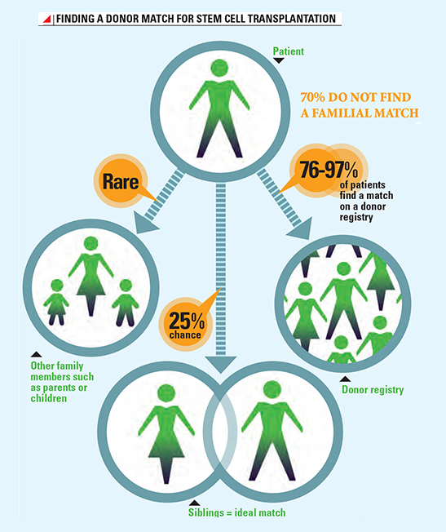
Provision of unrelated HSC donors
❶ Donor Selection
A 6/6 matched, related sibling donor is the accepted first choice.
* NOTE: HLA A, B, DR (6/6) sibling donor better than (10/10) unrelated donor.
Genetics dictate that siblings have a 25 percent chance of matching.
Those without a matched, related donor have 70 percent chance for Caucasians
Or only 10 percent chance for other or mixed ethnicities of finding a matched,
Cord blood & Haploidentical donors are acceptable as a donor source.
RN Lown and BE Shaw, Bone Marrow Transplantation (2013) 48, 210-219
Notes:
First preferences is SIB

Slide 20
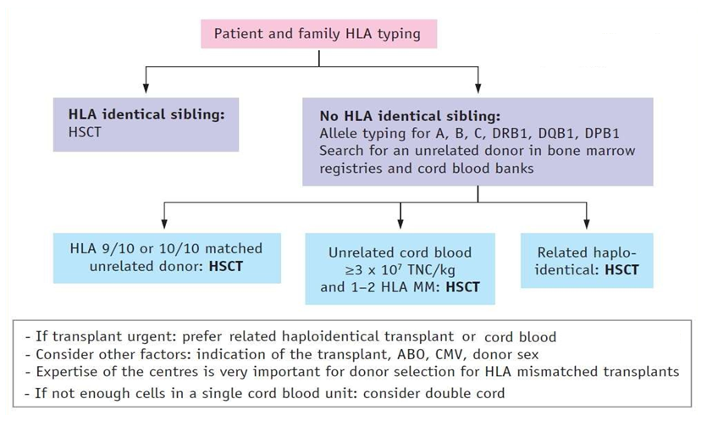
7
❶ Donor Selection
Notes:
Q: What is PRA?
A: A PRA test can be performed many different ways. Basically, we take known HLA proteins and react them with a patient’s serum. If the patient has antibodies to a particular HLA protein, the antibodies will bind. We then add other special proteins to allow us to detect that the antibody is bound to the HLA protein. By determining which HLA proteins a patient reacts to, we can determine if a potential patient/donor combination is likely to have a good or bad outcome.
Q: What causes anti-HLA antibodies to develop?
A: Anti-HLA antibodies can be triggered by blood transfusion, multiple pregnancies and by transplantation. Lymphocytes present in transfused blood are the source of the immunization causing anti-HLA antibody development.
Since a person can develop antibodies after a transfusion, it is important for a transplant candidate to submit a blood sample to the HLA laboratory approximately 14 days after each transfusion. The serum will be tested to determine whether anti-HLA antibodies have been produced.
If anti-HLA antibodies were produced as a response to the transfusion, the HLA specificity can be defined and avoided in selection of a suitable organ donor.
Q: Can anti-HLA antibodies change?
A: Yes and no. Once an antibody is made, it doesn’t really change. What changes are the types of antibodies that are made and the amount of these antibodies in the bloodstream. The immune system is very good at changing the antibodies that are made, to make the immune response even better. HLA antibody levels can be high following a transfusion or transplantation but significantly decrease in the months or years following. However, the cells that make antibodies can develop into memory cells and the antibody levels can go from undetectable to extremely high very quickly (within days) if a patient is exposed to a foreign HLA again

Slide 21

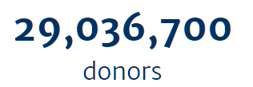

Bone Marrow Donors Worldwide
❶ Donor Selection
Total > ~ 30 million donors
73 stem cell donor registries from 52 countries
47 cord blood banks from 33 countries
www.bmdw.org
Notes:
Unrelated Mathc donor is the second best options

Slide 22












Alternative donor search algorithm in EUROPA
❶ Donor Selection
Indication for Allo-HSCT & no HLA-id family donor
Start URD search if age <60-65y (+ UCB if age <55-60y)
YES
¿HLA-id URD “on-time”?
URD Allo-HSCT
NO
¿UCB available?
TNC ≥ 2.5-3 x10⁷/kg (min 1500 x10⁶)
CD34+ ≥1.5-2 x10⁵/kg (min 10 x10⁶)
YES
UCB Allo-HSCT “Dual”
NO
¿Haplo?
YES
Haplo-HSCT (PTCy)

Slide 23
UNRELATED donor selection criteria
❶ Donor Selection
HLA matched* (A,B,C,DR,DQ; 10/10)
and permissive mismatches (DP)
Sex mismatch
ABO compatibility
CMV serological status
Donor: age and gender
HLA antibodies in the patient
* Note: Even with a complete 10/10 matched unrelated donor, the risk of GVHD is higher than for an HLA-identical sibling (6/6 match), presumably because the number of polymorphic minor H antigen differences is likely to be greater.
Notes:
And you decided untrelated DONOR
You have to evalaute your scientific preferencies or prioroties
For fully match URD -, you can evaluate DP status
Sex msmtch important for Female Donor for male recipient
If the patient is CMV seropositve you must select ..

Slide 24
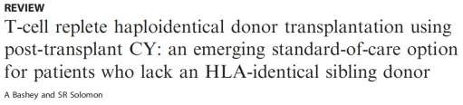
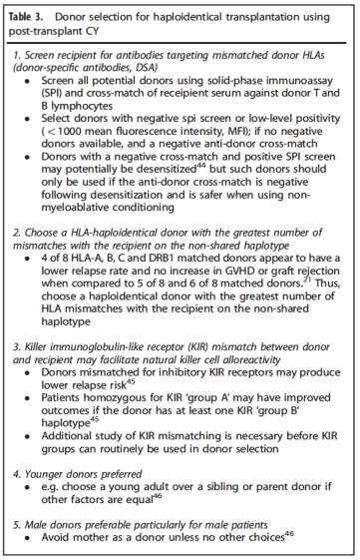
HAPLOIDENTICAL donor selection criteria
❶ Donor Selection
1.- No anti-HLA antibodies (patient)
2.- Haplo Matching (5/10) is enough
Higher HLA (5,7,8/10) mismatching (avoid)
3.- KIR alo-reactive donor
4.- Younger donor
5.- Male to Male (avoid mothers)

Slide 25
❶ Donor Selection
UCB Donor selection criteria
UK consensus: WHICH UNIT OR UNITS?
Search step | Search criteria | Comments
1st | Cell Dose | Same cell dose required for RIC and MAC >3.0 x10⁷ NC/kg and/or >1x10⁵ CD34+/kg
2nd | HLA match | 0-1 MM better than 2 - avoid 3-4 MM Prefer class I mismatches to class II Avoid C MM
3rd | Transplant indication | Malignant diseases: cell dose (>3.0x10⁷NC/kg ) HLA is the best prognostic factor because HLA differences reduce relapse (GVL) Non malignant diseases: increase cell dose (>5.0x10⁷NC/kg ) and find the best HLA match
₄th | Other considerations (if several options available) | ABO important only in RIC setting Cord bank accreditation and location
Notes: Where a single unit meeting these criteria cannot be identified, a double unit may be used

Slide 26
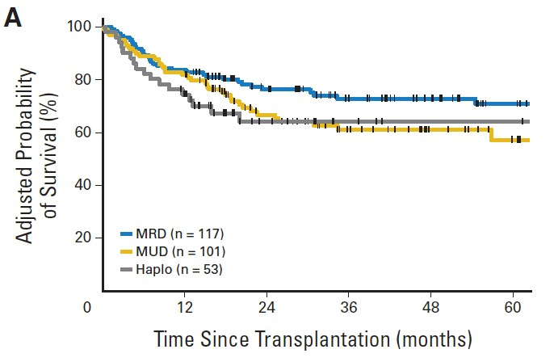
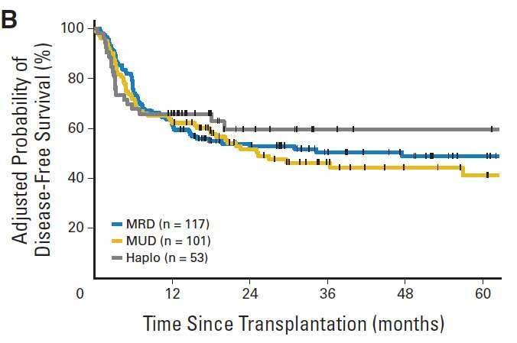
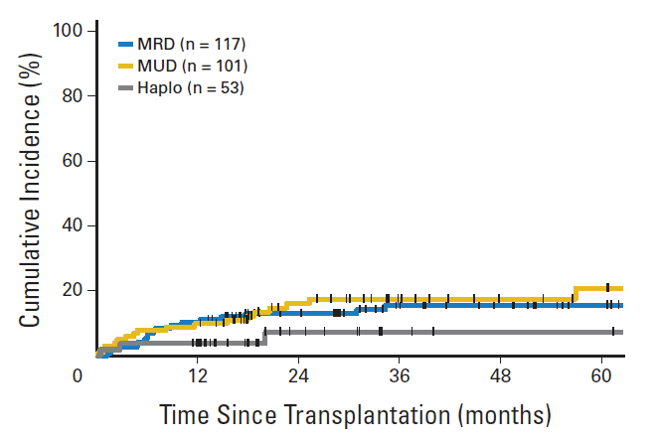
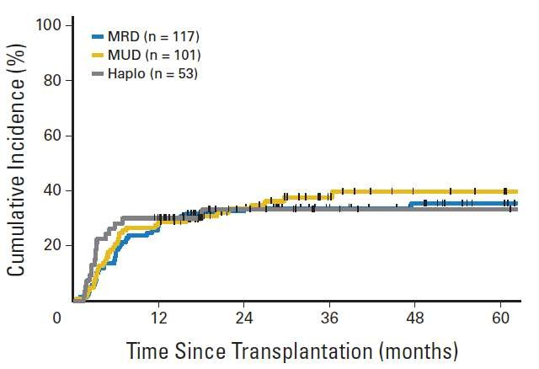
HAPLOIDENTICAL vs URD vs SIBLINGS
❸ Stem Cell Mobilization & Collection
Cell Dose and Source: effect on outcomes
OS
EFS
Relapse
NRM
Bashey A et al. J Clin Oncol. 2013 Feb 19.

Slide 27
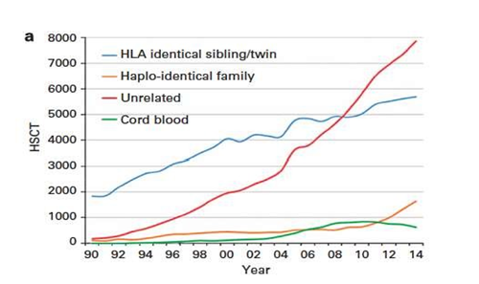
Allogeneic SCT: trends in 2014
❶ Donor Selection
Nowadays, and with a patient being a potential candidate for an allo-HSCT who lacks
a HLA well-matched donor (HLA identical sibling/MUD), physicians are faced with the need to select amongst different options: MMUD, CB or haploidentical transplants.
14

Slide 28
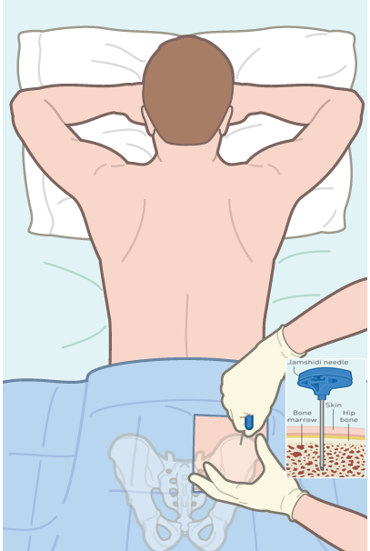
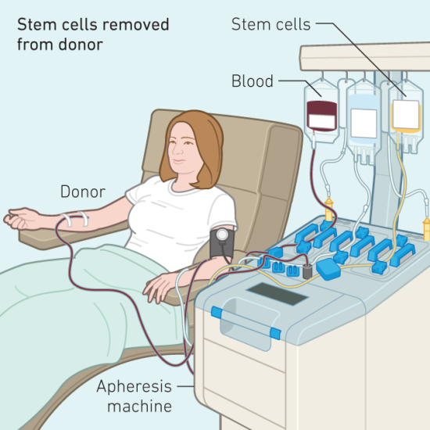
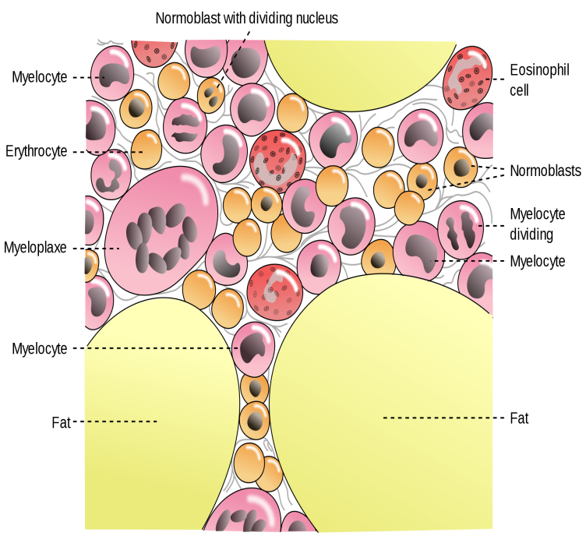

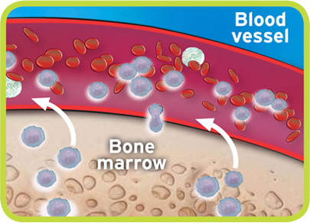
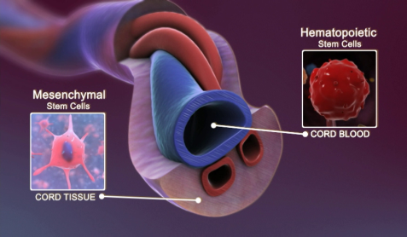
❷ Sources of Stem Cells
Bone Marrow
Peripheral Blood
Cord Blood

Slide 29

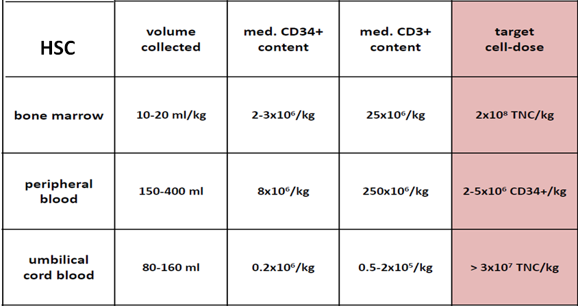
❷ Sources of Stem Cells
BM
PBSC
CB
*Cell contents according to source
15

Slide 30
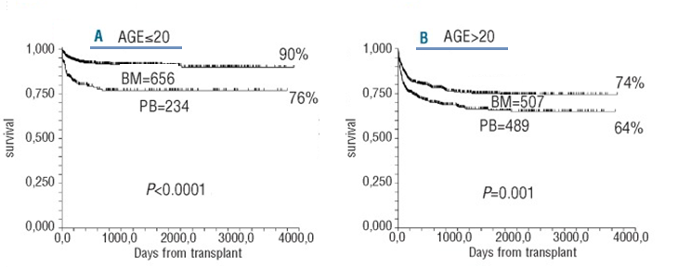
❷ Sources of Stem Cells
BM
PBSC
CB
*Cell contents according to source
*BM revealed survival advantage only for Acquired Aplastic Anemia
Bone marrow versus peripheral blood as the stem cell source for sibling transplants in acquired aplastic anemia: survival advantage for bone marrow in all age groups,
Andrea Bacigalupo, Haematologica. 2012 Aug; 97(8): 1142–1148
19

Slide 31
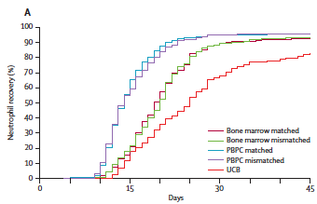
❷ Sources of Stem Cells
BM
PBSC
CB
Faster hematopoietic recovery
Faster immune recovery
Increased c.GvHD & GVL
Donor issues?
17
Notes:
If you use PBSC, you will get faster immınune and hemapoetic recovery AT THE EXPESE OF increased CGVHD
As you see in this picture Nötrofıi recovery is very faster for PBSC as compared with cstem cell sources
Avarege engraftmen day is 15 day earlier for PBSC

Slide 32
❷ Sources of Stem Cells
BM
PBSC
CB
1st Opt. > Cell dose - for engraftment
  Malignant diseases: (recomended cell dose) >3.0 x10⁷ NC/kg and/or >1x10⁵ CD34+/kg
  HLA is the best prognostic factor because HLA differences reduce relapse (GVL)
  Non malignant diseases: increase cell dose (>5.0x10⁷NC/kg ) and find the best HLA match
2nd Opt. > HLA matching - for homing
  0-1 MM better than 2 - avoid 3-4 MM
  Prefer class I mismatches to class II and Avoid C MM
17
Notes:
If you use PBSC, you will get faster immınune and hemapoetic recovery AT THE EXPESE OF increased CGVHD
As you see in this picture Nötrofıi recovery is very faster for PBSC as compared with cstem cell sources
Avarege engraftmen day is 15 day earlier for PBSC

Slide 33


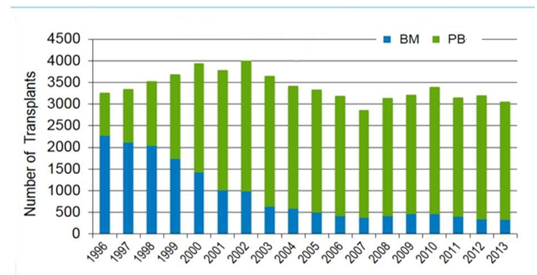
❷ Sources of Stem Cells
CIBMTR : Stem Cell Sources
Notes:
According to the CIBMTR registyries
BM usage increased last two decade

Slide 34
❸ Stem Cell Mobilization & Collection
The choice of a mobilization regimen
  Must comply with marketing authorizations and regulatory aspects
    rhG-CSF not allowed in patients < 18 years old
    plerixafor allowed only for autologous collection in patients with multiple myeloma or with lymphoma, and in association with rhG-CSF)

Slide 35
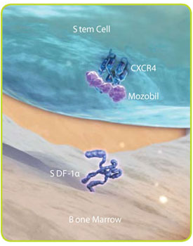
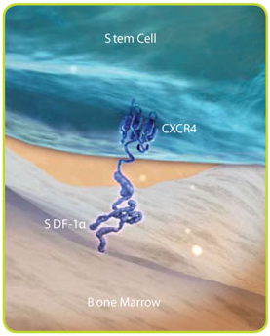

❸ Stem Cell Mobilization & Collection
Mobilization: Agents & Mechanisms
GCSF
Prelifaxor
HSC mobilisation
G-CSF
adhesive interactions between HSC and BM:
cell adhesions molecules
PMN
HSC
AMD 100
CD44
CXCR4
HSC
CD62L
VLA-4
NE CG MMP9
CD44
CXCR4
Kit
CD62L
Kit
VLA-4
HA
HA
CXCL 12c
CD62
KL VCAM-1
CXCL 12
CD62
KL VCAM-1
SDF-1 c
Extracellular matrix
SDF-1
Extracellular matrix
Extracellular matrix
osteoblast
osteoclast
osteoblast
osteoclast
De Clercq E. The bicyclam AMD3100 story. Nat Rev Drug Discov 2003; 2: 581–587
MP Rettig, G Ansstas and JF DiPersio. Leukemia. 2011 Sep 2. doi: 10.1038/leu.2011.197

Slide 36
Stem cell mobilization / G-CSF
❸ Stem Cell Mobilization & Collection
Filgrastim (G-CSF ) (Success rate: 70-95%)
Multi-step interactions in the marrow microenvironment lead to stem cell mobilization
Pain, headaches, arthralgias, malaise, fatigue, insomnia, and nause, Transient increase in ALP, ALT, LDH, Na and transient decrease in potasium, spontaneous splenic rupture
Increased spleen size in length (in 95% of pts) (mean increase,13%) but 10 days after G-CSF administration, spleen size returns to baseline.
CD-34+
Start leukaphaeresis on day 4,5
  Minimum number of CD34+ cells: 2 x 10⁶ /kg
G-CSF
10 -25 mcg/kg day , BID
circulating CD34 + cells
gradient> 20 / ϥL
1
2
11
3
4
5
6
7
8
9
10
12
13
14
Notes:
Models of HSPC mobilization by G-CSF and inhibitors of CXCR4 and VLA-4. (a) Bone marrow environment at baseline. HSPCs in the endosteal niche are likely in close contact with osteoblasts and nestin? MSCs, both of which express numerous HSPC retention factors, including CXCL12, VCAM-1 and SCF. The perivascular niche is more distant from the endosteum and includes both nestin? MSCs and CXCL12 abundant
reticular cells. Cells of the monocytic lineage support the maintenance of osteoblasts and MSCs. b-Adrenergic nerve cells of the sympathetic
nervous system regulate MSC proliferation and induce circadian oscillations of CXCL12 expression. (b) Model of G-CSF-induced HSPC
mobilization. Cells of the monocytic lineage express the receptor for G-CSF and provide factors that support the survival of MSCs and osteoblasts.
Upon 4–5 days of stimulation with G-CSF, the monocytes/macrophages disappear, leading to the loss of osteoblast lineage cells and reduced
expression of CXCL12, VCAM-1 and SCF on MSCs. Reduced expression of these important HSPC retention factors is also observed following G-CSF signaling through b-adrenergic nerve cells. The net effect of these signaling cascades is the disruption of HSPC retention interactions and mobilization of HSPCs into the peripheral blood. (c, d) Model of HSPC mobilization by inhibitors of CXCR4 or VLA-4. Targeted disruption of the interaction of CXCR4 or VLA-4 with their ligands results in the rapid (within hours) and reversible mobilization of HSPCs into the peripheral
circulation. An additive or synergistic affect on HSPC mobilization is observed when a CXCR4 inhibitor is combined with a VLA-4 antagonist, G-CSF or their combination. When used alone, inhibitors of CXCR4 and VLA-4 mobilize fewer HSPCs than G-CSF.
-- Stem cells may be induced to leave the bone marrow by administration of medications that are termed mobilizaiton agents. The most commonly used agent is filgrastim, also known as granulocyte colony stimulating factor. Filgrastim has a number of effects on the marrow environment including disruption of the CXCL4/CXCL12 axis, proliferation of HSC, and alterations in the adhesion factors VLA-4 and selectins as well as other effects. In total, its protean effects on the marrow microenvironment lead to stem cell mobilization after approximately 5 days of administration. The side effects are well known and include bone pain in approximately 100% of donors. Most donors experience flu-like symptoms most likely due to cytokine release. Filgrastim administration may be associated with significant leukocytosis which under the righ conditions can increase the risk of splenic rupture. This leukocytosis may also lead to a pro-thrombotic state where donors with underlying cardiac or cerebrovascular disease are more likely to experience thrombosis. Finally, there have been some reports of increased risk of development of acute myeloid leukemia in related donors who received filgrastim, however this risk may be explained by environmental or genetic susceiptibilities as well.
More recently, Plerixafor has been introduced for mobilizaiton of stem cells. Plerixafor is a reversible inhibitor of the CXCR4/CXCL12 axis that is usually administered in conjunction with filgrastim. This agent does not cause bone pain but is associated with abdominal discomfort in some patients as well as leukocytosis and potential for splenic rupture. The introduction of Plerixafor has decreased the number of patients who experience mobilization failure.
There are other agents in development for stem cell mobilization but are not currently FDA approved for this indication.

Slide 37
❸ Stem Cell Mobilization & Collection
Stem cell mobilization / G-CSF & Chemo
(G-CSF & Chemo) (Success rate: 70-95%)
.
Mostly use in chemosensitive cancer patients for autologous setting
Not only mobilise HSC but also eradicate tumoral mass
Solid tumors, Lymphomas, Leukemias, and Myeloma
Cy Treatment may also treat Autoimmune Disease
CD-34
G-CSF
CY
(Cy+ G-CSF)
Cy: 4gr/m2 and GCSF : 10-25 mcg/kg
1
2
3
4
5
1
2
4
5
6
7
8
9
10
3
11
12
13
14
15
16
17
18
19
Notes:
Models of HSPC mobilization by G-CSF and inhibitors of CXCR4 and VLA-4. (a) Bone marrow environment at baseline. HSPCs in the
endosteal niche are likely in close contact with osteoblasts and nestin? MSCs, both of which express numerous HSPC retention factors, including
CXCL12, VCAM-1 and SCF. The perivascular niche is more distant from the endosteum and includes both nestin? MSCs and CXCL12 abundant
reticular cells. Cells of the monocytic lineage support the maintenance of osteoblasts and MSCs. b-Adrenergic nerve cells of the sympathetic
nervous system regulate MSC proliferation and induce circadian oscillations of CXCL12 expression. (b) Model of G-CSF-induced HSPC
mobilization. Cells of the monocytic lineage express the receptor for G-CSF and provide factors that support the survival of MSCs and osteoblasts.
Upon 4–5 days of stimulation with G-CSF, the monocytes/macrophages disappear, leading to the loss of osteoblast lineage cells and reduced
expression of CXCL12, VCAM-1 and SCF on MSCs. Reduced expression of these important HSPC retention factors is also observed following
G-CSF signaling through b-adrenergic nerve cells. The net effect of these signaling cascades is the disruption of HSPC retention interactions and
mobilization of HSPCs into the peripheral blood. (c, d) Model of HSPC mobilization by inhibitors of CXCR4 or VLA-4. Targeted disruption of the
interaction of CXCR4 or VLA-4 with their ligands results in the rapid (within hours) and reversible mobilization of HSPCs into the peripheral
circulation. An additive or synergistic affect on HSPC mobilization is observed when a CXCR4 inhibitor is combined with a VLA-4 antagonist,
G-CSF or their combination. When used alone, inhibitors of CXCR4 and VLA-4 mobilize fewer HSPCs than G-CSF.
-- Stem cells may be induced to leave the bone marrow by administration of medications that are termed mobilizaiton agents. The most commonly used agent is filgrastim, also known as granulocyte colony stimulating factor. Filgrastim has a number of effects on the marrow environment including disruption of the CXCL4/CXCL12 axis, proliferation of HSC, and alterations in the adhesion factors VLA-4 and selectins as well as other effects. In total, its protean effects on the marrow microenvironment lead to stem cell mobilization after approximately 5 days of administration. The side effects are well known and include bone pain in approximately 100% of donors. Most donors experience flu-like symptoms most likely due to cytokine release. Filgrastim administration may be associated with significant leukocytosis which under the righ conditions can increase the risk of splenic rupture. This leukocytosis may also lead to a pro-thrombotic state where donors with underlying cardiac or cerebrovascular disease are more likely to experience thrombosis. Finally, there have been some reports of increased risk of development of acute myeloid leukemia in related donors who received filgrastim, however this risk may be explained by environmental or genetic susceiptibilities as well.
More recently, Plerixafor has been introduced for mobilizaiton of stem cells. Plerixafor is a reversible inhibitor of the CXCR4/CXCL12 axis that is usually administered in conjunction with filgrastim. This agent does not cause bone pain but is associated with abdominal discomfort in some patients as well as leukocytosis and potential for splenic rupture. The introduction of Plerixafor has decreased the number of patients who experience mobilization failure.
There are other agents in development for stem cell mobilization but are not currently FDA approved for this indication.

Slide 38
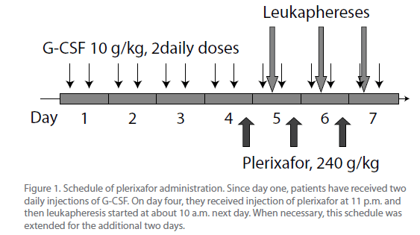
❸ Stem Cell Mobilization & Collection
Stem cell mobilization / G-CSF & Prelixafor
Plerixafor (Success rate: 70-80%) after any failure
Reversible inhibitor of the CXCR4/CXCL12 axis
    0.24 mg/kg body weight by subcutaneous (SC) injection.
    Approximately 11 hours prior to initiation of apheresis session (for up to 4 consecutive/ d) 6- to 10-fold increase in CD34⁺ cell, Typically administered in conjunction with filgrastim
    Side effects include abdominal discomfort, leukocytosis, potential for splenic rupture (rare)
0.24 mg/kg
MP Rettig, G Ansstas and JF DiPersio. Leukemia. 2011 Sep 2. doi: 10.1038/leu.2011.197
De Clercq E. The bicyclam AMD3100 story. Nat Rev Drug Discov 2003; 2: 581–587
Notes:
Mozobil is an inhibitor of the CXCR4 chemokine receptor and blocks binding of its cognate ligand stromal cell derived factor-1 (SDF-1α). SDF-1α and CXCR4 are recognized to play a role in the trafficking and homing of hematopoietic stem cells (HSC) to the marrow compartment.
Accidental finding: leukocytosis after a single intravenous dose of plerixafor
Originally tested clinically as an agent for the treatment of HIV infection by blocking the HIV entry into CD4⁺ T cells
Only for autologous collection / transplantation
not marketed for allogeneic collection / transplantation
For adult patients :
with lymphoid malignancies
“ … who mobilize poorly … “
in combination with rhG-CSF
Cost
cost / efficiency

Slide 39
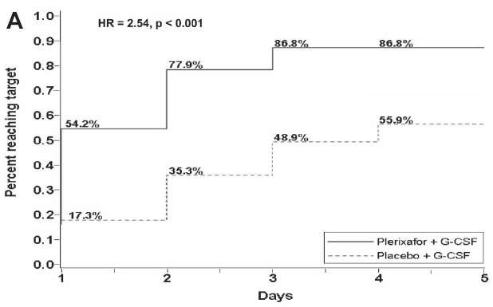
❸ Stem Cell Mobilization & Collection
Stem cell mobilization / G-CSF & Prelixafor
Kinetics of CD34+ collection in randomized trials
Kaplan-Meier estimate of proportion of multiple myeloma patients reaching 6x10e6 or more CD34+/kg (DiPersio JF et al, Blood 2009)

Slide 40

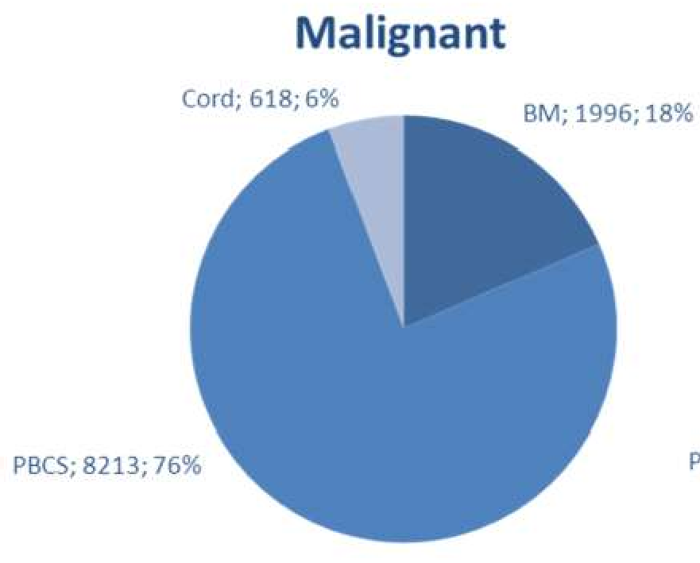
Peripheral blood stem cell donation by apheresis is nowadays the most commonly used stem cell source for allogeneic HSCT
❸ Stem Cell Mobilization & Collection
High T-cell content,
  immune effectors with potential consequences for the risk of GVHD in the allogeneic setting
High progenitor Cells,
  Accelerated cell recovery following myeloablative and reduced intensity conditioning regimen

Slide 41
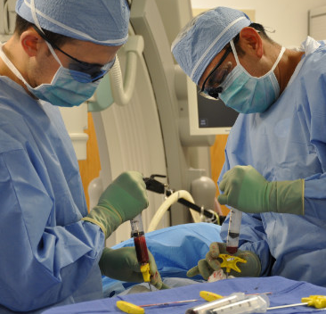
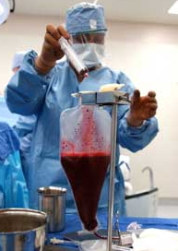
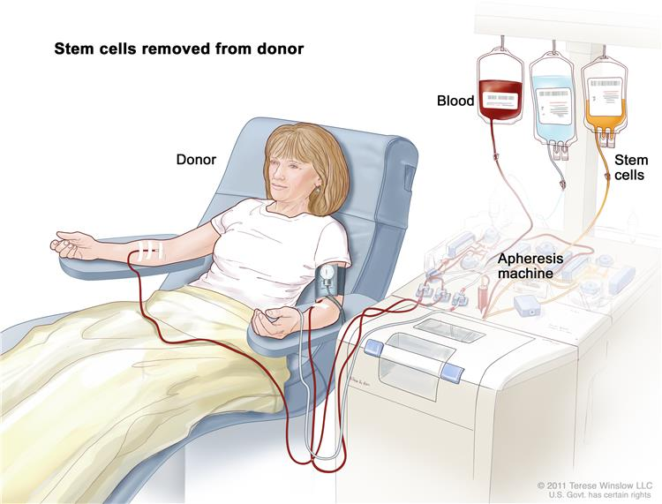

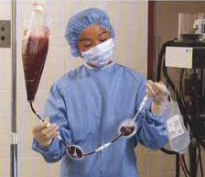


PBSC Apheresis Procedure
❸ Stem Cell Mobilization & Collection
    Stem Cell Collection Procedures
BM Harvesting Procedure
Mobilised Autologous Stem Cells
Removed from patients
BM Aspiration
BM collection
BM Fitration
Notes:
Once it has been determined that a patient is circulating sufficient CD34+ cells to undergo apheresis, the collection procedure begins. Patients may donate autologous cells via peripheral IV’s or via central venous catheter with two lumens. Whole blood is removed from the patient and flows through the apheresis machine. During apheresis the stem cell layer is separated from the remainder of the blood and removed. The remainder of the blood is returned to the patient and the stem cells are stored using 10% DMSO to prevent cell damage during the thaw procedure. This is a cryopreserved stem cell product.

Slide 42




❸ Stem Cell Mobilization & Collection
Collection of hematopietic stem cells
bone marrow peripheral blood

Slide 43
❸ Stem Cell Mobilization & Collection
    BM HARVESTING
BM Aspiration
harvest under general or regional anesthesia
  around 10-20ml/kg by multiple aspirations
  usually from the posterior superior iliac crests
BM collection
Erythrocytes depletion and/or volume reduction
  mandatory in case of major ABO mismatch to prevent severe hemolytic reactions
Use of continuous flow cell-separator such as Cobe Spectra allows for
  residual erythrocyte volume < 0,2ml/kg
  final volume < 10ml/kg
  CD34+ recovery around 80-90%
BM Fitration
Marrow Miner

Slide 44

❸ Stem Cell Mobilization & Collection
    UC COLLECTION
Collection at term (> 37 weeks)
  umbilical vein puncture with placenta in utero, after
    vaginal delivery
    cesarean section
  collection by gravity using a bag system containing ACD
Since cell dose is the main limitation of it is important to optimize UCB use,
  donor selection
  collection method

Slide 45


Peripheral-Blood Stem Cells versus Bone Marrow from Unrelated Donors
❸ Stem Cell Mobilization & Collection
Cell Dose and Source: effect on outcomes
Original Article
Figure: Survival after Randomization in the Intention-to-Treat Analysis.

Slide 46


❸ Stem Cell Mobilization & Collection
Cell Dose and Source: effect on outcomes

Slide 47

❸ Stem Cell Mobilization & Collection
Cell Source: effect on outcomes

Slide 48
❹ Conditioning Therapy
34

Slide 49


❹ Conditioning Therapy
Dose & Response Curve for Cytotoxic Chemothrapy
The first stage of the transplant.
May be given in one dose or over several days.
........................................................
Conditioning Chemothrapy Necessary for:
  Destroying remaining cancer cells
  Creating room in the bone marrow for the transplanted stem cells
  Supressing the patients immune system to prevent of graft rejection
  ......................................................................................
Conditioning regimen is dependent on the type of disease, the type of transplant, co-morbidities and age.
NMA
RIC
MA

Slide 50

❹ Conditioning Therapy
Dose & Response Curve with Cytotoxic Chemothrapy
Low Intensity
Moderate Intensity
High Intensity
Bacigalupo, Biol Blood Marrow Transplant. 2009 Dec; 15(12): 1628–1633.

Slide 51
❹ Conditioning Therapy
Regimen Intensity
Myeolablative conditioning
  Irreversibly destroys the haemopoietic function of the BM with high doses of CT ± TBI.
  Higher level of disease control
  Younger patients with a good performance status
  Quicker engraftment of donor cells
  Higher toxicities associated with higher transplant related mortality
Reduced intensity conditioning
  It aims to use enough immunosuppression to allow donor cells homing
  RIC can allow to homing without completely eradicating the recipients bone marrow.
  Regimens that have been developed to reduce the morbidity and mortality of Allo-HSCT
  Because of less regimen related toxicities, Can be given to older patients
  Reduction in morbidity and transplant related mortality

Slide 52

❺ Stem Cell Re-infusion
Stem Cell Re-infusion
At least 24 hour after the conditioning will be given on Day 0. These are generally given through a central line and takes approximately 30 minutes.
Stem cells are either cryopreserved or fresh.
Cryopreserved
  Usually for autologous transplants
  Most common side effects are reactions to DMSO
Fresh
  Usually for allogeneic transplants
  Administered much like a blood transfusion
  Generally better tolerated than frozen cells.

Slide 53
Stem cell transplantation
❻ Engraftment
Definition of engraftment
The stem cells of the donor have been taken up by the patient´s bone marrow (”have engrafted”)
Neutrophils
Day, 12
0,5 x
10⁹/L
5
10
days
15
20
Conditioning
Infusion of graft
The first of three days with neutrophil count> 0.5 x 10⁹/L

Slide 54
❻ Engraftment
ENGRAFTMENT
Haematopoietic Reconstitution
According to the Source
Thomson B G et al. Blood 2000;96:2703-2711
  Neutrophils > 0.5 x 10⁹/L
  Leucocytes > 1.0 x 10⁹/L
  Platelets (without transfusion) > 20 x 10⁹/L
  Without transfusion: no transfusions for at
  least seven days before reconstitution is recorded
*First of three consecutive days with the indicated blood cell levels:
Notes:
Engraftment isdefined asanabsolute neutrophil countthatisgreaterthan 500/micl and asustained platelet count that is greater than 20,000/micl that lasts for threeconsecutive dayswithout transfusions. Myeloidengraftment typically occurs within 28 days of the graft infusion, irrespective of whether an autologous, allogeneic matched related or unrelated product of marrow or blood progenitor cells is used. A hemoglobin level of at least 8 g/dL without transfusion support is an accepted threshold for red cell engraftment. Primary graft failure is defined as a failure to achieve these threshold counts beyond day 28 post transplantation.

Slide 55
❽ Early Complications of HSCT :
Early Complications (Major cause of morbidity and mortality)
Infection: | NASUAE & VOMITING
Netropenic Fever | ORAL MUCOSITIS
Bacterial | HEMORRHAGIC CYSTITIS
Viral | VENOOCCLUSİVE DİSEASE
Fungal | THROMBOTHIC MICROANGIOPATHY
Acute GvHD | CAPİLLARY LEAK SYNDROME
Skin | ENGRAFTMENT SYNDROME
Gasrointestinal | DIFFUSE ALVEOLAR HEMORRHAGE
Liver | IDIOPATHIC PNEUMONIA SYNDROME

Slide 56





❽ Early Complications of HSCT :
LATE EFFECTS …..

Slide 57

❽ Early Complications of HSCT : Mucosal Origin
The high dose chemo/radiotherapy used in standard conditioning
regimens has high emetic potential.

Slide 58

❽ Early Complications of HSCT : Mucosal Origin / NASUAE & VOMITING
The main principles of emesis control are:
- Nausea and vomiting are far easier to prevent than to treat
- Antiemetic therapy should be adjusted for the drug with the highest emetic risk
- The risk for emesis following highly emetogenic CTx lasts approximately 4 days

Slide 59

❽ Early Complications of HSCT : Mucosal Origin / NASUAE & VOMITING
The high dose chemo/radiotherapy used in standard conditioning regimens has high emetic potential.
✪
Notes:
In addition, there are several other factors that may further increase the risk of vomiting (consecutive day administration, prior cytotoxic treatment, and other medication, e.g. opiate analgesics).

Slide 60
❽ Early Complications of HSCT : Mucosal Origin / NASUAE & VOMITING
✪
Standard prophylaxis
A combination of a serotonin antagonist (setron) plus a neurokinin-1 antagonist (aprepitant) together with dexamethasone is considered to be the standard prophylaxis
✪
In case of failure of the prophylaxis :
the addition of further dexamethasone (max 20 mg/day) and/or a benzodiazepine (e.g. lorazepam max 4 mg iv) may help to counter increased patient anxiety and possible anticipatory emesis. . An alternative is to switch to a different serotonin antagonist, since there is an incomplete cross-resistance between agents
Notes:
The conditioning regimens used in HSCT are known to have a high emetogenic risk. A com-bination of a serotonin antagonist (setron) plus a neurokinin-1 antagonist (aprepitant) together with dexamethasone is considered to be the standard prophylaxis.

Slide 61

❽ Early Complications of HSCT : Mucosal Origin
It is characterized by mucosal damage
ranging from mild inflammation to extensive ulceration,
which may affect the oral cavity and other parts of the alimentary tract.

Slide 62


❽ Early Complications of HSCT : Mucosal Origin / ORAL MUCOSITIS
Typically, oral mucositis peaks between day 6 and 12, and resolution coincides with engraftment.
✪
Mucositis is associated with an increased risk of systemic infection resulting from bacteraemia associated with the breakdown of mucosal barriers.
Mucositis-associated pain and infection cause significant morbidity and mortality.
Both the severity and the duration of oral mucositis are decreased RIC regimens compared to myeloablative HSCT..

Slide 63

❽ Early Complications of HSCT : Mucosal Origin / ORAL MUCOSITIS
For the prevention of mucositis ; Routine Care
Routine mouth care typically consists of daily assessments by trained nurses using standardized tools to evaluate oral mucositis, pain and other oral complaints.
Gentle rinses (e.g. water, saline, sodium bicarbonate) are used routinely to remove debris and keep the oral tissues moist.
Patients should use a soft toothbrush or dental plaque accumulation

Slide 64
❽ Early Complications of HSCT : Mucosal Origin / ORAL MUCOSITIS
For the treatment and pain management of mucositis:
Many patients require narcotics . Fentanyl is recommended as the opioid of choice.
Amifostine is a phosphorylated aminothiol, which has a protective effect on normal tissues against radiation and alkylating agent toxicity.
There is increasing evidence for the use cryotherapy (e.g. ice cubes)
A biological approach aimed to prevent mucositis is the use of recombinant keratinocyte growth factor (KGF, palifermin, Kepivance®). Its benefits were associated with significantly less use of opioid analgesics and less frequent requirement for TPN support.
Notes:
Topical agents are available with or without analgesics including diphenhydramine, corticosteroids, antacids, sodium hyaluronate gel, and mucoadhesive protectants. calcium phosphate .

Slide 65

Early complications of Mucosal Origin
❽ Early Complications of HSCT : Mucosal Origin
Haemorrhagic cystitis (HC) can be a serious complication of HSCT
and causes significant morbidity, prolongation of hospitalisation, and, occasionally, death.
Various additional complications have been described in patients with HC:
obstructive uropathy, hydronephrosis, tubulointerstitial nephritis, acute renal failure and bladder perforation
Notes:
Haemorrhagic cystitis (HC) can be a serious complication of HSCT and causes significant morbidity, prolongation of hospitalisation, and, occasionally, death. Various additional complications have been described in patients with HC: obstructive uropathy, hydronephrosis, tubulointerstitial nephritis, acute renal failure and bladder perforation

Slide 66

❽ Early Complications of HSCT : Mucosal Origin / HEMORRHAGIC CYSTITIS
Incidence
Acute HC (up to 72 hrs after CT agents ) secondary to Cy is seen in 5–25 % of cases,
Late HC (usually more than 2 weeks after HSCT) are classically attributed to BK polyomavirus infection
It was reported as occurring in 7% of patients with RIC vs 17% of those undergoing MAC-HSCT
Clinical features
Haematuria, symptomatic or asymptomatic, is graded as follows:
  grade I, microscopic;
  grade II, macroscopic;
  grade III, with clots;
  grade IV, urinary retention
Notes:
And up to 58% in patients receiving MAC-HSCT from haplo or cord blood HSCT who had positive BK viruria

Slide 67


Proposed steps in the pathogenesis of BK virus-associated hemorrhagic cystitis
Early complications of Mucosal Origin
❽ Early Complications of HSCT : Mucosal Origin / HEMORRHAGIC CYSTITIS
Pathogenesis of late HC
The HC are classically attributed to BK polyomavirus and with other polyomaviruses, adenovirus or CMV infection.
Decoy cells in urine
Sensitivity: 100%
Specificity :71%
Notes:
2.2 Pathogenesis
Early bleeding (up to 72 hrs after CT agents) occurs when using conditioning therapies including Cy, ifosfamide, Bu (especially if associated with Cy), VP16 or TBI
Episodes of HC occurring late (usually more than 2 weeks after HSCT) are classically attributed to BK polyomavirus infection (and exceptionally to infections with other polyomaviruses, adenovirus or CMV). This fact, and the higher incidence of late-onset HC in allo-HSCT from alternative donors and in patients with advanced age, GvHD and thrombocytopenia, suggests that the pathogenesis of HC may be multifactorial.
Early bleeding (up to 72 hrs after CT agents) occurs almost exclusively when using conditioning therapies including Cy, whose metabolite acrolein produces direct toxicity to the urothelium. The risk of developing HC after Cy is dose dependent. Occasionally, other agents such as ifosfamide, Bu (especially if associated with Cy), VP16 or TBI have been implicated.

Slide 68
Treatment of hemorrhagic cystitis
❽ Early Complications of HSCT : Mucosal Origin / HEMORRHAGIC CYSTITIS
Treatment should be based on a three-step approach as follows:
Forced hydration plus intensive platelet support.
  bladder irrigation with saline, bladder instillation of formalin, alum, silver nitrate,
  sodium hyaluronate, PG-E2, GM-CSF or fibrin glue as well as with the administration of palifermin, hyperbaric oxygen, oestrogens, or recombinant FVIIa.
Intravesical or systemic cidofovir, or ribavirin , plus ciprofloxacin (reduces BK replication) have been reported as effective for cases of HC attributable to BK or adenovirus
If the above measures do not alleviate HC, other salvage approaches can be considered: selective embolisation of bladder arteries; catheterisation of both ureters to rest the bladder or: as a last resort, cystectomy.
Notes:
Forced hydration plus intensive platelet support. The use of procoagulant agents such as aminocaproic acid is contraindicated as they favour clot formation in the bladder.
Continuous bladder irrigation (via transurethral or suprapubic cystotomy) with saline. Some success has been reported with bladder instillation of formalin, alum, silver nitrate, sodium hyaluronate, prostaglandin E2, GM-CSF or fibrin glue as well as with the administration of palifermin, hyperbaric oxygen, oestrogens, or recombinant FVIIa. Similarly, systemic or intravesical cidofovir, ciprofloxacin (reduces BK replication) or ribavirin have been reported as effective for cases of HC attributable to BK or adenovirus.
If the above measures do not alleviate HC, other salvage approaches can be considered: selective embolisation of bladder arteries (one of the simplest and most effective measures in the hands of an expert angioradiologist); catheterisation of both ureters to rest the bladder; hypogastric bond (which can produce sexual impotence) or, as a last resort, cystectomy.

Slide 69

❽ Early Complications of HSCT : Vascular Origin
Hepatic veno-occlusive disease (VOD) is the term used to designate the symptoms and signs that appear early after HSCT as a consequence of conditioning regimen related hepatic toxicity.

Slide 70
❽ Early Complications of HSCT : Vascular Origin / VENOOCCLUSİVE DİSEASE
This syndrome is characterised by
  Jaundice,
  Fluid retention
  Tender hepatomegaly
appearing in the first 35–40 days after HSCT
VOD, also known as sinusoidal obstruction syndrome; is a potentially life-threatening complication of HSCT
The conditioning regimens given before HSCT result in the production of toxic metabolites by the hepatocytes in the liver. These metabolites trigger the activation, damage and inflammation of the endothelial cells that line the sinusoids*
  Richardson PG et al. Expert Opin Drug Saf 2013;12:123–136
Notes:
Experimental models show that the first events after endothelial injury caused by toxic metabolites are loss of fenestrae in sinusoidal endothelial cells (SEC), formation of gaps within and between SEC and rounding up or swelling of SEC. Consequently, red blood cells penetrate into the space of Disse and dissect off the sinusoidal lining cells, which embolise downstream and block the sinusoids, reducing the hepatic venous outflow and producing post-sinusoidal hypertension. Based on all these observations, some authors have proposed the term of sinusoidal obstruction syndrome for this complication (8).

Slide 71

Cell toxicity resulting from chemotherapy damages the lining of the liver sinusoids
❽ Early Complications of HSCT : Vascular Origin / VENOOCCLUSİVE DİSEASE
Endothelial cell and hepatocyte damage
Toxic metabolites resulting from the HSCT conditioning regimen damage and activate the sinusoidal endothelial cells, Activation and damage due to conditioning regimen-mediated injury. Damage is both directed and mediated by cytokines such as: TNF-α, IL-1b, IL-6
PAI-1,plasminogen activator inhibitor-1; TF, tissue factor Richardson PG et al. Expert Opin Drug Saf 2013;12:123–136
Notes:
The chemotherapy agents used as conditioning regimens for haematopoietic stem cell transplantation (HSCT) are metabolised in the liver.
Toxic metabolites are released by the hepatocytes, causing the damage and activation of the sinusoidal endothelial cells (SECs), which line the sinusoids.
These events can be triggered as soon as the conditioning regimen is administered.
The initial trigger for VOD is the activation and damage of the sinusoidal endothelial cells due to toxic metabolites resulting from the HSCT conditioning regimen¹
Inflammatory mediators such as cytokines and chemokines are released along with the enzyme heparanse, which breaks down the extracellular matrix¹
The rounding up of endothelial cells allows red blood cells, white blood cells and other debris accumulates in the space of Disse, leading to sinusoidal narrowing
Endothelial cells dissect off and embolise downstream, further contributing to this narrowing¹
A procoagulant and hypofibrinolytic state is also characteristic of VOD¹
This can lead to the complete obstruction of the hepatic sinusoids. In severe cases this can lead to multi-organ failure and death¹⁻³
References
Richardson PG et al. Expert Opin Drug Saf 2013;12:123–136
Bearman SI. Blood 1995;85:3005–3020
Coppell JA et al. Blood Rev 2003;17:63–70
References
Richardson PG et al. Expert Opin Drug Saf 2013;12:123–136

Slide 72

Activation of sinusoidal endothelial cells can trigger multiple pathways, resulting in inflammation and narrowing of the sinusoids
❽ Early Complications of HSCT : Vascular Origin / VENOOCCLUSİVE DİSEASE
Sinusoidal narrowing
The accumulation of cells and debris in the space of Disse, the peri-sinusoidal space located between the endothelium and the hepatocyte, lead to narrowing of the sinusoids
PAI-1,plasminogen activator inhibitor-1; TF, tissue factor Richardson PG et al. Expert Opin Drug Saf 2013;12:123–136
Notes:
The activated sinusoidal epithelial cells release inflammatory cytokines, adhesions molecules and heparanase. Heparanese digests the extracellular matrix that supports the structure of the sinusoids. The action of these factors causes the endothelial cells to round up, and gaps to form between the cells. Red blood cells, white blood cells and other cellular debris exits through these gaps into the space of Disse, the perisinusoidal space that is located between the endothelium and the hepatocytes. This accumulation of cells and debris in this space causes narrowing of the sinusoids. Endothelial cells can dissect off and embolise further downstream.
References
Carreras E et al. Biol Blood Marrow Transplant 2011;17:1713–1720
Richardson PG et al. Expert Opin Drug Saf 2013;12:123–136

Slide 73

VOD is characterised by increased clot formation and reduced clot breakdown
❽ Early Complications of HSCT : Vascular Origin / VENOOCCLUSİVE DİSEASE
Sinusoidal Obstruction Syndrome
The narrowing of the sinusoids, embolised endothelial cells and increased clot formation lead to the endpoint of VOD, namely obstruction of the sinusoids, Portal vein hypotension, Hepatic venous outflow obstruction
PAI-1,plasminogen activator inhibitor-1; TF, tissue factor Richardson PG et al. Expert Opin Drug Saf 2013;12:123–136
Notes:
An increase in the expression of tissue factor (TF) and plasminogen activator inhibitor-1 (PAI-1) causes an increase in clot formation and a decrease in the breakdown on clots.
This contributes to the deposition of fibrin, clot formation, and the narrowing of the sinusoids. This may ultimately lead to obstruction of the sinusoids.
This image shows the pathophysiology of VOD. The endothelial cells have rounded up, leading to gap formation, and some have dissected off into the bloodstream. The sinusoid has narrowed due to the accumulation of cells in the space of Disse. Clots forming at the sites of endothelial damage have caused the obstruction of the sinusoid.
References
Richardson PG et al. Expert Opin Drug Saf 2013;12:123–136

Slide 74
Diagnosis
❽ Early Complications of HSCT : Vascular Origin / VENOOCCLUSİVE DİSEASE
As for any syndrome, the diagnosis of VOD must be established clinically. All teams employing HSCT use one of the following two sets of clinical criteria;
Seattle criteria.
In the first 20 days after HSCT, the presence of two or more of the following:
    Bilirubin >2 mg/dL (>34 mmol/L);
    hepatomegaly or pain in the right upper quadrant;
    weight gain (>2% basal weight).
Baltimore criteria.
In the first 21 days after HSCT, the presence of
    Bilirubin at >2 mg/dL (>34 mmol/L) , Plus two or more of the following:
    a) painful hepatomegaly, b) Ascites, or c)weight gain (>5% basal weight).
Notes:
In both diagnostic criteria, other possible causes of these clinical features should be excluded before accepting a diagnosis of VOD (see differential diagnosis). Additionally, it is necessary to remember that some cases of VOD can appear late after HSCT.
This has ranged from 3% to 54% in the largest series. This variability is a consequence of the presence or absence of the well-known risk factors for this complication (see below). In the only prospective multi-centre study published, the incidence of VOD was 8% in cases of allo-HSCT and 3% in cases of auto-HSCT (5). In a large single-centre study, the cumulative incidences of VOD in cases of allo-HSCT in the last decade were 14% and 8% using Seattle or Baltimore criteria, respectively. The incidence in patients undergoing RIC-HSCT seems to be less than 2%

Slide 75



Diagnosis: Other studies that can complement the diagnosis are as follows.
❽ Early Complications of HSCT : Vascular Origin / VENOOCCLUSİVE DİSEASE
HEMODYNAMIC STUDY: a hepatic venous gradient pressure (HVGP): of ≥10 mmHg, However, a normal HVGP does not exclude this syndromic diagnosis, (Prognostic Value !).
Liver biopsy. classical histological changes seen with VOD
  concentric narrowing of the lumen of small intrahepatic veins, (more specific )
  Because of the patchy nature of VOD, a normal biopsy does not exclude this syndromic diagnosis
Biological studies. plasminogen activator inhibitor (PAI)-1 (marker with the highest specificity and sensitivity for VOD), vWF, thrombomodulin, e.g.
Light micrograph of sinusoidal obstruction syndrome in which venular occlusion has led to widespread zonal liver disruption and centrilobular hemorrhagic necrosis
Notes:
In both diagnostic criteria, other possible causes of these clinical features should be excluded before accepting a diagnosis of VOD (see differential diagnosis). Additionally, it is necessary to remember that some cases of VOD can appear late after HSCT.
An hepatic venous gradient pressure (HVGP): of ≥10 mmHg in a patient without a previous liver disease allows a precise differential diagnosis with a high degree of specificity. However, a normal HVGP does not exclude this syndromic diagnosis.
Liver biopsy. classical histological changes seen with VOD
concentric non-thrombotic narrowing of the lumen of small intrahepatic veins, (more specific )
eccentric narrowing of the venular lumen; phlebosclerosis; sinusoidal fibrosis or hepatocyte necrosis (less specific ) Because of the patchy nature of VOD, a normal biopsy does not exclude this syndromic diagnosis
Ultrasonography. A variety of abnormalities can be observed, such as gallbladder wall thickening, ascites, hepatomegaly and attenuated or reversed portal flow, but they are all non-specific.
Biological studies. Although the serum of patients with VOD shows an increase in levels of plasminogen activator inhibitor (PAI)-1 (marker with the highest specificity and sensitivity for VOD), vWF, thrombomodulin, E-selectin, sICAM, aminopropeptides of type III collagen and hyaluronic acid, they are all of little utility in daily clinical practice

Slide 76

D1. IMAGING STUDIES : (Ultrasonography,).
❽ Early Complications of HSCT : Vascular Origin / VENOOCCLUSİVE DİSEASE
Diagnosis (cont.)
US imaging is sensitive in detecting
Ascites,
Hepatosplenomegaly,
Portal vein enlargement,
Marked gallbladder wall edema (wall thickening > 6-8 mm),
Abnormal Doppler parameters
Notes:
ltrasonography may be abnormal in patients with hepatic sinusoidal obstruction syndrome (SOS), but is unlikely to be diagnostic for the disease. Ultrasonographic findings that are more common in SOS than other liver disorders occurring during hematopoietic cell transplantation (HCT) include the presence of ascites, an abnormal portal vein waveform, marked thickening of the gallbladder wall, and a hepatic artery resistance index greater than 0.75 [63]. Reversal of flow in the portal vein has been used to diagnose SOS, but the sensitivity is low [64,65].
However, ultrasonography is often abnormal in patients undergoing HCT in the absence of SOS. As an example, one study prospectively determined the prevalence of sonographic hepatobiliary abnormalities in 21 patients undergoing HCT [66]. Baseline scans were abnormal in 62 percent. Findings on serial examinations could not discriminate patients with SOS from those without the syndrome.
However, US findings are nonspecific and similar findings can be seen in patients with absence of SOS. Studies have shown that no US finding is strongly associated with veno-occlusive disease (VOD)

Slide 77

❽ Early Complications of HSCT : Vascular Origin / VENOOCCLUSİVE DİSEASE
Diagnosis (cont.)
D1. IMAGING STUDIES : (MRI).
A variety of abnormalities can be observed, such as gallbladder wall thickening, ascites, periportal edema, narrowed right hepatic vein , hepatomegaly and attenuated or reversed portal flow, but they are all non-specific.
Notes:
maging techniques have experienced major progress since the 1980s and the initial definition of the criteria for diagnosis of SOS/VOD,^{3, 4} raising the possibility that they may contribute to refining such diagnosis today. The role of ultrasound has been investigated in several studies, but most of them were published almost two decades ago, with conflicting results, as reviewed by Mahgerefteh et al.⁵³ The reported abnormalities in SOS/VOD are not specific, and included hepatomegaly, splenomegaly, gallbladder wall thickening, ascites and portal venous flow abnormalities.^{53, 54} The latter—decrease in velocity or reversal of the portal venous flow—are considered more specific for SOS/VOD, but usually occur late in the disease,^{53,54, 55} and their interest for SOS/VOD early diagnosis is limited.
Measurement of the hepatic venous gradient pressure through the jugular vein is the most accurate method to confirm the diagnosis of SOS/VOD.^{24, 56, 57} However, this technique is invasive, requires an expert hemodynamist, and is not routinely available in most centers. Therefore, doppler ultrasonography has been investigated to evaluate changes in portal circulation. Although the correlation between hepatic arterial resistive indices and portal hypertension is controversial, the hepatic arterial early acceleration index correlated directly with Hepatic venous pressure gradient.⁵⁸ Nevertheless, although non-invasive, this technique requires expert echographers, and is not available in most centers.
Few studies, mostly case reports, investigate the role of other imaging techniques.²³ Periportal edema, ascites and a narrow right hepatic vein on computerized tomography scans are suggestive of SOS/VOD.^{59, 60}Similarly, magnetic resonance imaging scans of patients with SOS/VOD have detected hepatomegaly, ascites, hepatic vein narrowing, gallbladder wall thickening, peri-portal cuffing or patchy signal enhancement of the liver.^{59, 61, 62, 63, 64} Of note, a high specificity of supramagnetic iron oxide-enhanced magnetic resonance imaging and gadoteric acid-enhanced magnetic resonance imaging for SOS/VOD diagnosis in patients with chemotherapy-treated colorectal liver metastases has been reported,^{65, 66} but these imaging modalities have not been evaluated in the setting of HCT.
At present, the role of imaging in SOS/VOD remains limited to ultrasound to assist in the exclusion of differential diagnoses. In addition, ultrasound may be helpful to confirm clinical findings such as hepatomegaly and ascites, which can be difficult to assess in particular in overweight patients. Baseline and serial ultrasound measurements may be useful for early detection of signs suggestive of SOS/VOD, although daily clinical examination and weight monitoring remain the gold standards. Prospective evaluation of hepatic arterial early acceleration index and of supramagnetic iron oxide- or gadoteric acid-enhanced magnetic resonance imaging for SOS/VOD monitoring/diagnosis seems indispensable before recommending their use and integration into the SOS/VOD diagnostic criteria.

Slide 78


2. Early complications of Vascular Origin
❽ Early Complications of HSCT : Vascular Origin / VENOOCCLUSİVE DİSEASE

Slide 79

2. Early complications of Vascular Origin
❽ Early Complications of HSCT : Vascular Origin
microangiopathic haemolytic anaemia and plt consumption,
resulting in thrombosis and fibrin deposition in the microcirculation
Especially, conditioning regimens produce a generalized endothelial dysfunction
Unlike that seen in patients with classical TTP, ADAMTS13 activity in patients with TMA rarely decreases to below 10% of normal

Slide 80

❽ Early Complications of HSCT : Vascular Origin / THROMBOTHIC MICROANGIOPATHY
TMA usually develops around day +60, but early (day +4) and late (2 years) episodes have been described.
Diagnostic Criteria
Clinical features for HSCT associated TMA
1. Microangiopathic haemolytic anaemia ,
(Defined as anaemia with >2–4% schistocytes, together with raised LDH)
2. Thrombocytopenia or increased requirement for platelet transfusions.
3. Renal dysfunction and/or neurological abnormalities
(such as cortical blindness, seizures and typical images in CT scans of the CNS.)
It is characterised as follows.

Slide 81







❽ Early Complications of HSCT : Vascular Origin / THROMBOTHIC MICROANGIOPATHY
Histologic examples of TA-TMA affecting various organs.
(A) Renal cortex with glomeruli showing red blood cell fragments can be seen (arrows)
(B) Lung arteriole showing debris nearly occluding vascular lumen (star)
(C) Submucosal arterioles of the small bowel showing injured endothelial cells
(D) Brain MRI: hyperintense FLAIR signal involving the bilateral cortex and subcortical white matter.
Notes:
Fig. 1. Histologic examples of TA-TMA affecting various organs. (A) Renal cortex with glomeruli showing thickened capillary walls and occluded vessel lumens. Red blood cell fragments can be seen (arrows) trapped in the mesangial matrix (H&E stain; magni fi cation ×200). Renal arteriole with separation of the endothelial cell layer and nearly occluded by endothelial debris (arrow heads) (H&E stain; magni fi cation ×200). (B) Lung arteriole showing denuded endothelial layer with large amount of debris nearly occluding vascular lumen (star) Red blood cell fragments extravagated into interstitial tissue (arrow) (H&E stain; magni fi cation ×200). (C) Submucosal arterioles of the small bowel showing injured endothelial cells and red cell extravasation (arrows). Vessel lumen is occupied by schistocytes and fi brinoid debris (star) (H&E stain; magni fi cation ×200). (D) Brain MRI: hyperintense FLAIR signal involving the bilateral (left N right) cortex and subcortical white matter. Effacement of sulci suggests associated swelling. Findings are suggestive of posterior reversible encephalopathy (PRES)

Slide 82

2. Early complications of Vascular Origin
❽ Early Complications of HSCT : Vascular Origin / THROMBOTHIC MICROANGIOPATHY
Notes:
3.5.7 Prevention
The only reasonable measure is to keep close observation (2–3 times per week) of the CNI, LDH and creatinine levels. If any of these markers increase, peripheral blood smears, haptoglobin levels and Coombs tests (direct and indirect antiglobulin tests) should be evaluated.
3.5.8 Treatment
The most effective measure is to stop CNI immediately (no dose reduction) by changing GvHD prophylaxis/treatment to another drug (corticosteroids, mycophenolate). Plasma exchange usually offers a poor response (median 35%; range 20–80%) probably because TMA is not associated with an absence or severe reduction of plasma ADAMTS13 activity and has a high associated mortality (80%). Some authors have reported successful results with defibrotide, rituximab, daclizumab and basiliximab therapies.

Slide 83

2. Early complications of Vascular Origin
❽ Early Complications of HSCT : Vascular Origin
Injury to the capillary endothelium
produces a loss of intravascular fluids to the interstitial space, which leads to the clinical manifestations of CLS
(probably caused by cytokines and VEGF)

Slide 84


2. Early complications of Vascular Origin
❽ Early Complications of HSCT : Vascular Origin / CAPİLLARY LEAK SYNDROME
Weight gain (>3% within 24 hrs) and
Generalised oedematous syndromes (e.g. ascites, pleural effusion or pericarditis) that characteristically do not respond to furosemide treatment.
3. Other features occasionally observed are tachycardia, hypotension,
renal insufficiency of pre-renal origin and hypoalbuminaemia
Clinical features
The absence of well-established clinical criteria for the diagnosis of CLS precludes an adequate estimation of its incidence.
This is characterised by the development in the first 15 days after HSCT of;
Notes:
Risk factors
The use of G-CSG, GM-CSF or K-CSF; high cumulative doses of CT in the pre-HSCT phase; unrelated or HLA-mismatched donor grafts.
Differential diagnosis;
From ES: its earlier development, the absence of skin rash and the poor response to corticosteroids.
From VOD : the absence of jaundice and painful hepatomegaly and the poor response to furosemide.
From DAH: generalised oedema.

Slide 85


❽ Early Complications of HSCT : Vascular Origin / CAPİLLARY LEAK SYNDROME
Treatment
Withdraw any growth factors. Despite being used systematically, corticosteroids offer poor responses. iv Ig and bevacizumab (anti-VEGF) have been used successfully in some cases .
Administration of bevacizumab.
. Chest CT before
5 days after
20 days after
Hiromasa Yabe et al. Blood 2010;115:2723-2724

Slide 86
3. Early complications of Vasc. / Pulm. Origin
❽ Early Complications of HSCT : Vascular & Pulmonary Origin
ENGRAFTMENT SYNDROME
ES is almost exclusively diagnosed after auto-HSCT.
In this setting, the incidence ranges from 5% to 25% (13% in the largest series).
It is rarely seen after conventional allo-HSCT, but is occasionally described after RIC allo.
This involves a massive release of pro-inflammatory cytokines (e.g. IL-2, TNF-α, IFN-γ and IL-6), M-GSF, EPO, products of degranulation and oxidative metabolism of neutrophils and systemic endothelial damage.

Slide 87

3. Early complications of Vasc. / Pulm. Origin
❽ Early Complications of HSCT : Pulmonary Origin / ENGRAFTMENT SYNDROME
Notes:
3.3.3 Clinical features and diagnostic criteria
The clinical manifestations and the Spitzer and Maiolino diagnostic criteria are listed in Table 5 (13, 16). A recent study showed that the Maiolino criteria - when correctly applied - are the best tool to establish an early diagnosis, despite being less specific than the Spitzer criteria. A sudden and significant increase in the level of C-reactive protein can help to establish the diagnosi

Slide 88




❽ Early Complications of HSCT : Pulmonary Origin / ENGRAFTMENT SYNDROME
(A) Day +8 PBSCT demonstrating relatively normal CXR despite fever and diarrhea.
Cutaneous rash
(B) Day +11 PBSCT (same patient) demonstrating increased heart size, diffuse interstitial infiltrates throughout both lungs with alveolar infiltrates in the lower lungs
The epidermis shows eosinophilic necrosis of epidermal keratinocytes and vacuolar change in the basal layer with perivascular lymphocytic infiltration
Notes:
3.3.3 Clinical features and diagnostic criteria
The clinical manifestations and the Spitzer and Maiolino diagnostic criteria are listed in Table 5 (13, 16). A recent study showed that the Maiolino criteria - when correctly applied - are the best tool to establish an early diagnosis, despite being less specific than the Spitzer criteria. A sudden and significant increase in the level of C-reactive protein can help to establish the diagnosi

Slide 89

❽ Early Complications of HSCT : Pulmonary Origin / ENGRAFTMENT SYNDROME
CRP levels …
A sudden and significant increase in the level of C-reactive protein can help to establish the diagnosis

Slide 90
❽ Early Complications of HSCT : Pulmonary Origin / ENGRAFTMENT SYNDROME
Early treatmant with PND (1mg/kg/12h) 3 day, and rapidly tapered over 7-8 day
Complete resolution in 1–5 days in >80% of the cases if steroids are introduced early.
Always broad spectrum ATBs
In all cases CRP values return to the normal
In some cases the symptoms (fever &skin rash) reappear after stopping steroid therapy.
Treatment
Notes:
3.3.5. Treatment
Methyl-PDN 1 mg/kg q 12 hrs (for 3 days) with progressive tapering off over 1 week. Because of the difficulty of excluding an infectious origin of the fever, this treatment should not be started until it has been confirmed that the fever does not respond to empirical antibiotic therapy and that cultures are negative.
3.3.6 Evolution
There is complete resolution in 1–5 days in >80% of the cases if steroids are introduced early. In some cases the symptoms reappear after stopping steroid therapy.

Slide 91

3. Early complications of Vasc. / Pulm. Origin
❽ Early Complications of HSCT : Pulmonary Origin / DIFFUSE ALVEOLAR HEMORRHAGE
DAH seems to originate from the disruption of the alveolar–capillary basement membrane by conditioning,
immune-mediated events and the return of neutrophils with marrow recovery.
The pathological observations on small arteries are very similar to those observed in veins affected by VOD
DAH is not related to low platelet counts.

Slide 92

❽ Early Complications of HSCT : Pulmonary Origin / DIFFUSE ALVEOLAR HEMORRHAGE
The reported incidence ranges from;
1% to 21% in cases of auto-HSCT and from
2% to 17% in cases of allo-HSCT.
Risk factors
Factors that favour this; complication are
Older age,
Previous thoracic radiation,
TBI and myeloablative conditioning.
Diagnosis
This is based on Chest X-ray /CT
BAL findings (progressively bloodier ) but not attributable to infection (absence of pathogens in BAL), on thrombocytopenia, fluid overload or heart failure.
Hemosiderin-laden macrophages in the lung.
Notes:
Successive aliquots of 20 mL, in at least three segmentary bronchi, become progressively more blood stained (indicating blood in the alveoli).

Slide 93


❽ Early Complications of HSCT : Pulmonary Origin / DIFFUSE ALVEOLAR HEMORRHAGE
Clinical features
The median times to onset in patients undergoing allo- and auto-HSCT are 19 and 12 days, but episodes after the first month are not uncommon. The main manifestations are as follows:
Shortness of breath and
Non-productive coughing ( haemoptysis is rare)
with or without fever;
Hypoxaemia (that can require oxygen therapy)
Chest X-ray or CT findings with
(focal or diffuse interstitial or alveolar infiltrates located in the middle and inferior lung fields)

Slide 94
❽ Early Complications of HSCT : Pulmonary Origin / DIFFUSE ALVEOLAR HEMORRHAGE
Treatment
After some small retrospective series, high-dose methyl-PDN (250–500 mg q 6 hrs, 4–5 days and tapering over 2–4 weeks) was considered the treatment of choice. However, many other authors have failed to observe any benefit of corticosteroids on the poor outcome associated with DAH. No other measures have proved to be effective.
Notes:
The overall mortality rate ranges from 60% to 100% (80–100% if patients require mechanical ventilation). With steroid therapy, many patients do not develop respiratory failure (85%) but most of them die from multi-organ dysfunction syndrome or sepsis.

Slide 95

3. Early complications of Vasc. / Pulm. Origin
❽ Early Complications of HSCT : Pulmonary Origin / IDIOPATHIC PNEUMONIA SYNDROME
IPS is characterised by the development around day +20 of
Fever, Non-productive cough, Tachypnoea and hypoxaemia, Diffuse alveolar or interstitial infiltrates
Notes:
IPS is the consequence of non-infectious lung injury after HSCT caused by the toxic effects of conditioning, immunological cell-mediated injury, inflammatory cytokines, flora-derived LPS and - probably - occult pulmonary infection

Slide 96

❽ Early Complications of HSCT : Pulmonary Origin / IDIOPATHIC PNEUMONIA SYNDROME
Diagnosis
Today, this diagnosis is accepted when there is evidence of:
Widespread alveolar injury
(clinical, radiological and/or functional)
Absence of active lower respiratory tract infection
(all cultures and tests in BAL or lung biopsies are negative)
c. Absence of cardiac dysfunction, acute renal failure or iatrogenic fluid overload.
Chest radiographs obtained on day 0

Slide 97

❽ Early Complications of HSCT : Pulmonary Origin / IDIOPATHIC PNEUMONIA SYNDROME
Emergency Management
1. Supportive care - IPS can rapidly progress to respiratory failure ventilatory support careful fluid balance including continuous veno-venous hemofiltration if required empiric and prophylactic (while on high-dose steroids) antimicrobials
2. Corticosteroids (Low or high doses of methyl-PDN)
Seem to have limited efficacy (except in DAH forms of IPS).
The dose of corticosteroids is not well defined. One approach is to use 1-2 mg/kg/day. Another approach is higher doses at 1 gm/d of methylprednisolone for 3 days followed by a rapid taper to 1 mg/kg. Steroids can then be tapered over a 2- to 3month period.
3. TNFα blockage
(Etanercept combination with systemic corticosteroids) Seems to be well tolerated and efficacious in 2-3. of patients and to improve survival )
Etanercept (Enbrel) 0.4 mg/kg (max 25mg) sc twice weekly
Notes:
Up to 60–80% of patients with IPS (95% if requiring mechanical ventilation) will die from progressive impairment of respiratory function

Slide 98
❽ Late Complications of HSCT
Late Effects
Chronic GvHD | Secondary MDS / leukaemia / malignancy
Late infection and immune defects | Late graft failure
Bronchiolitis obliterans syndrome | Relapsed disease
Late liver complications (i.e. Hepatitis B,C and iron overload) | Infertility / sexual dysfunction
Late ocular effects : cataracts & KC Sicca | Endocrine abnormalities e.g. hypothyroidism
Emotional issues | Cardiac failure
Fatigue | Dental late effects
QoL and neuropsychological problems | Back to work issues

Slide 99

❽ Late Complications of HSCT
LATE EFFECTS …..
Late Infections After HSCT

Slide 100
❽ Late Complications of HSCT
LATE EFFECTS …..
Late Infections After HSCT
Increased risk for infections in patients with delayed immune reconstitution (e.g., chronic GVHD, prolonged steroid exposure)
  Encapsulated bacteria
  CMV, VZV
  Aspergillus, PCP
According to the International consensus guidelines for prevention of
early and late infections published in 2009
  Recommends vaccinations program for transplant recipients
M Tomblyn et al, Biol Blood Marrow Transplant, 2009, 15, 1143 M Tomblyn et al, Bone Marrow Transplant, 2009, 44, 521

Slide 101

❽ Late Complications of HSCT
LATE EFFECTS …..
Late ocular effects
The development of ocular GVHD is strongly associated with systemic cGVHD and occurs in 60% up to 90% of patients with cGVHD
Chronic ocular GVHD shows inflammatory destruction of the conjunctivae and lacrimal gland with fibrosis resulting in:
  Tear deficiency
  Damaged ocular surface
There are two main non-malignant late ocular effects,
Kerato-conjunctivitis Sicca
Cataracts
2

Slide 102
Bronchiolitis obliterans syndrome
❽ Late Complications of HSCT
LATE EFFECTS …..
Late-onset pulmonary complications involving both the airway and lung parenchyma are frequent after HSCT,
Facts
  ~15% of cGVHD.
  high morbidity and mortality
  Small airway narrowing →45% of terminal bronchioles lost before
BOS prevelance
Median time 440 days (range 274-1690)
70% occurred within the first 2 years
30% developed between 2-4 years after HCT
Biol Blood Marrow Transplant. 2012;18:1479-87
Notes:
Clinical presentation and diagnosis
The clinical presentation of BO is usually insidious with dry cough, progressive dyspnea, and wheezing. In pulmonary function tests, a decline of >20% in FEV1 from the pre-transplant value, or <80% of the predicted FEV1 should alert transplant physicians. High resolution CT of the chest with inspiratory and expiratory phase images shows a characteristic mosaic pattern.
Bronchiolitis obliterans is a severe obstructive pulmonary manifestation characterised by a nonspecific inflammatory injury affecting primarily the small airways.
In advanced stages, due to the progressive peri-bronchiolar fibrosis, restrictive functional changes also develop.
BO is considered as the main pulmonary manifestation of chronic GvHD

Slide 103
❽ Late Complications of HSCT
LATE EFFECTS …..
Bronchiolitis obliterans syndrome
BOS Risk Factors ( Studies have shown that)
Very low IgG levels (<363)
Chronic GVHD
Sex mis-matching (M:F, F:M),
Stem cell source (peripheral >> marrow),
Conditioning regimen (myeloablative >> non- myeloablative)
were associated with increased risk of BOS after transplantation.
Au, ASBMT 2010

Slide 104

Onset of airflow obstruction is likely well before clinical symptoms
❽ Late Complications of HSCT
LATE EFFECTS …..
Bronchiolitis obliterans syndrome
Diagnostic criteria:
  Decreased FEV1 <75%, AND FEV1/FVC ratio of <0.7 on PFT
  RV>120% OR air trapping on computed tomography or lung biopsy
  absence of acute respiratory infection AND
  if no histologic evidence of cGVHD can be demonstrated
Williams, JAMA 2009

Slide 105



Bronchiolitis obliterans syndrome
❽ Late Complications of HSCT
LATE EFFECTS …..
New fixed airflow obstruction developing 1-2 years after transplant
Presents with nonspecific respiratory symptoms
Develops in the presence of active chronic GVHD
5-year posttransplant survival of BOS patients: 10%
H&E stain
“Chronic scarring process affecting the small airways of the lung which results in progressive obliteration of the small airways with resultant obstructive lung disease.”²
Findings on HRCT: air trapping, bronchial wall thickening, bronchiectasis, and bronchial dilations

Slide 106
Conventional Treatment of BOS
❽ Late Complications of HSCT
LATE EFFECTS …..
Bronchiolitis obliterans syndrome
Cornerstone of treatment is high dose, 1mg/kg/day Prednisone therapy that is then tapered over a long period of time, typically 12-18 months.

Slide 107
Conventional Treatment of BOS
❽ Late Complications of HSCT
LATE EFFECTS …..
Bronchiolitis obliterans syndrome
Non-Corticosteroid Immunosuppression is commonly used, but not in an organized fashion.
  Tacrolimus
  Sirolimus
  MMF
  CSA
  Azithromycin
  Inhaled Corticosteroids
  Extracorporeal Photophoresis
Lung transplantation
Notes:
Corticosteroid related morbidity is a function of both cumulative dose and average daily dosing.⁸
Three of the most common complications of glucorticoid therapy are decreased bone mineral density and fracture, opportunistic infection, and glucose intolerance.
A meta-analysis showed increase in cumulative prednisone dose from 1.5g to 13.9g, there was an decrease in Z-score from -0.5% in the spine to -4.7% and from -0.7% to -6.1% in the hip. In addition, with the same change in cumulative dose, relative risk of fracture doubled in both the hip and spine.⁹
When the dose of daily prednisone was increased from 20mg/day to 40mg/day, there was an OR of 2.1 of developing a serious infection.¹⁰
One study has shown that 47% of HCT patients with GVHD are treated with prednisone for >12 months and, of those, 68% developed hypertension and 30% developed diabetes mellitus. Prednisone exposure over this time frame of
> 0.25mg/kg/day was associated with a RR of 4.1 of developing persistent diabetes mellitus at 2 years post transplant.¹¹

Slide 108
FAM (Fluticasone /Azithromycin: /Montelukast) Therapy:
❽ Late Complications of HSCT
LATE EFFECTS …..
Bronchiolitis obliterans syndrome
Recent reports in both the stem cell and lung transplant literature suggest that inhaled corticosteroids, macrolides and leukotriene inhibitors may have anti-inflammatory and antifibrotic effects that might be beneficial in the treatment of BOS.
Notes:
Fluticasone:
There have been studies in transplant and HCT patients with BOS in which inhaled CS have stabilized or improved FEV₁ and improved clinical symptoms.^{11,12}
Inhaled Corticosteroids have 1/10th the effect on AM cortisol than that of oral prednisilone (Lipworth 1999).
Azithromycin:
Several studies have found that azithromycin use is associated with an improvement in FEV₁ with either reversal of AFO in or a slower progression of established BOS after lung transplantation¹³⁻¹⁵ and suggest that azithromycin has anti-inflammatory activity that may stop the progression of BOS after HCT.
Montelukast:
Leukotrienes have been implicated in immune mediated bronchiolitis in animal and human models¹⁶ and have also been implicated as a factor in lung fibrosis¹⁷. A small pilot study showed benefit of montelukast therapy in cGVHD patients with low side effect profile¹⁸.

Slide 109


Survival after Allogeneic Transplants
For Acute myeloid Leukemia,
57 % +/- 1
CR1 (n=11181)
^{46 % +/- 1} CR2 (n=2265)
^{20 % +/- 1} Adv (n=2754)
ALLO– As post-remission therapy for patients in First (> standart risk) or subsequent remission.

Slide 110

Survival after Allogeneic Transplants
for Myelodisplastic Syndrome (MDS),
ALLO; Any intermediate or high risk patients

Slide 111

Survival after Allogeneic Transplants
for Chronic Myeloid Leukemia (CML),
ALLO; As part of the initial management of patients with AP or BP or resistant to the TKI,

Slide 112

Survival after Allogeneic Transplants
for Chronic Lymhocytic Leukemia(CLL),
ALLO for Patients refractory to or relapsing after Tx with fludarabine containing regimens

Slide 113

Survival after Allogeneic Transplants
for Hodgkin Lymphoma (HL),
Allo-HSCT can be considered as the standard treatment option in eligible patients with sensitive relapse after auto-HSCT (S).

Slide 114




Survival after Allogeneic Transplants
for Non-HodgkinLymphoma (NHL),
ALLO-HSCT for LYMHOMAS should be considered chemosensitive relapse after AUTO (CO).

Slide 115


Survival after Allogeneic Transplants
for Aplastic Anemia (AA),
ALLO fo patients with SAA AND FANCONI who have a well matched sibling donor (S)

Slide 116


Survival after Allogeneic Transplants
for Benign Hematologic Diseases (BHD),
Allo-HSCT from a related sibling OR CB donor (S) unrelated or haplotype donor (CO).

Slide 117

Survival after Autologous Transplants for Hodgkin Lymphoma, 2003-2013
Survival after Autologous Transplants
For Hodgkin Lymphoma, 2014
Treatment of chemotherapy-sensitive relapsed disease.
Notes:
Slide 32: Transplantation for Hodgkin Lymphoma (HL) is indicated in patients who have failed initial chemotherapy or radiation therapy. Survival after HCT for HL depends on disease response to previous salvage therapy. Among the 8,631 patients receiving autotransplants for HL between 2003 and 2013, the 3-year probabilities of survival were 81% ± 1% and 64% ± 2% for patients with chemosensitive and with chemoresistant disease, respectively.

Slide 118

Survival after Autologous Transplants for Follicular Lymphoma, 2003-2013
Survival after Autologous Transplants
For Follicular Lymphoma, 2014
Treatment of Ch sensitive relapsed Dis. or Clinically progressive /aggressive Ds
Notes:
Slide 34: Transplantation for follicular lymphoma (FL) is generally reserved for patients with recurrent or aggressive disease. Autotransplantation is most commonly done in patients with chemosensitive disease. Among the 2,798 patients receiving an autotransplant for FL between 2003 and 2013. The 3-year probabilities of survival were 78% ± 1% and 62% ± 4% for patients with chemosensitive and chemoresistant disease, respectively.

Slide 119

Survival after Autologous Transplants for Diffuse Large B-cell Lymphoma (DLBCL), 2003-2013
Survival after Autologous Transplants
For Diffuse Large B-Cell Lymphoma, 2014
Treatment of chemotherapy sensitive relapsed disease.
Notes:
Slides 36 & 37: Autotransplants are an accepted treatment indication for diffuse large B-cell lymphoma (DLBCL) and, similar to FL, most autotransplants are performed in patients with chemosensitive disease. Among the 11,356 patients who received an autotransplant for DLBCL between 2003 and 2013, the 3-year probabilities of survival were 64% ± 1% and 42% ± 2% for patients with chemosensitive and chemoresistant disease, respectively. Allogeneic HCT for treatment of DLBCL is performed less frequently than for FL and is generally used only in patients with aggressive disease that has been resistant to previous therapies, including autotransplants. Among the 1,040 patients who underwent an HLA-matched sibling HCT for DLBCL from 2003 to 2013, the 3-year probabilities of survival were 49% ± 2% and 25% ± 3% for patients with chemosensitive and chemoresistant disease, respectively.

Slide 120

Survival after Transplants for Mantle Cell Lymphoma, 2003-2013
Survival After Transplants
For Mantle Cell Lymphoma, 2014
As consolidation therapy in first CR or for the treatment of chemotherapy sensitive relapsed Ds
Notes:
Slide 38: The optimal timing and type of HCT for mantle cell lymphoma (MCL) is not well defined. As with other mature B-cell lymphoproliferative disorders, autotransplantation is the most common transplant approach. Among the 4,360 patients who received an autotransplant for MCL between 2003 and 2013, the 3-year probability of survival was 78% ± 1%. Among 1,414 patients who underwent an allogeneic transplantation for MCL during the same period, the 3-year probabilities of survival was 52% ± 1% .

Slide 121

Survival after Autologous Transplants for Multiple Myeloma, 2000-2013
Survival after Autologous Transplants
For Multiple Myeloma,
As consolidation therapy following initial response to CT or relapsed / refractory Ds
Notes:
Slide 40: Outcomes after autotransplants with the addition of novel agents and combinations for the treatment of multiple myeloma have significant impact survival in the last decade. The 3 year overall survival among autotransplant recipients for multiple myeloma were 68% ± 1%, 73% ± 1% and 77% ± 1% of the transplants were performed in 2000 to 2003, 2004 to 2007 and 2008 to 2011, respectively.

Slide 122











ERCİYES KEMİK İLİĞİ VE KÖK HÜCRE NAKLİ MERKEZİ
Kayseri, Erciyes University Hospital (BMT), CIC 627, A (140 142) 77/63)
3th at the list of European Bone Marrow Numbers.

Slide 123














ERCİYES KÖK HÜCRE VE GENOM ARAŞTIRMALARI MERKEZİ

Slide 124

Thank you for your attention

