Slide 1
GRAFT VERSUS HOST DİSEASE
Mustafa CETIN
ERCIYES UNIVERSITY BMT CENTER, KAYSERI-2017
Notes:
Ten to the sixth power

Slide 2
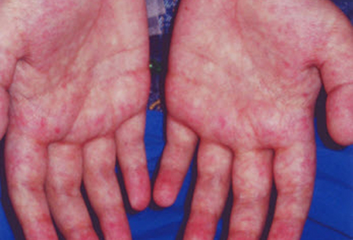
GRAFT VERSUS HOST DISEASE occuring after HSCT
GVHD occurs when immune cells transplanted from
a non-identical donor (the graft) recognize the transplant recipient (the host) as foreign, thereby initiating an immune reaction that causes disease in the transplant recipient

Slide 3
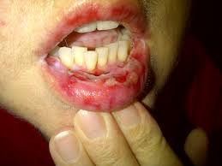
GRAFT VERSUS HOST DISEASE occuring after HSCT
Historically, it was divided based on the timing of occurrence
  Acute – within the first 100 days
  Chronic – after first 100 days
Notes:
Inflammatory condition affecting one or more of the skin, gastrointestinal tract and liver, and occurring within 100 days of allogeneic transplantation
Later acknowledgement of similar syndrome occurring beyond day 100, known as late onset acute GvHD (particularly after RICT and DLI)
Affects 35-45% of recipients of HLA matched, and
60-80% of one Ag mismatched transplants
Affects approximately 40% of recipients of DLI but incidence rises with increasing cell dose

Slide 4
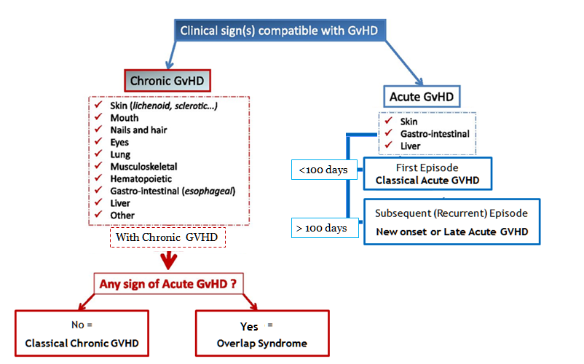
The NIH consensus;
GRAFT VERSUS HOST DISEASE occuring after HSCT
recognized 2 main categories of GVHD, each with 2 subcategories.
similar syndrome occurs beyond day 100,
known as late onset acute GvHD
particularly after RICT and DLI
Notes:
The NIH consensus conference recognized 2 main categories of GVHD, each with 2 subcategories. The broad category of acute GVHD includes classic acute GVHD (maculopapular erythematous rash, gastrointestinal symptoms, or cholestatic hepatitis) and also includes persistent, recurrent, or late-onset acute GVHD occurring more than 100 days after transplantation. The broad category of chronic GVHD includes classic chronic GVHD, presenting with manifestations that can be ascribed only to chronic GVHD. Chronic GVHD also includes an overlap syndrome, which has diagnostic or distinctive chronic GVHD manifestations together with features typical of acute GVHD

Slide 5
GRAFT VERSUS HOST DISEASE occuring after HSCT
GRAFT VERSUS HOST DISEASE occuring after HSCT
  Acute GVHD occurs
    in up to 40% of sibling donor recipients
    and up to 70% of unrelated donor recipients
  Chronic GVHD occurs in
    50% of 3-month survivors after allo HCT
  Recipients of DLI occurs in ( 40%) but incidence rises with increasing cell dose

Slide 6
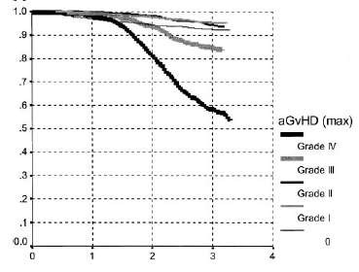
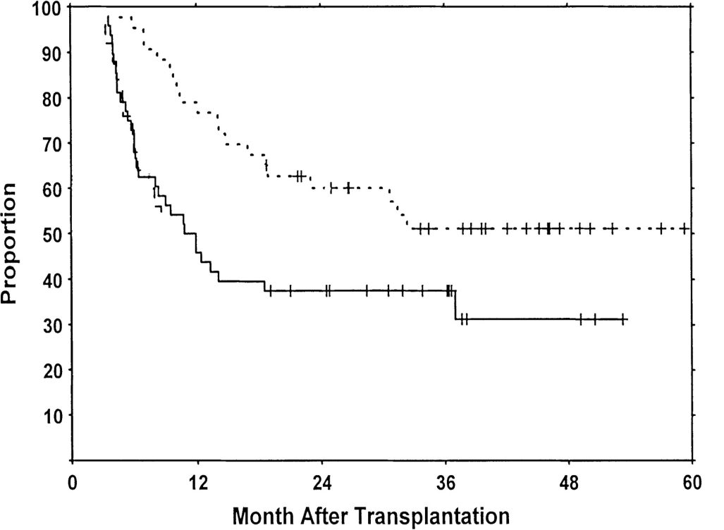
GRAFT VERSUS HOST DISEASE occuring after HSCT
GRAFT VERSUS HOST DISEASE occuring after HSCT
Impact of GvHD on survival
low-risk chronic GVHD
high-risk chronic GVHD
Gratwohl et al, Blood, 2002
Blood 2001 98:1695-1700;

Slide 7
GVHD Pathogenetic Definiation
GRAFT VERSUS HOST DISEASE occuring after HSCT
GRAFT VERSUS HOST DISEASE occuring after HSCT
Remains poorly understood
Cellulary involvement, Cytokine storms and prolonged use of immune suppression:
  ➔ Increased infections
  ➔ Organ dysfunctions
  ➔ Increased morbidity
  ➔ Impaired QOL
Uncontrolled Immüne attack causes to the non-relapse mortality.

Slide 8
GRAFT VERSUS HOST DISEASE occuring after HSCT
GRAFT VERSUS HOST DISEASE occuring after HSCT
Today Topics
Acute GvHD >> Chronic GVHD
Definition
Incidence
Pathophysiology
Diagnosis
  Clinical
  Pathological
Prevention & treatment
  Pharmacological
  Immunomodulation
  Cellular Therapies

Slide 9
ACUTE
GRAFT VERSUS
HOST DİSEASE
Acute GVHD is a common complication of allogeneic hematopoietic cell transplant (HCT)
that classically presents in the early post-transplantation period. It is thought to be primarily a T cell mediated disease that occurs when immune cells transplanted from a non-identical donor (the graft) recognize the transplant recipient (the host) as foreign, thereby initiating an immune reaction that causes disease in the transplant recipient. The skin, gastrointestinal tract, and liver are the principal target organs in patients with acute GVHD.

Slide 10
Basic for aGVHD Understanding?
ACUTE GRAFT VERSUS HOST DISEASE occuring after HSCT
A donor origin cell mediated reaction against to the recipient tissues
It requires (prerequisites):
  .. a recipient expresses tissue antigens that are not present in the donor.
  .. a donor graft react against to the recipient antigens with immunologically competent cells
Recipient unable to overcome immune attack
Notes:
Graft must contain immunologically competent cells
Recipient must express tissue antigens not present in the donor

Slide 11
Why do we have to HLA match?
ACUTE GRAFT VERSUS HOST DISEASE occuring after HSCT
BMT = immune system transplant
HLA molecules act as T cell “superantigens”
All somatic tissues express HLA class I
Transferred T cell could “over-react” to recipient

Slide 12
If there is a “match”, why GVHD?
ACUTE GRAFT VERSUS HOST DISEASE occuring after HSCT
HLA molecules “show” what’s inside
We are all different inside
GVHD results from T cell reactivity toward polymorphisms between donor and host.
  This can be a good thing (GVL)
    or
  This can be a bad thing (GVHD)

Slide 13
Polymorphisms can help rid disease or cause GVHD
ACUTE GRAFT VERSUS HOST DISEASE occuring after HSCT
HA-1
  polymorphic
  unknown function
  expressed only on hematopoietic cells
  target for CTL responses
  CTL response leads to less relapse, no GVHD
H -Y
  antigen from Y chromosome
  expressed ubiquitously
  target for CTL responses
  CTL response leads to less relapse, more GVHD

Slide 14
Basic Cellulary RESPONSE: Afferent PHASE
ACUTE GRAFT VERSUS HOST DISEASE occuring after HSCT
Viral or intracellular protein
Nucleus
HLA Class I -
Virus
Endogenous substance
Displayed with HLA molecule

Slide 15
Basic Cellulary RESPONSE: Afferent PHASE
ACUTE GRAFT VERSUS HOST DISEASE occuring after HSCT
Degraded in peptides
Combined with HLA molecules
HLA Class II -
Displayed with HLA molecule
Exogenous substance

Slide 16
Basic Cellulary RESPONSE: Afferent PHASE
ACUTE GRAFT VERSUS HOST DISEASE occuring after HSCT
HLA Class II - i.e. HLA - DR, DQ, DP
“Regulator”
“Trouble”
signal
CD4
APCs
Dendritic cell
B cell
Macrophage
“Submitted to the …
“Enforcer”
CD8
HLA Class I - i.e. HLA-A, B, C
Notes:
GVHD is a common complication and cause of mortality after allogeneic blood and marrow transplant (AlloBMT). T cells present in the donor stem cell graft can target antigens present on the leukemia, termed the graft-versus-leukemia (GVL) effect, resulting in clinical remissions and cures. Unfortunately T cells can also target host tissues that express minor histocompatibility antigens (mHAs) that are mismatched to the donor, leading to GVHD.
GVHD pathogenesis can be divided into distinct phases. Inflammation from the conditioning regimen activates antigen presenting cells (APCs) in the host expressing mHAs that are foreign to the donor prime and activate donor T cells. Cytokines stimulated by the inflammation, such as gamma interferon (IFNg), enhance this activation. Donor T cells proliferate in response to being exposed to foreign mHAs present on APCs, and attack host organs like liver, gut and skin.
The activated T cells can also produce further cytokines that exacerbate GVHD further. Because GVHD can be a life threatening complication, it is typically treated with immunosuppressant drugs for weeks to months. The paradox is that GVHD, and the current drugs used for treating GVHD, inhibit the function of the donor T cells – simultaneously abrogating GVL. Therefore while GVHD may be controlled, the leukemia relapses. If GVHD is not treated, T cells may be intact to cause GVL but GVHD eventually kills the patient. Thus clinicians often allow a small amount of GVHD to occur, to reap any concurrent GVL effect, but then treat GVHD as it worsens before it becomes uncontrollable and lethal.

Slide 17
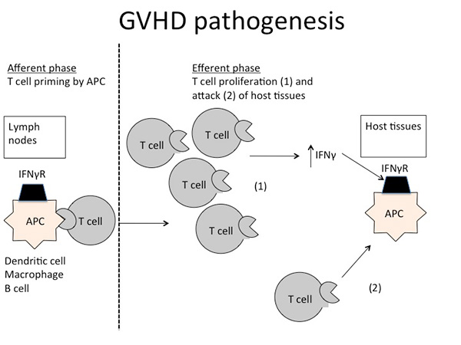
ACUTE GVHD: Pathogenetic Definiation
ACUTE GRAFT VERSUS HOST DISEASE occuring after HSCT

Slide 18
ACUTE GRAFT VERSUS HOST DISEASE occuring after HSCT
Acute GvHD: Pathophysiology
Activation of antigen presenting cells (APCs) by tissue damage induced by conditioning regimen:
  Typically involves TNF alfa, IL1, IL6 and lipopolysaccharide (LPS)
Donor T-cells proliferate, differentiate and migrate:
  CD4 cells typically recognising Class II and CD8 recognising Class I antigens.
  Process modulated by NK, T-regs and MSCs,
  Production of IL-2, IL-12, TNF alfa and IFN-gamma
Target tissue destruction through Fas-Fas ligand (liver) and perforin-granzyme pathway (GIT)

Slide 19
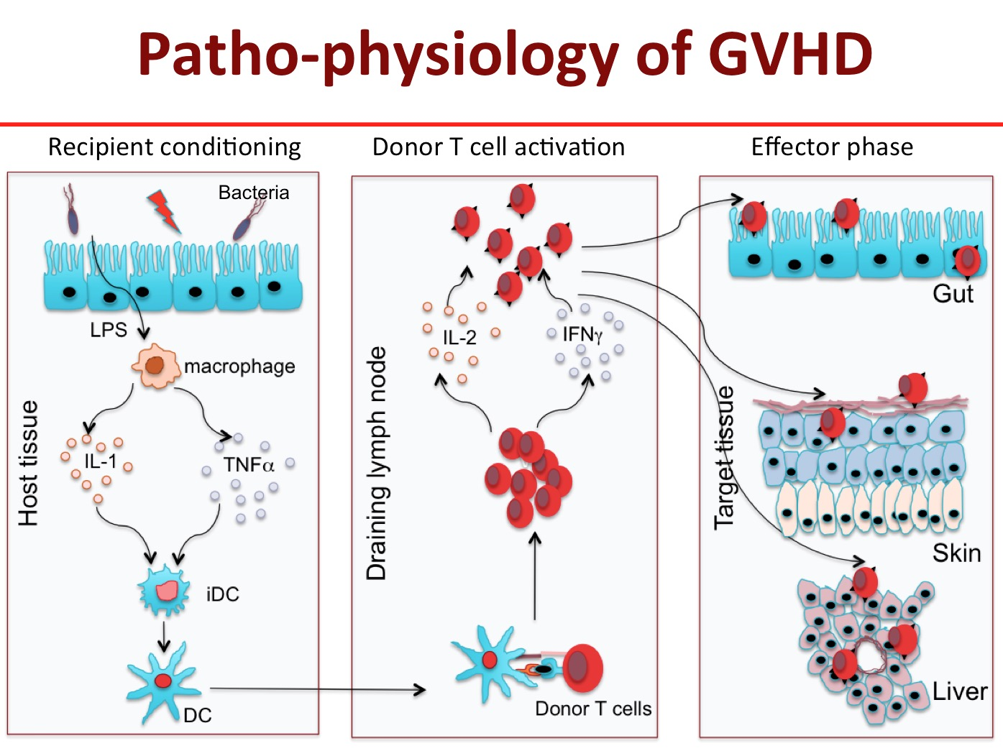
ACUTE GRAFT VERSUS HOST DISEASE occuring after HSCT
Notes:
HSCT without T cells results in poor engraftment and recurrent infections. Infused T cells also mediate anticancer effect against some lymphoma and leukemia. However, these donor T cells recognize the recipient’s cells as foreign and attack the epithelial cells in the skin, liver and gut causing acute graft versus host disease (GVHD) that accounts for significant morbidity and about 50% mortality associated with HSCT. Therefore, it is essential to identify the molecule(s) in donor T cells that are responsible for induction of GVHD.
I have been studying the cellular mechanism of GVHD and the interactions between subpopulations of T cells involved in induction or prevention of the disease. My research demonstrates that naive phenotype subset of T cells (memory phenotype) that cause acute GVHD while memory phenotype T cells do not. Memory phenotype T cells have these unique characteristics i) reduced proliferation and IL-2 production in response to recipient antigens (allo-antigens) and ii) havereduced ability to traffic to target to GVHD target organs. Therefore, I intend to identify transcription factors and cell signaling molecules that regulate their functions
Figure 1: Pathogenesis of acute GVHD. Conditioning by irradiation and/or chemotherapy causes tissue damage. Damaged tissues and cells release DAMPs (HMGB-1), PAMPs (LPS) from gut microbiota as well as inflammatory cytokines such as IL-1β, IL-6, and TNF-α, which contribute to the “cytokine storm.” These are the first danger signals that activate host APCs, which activate and polarized donor T-cells toward pathogenic T-cells (TH1 and TH17 for CD4 and TC1, TC17 for CD8). Activated pathogenic T-cells infiltrate target organs (i.e., GI tract, liver, skin) and amplify local tissue destruction. The presence of regulatory T-cells (Tregs) helps reduce GVHD severity through the inhibition of pathogenic cells activation and/or expansion at early or further phases of GVHD. Some of these DAMPs and PAMPs such as elafin (skin-specific), regenerating islet-derived 3-alpha (REG3α, gut-specific), and suppressor of tumorigenicity 2 (ST2, a member of the IL-1 receptor family, binding IL-33) have been shown to be biomarkers

Slide 20
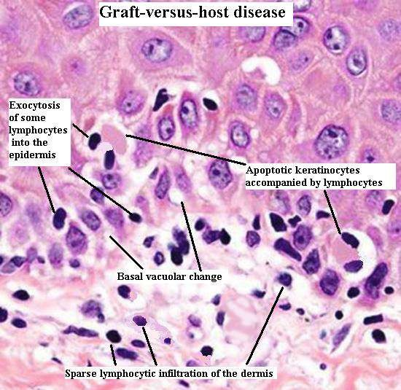
ACUTE GRAFT VERSUS HOST DISEASE occuring after HSCT
Acute GvHD: pathophysiology

Slide 21
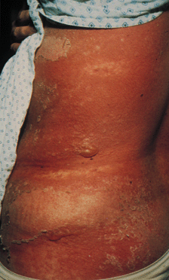
ACUTE GRAFT VERSUS HOST DISEASE occuring after HSCT
Acute GvHD: Clinical manifestations;
A classic maculopapular rash;
Persistent nausea and/or emesis;
Abdominal cramps with diarrhea; and
A rising serum bilirubin concentration.
Graft Versus Host Disease of the Skin: Grade IV
Notes:
Clinical manifestations of acute GVHD include a classic maculopapular rash; persistent nausea and/or emesis; abdominal cramps with diarrhea; and a rising serum bilirubin concentration. In contrast, patients with chronic GVHD commonly demonstrate skin involvement resembling lichen planus or the cutaneous manifestations of scleroderma; dry oral mucosa with ulcerations and sclerosis of the gastrointestinal tract; and a rising serum bilirubin concentration

Slide 22
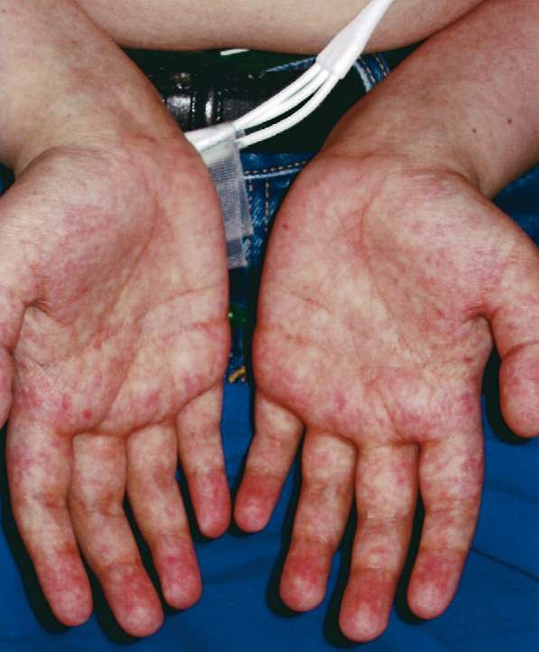
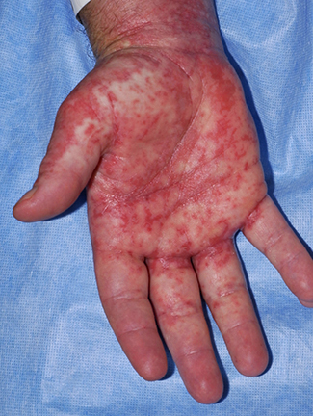
ACUTE GRAFT VERSUS HOST DISEASE occuring after HSCT
Acute GvHD: Skin
  Most common organ affected (>80% )
  Macular papular rash affecting any part of the body, typically palmar & plantar erythema and sparing the scalp
    Pt may complain of pain or itching to affected areas
    Rash becomes confluent as it progresses however, blisters may form.
    Severe cases resemble burn patients
    Usually correlates with engraftment;
    reduced intensity have delayed onset of GVHD
Differential diagnosis:
  Chemotherapy/radiation, drug, infection, engraftment

Slide 23
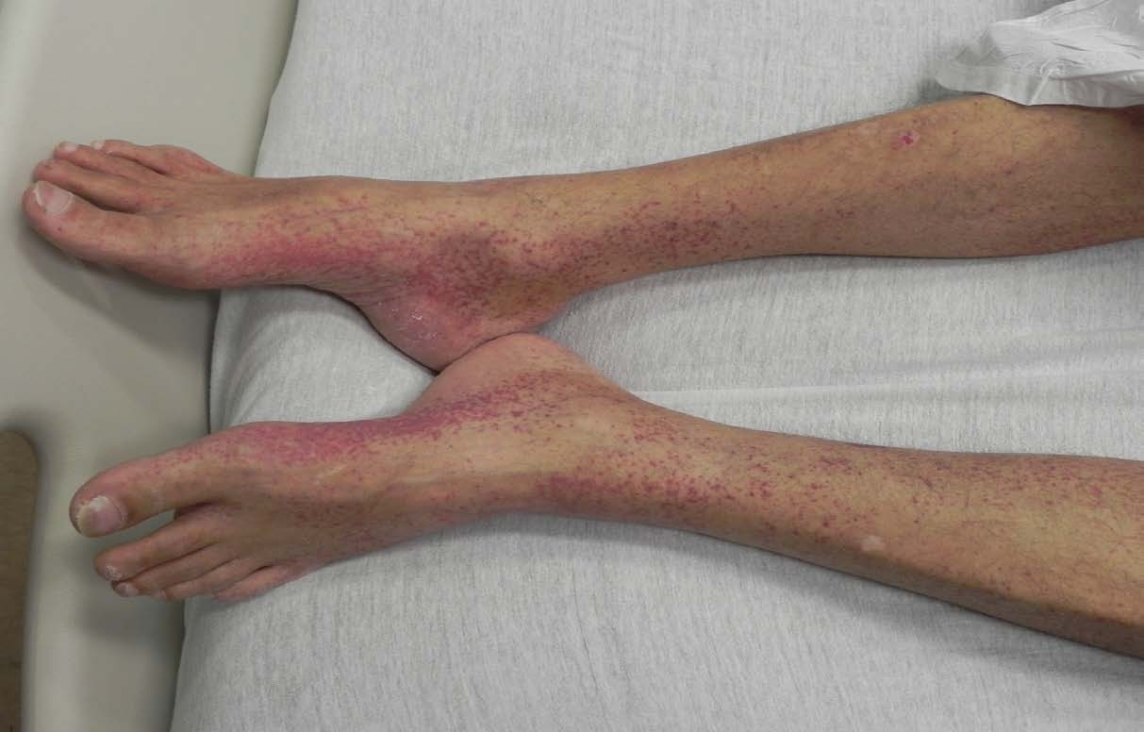
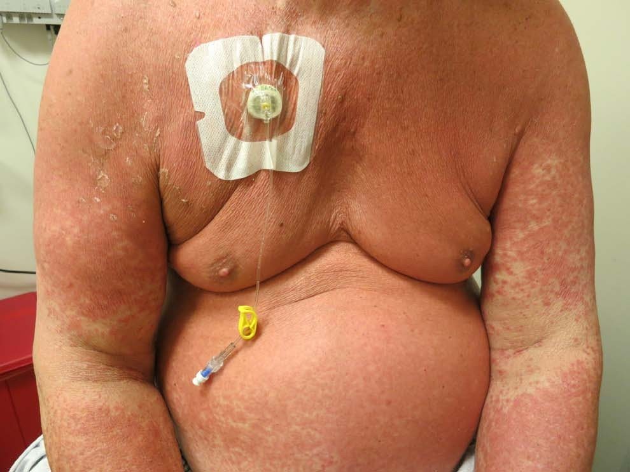
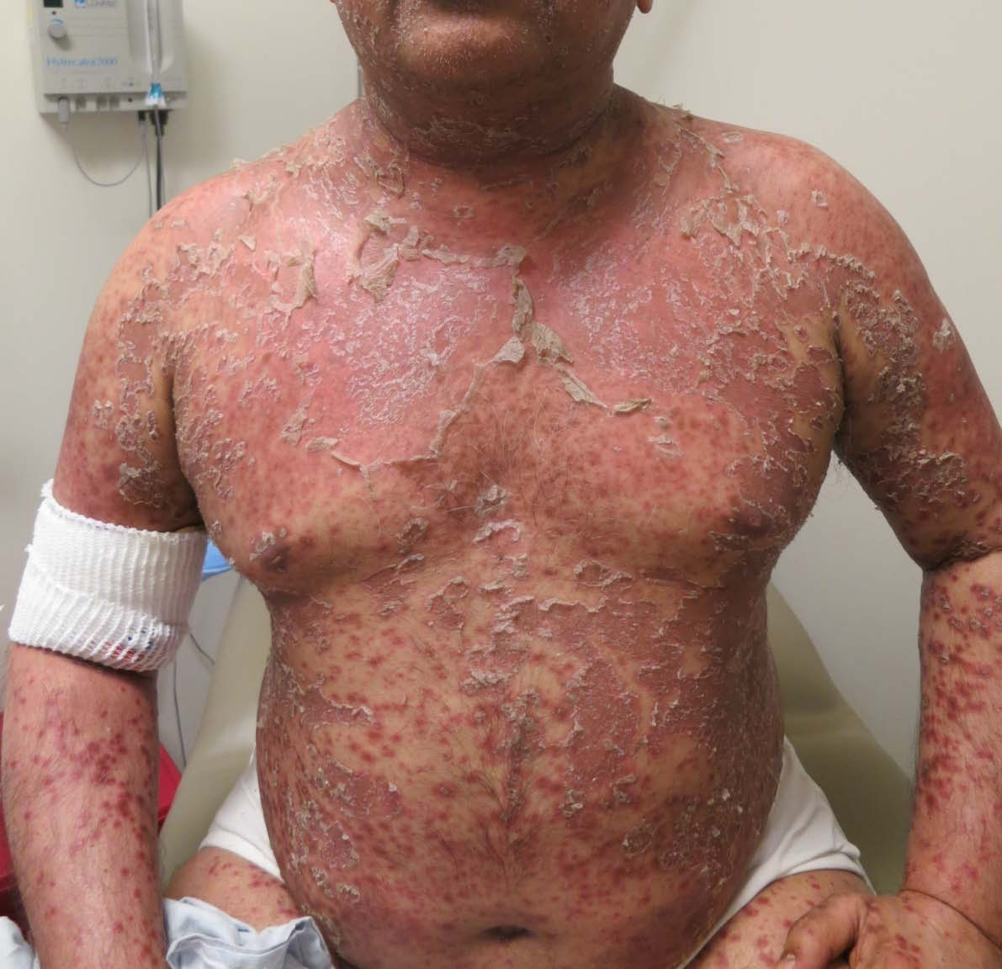
ACUTE GRAFT VERSUS HOST DISEASE occuring after HSCT
Skin

Slide 24
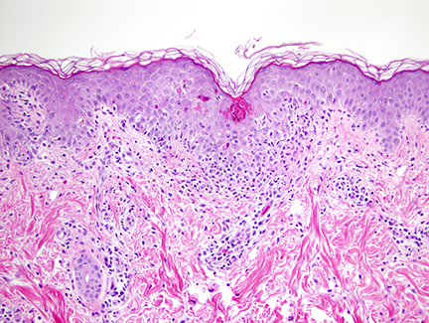
Skin aGVHD: Histologic examination
ACUTE GRAFT VERSUS HOST DISEASE occuring after HSCT
Characteristic findings include exocytosed lymphocytes, dyskeratotic epidermal keratinocytes, follicular involvement, satellite lymphocytes adjacent to or surrounding dyskeratotic epidermal keratinocytes, and dermal perivascular lymphocytic infiltration
Apoptotic keratinocytes in the epidermis, vacuolization of the basal layer, and lymphocyte exocytosis are present in this specimen of histologic grade 2 acute graft-versus-host disease. A lymphocytic infiltrate at the dermal-epidermal junction and surrounding blood vessels is also present.
Notes:
Histologic examination of the skin reveals changes in the dermal and epidermal layers

Slide 25
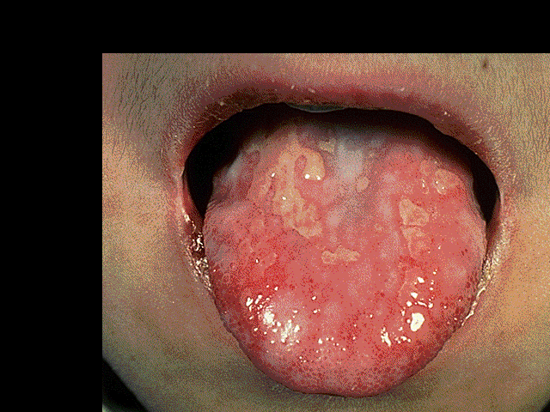
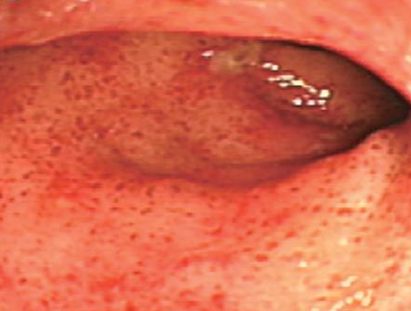
ACUTE GRAFT VERSUS HOST DISEASE occuring after HSCT
Acute GvHD: GIT
Approximately 50% of cases
Nausea, vomiting and anorexia
Watery diarrhoea (typically green) and
abdo cramps progressing to ileus and bloody diarrhoea
Differential diagnosis:
  Chemotherapy/radiation, medications, infections

Slide 26
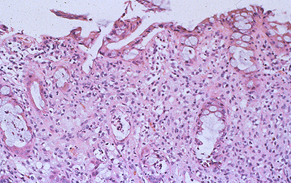
GIS aGVHD: Histologic examination
ACUTE GRAFT VERSUS HOST DISEASE occuring after HSCT
Pathology: apoptotic bodies in base of crypts, crypt abscesses, loss and flattening of surface epithelium
Rectal biopsy in a patient with acute graft-versus-host disease (GVHD) shows crypt cell necrosis with the accumulation of degenerative material in the dead crypts.
Notes:
Apoptosis at base of
epidermal rete pegs
Dyskeratosis with adjacent satellite lymphocytes
Perivascular lymphocytic infiltration in the dermis.

Slide 27
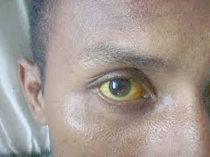
ACUTE GRAFT VERSUS HOST DISEASE occuring after HSCT
Acute GvHD: Liver
Approximately 50% of cases
Cholestatic hyperbilirubinaemia
  Increased bilirubin,
  alkaline phosphatase
  Transaminitis less common
Differential diagnosis:
Difficult to distinguish from other causes of hepatic toxicity i.e. veno-occlusive disease, drugs, viral infections, sepsis, iron overload

Slide 28
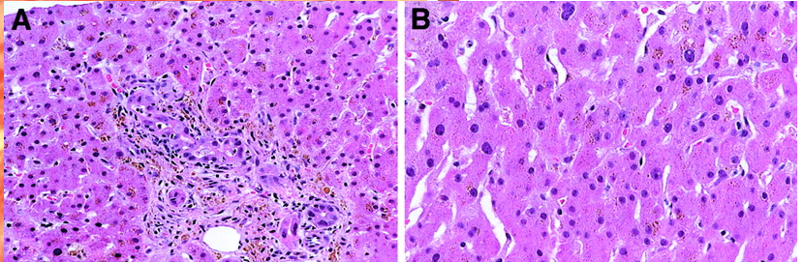
ACUTE GRAFT VERSUS HOST DISEASE occuring after HSCT
Acute GvHD: Liver Histopathology
Biopsy often not performed because of concurrent thrombocytopenia
Pathology: endothelialitis, lymphocytic infiltrate of portal areas, pericholangitis, bile duct destruction
Characteristic histology of classical liver GVHD with bile duct lymphocytic infiltrates and injury. (A) Portal lymphocytic inflammation is also present. (B)

Slide 29
Grading of Acute Skin GVHD
ACUTE GRAFT VERSUS HOST DISEASE occuring after HSCT
Grade | Description
I | Rash <25% of body
II | Rash 25% – 50% of body
III | Generalized erythroderma or rash >50% of body
IV | Bullae formation and/or with desquamation

Slide 30
Grading of Acute Liver GVHD
ACUTE GRAFT VERSUS HOST DISEASE occuring after HSCT
Grade | Description
I | Bilirubin 2-3 mg/dL
II | Bilirubin 3.1-6 mg/dL
III | Bilirubin 6.1 – 15 mg/dL
IV | Bilirubin > 15 mg/dL

Slide 31
Grading of Acute Gut GVHD
ACUTE GRAFT VERSUS HOST DISEASE occuring after HSCT
Grade | Description
I | Diarrhea 500-1000 ml/day (or persistent nausea, vomiting or anorexia with biopsy proven upper GI involvement)
II | Diarrhea 1000 - 1500 ml/day
III | Diarrhea > 1500 mL/day
IV | Severe abdominal pain (w/o) ileus or stool with frank blood

Slide 32
Overall Grade (Stage) of Acute GVHD
ACUTE GRAFT VERSUS HOST DISEASE occuring after HSCT
Stage | Skin | Liver | Gut
I | I-II | None | None
II | III | I or | I
III |  | II-III or | II-IV
IV | IV | IV
5 year survival
STAGE III: 40 %
STAGE IV: 20 %

Slide 33
ACUTE GRAFT VERSUS HOST DISEASE occuring after HSCT
Acute GvHD: Risk Factors
Degree of (HLA) mismatch
  HLA-A, -B, -C, and –DRB
Gender disparity and donor parity
  Female to male
  Multiparity ➔ Maternal allo-immunization
Age of donor and recipient
Intensity of conditioning regimen
  Reduce intensity vs. myeloablative
Source of graft
      Peripheral blood vs. marrow vs. cord
CMV seropositivity

Slide 34
Acute GvHD: Prevention and treatment
ACUTE GRAFT VERSUS HOST DISEASE occuring after HSCT
Prophylaxis REGIMENS:
  Calcineurin inhibitor (Cyclosporine/Tacrolimus) + MTX
  Tacrolimus + Sirolimus is another frequently used combination
    Randomized study showed comparable efficacy to Tacro/Siro
  Cellcept-based regimen
  Post-transplant Cytoxan
    Unique for haploidentical HCT
  The addition of mini-dose ATG & Velcade & MTX,
    Mismatch cases with lower likelihood of relapse
Notes:
Pharmacological
Immunosuppression
Corticosteroids
Methotrexate
Inhibition of cytoplasmic calcineurine (enzyme involved in T-cell
activation)
Cyclosporine
Tacrolimus (FK506)
Mycophenylate mofetil
Active compound, mycophenolic acid, Inhibits inosine monophosphate dehydrogenase (enzyme essential to de novo synthesis of guanosine nucleotides) and terminates DNA synthesis
Sirolimus (binds to FKBP12) can be used in combination with FK506
Vorinostat (histone deacetylase inhibitor)
Immunological and Cellular
Antithymocyte globulin (ATG, ALG)
Monoclonal antibodies
CD20: rituximab
CD52: alemtuzamab (Campath)
CD2: alefacept (Blocks CD3-LFA3 interaction)
CD3: OKT3, visilizumab
CD147: ABX-CBL
TNF: infliximab, etanercept, adalimumab, certolizumab
IL2/IL2R (CD25): dacluzamab, inolimomab, basiliximab, denileukin diftitox
Extracorporeal photophoresis
Cellular
T-cell depletion
Mesenchymal stem cells
T-regulatory cells
Suicide gene therapy of donor T-cells

Slide 35
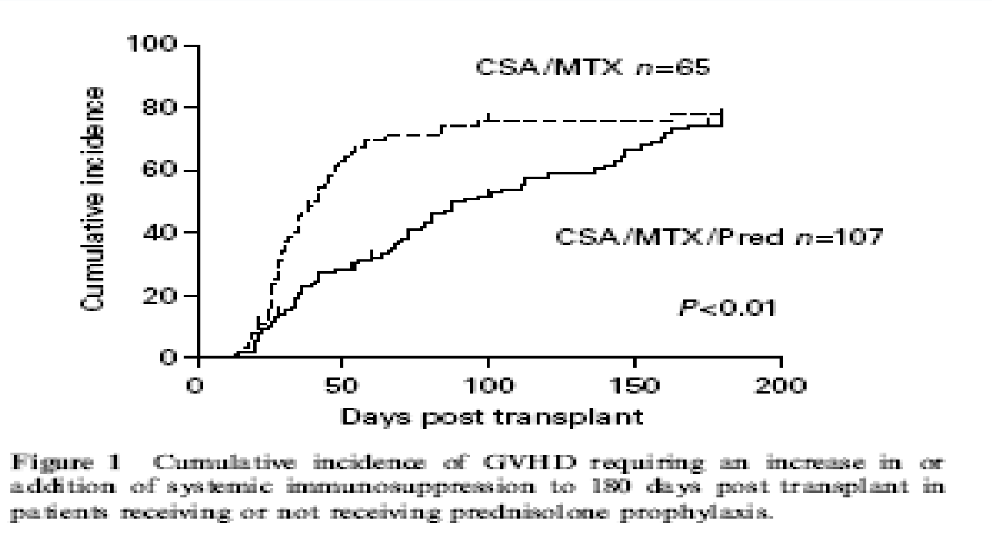
Acute GvHD: Prevention
ACUTE GRAFT VERSUS HOST DISEASE occuring after HSCT
Hoyt et al, BMT 2008

Slide 36
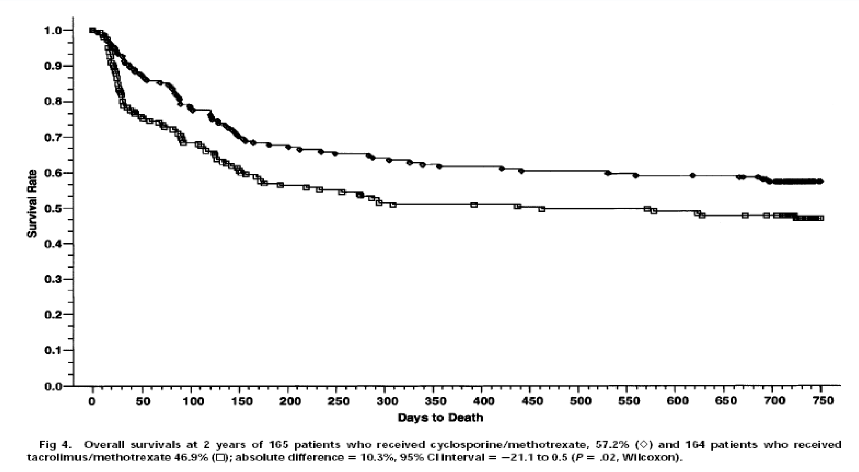
Acute GvHD: Prevention
ACUTE GRAFT VERSUS HOST DISEASE occuring after HSCT
Phase III trial CsA + MTX / FK506 + MTX in sibling transplants
Ratanatharathorn et al Blood 1998
CsA/MTX n=165 FK506/MTX n=164

Slide 37
Acute GvHD: Unrelated transplants
ACUTE GRAFT VERSUS HOST DISEASE occuring after HSCT
Parameter | CsA-MTX-ATG % N=103 | CsA-MTX % N-98 | P value
aGvHD > I | 33 | 51 | 0.01
aGvHD > II | 12 | 24.5 | 0.054
Any cGvHD | 31 | 59 | <0.0001
Ext CGvHD | 12 | 43 | <0.0001
100d TRM | 11 | 13 | NS
2yr TRM | 20 | 29 | NS
2yr relapse | 29 | 24 | NS
2yr DFS | 52 | 48 | NS
Finke et al, Lancet Oncology 2009 10: 855-864

Slide 38
ACUTE GRAFT VERSUS HOST DISEASE occuring after HSCT
Acute GVHD Treatment
Grade I skin GVHD
  Managed with topical steroid therapy + optimizing immunosuppression levels
Non-absorbable steroid are very useful adjuvant therapy in GI GVHD
Survival correlates directly with the response to initial therapy
Topical Steroids
  Triamcinolone acetone 0.1% cream
    Apply twice daily
    Do not use on face
Calcineurin inhibitors:
  Tacrolimus cream 0.03% or 0.1%
    Apply twice daily
Notes:
Gold standard is cyclosporine and methotrexate
CsA/MTX and FK506/MTX better than CsA alone
No benefit in adding corticosteroid
FK506/MTX may be better than CsA/MTX
BMT-CTN completing a study on Sirolimus plus FK506 vs FK506/MTX
Decreased incidence with ATG

Slide 39
Acute GVHD Treatment
ACUTE GRAFT VERSUS HOST DISEASE occuring after HSCT
Initiated once GVHD is suspected or confirmed
Corticosteroid remains the standard first line therapy
  Randomized studies failed to show benefit of combining other agents
  Starting M. Pred. dose 1-2mg/Kg
    10mg/kg was not superior to 2mg/kg
    1mg/kg might be enough for grade II disease
Notes:
Gold standard is cyclosporine and methotrexate
CsA/MTX and FK506/MTX better than CsA alone
No benefit in adding corticosteroid
FK506/MTX may be better than CsA/MTX
BMT-CTN completing a study on Sirolimus plus FK506 vs FK506/MTX
Decreased incidence with ATG

Slide 40
Refractory aGVHD
ACUTE GRAFT VERSUS HOST DISEASE occuring after HSCT
Steroid refractory defined as
  GVHD progression after 3 days of therapy
  No improvement in 1 week of therapy
  No resolution in 2 weeks of therapy
Second-line treatment characterized by
High failure rate
Significant toxicities
Poor survival
No standard of care for second or beyond therapy
  No data for efficacy for one regimen over another

Slide 41
Acute GvHD: 2nd line treatment
ACUTE GRAFT VERSUS HOST DISEASE occuring after HSCT
Treatment | Response | Survival
ATG | 51% | 35%
Anti-IL2R | 40-70% | <30%
Anti-TNF | 67% | 38%
CsA to tacro | 10%
Tacro + ATG |  | 35%
MMF | 40% | 16% - 37%
Pentostatin | 50% | 26%
OKT3 | 50% | 45%

Slide 42
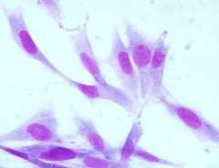




Acute GvHD: 3nd line treatment - MSC
ACUTE GRAFT VERSUS HOST DISEASE occuring after HSCT
Derived from bone
marrow stroma
Exhibit immunosuppressive properties
Non-HLA restricted
Progenitors
Bone
Chondrocytes
Adipocyte
Muscle

Slide 43
Acute GvHD: 3nd line treatment - MSC
ACUTE GRAFT VERSUS HOST DISEASE occuring after HSCT
Response rates | N = 55
Overall response | 71%
Complete response | 54%
Le Blanc et al, Lancet 2008
Response rates | N = 50
Overall response | 66%
Complete response | 34%
Resnick et al Am J Blood Res, 2013
Response rates | N = 37
Overall response | 78%
Complete response | 65%
Ball et al Brit J Haem, 2013
Response rates at 28 days | N = 40
Overall response | 67.5%
Complete response | 27.5%
Introna et al, BBMT2014

Slide 44
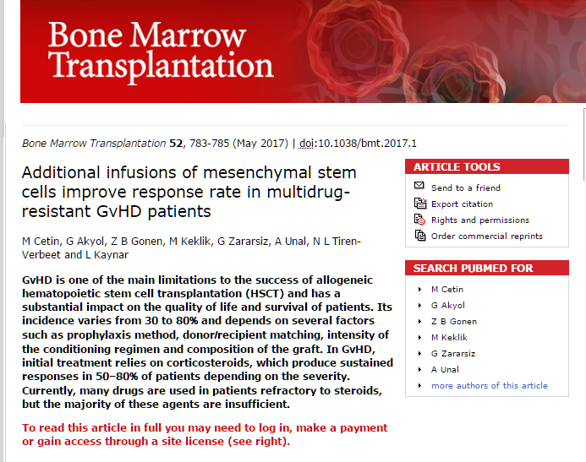
Acute GvHD: 3nd line treatment - MSC
ACUTE GRAFT VERSUS HOST DISEASE occuring after HSCT
Introna et al, BBMT2014

Slide 45
CHRONIC GRAFT VERSUS
HOST DİSEASE
cGvHD is an immunoregulatory disorder occurring
after allogeneic HSCT and shares features of autoimmunity and immunodeficiency.
The cGVHD resemble other autoimmune diseases such as Sjögren syndrome, scleroderma, primary biliary cirrhosis and immuncytopenias

Slide 46
The NIH consensus;
CHRONIC GRAFT VERSUS HOST DISEASE occuring after HSCT
recognized 2 main categories of GVHD, each with 2 subcategories.
similar syndrome occurs beyond day 100,
known as late onset acute GvHD
particularly after RICT and DLI
Notes:
The NIH consensus conference recognized 2 main categories of GVHD, each with 2 subcategories. The broad category of acute GVHD includes classic acute GVHD (maculopapular erythematous rash, gastrointestinal symptoms, or cholestatic hepatitis) and also includes persistent, recurrent, or late-onset acute GVHD occurring more than 100 days after transplantation. The broad category of chronic GVHD includes classic chronic GVHD, presenting with manifestations that can be ascribed only to chronic GVHD. Chronic GVHD also includes an overlap syndrome, which has diagnostic or distinctive chronic GVHD manifestations together with features typical of acute GVHD

Slide 47
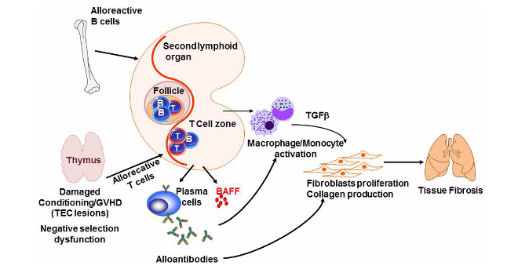

CHRONIC GRAFT VERSUS HOST DISEASE occuring after HSCT
The pathophysiology
Gérard Socié, and Jerome Ritz Blood 2014;124:374-38
Pathogenesis of chronic GVHD The thymic epithelial cells (TECs) are damaged by alloreactive T-cells leading to impaired negative selection. In addition, alloreactive B- and T-cells cross talk leading to sBAFF release and production of alloantibodies by plasma cells. At the same time, cytokines and chemokines produced by B- and T-cells activate macrophagesand monocytes. Together, antibodies and TGFβ induce fibroblasts proliferation and activation as well as collagen production, which results in fibrosis intarget organs such as the lung
Notes:
The pathophysiology of chronic GVHD. (A) General mechanisms. The acute graft-versus-host reaction is characterized by tissue damage mediated by inflammatory mediators, T cells, and cells from the innate immune system. Among target organs, two are particularly important for the development of subsequent chronic GVHD: (1) thymic epithelial cells (TECs) are damaged by alloreactive T cells leading to decreased generation of natural Tregs and release of self-reactive T cells. (2) Bone marrow microenvironment damage may explain disturbed B-cell homeostasis. The potent role of antigen-presenting cells (APCs) and the cross talk between B and T cells in chronic GVHD is poorly understood. (B) B cells and chronic GVHD. Patients with chronic GVHD have increased B-cell activation factor (BAFF):B-cell ratios, delayed reconstitution of naive B cells, and increased numbers of pregerminal center B cells. Patients with active chronic GVHD have elevated numbers of CD21– transitional B cells and a deficiency of memory CD27⁺ B cells. Patients who develop chronic GVHD have elevated levels of BAFF, a relative reduction in naive B cells, and relatively higher numbers of activated memory type B cells. Patients with hypogammaglobulinemia have elevated CD19⁺CD21^{low} (immature) and CD19⁺CD21^{high}CD38^{high}IgM^{high} (transitional) B cells. CD19⁺CD10–CD27–CD21^{high} naive B cells are elevated in all patients with chronic GVHD. (C) Conventional T cells, Tregs, and chronic GVHD. An appropriate balance between Tregs and Tconv is critical for the maintenance of peripheral tolerance. In the setting of allogeneic HSCT, Tregs have been shown to play an important role in the establishment of tolerance between recipient tissues and donor-derived immunity. Monitoring of CD4⁺ T-cell subsets shows that Tregs rapidly expand after HSCT, but Treg levels subsequently decline in patients with prolonged CD4⁺ lymphopenia. This results in a relative deficiency of Tregs, which is associated with a high incidence of extensive chronic GVHD. In chronic lichenoid GVHD, a mixed Th1/Th17 signature with upregulated Th1/Th17 cytokine/chemokine transcripts and elevated numbers of interferon gamma (IFN-γ)– and IL-17–producing CD8⁺ T cells has been described. (D) Current issues in chronic GVHD pathophysiology. The hallmark of chronic GVHD is inflammatory fibrosis; putative mechanisms are described in the left part of the figure. Although a role of B- and T-cell subsets has been described, the cross talk between B and T cells is not well understood. Recent evidence from an experimental model suggests that a key player might be the T-follicular helper (TfH) cells. ICOS, inducible costimulatory [molecule]; NK, natural killer [cell]; TGFβ, transforming growth factor beta; TNFα, tumor necrosis factor alpha.

Slide 48
Epidemiology
CHRONIC GRAFT VERSUS HOST DISEASE occuring after HSCT
Most serious and common long-term complication
of allogeneic transplantation
  Occurs in 30-40 % of patients surviving >100 days
  30% (young, with sibling donors) to
  70% (older, unrelated donors)
Median time to development is 4-6 months after transplant
50% have 3 or more involved organs/tissues
On average therapy is required for 2-3 years

Slide 49
CHRONIC GRAFT VERSUS HOST DISEASE occuring after HSCT
Risk factors
Increased incidence due to:
Mismatched donor
History of acute GVHD
Older recipient age
Use of peripheral blood as stem cell source
Donor lymphocytes Infusion for relaps
  Similar factors for acute GVHD
Flowers, M et al Blood. 2011 March 17; 117(11): 3214–3219.
32
Notes:
A study from Seattle showed that the higher the degree of HLA disparity, the earlier the onset of symptoms, with a median of 201 days in HLA identical siblings, and 133 days in matched unrelated donors transplanted with bone marrow and after standard conditioning (18).
The most frequently involved sites of the clinical manifestations of 324 pts were the mouth (89%), skin (81%), gastrointestinal tract (48%), liver (47%), eyes (47%).
The disease started with a quiescent onset (followed acute GvHD with a remission period) in 60%, with a progressive onset (cGvHD transformed from acute) in 13%, and with de novo onset (no prior acute GvHD) in 27% of the cases.

Slide 50

CHRONIC GRAFT VERSUS HOST DISEASE occuring after HSCT
Poor Prognostic Signs
  Persistent severe thrombocytopenia
  Lichenoid changes on skin histology
  Serum bilirubin >1.2 mg/dl
  Progressive onset from acute to chronic
  Karnofsky performance <70%
15% still require therapy 7+ years after diagnosis
Notes:
There are no laboratory markers to predict the severity and morbidity of cGVHD.

Slide 51
Hematopoietic and Immune System:
CHRONIC GRAFT VERSUS HOST DISEASE occuring after HSCT
Although not diagnostic, patients with chronic GVHD commonly have laboratory abnormalities reflecting changes in the hematopoietic and immune systems. These findings include
Thrombocytopenia,
Eosinophilia,
Lymphopenia,
Hypo/hypergammaglobulinemia, and
Autoantibodies.
While the etiology of these findings is not entirely clear, myelosuppression in patients with GVHD appears to be at least partially related to damage of the bone marrow niche by infiltrative T cells from the graft .
Notes:
cGVHD as a disease process is immunosuppressive, and the treatment is further immunosuppressive. The combination acts as a double-edged sword in that both the disease and the treatment further compromise the patient’s ability to fight infection.
The combination results in functional asplenia (poor splenic function), variable IgG levels, opportunistic infections, cytopenia (thrombocytopenia and lymphocytopenia), and eosinophilia and place the patient at high risk for infection.
Immune recovery is slower for those people affected by cGVHD.
The cytopenias seen in cGVHD can be isolated (platelets: single cell line) or in multiple lines (neutrophils and platelets).
A complete blood cell count with differential will usually demonstrate eosinophilia.
A bone marrow examination may be needed to show if the problem is due to graft failure, relapse, or an immune process.

Slide 52
Immune System:
CHRONIC GRAFT VERSUS HOST DISEASE occuring after HSCT
Chronic GVHD is immunosuppressive, and cGVHD
treatment is further immunosuppressive, resulting in
  Functional asplenia
  Variable immunoglobulin G (IgG) levels
  Opportunistic infections
  Cytopenia (thrombocytopenia)
Notes:
cGVHD as a disease process is immunosuppressive, and the treatment is further immunosuppressive. The combination acts as a double-edged sword in that both the disease and the treatment further compromise the patient’s ability to fight infection.
The combination results in functional asplenia (poor splenic function), variable IgG levels, opportunistic infections, cytopenia (thrombocytopenia and lymphocytopenia), and eosinophilia and place the patient at high risk for infection.
Immune recovery is slower for those people affected by cGVHD.
The cytopenias seen in cGVHD can be isolated (platelets: single cell line) or in multiple lines (neutrophils and platelets).
A complete blood cell count with differential will usually demonstrate eosinophilia.
A bone marrow examination may be needed to show if the problem is due to graft failure, relapse, or an immune process.

Slide 53
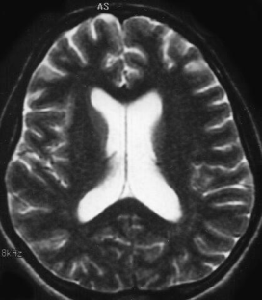
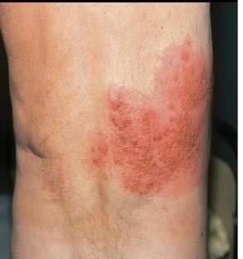
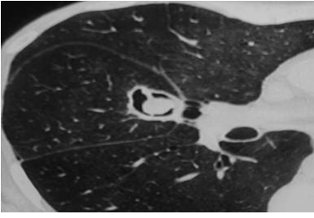
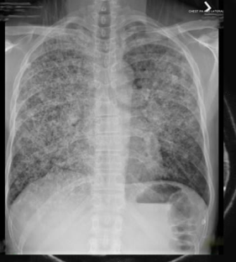
CHRONIC GRAFT VERSUS HOST DISEASE occuring after HSCT
Late Infections with cGVHD
Increased risk for infections in patients with delayed immune reconstitution (e.g., chronic GVHD, prolonged steroid exposure)
  Encapsulated bacteria
  CMV, VZV
  Aspergillus, PCP
International consensus guidelines for prevention of early and late infections published in 2009
  Recommendations for vaccinations in transplant recipients
meningitis
shingles
mold İnf.
pneumonia
M Tomblyn et al, Biol Blood Marrow Transplant, 2009, 15, 1143 M Tomblyn et al, Bone Marrow Transplant, 2009, 44, 521

Slide 54
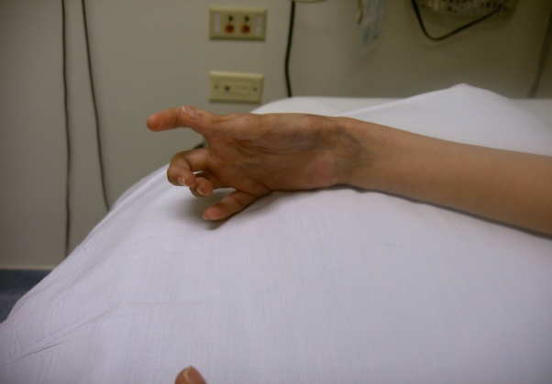
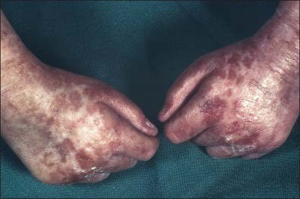
Target Organs
CHRONIC GRAFT VERSUS HOST DISEASE occuring after HSCT
The presenting symptoms are in some ways similar to those found in other well-established autoimmune syndromes.
However, in chronic GVHD, there is not a uniform presentation, but rather a variable involvement of these and other organs.
Skin- 67 percent
Oral- 60 percent
Ocular- 48 percent
Hepatic- 52 percent
Pulmonary- 50 percent
Gastrointestinal (GI)- 30 percent
Gynecological- 12 percent
Musculoskeletal- 48 percent
Immunologic- 50 percent
Arai S et al Blood. 2011 Oct 13;118(15):4242-9.

Slide 55
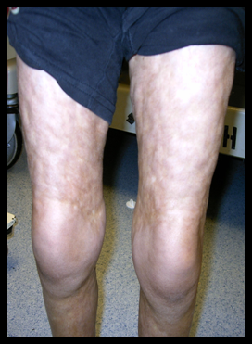

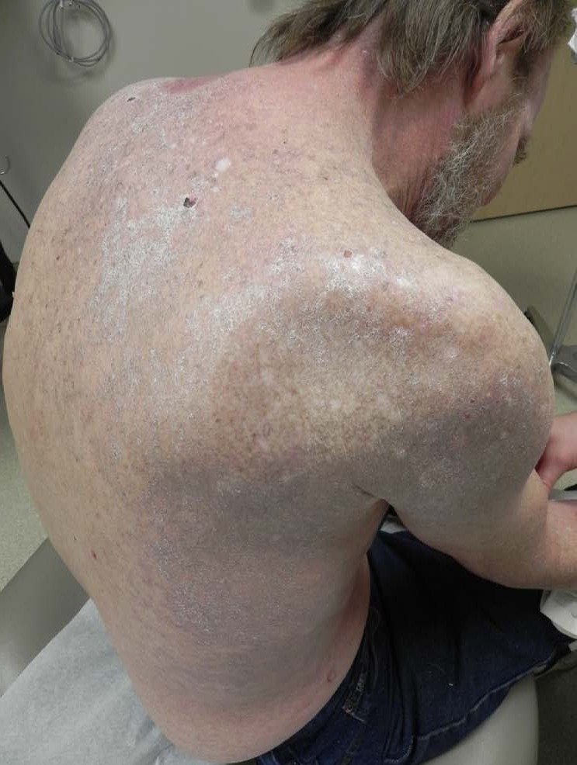
Skin Manifestations
CHRONIC GRAFT VERSUS HOST DISEASE occuring after HSCT
Most commonly involved organ
Inflammatory changes cause
Poikiloderma-like features
Lichen planus-like features
Sclerotic features
Morphea-like features
Lichen sclerosis-like features
Skin lichen planus lesions with shiny and violaceous papules of the back.
Notes:
The skin is the most frequently involved organ system in cGVHD. There are two types of involvement: sclerodermatous (comparable to scleroderma) and lichenoid (similar to lichen planus).
Initially, the skin may be erythematous, with plaques and areas of desquamation, which can progress to skin that is hyper- or hypopigmented with tightening (hide-like skin) and atrophy. Joint contractures may result secondary to the fibrotic thickening and sclerodermatous changes. The distribution of skin cGVHD is not the typical allocation seen with acute involvement. Other clinical presentations include atrophy of the skin with pigmentation, changes of the fingernails with vertical ridging, and alopecia. Skin previously involved with aGVHD or herpes zoster is usually more susceptible to cGVHD.

Slide 56
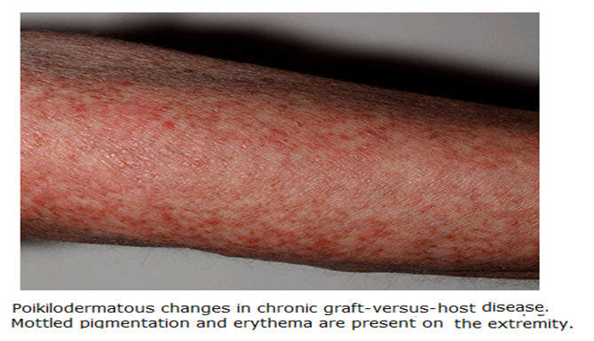
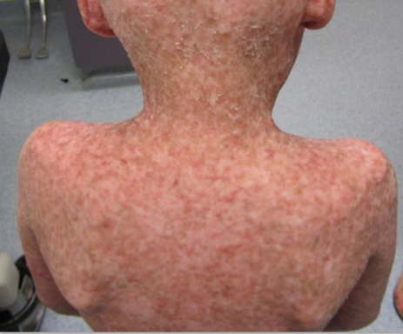
CHRONIC GRAFT VERSUS HOST DISEASE occuring after HSCT
a. Poikiloderma
A combination of atrophy, hypopigmentation, and hyperpigmentation in the skin usually appearing as patches with mottled pigmentation and telangiectasias
multicolor epidermal atrophy, red, brown, hypopigmented skin:

Slide 57
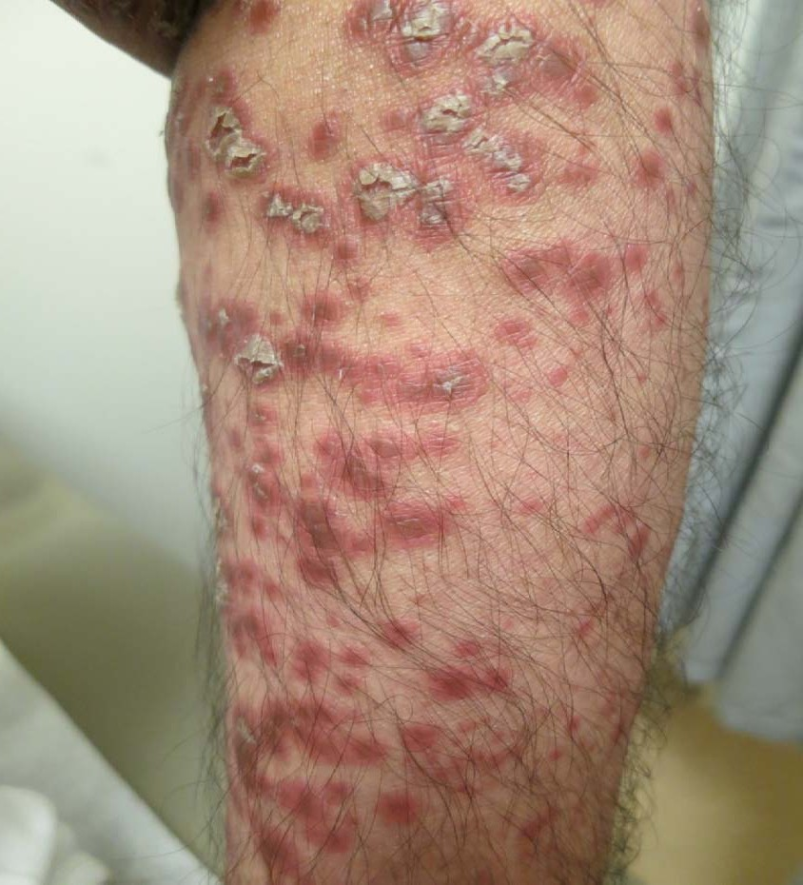
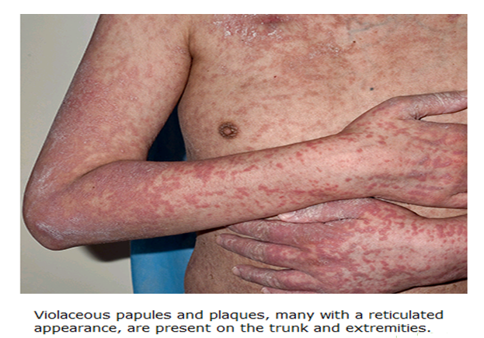
CHRONIC GRAFT VERSUS HOST DISEASE occuring after HSCT
b. Lichen planus
Erythematous to violaceous papules or plaques with a predilection for the dorsal hands and feet, forearms, and trunk.
Notes:
Lichenoid changes
Erythematous raised papular skin rash
May present with only dryness,
hypo- or hyperpigmentation

Slide 58
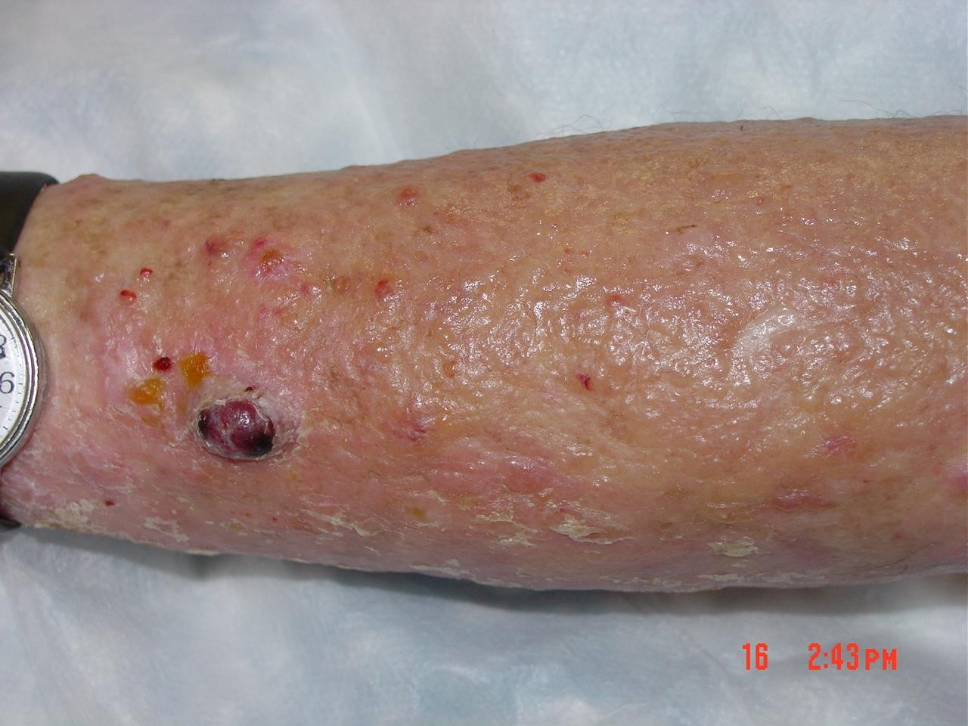
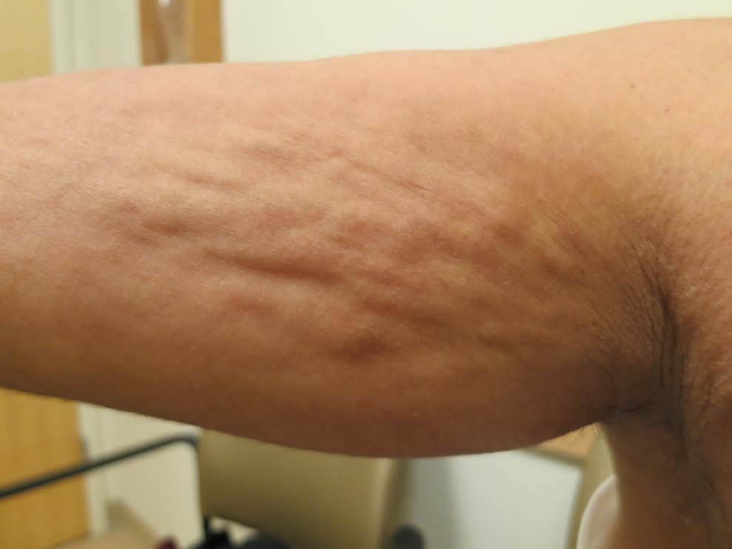
CHRONIC GRAFT VERSUS HOST DISEASE occuring after HSCT
c. Sclerosis
A cellulite-like rippled appearance of the skin due to thickening of the fibrous septae within fat, particularly on the medial arms and thighs
Severe sclerosis with blister formation
A cellulite-like rippled appearance of the skin due to thickening of the fibrous septae within fat

Slide 59
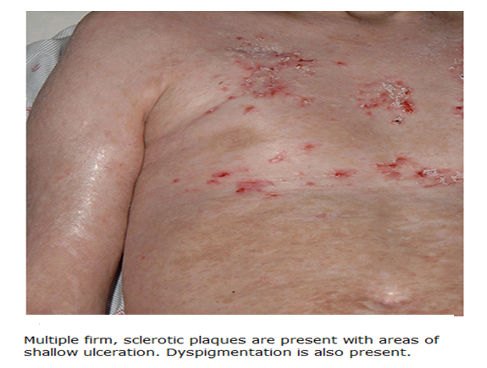
CHRONIC GRAFT VERSUS HOST DISEASE occuring after HSCT
d. Morphea-like Lesions
Firm, hyperpigmented, hypopigmented, or skin-colored plaques. Affected skin often has a shiny appearance and demonstrates hair loss secondary to elimination of adnexal structures.

Slide 60
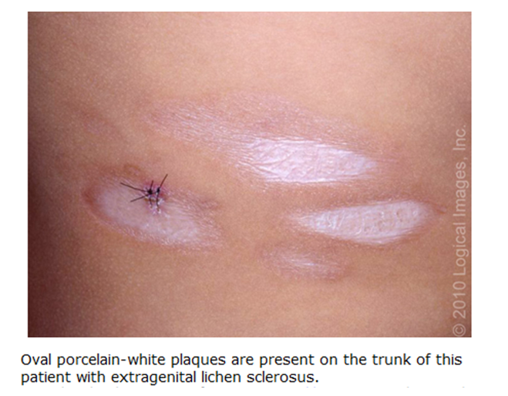
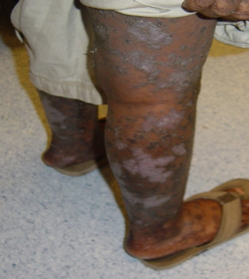
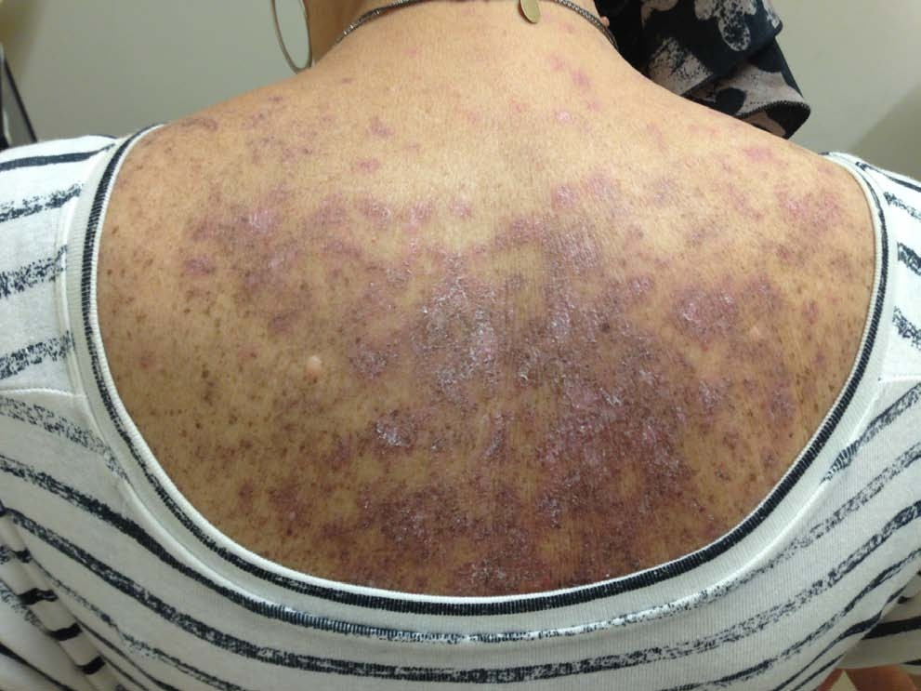
CHRONIC GRAFT VERSUS HOST DISEASE occuring after HSCT
e. Lichen sclerosis-like features
A dermatosis characterized by epidermal atrophy and superficial dermal fibrosis
Dry scaling shiny skin, may have some cigarette paper wrinkling of skin: lichen sclerosus

Slide 61
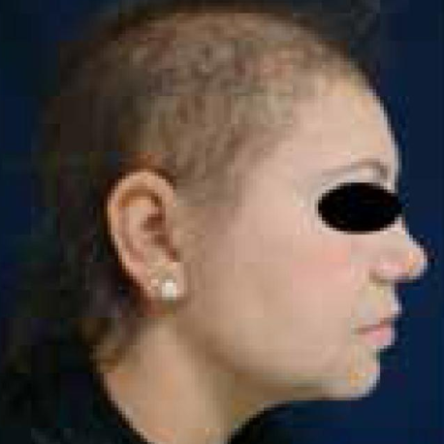
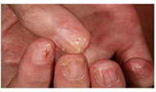
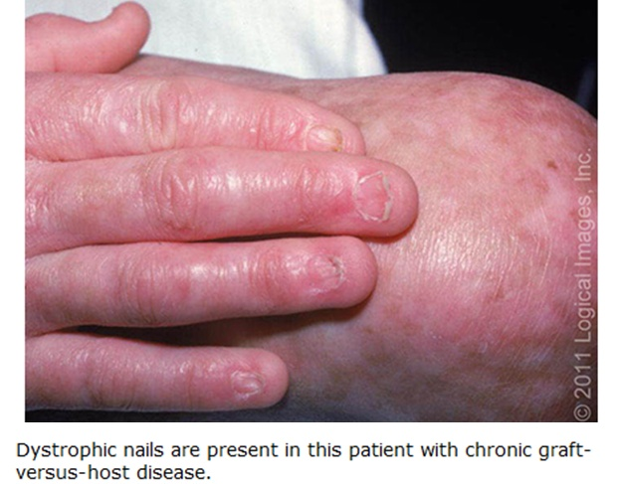
CHRONIC GRAFT VERSUS HOST DISEASE occuring after HSCT
Skin & appendages
Sign and Sypmtoms In advanced cases
Scalp alopecia, loss of body hair,
Sclerosis provokes functional impairment with severe joint contractures.
Nail dystrophy, longitudinal ridging, nail splitting or nail loss.
Hair thinning in frontoparietal region, with SPARSE and fragile hair. Prominent temporal alopecia in patient
(Lichen planus lesions of the nails showing thinning of the nail plate, longitudinal lines, and pterygium formation.
Nail dystrophy, longitudinal ridging, nail splitting or nail loss.
Notes:
The diagnosis of cGvHD is based on its clinical manifestations. The signs and symptoms of cGvHD may occur in any organ but the most frequently affected organs/sites are the skin, nails, mouth, eyes, female genitalia, gastrointestinal tract, liver, lungs, muscles, fascia and joints. The disease may be mono-symptomatic, but can also be widespread and leading to debilitating consequences such as end stage lung disease or joint contractures. Since the NIH consensus development project on cGvHD in 2005 new diagnostic and staging criteria has been established (14).
The consensus group defined diagnostic signs (any one of these signs itself establishes the diagnosis of cGvHD without further investigation), distinctive signs (should be confirmed by pertinent biopsy or other relevant test, e.g. Schirmer), other features of cGvHD which are not specific, and common signs that occur both in acute and chronic GvHD

Slide 62
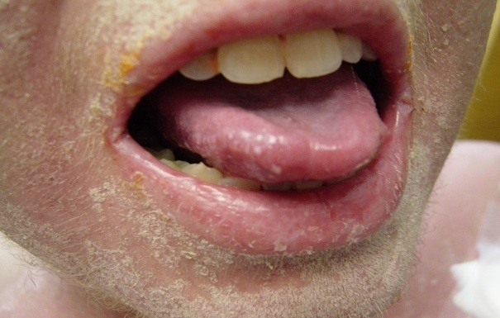
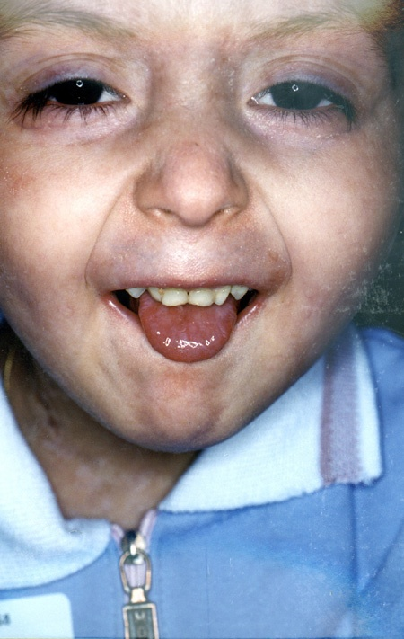
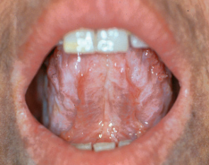
CHRONIC GRAFT VERSUS HOST DISEASE occuring after HSCT
Oral Mucosa cGVHD
lingual ulceration
erythema, flat villi, sclerodermatous fibrosis that causes her to be unable to open her mouth
erythema with lichenoid lesions
Notes:
These photos depict oral cGVHD.

Slide 63
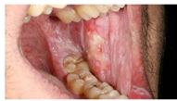

CHRONIC GRAFT VERSUS HOST DISEASE occuring after HSCT
Oral Mucosa cGVHD
Lichenoid changes
Lichen planus-like lesions on buccal mucosa showing a lacework of white streaks and erosions.
Notes:
The diagnosis of cGvHD is based on its clinical manifestations. The signs and symptoms of cGvHD may occur in any organ but the most frequently affected organs/sites are the skin, nails, mouth, eyes, female genitalia, gastrointestinal tract, liver, lungs, muscles, fascia and joints. The disease may be mono-symptomatic, but can also be widespread and leading to debilitating consequences such as end stage lung disease or joint contractures. Since the NIH consensus development project on cGvHD in 2005 new diagnostic and staging criteria has been established (14).
The consensus group defined diagnostic signs (any one of these signs itself establishes the diagnosis of cGvHD without further investigation), distinctive signs (should be confirmed by pertinent biopsy or other relevant test, e.g. Schirmer), other features of cGvHD which are not specific, and common signs that occur both in acute and chronic GvHD

Slide 64



CHRONIC GRAFT VERSUS HOST DISEASE occuring after HSCT
Ocular Involvement
Approximately 40 to 60 percent of adult patients with chronic GVHD will have involvement of their eyes. Ocular findings on examination included:
Keratoconjunctivitis sicca:– 53.4 percent
Aqueous tear deficiency (Schirmer score ≤5 mm)
Cataracts – 39.4 percent
Corneal epithelial staining – 33.6 percent
Conjunctival hyperemia – 10.5 percent
Chemosis – 3 percent

Slide 65

CHRONIC GRAFT VERSUS HOST DISEASE occuring after HSCT
Hepatic Involvement &
Approximately half of patients with chronic GVHD have some involvement of the liver
May have few relatively mild symptoms
  Jaundice
  Mild hepatomegaly
  Abnormal coagulation
  Elevated alkaline phosphatase
  Elevated transaminases
  Elevated bilirubin
In all cases, infection, drug effects, malignancy, or other causes must be excluded
Notes:
[17]. Often liver involvement is manifested as liver function test abnormalities without other major complications. The liver function tests are most consistent with those of cholestasis, with elevations in the serum alkaline phosphatase, ALT or AST, and bilirubin concentrations. There are no signs that are diagnostic or distinctive and the same liver findings occur in patients with acute and chronic GVHD [1]. Liver biopsies are performed to confirm involvement when isolated hepatic GVHD is suspected. Biopsies variably showing lobular hepatitis, chronic persistent hepatitis, chronic active hepatitis, and a reduction or absence of small bile ducts with cholestasis [26,27]. In most patients, the pathophysiology is suggestive of that observed with primary biliary cirrhosis, including biliary cell necrosis and basement membrane thickening [28].
The patient with hepatic involvement with cGVHD may have relatively few symptoms until the process becomes severe. The disease manifests itself as a cholestatic obstructive picture. Before the patient starts immunosuppressive therapy, numerous other diseases should be ruled out, such as hepatitis, Epstein-Barr virus (EBV), infection (viral and fungal), iron overload, and pharmacologically induced hepatitis.
It is of the utmost importance that the etiology of hepatic inflammation be clarified. Treating GVHD with immune suppression in the presence of an undiagnosed infection may cause, with high likelihood, a potential fatal flare of infection. Treating an infection without diagnosing GVHD will allow for an acute exacerbation of GVHD.

Slide 66


CHRONIC GRAFT VERSUS HOST DISEASE occuring after HSCT
Hepatic Involvement &
Liver biopsies are performed to confirm involvement when isolated hepatic GVHD is suspected
In cGVHD, the bile duct has collapsed syncytia of different sizes and irregularly arranged or missing nuclei.
Healthy Hepatic Biopsy
cGVHD Hepatic Biopsy
Notes:
The target in cGVHD are the bile ducts. A healthy bile duct is not infiltrated by lymphocytes.
Instead, in cGVHD, there are features of degeneration. The cells vary in size and shape. Some cells have dark nuclei (black arrow), whereas others have clear nuclei (green arrow).
The epithelial lining of the bile duct is very disorganized, with some nuclei forming clumps and other areas in which nuclei are not seen (red arrow).
This bile duct is also shrunken. It should be bigger. This is not appreciated in the image.
If this persists, the bile duct can continue degenerating and even disappear.

Slide 67

CHRONIC GRAFT VERSUS HOST DISEASE occuring after HSCT
Pulmonary Involvement &
Pulmonary involvement is present in approximately half of patients with chronic GVHD and may manifest as obstructive and/or restrictive changes
Sinusitis
  Sicca syndrome
Bronchiolitis Obliterans (BO)
  Fibrotic process
  Dyspnea, cough, and/or exercise intolerance
  Computed tomograpy (CT) scan:
  patchy hyperaeration, bronchial dilation, increased density
Bronchiolitis Obliterans organizing pneumonia (BOOP)
  Shortness of breath (SOB), cough, and fever
  CT scan: peripheral patchy airspace consolidation, nodular opacities
Notes:
There is a 5%–10% incidence of sinopulmonary manifestations in individuals with cGVHD. Late onset noninfectious pulmonary complications include Bronchiolitis Obliterans (BO), Bronchiolitis Obliterans organizing pneumonia (BOOP), and restrictive pulmonary disease.
Sinusitis is a common complication of cGVHD as a result of sicca syndrome.
BO syndrome is a fibrotic process. The patient has dyspnea, a cough, and/or exercise intolerance. The chest CT reveals patchy hyperaeration, bronchial dilation, and increased density.
BOOP is a nonfibrotic disease process. The patient is short of breath, is usually febrile, and has a cough. A chest CT reveals peripheral patchy airspace consolidation and nodular opacities.

Slide 68



CHRONIC GRAFT VERSUS HOST DISEASE occuring after HSCT
Gut Involvement &
Normal Gut Biopsy
Clinical Manifestations
Diarrhea
Anorexia
Nausea and vomiting
Abdominal pain and cramping
Wasting syndrome
  Malabsorption
  Weight loss
  Poor performance status
  Progressive GI symptoms
  (early satiety, dysphagia)
Infection
cGVHD GutBiopsy
Notes:
The best endoscopic diagnosis strategy for GI symptoms of cGVHD is unknown. For patients with diarrhea, the biopsy with the highest yield for diagnosis was the distal colon. Patients with complaints of nausea and vomiting had variable biopsy results, and some had esophageal strictures that needed to be opened. A combination of upper endoscopy with sigmoidoscopy and colonoscopy with ileal biopsies may be beneficial.
These pictures depict a normal and a cGVHD gut biopsy. The image on the right is from the colon; it shows severe cGVHD. The black arrows depict the glands in a normal biopsy. The most noticeable feature in the cGVHD gut biopsy is that there are no glands (green arrow).
Apoptosis in the neck region of the gastric gland is commonly seen in cGVHD.
GI symptoms are listed but may be complicated by associated infection. Cytomegalovirus (CMV), bacterial overgrowth, other viral etiologies, and clostridium difficile may complicate the overall clinical picture. Other symptoms associated with GI cGVHD include painful swallowing, nausea and vomiting, anorexia, diarrhea, abdominal pain and/or cramping, and wasting syndrome (malabsorption, weight loss, poor performance status, dysphagia, and early satiety).
Weight loss occurs in about 20% to 30% of patients after HPCT. The cGVHD scoring system explained later associates severe weight loss with poor outcome. The etiology of weight loss is poorly understood. Possible causes include GVHD, poor intake, malabsorption, increased caloric needs, hypercatabolism, increased energy expenditure, and pancreatic insufficiency.
Pancreatic exocrine insufficiency with steatorrhea can be seen on CT as volume loss of pancreas and notable nausea, vomiting, loss of appetite, and weight loss with or without abdominal pain. This occurs in about 16% of patients with GI complications of cGVHD. Supplementation with pancreatic enzymes has been reported to be beneficial.

Slide 69
Gynecological cGVHD:
CHRONIC GRAFT VERSUS HOST DISEASE occuring after HSCT
Vaginal epithelial damage occurs due to cGVHD
  Inflammation
  Stricture formation
  Narrowing
Vaginal sicca
Vaginal atrophy
  Leads to painful sexual intercourse
Symptoms may include
  Inflammation
  Dry vagina
  Obstruction of menstrual flow because of strictures
Notes:
Extensive cGVHD can affect the vaginal epithelium, causing inflammation, stricture formation, and narrowing. The patient may complain of painful sexual intercourse and the need for a lubricant and a change in menstrual flow secondary to stricture formation.

Slide 70



Muscle /Fascia /Joints
CHRONIC GRAFT VERSUS HOST DISEASE occuring after HSCT
Musculoskeletal Involvement &
The severe damage done by sclerodermatous skin cGVHD can cause significant musculoskeletal involvement
    Stiffness
    Contractures
    Joint pain
    Limited ROM
    Muscle cramps
    Carpal spasm
    Swelling
    Arthralgias
Notes:
Musculoskeletal involvement is the direct result of the sclerodermatous changes seen in skin cGVHD. The constellation of symptoms is listed here.
Patients with cGVHD have a lower physical performance test result compared to the control group. The testing can be done of children as young as 6 years. Some of the decreased physical performance may be attributed to stiffness and SOB. There was a strong association between muscle weakness and cGVHD.

Slide 71



CHRONIC GRAFT VERSUS HOST DISEASE occuring after HSCT
Musculoskeletal Involvement &
Fasciitis
  Diagnostic sign of cGVHD
  Skin swelling: skin taut, bound down, and irregularly thickened, with small depressed areas (orange peel) Contractures, joint stiffness
  Pathology: lymphocytic infiltrates, increase of collagen fibers
Myositis
  Distinctive sign of cGVHD
  Moderate to severe proximal muscle weakness, myalgia, fever, contracture, and skin induration
  Elevated creatinine phosphokinase and aldolase enzyme
  Pathology: degeneration, necrosis, and regeneration of muscle fibers
Notes:
Diagnosis of fasciitis may be made with clinical signs and a magnetic resonance image showing the presence of inflammation or thickening of the fascia.
Those with fasciitis frequently had BO and sicca syndrome and less often had complications of oral and skin involvement.
Make sure to rule out other causes of fasciitis and/or myositis.
Treatment: immunosuppressive therapies should be intensified and/or restarted.

Slide 72
CHRONIC GRAFT VERSUS HOST DISEASE occuring after HSCT
Prophylaxis treatment
There is no agreed upon standard propylaxis regimen
Multiple different regimens, eg
Glucocorticoids,
Cyclosporine, IV.
Immune Globulin
have been used in an attempt to prevent the development of chronic GVHD; most have been ineffective .
Two potential exceptions are the use of ANTITHYMOCYTE GLOBULIN (ATG) as part of the preparative regimen and the use of RITUXIMAB in the post-transplant period.
Notes:
ATG is commonly incorporated into the prophylactic regimen for patients with an unrelated donor or haploidentical donor undergoing either myeloablative or reduced intensity conditionin

Slide 73
CHRONIC GRAFT VERSUS HOST DISEASE occuring after HSCT
Prophylaxis treatment
The addition of Anti-lymphocyte globulin to conditioning regimen
Phase 3 trial, 161 patients
Median follow-up of 24 months
GVHD prophylaxis with Cyclosporine and Methotraxate ± ATG
The addition of antilymphocyte globulin resulted in a lower chronic GVHD (32 versus 69 percent) and a higher percentage of patients able to discontinue cyclosporine (91 versus 39 percent)..
Notes:
Rates of acute GVHD, relapse-free survival, and overall survival at two years were similar between the two groups. The two groups also had similar rates of CMV reactivation and EBV reactivation, and no cases of post-transplant lymphoproliferative disorder.

Slide 74
cGVHD: Primary Treatment
CHRONIC GRAFT VERSUS HOST DISEASE occuring after HSCT
Systemic treatment
  Progressive onset
  Thrombocytopenia
  Multiple organs sites affected >3
  Pulmonary involvement
Initial treatment often employs
  Single agent corticosteroids
  Combination with calcineurin inhibitor
Most patients require immunosuppressive treatment for up to 1 year..
Notes:
Advances in the understanding of cGVHD have helped in the treatment of the process. cGVHD treatment is based on maintaining a fine balance between the amount of immunosuppression and the cGVHD. The selection of cGVHD treatment is often protocol and institutional specific. The following drugs are employed: tacrolimus, steroids, cyclosporine, and mycophenolate mofetil.
From Filipovich, A. H., Weisdorf, D., Pavletic, S., Socie, G., Wingard, J. R., Lee, S. J., et al. (2005). National Institutes of Health consensus development project on criteria for clinical trials in chronic graft-versus-host disease: I. Diagnosis and staging working group report. Biology of Blood and Marrow Transplantation, 11(12), 954.

Slide 75
CHRONIC GRAFT VERSUS HOST DISEASE occuring after HSCT
Prophylaxis treatment
Nonrandomized trial has evaluated the use of rituximab in the post-transplant period:
Phase II trial of 65 adults
Rituximab (375 mg/m² given on day 100 and at 6, 9, and 12 months)
Two-year rates of chronic GVHD of 31 percent,
Rituximab was also associated with a lower rate of TRM (5 versus 19 percent) and improved overall survival (71 versus 56 percent) at four years.

Slide 76
Initial first line treatment
Standard first line systemic treatment is orally administered
prednisolone 1 mg/kg and cyclosporin (CsA) 10 mg/kg with
the dose of CSA adjusted to plasma levels
In practice this usually starts 2 weeks after evidence of clinical improvement.
The tapering should not be start before 4 week
The tapering should be very slow ➔0.25 mg/kg reduction every 2 week
After 2 months, continue with stable effective dose (mostly 0.25 mg/kg )
Then after, a 4 months interval an even slower taper may be initiated reaching steroid-free status by the end of the first year but still on CSA treatment
Notes:
Standard first line systemic treatment is orally administered prednisolone 1 mg/kg and cyclosporin (CsA) 10 mg/kg with the dose of CSA adjusted to plasma levels. The corticosteroid component is the main part of the therapy while the addition of CsA had the advantage of less avascular necrosis in a prospective randomised study (19, 20). Attempts to add a third immune-suppressive drug (azathioprine, thalidomide or mycophenolate mofetil) to the standard initial treatment did not improve results and should be avoided (21, 22). Because of the significant morbiditiy caused by long-term steroid treatment the dose of prednisolone should be tapered according to response. In practice this usually starts 2 weeks after evidence of improvement of clinical manifestations. The tapering should be very slow with a typical approach starting with 0.25 mg/kg reduction on alternating days reaching no steroid on every second days by 2 months. Then after a 4 months interval an even slower taper may be initiated (23).
Steroid-refractory cGvHD is defined as progression on prednisolone at 1 mg/kg/day for 2 weeks or stable disease on >0.5 mg/kg/day prednisolone for 4–8 weeks or an inability to taper prednisolone below 0.5 mg/kg/day.

Slide 77
CHRONIC GRAFT VERSUS HOST DISEASE occuring after HSCT
Prophylaxis treatment
Nonrandomized trial has evaluated the use of rituximab in the post-transplant period:
Phase II trial of 65 adults
Rituximab (375 mg/m² given on day 100 and at 6, 9, and 12 months)
Two-year rates of chronic GVHD of 31 percent,
Rituximab was also associated with a lower rate of TRM (5 versus 19 percent) and improved overall survival (71 versus 56 percent) at four years.

Slide 78
Initial first line treatment
Steroid-refractory cGvHD is defined as
  Progression on prednisolone at 1 mg/kg/day for 2 weeks or
  Stable disease on >0.5 mg/kg/day prednisolone for 4–8 weeks or
There is no standard salvage second line treatment of cGvHD.
Notes:
Standard first line systemic treatment is orally administered prednisolone 1 mg/kg and cyclosporin (CsA) 10 mg/kg with the dose of CSA adjusted to plasma levels. The corticosteroid component is the main part of the therapy while the addition of CsA had the advantage of less avascular necrosis in a prospective randomised study (19, 20). Attempts to add a third immune-suppressive drug (azathioprine, thalidomide or mycophenolate mofetil) to the standard initial treatment did not improve results and should be avoided (21, 22). Because of the significant morbiditiy caused by long-term steroid treatment the dose of prednisolone should be tapered according to response. In practice this usually starts 2 weeks after evidence of improvement of clinical manifestations. The tapering should be very slow with a typical approach starting with 0.25 mg/kg reduction on alternating days reaching no steroid on every second days by 2 months. Then after a 4 months interval an even slower taper may be initiated reaching steroid-free status by the end of the first year but still on CSA treatment (23).
Steroid-refractory cGvHD is defined as progression on prednisolone at 1 mg/kg/day for 2 weeks or stable disease on >0.5 mg/kg/day prednisolone for 4–8 weeks or an inability to taper prednisolone below 0.5 mg/kg/day.

Slide 79
CHRONIC GRAFT VERSUS HOST DISEASE occuring after HSCT
Prophylaxis treatment
Nonrandomized trial has evaluated the use of rituximab in the post-transplant period:
Phase II trial of 65 adults
Rituximab (375 mg/m² given on day 100 and at 6, 9, and 12 months)
Two-year rates of chronic GVHD of 31 percent,
Rituximab was also associated with a lower rate of TRM (5 versus 19 percent) and improved overall survival (71 versus 56 percent) at four years.

Slide 80

Second line treatment
Notes:
In the event that the HPCT recipient does not respond to conventional cGVHD therapy, there are other treatment options. Newer options of therapy based on an understanding of the cellular pathophysiology of GVHD include the use of monoclonal (etanercept [Enbrel®], infliximab [Remicade®], and alemtuzumab [Campath-1H®]) or polyclonal (antithymocyte globulin) antibodies. Additional newer options for the treatment of cGVHD include the use of thalidomide, hydroxychloroquine, and pentostatin as pharmaceutical agents.
Ultraviolet (UV) radiation, in addition to systemic immunosuppression, has been used in the treatment of refractory cGVHD. The two approaches used are ECP and psoralen and UVA irradiation (PUVA). The advantage of ECP and PUVA are that the treatments may allow a reduction in systemic immunosuppression.
Evaluate the treatment option that will best help keep the patient compliant with therapy. There are different salvage therapies to choose from that may be effective for the organs involved. The HPCT team will need to give each treatment choice at least a month or two before deciding it is a treatment failure.
There is no standard salvage treatment of cGvHD. A large number of options have been tested in rather small phase II clinical trials with different enrolment and response criteria making their comparative evaluation difficult. Possibilities include mycofenolate mofetil, tacrolimus, rapamycin, rituximab, thalidomide, extracorporeal photopheresis, pulsed high dose steroids (10 mg/kg/day for 4 days), total lymphoid irradiation (1 Gy), alemtuzumab, pentostatin, revlimid, anti-IL-2 receptor Ab, anti-TNF receptor Ab, and recently tyrosine kinase (PDGFR, TGF-β) inhibitors such as imatinib, nilotinib, or dasatinib (Table 10) (24).

Slide 81


Quality of Life Issues Facing HPCT Recipients
Fatigue
Stress & Depression
Sleep disturbance
Nutrition: weight loss or gain
Activity and exercise
Friendships
Growth and development
School or work
Notes:
This slide depicts the numerous psychosocial issues that surround the HPCT recipient. These issues are discussed in the following slides.

Slide 82
CHRONIC GRAFT VERSUS HOST DISEASE occuring after HSCT
Prophylaxis treatment
Nonrandomized trial has evaluated the use of rituximab in the post-transplant period:
Phase II trial of 65 adults
Rituximab (375 mg/m² given on day 100 and at 6, 9, and 12 months)
Two-year rates of chronic GVHD of 31 percent,
Rituximab was also associated with a lower rate of TRM (5 versus 19 percent) and improved overall survival (71 versus 56 percent) at four years.

Slide 83

Beni Dinlediğiniz İçin Teşekkür Ederim

