Slide 1
GRAFT VERSUS HOST DİSEASE
Mustafa CETIN
Notes:
Ten to the sixth power

Slide 2
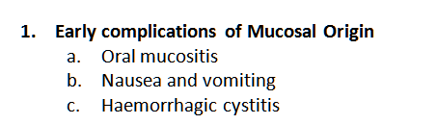
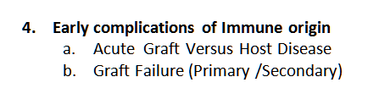
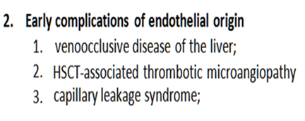
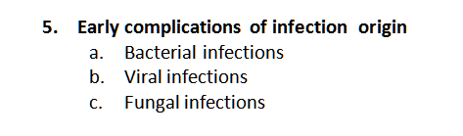
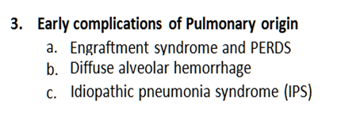
Early complications of high-dose therapy and stem cell transplantation
LATE EFFECTS …..

Slide 3
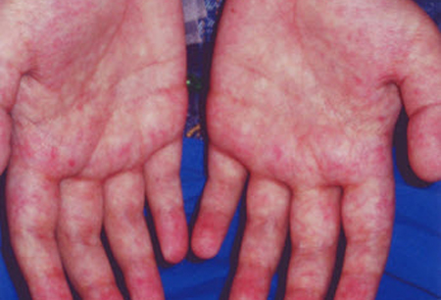
Acute GRAFT VERSUS HOST DISEASE occuring after HSCT
GVHD occurs when immune cells transplanted from
a non-identical donor (the graft) recognize the transplant recipient (the host) as foreign, thereby initiating an immune reaction that causes disease in the transplant recipient

Slide 4
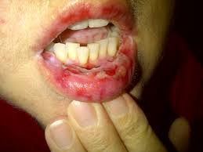
Acute GRAFT VERSUS HOST DISEASE occuring after HSCT
Historically, it was divided based on the timing of occurrence
  Acute – within the first 100 days
  Chronic – after first 100 days
Notes:
Inflammatory condition affecting one or more of the skin, gastrointestinal tract and liver, and occurring within 100 days of allogeneic transplantation
Later acknowledgement of similar syndrome occurring beyond day 100, known as late onset acute GvHD (particularly after RICT and DLI)
Affects 35-45% of recipients of HLA matched, and
60-80% of one Ag mismatched transplants
Affects approximately 40% of recipients of DLI but incidence rises with increasing cell dose

Slide 5
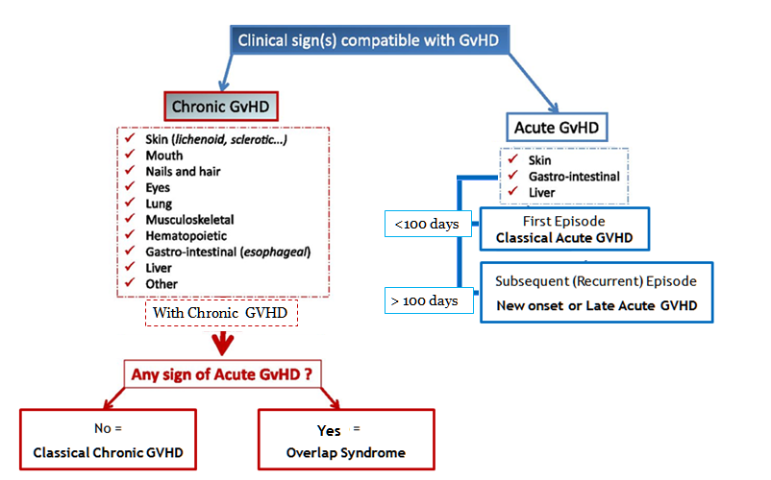
The NIH consensus;
recognized 2 main categories of GVHD, each with 2 subcategories.
similar syndrome occurs beyond day 100,
known as late onset acute GvHD
particularly after RICT and DLI
Notes:
The NIH consensus conference recognized 2 main categories of GVHD, each with 2 subcategories. The broad category of acute GVHD includes classic acute GVHD (maculopapular erythematous rash, gastrointestinal symptoms, or cholestatic hepatitis) and also includes persistent, recurrent, or late-onset acute GVHD occurring more than 100 days after transplantation. The broad category of chronic GVHD includes classic chronic GVHD, presenting with manifestations that can be ascribed only to chronic GVHD. Chronic GVHD also includes an overlap syndrome, which has diagnostic or distinctive chronic GVHD manifestations together with features typical of acute GVHD

Slide 6
GRAFT VERSUS HOST DISEASE occuring after HSCT
  Acute GVHD occurs
    in up to 40% of sibling donor recipients
    and up to 70% of unrelated donor recipients
  Chronic GVHD occurs in
    50% of 3-month survivors after allo HCT
  Recipients of DLI occurs in ( 40%) but incidence rises with increasing cell dose

Slide 7
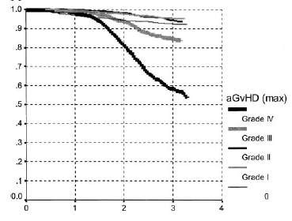
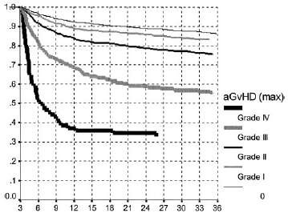
GRAFT VERSUS HOST DISEASE occuring after HSCT
Impact of aGvHD on survival
Gratwohl et al, Blood, 2002

Slide 8
GVHD Pathogenetic Definiation
GRAFT VERSUS HOST DISEASE occuring after HSCT
Remains poorly understood
Cellulary involvement, Cytokine storms and prolonged use of immune suppression:
  ➔ Increased infections
  ➔ Organ dysfunctions
  ➔ Increased morbidity
  ➔ Impaired QOL
Uncontrolled Immüne attack causes to the non-relapse mortality.

Slide 9
GRAFT VERSUS HOST DISEASE occuring after HSCT
Today Topics
Acute GvHD >> Chronic GVHD
Definition
Incidence
Pathophysiology
Diagnosis
  Clinical
  Pathological
Prevention & treatment
  Pharmacological
  Immunomodulation
  Cellular Therapies

Slide 10
GRAFT VERSUS HOST DISEASE occuring after HSCT
ACUTE
GRAFT VERSUS
HOST DİSEASE

Slide 11
Basic for GVHD Understanding?
GRAFT VERSUS HOST DISEASE occuring after HSCT
A donor origin cell mediated reaction against to the recipient tissues
It requires (prerequisites):
  .. a recipient expresses tissue antigens that are not present in the donor.
  .. a donor graft react against to the recipient antigens with immunologically competent cells
Recipient unable to overcome immune attack
Notes:
Graft must contain immunologically competent cells
Recipient must express tissue antigens not present in the donor

Slide 12
Basic Cellulary RESPONSE: Afferent PHASE
ACUTE GRAFT VERSUS HOST DISEASE occuring after HSCT
Degraded in peptides
Combined with HLA molecules
HLA Class I -
Displayed with HLA molecule
Exogenous substance

Slide 13
Basic Cellulary RESPONSE: Afferent PHASE
ACUTE GRAFT VERSUS HOST DISEASE occuring after HSCT
Viral or intracellular protein
Nucleus
HLA Class II -
Virus
Endogenous substance
Displayed with HLA molecule

Slide 14
Basic Cellulary RESPONSE: Afferent PHASE
ACUTE GRAFT VERSUS HOST DISEASE occuring after HSCT
HLA Class II - i.e. HLA - DR, DQ, DP
“Regulator”
“Trouble”
signal
CD4
APCs
Dendritic cell
B cell
Macrophage
“Submitted to the …
“Enforcer”
CD8
HLA Class I - i.e. HLA-A, B, C
Notes:
GVHD is a common complication and cause of mortality after allogeneic blood and marrow transplant (AlloBMT). T cells present in the donor stem cell graft can target antigens present on the leukemia, termed the graft-versus-leukemia (GVL) effect, resulting in clinical remissions and cures. Unfortunately T cells can also target host tissues that express minor histocompatibility antigens (mHAs) that are mismatched to the donor, leading to GVHD.
GVHD pathogenesis can be divided into distinct phases. Inflammation from the conditioning regimen activates antigen presenting cells (APCs) in the host expressing mHAs that are foreign to the donor prime and activate donor T cells. Cytokines stimulated by the inflammation, such as gamma interferon (IFNg), enhance this activation. Donor T cells proliferate in response to being exposed to foreign mHAs present on APCs, and attack host organs like liver, gut and skin.
The activated T cells can also produce further cytokines that exacerbate GVHD further. Because GVHD can be a life threatening complication, it is typically treated with immunosuppressant drugs for weeks to months. The paradox is that GVHD, and the current drugs used for treating GVHD, inhibit the function of the donor T cells – simultaneously abrogating GVL. Therefore while GVHD may be controlled, the leukemia relapses. If GVHD is not treated, T cells may be intact to cause GVL but GVHD eventually kills the patient. Thus clinicians often allow a small amount of GVHD to occur, to reap any concurrent GVL effect, but then treat GVHD as it worsens before it becomes uncontrollable and lethal.

Slide 15
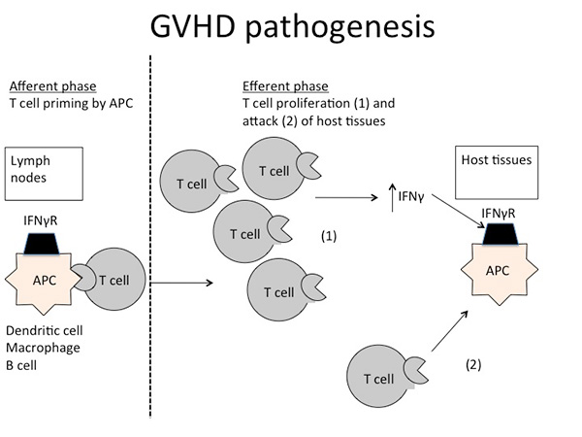
ACUTE GVHD Pathogenetic Definiation
ACUTE GRAFT VERSUS HOST DISEASE occuring after HSCT

Slide 16
Why do we have to HLA match?
ACUTE GRAFT VERSUS HOST DISEASE occuring after HSCT
BMT = immune system transplant
HLA molecules act as T cell “superantigens”
All somatic tissues express HLA class I
Transferred T cell could “over-react” to recipient

Slide 17
If there is a “match”, why GVHD?
ACUTE GRAFT VERSUS HOST DISEASE occuring after HSCT
HLA molecules “show” what’s inside
We are all different inside
GVHD results from T cell reactivity toward polymorphisms between donor and host.
  This can be a good thing (GVL)
    or
  This can be a bad thing (GVHD)

Slide 18
Polymorphisms can help rid disease or cause GVHD
ACUTE GRAFT VERSUS HOST DISEASE occuring after HSCT
H -Y
  antigen from Y chromosome
  expressed ubiquitously
  target for CTL responses
  CTL response leads to less relapse, more GVHD
HA-1
  polymorphic
  unknown function
  expressed only on hematopoietic cells
  target for CTL responses
  CTL response leads to less relapse, no GVHD

Slide 19
Acute GvHD: Pathophysiology
ACUTE GRAFT VERSUS HOST DISEASE occuring after HSCT
Activation of antigen presenting cells (APCs) by tissue damage induced by conditioning regimen:
  Typically involves TNF alfa, IL1, IL6 and lipopolysaccharide (LPS)
Donor T-cells proliferate, differentiate and migrate:
  CD4 cells typically recognising Class II and CD8 recognising Class I antigens.
  Process modulated by NK, T-regs and MSCs,
  Production of IL2, IL-12, TNF alfa and IFN-gamma
Target tissue destruction through Fas-Fas ligand (liver) and perforin-granzyme pathway (GIT)

Slide 20
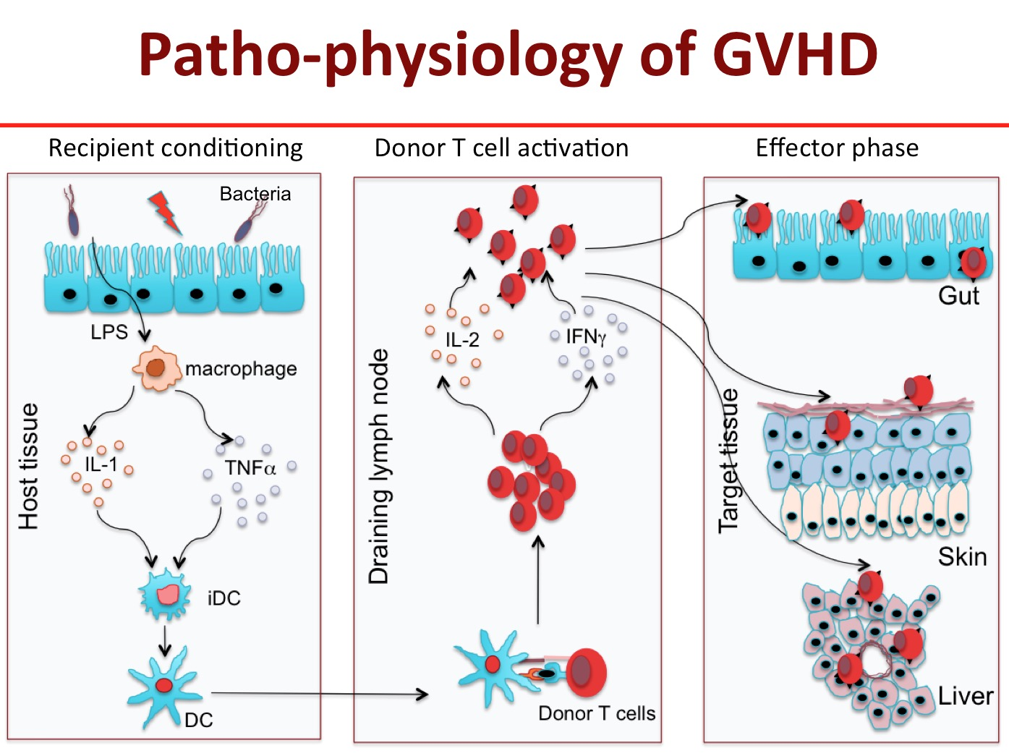
ACUTE GRAFT VERSUS HOST DISEASE occuring after HSCT
Notes:
HSCT without T cells results in poor engraftment and recurrent infections. Infused T cells also mediate anticancer effect against some lymphoma and leukemia. However, these donor T cells recognize the recipient’s cells as foreign and attack the epithelial cells in the skin, liver and gut causing acute graft versus host disease (GVHD) that accounts for significant morbidity and about 50% mortality associated with HSCT. Therefore, it is essential to identify the molecule(s) in donor T cells that are responsible for induction of GVHD.
I have been studying the cellular mechanism of GVHD and the interactions between subpopulations of T cells involved in induction or prevention of the disease. My research demonstrates that naive phenotype subset of T cells (memory phenotype) that cause acute GVHD while memory phenotype T cells do not. Memory phenotype T cells have these unique characteristics i) reduced proliferation and IL-2 production in response to recipient antigens (allo-antigens) and ii) havereduced ability to traffic to target to GVHD target organs. Therefore, I intend to identify transcription factors and cell signaling molecules that regulate their functions
Figure 1: Pathogenesis of acute GVHD. Conditioning by irradiation and/or chemotherapy causes tissue damage. Damaged tissues and cells release DAMPs (HMGB-1), PAMPs (LPS) from gut microbiota as well as inflammatory cytokines such as IL-1β, IL-6, and TNF-α, which contribute to the “cytokine storm.” These are the first danger signals that activate host APCs, which activate and polarized donor T-cells toward pathogenic T-cells (TH1 and TH17 for CD4 and TC1, TC17 for CD8). Activated pathogenic T-cells infiltrate target organs (i.e., GI tract, liver, skin) and amplify local tissue destruction. The presence of regulatory T-cells (Tregs) helps reduce GVHD severity through the inhibition of pathogenic cells activation and/or expansion at early or further phases of GVHD. Some of these DAMPs and PAMPs such as elafin (skin-specific), regenerating islet-derived 3-alpha (REG3α, gut-specific), and suppressor of tumorigenicity 2 (ST2, a member of the IL-1 receptor family, binding IL-33) have been shown to be biomarkers

Slide 21
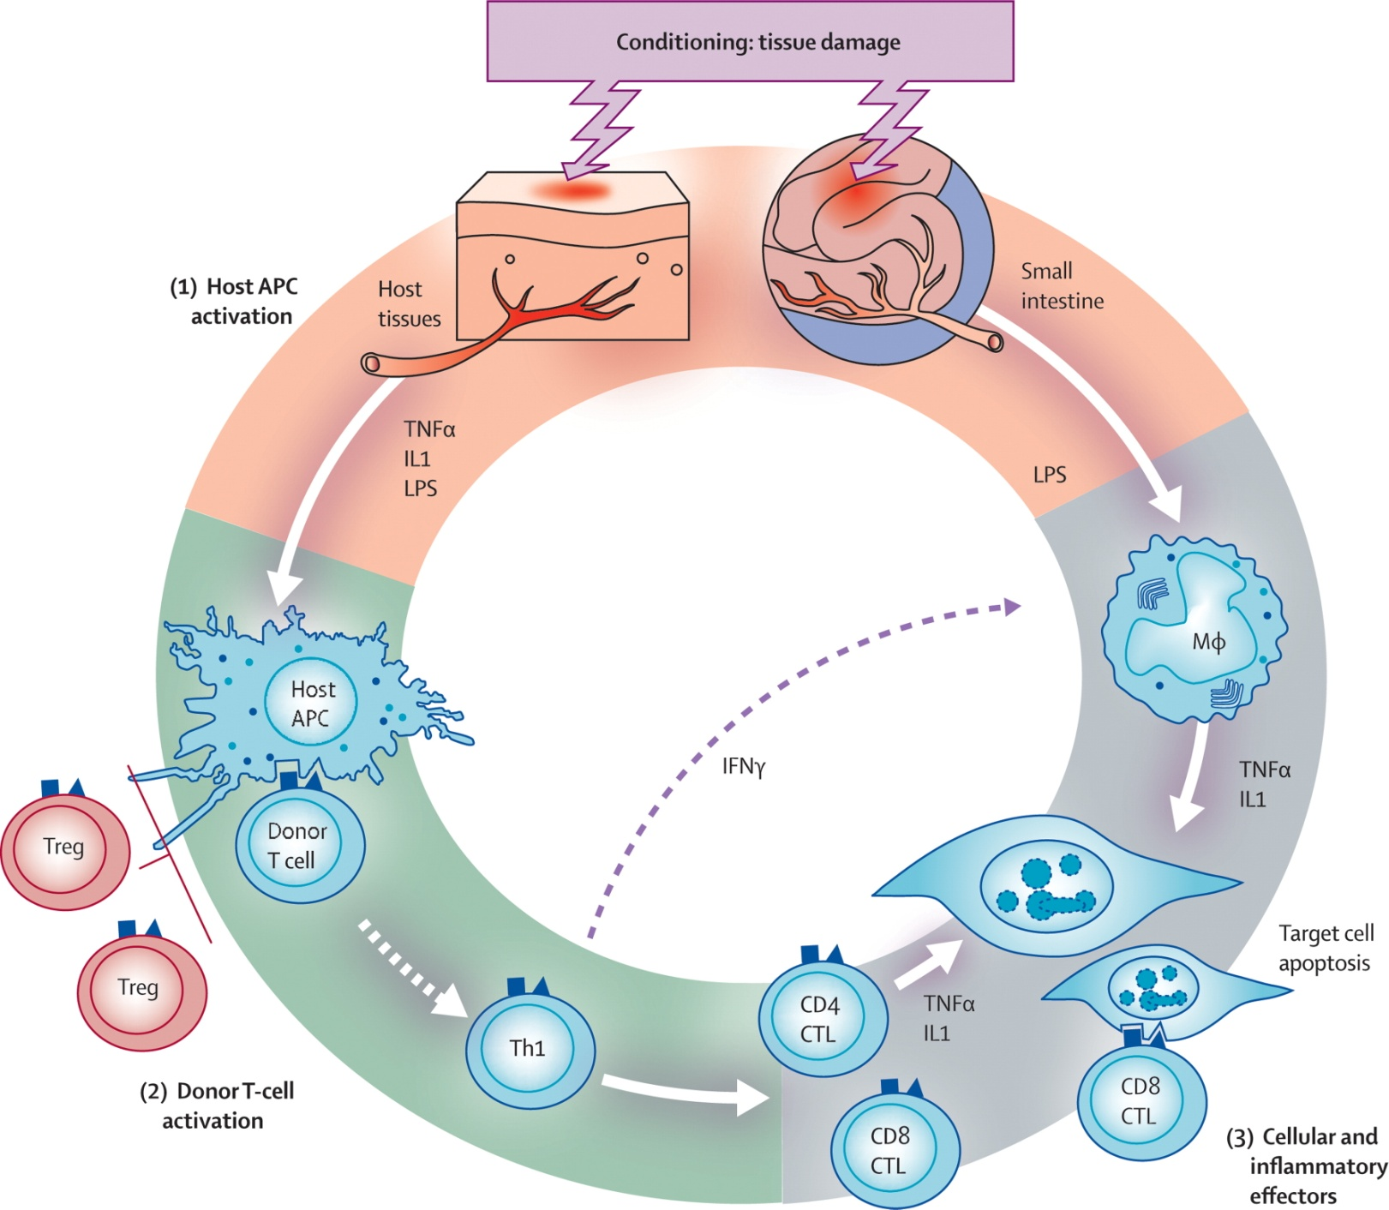

ACUTE GRAFT VERSUS HOST DISEASE occuring after HSCT
Acute GvHD:
Pathophysiology
The Lancet 2009 373, 1550-1561DOI: (10.1016/S0140-6736(09)60237-3)
Notes:
Pathophysiology of acute GVHD
IL 1=interleukin 1. IFN γ=interferon γ. LPS=lipopolysaccharide. Treg=regulatory T cell. Th1=T-helper 1 cell. CTL=cytotoxic T lymphocyte.

Slide 22
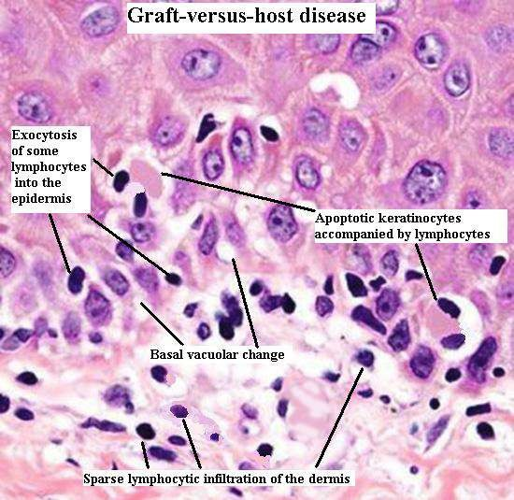
ACUTE GRAFT VERSUS HOST DISEASE occuring after HSCT
Acute GvHD: Pathophysiology

Slide 23
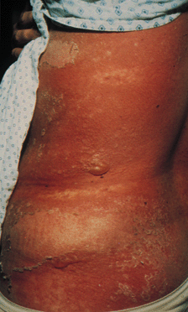
ACUTE GRAFT VERSUS HOST DISEASE occuring after HSCT
Clinical manifestations of Acute GvHD İnclude;
Graft Versus Host Disease of the Skin: Grade IV
A classic maculopapular rash;
Persistent nausea and/or emesis;
Abdominal cramps with diarrhea; and
A rising serum bilirubin concentration.
Notes:
Clinical manifestations of acute GVHD include a classic maculopapular rash; persistent nausea and/or emesis; abdominal cramps with diarrhea; and a rising serum bilirubin concentration. In contrast, patients with chronic GVHD commonly demonstrate skin involvement resembling lichen planus or the cutaneous manifestations of scleroderma; dry oral mucosa with ulcerations and sclerosis of the gastrointestinal tract; and a rising serum bilirubin concentration

Slide 24
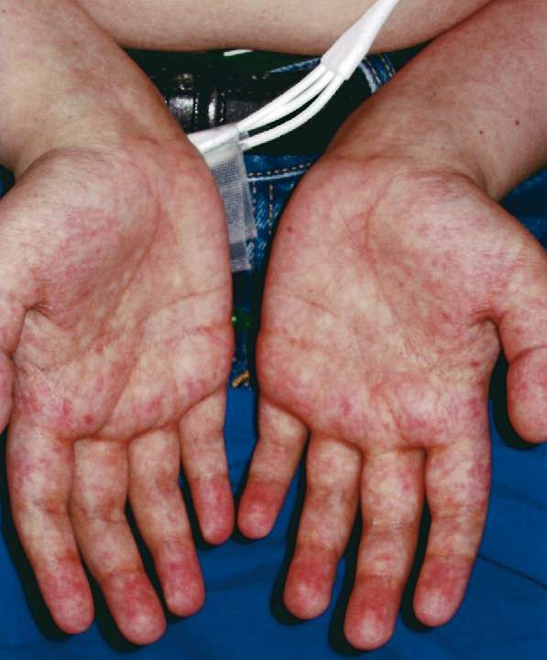
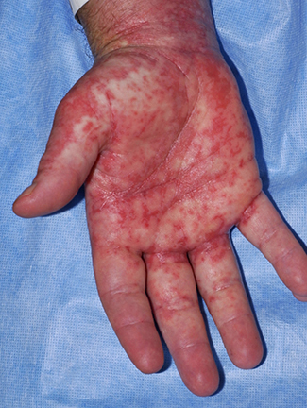
Acute GvHD: Skin
ACUTE GRAFT VERSUS HOST DISEASE occuring after HSCT
  Most common organ affected (>80% )
  Macular papular rash affecting any part of the body, typically palmar & plantar erythema and sparing the scalp
    Pt may complain of pain or itching to affected areas
    Rash becomes confluent as it progresses however, blisters may form.
    Severe cases resemble burn patients
    Usually correlates with engraftment;
    reduced intensity have delayed onset of GVHD
Differential diagnosis:
  Chemotherapy/radiation, drug, infection, engraftment

Slide 25
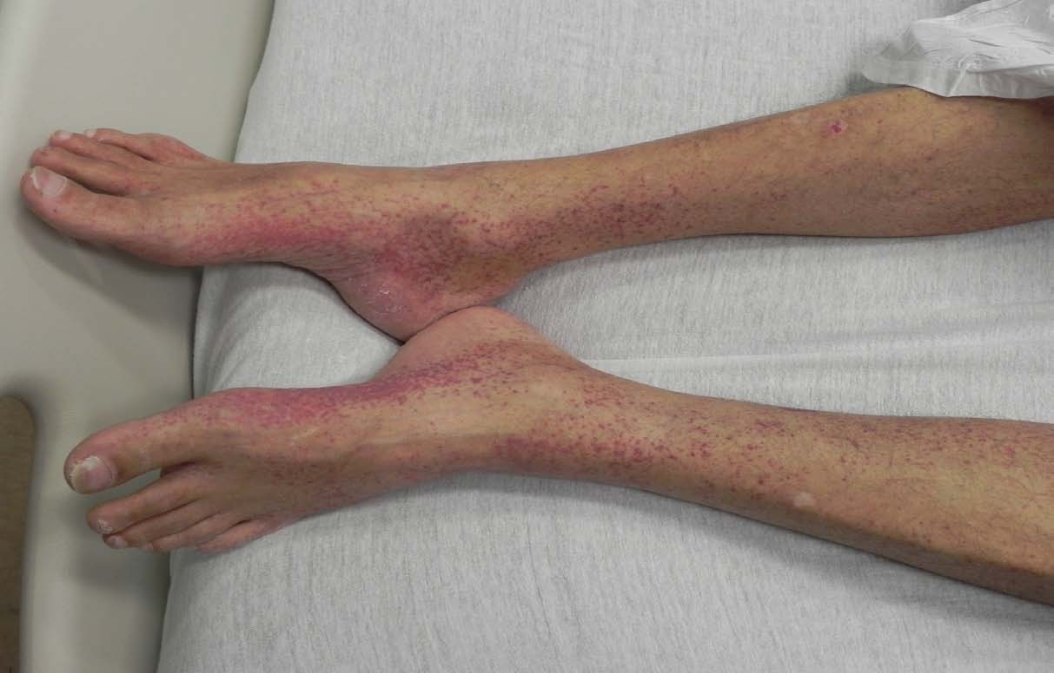
ACUTE GRAFT VERSUS HOST DISEASE occuring after HSCT
Skin

Slide 26
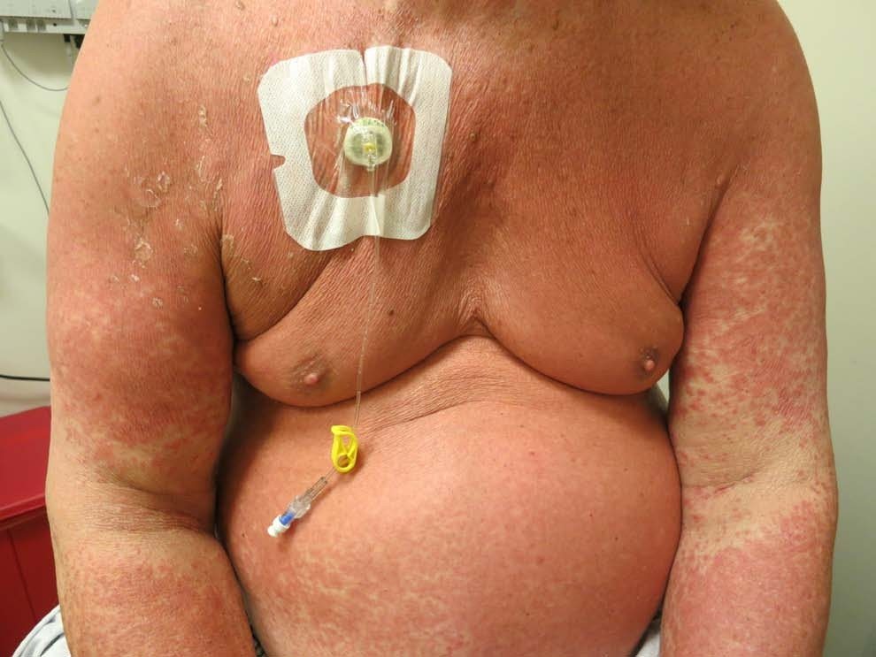
ACUTE GRAFT VERSUS HOST DISEASE occuring after HSCT
Skin

Slide 27
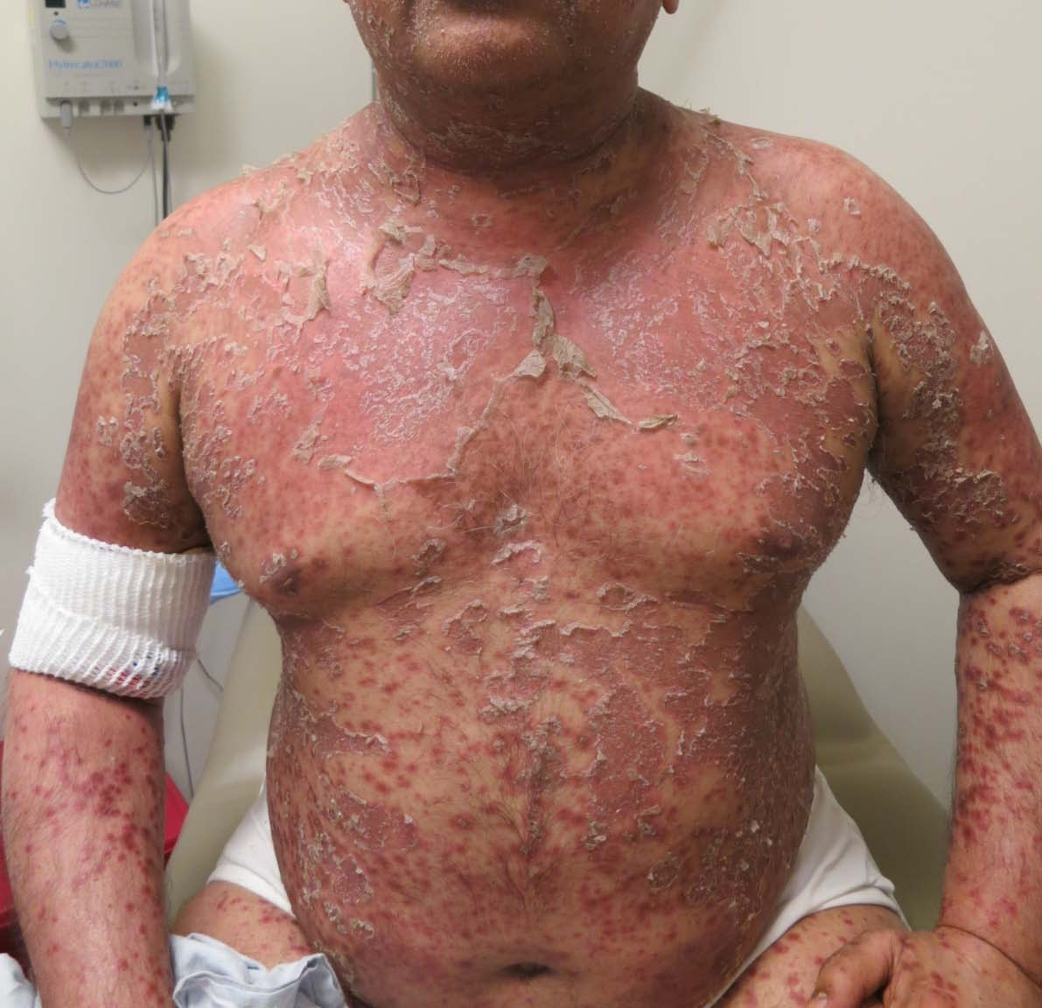
ACUTE GRAFT VERSUS HOST DISEASE occuring after HSCT
Skin
Multiple bullae and areas of denuded epidermis are present.

Slide 28
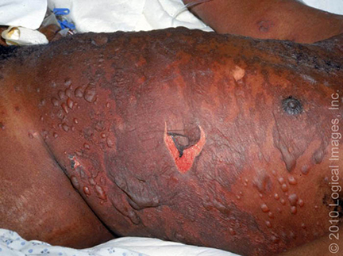
ACUTE GRAFT VERSUS HOST DISEASE occuring after HSCT
Skin
Toxic epidermal necrolysis
In severe GVHD, the maculopapular rash forms bullous lesions with toxic epidermal necrolysis mimicking Stevens-Johnson syndrome

Slide 29
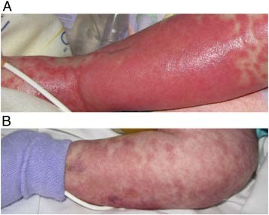
ACUTE GRAFT VERSUS HOST DISEASE occuring after HSCT
Skin

Slide 30
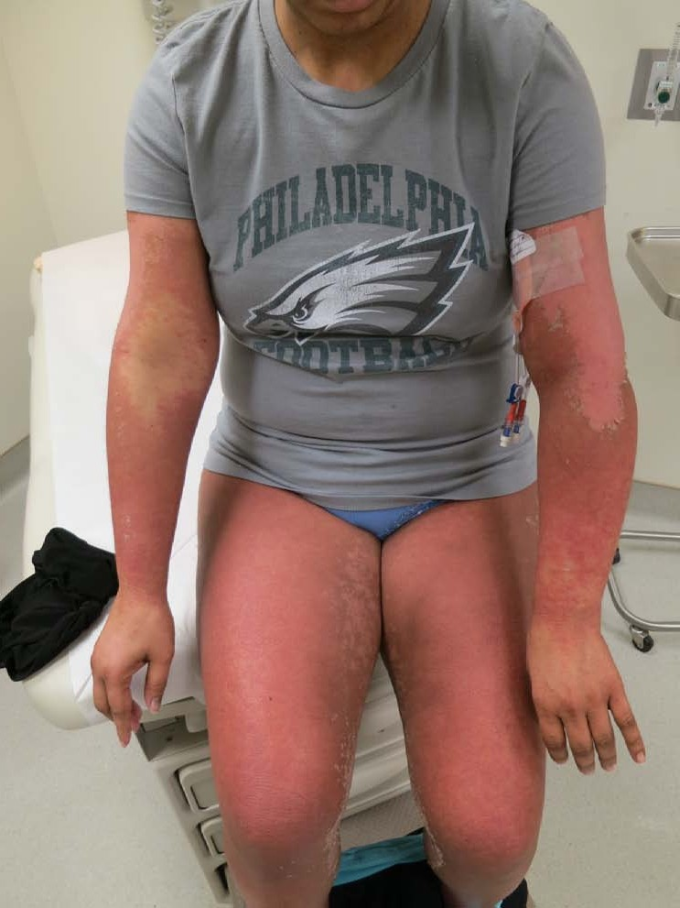
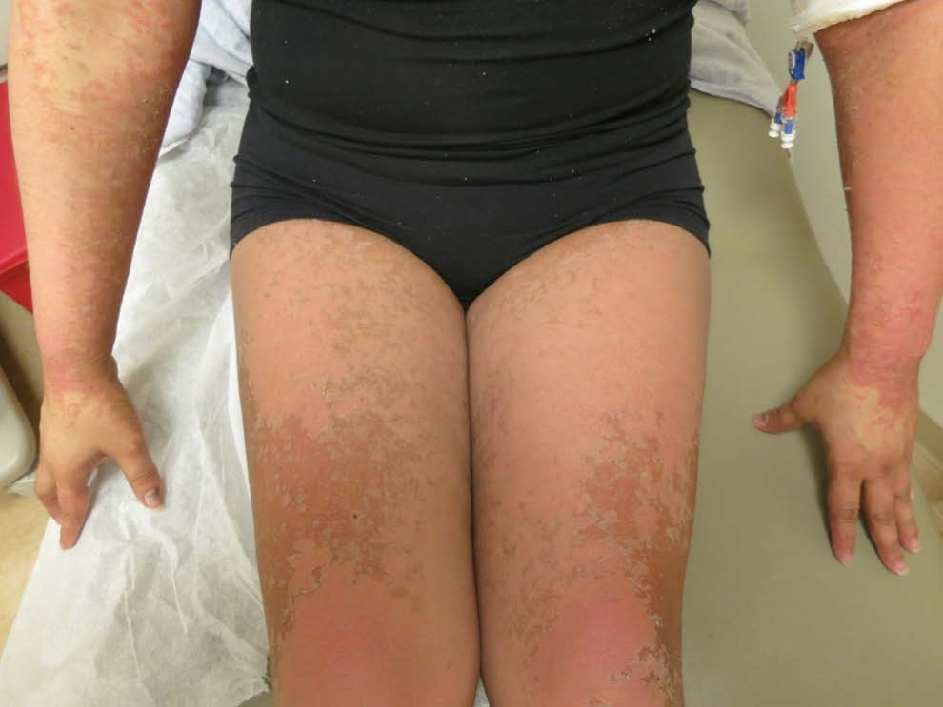
ACUTE GRAFT VERSUS HOST DISEASE occuring after HSCT
Skin

Slide 31
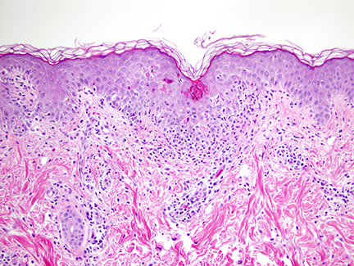
Histologic examination
ACUTE GRAFT VERSUS HOST DISEASE occuring after HSCT
Characteristic findings include exocytosed lymphocytes, dyskeratotic epidermal keratinocytes, follicular involvement, satellite lymphocytes adjacent to or surrounding dyskeratotic epidermal keratinocytes, and dermal perivascular lymphocytic infiltration
Apoptotic keratinocytes in the epidermis, vacuolization of the basal layer, and lymphocyte exocytosis are present in this specimen of histologic grade 2 acute graft-versus-host disease. A lymphocytic infiltrate at the dermal-epidermal junction and surrounding blood vessels is also present.
Notes:
Histologic examination of the skin reveals changes in the dermal and epidermal layers

Slide 32
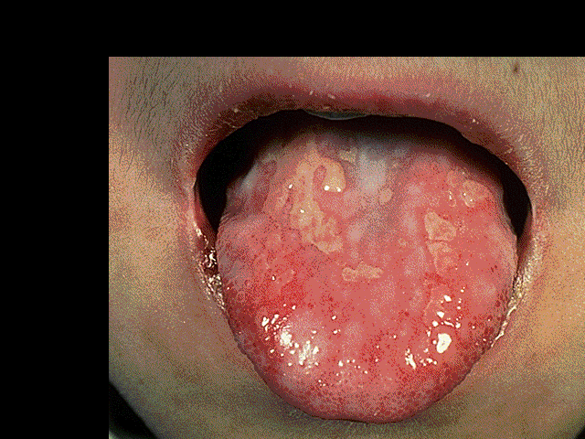
ACUTE GRAFT VERSUS HOST DISEASE occuring after HSCT
Acute GvHD: GIT
Approximately 50% of cases
Nausea, vomiting and anorexia
Watery diarrhoea (typically green) and
abdo cramps progressing to ileus and bloody diarrhoea
Differential diagnosis:
  Chemotherapy/radiation, medications, infections

Slide 33
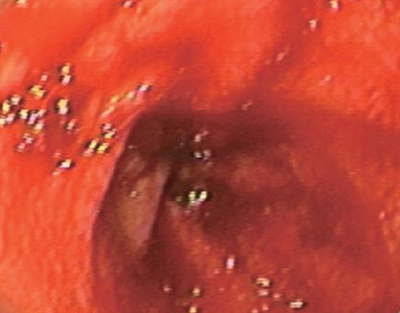
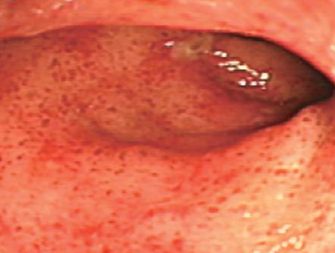
ACUTE GRAFT VERSUS HOST DISEASE occuring after HSCT
Acute GvHD: GIT
Endoscopy: patchy ulceration
CT scan: luminal dilatation with thickening of small bowel wall (ribbon sign), may have fluid levels

Slide 34
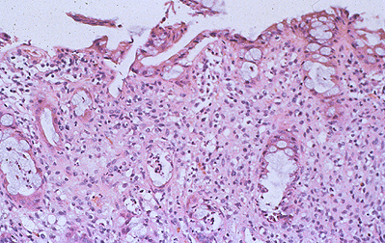
Histologic examination
ACUTE GRAFT VERSUS HOST DISEASE occuring after HSCT
Pathology: apoptotic bodies in base of crypts, crypt abscesses, loss and flattening of surface epithelium
Rectal biopsy in a patient with acute graft-versus-host disease (GVHD) shows crypt cell necrosis with the accumulation of degenerative material in the dead crypts.
Notes:
Apoptosis at base of
epidermal rete pegs
Dyskeratosis with adjacent satellite lymphocytes
Perivascular lymphocytic infiltration in the dermis.

Slide 35
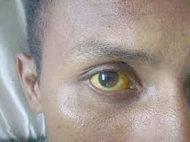
ACUTE GRAFT VERSUS HOST DISEASE occuring after HSCT
Acute GvHD: Liver
Approximately 50% of cases
Cholestatic hyperbilirubinaemia
  Increased bilirubin,
  alkaline phosphatase
  Transaminitis less common
Differential diagnosis:
Difficult to distinguish from other causes of hepatic toxicity i.e. veno-occlusive disease, drugs, viral infections, sepsis, iron overload

Slide 36
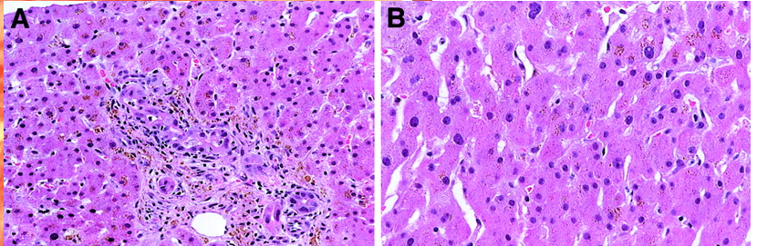
ACUTE GRAFT VERSUS HOST DISEASE occuring after HSCT
Acute GvHD: Liver
Biopsy often not performed because of concurrent thrombocytopenia
Pathology: endothelialitis, lymphocytic infiltrate of portal areas, pericholangitis, bile duct destruction
Characteristic histology of classical liver GVHD with bile duct lymphocytic infiltrates and injury. (A) Portal lymphocytic inflammation is also present. (B)

Slide 37
Grading of Acute Skin GVHD
ACUTE GRAFT VERSUS HOST DISEASE occuring after HSCT
Grade | Description
I | Rash <25% of body
II | Rash 25% – 50% of body
III | Generalized erythroderma or rash >50% of body
IV | Bullae formation and/or with desquamation

Slide 38
Grading of Acute Liver GVHD
ACUTE GRAFT VERSUS HOST DISEASE occuring after HSCT
Grade | Description
I | Bilirubin 2-3 mg/dL
II | Bilirubin 3.1-6 mg/dL
III | Bilirubin 6.1 – 15 mg/dL
IV | Bilirubin > 15 mg/dL

Slide 39
Grading of Acute Gut GVHD
ACUTE GRAFT VERSUS HOST DISEASE occuring after HSCT
Grade | Description
I | Diarrhea 500-1000 ml/day (or persistent nausea, vomiting or anorexia with biopsy proven upper GI involvement)
II | Diarrhea 1000 - 1500 ml/day
III | Diarrhea > 1500 mL/day
IV | Severe abdominal pain (w/o) ileus or stool with frank blood

Slide 40
Overall Grade (Stage) of Acute GVHD
ACUTE GRAFT VERSUS HOST DISEASE occuring after HSCT
Stage | Skin | Liver | Gut
I | I-II | None | None
II | III | I or | I
III |  | II-III or | II-IV
IV | IV | IV
5 year survival
O. Grade III: 40 %
O. Grade IV: 20 %

Slide 41
ACUTE GRAFT VERSUS HOST DISEASE occuring after HSCT
Acute GvHD: Risk Factors
Degree of (HLA) mismatch
  HLA-A, -B, -C, and –DRB
Gender disparity and donor parity
  Female to male
  Multiparity ➔ Maternal allo-immunization
Age of donor and recipient
Intensity of conditioning regimen
  Reduce intensity vs. myeloablative
Source of graft
      Peripheral blood vs. marrow vs. cord
CMV seropositivity

Slide 42
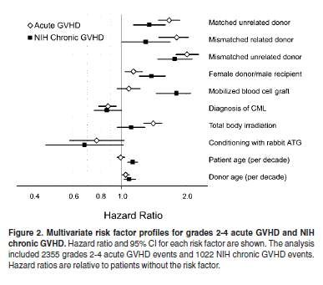
ACUTE GRAFT VERSUS HOST DISEASE occuring after HSCT
Risk factors for aGvHD
Flowers et al, Blood, 2011

Slide 43
Acute GvHD: Prevention and treatment
ACUTE GRAFT VERSUS HOST DISEASE occuring after HSCT
Prophylaxis REGIMENS:
  Calcineurin inhibitor (Cyclosporine/Tacrolimus) + MTX
  Tacrolimus + Sirolimus is another frequently used combination
    Randomized study showed comparable efficacy to Tacro/Siro
  Cellcept-based regimen
  Post-transplant Cytoxan
    Unique for haploidentical HCT
  The addition of mini-dose ATG & Velcade & MTX,
    Mismatch cases with lower likelihood of relapse
Notes:
Pharmacological
Immunosuppression
Corticosteroids
Methotrexate
Inhibition of cytoplasmic calcineurine (enzyme involved in T-cell
activation)
Cyclosporine
Tacrolimus (FK506)
Mycophenylate mofetil
Active compound, mycophenolic acid, Inhibits inosine monophosphate dehydrogenase (enzyme essential to de novo synthesis of guanosine nucleotides) and terminates DNA synthesis
Sirolimus (binds to FKBP12) can be used in combination with FK506
Vorinostat (histone deacetylase inhibitor)
Immunological and Cellular
Antithymocyte globulin (ATG, ALG)
Monoclonal antibodies
CD20: rituximab
CD52: alemtuzamab (Campath)
CD2: alefacept (Blocks CD3-LFA3 interaction)
CD3: OKT3, visilizumab
CD147: ABX-CBL
TNF: infliximab, etanercept, adalimumab, certolizumab
IL2/IL2R (CD25): dacluzamab, inolimomab, basiliximab, denileukin diftitox
Extracorporeal photophoresis
Cellular
T-cell depletion
Mesenchymal stem cells
T-regulatory cells
Suicide gene therapy of donor T-cells

Slide 44
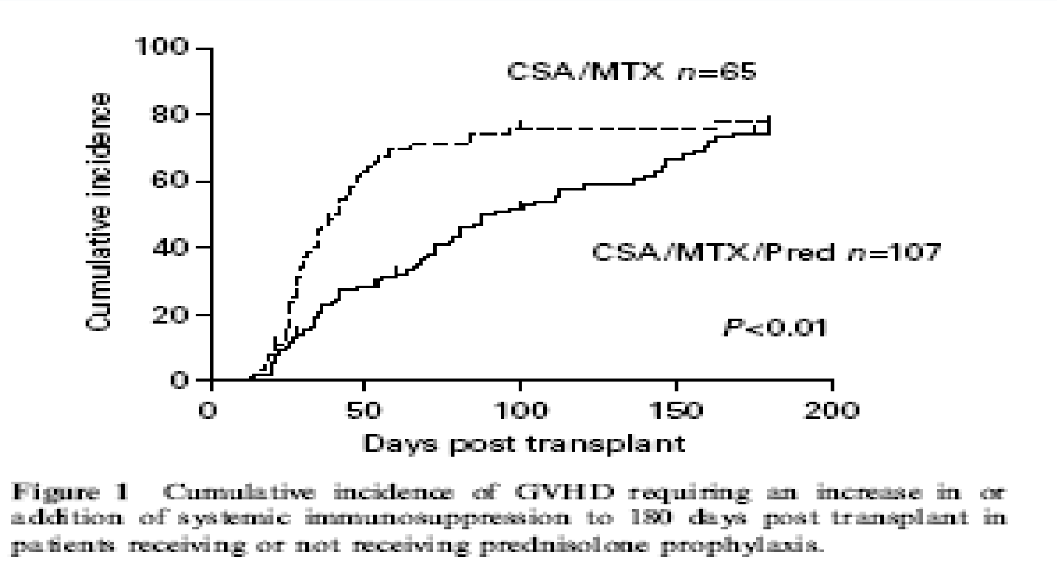
Acute GvHD: Prevention
ACUTE GRAFT VERSUS HOST DISEASE occuring after HSCT
Hoyt et al, BMT 2008

Slide 45
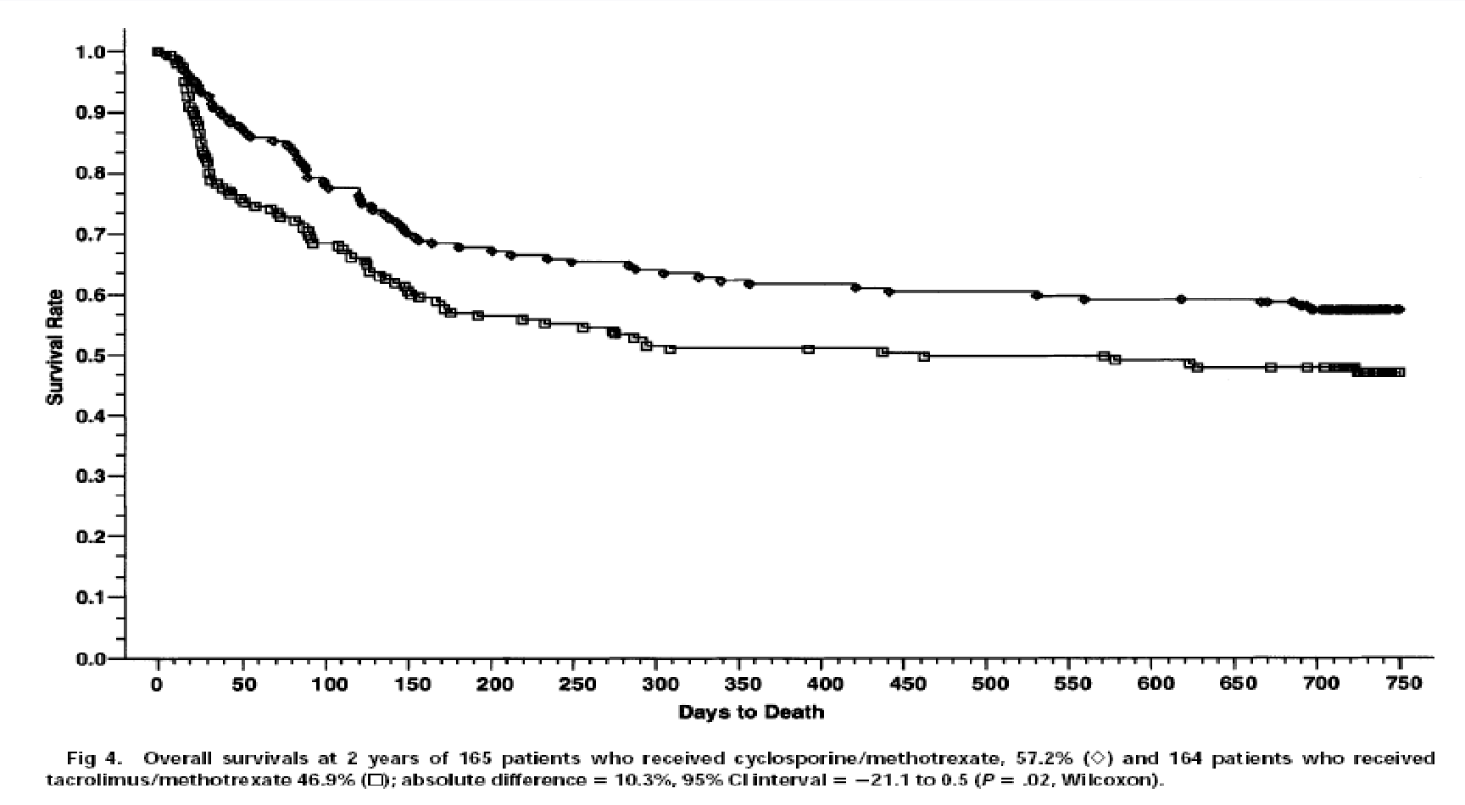
Acute GvHD: Prevention
ACUTE GRAFT VERSUS HOST DISEASE occuring after HSCT
Phase III trial CsA + MTX / FK506 + MTX in sibling transplants
Ratanatharathorn et al Blood 1998
CsA/MTX n=165 FK506/MTX n=164

Slide 46
Acute GvHD: Unrelated transplants
ACUTE GRAFT VERSUS HOST DISEASE occuring after HSCT
Parameter | CsA-MTX-ATG % N=103 | CsA-MTX % N-98 | P value
aGvHD > I | 33 | 51 | 0.01
aGvHD > II | 12 | 24.5 | 0.054
Any cGvHD | 31 | 59 | <0.0001
Ext CGvHD | 12 | 43 | <0.0001
100d TRM | 11 | 13 | NS
2yr TRM | 20 | 29 | NS
2yr relapse | 29 | 24 | NS
2yr DFS | 52 | 48 | NS
Finke et al, Lancet Oncology 2009 10: 855-864

Slide 47
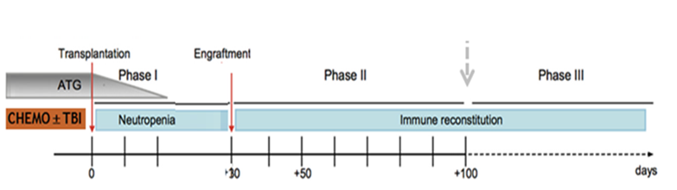
Acute GvHD: Prevention and treatment
ACUTE GRAFT VERSUS HOST DISEASE occuring after HSCT
DURATION:
  Started before day 0
  Continue for at least 3-6 months:
    Depends on donor source
      Risk of disease relapse
        Occurrence of GVHD
Notes:
Pharmacological
Immunosuppression
Corticosteroids
Methotrexate
Inhibition of cytoplasmic calcineurine (enzyme involved in T-cell
activation)
Cyclosporine
Tacrolimus (FK506)
Mycophenylate mofetil
Active compound, mycophenolic acid, Inhibits inosine monophosphate dehydrogenase (enzyme essential to de novo synthesis of guanosine nucleotides) and terminates DNA synthesis
Sirolimus (binds to FKBP12) can be used in combination with FK506
Vorinostat (histone deacetylase inhibitor)
Immunological and Cellular
Antithymocyte globulin (ATG, ALG)
Monoclonal antibodies
CD20: rituximab
CD52: alemtuzamab (Campath)
CD2: alefacept (Blocks CD3-LFA3 interaction)
CD3: OKT3, visilizumab
CD147: ABX-CBL
TNF: infliximab, etanercept, adalimumab, certolizumab
IL2/IL2R (CD25): dacluzamab, inolimomab, basiliximab, denileukin diftitox
Extracorporeal photophoresis
Cellular
T-cell depletion
Mesenchymal stem cells
T-regulatory cells
Suicide gene therapy of donor T-cells

Slide 48
Acute GVHD Treatment
ACUTE GRAFT VERSUS HOST DISEASE occuring after HSCT
Initiated once GVHD is suspected or confirmed
Corticosteroid remains the standard first line therapy
  Randomized studies failed to show benefit of combining other agents
  Starting M. Pred. dose 1-2mg/Kg
    10mg/kg was not superior to 2mg/kg
    1mg/kg might be enough for grade II disease
Notes:
Gold standard is cyclosporine and methotrexate
CsA/MTX and FK506/MTX better than CsA alone
No benefit in adding corticosteroid
FK506/MTX may be better than CsA/MTX
BMT-CTN completing a study on Sirolimus plus FK506 vs FK506/MTX
Decreased incidence with ATG

Slide 49
Acute GVHD Treatment
ACUTE GRAFT VERSUS HOST DISEASE occuring after HSCT
Grade I skin GVHD
  Managed with topical therapy + optimizing immunosuppression levels
Non-absorbable steroid are very useful adjuvant therapy in GI GVHD
Survival correlates directly with the response to initial therapy
Notes:
Gold standard is cyclosporine and methotrexate
CsA/MTX and FK506/MTX better than CsA alone
No benefit in adding corticosteroid
FK506/MTX may be better than CsA/MTX
BMT-CTN completing a study on Sirolimus plus FK506 vs FK506/MTX
Decreased incidence with ATG

Slide 50
Salvage Therapy for Steroid Resistant aGVHD
ACUTE GRAFT VERSUS HOST DISEASE occuring after HSCT
Cellcept (Mycofenelat Mofetil, MMF)
Extracorporeal photopheresis (ECP)
Anti-TNF antibodies-
  Infliximab, Etanercept
  Infliximab: Begin gtt within 3 hrs from preparation, and infuse at least over 2hrs. Risk of hypersensitivity rxn. Monitor vital signs closely
IL2 inhibitors-
  Basiliximab
  Hypersensitivity rxn, monitor vital sign
Nucleoside analogues- Pentostatin
  Infuse over 15 mins, and pre-infusion hydration is given usually
m-TOR inhibitor-
  Sirolimus
Rituximab
  Infused over 4 hrs, and associated with risk of hypersensitivity reaction

Slide 51
Topical Agents for Cutaneous GVHD
ACUTE GRAFT VERSUS HOST DISEASE occuring after HSCT
Topical Steroids
  Different potency
  Triamcinolone acetone 0.1% cream
    Apply twice daily
    Do not use on face
Calcineurin inhibitors:
  Tacrolimus cream 0.03% or 0.1%
    Apply twice daily

Slide 52
Refractory aGVHD
ACUTE GRAFT VERSUS HOST DISEASE occuring after HSCT
Steroid refractory defined as
  GVHD progression after 3 days of therapy
  No improvement in 1 week of therapy
  No resolution in 2 weeks of therapy
Second-line treatment characterized by
High failure rate
Significant toxicities
Poor survival
No standard of care for second or beyond therapy
  No data for efficacy for one regimen over another

Slide 53
Nursing Management :Acute GVHD
ACUTE GRAFT VERSUS HOST DISEASE occuring after HSCT
Skin
Skin cleansing
Moisturize skin/Avoid drying lotions
Topical antihistamines
Topical steroids
Analgesics
Maintain mobility with passive range of motion (ROM)
Educate patient to avoid sun exposure and dehydration

Slide 54
Nursing Management: Acute GVHD
ACUTE GRAFT VERSUS HOST DISEASE occuring after HSCT
Gut
Maintain fluid and electrolyte balance
Sitz baths for comfort
Prevent rectal fissures
Administer platelets as needed/ordered
Nutritional support
Protective barrier on rectal area

Slide 55
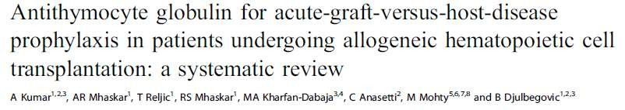
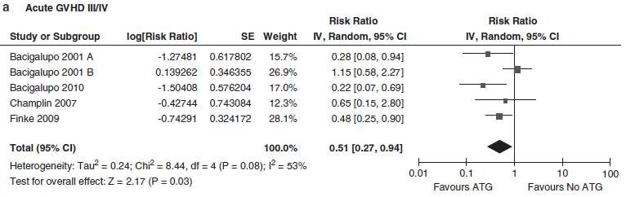
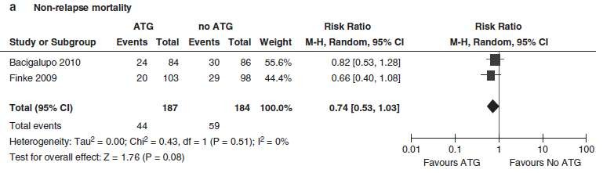
Kumar et al., Leukemia 2012

Slide 56
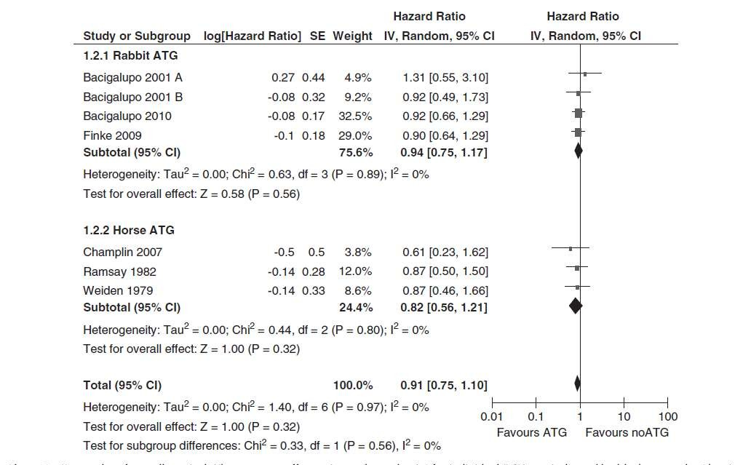
Overall survival
ACUTE GRAFT VERSUS HOST DISEASE occuring after HSCT
Kumar et al., Leukemia 2012

Slide 57
Acute GvHD: Prevention
ACUTE GRAFT VERSUS HOST DISEASE occuring after HSCT
SUMMARY
Gold standard is cyclosporine and methotrexate
  CsA/MTX and FK506/MTX better than CsA alone
  No benefit in adding corticosteroid
  CsA/MTX also may be better than FK506/MTX
  Decreased incidence with ATG but little or no change in outcome
Side effects
  Metabolic (low Mg, increased K, increased bilirubin)
  Hypertension, nephrotoxicity
  Neurological (altered mental state, seizures, classical signs on MRI)
  Transplant associated thrombotic thrombocytopenic purpura (TTP) – does not respond to plasmapheresis
Mandatory monitoring of drug levels

Slide 58
Acute GvHD: Treatment
ACUTE GRAFT VERSUS HOST DISEASE occuring after HSCT
SUMMARY
Grade I skin disease may be controlled with topical steroids alone
For GvHD > grade I, gold standard is corticosteroid
  2mg/kg methylprednisolone
  Several studies show no benefit in increasing dose
  One study of steroid plus etanercept showed 70% resolution in one month
Steroid refractory aGvHD
  ATG
  MoAbs
  MSC
  ECP
  Ruxolitinib
Supportive care is critical: antimicrobial prophylaxis, management of hyperglycaemia, antibody replacement, manage cytopenias

Slide 59
Acute GvHD: 2nd line treatment
ACUTE GRAFT VERSUS HOST DISEASE occuring after HSCT
Treatment | Response | Survival
ATG | 51% | 35%
Anti-IL2R | 40-70% | <30%
Anti-TNF | 67% | 38%
CsA to tacro | 10%
Tacro + ATG |  | 35%
MMF | 40% | 16% - 37%
Pentostatin | 50% | 26%
OKT3 | 50% | 45%

Slide 60
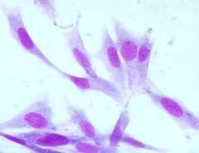




Acute GvHD: 3nd line treatment - MSC
ACUTE GRAFT VERSUS HOST DISEASE occuring after HSCT
Derived from bone
marrow stroma
Exhibit immunosuppressive properties
Non-HLA restricted
Progenitors
Bone
Chondrocytes
Adipocyte
Muscle

Slide 61
Acute GvHD: 3nd line treatment - MSC
ACUTE GRAFT VERSUS HOST DISEASE occuring after HSCT
Response rates | N = 55
Overall response | 71%
Complete response | 54%
Le Blanc et al, Lancet 2008
Response rates | N = 50
Overall response | 66%
Complete response | 34%
Resnick et al Am J Blood Res, 2013
Response rates | N = 37
Overall response | 78%
Complete response | 65%
Ball et al Brit J Haem, 2013
Response rates at 28 days | N = 40
Overall response | 67.5%
Complete response | 27.5%
Introna et al, BBMT2014

Slide 62
CHRONIC GRAFT VERSUS
HOST DİSEASE
cGvHD is an immunoregulatory disorder occurring
after allogeneic HSCT and shares features of autoimmunity and immunodeficiency.
The cGVHD resemble other autoimmune diseases such as Sjögren syndrome, scleroderma, primary biliary cirrhosis and immuncytopenias

Slide 63
The NIH consensus;
recognized 2 main categories of GVHD, each with 2 subcategories.
similar syndrome occurs beyond day 100,
known as late onset acute GvHD
particularly after RICT and DLI
Notes:
The NIH consensus conference recognized 2 main categories of GVHD, each with 2 subcategories. The broad category of acute GVHD includes classic acute GVHD (maculopapular erythematous rash, gastrointestinal symptoms, or cholestatic hepatitis) and also includes persistent, recurrent, or late-onset acute GVHD occurring more than 100 days after transplantation. The broad category of chronic GVHD includes classic chronic GVHD, presenting with manifestations that can be ascribed only to chronic GVHD. Chronic GVHD also includes an overlap syndrome, which has diagnostic or distinctive chronic GVHD manifestations together with features typical of acute GVHD

Slide 64
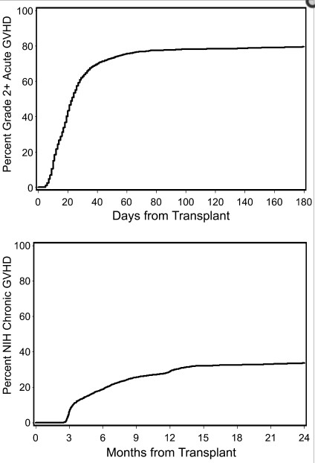
When Does It Occur?
Flowers, M et al Blood. 2011 March 17;
117(11): 3214–3219.

Slide 65
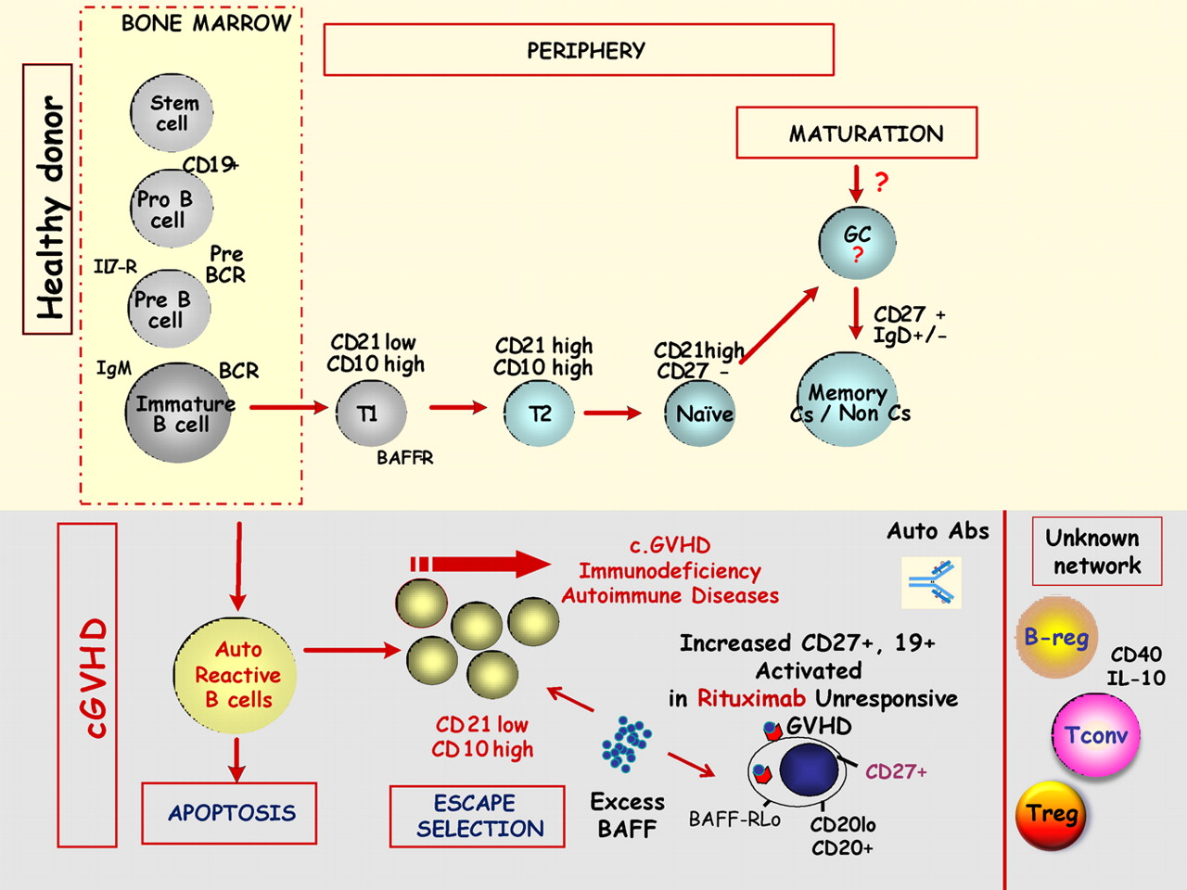

B-cell homeostasis in chronic GVHD. The top part of the figure schematizes the physiologic B-cell maturation from bone marrow to the peripheral blood of main B-cell subsets.
Gérard Socié Blood 2011;117:2086-2087
Notes:
B-cell homeostasis in chronic GVHD. The top part of the figure schematizes the physiologic B-cell maturation from bone marrow to the peripheral blood of main B-cell subsets. BCR indicates B-cell receptor; Il7-R, interleukin 7 receptor; T1, transitional 1 B cell; T2, transitional 2 B cell; Cs, class switch; and GC, germinal center. The bottom part of the figure schematizes the current knowledge of these B-cell subsets in the pathophysiology of chronic GVHD. Breg indicates B regulatory cells; Treg, T regulatory cells; Tconv, conventional T cells; and BAFF, B cell activation factor.

Slide 66
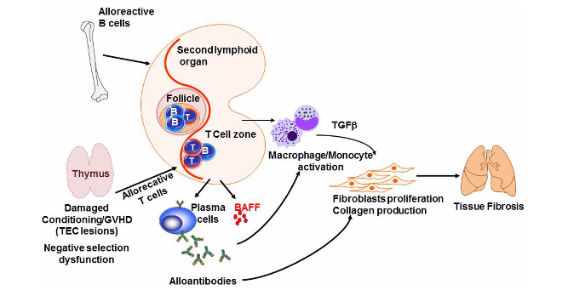
The pathophysiology
Gérard Socié, and Jerome Ritz Blood 2014;124:374-38
Notes:
Pathogenesis of chronic GVHD The thymic epithelial cells (TECs) are damaged by alloreactive T-cells leading to impaired negative selection. In addition, alloreactive B- and T-cells cross talk leading to sBAFF release and production of alloantibodies by plasma cells. At the same time, cytokines and chemokines produced by B- and T-cells activate macrophagesand monocytes. Together, antibodies and TGFβ induce fibroblasts proliferation and activation as well as collagen production, which results in fibrosis intarget organs such as the lung
The pathophysiology of chronic GVHD. (A) General mechanisms. The acute graft-versus-host reaction is characterized by tissue damage mediated by inflammatory mediators, T cells, and cells from the innate immune system. Among target organs, two are particularly important for the development of subsequent chronic GVHD: (1) thymic epithelial cells (TECs) are damaged by alloreactive T cells leading to decreased generation of natural Tregs and release of self-reactive T cells. (2) Bone marrow microenvironment damage may explain disturbed B-cell homeostasis. The potent role of antigen-presenting cells (APCs) and the cross talk between B and T cells in chronic GVHD is poorly understood. (B) B cells and chronic GVHD. Patients with chronic GVHD have increased B-cell activation factor (BAFF):B-cell ratios, delayed reconstitution of naive B cells, and increased numbers of pregerminal center B cells. Patients with active chronic GVHD have elevated numbers of CD21– transitional B cells and a deficiency of memory CD27⁺ B cells. Patients who develop chronic GVHD have elevated levels of BAFF, a relative reduction in naive B cells, and relatively higher numbers of activated memory type B cells. Patients with hypogammaglobulinemia have elevated CD19⁺CD21^{low} (immature) and CD19⁺CD21^{high}CD38^{high}IgM^{high} (transitional) B cells. CD19⁺CD10–CD27–CD21^{high} naive B cells are elevated in all patients with chronic GVHD. (C) Conventional T cells, Tregs, and chronic GVHD. An appropriate balance between Tregs and Tconv is critical for the maintenance of peripheral tolerance. In the setting of allogeneic HSCT, Tregs have been shown to play an important role in the establishment of tolerance between recipient tissues and donor-derived immunity. Monitoring of CD4⁺ T-cell subsets shows that Tregs rapidly expand after HSCT, but Treg levels subsequently decline in patients with prolonged CD4⁺ lymphopenia. This results in a relative deficiency of Tregs, which is associated with a high incidence of extensive chronic GVHD. In chronic lichenoid GVHD, a mixed Th1/Th17 signature with upregulated Th1/Th17 cytokine/chemokine transcripts and elevated numbers of interferon gamma (IFN-γ)– and IL-17–producing CD8⁺ T cells has been described. (D) Current issues in chronic GVHD pathophysiology. The hallmark of chronic GVHD is inflammatory fibrosis; putative mechanisms are described in the left part of the figure. Although a role of B- and T-cell subsets has been described, the cross talk between B and T cells is not well understood. Recent evidence from an experimental model suggests that a key player might be the T-follicular helper (TfH) cells. ICOS, inducible costimulatory [molecule]; NK, natural killer [cell]; TGFβ, transforming growth factor beta; TNFα, tumor necrosis factor alpha.

Slide 67
Epidemiology
Most serious and common long-term complication
of allogeneic transplantation
  Occurs in 30-40 % of patients surviving >100 days
  30% (young, with sibling donors) to
  70% (older, unrelated donors)
Median time to development is 4-6 months after transplant
50% have 3 or more involved organs/tissues
On average therapy is required for 2-3 years

Slide 68
Risk factors
Increased incidence due to:
Mismatched donor
History of acute GVHD
Older recipient age
Use of peripheral blood as stem cell source
Donor lymphocytes Infusion for relaps
  Similar factors for acute GVHD
Flowers, M et al Blood. 2011 March 17; 117(11): 3214–3219.
32
Notes:
A study from Seattle showed that the higher the degree of HLA disparity, the earlier the onset of symptoms, with a median of 201 days in HLA identical siblings, and 133 days in matched unrelated donors transplanted with bone marrow and after standard conditioning (18).
The most frequently involved sites of the clinical manifestations of 324 pts were the mouth (89%), skin (81%), gastrointestinal tract (48%), liver (47%), eyes (47%).
The disease started with a quiescent onset (followed acute GvHD with a remission period) in 60%, with a progressive onset (cGvHD transformed from acute) in 13%, and with de novo onset (no prior acute GvHD) in 27% of the cases.

Slide 69

Poor Prognostic Signs
  Persistent severe thrombocytopenia
  Lichenoid changes on skin histology
  Serum bilirubin >1.2 mg/dl
  Progressive onset from acute to chronic
  Karnofsky performance <70%
15% still require therapy 7+ years after diagnosis
Notes:
There are no laboratory markers to predict the severity and morbidity of cGVHD.

Slide 70
Hematopoietic and Immune System:
Although not diagnostic, patients with chronic GVHD commonly have laboratory abnormalities reflecting changes in the hematopoietic and immune systems. These findings include
Thrombocytopenia,
Eosinophilia,
Lymphopenia,
Hypo/hypergammaglobulinemia, and
Autoantibodies.
While the etiology of these findings is not entirely clear, myelosuppression in patients with GVHD appears to be at least partially related to damage of the bone marrow niche by infiltrative T cells from the graft .
Notes:
cGVHD as a disease process is immunosuppressive, and the treatment is further immunosuppressive. The combination acts as a double-edged sword in that both the disease and the treatment further compromise the patient’s ability to fight infection.
The combination results in functional asplenia (poor splenic function), variable IgG levels, opportunistic infections, cytopenia (thrombocytopenia and lymphocytopenia), and eosinophilia and place the patient at high risk for infection.
Immune recovery is slower for those people affected by cGVHD.
The cytopenias seen in cGVHD can be isolated (platelets: single cell line) or in multiple lines (neutrophils and platelets).
A complete blood cell count with differential will usually demonstrate eosinophilia.
A bone marrow examination may be needed to show if the problem is due to graft failure, relapse, or an immune process.

Slide 71
Immune System:
Chronic GVHD is immunosuppressive, and cGVHD
treatment is further immunosuppressive, resulting in
  Functional asplenia
  Variable immunoglobulin G (IgG) levels
  Opportunistic infections
  Cytopenia (thrombocytopenia)
Notes:
cGVHD as a disease process is immunosuppressive, and the treatment is further immunosuppressive. The combination acts as a double-edged sword in that both the disease and the treatment further compromise the patient’s ability to fight infection.
The combination results in functional asplenia (poor splenic function), variable IgG levels, opportunistic infections, cytopenia (thrombocytopenia and lymphocytopenia), and eosinophilia and place the patient at high risk for infection.
Immune recovery is slower for those people affected by cGVHD.
The cytopenias seen in cGVHD can be isolated (platelets: single cell line) or in multiple lines (neutrophils and platelets).
A complete blood cell count with differential will usually demonstrate eosinophilia.
A bone marrow examination may be needed to show if the problem is due to graft failure, relapse, or an immune process.

Slide 72
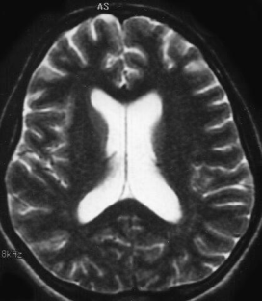
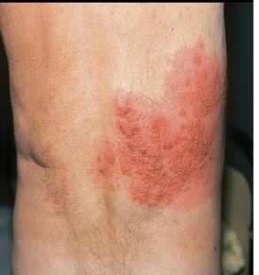
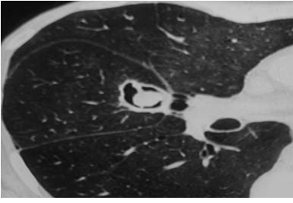
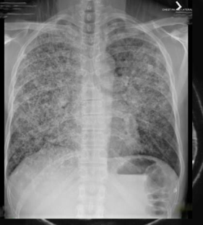
Late Infections with cGVHD
Increased risk for infections in patients with delayed immune reconstitution (e.g., chronic GVHD, prolonged steroid exposure)
  Encapsulated bacteria
  CMV, VZV
  Aspergillus, PCP
International consensus guidelines for prevention of
early and late infections published in 2009
  Recommendations for vaccinations in transplant recipients
meningitis
shingles
mold İnf.
pneumonia
M Tomblyn et al, Biol Blood Marrow Transplant, 2009, 15, 1143 M Tomblyn et al, Bone Marrow Transplant, 2009, 44, 521

Slide 73
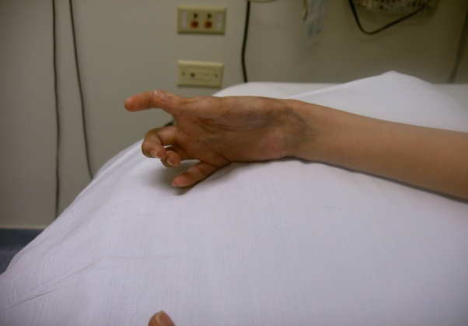
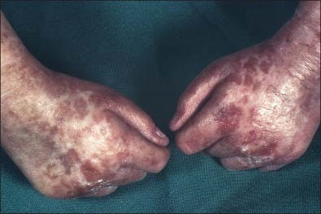
Target Organs
The presenting symptoms are in some ways similar to those found in other well-established autoimmune syndromes.
However, in chronic GVHD, there is not a uniform presentation, but rather a variable involvement of these and other organs.
Skin- 67 percent
Oral- 60 percent
Ocular- 48 percent
Hepatic- 52 percent
Pulmonary- 50 percent
Gastrointestinal (GI)- 30 percent
Gynecological- 12 percent
Musculoskeletal- 48 percent
Immunologic- 50 percent
Arai S et al Blood. 2011 Oct 13;118(15):4242-9.

Slide 74
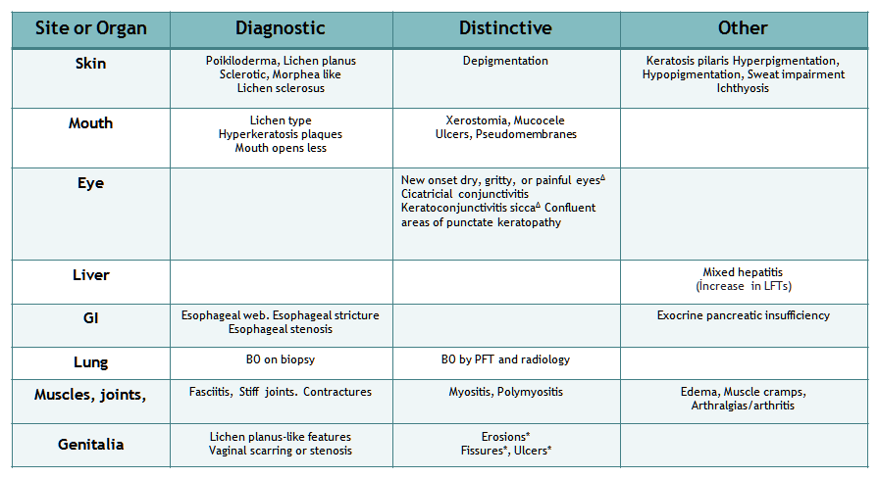
Diagnosis with NIH Classification &
Diagnostic (sufficient to establish the diagnosis of chronic GVHD)
Distinctive (seen in chronic GVHD, but insufficient alone to establish a diagnosis)
Notes:
cGVHD is defined by the presence of at least one distinctive manifestation with support by histologic, radiologic, or laboratory evidence or diagnostic clinical sign of cGVHD without the features of aGVHD overlap syndrome where there are features of aGVHD and cGVHD present
There is no time limit after stem cell transplant for the diagnosis of any clinical features
The differential diagnosis must be ruled out for each system affected
Clinical score of 0 to 3 for involved sites/organs
Here are a few examples of diagnostic signs versus distinctive symptoms taken from Filipovich, A. H., Weisdorf, D., Pavletic, S., Socie, G., Wingard, J. R., Lee, S. J., et al. (2005). National Institutes of Health consensus development project on criteria for clinical trials in chronic graft-versus-host disease: I. Diagnosis and staging working group report. Biology of Blood and Marrow Transplantation , 11(12), 948. Reprinted with permission of Elsevier.

Slide 75



Skin Manifestations
Most commonly involved organ
Inflammatory changes cause
Poikiloderma-like features
Lichen planus-like features
Sclerotic features
Morphea-like features
Lichen sclerosis-like features
Skin lichen planus lesions with shiny and violaceous papules of the back.
Notes:
The skin is the most frequently involved organ system in cGVHD. There are two types of involvement: sclerodermatous (comparable to scleroderma) and lichenoid (similar to lichen planus).
Initially, the skin may be erythematous, with plaques and areas of desquamation, which can progress to skin that is hyper- or hypopigmented with tightening (hide-like skin) and atrophy. Joint contractures may result secondary to the fibrotic thickening and sclerodermatous changes. The distribution of skin cGVHD is not the typical allocation seen with acute involvement. Other clinical presentations include atrophy of the skin with pigmentation, changes of the fingernails with vertical ridging, and alopecia. Skin previously involved with aGVHD or herpes zoster is usually more susceptible to cGVHD.

Slide 76

a. Poikiloderma
A combination of atrophy, hypopigmentation, and hyperpigmentation in the skin usually appearing as patches with mottled pigmentation and telangiectasias

Slide 77

a. Poikiloderma
multicolor epidermal atrophy, red, brown, hypopigmented skin:
Notes:
This slide depicts cGVHD.
The upper left photo depicts hypopigmentation of the buttock area with cGVHD.
The right upper photo portrays a child with sclerodermatous and lichenoid skin involvement (arrow) as a result of cGVHD.
The lower head pho
to demonstrates lichenoid changes with both hypo- and hyperpigmentation of the head, neck, and shoulders.
Lichenoid changes
Erythematous raised papular skin rash
May present with only dryness,
hypo- or hyperpigmentation

Slide 78

b. Lichen planus
Erythematous to violaceous papules or plaques with a predilection for the dorsal hands and feet, forearms, and trunk.
Notes:
Lichenoid changes
Erythematous raised papular skin rash
May present with only dryness,
hypo- or hyperpigmentation

Slide 79

b. Lichen planus
Erythematous to violaceous papules or plaques with a predilection for the forearms.

Slide 80

c. Sclerosis
A cellulite-like rippled appearance of the skin due to thickening of the fibrous septae within fat, particularly on the medial arms and thighs

Slide 81

c. Sclerosis
A cellulite-like rippled appearance of the skin due to thickening of the fibrous septae within fat
Severe sclerosis with blister formation

Slide 82


c. Sclerosis
Severe sclerosis & fibrotic thickening
Notes:
I. Sclerodermatous presentation
Leads to contractures and nerve compression

Slide 83


c. Sclerosis
Take note of the atrophy of the skin with nodular appearance of the thighs and calves in these photos. Also present in the pictures are hypo- and hyperpigmentation with hide-like skin.
sclerodermatous skin involvement.

Slide 84


3. Sclerotic lesions
Notes:
To evaluate the skin, you must feel and move it. When you look at the chest, it may appear to have old GVHD signs of hypo/hyperpigmentation. When you feel the skin, you will see that there are areas of thickening and it is difficult to pinch or move the skin.

Slide 85

d. Morphea-like Lesions
Firm, hyperpigmented, hypopigmented, or skin-colored plaques. Affected skin often has a shiny appearance and demonstrates hair loss secondary to elimination of adnexal structures.

Slide 86

e. Lichen sclerosis-like features
A dermatosis characterized by epidermal atrophy and superficial dermal fibrosis

Slide 87

e. Lichen sclerosis-like features
Dry scaling shiny skin, may have some cigarette paper wrinkling of skin: lichen sclerosus

Slide 88

e. Lichen sclerosis-like features

Slide 89



Skin & appendages
Sign and Sypmtoms In advanced cases
Scalp alopecia, loss of body hair,
Sclerosis provokes functional impairment with severe joint contractures.
Nail dystrophy, longitudinal ridging, nail splitting or nail loss.
Hair thinning in frontoparietal region, with SPARSE and fragile hair. Prominent temporal alopecia in patient
(B) Lichen planus lesions of the nails showing thinning of the nail plate, longitudinal lines, and pterygium formation.
Notes:
The diagnosis of cGvHD is based on its clinical manifestations. The signs and symptoms of cGvHD may occur in any organ but the most frequently affected organs/sites are the skin, nails, mouth, eyes, female genitalia, gastrointestinal tract, liver, lungs, muscles, fascia and joints. The disease may be mono-symptomatic, but can also be widespread and leading to debilitating consequences such as end stage lung disease or joint contractures. Since the NIH consensus development project on cGvHD in 2005 new diagnostic and staging criteria has been established (14).
The consensus group defined diagnostic signs (any one of these signs itself establishes the diagnosis of cGvHD without further investigation), distinctive signs (should be confirmed by pertinent biopsy or other relevant test, e.g. Schirmer), other features of cGvHD which are not specific, and common signs that occur both in acute and chronic GvHD

Slide 90

Skin & appendages
Nail dystrophy, longitudinal ridging, nail splitting or nail loss.

Slide 91

Diagnostic Biopsy
Skin & appendages
Healthy Skin Biopsy
cGVHD Skin Biopsy
The top of the tissue in the image shows a relatively thin purple-blue layer (red arrow), the epidermis. Normally it is thicker than in the picture.
The dermis, the pink area below the epidermis, is practically empty in this case. There are few small capillaries and some cells, but normally the dermis has hair follicles and sweat glands, which are gone (blue arrow) in this case. The pink material is collagen, demonstrating dermal fibrosis. The typical changes in cGVHD of the skin are epidermal and dermal atrophy, as is seen here.
Notes:
This slide depicts a normal skin biopsy and a skin biopsy of a patient with cGVHD.
In the cGVHD slide, note the following: The top of the tissue in the image shows a relatively thin purple-blue layer (red arrow), the epidermis. Normally it is thicker than in the picture.
The dermis, the pink area below the epidermis, is practically empty in this case. There are few small capillaries and some cells, but normally the dermis has hair follicles and sweat glands, which are gone (blue arrow) in this case. The pink material is collagen, demonstrating dermal fibrosis.
The typical changes in cGVHD of the skin are epidermal and dermal atrophy, as is seen here.
There are many different findings, depending on the type of skin change.

Slide 92




Oral-Dental Involvement
They are characterised by;
… Mucosal atrophy,
… Erythema, sclerosis
… Lichenoid & hyperkeratinoid lesions,
… Salivary gland dysfunction,
… Taste disorders, and
… Dental complications.
They are characterised by;
Notes:
The symptoms most often reported are pain, sensitivity to normally tolerated items, and xerostomia. Secondary oral infections, such as candidiasis, herpes simplex and cytomegalovirus can complicate and exacerbate oral lesions. Painful mucosal ulcers hinder normal food ingestion. Rampant dental decay may occur in patients with sicca syndrome, poor dental hygiene and large-scale consumption of sugar-containing food or drinks.
The oral mucosa is commonly involved in cGVHD. The recipient develops dryness, sensitivity to acidic or spicy foods, and oral pain. The patient may have xerostomia (dryness) that is uncomfortable and interferes with nutrition. The patient is at increased risk for dental caries. At physical examination, the oral mucosa will show white lacy appearing striae to plaque-type lesions on the buccal mucosa and/or lateral tongue. This is sometimes misdiagnosed as oral candidiasis.

Slide 93



Oral Mucosa cGVHD
lingual ulceration
erythema, flat villi, sclerodermatous fibrosis that causes her to be unable to open her mouth
erythema with lichenoid lesions
Notes:
These photos depict oral cGVHD.

Slide 94


Oral Mucosa cGVHD
Lichenoid changes
Lichen planus-like lesions on buccal mucosa showing a lacework of white streaks and erosions.
Notes:
The diagnosis of cGvHD is based on its clinical manifestations. The signs and symptoms of cGvHD may occur in any organ but the most frequently affected organs/sites are the skin, nails, mouth, eyes, female genitalia, gastrointestinal tract, liver, lungs, muscles, fascia and joints. The disease may be mono-symptomatic, but can also be widespread and leading to debilitating consequences such as end stage lung disease or joint contractures. Since the NIH consensus development project on cGvHD in 2005 new diagnostic and staging criteria has been established (14).
The consensus group defined diagnostic signs (any one of these signs itself establishes the diagnosis of cGvHD without further investigation), distinctive signs (should be confirmed by pertinent biopsy or other relevant test, e.g. Schirmer), other features of cGvHD which are not specific, and common signs that occur both in acute and chronic GvHD

Slide 95



Ocular Involvement
Approximately 40 to 60 percent of adult patients with chronic GVHD will have involvement of their eyes. Ocular findings on examination included:
Keratoconjunctivitis sicca:– 53.4 percent
Aqueous tear deficiency (Schirmer score ≤5 mm)
Cataracts – 39.4 percent
Corneal epithelial staining – 33.6 percent
Conjunctival hyperemia – 10.5 percent
Chemosis – 3 percent

Slide 96

Hepatic Involvement &
Approximately half of patients with chronic GVHD have some involvement of the liver
May have few relatively mild symptoms
  Jaundice
  Mild hepatomegaly
  Abnormal coagulation
  Elevated alkaline phosphatase
  Elevated transaminases
  Elevated bilirubin
In all cases, infection, drug effects, malignancy, or other causes must be excluded
Notes:
[17]. Often liver involvement is manifested as liver function test abnormalities without other major complications. The liver function tests are most consistent with those of cholestasis, with elevations in the serum alkaline phosphatase, ALT or AST, and bilirubin concentrations. There are no signs that are diagnostic or distinctive and the same liver findings occur in patients with acute and chronic GVHD [1]. Liver biopsies are performed to confirm involvement when isolated hepatic GVHD is suspected. Biopsies variably showing lobular hepatitis, chronic persistent hepatitis, chronic active hepatitis, and a reduction or absence of small bile ducts with cholestasis [26,27]. In most patients, the pathophysiology is suggestive of that observed with primary biliary cirrhosis, including biliary cell necrosis and basement membrane thickening [28].
The patient with hepatic involvement with cGVHD may have relatively few symptoms until the process becomes severe. The disease manifests itself as a cholestatic obstructive picture. Before the patient starts immunosuppressive therapy, numerous other diseases should be ruled out, such as hepatitis, Epstein-Barr virus (EBV), infection (viral and fungal), iron overload, and pharmacologically induced hepatitis.
It is of the utmost importance that the etiology of hepatic inflammation be clarified. Treating GVHD with immune suppression in the presence of an undiagnosed infection may cause, with high likelihood, a potential fatal flare of infection. Treating an infection without diagnosing GVHD will allow for an acute exacerbation of GVHD.

Slide 97


Hepatic Involvement &
Liver biopsies are performed to confirm involvement when isolated hepatic GVHD is suspected
In cGVHD, the bile duct has collapsed syncytia of different sizes and irregularly arranged or missing nuclei.
Healthy Hepatic Biopsy
cGVHD Hepatic Biopsy
Notes:
The target in cGVHD are the bile ducts. A healthy bile duct is not infiltrated by lymphocytes.
Instead, in cGVHD, there are features of degeneration. The cells vary in size and shape. Some cells have dark nuclei (black arrow), whereas others have clear nuclei (green arrow).
The epithelial lining of the bile duct is very disorganized, with some nuclei forming clumps and other areas in which nuclei are not seen (red arrow).
This bile duct is also shrunken. It should be bigger. This is not appreciated in the image.
If this persists, the bile duct can continue degenerating and even disappear.

Slide 98

Pulmonary Involvement &
Pulmonary involvement is present in approximately half of patients with chronic GVHD and may manifest as obstructive and/or restrictive changes
Sinusitis
  Sicca syndrome
Bronchiolitis Obliterans (BO)
  Fibrotic process
  Dyspnea, cough, and/or exercise intolerance
  Computed tomograpy (CT) scan:
  patchy hyperaeration, bronchial dilation, increased density
Bronchiolitis Obliterans organizing pneumonia (BOOP)
  Shortness of breath (SOB), cough, and fever
  CT scan: peripheral patchy airspace consolidation, nodular opacities
Notes:
There is a 5%–10% incidence of sinopulmonary manifestations in individuals with cGVHD. Late onset noninfectious pulmonary complications include Bronchiolitis Obliterans (BO), Bronchiolitis Obliterans organizing pneumonia (BOOP), and restrictive pulmonary disease.
Sinusitis is a common complication of cGVHD as a result of sicca syndrome.
BO syndrome is a fibrotic process. The patient has dyspnea, a cough, and/or exercise intolerance. The chest CT reveals patchy hyperaeration, bronchial dilation, and increased density.
BOOP is a nonfibrotic disease process. The patient is short of breath, is usually febrile, and has a cough. A chest CT reveals peripheral patchy airspace consolidation and nodular opacities.

Slide 99


Bronchiolitis obliterans syndrome
New fixed airflow obstruction developing 1-2 years after transplant
Presents with nonspecific respiratory symptoms
Develops in the presence of active chronic GVHD
5-year posttransplant survival of BOS patients: 10%
H&E stain
Trichrom stain

Slide 100

Bronchiolitis obliterans syndrome
“Chronic scarring process affecting the small airways of the lung which results in progressive obliteration of the small airways with resultant obstructive lung disease.”²

Slide 101

Onset of airflow obstruction is likely well before clinical symptoms
Bronchiolitis obliterans syndrome
Diagnostic criteria:
  Decreased FEV1 <75%, AND FEV1/FVC ratio of <0.7 on PFT
  RV>120% OR air trapping on computed tomography or lung biopsy
  absence of acute respiratory infection AND
  if no histologic evidence of cGVHD can be demonstrated
Williams, JAMA 2009

Slide 102

Findings on HRCT: air trapping, bronchial wall thickening, bronchiectasis, and bronchial dilations
Bronchiolitis obliterans syndrome
Gunn, J Thorac Imaging 2008

Slide 103

Gut Involvement &
Clinical Manifestations
Diarrhea
Anorexia
Nausea and vomiting
Abdominal pain and cramping
Wasting syndrome
  Malabsorption
  Weight loss
  Poor performance status
  Progressive GI symptoms
  (early satiety, dysphagia)
Infection
Notes:
GI symptoms are listed but may be complicated by associated infection. Cytomegalovirus (CMV), bacterial overgrowth, other viral etiologies, and clostridium difficile may complicate the overall clinical picture. Other symptoms associated with GI cGVHD include painful swallowing, nausea and vomiting, anorexia, diarrhea, abdominal pain and/or cramping, and wasting syndrome (malabsorption, weight loss, poor performance status, dysphagia, and early satiety).
Weight loss occurs in about 20% to 30% of patients after HPCT. The cGVHD scoring system explained later associates severe weight loss with poor outcome. The etiology of weight loss is poorly understood. Possible causes include GVHD, poor intake, malabsorption, increased caloric needs, hypercatabolism, increased energy expenditure, and pancreatic insufficiency.
Pancreatic exocrine insufficiency with steatorrhea can be seen on CT as volume loss of pancreas and notable nausea, vomiting, loss of appetite, and weight loss with or without abdominal pain. This occurs in about 16% of patients with GI complications of cGVHD. Supplementation with pancreatic enzymes has been reported to be beneficial.

Slide 104


Diagnostic Biopsy
Gut Involvement &
Normal Gut Biopsy
cGVHD GutBiopsy
Notes:
The best endoscopic diagnosis strategy for GI symptoms of cGVHD is unknown. For patients with diarrhea, the biopsy with the highest yield for diagnosis was the distal colon. Patients with complaints of nausea and vomiting had variable biopsy results, and some had esophageal strictures that needed to be opened. A combination of upper endoscopy with sigmoidoscopy and colonoscopy with ileal biopsies may be beneficial.
These pictures depict a normal and a cGVHD gut biopsy. The image on the right is from the colon; it shows severe cGVHD. The black arrows depict the glands in a normal biopsy. The most noticeable feature in the cGVHD gut biopsy is that there are no glands (green arrow).
Apoptosis in the neck region of the gastric gland is commonly seen in cGVHD.

Slide 105



Gut Involvement &
Notes:
he gastrointestinal tract is involved in the majority of patients with chronic GVHD. In a prospective study, oral lesions were seen in approximately 60 percent of patients and involvement of other areas of the gastrointestinal tract was present in 30 percent [17].
The oral mucosa is commonly dry, often resulting in pain secondary to ulceration [5,17,29]. Findings on examination of the oral cavity that can establish the presence of chronic GVHD without the need for further testing or evidence of other organ involvement (ie, diagnostic features) are lichen-type features, hyperkeratotic plaques, or restriction of the mouth opening from sclerosis [1,30]. Other signs include xerostomia, mucocele, mucosal atrophy, pseudomembranes, ulcers, gingivitis, mucositis, erythema, and pain. Importantly, gingivitis, mucositis, erythema, and pain may be seen in both acute and chronic GVHD and, when present with other features of chronic GVHD, are used to designate the overlap subtype of chronic GVHD. (See 'NIH consensus criteria' below.)
Patients with chronic GVHD may also have involvement of the esophagus, resulting in dysphagia, painful ulcers, and gradual weight loss. Findings on radiography may include webs, ring-like narrowing, and a tapering structure of the mid and upper esophagus [31]. The presence of an esophageal web and strictures or stenosis in the upper to mid third of the esophagus is diagnostic of chronic GVHD [1].
Among patients with small bowel and colonic involvement, common symptoms and signs include anorexia, nausea, vomiting, chronic diarrhea, malabsorption, weight loss, and failure to thrive (usually in infants and children). These symptoms can be seen in acute GVHD and the overlap subtype of chronic GVHD. Chronic GVHD can also result in exocrine pancreatic insufficiency.
Endoscopy is commonly performed to investigate gastrointestinal tract involvement. Findings on endoscopy are variable and range from loss of vascular markings and/or focal mild erythema to severe erythema, edema, exudates, erosions, and ulceration [32]. Biopsy specimens may demonstrate increased crypt apoptosis (grade 1), apoptosis with crypt abscesses (grade 2), individual crypt necrosis (grade 3), and total denudation of areas of mucosa (grade 4)

Slide 106



Gut Involvement &

Slide 107
Gynecological cGVHD:
Vaginal epithelial damage occurs due to cGVHD
  Inflammation
  Stricture formation
  Narrowing
Vaginal sicca
Vaginal atrophy
  Leads to painful sexual intercourse
Symptoms may include
  Inflammation
  Dry vagina
  Obstruction of menstrual flow because of strictures
Notes:
Extensive cGVHD can affect the vaginal epithelium, causing inflammation, stricture formation, and narrowing. The patient may complain of painful sexual intercourse and the need for a lubricant and a change in menstrual flow secondary to stricture formation.

Slide 108



Muscle /Fascia /Joints
Musculoskeletal Involvement &
The severe damage done by sclerodermatous skin cGVHD can cause significant musculoskeletal involvement
    Stiffness
    Contractures
    Joint pain
    Limited ROM
    Muscle cramps
    Carpal spasm
    Swelling
    Arthralgias
Notes:
Musculoskeletal involvement is the direct result of the sclerodermatous changes seen in skin cGVHD. The constellation of symptoms is listed here.
Patients with cGVHD have a lower physical performance test result compared to the control group. The testing can be done of children as young as 6 years. Some of the decreased physical performance may be attributed to stiffness and SOB. There was a strong association between muscle weakness and cGVHD.

Slide 109

Musculoskeletal Involvement &
Fasciitis
  Diagnostic sign of cGVHD
  Skin swelling: skin taut, bound down, and irregularly thickened, with small depressed areas (orange peel)
  Contractures, joint stiffness
  Pathology: lymphocytic infiltrates, increase of collagen fibers
Myositis
  Distinctive sign of cGVHD
  Moderate to severe proximal muscle weakness, myalgia, fever, contracture, and skin induration
  Elevated creatinine phosphokinase and aldolase enzyme
  Pathology: degeneration, necrosis, and regeneration of muscle fibers
Notes:
Diagnosis of fasciitis may be made with clinical signs and a magnetic resonance image showing the presence of inflammation or thickening of the fascia.
Those with fasciitis frequently had BO and sicca syndrome and less often had complications of oral and skin involvement.
Make sure to rule out other causes of fasciitis and/or myositis.
Treatment: immunosuppressive therapies should be intensified and/or restarted.

Slide 110


Musculoskeletal Involvement &

Slide 111



Musculoskeletal Involvement &
Joints Contractures
Notes:
These pictures depict the contractures seen in significant skin cGVHD involvement.
Long-term and conservative management with physical therapy and orthotics is generally successful in restoring most of the individual’s premorbid functional status. Surgical interventions do not seem to improve functional status in those affected by cGVHD.

Slide 112
Prophylaxis treatment
There is no agreed upon standard propylaxis regimen
Multiple different regimens, eg
Glucocorticoids,
Cyclosporine, IV.
Immune Globulin
have been used in an attempt to prevent the development of chronic GVHD;
most have been ineffective .
Two potential exceptions are the use of ANTITHYMOCYTE GLOBULIN (ATG) as part of the preparative regimen and the use of RITUXIMAB in the post-transplant period.
Notes:
ATG is commonly incorporated into the prophylactic regimen for patients with an unrelated donor or haploidentical donor undergoing either myeloablative or reduced intensity conditionin

Slide 113
Prophylaxis treatment
The addition of Anti-lymphocyte globulin to conditioning regimen
Phase 3 trial, 161 patients
Median follow-up of 24 months
GVHD prophylaxis with Cyclosporine and Methotraxate ± ATG
The addition of antilymphocyte globulin resulted in a lower chronic GVHD (32 versus 69 percent) and a higher percentage of patients able to discontinue cyclosporine (91 versus 39 percent)..
Notes:
Rates of acute GVHD, relapse-free survival, and overall survival at two years were similar between the two groups. The two groups also had similar rates of CMV reactivation and EBV reactivation, and no cases of post-transplant lymphoproliferative disorder.

Slide 114
Prophylaxis treatment
Nonrandomized trial has evaluated the use of rituximab
in the post-transplant period:
Phase II trial of 65 adults
Rituximab (375 mg/m² given on day 100 and at 6, 9, and 12 months)
Two-year rates of chronic GVHD of 31 percent,
Rituximab was also associated with a lower rate of TRM (5 versus 19 percent) and improved overall survival (71 versus 56 percent) at four years.

Slide 115
General Treatment
Limited disease necessitates only local treatment, and this avoids further immuno-suppression which might result in infectious complications and the other side effects of long term steroids.
In the case of extensive disease systemic treatment is necessary and patience and appropriate evaluation of response is very important.
Most patients require immunosuppressive treatment for up to 1 year..

Slide 116
cGVHD: Primary Treatment
Systemic treatment
  Progressive onset
  Thrombocytopenia
  Multiple organs sites affected >3
  Pulmonary involvement
Initial treatment often employs
  Single agent corticosteroids
  Combination with calcineurin inhibitor
Notes:
Advances in the understanding of cGVHD have helped in the treatment of the process. cGVHD treatment is based on maintaining a fine balance between the amount of immunosuppression and the cGVHD. The selection of cGVHD treatment is often protocol and institutional specific. The following drugs are employed: tacrolimus, steroids, cyclosporine, and mycophenolate mofetil.
From Filipovich, A. H., Weisdorf, D., Pavletic, S., Socie, G., Wingard, J. R., Lee, S. J., et al. (2005). National Institutes of Health consensus development project on criteria for clinical trials in chronic graft-versus-host disease: I. Diagnosis and staging working group report. Biology of Blood and Marrow Transplantation, 11(12), 954.

Slide 117
Initial first line treatment
Standard first line systemic treatment is orally administered
prednisolone 1 mg/kg and cyclosporin (CsA) 10 mg/kg with
the dose of CSA adjusted to plasma levels
In practice this usually starts 2 weeks after evidence of clinical improvement.
The tapering should not be start before 4 week
The tapering should be very slow ➔0.25 mg/kg reduction every 2 week
After 2 months, continue with stable effective dose (mostly 0.25 mg/kg )
Then after, a 4 months interval an even slower taper may be initiated reaching steroid-free status by the end of the first year but still on CSA treatment
Notes:
Standard first line systemic treatment is orally administered prednisolone 1 mg/kg and cyclosporin (CsA) 10 mg/kg with the dose of CSA adjusted to plasma levels. The corticosteroid component is the main part of the therapy while the addition of CsA had the advantage of less avascular necrosis in a prospective randomised study (19, 20). Attempts to add a third immune-suppressive drug (azathioprine, thalidomide or mycophenolate mofetil) to the standard initial treatment did not improve results and should be avoided (21, 22). Because of the significant morbiditiy caused by long-term steroid treatment the dose of prednisolone should be tapered according to response. In practice this usually starts 2 weeks after evidence of improvement of clinical manifestations. The tapering should be very slow with a typical approach starting with 0.25 mg/kg reduction on alternating days reaching no steroid on every second days by 2 months. Then after a 4 months interval an even slower taper may be initiated (23).
Steroid-refractory cGvHD is defined as progression on prednisolone at 1 mg/kg/day for 2 weeks or stable disease on >0.5 mg/kg/day prednisolone for 4–8 weeks or an inability to taper prednisolone below 0.5 mg/kg/day.

Slide 118
Initial first line treatment
Steroid-refractory cGvHD is defined as
  Progression on prednisolone at 1 mg/kg/day for 2 weeks or
  Stable disease on >0.5 mg/kg/day prednisolone for 4–8 weeks or
There is no standard salvage second line treatment of cGvHD.
Notes:
Standard first line systemic treatment is orally administered prednisolone 1 mg/kg and cyclosporin (CsA) 10 mg/kg with the dose of CSA adjusted to plasma levels. The corticosteroid component is the main part of the therapy while the addition of CsA had the advantage of less avascular necrosis in a prospective randomised study (19, 20). Attempts to add a third immune-suppressive drug (azathioprine, thalidomide or mycophenolate mofetil) to the standard initial treatment did not improve results and should be avoided (21, 22). Because of the significant morbiditiy caused by long-term steroid treatment the dose of prednisolone should be tapered according to response. In practice this usually starts 2 weeks after evidence of improvement of clinical manifestations. The tapering should be very slow with a typical approach starting with 0.25 mg/kg reduction on alternating days reaching no steroid on every second days by 2 months. Then after a 4 months interval an even slower taper may be initiated reaching steroid-free status by the end of the first year but still on CSA treatment (23).
Steroid-refractory cGvHD is defined as progression on prednisolone at 1 mg/kg/day for 2 weeks or stable disease on >0.5 mg/kg/day prednisolone for 4–8 weeks or an inability to taper prednisolone below 0.5 mg/kg/day.

Slide 119

Second line treatment
Notes:
In the event that the HPCT recipient does not respond to conventional cGVHD therapy, there are other treatment options. Newer options of therapy based on an understanding of the cellular pathophysiology of GVHD include the use of monoclonal (etanercept [Enbrel®], infliximab [Remicade®], and alemtuzumab [Campath-1H®]) or polyclonal (antithymocyte globulin) antibodies. Additional newer options for the treatment of cGVHD include the use of thalidomide, hydroxychloroquine, and pentostatin as pharmaceutical agents.
Ultraviolet (UV) radiation, in addition to systemic immunosuppression, has been used in the treatment of refractory cGVHD. The two approaches used are ECP and psoralen and UVA irradiation (PUVA). The advantage of ECP and PUVA are that the treatments may allow a reduction in systemic immunosuppression.
Evaluate the treatment option that will best help keep the patient compliant with therapy. There are different salvage therapies to choose from that may be effective for the organs involved. The HPCT team will need to give each treatment choice at least a month or two before deciding it is a treatment failure.
There is no standard salvage treatment of cGvHD. A large number of options have been tested in rather small phase II clinical trials with different enrolment and response criteria making their comparative evaluation difficult. Possibilities include mycofenolate mofetil, tacrolimus, rapamycin, rituximab, thalidomide, extracorporeal photopheresis, pulsed high dose steroids (10 mg/kg/day for 4 days), total lymphoid irradiation (1 Gy), alemtuzumab, pentostatin, revlimid, anti-IL-2 receptor Ab, anti-TNF receptor Ab, and recently tyrosine kinase (PDGFR, TGF-β) inhibitors such as imatinib, nilotinib, or dasatinib (Table 10) (24).

Slide 120
Extracorporeal photopheresis (ECP)
A literature review identified 735 patients with steroid-resistant, steroid-intolerant, or steroid-dependent chronic GVHD treated with ECP
ECP resulted in overall response rates of 50 to 65 percent (approximately 30 to 35 percent complete) and approximately 25 to 35 percent of patients were able to significantly taper steroid use.
Responses were less likely in patients with more extensive disease, those with a history of acute GVHD, and patients with thrombocytopenia.
Notes:
ECP is not fully understood in the treatment of cGVHD. ECP leads to the apoptosis, programmed cell death, of mononuclear cells. UV, in addition to systemic immunosuppression, has been used in the treatment of refractory cGVHD. The two approaches used are ECP and PUVA. The advantage of ECP and PUVA are that the treatments may allow a reduction in systemic immunosuppression.
PUVA has been used for numerous other dermatological diseases; however, its success in cGVHD is not clearly understood. HPCT recipients are given methoxypsoralen 2 hours before the UV exposure, occurring on a structured treatment regimen.

Slide 121



Extracorporeal photopheresis (ECP)
Extracorporeal photopheresis (ECP) consists of re-infusion of ultraviolet-irradiated autologous peripheral lymphocytes that have been collected by apheresis and incubated with 8-methoxypsoralen
Notes:
ECP is not fully understood in the treatment of cGVHD. ECP leads to the apoptosis, programmed cell death, of mononuclear cells. UV, in addition to systemic immunosuppression, has been used in the treatment of refractory cGVHD. The two approaches used are ECP and PUVA. The advantage of ECP and PUVA are that the treatments may allow a reduction in systemic immunosuppression.
PUVA has been used for numerous other dermatological diseases; however, its success in cGVHD is not clearly understood. HPCT recipients are given methoxypsoralen 2 hours before the UV exposure, occurring on a structured treatment regimen.

Slide 122
What Is Extracorporeal photopheresis?
The photoactivated white blood cells are returned to the patient
Photoactivation with UVA light
Methoxsalen
White blood cells are treated with methoxsalen and exposed to UVA light
Blood is separated by centrifugation and red blood cells are returned
The UVAR XTS Instrument draws blood from the patient
Notes:
A schematic overview of the ECP procedure.
Using the UVAR® Photopheresis System, whole blood is removed from the patient.
The red blood cells are separated from the white blood cells (buffy coat) by centrifugation.
The red blood cells are returned to the patient.
UVADEX® (methoxsalen) Sterile Solution is injected directly into the harvested white blood cells.
The buffy coat and drug mixture is then exposed to UVA light (320-400 nm) to photoactivate the UVADEX® (methoxsalen).
The photoactivated cells are then reinfused into the patient, where they exhibit immunomodulatory properties.

Slide 123
Extracorporeal photopheresis (ECP)
Procedures
  150-300 ml of buffy coat (white cells) is collected by apheresis
  Methoxypsoralen (photosensitizing agent) is added to collection bag
  Cells are exposed to UV light
  Infused into the patient
  Well tolerated
    Hypo- or hypertension may occur
    Fluid shifts
    Ongoing to determine length, regularity, and timing of ECP
Notes:
The ECP process entails the use of methoxypsoralen and UV light on cells collected by apheresis and infused into the patient. During the usual apheresis institutional procedure, 150 to 300 ml of buffy coat (white cells) is collected and methoxypsoralen (photosensitizing agent) is injected into the collection bag, exposed to UV light, and then infused into the patient. Research is ongoing on determining the length, regularity, and timing of ECP in the treatment of cGVHD.
ECP is well tolerated, with some hypo- or hypertension during the procedure. Preexisting conditions should be evaluated. Medications may be adjusted for procedure days (hold Lasix until after procedure). The incidence of infections is not greater with ECP.

Slide 124




Extracorporeal photopheresis (ECP)
Before ECP
After ECP
Before ECP
After ECP
Notes:
Before and after the use of ECP for a few years.
ECP causes an enhancement of T regulatory cell reactivity (Bladon, 2008). The regulatory T cells inhibit immune response, allowing for immune tolerance.
Complete responses of cutaneous cGVHD have been noted, with improvement in sclerodermal skin, less consistently in the liver and gut. Responses are more frequent when started earlier. There have been several reports of the steroid sparing effect of ECP.

Slide 125

Ancillary treatment
Systemic therapy always should be accompanied with appropriate
local treatment of the affected organs and sites accordingly

Slide 126


Musculoskeletal Involvement &
Physical Therapy Evaluation
Therapist objective findings:
2-minute walk test: 7 laps (patient not out of breath after test, limited by shoes, wearing sandals with heel) (1 lap = 50 feet)
Grip Strength
Trial | Left | Right
1 | 18 kg/40 lb | 19 kg/42 lb
2 | 21 kg/45 lb | 20 kg/45 lb
3 | 20 kg/43 lb | 22 kg/52 lb
Dominant hand: right Dynamometer position: 2
Notes:
126
Physical therapy is encouraged; monitoring the child’s ability to do the walk test can give some insight into his or her function. The NIH cGVHD Consensus Group recommends that a grip strength be measured in all children big enough to grasp the device.

Slide 127












Physical Therapy Clinician Evaluation
ROM is measured for all the joints by physical therapy, but the MD /APN can do a basic evaluation: 1- poor mobility to 7= full mobility
2
3
6
Shoulder
2
4
7
Elbow
Foot Dorsiflexion
1
4
6
3
Wrist &
Fingers
2
Notes:
Many studies have adopted this simple exercise to help clinicians when a physical therapist is not available.
The gross exam used in clinical trials to evaluate the chronic GVHD.
This is a evaluation form adapted from the quality of life study for the Fred Hutchinson HPCT program.

Slide 128


Quality of Life Issues Facing HPCT Recipients
Fatigue
Stress & Depression
Sleep disturbance
Nutrition: weight loss or gain
Activity and exercise
Friendships
Growth and development
School or work
Notes:
This slide depicts the numerous psychosocial issues that surround the HPCT recipient. These issues are discussed in the following slides.

Slide 129

Fatigue
Symptoms
  Tired, unable to do what peers are doing
  General weakness
  Unable to concentrate
  Irritability
  Lasting months to years
Management
  Create schedule with quiet time
  Encourage routine exercise
  Get 10 to 12 hours of sleep a night
  Consider stimulant medication

Slide 130

Nutrition
Symptoms
  cGVHD increases your calorie needs
  Encourage well-balanced meals
  Give healthy snacks throughout the day
  Increase the protein in the patient’s diet
  Increase fluids to keep well hydrated
Management
  Follow up with HPCT team
  Check dietary restrictions d/t medications
  May need supplements if diet is not well balanced
  May need help creating a diet plan with the nutritionist
  Follow up with diabetic educator if diabetes from long-term steroid use

Slide 131

Depression
Symptoms
  Sleeping more
  Lack of energy
  Body image altered
  Noncompliance
  Easily agitated
  Withdrawn
  Lack of interest in activities
Management
  Planned activities
  Schedule breaks
  Talk to specialist
  Medications

Slide 132
Transitions
Transition to school
  Sharing information with school
  Preparing student for the transition
  Planning curriculum, educational support
  Establishing connections
After school
  Vocational planning in high school
  Guidance counselor assistance for planning postsecondary education
  Seek colleges and technical schools with learning support programs

Slide 133

Health Maintenance Guidelines
Physical examination with labs
Eye examination
Dental examination
Pulmonary evaluation
Gynecological examination
(if of age)
Physical therapy evaluation with ROM testing
Endocrine evaluation

Slide 134
Summary
Chronic GVHD remains a
  Common problem
  Affects multiple organs
  Affects quality of life
We are doing better at
  Understanding of the spectrum
  Assessment of severity
  Response assessment in some organs
We need to do better
  In predicting chronic GVHD
  Identifying new targets that can be affected by medicines
Transplant centers need to
  Provide or coordinate
Complete and comprehensive care of the patient and family
Notes:
In summary, GVHD is an effect of the function of the immune system. GVHD occurs when the T-cell lymphocytes present in the graft (donor cells) recognize the antigens and cells of the recipient (the host) as foreign. This attack results in varying degrees of damage to the recipient’s tissues. The targeted tissues in aGVHD are the skin, gut, and liver, causing significant symptoms and complications. Despite numerous advances in ongoing research in BMT, cGVHD continues to be a major cause of increased morbidity and mortality.
The role of the nurse in providing care for the patient with cGVHD is vital to the well-being of the recipient. cGVHD is a major complication of allogeneic BMT; nursing input is imperative. The key nursing responsibilities are numerous and affect the outcome for the BMT patient. The nurse administers the necessary prophylactic and treatment immunosuppressants and monitors for toxicities as well as the effectiveness of the treatment. Ongoing education of the patient and family regarding GVHD, recognition of symptoms, treatment, and management is another role for the nurse, as well as assessing the patient for ongoing symptoms, such as infection, electrolyte abnormalities, malnutrition, and alterations in skin integrity, which remains vital to outcome. Nurses also provide comprehensive multidisciplinary continuity of care for these very complex patients, obtaining the necessary consultations and referrals. This all can be a challenge.

Slide 135

Beni Dinlediğiniz İçin Teşekkür Ederim

Slide 136
Organ-specific management and supportive care in cGVHD

Slide 137


Wound Management
Erosions and ulcerations are common:
  Poor nutrition
  Chronic illness
  Compromised skin barrier function
  Immunosuppression
Wound healing severely effected by sclerosis, edema

Slide 138
Wound Management
Dermatology / wound care clinic
Non-stick dressings:
  Vaseline gauze, Telfa
Debridement of adherent slough:
  Enzymatic debridement (collagenase / Santyl) or sharp debridement with a curette
Compression(!):
  Compression stockings, Coban / Ace wrap, Unna boot
Adjuvant care:
  Skin graft / plastic surgery
  Collagen, fibroblast, keratinocyte (skin substitute) products
  Hyperbaric oxygen therapy

Slide 139
Sensitive skin care:
Remember its importance
Dove or other gentle, bland soap
No washcloth or rough material; just hands
Warm water, not hot
Max one shower per day
Moisturize at least twice daily with a thick, bland cream

Slide 140
Sensitive skin care:
Topical therapy – steroid or topical calcineurin inhibitors
Regular moisturizers for xerosis
Annual skin check by dermatologist
  Increased risk of skin cancer
ECP is effective in skin GVHD
Physiotherapy for scleroderma like cases
Sun exposure may be associated with GVHD flare
Post-transplant patients have increased risk of skin cancer

Slide 141


Sensitive skin care:
Assess for
  Altered integrity
  Altered body image
  Nail integrity
  Monitor for infection
Notes:
The patient with cGVHD of the skin requires comprehensive assessment of the skin. The skin should be monitored daily for the development of new areas of cGVHD, alterations in the integrity of the skin and nails, and infection.
Zoster is on the left and fungal infection on right.

Slide 142

Sensitive skin care:
Promote skin care
Administer hydrating lotions, pain medications, antibiotics, and topical medications
Give immunosuppressant therapy and obtain drug levels as indicated
Use clear nail polish to strengthen nails and prevent breakage
Encourage frequent nail care
Consult dermatology
Educate on sun damage and use of sunscreen
Promote range of motion (ROM) exercises
Support the altered body image and give multidisciplinary team support
Notes:
The goal of nursing management for the patient with cGVHD of the skin is to keep the recipient’s skin clean (with a mild, nonirritating soap) and well hydrated and lubricated (with gentle, moisturizing lotions) to help decrease the pruritus that is commonly experienced. Select patients may require topical antipruritic or steroid therapy. Ointments are preferable to creams for skin cGVHD. Ointments will better penetrate the skin. Dermatology consultation may be indicated.
Administer immunosuppressant therapy and obtain necessary drug levels. Remember to monitor drug levels in those patients receiving topical Protopic because it is readily absorbed via the skin. Instruct the recipient and family about immunosuppressant therapy, as well as special precautions, toxicities, and instructions.
Special attention must be paid to the patient’s nails. Clear nail polish is helpful in sealing the vertical ridging seen in these patients.
Educate the recipient and family regarding sun precautions (sunblock, protective clothing, avoidance) with skin GVHD involvement.
Physical and occupational therapy are necessary consultations because these patients lose joint mobility rapidly as their GVHD progresses.
The psychological effect of cGVHD on the patient and the family is quite significant. The recipient may feel guilt, denial, anger, and despair and avoid social interactions. Psychosocial support is imperative and should be addressed as soon as a diagnosis is made. Extensive cGVHD can be devastating to a patient because it has a negative effect on the recipient’s quality of life and self-image.

Slide 143
Oral-Dental Care
Topical corticosteroids such as budesonide mouthwash may be used as adjunctive therapy for oral GvHD.
Systemic treatment of chronic GvHD is usually required.
Regular dental review is important.
  Dexamethasone elixir
  Artificial saliva
  Salivary stimulants
  Adequate hydration

Slide 144
Oral Mucosa Care
Assess for
  Intake
  Altered taste
  Anorexia
  Increased sensitivity to
  acidic or spicy foods
  Oral pain
  Oral infections
  Ability to open the mouth
Notes:
Careful assessment of cGVHD oral involvement is essential; pay particular attention to the recipient’s ability to eat and drink. Also during the examination of the patient’s oral cavity, the patient’s ability to open his or her mouth must be assessed. Inability to open the mouth will affect nutritional status and speech.

Slide 145

Oral Mucosa Care
Provide steroid rinses as indicated
Instruct patient and family on dental hygiene
Assist with mouth care
Educate regarding dietary recommendations
Consult dental and nutrition
Notes:
The treatment of the patient with oral cGVHD is focused on instructing the patient about aggressive mouth care, which may include the use of steroid rinses. Consultations are necessary with the dietary and dental services when diagnosing cGVHD as necessary to obtain a baseline of the recipient’s condition. Ongoing education must address dietary recommendations, dental care, and proper use of the prescribed supplements.

Slide 146
Musculoskeletal Care:
Nursing Assessment and Management
Assess
  Performance score
  Ability to perform ADL
  Pain
  ROM
  Monitor for signs and symptoms of physiologic dysfunction
  Monitor for bone damage
  Nutritional status
Management
  Prepare for diagnostic tests
  Consult rehabilitation services
  Consult orthopedics
  Administer medications
  Collaborate with interdisciplinary team
Notes:
The patient experiencing musculoskeletal involvement exhibits an array of signs and symptoms of physiologic dysfunction: weakness, fatigue, pain, muscle weakness, muscle wasting, limited ROM, neuropathy, and an inability to complete ADL.
The diagnostic workup is determined by the recipient’s symptoms. The battery of tests may include EMG, physical therapy and occupational assessment, and bone density studies.
The management is based on the patient’s symptoms and diagnostic test results. Several options in management include calcium, antiosteoporosis medications, and aggressive physical and occupational therapy.

Slide 147
Musculoskeletal Care:
Treatment of Contractures
Physical / occupational therapy
Massage
Heat therapies
Whirlpool
Stretching and strengthening exercises

Slide 148

Musculoskeletal Care:
Treatment of Contractures

Slide 149



Treatment options of ocular GVHD / KCS
    Lid care/warm compress/humidified environment
Topical treatment
  Mild disease
    Artificial Tears,
    Viscous tears during the day
    Viscous ointment at bedtime,
  Moderate/severe
    Cyclosporine / tacrolimus eye drops
    Topical steroid drops
    Autologous serum drops
Systemic doxycycline
Punctum plugs
16

Slide 150
Eye Care
Preservative-free artificial tears
Gas permeable scleral lenses, tear duct plugs, duct closure (via laser)
Topical steroids, tacrolimus
Sunglasses can be helpful
Early consultation with an ophthalmologist

Slide 151
Eye Care
  Artificial tears
  Lubrication
  Topical anti-inflammatory (steroid/cyclosporine emulsion) treatment
  Referral to specialist for change in vision
  Occlusive eyewear to prevent evaporation

Slide 152

Hepatic cGVHD Nursing
Assess
  Jaundice
  Hepatic size
  Right upper quadrant pain
  Skin irritation associated with hyperbilirubinemia
Administer immunosuppressants.
Avoid hepatotoxic agents.
Send necessary laboratory tests.
Prepare for diagnostic testing.
Provide skin care.
Notes:
The recipient's range of symptoms of hepatic cGVHD include nausea and vomiting, increasing hepatic size, hepatic tenderness, right upper quadrant pain, pruritus secondary to the associated hyperbilirubinemia, and jaundice. The nurse will assess the patient for jaundice and the sclera for icteric appearance. The abdomen can be palpated for hepatic size. The patient should be assessed for pain with age-appropriate pain scales. The nurse will assess skin irritation.

Slide 153

Pulmonary cGVHD Nursing
Assess
  Breath sounds
  Color
  Dyspnea
  Cough
  Oxygen saturation
  Activity intolerance and fatigue
  Inability to complete activities of daily living (ADL)
  Infection
Notes:
The assessment of the patient with pulmonary GVHD involvement is outlined here. These points should be assessed in all cGVHD patients.

Slide 154

Pulmonary cGVHD Nursing
Encourage breathing exercises
Perform pulmonary toilet
as necessary
Prepare for follow-up scans and PFTs
Administer immunosuppressants and draw appropriate levels
Notes:
The nurse will encourage the patient to perform incentive spirometry and other forms of pulmonary rehabilitation. Chest pulmonary toilet may be indicated. The patient may require follow-up scans and PFTs. As in all other cGVHD complications, administering medications and drawing drug levels is critical. The treatment of the patient with pulmonary components of GVHD are specific to the disease process the patient is experiencing.
In general, the recipient and family should receive education about all immunosuppressants (purpose, side effects, and special precautions), disease process, compliance with steroids, and keeping surveillance study and consultation appointments.

Slide 155

Gut cGVHD Nursing
Assess
  Nausea and vomiting
  Diarrhea
  Pain
  Dysphagia
  Weight loss
  Bleeding
  Fluid status
  Caloric intake
Notes:
The patient with gut GVHD requires an all-inclusive assessment of his or her symptoms. The recipient's gut GVHD range of symptoms include nausea and vomiting and diarrhea to early satiety and malabsorption. A detailed patient history should be obtained regarding the patient’s symptoms. The goal of the treatment of the patient with gut GVHD is to control the symptoms and support the patient until the immunosuppressant agents have a chance to work.

Slide 156
Gut cGVHD Nursing
Test stools for blood
Measure stool output
Administer fluids
Provide nutritional support
  Enteral
  Parenteral
Administer medications
  Immunosuppressants
  Supportive care agents
Prepare for diagnostic procedures
Consult nutrition
Educate regarding diet, immunosuppression, and associated infection
Notes:
The interventions listed here include some of the many activities of the nurse caring for a patient with cGVHD. The HPCT team will also need to prepare and educate the recipient and family for diagnostic tests, depending on the clinical manifestations, such as endoscopy, stool cultures, stool fecal fat studies, amylase, absorption tests, and indicated radiographic studies.
The HPCT nurse will administer immunosuppressant therapy and obtain necessary drug levels. Instruct the recipient and family regarding immunosuppressant therapy, as well as special precautions, toxicities, and instructions.
Educate the recipient and family about food restrictions (milk products and caffeine) and to consume a low-fat, low-fiber diet. In extensive cases of gut GVHD, the patient’s ability to absorb oral medications may be impaired.

Slide 157
Gynecology: Nursing Assessment and Management
Assess (within the context of normal growth and development)
  Sexual dysfunction
  Pain
  Altered body image
  Infection
Management
  Consult gynecologist
  Encourage use of lubricants
  Encourage discussion of sexual issues
  Encourage interdisciplinary team management/specialty referral
  Administer medications
Notes:
Gynecological involvement should be assessed within the context of normal growth and development. The diagnostic evaluation, diagnosis, and management should be performed by an adolescent gynecologist.

Slide 158
Genital Care
Organ-specific management
and supportive care in cGVHD
Early detection as part of general exam-must inquire as most patients are hesitant to disclose
Early consultation with a gynecologist
Lubricant
Topical steroids (clobetasol ointment)
Topical tacrolimus (Protopic)
Topical estrogen / estrogen replacement
Vaginal dilator, lysis of scarring
Biol Blood Marrow Transplant 2003;9:760-5. Chronic GVHD: interdisciplinary management: Cambridge U Press;2009;207-15.

Slide 159
cGVHD: Pediatric Poor Prognostic Signs
Recipient age
aGVHD Grade II-IV
Female donor to male recipient
Diagnosis of malignancy
TBI in conditioning
Notes:
Cord blood transplants had a decreased incidence of cGVHD.
The age and prior aGVHD were reproducible findings in other centers.

Slide 160
COMPLEMAETARY QUESTIONS

Slide 161
Historically, acute GVHD defined as symtomps occuring within the first 100 days
True
False

Slide 162
Historically, acute GVHD defined as symtomps occuring within the first 100 days
True
False

Slide 163
Which of the following statements is untrue?
A In HSCT setting, not only hematopoetic system is transplated but also immune system is trarsferred to the recipient
B Transferred T cell could “over-react” to recipient
C Transferred T cells won’t tolerate if they can’t bind their own HLA molecule
D HLA match enought to prevent GVHD
Notes:
GvHD can only be diagnosed within the first 100 days of transplant
GvHD can only be diagnosed within the first 100 days of transplant
GvHD can only be diagnosed within the first 100 days of transplant

Slide 164
Which of the following statements is untrue?
A In HSCT setting, not only hematopoetic system is transplated but also immune system is trarsferred to the recipient
B Transferred T cell could “over-react” to recipient
C Transferred T cells won’t tolerate if they can’t bind their own HLA molecule
D HLA match enought to prevent GVHD
Notes:
GvHD can only be diagnosed within the first 100 days of transplant
GvHD can only be diagnosed within the first 100 days of transplant
GvHD can only be diagnosed within the first 100 days of transplant

Slide 165
Why do we have to match?
BMT = immune system transplant
HLA molecules act as T cell “superantigens”
All somatic tissues express HLA class I
Transferred T cell could “over-react” to recipient
Transferred T cells won’t tolerate if they can’t bind their own HLA molecule

Slide 166
Which of the following statements is untrue?
A The incidence and severity of GvHD increases with increasing HLA disparity
B One of the prerequisites for the occurrence of GvHD is lack of immunocompetence in the patient
C GvHD can only be diagnosed within the first 100 days of transplant
D Epithelial tissue damage is modulated through cytokines
Notes:
GvHD can only be diagnosed within the first 100 days of transplant
GvHD can only be diagnosed within the first 100 days of transplant
GvHD can only be diagnosed within the first 100 days of transplant

Slide 167
Which of the following statements is untrue?
A The incidence and severity of GvHD increases with increasing HLA disparity
B One of the prerequisites for the occurrence of GvHD is lack of immunocompetence in the patient
C GvHD can only be diagnosed within the first 100 days of transplant
D Epithelial tissue damage is modulated through cytokines
Notes:
GvHD can only be diagnosed within the first 100 days of transplant
GvHD can only be diagnosed within the first 100 days of transplant
GvHD can only be diagnosed within the first 100 days of transplant

Slide 168
The NIH consensus;
recognized 2 main categories of GVHD, each with 2 subcategories.
similar syndrome occurs beyond day 100,
known as late onset acute GvHD
particularly after RICT and DLI
Notes:
The NIH consensus conference recognized 2 main categories of GVHD, each with 2 subcategories. The broad category of acute GVHD includes classic acute GVHD (maculopapular erythematous rash, gastrointestinal symptoms, or cholestatic hepatitis) and also includes persistent, recurrent, or late-onset acute GVHD occurring more than 100 days after transplantation. The broad category of chronic GVHD includes classic chronic GVHD, presenting with manifestations that can be ascribed only to chronic GVHD. Chronic GVHD also includes an overlap syndrome, which has diagnostic or distinctive chronic GVHD manifestations together with features typical of acute GVHD

Slide 169
Which of the following is not a feature of acute GvHD?
A Nausea
B Raised serum bilirubin concentration
C Lichen planus
D Rash-Bullae

Slide 170
Which of the following is not a feature of acute GvHD?
A Nausea
B Raised serum bilirubin concentration
C Lichen planus
D Rash-Bullae

Slide 171
Clinical manifestations of Acute GvHD İnclude;
Graft Versus Host Disease of the Skin: Grade IV
A classic maculopapular rash;
Persistent nausea and/or emesis;
Abdominal cramps with diarrhea; and
A rising serum bilirubin concentration.
Notes:
Clinical manifestations of acute GVHD include a classic maculopapular rash; persistent nausea and/or emesis; abdominal cramps with diarrhea; and a rising serum bilirubin concentration. In contrast, patients with chronic GVHD commonly demonstrate skin involvement resembling lichen planus or the cutaneous manifestations of scleroderma; dry oral mucosa with ulcerations and sclerosis of the gastrointestinal tract; and a rising serum bilirubin concentration

Slide 172
Which of the following has not been reported as a risk factor for acute GvHD?
A Older patient age
B The use of fludarabine in the conditioning regimen
C CMV seropositivity
D Gender disparity between donor and recipient

Slide 173
Which of the following has not been reported as a risk factor for acute GvHD?
A Older patient age
B The use of fludarabine in the conditioning regimen
C CMV seropositivity
D Gender disparity between donor and recipient

Slide 174
Acute GvHD: Risk Factors
Degree of (HLA) mismatch
  HLA-A, -B, -C, and –DRB
Gender disparity and donor parity
  Female to male
  Multiparity ➔ Maternal allo-immunization
Age of donor and recipient
Intensity of conditioning regimen
  Reduce intensity vs. myeloablative
Source of graft
      Peripheral blood vs. marrow vs. cord
CMV seropositivity

Slide 175

Notes:
Figure 1: Pathogenesis of acute GVHD. Conditioning by irradiation and/or chemotherapy causes tissue damage. Damaged tissues and cells release DAMPs (HMGB-1), PAMPs (LPS) from gut microbiota as well as inflammatory cytokines such as IL-1β, IL-6, and TNF-α, which contribute to the “cytokine storm.” These are the first danger signals that activate host APCs, which activate and polarized donor T-cells toward pathogenic T-cells (TH1 and TH17 for CD4 and TC1, TC17 for CD8). Activated pathogenic T-cells infiltrate target organs (i.e., GI tract, liver, skin) and amplify local tissue destruction. The presence of regulatory T-cells (Tregs) helps reduce GVHD severity through the inhibition of pathogenic cells activation and/or expansion at early or further phases of GVHD. Some of these DAMPs and PAMPs such as elafin (skin-specific), regenerating islet-derived 3-alpha (REG3α, gut-specific), and suppressor of tumorigenicity 2 (ST2, a member of the IL-1 receptor family, binding IL-33) have been shown to be biomarkers

Slide 176
Questions
What is the most frequently involved organ for cGVHD?
  Gut
  Lungs
  Skin
  Eyes
  Liver
Notes:
C. Skin is the most frequently involved organ.

Slide 177
Questions
What treatments would you think of using for cGVHD of the skin?
  ECP
  Pentostatin
  GLEEVEC®
  Hydroxychloroquine
  Thalidomide
Notes:
C. GLEEVEC® is being used for severe sclerodermal changes.

Slide 178
Questions
A child with some cGVHD of the skin that is resolving and a lung score of 1 would be rated per the cGVHD global scoring as?
  Mild
  Moderate
  Severe
Notes:
B. Moderate: the lung score of 1 pushes the person to the next level even if everything else is resolving.
Moderate: 1 organ site with significant disability (score 2)
3 organ sites affected (minimal impairment: score 1)
Lung score 1

Slide 179
Questions
A child with a diagnostic clinical sign of cGVHD with no signs of aGVHD would be rated per the cGVHD global scoring as?
  Mild
  Moderate
  Severe
Notes:
A. Mild

Slide 180
Questions
What type of cGVHD comes after a resolution of aGVHD?
De novo
Progressive
Quiescent
Notes:
C. Quiescent

