Slide 1
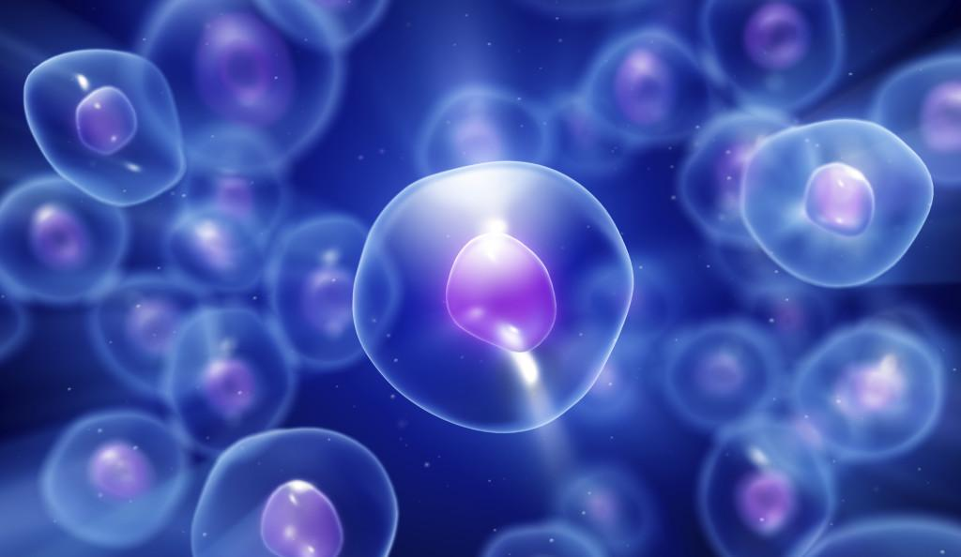
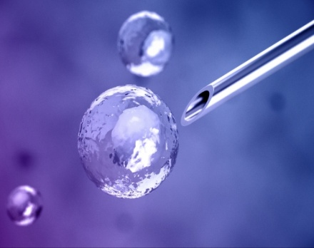
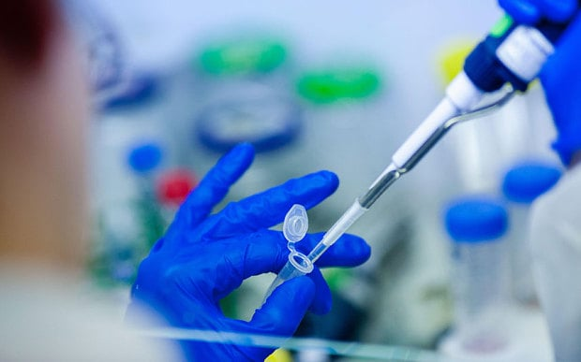

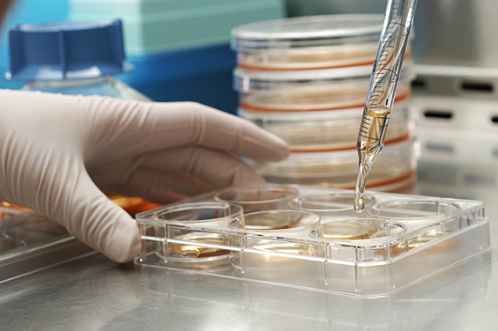
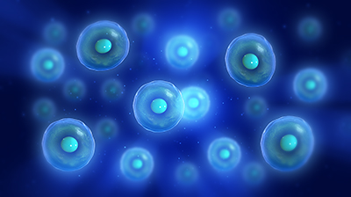






Allogenic Stem Cell Transplantation Present and Future
Mustafa CETIN, MD December, 2016
Erciyes University BMT Center

Slide 2
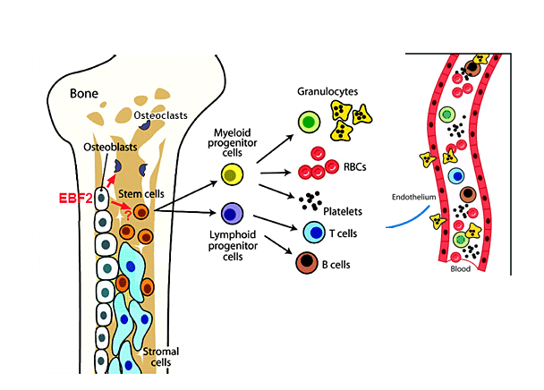
What are the Hematopoetic Stem Cells?
(HSCs)

Slide 3
Why do we want Stem Cells
Restoration of patient’s own hematopoetic tissue in the…. autologous setting (The correction of HDC-induced aplasia)
  to eradicate chemosensitive tumor
Installation of new hematopoietic tissue in the….
allogeneic setting (chimerism)
  to develop alloreactivity (GVL) against malignant disorders
  to correct functional defects observed in inherited or acquired non- malignant disorders
Notes:
İn this way, we can eracdicate tumor
With the help of chimeric structure to improve congenital or acquired functional defects (such as sixkle cell, B thalesemia )

Slide 4
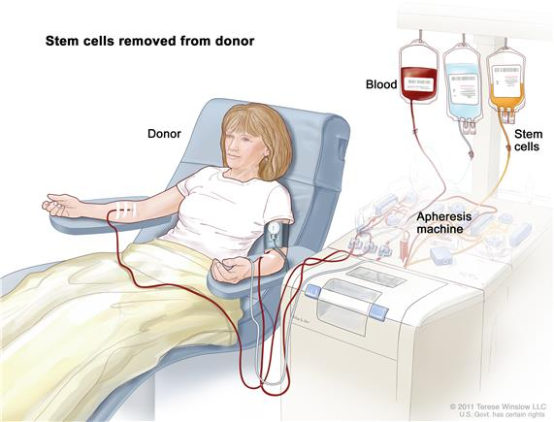
Allogenic Haematopoietic Stem Cell Transplantation
(Allo-SCT)
Allogeneic – from another person
  Sibling donor – HLA matched brother or sister
  Syngeneic – from an identical twin
  Unrelated donor – found using a donor registry
  Haploidentical – half-matched family member
Donor Apheresis
Patient
Transplantation
ENGRAFTMANT
Conditioning CT
Notes:
+A procedure in which a person receives blood-forming stem cells (cells from which all blood cells develop) from a genetically similar, but not identical, donor. This is often a sister or brother, but could be an unrelated donor.
Stem cell transplant (Step 1). Blood is taken from a vein in the arm of the donor. The patient or another person may be the donor. The blood flows through a machine that removes the stem cells. Then the blood is returned to the donor through a vein in the other arm.
Stem cell transplant (Step 2). The patient receives chemotherapy to kill blood-forming cells. The patient may receive radiation therapy (not shown).
Stem cell transplant (Step 3). The patient receives stem cells through a catheter placed into a blood vessel in the chest.

Slide 5

Factors determining HSCT outcome
Pretransplantation
Transplantatıon
Posttransplantation
DISEASE STATUS
Type of Disease
Indication status
Remission status
(Suitable BM)
Prior treatments
PATIENT
Clinical Elgibility Criterias
EBMT risk score (Age,PS,etc)
Comorbidity index
GvHD PROPHYLAXIS
Pharmacological
T-cell Depletion
CONDITIONING
Myeloablative & RIC
Organ Toxicity
STEM CELL SOURCE/DOSE
Bone Marrow
Peripheral Blood / UCB
IMMUNE RECONSTITUTION
Infections GvHD
GVT effect
DONOR STATUS (IDEAL GRAFT)
HLA matched
HLA mismatched Haploidentical
D/R sex combinations
ABO, CMV serostatus,…
Notes:
As increase the number of risk factor and comorbidities, the patients obtain low response rate and lon

Slide 6
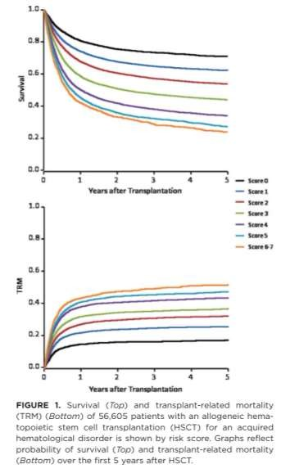
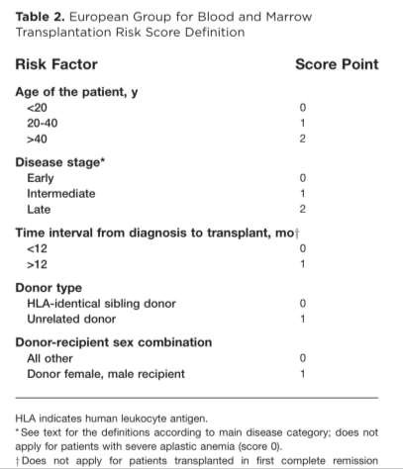
EBMT risk index
Hematopoietic cell transplantation
A Gratwohl et al. Cancer 2009

Slide 7







Influence of age on 10-year survival in HLA identical siblings
28
OS survival at 5 years n=4267
1.00
Age groups
0.75
<=20 | 79%
>20 | 73%
>30 | 68%
>40 | 61%
>50 | 46%
Survival
0.50
0.25
0.00
0
500 1000 1500
Days since Transplantation
2000
SAA-EBMT registry, update July 2012
14
Notes:
Studies have suggested that a DPB1 matching does not impact overall survival
DPB1 match increases relapse risk
DPB1 mismatch increases acute GVHD and TRM

Slide 8


Allogeneic SCT is a complex procedure

Slide 9
Today Topics
  Donor selection
    Donor Screening & Identification
  Source of Stem Cells
    Stem Cell Mobilization
    Stem Cell Collection
    Stem Cell processing
  Conditioning Regimen
  Stem Cell Infusion
  Engraftment (allograft /Chemerism)
  Prophilaxis (GVHD, infection,VOD )
  Early & Late Effects (Control)
  IBMTR results

Slide 10
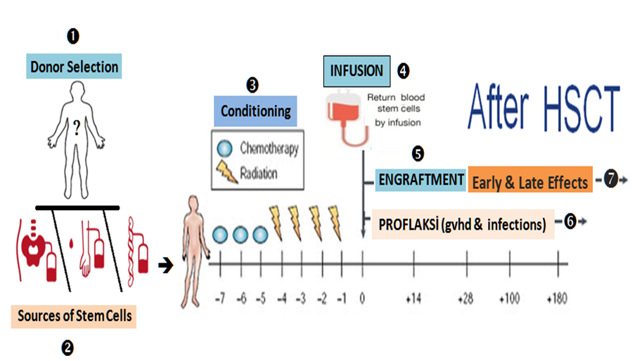
34

Slide 11
❶ Donor Selection
Stem Cell Donor AVAILABILITY
HLA-identical sibling
  First choice
Unrelated donor
Cord blood
Other related donor
  Haploidentical
1/3 patients in population
>29 million donors worldwide
• ~700 000 cords
• Inevitable ?

Slide 12
Requirements for the ideal graft/donor
❶ Donor Selection
Fast and stable engraftment HAPLO and SIB
No / Low GvHD TWIN / SIB
Early immune reconstitution SIB
Strong and lasting GvT effect HAPLO>CB>SIB
Chances for immunotherapy SIB >HAPLO >, CML- DLI
Quick availability SIB>HAPLO>CB>URD
No/Low infectious risks TWIN/SIB
Safe for patient, low TRM SIB
Cheapest procedure SIB
Notes:
Who is the wonderful donor
Best approprfaite donor for ….

Slide 13
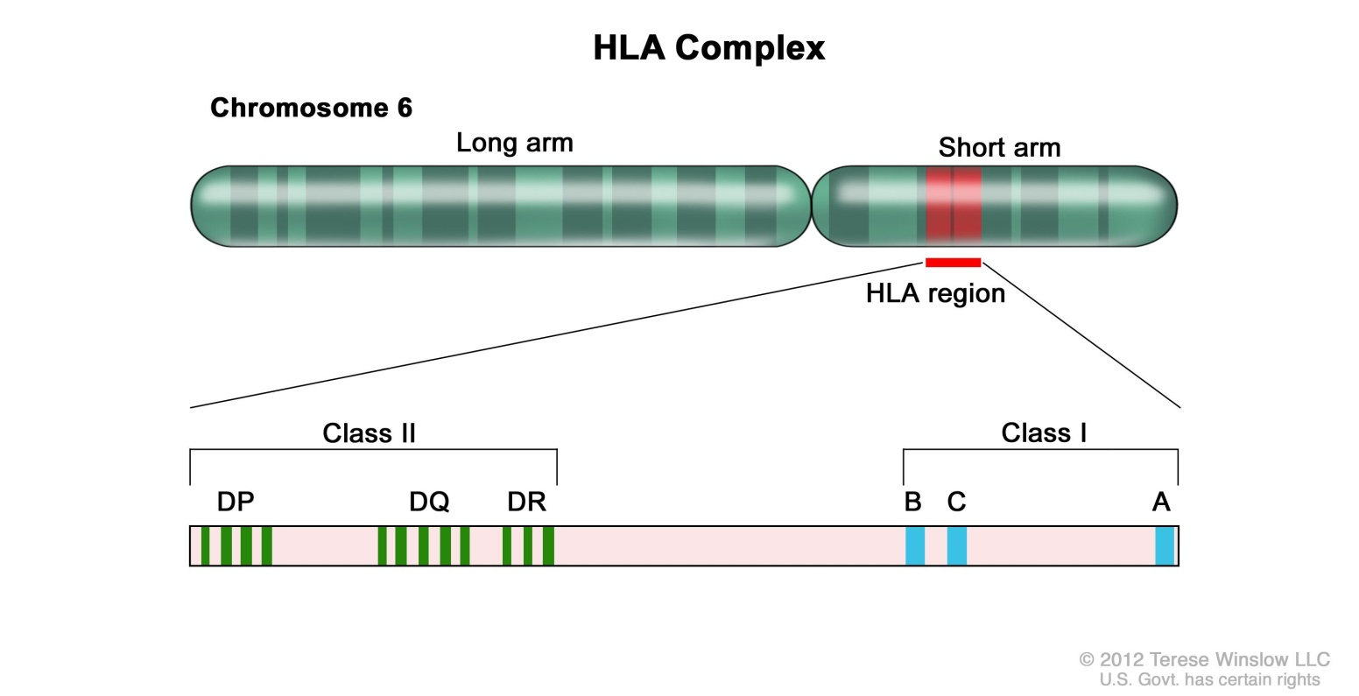
Why is HLA so important?
❶ Donor Selection
Human Leukocyte Antigen
One of the most gene- dense regions of the genome
Discovered: in mice (1937), humans (1954)
HLA is in the MHC on Chr6:
HLA is a protein – or marker – found on most cells in your body.
Notes:
First requirement for TX

Slide 14
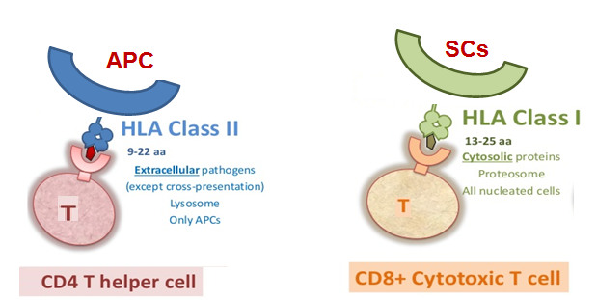
The Major Histocompatibility Complex & Antigen recognition
❶ Donor Selection
MHC
HLA, present peptides to T cells, thus allowing elimination of foreign particles and recognition of self or non-self
SO, If donor proteins are presented to the host T CELL , (HVG,Rejection)
If host proteins are presented Donor T CELL (GVHD, GVT effect)

Slide 15



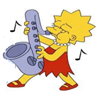

❶ Donor Selection
The HLA Family
A1 A2
A3 A26
Cw7 Cw5
Cw7 Cw8
B8 B44
B7 B14
Half of our HLA markers are inherited from our mother and half from our father
A1 A3
A1 A26
A2 A3
Cw7 Cw7
Cw7 Cw8
Cw5 Cw7
B8
B7
B8 B14
B44 B7
Each brother and sister has a 25%, or 1 in 4, chance of matching you, if they have the same mother and father
Notes:
Half of your HLA markers are inherited from your mother and half from your father.. It is highly unlikely that other family members will match you. Under very rare circumstances, family members other than siblings may be tested.
.
,

Slide 16
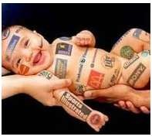
❶ Donor Selection
The HLA Family
A1 A2
A3 A26
Cw7 Cw5
Cw7 Cw8
B8 B44
B7 B14
A1 A3
A1 A26
A2 A3
A1 A3
Cw7 Cw7
Cw7 Cw8
Cw5 Cw7
Cw7 Cw7
B8
B7
B8 B14
B44 B7
B8
B7
HLA matched
Unfortunately, there is only a 25-percent chance of a sibling match
Notes:
Each brother and sister has a 25%, or 1 in 4, chance of matching each-other

Slide 17

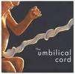
❶ Donor Selection
The HLA Family
A1 A2
A3 A26
Cw7 Cw5
Cw7 Cw8
B8 B44
B7 B14
A1 A3
Cw7 Cw7
B8
B7
A1 A3
A1 A26
A2 A3
Cw7 Cw7
Cw7 Cw8
Cw5 Cw7
B8
B7
B8 B14
B44 B7

Slide 18
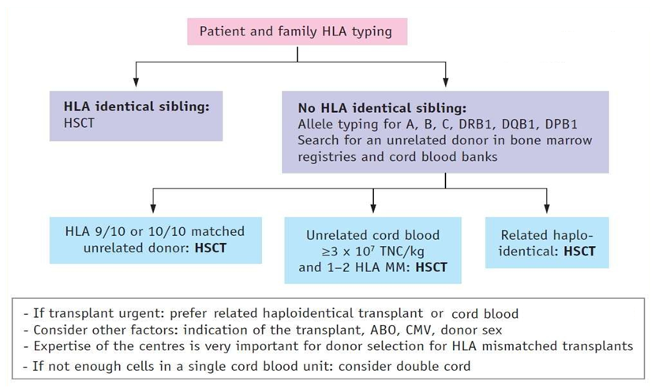
7
❶ Donor Selection
Notes:
Q: What is PRA?
A: A PRA test can be performed many different ways. Basically, we take known HLA proteins and react them with a patient’s serum. If the patient has antibodies to a particular HLA protein, the antibodies will bind. We then add other special proteins to allow us to detect that the antibody is bound to the HLA protein. By determining which HLA proteins a patient reacts to, we can determine if a potential patient/donor combination is likely to have a good or bad outcome.
Q: What causes anti-HLA antibodies to develop?
A: Anti-HLA antibodies can be triggered by blood transfusion, multiple pregnancies and by transplantation. Lymphocytes present in transfused blood are the source of the immunization causing anti-HLA antibody development.
Since a person can develop antibodies after a transfusion, it is important for a transplant candidate to submit a blood sample to the HLA laboratory approximately 14 days after each transfusion. The serum will be tested to determine whether anti-HLA antibodies have been produced.
If anti-HLA antibodies were produced as a response to the transfusion, the HLA specificity can be defined and avoided in selection of a suitable organ donor.
Q: Can anti-HLA antibodies change?
A: Yes and no. Once an antibody is made, it doesn’t really change. What changes are the types of antibodies that are made and the amount of these antibodies in the bloodstream. The immune system is very good at changing the antibodies that are made, to make the immune response even better. HLA antibody levels can be high following a transfusion or transplantation but significantly decrease in the months or years following. However, the cells that make antibodies can develop into memory cells and the antibody levels can go from undetectable to extremely high very quickly (within days) if a patient is exposed to a foreign HLA again

Slide 19
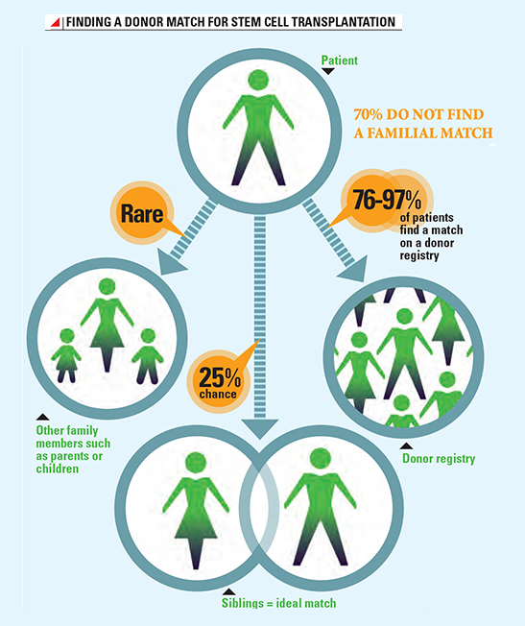
Provision of unrelated HSC donors
❶ Donor Selection
RN Lown and BE Shaw, Bone Marrow Transplantation (2013) 48, 210-219
A matched, related donor is the accepted first choice.
Genetics dictate that siblings have a 25 percent chance of matching.
Those without a matched, related donor have 70 percent chance for Caucasians
Or only 10 percent chance for other or mixed ethnicities of finding a matched,
Cord blood & Haploidentical ARE matched to be acceptable as a donor source.
Notes:
First preferences is SIB

Slide 20
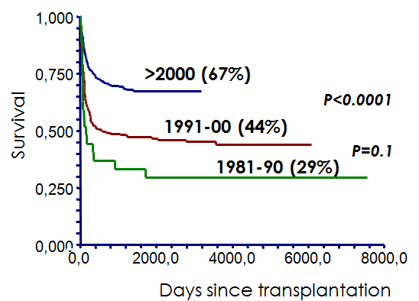



❶ Donor Selection
Notes:
HLA tissue types are inherited, so your best chance of finding a match is with a brother or sister. However, 70% of patients do not have a suitable donor in their family. If you do not have a donor in your family, your doctor can search for a marrow donor or cord blood unit.

Slide 21
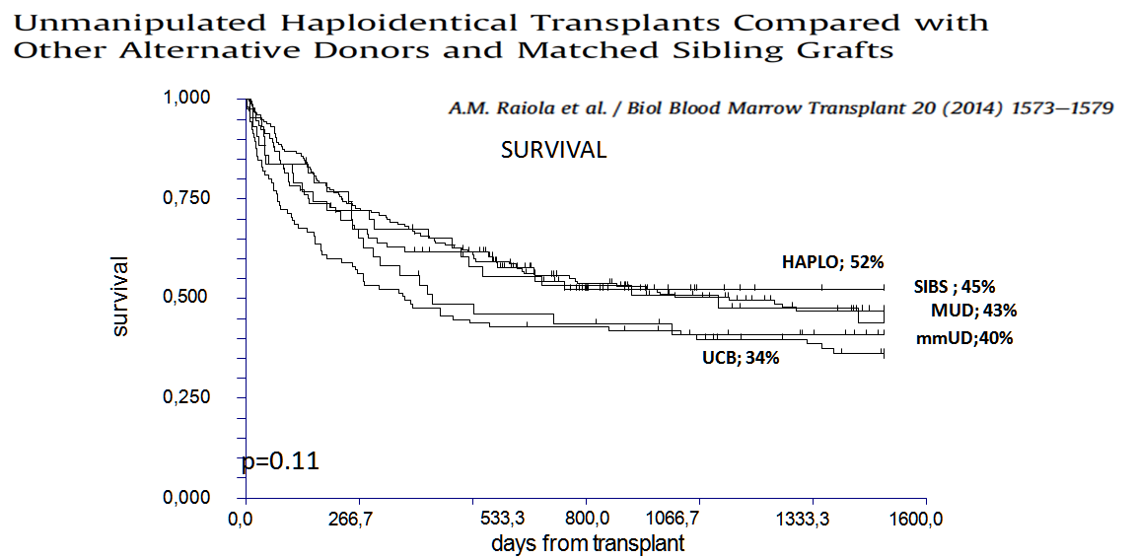
The Genova experience
Notes:
With the understanding of graft behaivor and comtemperary methods providing infection control and immune manangement improved the survival of alternative donors

Slide 22

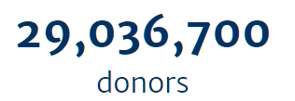

Bone Marrow Donors Worldwide
❶ Donor Selection
Total > ~ 30 million donors
73 stem cell donor registries from 52 countries
47 cord blood banks from 33 countries
www.bmdw.org
Notes:
Unrelated Mathc donor is the second best options

Slide 23












Alternative donor search algorithm in HGUGM
❶ Donor Selection
Indication for Allo-HSCT & no HLA-id family donor
Start URD search if age <60-65y (+ UCB if age <55-60y)
YES
¿HLA-id URD “on-time”?
URD Allo-HSCT
NO
¿UCB available?
HLA match ≥ 4/8
TNC ≥ 2.5-3 x10⁷/kg (min 1500 x10⁶)
CD34+ ≥1.5-2 x10⁵/kg (min 10 x10⁶)
YES
UCB Allo-HSCT “Dual”
UCB Unit validation
(Viability, CFU-GMs, cell recovery, CB Bank,…)
NO
¿Haplo?
YES
Haplo-HSCT (PTCy)

Slide 24
UNRELATED donor selection criteria
❶ Donor Selection
HLA matched and permissive mismatches (DP)
Sex mismatch D/R
ABO compatibility
CMV serological status D/R
Donor: age and gender
HLA antibodies in the patient
Notes:
And you decided untrelated DONOR
You have to evalaute your scientific preferencies or prioroties
For fully match URD -, you can evaluate DP status
Sex msmtch important for Female Donor for male recipient
If the patient is CMV seropositve you must select ..

Slide 25
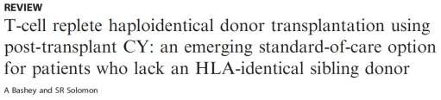
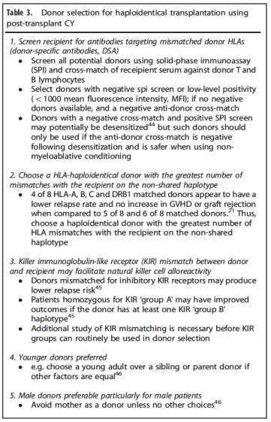
HAPLOIDENTICAL donor selection criteria
❶ Donor Selection
1.- No anti-HLA antibodies (patient)
2.- Higher HLA mismatch
3.- KIR alo-reactive donor
4.- Younger donor
5.- Male → Male (avoid mothers)

Slide 26
❶ Donor Selection
UCB Donor selection criteria
UK consensus: WHICH UNIT OR UNITS?
Search step | Search criteria | Comments
1st | Cell Dose | Same cell dose required for RIC and MAC >3.0 x10⁷ NC/kg and/or >1x10⁵ CD34+/kg
2nd | HLA match | 0-1 MM better than 2 - avoid 3-4 MM Avoid ≤4/8 units Prefer class I mismatches to class II Avoid C MM
3rd | Transplant indication | Malignant diseases: cell dose (>3.0x10⁷NC/kg ) HLA is the best prognostic factor because HLA differences reduce relapse (GVL) Non malignant diseases: increase cell dose (>5.0x10⁷NC/kg ) and find the best HLA match (avoid CB ≤4/8 units)
₄th | Other considerations (if several options available) | ABO important only in RIC setting Cord bank accreditation and location
Notes: Where a single unit meeting these criteria cannot be identified, a double unit may be used

Slide 27
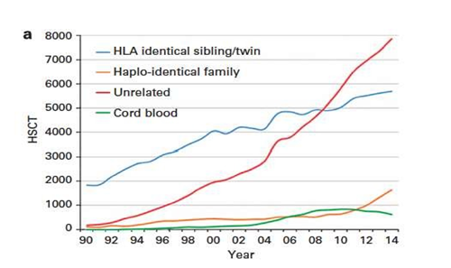
Allogeneic SCT: trends in 2014
❶ Donor Selection
Nowadays, and with a patient being a potential candidate for an allo-HSCT who lacks
a HLA well-matched donor (HLA identical sibling/MUD), physicians are faced with the need to select amongst different options: MMUD, CB or haploidentical transplants.
14

Slide 28
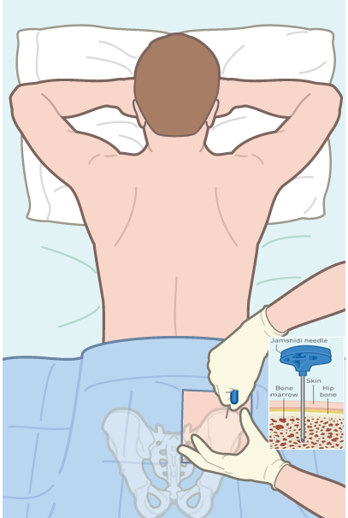
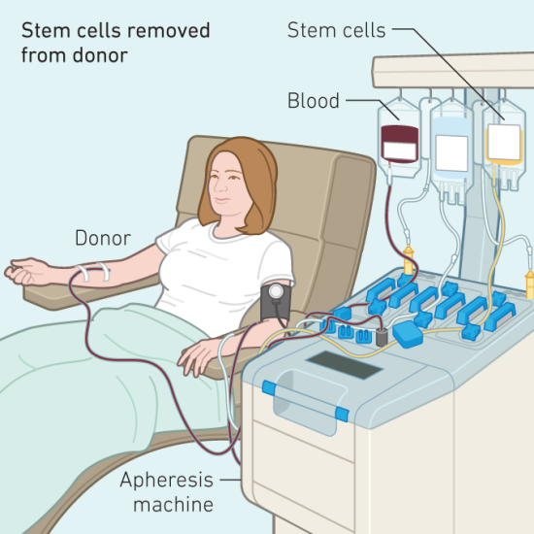
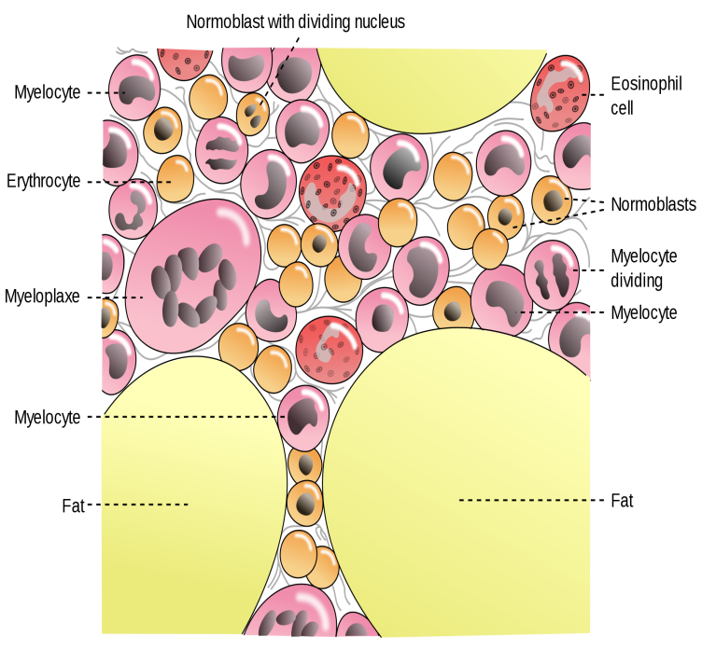
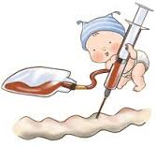
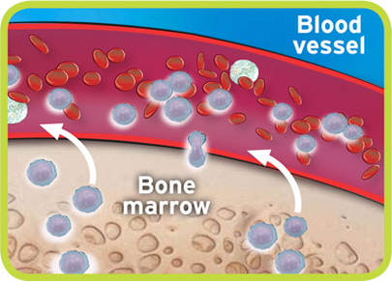
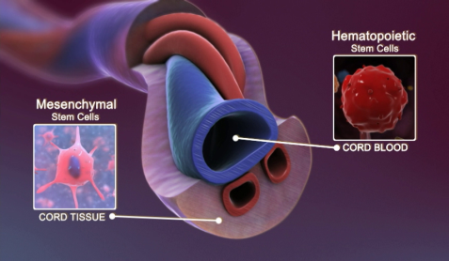
❷ Sources of Stem Cells
Bone Marrow
Peripheral Blood
Cord Blood

Slide 29

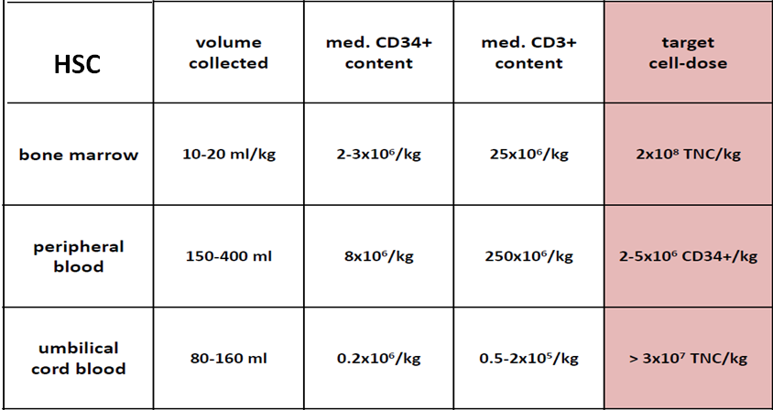
❷ Sources of Stem Cells
BM
PBSC
CB
*Cell contents according to source
15

Slide 30
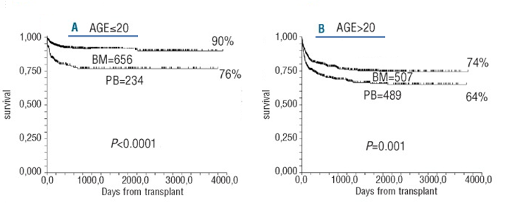
❷ Sources of Stem Cells
BM
PBSC
CB
*Cell contents according to source
Survival Advantage for Acquired Aplastic Anemia
Bone marrow versus peripheral blood as the stem cell source for sibling transplants in acquired aplastic anemia: survival advantage for bone marrow in all age groups, Andrea Bacigalupo, Haematologica. 2012 Aug; 97(8): 1142–1148
19

Slide 31
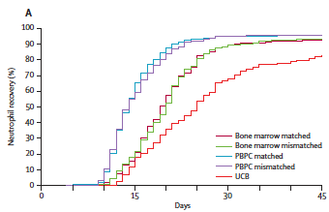
❷ Sources of Stem Cells
BM
PBSC
CB
Faster hematopoietic recovery
Faster immune recovery
Increased c.GvHD
Donor issues?
17
Notes:
If you use PBSC, you will get faster immınune and hemapoetic recovery AT THE EXPESE OF increased CGVHD
As you see in this picture Nötrofıi recovery is very faster for PBSC as compared with cstem cell sources
Avarege engraftmen day is 15 day earlier for PBSC

Slide 32


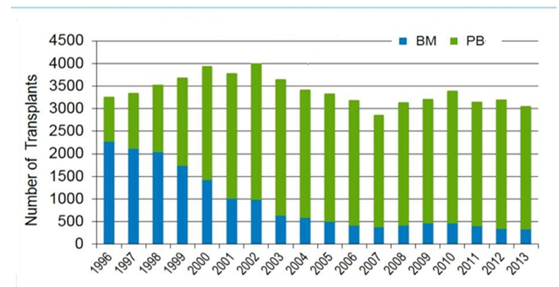
❷ Sources of Stem Cells
CIBMTR : Stem Cell Sources
Notes:
According to the CIBMTR registyries
BM usage increased last two decade

Slide 33

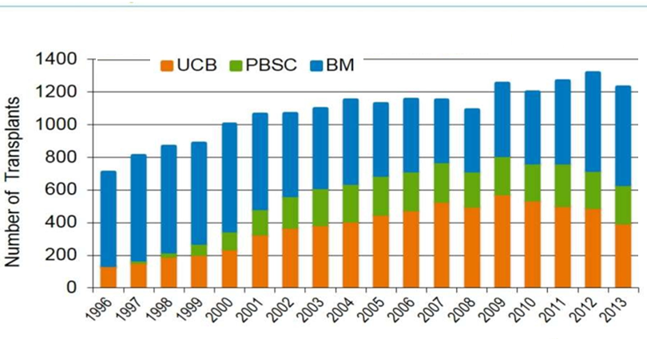
❷ Sources of Stem Cells
CIBMTR : Stem Cell Sources
Notes:
Along past 15 yaers, the number of UCB usage have been increased yeaR BY YEAR

Slide 34

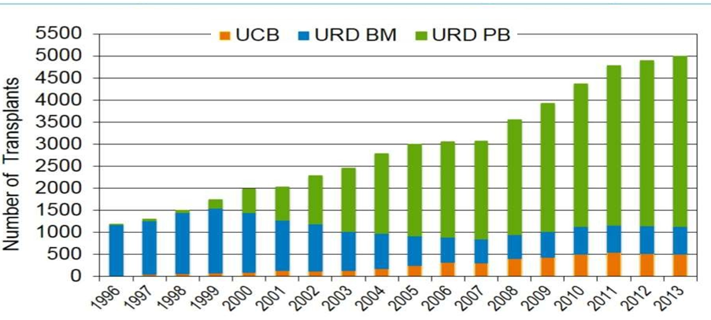
❷ Sources of Stem Cells
CIBMTR : Stem Cell Sources
Notes:
For adult patients, we are seeing that an sharp increase in usage of BM as a stem cell source

Slide 35
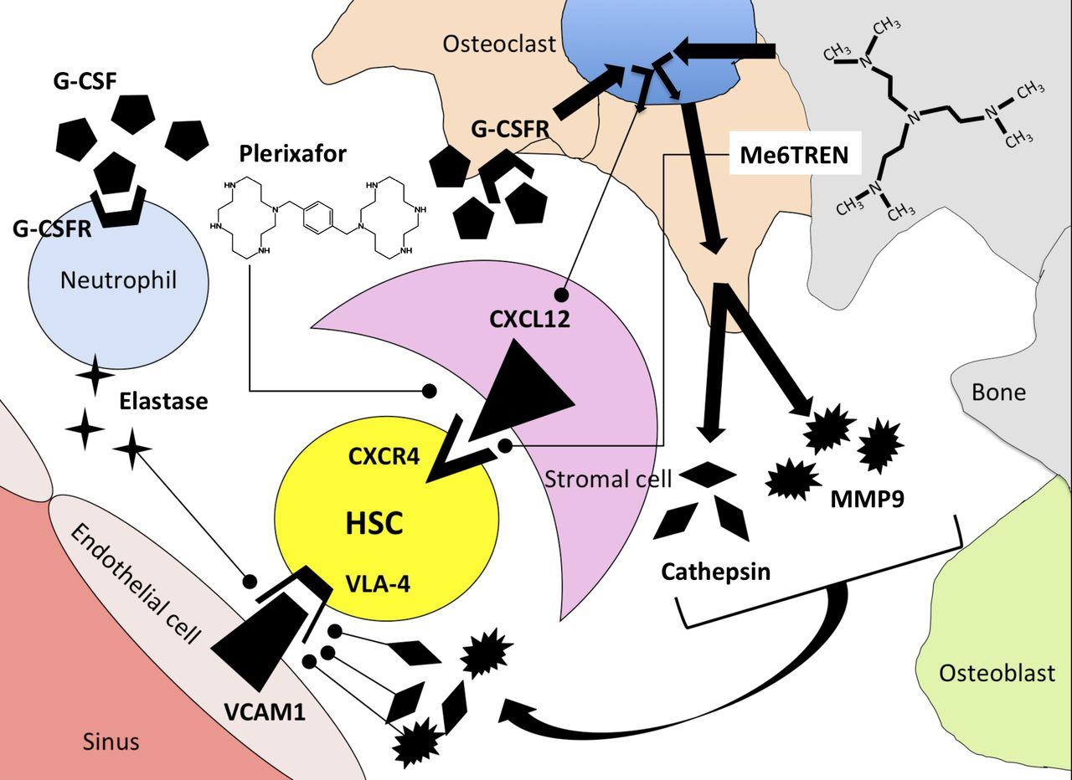

❸ Stem Cell Mobilization & Collection
Mobilization: Agents & Mechanisms
SDF-1
Sakura Hosoba, and Edmund K. Waller Blood 2014;123:310-311
Notes:
IF YOU SELECT PBSC AS A SOURCE OF STEM CELL, YOU HAVE TO MOBLİZE STEM CELL AND USE MOBISILISINDG D RUGS
Mechanism of release of HSCs from the bone marrow microenvironment using G-CSF, plerixafor, or Me6TREN as mobilization agents. G-CSF induces synthesis of proteases elastase, cathepsin, and MMP9 by neutrophils and osteoclasts after binding to G-CSF receptors (G-CSFR). Proteases degrade adhesion molecules that tether HSCs to stromal cells in the bone-marrow microenvironment. As a secondary effect mediated through osteoclasts, G-CSF binding leads to downregulation of CXCL12 on bone-marrow stromal cells. Plerixafor antagonizes binding of CXCR4 to CXCL12, whereas Me6TREN has reported activity in antagonizing CXCR4/CXCL12 binding as well as inducing synthesis of MMP9.
ew mobilizing agents are needed to increase the number of stem cells in peripheral blood for effective reconstitution of hematopoiesis. Here, we report that the molecule Me6TREN (Me6) can induce rapid mobilization of hematopoietic progenitor cells and that Me6 exhibits more significant effects than granulocyte colony-stimulating factor (G-CSF) or AMD3100. Me6 also mobilizes long-term repopulating cells, which successfully engraft and expand in a multilineage fashion in primary and secondary transplant recipients. Mechanistically, Me6 inhibits both the SDF-1α–induced migration and VLA-4–mediated adhesion of mouse and human hematopoietic cells. Me6 appears to mobilize HSPCs by activating MMP-9 expression and disrupting the SDF-1α/CXCR4 axis. Therefore, Me6 may become a new potent and efficacious mobilizing agent of HSPCs.

Slide 36
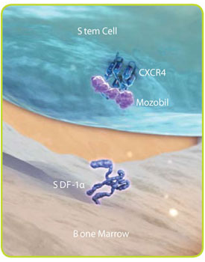
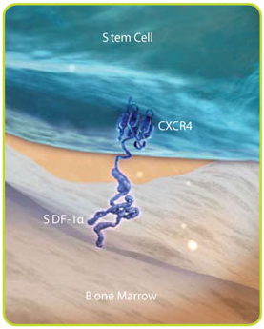

❸ Stem Cell Mobilization & Collection
Mobilization: Agents & Mechanisms
GCSF
Prelifaxor
HSC mobilisation
G-CSF
adhesive interactions between HSC and BM:
cell adhesions molecules
PMN
HSC
AMD 100
CD44
CXCR4
HSC
CD62L
VLA-4
NE CG MMP9
CD44
CXCR4
Kit
CD62L
Kit
VLA-4
HA
HA
CXCL 12c
CD62
KL VCAM-1
CXCL 12
CD62
KL VCAM-1
SDF-1 c
Extracellular matrix
SDF-1
Extracellular matrix
Extracellular matrix
osteoblast
osteoclast
osteoblast
osteoclast
De Clercq E. The bicyclam AMD3100 story. Nat Rev Drug Discov 2003; 2: 581–587
MP Rettig, G Ansstas and JF DiPersio. Leukemia. 2011 Sep 2. doi: 10.1038/leu.2011.197

Slide 37
Stem cell mobilization / G-CSF
❸ Stem Cell Mobilization & Collection
Filgrastim (G-CSF ) (Success rate: 70-95%)
Multi-step interactions in the marrow microenvironment lead to stem cell mobilization
Pain, headaches, arthralgias, malaise, fatigue, insomnia, and nause, Transient increase in ALP, ALT, LDH, Na and transient decrease in potasium, spontaneous splenic rupture
Increased spleen size in length (in 95% of pts) (mean increase,13%) but 10 days after G-CSF administration, spleen size returns to baseline.
CD-34+
Start leukaphaeresis on day 4,5
  Minimum number of CD34+ cells: 2 x 10⁶ /kg
G-CSF 10 -25 mcg/kg day , BID
circulating CD34 + cells
gradient> 20 / ϥL
1
2
11
3
4
5
6
7
8
9
10
12
13
14
Notes:
Models of HSPC mobilization by G-CSF and inhibitors of CXCR4 and VLA-4. (a) Bone marrow environment at baseline. HSPCs in the endosteal niche are likely in close contact with osteoblasts and nestin? MSCs, both of which express numerous HSPC retention factors, including CXCL12, VCAM-1 and SCF. The perivascular niche is more distant from the endosteum and includes both nestin? MSCs and CXCL12 abundant
reticular cells. Cells of the monocytic lineage support the maintenance of osteoblasts and MSCs. b-Adrenergic nerve cells of the sympathetic
nervous system regulate MSC proliferation and induce circadian oscillations of CXCL12 expression. (b) Model of G-CSF-induced HSPC
mobilization. Cells of the monocytic lineage express the receptor for G-CSF and provide factors that support the survival of MSCs and osteoblasts.
Upon 4–5 days of stimulation with G-CSF, the monocytes/macrophages disappear, leading to the loss of osteoblast lineage cells and reduced
expression of CXCL12, VCAM-1 and SCF on MSCs. Reduced expression of these important HSPC retention factors is also observed following G-CSF signaling through b-adrenergic nerve cells. The net effect of these signaling cascades is the disruption of HSPC retention interactions and mobilization of HSPCs into the peripheral blood. (c, d) Model of HSPC mobilization by inhibitors of CXCR4 or VLA-4. Targeted disruption of the interaction of CXCR4 or VLA-4 with their ligands results in the rapid (within hours) and reversible mobilization of HSPCs into the peripheral
circulation. An additive or synergistic affect on HSPC mobilization is observed when a CXCR4 inhibitor is combined with a VLA-4 antagonist, G-CSF or their combination. When used alone, inhibitors of CXCR4 and VLA-4 mobilize fewer HSPCs than G-CSF.
-- Stem cells may be induced to leave the bone marrow by administration of medications that are termed mobilizaiton agents. The most commonly used agent is filgrastim, also known as granulocyte colony stimulating factor. Filgrastim has a number of effects on the marrow environment including disruption of the CXCL4/CXCL12 axis, proliferation of HSC, and alterations in the adhesion factors VLA-4 and selectins as well as other effects. In total, its protean effects on the marrow microenvironment lead to stem cell mobilization after approximately 5 days of administration. The side effects are well known and include bone pain in approximately 100% of donors. Most donors experience flu-like symptoms most likely due to cytokine release. Filgrastim administration may be associated with significant leukocytosis which under the righ conditions can increase the risk of splenic rupture. This leukocytosis may also lead to a pro-thrombotic state where donors with underlying cardiac or cerebrovascular disease are more likely to experience thrombosis. Finally, there have been some reports of increased risk of development of acute myeloid leukemia in related donors who received filgrastim, however this risk may be explained by environmental or genetic susceiptibilities as well.
More recently, Plerixafor has been introduced for mobilizaiton of stem cells. Plerixafor is a reversible inhibitor of the CXCR4/CXCL12 axis that is usually administered in conjunction with filgrastim. This agent does not cause bone pain but is associated with abdominal discomfort in some patients as well as leukocytosis and potential for splenic rupture. The introduction of Plerixafor has decreased the number of patients who experience mobilization failure.
There are other agents in development for stem cell mobilization but are not currently FDA approved for this indication.

Slide 38
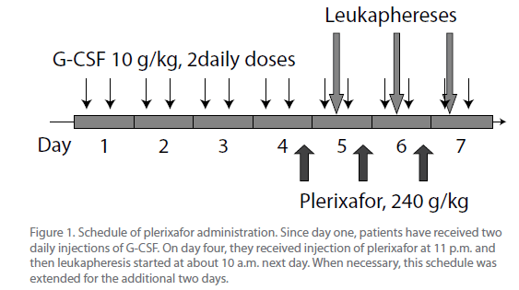
❸ Stem Cell Mobilization & Collection
Stem cell mobilization / Prelixafor
Plerixafor (Success rate: 70-80%) after any failure
Reversible inhibitor of the CXCR4/CXCL12 axis
    0.24 mg/kg body weight by subcutaneous (SC) injection.
    Approximately 11 hours prior to initiation of apheresis session (for up to 4 consecutive/ d) 6- to 10-fold increase in CD34⁺ cell, Typically administered in conjunction with filgrastim
    Side effects include abdominal discomfort, leukocytosis, potential for splenic rupture (rare)
0.24 mg/kg
MP Rettig, G Ansstas and JF DiPersio. Leukemia. 2011 Sep 2. doi: 10.1038/leu.2011.197
De Clercq E. The bicyclam AMD3100 story. Nat Rev Drug Discov 2003; 2: 581–587
Notes:
Mozobil is an inhibitor of the CXCR4 chemokine receptor and blocks binding of its cognate ligand stromal cell derived factor-1 (SDF-1α). SDF-1α and CXCR4 are recognized to play a role in the trafficking and homing of hematopoietic stem cells (HSC) to the marrow compartment.
Accidental finding: leukocytosis after a single intravenous dose of plerixafor
Originally tested clinically as an agent for the treatment of HIV infection by blocking the HIV entry into CD4⁺ T cells
Only for autologous collection / transplantation
not marketed for allogeneic collection / transplantation
For adult patients :
with lymphoid malignancies
“ … who mobilize poorly … “
in combination with rhG-CSF
Cost
cost / efficiency

Slide 39
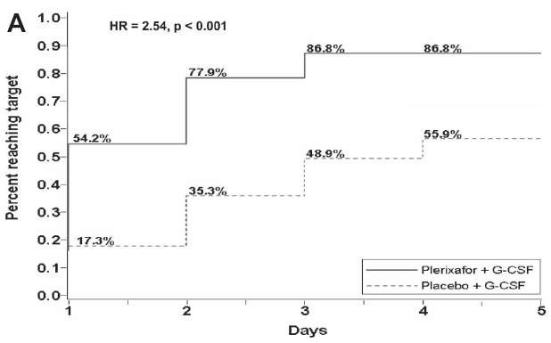
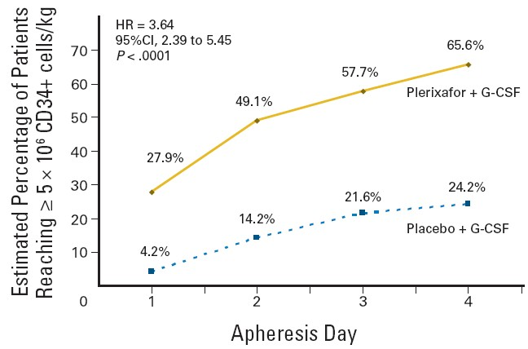
❸ Stem Cell Mobilization & Collection
GCSF vs GCSF + Plerixafor
Kinetics of CD34+ collection in randomized trials
Kaplan-Meier estimate of proportion of
multiple myeloma patients reaching 6x10e6 or more CD34+/kg (DiPersio JF et al, Blood 2009)
Kaplan-Meier estimate of proportion of non hodgkin’s lymphoma patients reaching 5x10e6 or more CD34+/kg (DiPersio JF et al, JCO 2009)

Slide 40
❸ Stem Cell Mobilization & Collection
The choice of a mobilization regimen
  Must comply with marketing authorizations and regulatory aspects
    rhG-CSF not allowed in patients < 18 years old
    plerixafor allowed only for autologous collection in patients with multiple myeloma or with lymphoma, and in association with rhG-CSF)

Slide 41
❸ Stem Cell Mobilization & Collection
The choice of a mobilization regimen
  Affects the quality of stem and progenitor (CD34⁺) cells mobilization and collection, but also affects the stem cell product for its contents in other cell populations
    immune effectors with potential consequences for the
risk of GVHD in the allogeneic setting
    neutrophil precursors with potential consequences on graft processing and freeze/thaw in the autologous setting)
Notes:
Inter-individual variability in response to mobilization
treatments
Clinical factors
age, sex, ethnic origin, weight ….
Genetic factors:
Benboubker L et al, Br J Haematol, 2001, 113, 247
Bogunia-Kubik K et al, Bone Marrow Transpl, 2009,
Martin-Antonio et al, Haematologica, 2011, 96, 102
Donor collection and recipient transplantation are usually synchronized
“uncomfortable” situation in case of poor mobilization

Slide 42
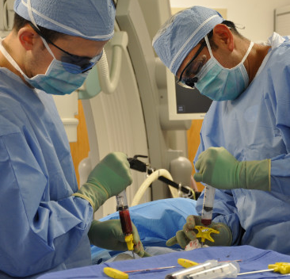
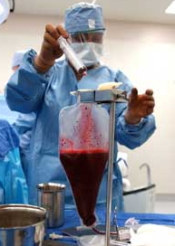
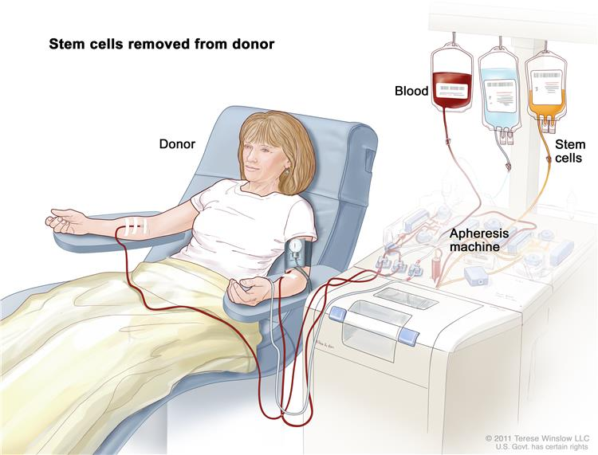

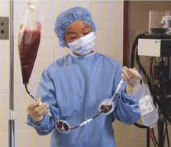
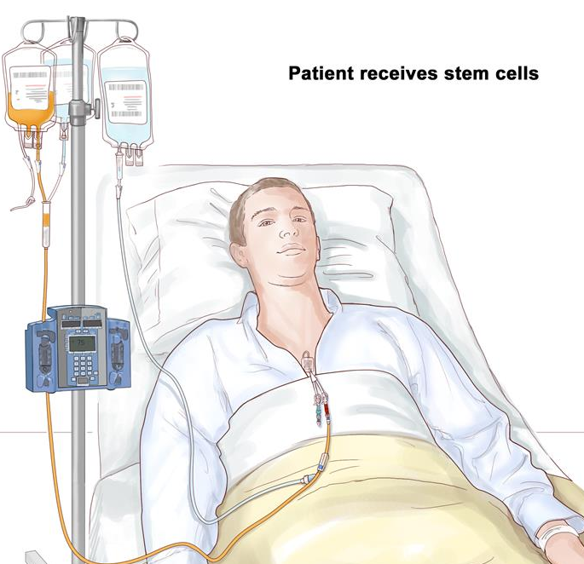

PBSC Apheresis Procedure
❸ Stem Cell Mobilization & Collection
    Stem Cell Collection Procedures
BM Harvesting Procedure
Mobilised Autologous Stem Cells
Removed from patients
BM Aspiration
BM collection
BM Fitration
Notes:
Once it has been determined that a patient is circulating sufficient CD34+ cells to undergo apheresis, the collection procedure begins. Patients may donate autologous cells via peripheral IV’s or via central venous catheter with two lumens. Whole blood is removed from the patient and flows through the apheresis machine. During apheresis the stem cell layer is separated from the remainder of the blood and removed. The remainder of the blood is returned to the patient and the stem cells are stored using 10% DMSO to prevent cell damage during the thaw procedure. This is a cryopreserved stem cell product.

Slide 43
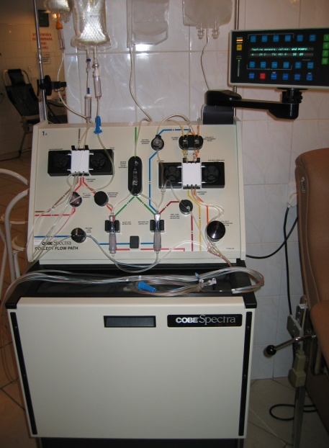
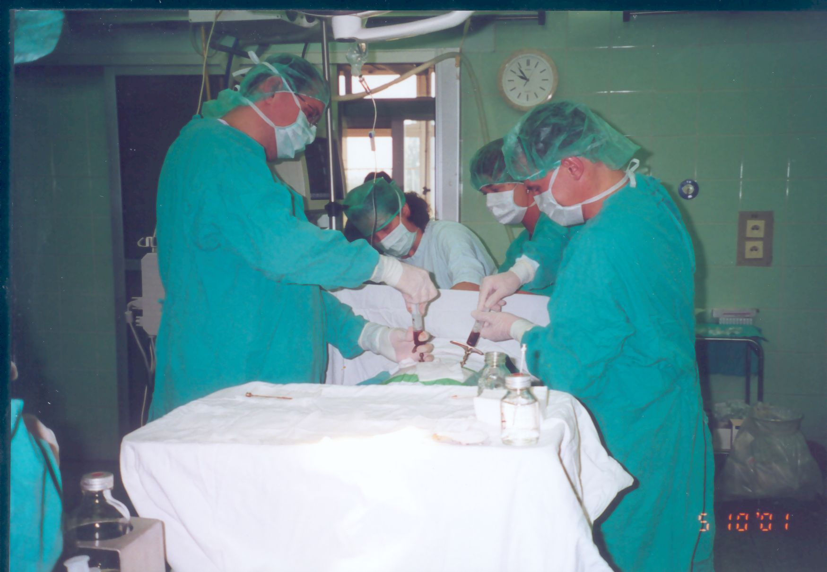
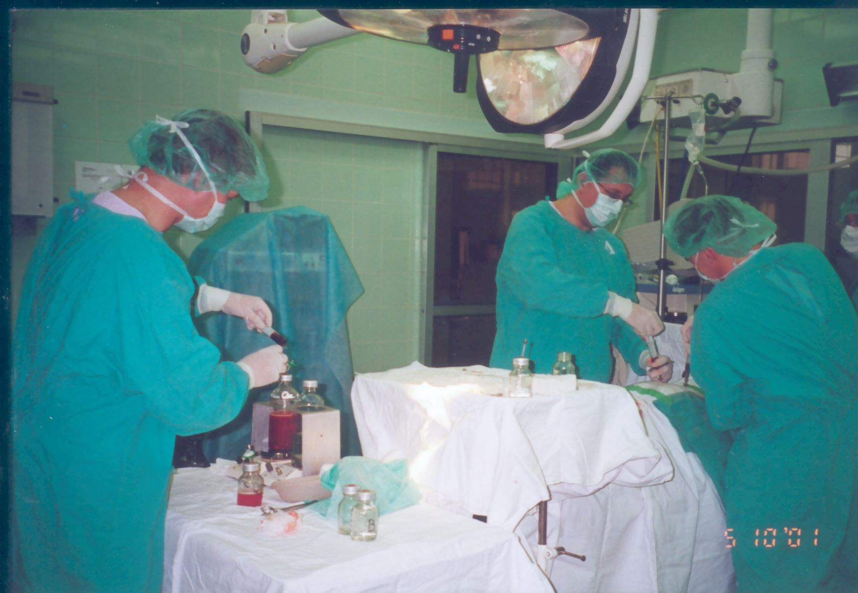
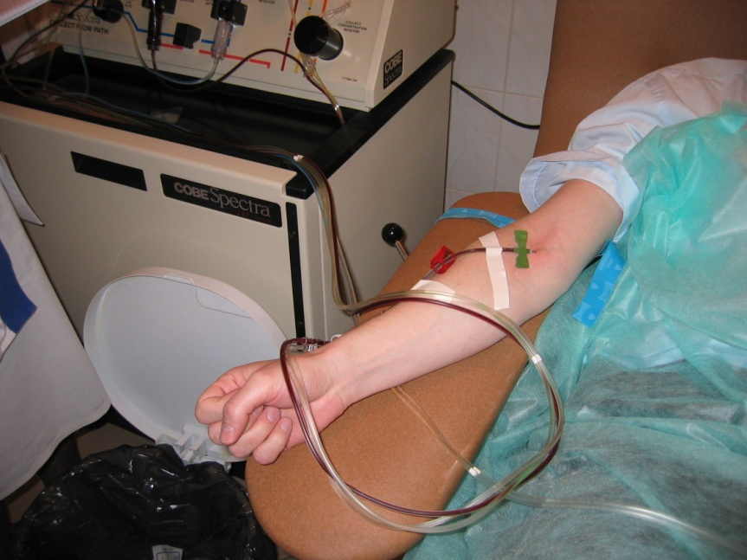
❸ Stem Cell Mobilization & Collection
Collection of hematopietic stem cells
bone marrow peripheral blood

Slide 44


Peripheral blood stem cell donation by apheresis is nowadays the most commonly used stem cell source for allogeneic HSCT
❸ Stem Cell Mobilization & Collection
    Stem Cell Collection Procedures
High progenitor and T-cell content
Accelerated cell recovery following myeloablative and reduced intensity conditioning regimen

Slide 45


❸ Stem Cell Mobilization & Collection
    Stem Cell Collection Procedures - APHERESIS
cytapheresis is based on the specific gravity of cell types
CD34+ progenitor 1.074
Okafor C et al, 2010
improvements in collection techniques
  circulating CD34 monitoring strategies
  large volume leukapheresis (at least 3 blood vol.)
  new continuous flow separators (Spectra Optia® & )

Slide 46


    Stem Cell Collection Procedures - APHERESIS
Different types of cell processors are marketed
SPECTRA OPTIA (Terumo BCT)
AMICUS CS3000 (Fresenius Kabi)

Slide 47
❸ Stem Cell Mobilization & Collection
    BM HARVESTING
BM Aspiration
harvest under general or regional anesthesia
  around 10-20ml/kg by multiple aspirations
  usually from the posterior superior iliac crests
BM collection
Wang TF et al, 2011
procedure limited by
  contraindication to general anesthesia
  operating room availability
development of new techniques
  less invasive devices, without general anesthesia
  Development was abandoned for the Marrow Miner (Hospira)
BM Fitration
Marrow Miner

Slide 48
❸ Stem Cell Mobilization & Collection
    BM HARVESTING
Erythrocytes depletion and/or volume reduction
  mandatory in case of major ABO mismatch to prevent severe hemolytic reactions
Use of continuous flow cell-separator such as Cobe Spectra allows for
  residual erythrocyte volume < 0,2ml/kg
  final volume < 10/ml/kg
  CD34+ recovery around 80-90%
Larghero J et al, 2006

Slide 49

❸ Stem Cell Mobilization & Collection
    UC COLLECTION
Collection at term (> 37 weeks)
  umbilical vein puncture with placenta in utero, after
    vaginal delivery
    cesarean section
  collection by gravity using a bag system containing ACD
Since cell dose is the main limitation of it is important to optimize UCB use,
  donor selection
  collection method

Slide 50

HSC Storage
❸ Stem Cell Mobilization & Collection
storage in liquid nitrogen at a temperature of
  -156ºC (vapor phase)
  -196ºC (liquid phase)
container should be temperature-monitored 24h/24h
to avoid transient warming during storage
no use-by date
  BM autologous SCT after 21 years of cryopreservation
    Holter J et al, 2011
  Recovery of functional UCB progenitor after 15 years
    Broxmeyer HE et al, 2003

Slide 51



❸ Stem Cell Mobilization & Collection
Cell Dose and Source: effect on outcomes

Slide 52



❸ Stem Cell Mobilization & Collection
Cell Dose and Source: effect on outcomes

Slide 53

❸ Stem Cell Mobilization & Collection
Cell Dose and Source: effect on outcomes

Slide 54


❸ Stem Cell Mobilization & Collection
Cell Dose and Source: effect on outcomes

Slide 55

Original Article
Peripheral-Blood Stem Cells versus Bone Marrow from Unrelated Donors
❸ Stem Cell Mobilization & Collection
Cell Dose and Source: effect on outcomes
Claudio Anasetti, M.D., Brent R. Logan, Ph.D., Stephanie J. Lee, M.D., M.P.H., Edmund K. Waller, M.D., Ph.D., Daniel J. Weisdorf, M.D., John R. Wingard, M.D., Corey S. Cutler, M.D., M.P.H., Peter Westervelt, M.D., Ph.D., Ann Woolfrey, M.D., Stephen Couban, M.D., Gerhard Ehninger, M.D., Laura Johnston, M.D., Richard T. Maziarz, M.D., Michael A. Pulsipher, M.D., David
L. Porter, M.D., Shin Mineishi, M.D., John M. McCarty, M.D., Shakila P. Khan, M.D., Paolo Anderlini, M.D., William I. Bensinger, M.D., Susan F.
Leitman, M.D., Scott D. Rowley, M.D., Christopher Bredeson, M.D., Shelly L. Carter, Sc.D., Mary M. Horowitz, M.D., Dennis L. Confer, M.D., for the Blood
and Marrow Transplant Clinical Trials Network
N Engl J Med
Volume 367(16):1487-1496
October 18, 2012

Slide 56

❸ Stem Cell Mobilization & Collection
Cell Dose and Source: effect on outcomes
Survival after Randomization in the Intention-to-Treat Analysis.
Anasetti C et al. N Engl J Med 2012;367:1487-1496

Slide 57




❸ Stem Cell Mobilization & Collection
Cell Dose and Source: effect on outcomes

Slide 58

❸ Stem Cell Mobilization & Collection
Cell Dose and Source: effect on outcomes
Kollman C et al. Blood 2016 127: 260-267

Slide 59

❸ Stem Cell Mobilization & Collection
Cell Dose and Source: effect on outcomes
Kollman C et al. Blood 2016 127: 260-267

Slide 60


Studies have suggested that a DPB1 matching does not impact overall survival
DPB1 match increases relapse risk
DPB1 mismatch increases acute GVHD and TRM

Slide 61



HAPLO-RIC and PT-Cy results: URD comparison
❸ Stem Cell Mobilization & Collection
Cell Dose and Source: effect on outcomes
NRM
Relapse
OS
HAPLO n=88
URD n=737
p=0.06
p=0.001
p=0.71
Ciurea S et al. Blood 2015; 126(8):1033-1040.

Slide 62




HAPLOIDENTICAL vs URD vs SIBLINGS
❸ Stem Cell Mobilization & Collection
Cell Dose and Source: effect on outcomes
OS
EFS
Relapse
NRM
Bashey A et al. J Clin Oncol. 2013 Feb 19.

Slide 63

❹ Conditioning Therapy
34

Slide 64


❹ Conditioning Therapy
Dose & Response Curve with Cytotoxic Chemothrapy
MAC Auto for Tumoral Eradication
MAC Allo for BM Ablation
Cytotoxic Chemotherapy
RIC Allo for GVL
Bacigalupo,
Biol Blood Marrow Transplant.
2009 Dec; 15(12): 1628–1633.
Results in reversible myelosuppression (usually within 28 d) when given without stem cell support
TUMORAL CHEMOSENSITIVITY

Slide 65
❹ Conditioning Therapy
Dose & Response Curve with Cytotoxic Chemothrapy
The first stage of the transplant.
May be given in one dose or over several days.
........................................................
Necessary for:
  Destroying remaining cancer cells
  Creating room in the bone marrow for the transplanted stem cells
  Supressing the patients immune system to prevent of graft rejection
  ......................................................................................
Conditioning regimen is dependent on the type of disease, the type of
transplant, co-morbidities and age.

Slide 66
❹ Conditioning Therapy
Regimen Intensity
Low Intensity
High Intensity
Flu / Cy BEAM Cy / TBI
Less regimen related toxicity
Rely on later GVL effect
Increase in regimen related toxicities
Increased level of disease control

Slide 67
❹ Conditioning Therapy
Regimen Intensity
Myeolablative conditioning
  Irreversibly destroys the haemopoietic function of the BM with high doses of CT ± TBI.
  Higher level of disease control
  Younger patients with a good performance status
  Quicker engraftment of donor cells
  Higher toxicities associated with higher transplant related mortality
Reduced intensity conditioning
  It aims to use enough immunosuppression to allow donor cells homing
  RIC can allow to homing without completely eradicating the recipients bone marrow.
  Regimens that have been developed to reduce the morbidity and mortality of Allo-HSCT
  Because of less regimen related toxicities, Can be given to older patients
  Reduction in morbidity and transplant related mortality

Slide 68
34

Slide 69

❺ Stem Cell Re-infusion
Stem Cell Re-infusion
At least 24 hour after the conditioning will be given on Day 0. These are generally given through a central line and takes approximately 30 minutes.
Stem cells are either cryopreserved or fresh.
Cryopreserved
  Usually for autologous transplants
  Most common side effects are reactions to DMSO
Fresh
  Usually for allogeneic transplants
  Administered much like a blood transfusion
  Generally better tolerated than frozen cells.

Slide 70

Quality control of HSC grafts
❺ Stem Cell Re-infusion
Numeration of viable CD34+ and lymphocytes sub-population
  single-platform flow cytometry techniques
  standardized methodologies using commercially available kits including viability dye
Functionnal assays: colony-forming units
Dauber K et al, 2011
difficult to interpret due to the subjective nature of the readout
important inter-laboratory variability
but unique predictor of graft potency !

Slide 71

Quality control of HSC grafts
❺ Stem Cell Re-infusion
microbial contamination
  incidence depends on the origine of the cell product
    1-5% for PB
    5-10% for BM
    10-15% for UCB
  mostly due to coagulase-negative Staphylococcus sp.
  cryopreservation usually do not eradicate bacteria
in case of culture-positive products
  results not available at the time of infusion for fresh products
  infections attributable to the culture
positive product extremely rare
  antibiotic prophylaxis should be discussed depending on the type of contaminant
Kamble R et al, 2005

Slide 72

HSC grafts distribution and infusion
❺ Stem Cell Re-infusion
Verification of release criteria
  storage/transportation temperature
  cell dose and if applicable cell recovery and viability
  product conformity / ABO compatibility
  labelling (ISBT128 conformity)
Distribution to transplant units
  check patient/donor identity and labelling
  infuse immediatly after reception
  pre-medication as per institutional guidelins

Slide 73



HSC products shipment
❺ Stem Cell Re-infusion
lack of precise standards (JACIE +4-24ºC)
  based upon published data, storage and transportation
    of fresh HSC products at +4-8ºC
    of thawed HSC product at +20-24ºC
  PB is more sensitive to temperature than BM
use of cooling elements should be restricted to
medical coolers that will not freeze the product
temperature monitoring (data logger) is mandatory
Antonenas V et al, 2006

Slide 74

Adverse events associated with HSC infusion
❺ Stem Cell Re-infusion
AE after infusion of fresh HSC grafts are
  sporadic and moderate to mild
  mostly related to temperature and volume
AE after infusion of thawed HSC grafts are
  more common (20-60%)
  sometimes life-threatening
    cardiovascular
    neurological
suspected causative agents
  lysis products of cellular contaminants (granulocytes)
  idiosyncratic reactions to residual DMSO or dextran-40
Calmels B et al, 2007

Slide 75

AEs following HSCT infusion
❺ Stem Cell Re-infusion

Slide 76
❺ Engraftment

Slide 77
Stem cell transplantation
❻ Engraftment
Definition of engraftment
The stem cells of the donor have been taken up by the patient´s bone marrow (”have engrafted”)
Neutrophils
Day, 12
0,5 x
10⁹/L
5
10
days
15
20
Conditioning
Infusion of graft
The first of three days with neutrophil count> 0.5 x 10⁹/L

Slide 78
❻ Engraftment
ENGRAFTMENT
Haematopoietic Reconstitution
According to the Source
Thomson B G et al. Blood 2000;96:2703-2711
First of three consecutive days with the indicated blood cell levels:
  Neutrophils > 0.5 x 10⁹/L
  Leucocytes > 1.0 x 10⁹/L
  Platelets (without transfusion) > 20 x 10⁹/L
  Platelets (without transfusion) > 50 x 10⁹/L
  Without transfusion: no transfusions for at
  least seven days before reconstitution is recorded

Slide 79
❻
❼Prophylaxis (GVHD & Infections)

Slide 80
GvHD: Prevention
❼ Prophylaxis (GVHD & Infections)
Gold standard is cyclosporine and methotrexate
  CsA/MTX and FK506/MTX better than CsA alone
  No benefit in adding corticosteroid
  FK506/MTX may be better than CsA/MTX
  BMT-CTN : Sirolimus plus FK506 vs FK506/MTX
  Decreased incidence with ATG but little or no change in outcome
Side effects
  Metabolic (low Mg, increased K, increased bilirubin)
  Hypertension, nephrotoxicity
  Neurological (altered mental state, seizures, )
  Transplant associated thrombotic thrombocytopenic purpura (TTP) – does not respond to plasmapheresis
Mandatory monitoring of drug levels

Slide 81
❼ Complications of HSCT

Slide 82
❽ Early Complications of HSCT
Early Complications (Major cause of morbidity and mortality)
Infections: | Hepatic veno-occlusive disease
Bacterial | Haemorrhagic cystitis
Viral | Capillary leak syndrome
Fungal | Diffuse alveolar haemorrhage
Acute GvHD | Idiopathic pneumonia syndrome
 | Multi-organ dysfuntion syndrome

Slide 83
❽ Late Complications of HSCT
Late Effects
Chronic GvHD | Back to work issues
Late infection and immune defects | Secondary MDS / leukaemia / malignancy
Restrictive lung diseases and COPD (Pulmonary late effects ) | Late graft failure
Late liver complications (i.e. Hepatitis B,C and iron overload) | Relapsed disease
Late ocular effects & cataracts | Infertility / sexual dysfunction
QoL and neuropsychological functioning including intellectual and / or concentration issues | Endocrine abnormalities e.g. hypothyroidism
Emotional issues | Cardiac failure
Fatigue | Dental late effects

Slide 84


Stem Cell Transplantation Activity in Europe
N. allogeneic transplants per 10 million population
0 or no report 1 - 50
51 – 100
101 - 150
151 – 200
201 – 300
> 300
JR. Passweg, H. Baldomero et al, Bone Marrow Transplantation (2015) 50, 476–482

Slide 85

HSCT Activity in Europe 1990-2012:
Stem Cell Transplantation Activity in Europe

Slide 86

Stem Cell Transplantation Activity in Europe
Main Indications
Allogeneic 1st HSCT
 | Leukemia | 10690 | 500 | 11190
 | Lymphoma | 1678 | 7880 | 9558
 | Plasma Cell disorder | 606 | 9794 | 10400
 | Bone marrow failure | 772 | 1 | 773
 | Solid tumor | 60 | 1483 | 1543
 | Non-malignant disorders | 1024 | 178 | 1202
 | Other | 120 | 23 | 143
 | Total 1st Transplants | 14950 | 19859 | 34809

Slide 87



Stem Cell Transplantation Activity in CIBMTR
57 % +/- 1
CR1 (n=11181)
^{46 % +/- 1} CR2 (n=2265)
^{20 % +/- 1} Adv (n=2754)
ALLO– As post-remission therapy for patients in first or subsequent remission.

Slide 88


Stem Cell Transplantation Activity in CIBMTR
52 % +/- 1
CR1 (n=4071)
32 % +/- 2
CR2 (n=1173)
16 % +/- 2
Adv (n=834)
ALLO– As post-remission therapy for patients in first or subsequent remission.

Slide 89

Stem Cell Transplantation Activity in CIBMTR
Survival After Allogenic Transplants for Myelodisplastic Syndrome (MDS)
ALLO; Any intermediate or high risk patients

Slide 90

Stem Cell Transplantation Activity in CIBMTR
Survival After HLA Matching Sibling Transplants for CML
ALLO; As part of the initial management of patients with AP or BP or resistant to the TKI,

Slide 91


Stem Cell Transplantation Activity in CIBMTR
In patients with marrow failure;or leukemic transformation; patients unresponsive to JAK2-i

Slide 92

Stem Cell Transplantation Activity in CIBMTR
Survival After Allogeneic Transplants for Chronic Lymhocytic Leukemia
ALLO for Patients refractory to or relapsing after Tx with fludarabine containing regimens

Slide 93

Stem Cell Transplantation Activity in CIBMTR
Survival After Allogeneic Transplants for Hodgkin Lymphomas
allo-HSCT can be considered as the standard treatment option in eligible patients with sensitive relapse after auto-HSCT (S).

Slide 94


Stem Cell Transplantation Activity in CIBMTR
ALLO : Treatment of CTx sensitive relapsed disease or clinically progressive / aggressive Ds

Slide 95





Stem Cell Transplantation Activity in CIBMTR
ALLO-HSCT for LYMHOMAS should be considered chemosensitive relapse after AUTO (CO).

Slide 96



Stem Cell Transplantation Activity in CIBMTR
ALLO fo patients with SAA AND FANCONI who have a well matched sibling donor (S)

Slide 97




Stem Cell Transplantation Activity in CIBMTR
Allo-HSCT from a related sibling OR CB donor (S) unrelated or haplotype donor (CO).

Slide 98

51

Slide 99











ERCİYES KEMİK İLİĞİ VE KÖK HÜCRE NAKLİ MERKEZİ
Kayseri, Erciyes University Hospital (BMT), CIC 627, A (140 142) 77/63)
3th at the list of European Bone Marrow Numbers.

Slide 100












ERCİYES KÖK HÜCRE VE GENOM ARAŞTIRMALARI MERKEZİ

Slide 101

Thank you for your attention

