Slide 1
Relapse after allogeneic stem cell transplantation
Dr: Mustafa ÇETİN
Kayseri, 2017

Slide 2
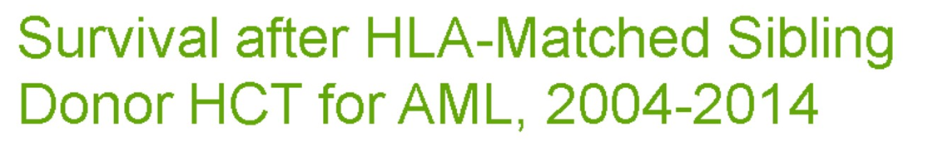
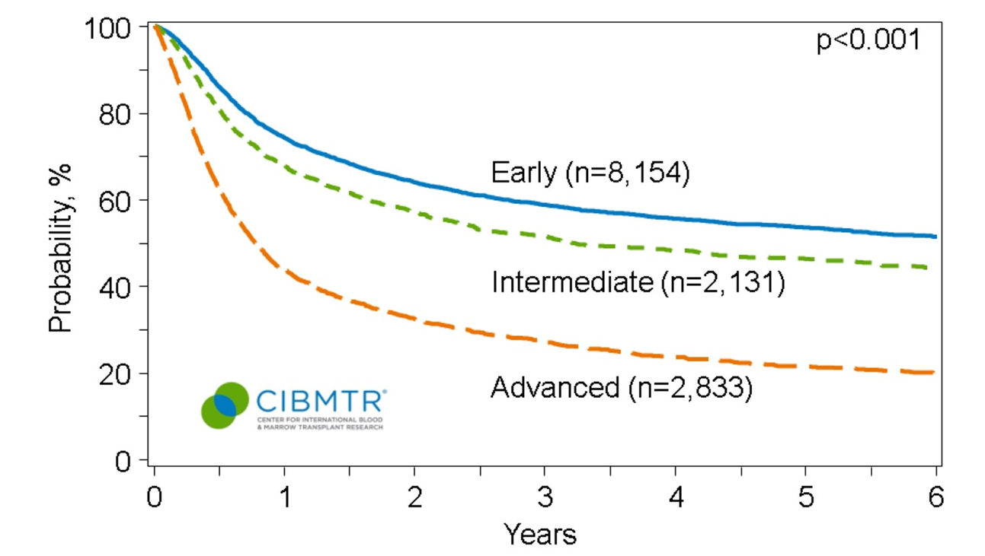
Survival after HLA-Matched Sibling Donor HCT for AML, 2004-2014
30-40 %
40-50 %
60-80 %
Notes:
Slides 20 & 21: The CIBMTR has data for 32,272 patients receiving an HLA-matched sibling (n=13,118) or unrelated donor (n=19,154) transplant for AML between 2004 and 2014. Their disease status at the time of transplant and the donor type are the major predictors of post-transplant survival. The 3-year probabilities of survival after HLA-matched sibling transplant in this cohort was 59% ± 1%, 51% ± 1%, and 27% ± 1% for patients with early, intermediate, and advanced disease, respectively. The probabilities of survival after an unrelated donor transplant were 51% ± 1%, 48%± 1%, and 25% ± 1% for patients with early, intermediate, and advanced disease, respectively.

Slide 3
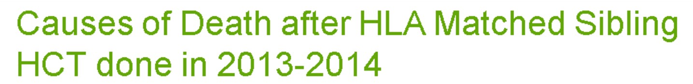
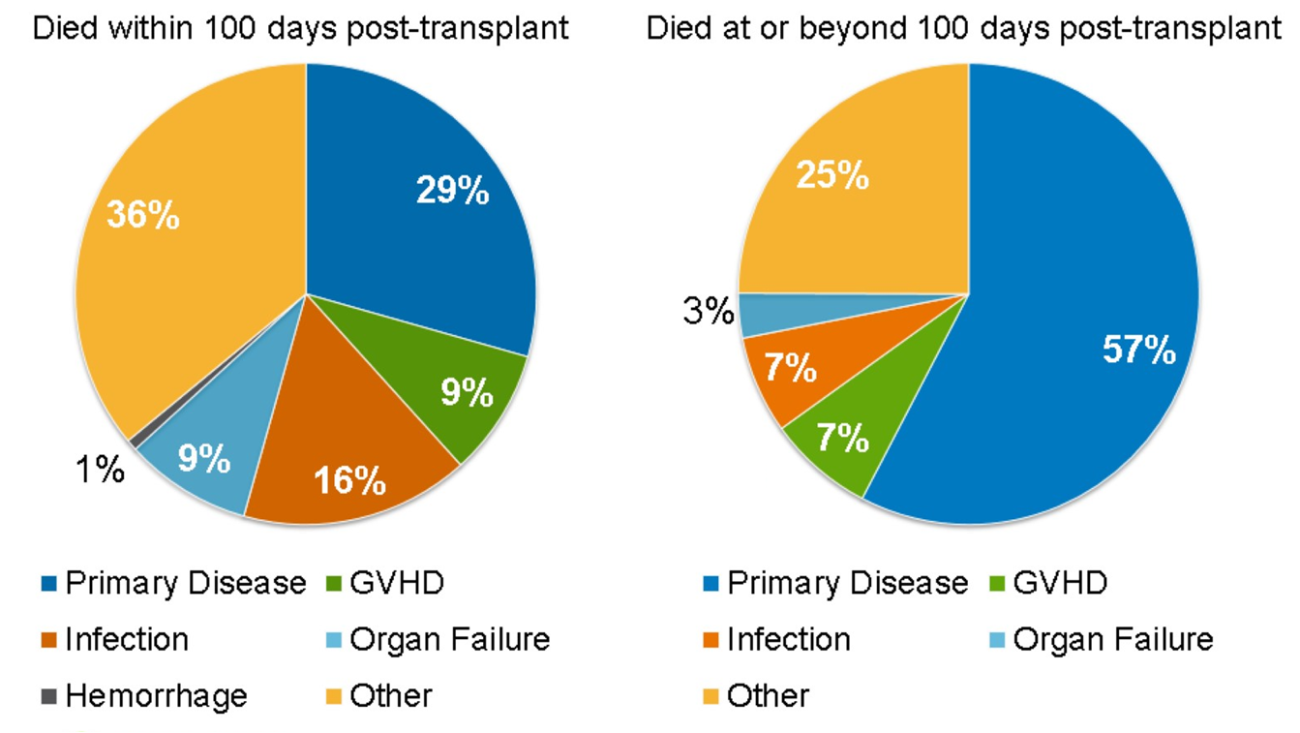

Causes of Death after HLA Matched Sibling HCT done in 2013-2014
Notes:
Slides 16-18: After an autologous HCT, primary disease is the most commonly reported cause of death representing 69% of deaths. Among HLA-matched sibling transplant recipients, within the first 100 days, primary disease accounts for 29% of deaths, while infection and graft-versus-host disease represent 25% of deaths. At or after 100 days, 57% of deaths are attributed to primary disease. After unrelated donor allogeneic HCT, within 100 days, mortality related to GVHD, infection, organ failure and graft rejection accounts for 33% of deaths. After 100 days, 46% of deaths are related to primary disease.

Slide 4
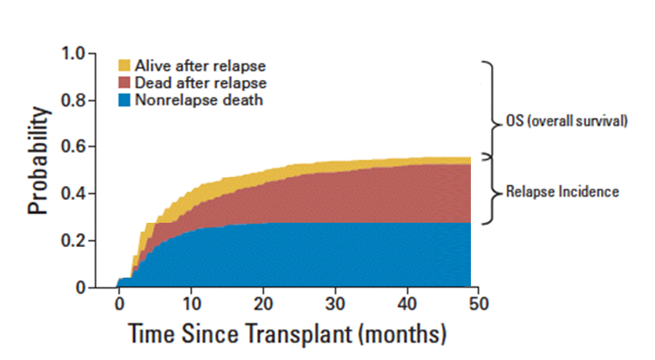
Relapse is the leading cause of treatment failure post-HSCT
The incidence is from about 10 % to more than 50 %
The outcome is generally poor..
Relapse/ disease progression is the most common cause of death
after the transplantation in many settings.

Slide 5
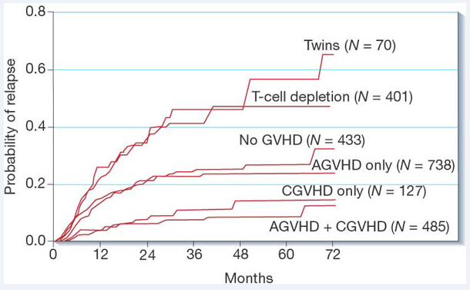
Disease relapse after allografting
Appelbaum et al. Nature 2001

Slide 6
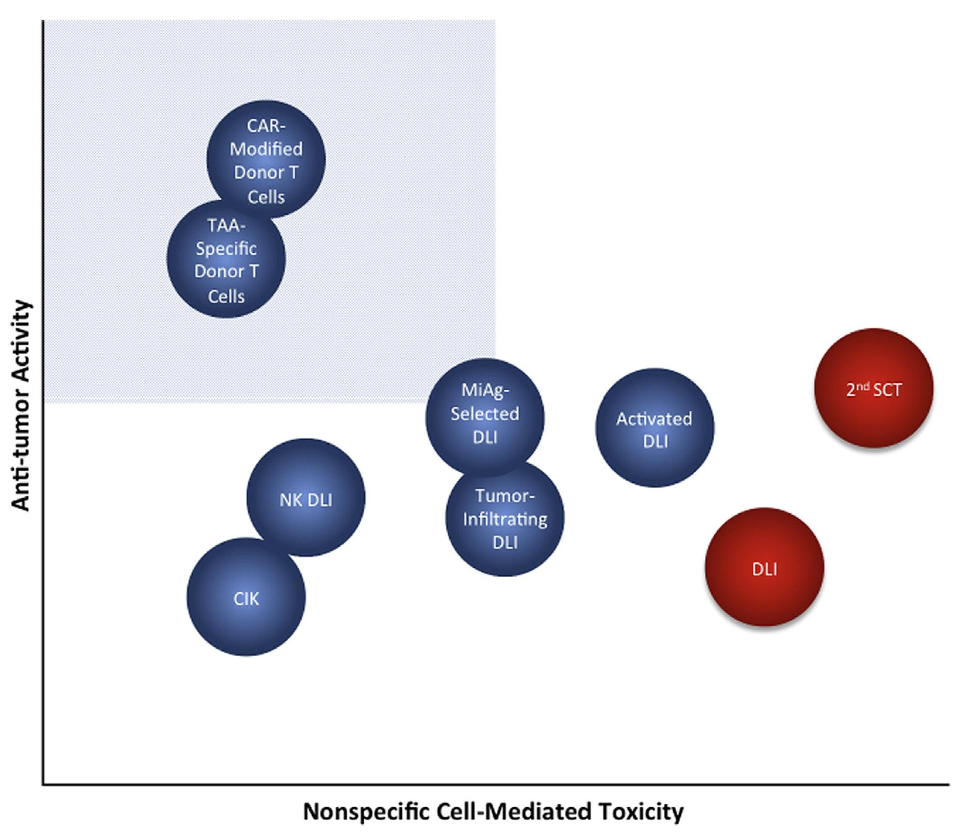
Approaches to relapse after allogeneic HSCT
Options at relapse
Second allogeneic transplantation
Withdrawal of immunosuppression
Donor lymphocyte infusion (DLI)
Chemotherapy with /without DLI
Novel drugs with or without DLI
  hypomethylating agents
  tyrosine kinase inhibitors
  proteasome inhibitors
  monoclonal antibodies
  thalidomide, lenalidomide
  interferon
Novel cellular therapies (CAR T Cell)
palliation
de Lima et al, BBMT 2014
Little progress has been made in recent years in reducing the incidence of relapse post-transplantation.

Slide 7
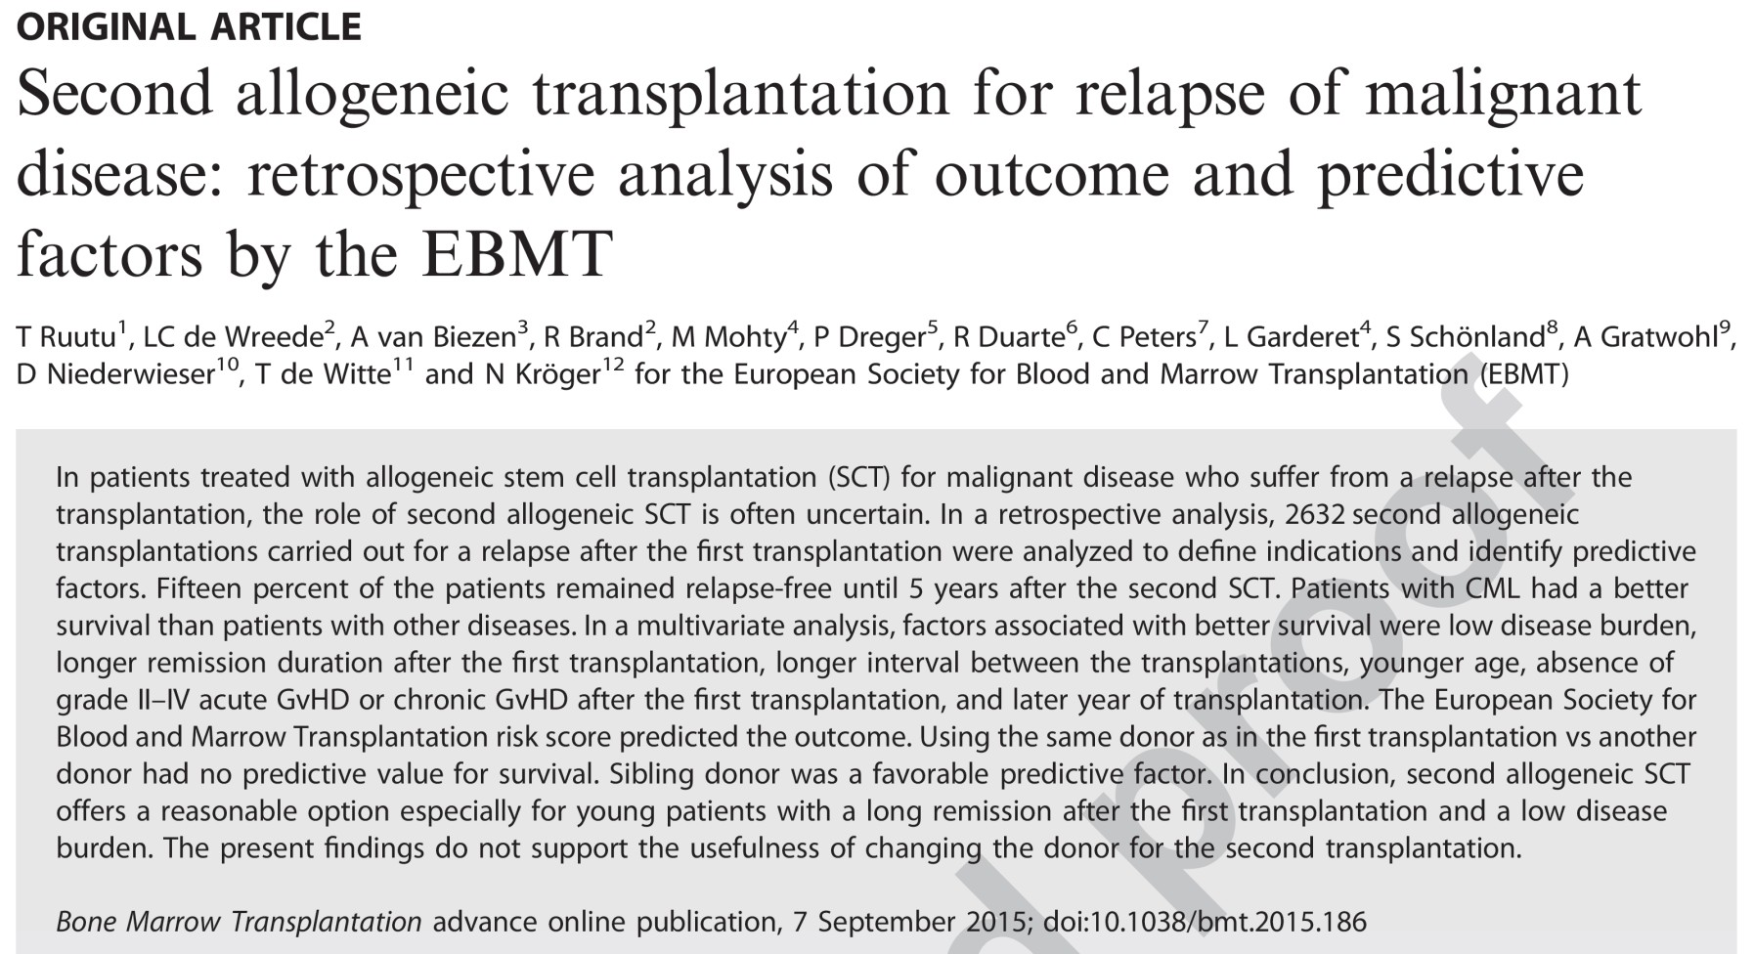
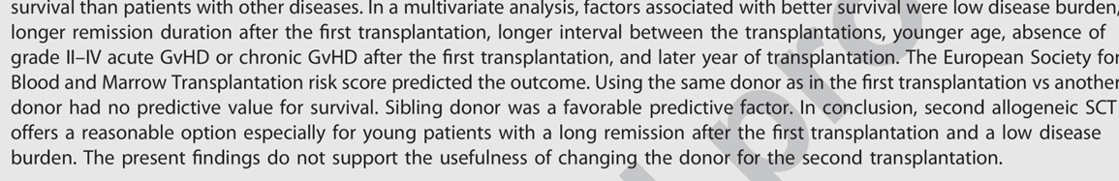
Second allogeneic transplantation Approaches to relapse after allo-HSCT
7
Second allogeneic transplantation for relapse of malignant disease: retrospective analysis of outcome and predictive factors by the EBMT. Bone Marrow Transplant. 2015

Slide 8

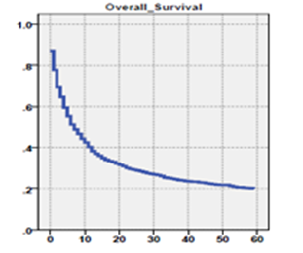
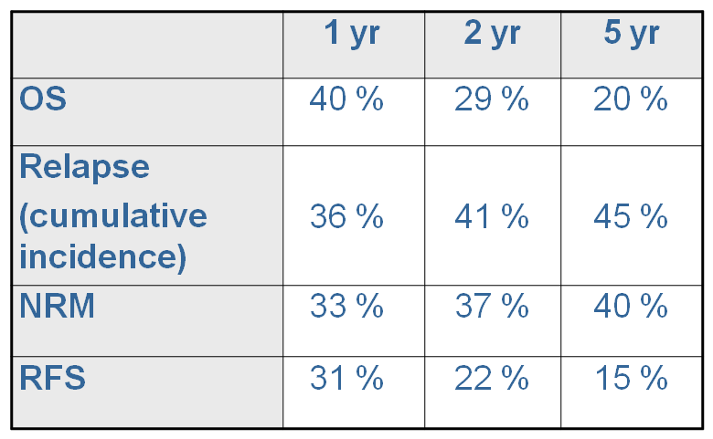
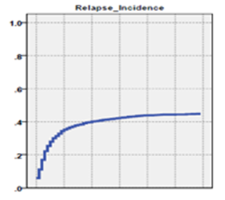
Outcome
Second allogeneic transplantation Approaches to relapse after allo-HSCT
%20-25
%40-45
Second allogeneic transplantation for relapse of malignant disease: retrospective analysis of outcome and predictive factors by the EBMT. Bone Marrow Transplant. 2015

Slide 9
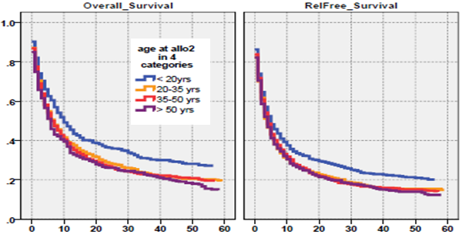
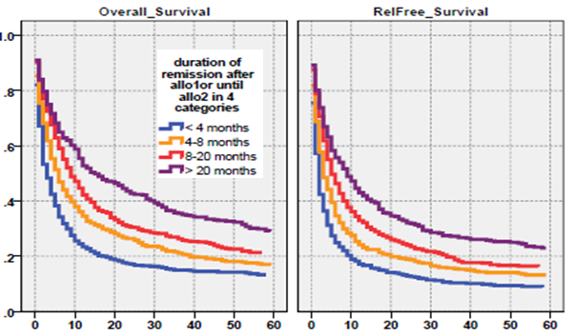
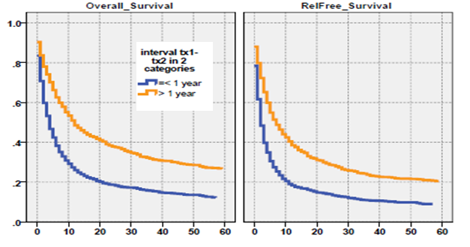
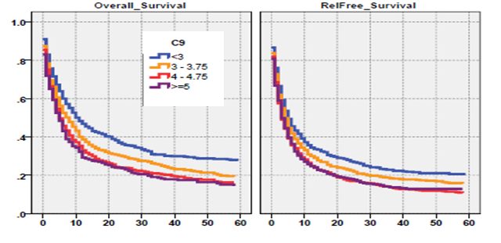
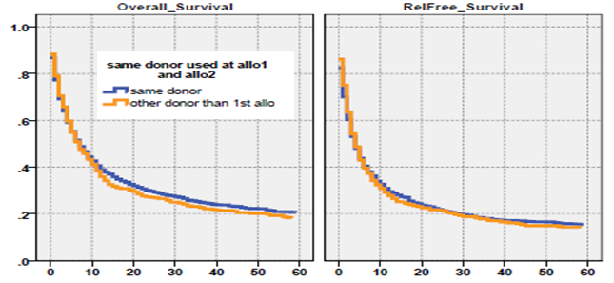
Duration of remission
Factors significantly associated with better survival
Age
Interval between transplantations
EBMT risk score
Same or other donor
Second allogeneic transplantation for relapse of malignant disease: retrospective analysis of outcome and predictive factors by the EBMT. Bone Marrow Transplant. 2015
Notes:
Low disease burden
Longer remission duration after first transplantation
Longer interval between first and second transplantation
Younger age
Absence of grade II-IV acute GvHD after first
transplantation
Absence of chronic GvHD after first transplantation
Sibling donor
Later year of transplatation
EBMT risk score
No significant impact on survival:
Intensity of conditioning (myeloablative vs. RIC) at first or second transplantation
Donor: same as in first transplantation or
other
Source of graft (BM vs. PBSC)

Slide 10
Factors significantly associated with better survival
Second allogeneic transplantation for a relapse of malignant disease after the first allogeneic transplantation offers a reasonable treatment option especially for
  Young patients with
  Long time remission after first Tx, > 1 year
  Long time interval from the first transplantation, > 1 year
  Low EBMT risk score
  Low disease burden.
The outcome was marginally better with a sibling donor compared with MUD
The intensity of conditioning did not significantly affect the survival.
There was no significant difference between BM and PBSC grafts for the outcome.
The present results do not support the usefulness of changing the donor for the second transplantation
31
Notes:
No significant impact on survival:
Intensity of conditioning (myeloablative vs. RIC) at first or second transplantation
Donor: same as in first transplantation or
other
Source of graft (BM vs. PBSC)

Slide 11
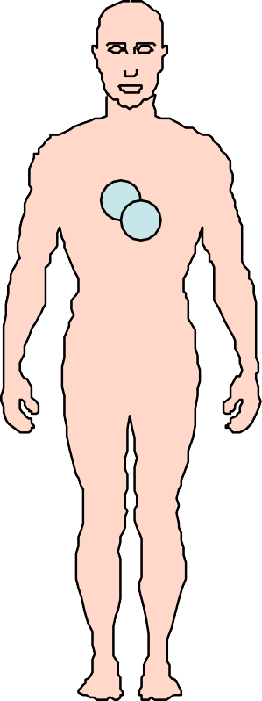
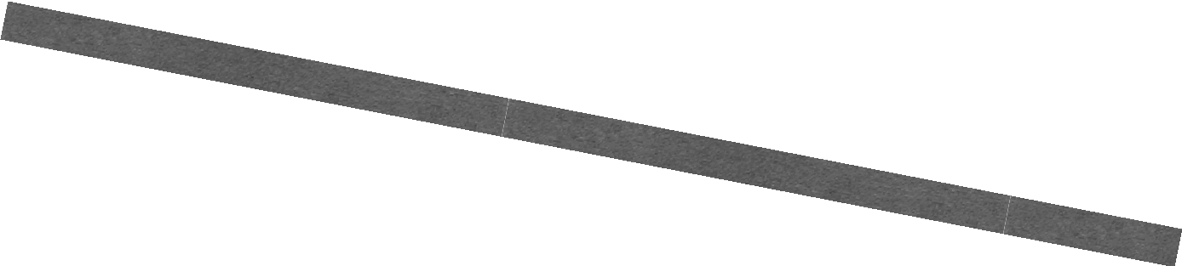
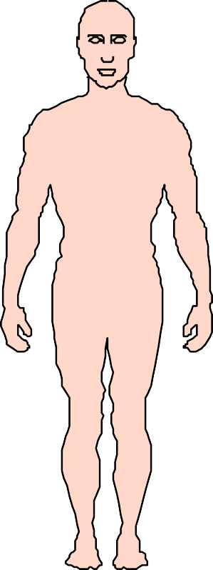


Can we provacate GvL with Donor T cell infusion ?
Relapse
MRD
Low Chimerism
GvL
Immune reconstitution
High Chemerism
DLI

Slide 12
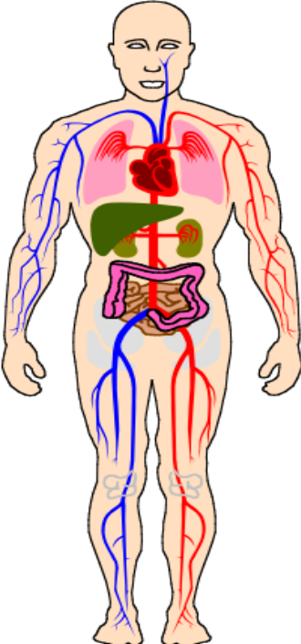
Donor lymphocyte infusions (DLI):
Cellular Immune
Therapy
Preparative
Regimen
Dsc
DT
D
D
DT
D
D
HSCT
+DLI
Dsc
DT
DB
R
R
DNK
Dsc
R
DT
DNK
R_{L}
R
D
R_{L}
R_{L}
D
Recipient
Donor
Mixed Chimera
Complete Chimera
Notes:
MSCs are immune privileged cells. The fact that MSCs from children can persist in mothers for decades suggests that these cells can escape immune surveillance for a long period of time [43].
The immune phenotype of MSCs is generally described as major histocompatibility (MHC) I positive and MHC II negative.
THEY ALSO LACK THE COSTİMULATORY MOLECULES CD40, CD80, and CD86. Although expressing low levels of MHC I antigens can activate T cells, the absence of costimulatory molecules cannot initiate secondary signals, thus leaving the T cells anergic [44].
BESİDES, THE EXPRESSİON OF LOW LEVELS OF MHC I İS İMPORTANT İN PROTECTİNG MSCS FROM NATURAL KİLLER CELL-MEDİATED CYTOTOXİCİTY.
The use of MSCs in clinical applications requires understanding of their biological characteristics that contribute to the therapeutic effects.
Currently, the following four properties are considered the most important (Figure 3):
(1) the ability to home to sites of inflammation following tissue injury when injected intravenously
2) the ability to differentiate into various cell types
(3) the ability to secrete multiple bioactive molecules capable of stimulating recovery of injured cells and inhibiting inflammation
(4) the lack of immunogenicity and the ability to perform immunomodulatory functions. Although we divide the effects of MSCs into these four aspects for better description in this review, in fact, these four aspects are combined and overlapped. Their exact roles in the therapeutic effects of MSCs remain to be further elucidated.

Slide 13
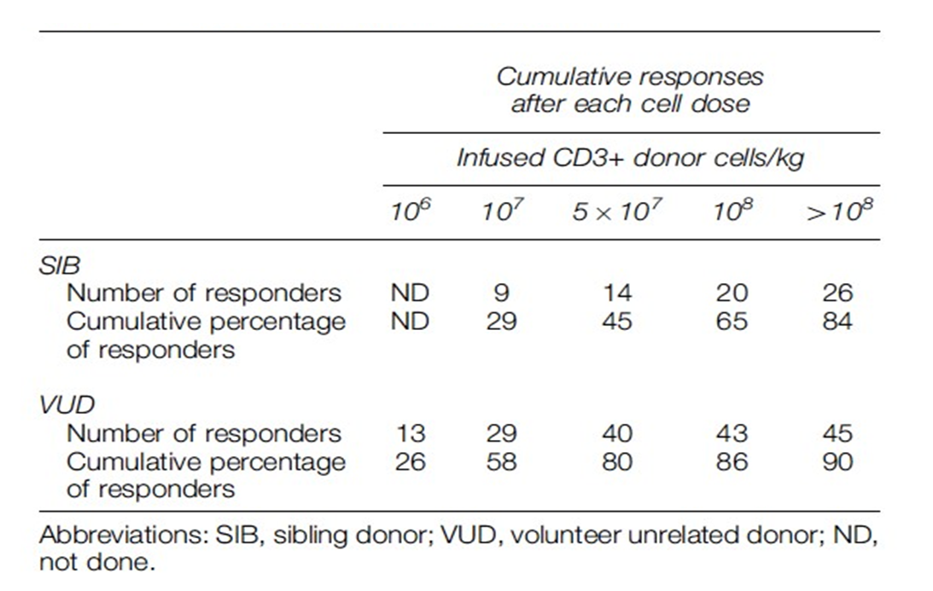
The cell dose affects response rate
Simula et al, Leukemia 2007

Slide 14
Escalating dose regimens for DLI
SIB VUD
(CD3 cells /Kg) (CD3cells /Kg)
First dose | 10 ⁷ | 10 ⁶
Second dose | 5x10⁷ | 10⁷
Third dose | 10 ⁸ | 5x10⁷
Fourth dose | - | 10 ⁸
Simula et al, Leukemia 2007

Slide 15
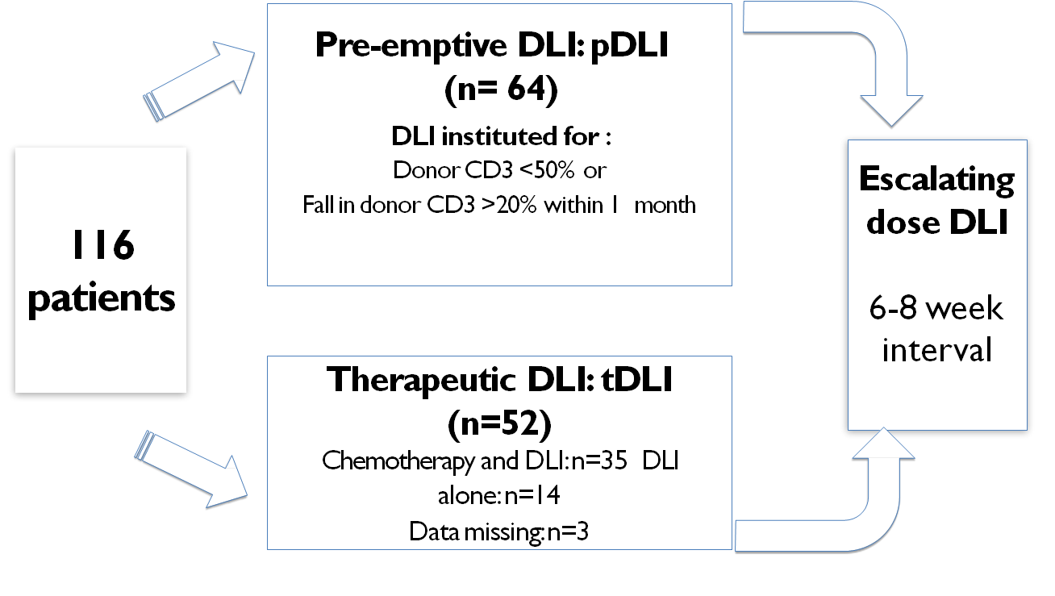
Pre-emptive DLI for relapse of AML/MDS after RIC HSCT
Krishnamurthy, Potter et al, BBMT ,2013

Slide 16
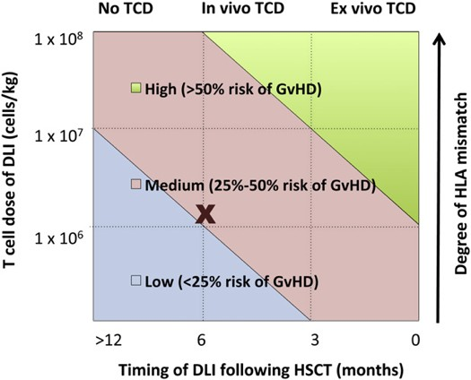
Pre-emptive DLI for relapse of AML/MDS after RIC HSCT
64 patients pre-emptive DLI : OS of 80% and EFS of 65%
Early administration of pre-emptive DLI correlates with durable AML/MDS remission
Acute GvHD (31%):
Chronic: GvHD (19%):
Krishnamurthy, Potter et al, BBMT ,2013

Slide 17
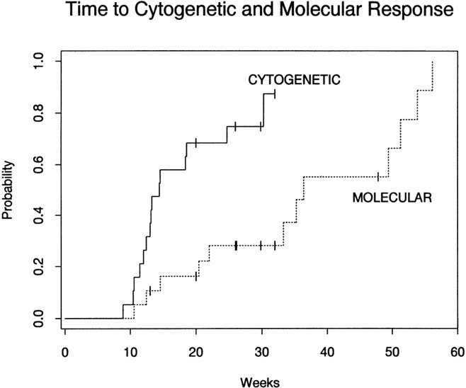

Probability of complete cytogenetic response and molecular remission after CD4+ DLI in patients with relapsed early-phase CML
Nineteen patients (%70) with cytogenetic or stable-phase CML relapse were evaluable for response.
Alyea E P et al. Blood 1998;91:3671-3680
©1998 by American Society of Hematology

Slide 18



αβ T Hücre Depleted DLI
DLI
DLI
DLI
αβ T Hücre Depleted Haplo
1-5 x 10 ⁶ TcR-γδ
≤2.5 x 10 ⁴ αβT cell
1-5 x 10 ⁶ CD3 T cell
1-5 x 10 ⁶ NK cell
Relapse
Preliminary Results
Response rate : 60 %
A GVHD rate : 28 %
cGVHD arte : 16%

Slide 19
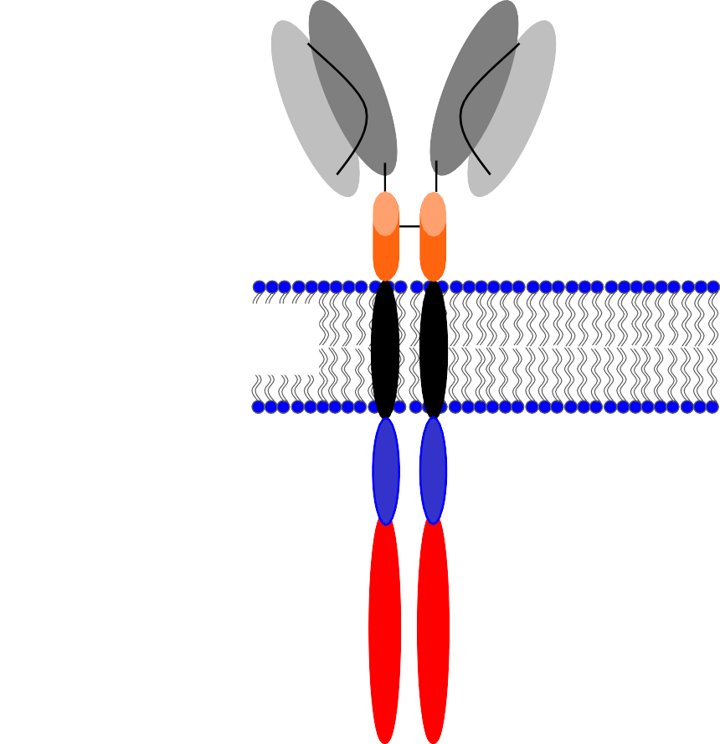


CAR-T:
Adoptif T Hücre Tedavisi
Kimerik antijen reseptörleri – T Hücre
  T Hücrelere tümör spesisfik CAR aktarılır
  CAR: Antijen spesifik füzyon molekülü ve sinyal domain içerir.
  Şimdiye kadar 3 tip geliştirilmiştir: 1. /2./3. nesil
  Ko-stümülatör molekülleri farklıdır.
scFv
Hinge Transmembrane
Co-stimulatory domain
Signalling domain
POOLED RESPONSE DATA
ALL (adults and children) – 80% CR (UPenn & MSKCC)
CLL – 22% CR (UPenn)
Maus M V et al. Blood 2014;123:2625-2635
Notes:
An antigen recognition domain is coupled with cytoplasmic elements normally found on signaling receptors
Antigen recognition
For CLL, the target has generally been CD19
Single chain variant fragment (scFv), often from monoclonal antibodies or phage display
Recognize antigen in the absence of MHC
Signaling elements include cytoplasmic domains from:
CD3 zeta chain
4-1BB (CD137 or TNFRSF9)
CD28
CD134 (OX-40)

Slide 20
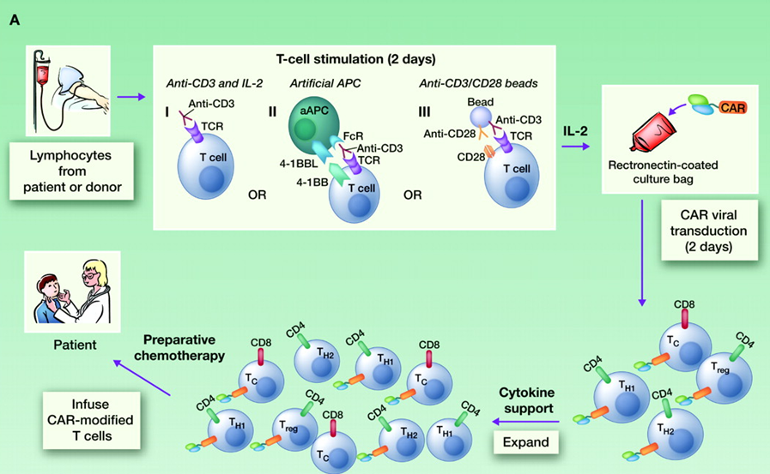

CAR-T:
Product manufacture and testing
Lee D W et al. Clin Cancer Res 2012;18:2780-2790
Notes:
General schema for the preparation, transduction, and infusion of CAR-modified T cells. A, apheresed T cells from a patient or an allogeneic donor are activated. Three accepted methods are illustrated: (i) stimulation with the activating CD3 antibody, OKT3, in the presence of IL-2; (ii) stimulation with anti-CD3– and anti-CD28–coated paramagnetic beads in the presence of IL-2; and (iii) stimulation with aAPC (expressing 4-1BBL and an Fc receptor) with OKT3 and IL-2. Activated cells are then transduced with the CAR using a retro- or lentiviral platform. Because the CAR is integrated into the T-cell genome, all daughter cells that are generated (a mix of CD4⁺ [Th1/Th2/T_{H}17/Treg] and CD8⁺ T cells) during this expansion also express the CAR. CAR T cells are then infused into the patient after preparative chemotherapy. B, generation of CAR-expressing T cells generally results in a several-hundred-fold expansion over 14 days. Such extensive proliferation may generate predominantly T_{EFF} cells, which have cytotoxic capabilities but limited proliferative potential compared with T-effector and T_{CM} cells. C, less intense stimulation and/or modulation of stimulation methods may produce more naïve T cells or T-central memory cells, which have an increased likelihood of persistence.

Slide 21
CAR-T:
Product manufacture and testing
Apheresis product from patient
Additional (in-process) tests during manufacture
Viability
Cell count
Phenotype
Sterility
Expanded gene modified T cells
Select T cells
Bead removal
Product release tests
Flow cytometry (phenotype/ScFv) Residual bead count
Potency (cytokine production?) Vector copy number (PCR)
Mycoplasma
Replication-competent vector (PCR + culture)
Viability / cell count
Activate T cells with CD3/CD28 beads
Gene Transfer Vector
Harvest
Transduce
Cryopreserve
Transduce
um
5
Final wash and formulation
Sterility (bacterial and fungal) Endotoxin
Fresh Medi
IL-2 / IL-1
Some test results may not be known at time of infusion
10
Culture (days)
Infuse to patient

Slide 22

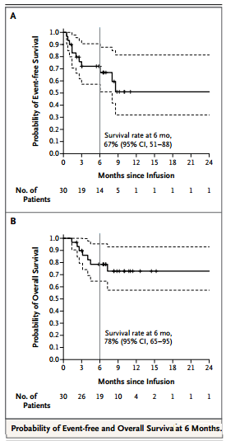
27/30: 1. ayda TAM CEVAP
19/27: Remisyonda KALDI (Ortanca takip 7 ay)
22/27: Negatif MRD (< 0.01% , flow)
7/27: 6 hafta ile 8.5 ay içinde nüksetti
  4 CD19+ (Relapsta CAR T hücre negatif)
  3 CD19- (Relapsta CAR T Hücre pozitif)
2 hasta SSS hast→ 6.ayda blast negatif
6 aylık EFS 67% (95% CI, 51-88)
6 aylık OS: 78% (95% CI, 65-95)
Notes:
Initial reports were very impressive
Longest remission being 2 years
40% of children obtain CR after 2 or more BM relapses

Slide 23
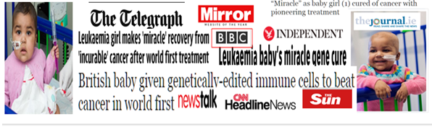
11 aylık kız çocuğu
high risk CD19+ ALL ,t(11;19) BMT sonrası nüks
Lenfodeplesyon sonrası (4.5x10⁶/kg) UCART19 T
Kısa süre sonra sitogenetik ve moleküler remisyon
İlk defa universal CAR T 19 (UCART19) hücre Gen Editing Yöntemi ile elde edildi.
Transcription activator-like effector nucleases (TALEN)s teknolojisi kullanarak üretilen mismatched donör CAR19 T Hücre uygulaması.
TCR alfa geni knock out yapılarak hasta GVHD engellenmeye çalışıldı ve CD52 geni knock out yapılarak alemptuzumaba dirençli hale getirildi.
Switch-off geni olarak rituximaba duyarlı theRQR8 marker/knock-in
(Üçüncü parti GMP )
(LENFODEPLESYON)
(SUİCİDE GENİ )
3. Nesil self inaktif lentiviral vector ile 4g7 CAR19 (CD19 scFv- 41BB- CD3ζ) linked to RQR8) kodlandı (transdükte edildi)
Notes:
Chimeric antigen receptor (CAR)19 T-cells exhibit powerful anti-leukemic effects in patients with B cell malignancies. However, the complexity of production of patient bespoke T cell products is a major barrier to the broader application of this approach. We are investigating a novel strategy to enable “off-the-shelf”’ therapy with mismatched donor CAR19 T cells. Transcription activator-like effector nucleases (TALEN)s can be used to overcome HLA barriers by eliminating the risk of graft-versus-host disease (GvHD) through disruption of T cell receptor expression, and by simultaneously targeting CD52, cells can be rendered insensitive to the lymphodepleting agent Alemtuzumab. Administration of Alemtuzumab can then be exploited to prevent host-mediated rejection of HLA mismatched CAR19 T cells. We manufactured a bank of such cells from volunteer donor T cells under GMP conditions on behalf of Cellectis S.A for final stage validation studies using a, an abbreviated sort/suicide gene encoding both CD34 and CD20 epitopes. Cells were then electroporated with two pairs of TALEN mRNA for multiplex targeting of both the T cell receptor alpha constant chain locus, and the CD52 gene locus. Following ex-vivo expansion, cells still expressing TCR were depleted using CliniMacs alpha/beta TCR depletion, yielding a T cell product with <1% TCR expression, 85% of which expressed CAR19, and 64% becoming CD52 negative. This universal CAR19 (UCART19) cell bank has been characterized in detail, including sterility, molecular and cytometric analyses and human/murine functional studies ahead of submissions for regulatory approvals and Phase 1 testing in trials for relapsed B cell leukaemia. In the interim we received a request for therapy on a compassionate basis for an infant with refractory relapsed B-ALL, and with the agreement of Cellectis, we treated this first patient under UK special therapy regulations. Leukaemic blasts expressed CD19 but were CD52negative. Her disease progressed despite treatment with Blinatumomab (70% blasts in marrow) and we were unable to generate donor-derived CAR19 T cells on an existing study. Following institutional ethics review, detailed counseling, and parental consent, the patient received cytoreduction with Vincristine, Dexamethasone and Asparaginase followed by lymphodepleting conditioning with Fludarabine 90mg/m², Cyclophosphamide 1.5g/m²and Alemtuzumab 1mg/kg. Immediately prior to infusion of UCART19 cells, the bone marrow showed persisting disease (0.5% FISH positive). She received a single dose (4.5x10⁶/kg) of UCART19 T cells without any significant toxicity. To date there has been no significant perturbation of cytokine levels in peripheral blood, and no indication of cytokine release syndrome. Although profoundly lymphopenic, UCART19 T cells were detectable by qPCR in the circulation by day 14 and at increased levels in both blood (VCN 0.35) and marrow (VCN 0.22) on day 28. The patient exhibited signs of count recovery and the bone marrow, while hypoplastic, was in cytogenetic and molecular remission. Chimerism was 90% donor, and a clearly demarcated population (7%) of third party cells indicated persistence of UCART19. A residual persistence of 3% recipient cells in the marrow suggests that leukemic clearance was not mediated by transplant mediated alloreactivity.
Within the short period of follow up available, our intervention comprising lymphodepletion and infusion of UCART19 T cells has induced molecular remission where all other treatments had failed. This first-in-man application of TALEN engineered cells provides early proof of concept evidence for a ready-made T cell strategy that will now be tested in early phase clinical trials.

Slide 24
CAR-T:
Other Targets,,,
Hedef Antijen | Kanser Tipi
α-Folate receptor, GD2 | Ovarian carcinoma
CAIX | Renal cell carcinoma
CD20 | B cell malignancies
CEA, EGP-40 | Colorectal cancer
Erb-B2, CEA | Breast cancer
CD33, CD123 | AML
CD30 | Hodgkin lymphoma
CD44 | Cervical Carcinoma
GD3 | Melanoma
Her2/neu | Glioblastoma, glioma, lung Carcinoma
PSMA | Prostate
MUC1 | Breast, ovarian carcinoma
Notes:
And CAR T cells are being looked at in a number of different diseases including

Slide 25
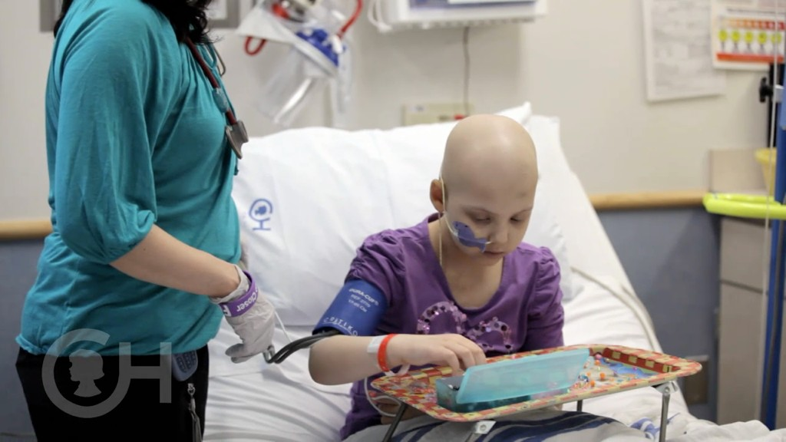

Slide 26
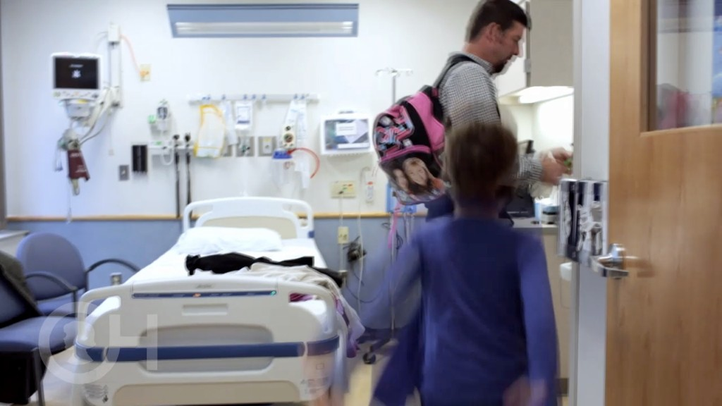
Thank you for your attention …

