Slide 1
General Overwiew:
New Approach to Mantle Cell Lymphoma
Dr. Mustafa ÇETİN, Kayseri-2017

Slide 2
Subtypes of NHL
Mantle cell
(6-8 %)
Burkitt
(2.5%)
Follicular
(25%)
Other subtypes
(9%)
Small lymphocytic lymphoma/CLL
(7%)
T and NK cell
(12%)
MALT-type
marginal-zone B cell (7.5%)
Nodal-type
marginal-zone B cell
(< 2%)
Diffuse large B cell
(30%)
Lymphoplasmacytic
(< 2%)
Mantle cell lymphoma comprises about 7 percent of adult non-Hodgkin lymphomas in the United States and Europe with an incidence of approximately 4 to 8 cases per million persons per year

Slide 3
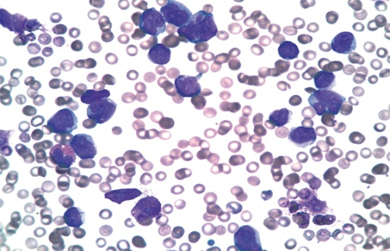
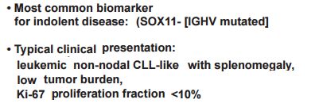
MCL: Clinical Features
Accounts for ~ 6% of B-cell NHL cases
Typically a disease of the elderly
  Median age greater than 65 years old, 74% male
Generally regarded as aggressive and incurable
Indolent presentation, 10-15%
Armitage JO. Oncology (Williston Park). 1998;12(10 suppl 8):49-55. Fisher RI, et al. Hematology Am Soc Hematol Educ Program. 2004:221-226. O’Connor OA, et al. Leuk Lymphoma. 2008;49(Suppl 1):59-66.
Notes:
GI, gastrointestinal; NHL, non-Hodgkin’s lymphoma; PB, peripheral blood.
Mantle cell lymphoma accounts for approximately 6% of all B-cell non-Hodgkin’s lymphoma. It has a moderately aggressive course and an unusual male predominance, with approximately 74% of cases occurring in men. The median age at diagnosis is 63 years. The vast majority of patients (> 90%) has advanced-stage disease at diagnosis, and involvement of the bone marrow and GI tract are common.
Fisher et al. Hematology. 2004;221.

Slide 4
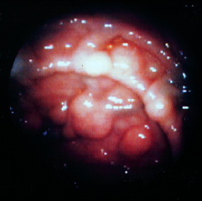
MCL: Clinical Features
> 90% stage III/IV, including marrow involvement
  Blood (lymphocytosis), and lymphadenopathy (75-90 %)
  Extranodal sites common
  GI (upper and lower, can present as lymphomatous polyposis coli), (25 %)
  CNS involvement rare (<5%)
  Leukemic phase, PB flow commonly positive
Most patients present with advanced stage disease..
Cheah CY, et al. Ann Oncol. 2013;24:2119-2123
Notes:
Reasonable to screen if blastoid variant, high tumor burden, elevated LDH, high MIPI score, CNS symptoms
Indolent presentation→more like CLL. Present with lymphocytosis, splenomegaly. Look like CLL
Sox11 expression→low or no expression a/w more indolent
Sox11 transcription factor

Slide 5
Pretreatment Workup
History and physical examination
  Evidence of GI blood loss?
  Early satiety
Pretreatment evaluation
  CBC, COMP, LDH, B2M, IF, quantitative immunoglobulins
  HBsAg, hep B core Ab (hep B PCR if either is positive)
  Diagnostic CT with PET
    GI tract involvement by PET may be unreliable
  Panendoscopy
    Controversial; does it change treatment?
      Depends on goals of therap
      Establish bleeding risk: if negative, no need to repeat to confirm CR
  Echocardiogram
  When appropriate: pregnancy testing
Notes:
B2M, β2-microglobulin; CBC, complete blood count; COMP, complete metabolic panel; CR, complete response; CT, computed tomography; GI, gastrointestinal; Hep B core Ab, hepatitis B core antibody; HBsAg, hepatitis B surface antigen; IF, immunofixation; LDH, lactate dehydrogenase; PCR, polymerase chain reaction; PET, positron emission tomography.
The pretreatment evaluation is relatively standard for patients with lymphoma. However, historical and physical examination should be focused with specific attention to evidence of gastrointestinal (GI) blood loss and early satiety. In addition, the pretreatment evaluation for MCL includes panendoscopy. The use of this procedure has been somewhat controversial because of the question of whether the results change the management approach and the concern that if the results are positive, is there a substantial risk for GI tract bleeding? However, the National Comprehensive Cancer Network guidelines recommend and Memorial Sloan-Kettering policy dictates that panendoscopy is performed. Only approximately one half of patients at Memorial Sloan-Kettering have GI tract involvement. At some centers, GI tract involvement is reported to be present in as high as 90% of patients; in such settings, it becomes less critical to assess for GI tract involvement because it can be assumed and assessments can be reserved for the end of treatment to ensure that the GI tract is negative.

Slide 6
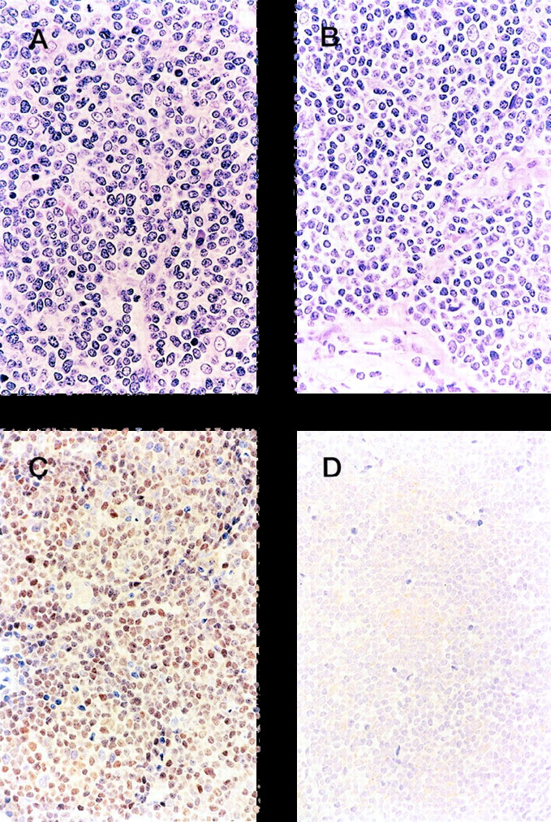
MCL: Critical Role of Cyclin D1
100
  Some cases of MCL express cyclin D2 or D2
80
60
OS (%)
All patients
Cyclin D1+
Cyclin D1-
H&E
40
P = .0002
H&E
20
0
0
5
10
15
Yrs
Nuclear staining for cyclin D1 (BCL-1) is present in >90 percent of cases, including those that are CD5 negative.
Cyclin D1
Cyclin D1
This research was originally published in Blood. Yatabe Y, et al. Blood. 2000;95:2253-2261 © the American Society of Hematology.
Notes:
CLL, chronic lymphocytic leukemia; H&E, hematoxylin and eosin; MCL, mantle cell lymphoma.
The critical role of cyclin D1 expression was reported by Yatabe and colleagues in 2000 when they demonstrated that CD20-positive, CD5-positive, and CD23-negative lymphoma that lacked expression of cyclin D1 did not exhibit behavior typical of MCL, but in fact was a variant of chronic lymphocytic leukemia. Although some cases of MCL can express cyclin D2 or D3, these cases are so rare that they are overwhelmed by variant cases of chronic lymphocytic leukemia.

Slide 7
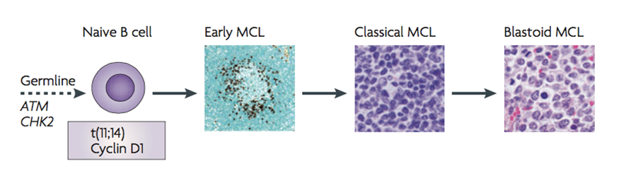
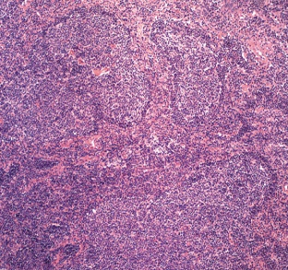
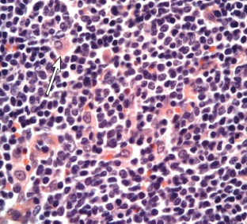
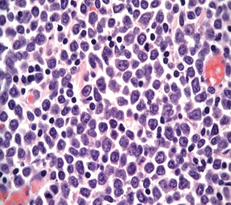
The histologic pattern of MCL
Mantle Zone
Nodular type
Diffuse type
Blastoid type
5% to 7%
10% to 15%
70 % to 75%
5% to 7%
The histologic pattern of MCL may be diffuse, nodular, or mantle zone, or a combination of the three.
Most cases are composed exclusively of small to medium-sized lymphoid cells, with slightly irregular or "notched," nuclei
Jares P, et al. Nat Rev Cancer. 2007;7:750-762
Notes:
The t(11;14) translocation occurs in an immature B cell and leads to the constitutive deregulation of cyclin D1
Cyclin D1 overexpression by IHC. FISH for (11:14) translocation
Cyclin D1- protein required for progression through the G1 phase of the cell cycle
expansion of tumour B cells in the mantle zone areas of lymphoid follicles.
Acquired inactivation of DNA damage response pathways may facilitate additional genetic alterations and the development of classical mantle cell lymphoma
Target cell cycle and senescence regulatory pathways, leading to more proliferative and aggressive variants of MCL.

Slide 8
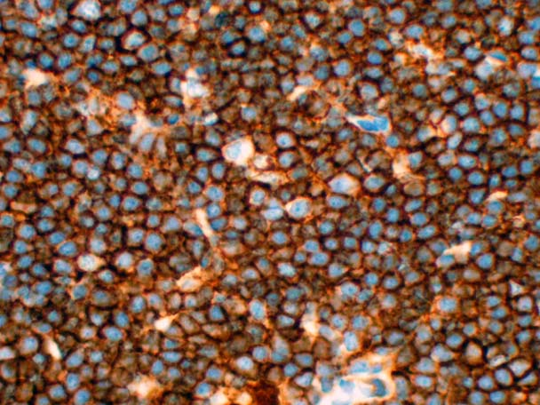
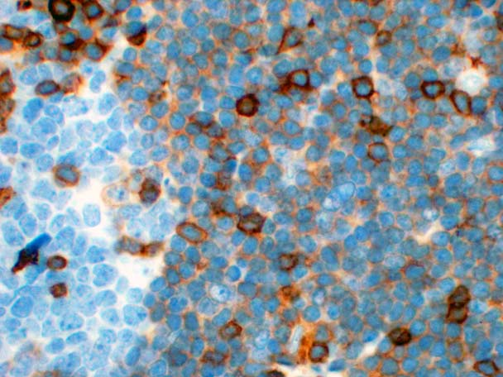
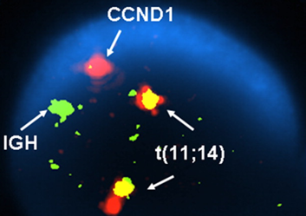
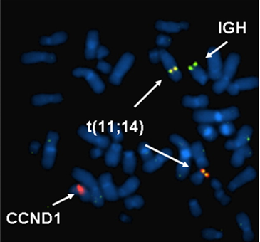
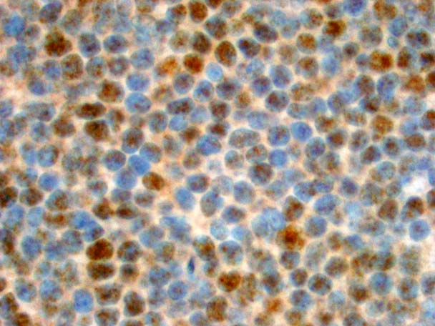
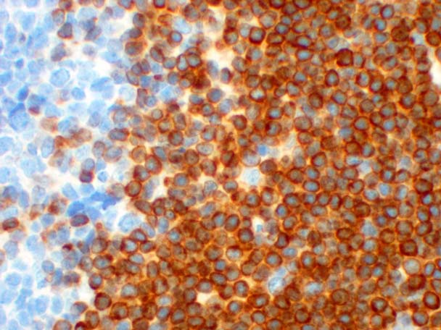
MCL: Pathology
CD20
CD5
Cyclin D1
BCL2
Typical immunophenotype:
CD20+, CD5+, CD23-, CCND1+, FMC7+, BCL2+
Dual-color, dual-fusion translocation DNA probe,) identifying the presence of the t(11;14) [IGH, 14q32/CCND1,11q13].
Mantle cell tumor cells express high levels of surface membrane IgM and IgD (sIgM±IgD), which is more often of lambda light chain type. They also express pan-B cell antigens (eg, CD19, CD20), CD5, and FMC7. Nuclear staining for cyclin D1 (BCL-1) is present in >90 percent of cases, including those that are CD5 negative. (See 'Immunophenotype' above.) ●Although not specific for MCL, the majority of cases will demonstrate t(11;14) by conventional cytogenetics or FISH
Notes:
IgH, immunoglobulin heavy chain.
The typical immunophenotype for MCL is that of a CD20-positive, CD5-positive, cyclin D1-positive, FMC7-positive, and BCL2-positive tumor. The absence of CD23 is typical. Morphologic variants of MCL include diffuse histology, which is the most common occurring in approximately 75% of patients, nodular histology occurring in 10% to 15% of patients, mantle zone histology occurring in 5% to 7% of patients, and blastoid histology occurring in approximately 5% of patients.
The translocation t(11;14), which juxtaposes the immunoglobulin heavy chain gene with the cyclin D1 gene on chromosome 11, is the most common cytogenetic abnormality observed in MCL, and it is easily detected by FISH.

Slide 9
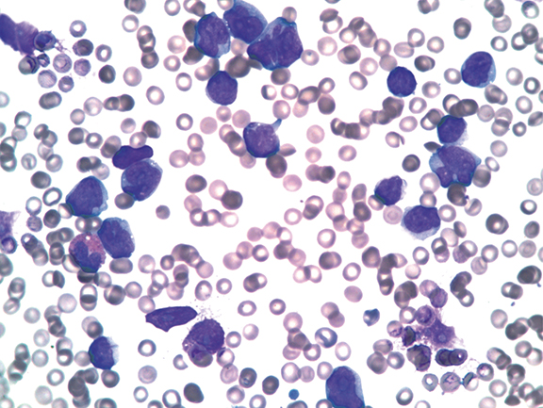
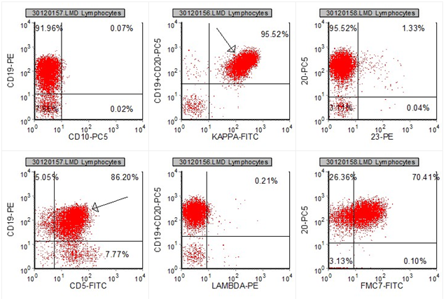
MCL: Flow cytometry
MCL express high levels of surface membrane IgM and IgD (sIgM±IgD),.They also express pan-B cell antigens (eg, CD19, CD20), CD5, and FMC7.

Slide 10
MCL International Prognostic Index
Survival in MCL by MIPI Risk Group
4 factors associated with OS
  Age
  ECOG PS
  LDH
  WBC
1.0
0.8
0.6
Low
Risk group definitions
  Low risk (< 5.7)
  Int. risk (≥ 5.7 to < 6.2)
  High risk (≥ 6.2)
Risk groups are well separated
Probability of OS
0.4
Int
0.2
High
0
0
12
24
36
48
60
72
84
96
Mos Since Registration
This research was originally published in Blood.
Hoster E, et al. Blood. 2008;111:558-565 © the American Society of Hematology.
Online MIPI calculator: www.europeanmcl.net/en/clinical_mipi.php.
Notes:
ECOG PS, Eastern Cooperative Oncology Group performance score; LDH, lactate dehydrogenase; MCL, mantle cell lymphoma; MIPI, Mantle Cell Lymphoma International Prognostic Index; OS, overall survival; ULN, upper limit of normal; WBC, white blood cell.
Prognosis in MCL can also be dictated by the MIPI. The full index involves a complex weighted algorithm that includes age, performance score, LDH, and white blood cell count. However, this index includes complicated logarithms and coefficients that are difficult to remember, and one needs to use a Web site calculator for determining this value on a regular basis. The risk groups are defined as follows: low risk as < 5.7, high risk as ≥ 6.2, and intermediate risk as everyone in between.

Slide 11
Simplified MIPI
Points | Age, Yrs | ECOG PS | LDH, x ULN | WBC, 10⁹/L
0 | < 50 | 0-1 | < 0.67 | < 6.7
1 | 50-59 | -- | 0.67-0.99 | 6.7 ≤ 10
2 | 60-69 | 2-4 | 1.0-1.49 | 10 ≤ 15
3 | ≥ 70 | -- | > 1.5 | ≥ 15
Risk groups
  Low risk: 0-3 points
  Intermediate risk: 4-5 points
  High risk: 6-11 points
This model provides good curve separation in the dataset without calculation
This research was originally published in Blood. Hoster E, et al. Blood. 2008;111:558-565 © the American Society of Hematology. Online MIPI calculator: www.europeanmcl.net/en/clinical_mipi.php.
Notes:
LDH, lactate dehydrogenase; MIPI, Mantle Cell Lymphoma International Prognostic Index; ULN, upper limit of normal; WBC, white blood cell.
The authors realized that this was a complex calculation and suggested a simplified MIPI that takes into account age, performance score, LDH level, and white blood cell count and assigns different numerical point values to different values for these parameters. However, I would argue that the simplified index is not as simple as the International Prognostic Index that is routinely used in diffuse large B-cell lymphoma. When applying the simplified MIPI, low-risk patients have 0-3 points, intermediate-risk patients have 4-5 points, and high-risk patients have 6-11 points. When this model is applied to the case patient, the score reveals that the patient has intermediate-risk disease, with points accrued for age, LDH, and white blood cell count.

Slide 12
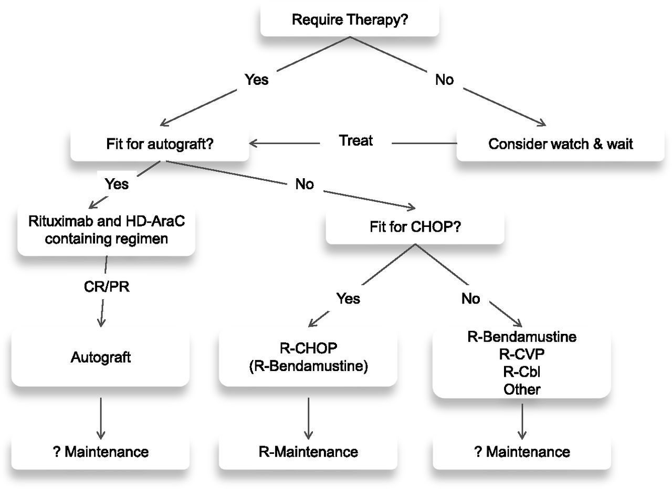

Current first-line therapy pathway for MCL
Elias Campo, and Simon Rule Blood 2015;125:48-55
Notes:
Current first-line therapy pathway for mantle cell lymphoma.
Mantle Cell Lymphoma Management and Outcome in the U.K's Population-Based Haematological Malignancy Research Networ

Slide 13
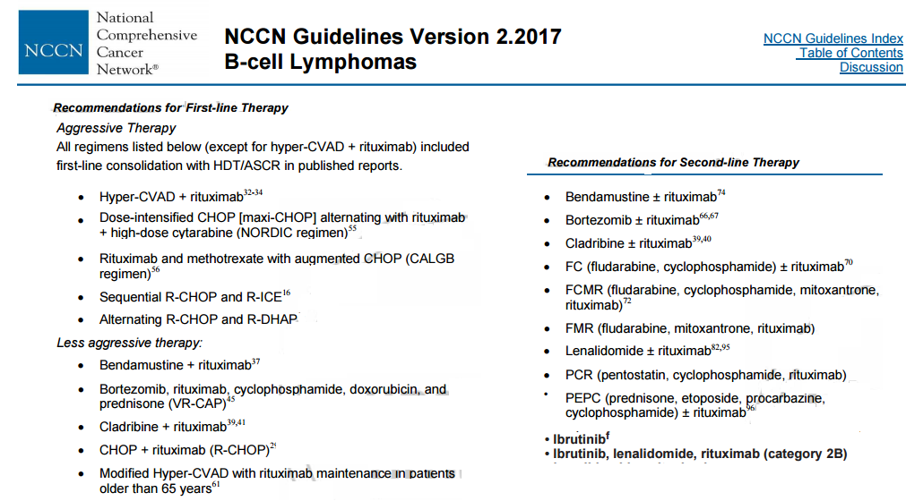

Slide 14
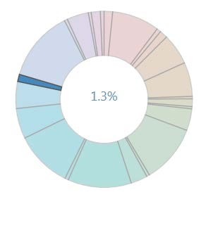
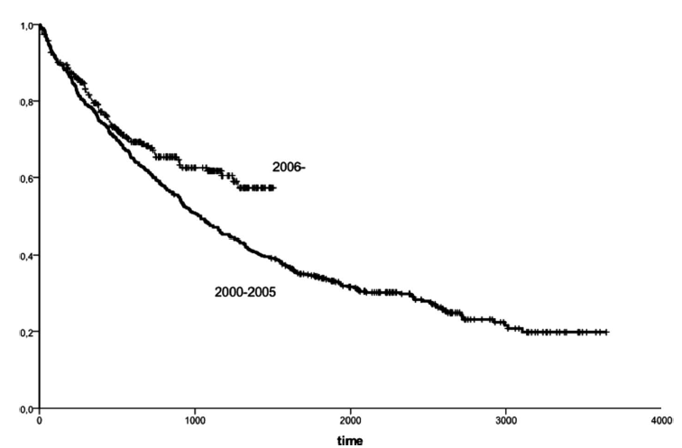

Rare and incurable
Left image: HMRN statistics downloaded from https://www.hmrn.org/statistics/incidence. Data shown for mantle cell lymphoma incidence as a percentage of all haematological malignancies;
Right image: Abrahamsson et al, Leukaemia & Lymphoma 2011. Swedish lymphoma registry data showing overall survival in days for 785 patients diagnosed with MCL before or after 2006

Slide 15
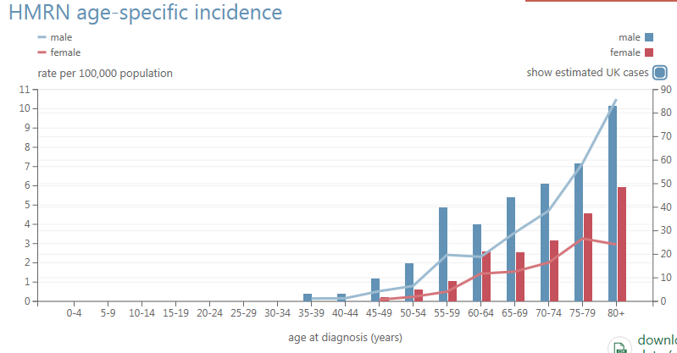
Most not fit for intensive therapy
Haematological Malignancy Research Network
Median age is 73 years
2/3 not fit for intensive approaches
31%
69%
Source: HMRN https://www.hmrn.org/statistics/incidence

Slide 16
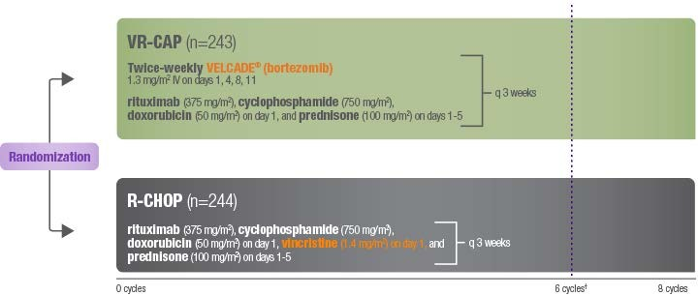
Is VR-CAP better than RCHOP?
VR-CAP (LYM-3002 trial)
Untreated MCL unsuitable for transplant
Robak et al, NEJM 2015. 487 patients. VR-CAP vs RCHOP: toxicity (serious adverse events 38%
vs 30%, peripheral neuropathy 30% vs 27% ). Higher CR (53% vs 42%) and PFS rates (25 vs 14 months) for VR-CAP

Slide 17

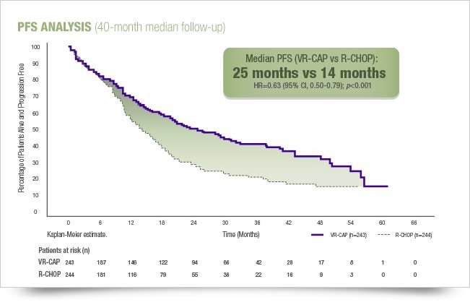
Is VR-CAP better than RCHOP?
Higher CR (53% vs 42%) and , PFS rates (25 vs 14 months) for VR-CAP
Robak et al, NEJM 2015. 487 patients.

Slide 18
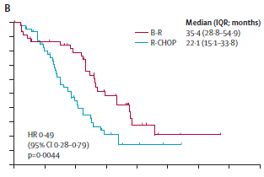
Is R-Bendamustine better than RCHOP?
STiL NHL 1-2003 trial ; PFS data shown for MCL subgroup (94/560 patients).
PFS
Longer PFS and less toxicity for R-bendamustine …
Rummel et al Lancet 2013. Comparable response rates, higher PFS and less toxicity for R-bendamustine, no survival data presented.

Slide 19
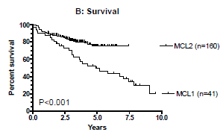
Can Cytarabine improve survival?
6 year follow-up of MCL2 trial
AraC prolongs survival in young patients treated intensively
Can Ara-C improve survival
MCL2: maxiCHOP x 3 alternating with R- ARA-C x 3 + BEAM ASCT
vs
in the elderly?
MCL1: maxiCHOP x 4
+ BEAM ASCT
Geisler et al, BJH 2012.

Slide 20
R-B plus cytarabine? R-BAC 500
CGA ‘fit’ pts aged 61-80 with untreated MCL:
Induction phase x 6 cycles q3 weeks
Rituximab (375mg/m²)
Phase ll trial
Untreated MCL
57 elderly patients.
Bendamustine (70mg/m²)
Cytarabine (500mg/m²)
Day
1 2 3 4
Visco et al, 13-ICML 2015 . Median age 71 (61-79) 91% advanced stage disease, 45% high MIPI, 9% blastoid. Median 5.3 cycles delivered/pt. Median FU 18 months

Slide 21
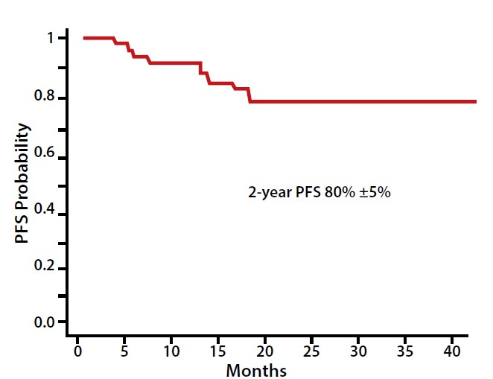
R-B plus cytarabine? R-BAC 500
Ongoing phase ll trial of RBAC-500 in untreated MCL in the elderly.
Visco et al, 13-ICML 2015
2 year PFS compares favourably with R-B but longer follow-up needed to establish any survival advantage

Slide 22
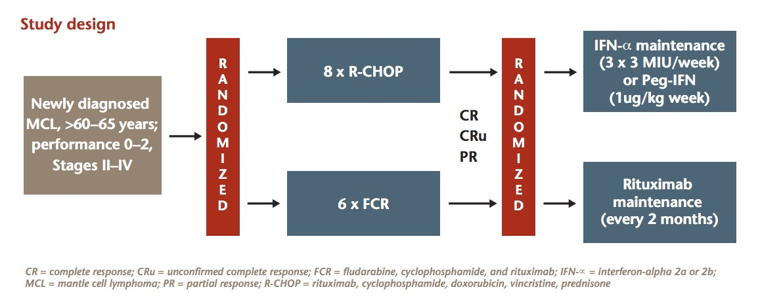
European MCL Elderly trial
Maintenance continued until progression
Kluin Nelemans et al, NEJM 2010. Median survival not reached at median follow-up of 36 months

Slide 23
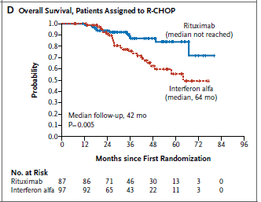
European MCL Elderly trial
4yr survival 87% for RCHOP followed by maintenance Rituximab
Kluin Nelemans et al, NEJM 2010. Median survival not reached at median follow-up of 36 months

Slide 24
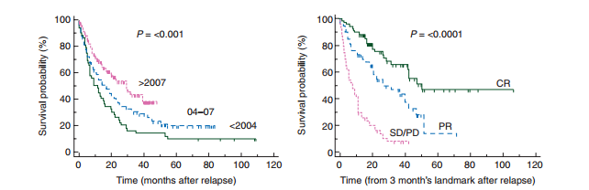
Short survival for those who relapse after ASCT
Eligible patients were aged 18 years or more who underwent a first autoSCT for MCL between 2000 and 2009, subsequently relapsed, and were registered with the EBMT database
Dietrich et al, Annals of Oncology 2014. EBMT data. ASCT = autologous stem cell transplant
Notes:
Background: Autologous stem-cell transplantation (autoSCT) is considered a standard treatment of non-frail patients with mantle cell lymphoma (MCL), but little is known about outcome of MCL patients relapsing after autoSCT. We therefore sought to analyse the outcome after autoSCT failure and the efficacy of a rescue stem-cell transplantation (SCT) in this setting. Patients and methods: Patients with MCL were eligible if they had relapsed after autoSCT performed between 2000 and 2009. A total of 1054 patients could be identified in the EBMT registry. By contacting the transplant centres, a full dataset could be retrieved for 360 patients. Results: Median overall survival (OS) after relapse of the whole study group was 19 months. A long (>12 months) interval between autoSCT and relapse [P < 0.001, hazard ratio (HR) 0.62], primary refractory disease (P < 0.02, HR 1.92), prior highdose ARA-C treatment (P = 0.04, HR 1.43), and the year of relapse (P = 0.02, HR 0.92) significantly influenced OS from relapse in multivariate analysis. Eighty patients (22%) received a rescue allogeneic SCT (alloSCT). Relapse incidence, non-relapse mortality, and OS 2 years after alloSCT was 33% [confidence interval (95% CI 21% to 45%)], 30% (95% CI 19% to 42%), and 46% (95% CI 33% to 59%), respectively. Remission duration after autoSCT was the only variable significantly affecting the outcome of salvage alloSCT. In contrast, rescue autoSCT was not associated with long-term disease control. However, individual patients survived long term even without salvage transplantation. Conclusions: MCL recurrence within 1 year after autoSCT has an extremely dismal outcome, while the prognosis of patients with longer remission durations after autoSCT is significantly better. AlloSCT may offer the possibility of durable survival when performed for patients with a remission duration of more than 12 months after first autoSCT, but the favourable effect of a salvage alloSCT in this setting needs further validation

Slide 25
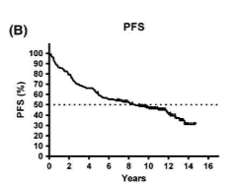
Inevitable relapse
MCL2 regimen
Rummel et al Lancet 2013. STiL NHL 1-2003 trial
Eskelund et al, BJH 2016. 15 year follow-up of MCL2 trial

Slide 26
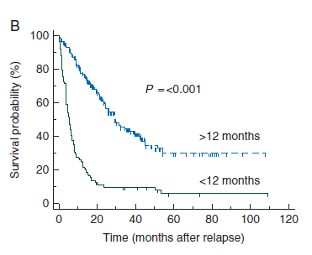
Short survival for those who relapse after ASCT
Relapse rate 47% at 5 years
Median survival of 19 months
Very short survival for relapse <12 months of ASCT
Eligible patients were aged 18 years or more who underwent a first autoSCT for MCL between 2000 and 2009, subsequently relapsed, and were registered with the EBMT database
Dietrich et al, Annals of Oncology 2014. EBMT data. ASCT = autologous stem cell transplant
Notes:
Background: Autologous stem-cell transplantation (autoSCT) is considered a standard treatment of non-frail patients with mantle cell lymphoma (MCL), but little is known about outcome of MCL patients relapsing after autoSCT. We therefore sought to analyse the outcome after autoSCT failure and the efficacy of a rescue stem-cell transplantation (SCT) in this setting. Patients and methods: Patients with MCL were eligible if they had relapsed after autoSCT performed between 2000 and 2009. A total of 1054 patients could be identified in the EBMT registry. By contacting the transplant centres, a full dataset could be retrieved for 360 patients. Results: Median overall survival (OS) after relapse of the whole study group was 19 months. A long (>12 months) interval between autoSCT and relapse [P < 0.001, hazard ratio (HR) 0.62], primary refractory disease (P < 0.02, HR 1.92), prior highdose ARA-C treatment (P = 0.04, HR 1.43), and the year of relapse (P = 0.02, HR 0.92) significantly influenced OS from relapse in multivariate analysis. Eighty patients (22%) received a rescue allogeneic SCT (alloSCT). Relapse incidence, non-relapse mortality, and OS 2 years after alloSCT was 33% [confidence interval (95% CI 21% to 45%)], 30% (95% CI 19% to 42%), and 46% (95% CI 33% to 59%), respectively. Remission duration after autoSCT was the only variable significantly affecting the outcome of salvage alloSCT. In contrast, rescue autoSCT was not associated with long-term disease control. However, individual patients survived long term even without salvage transplantation. Conclusions: MCL recurrence within 1 year after autoSCT has an extremely dismal outcome, while the prognosis of patients with longer remission durations after autoSCT is significantly better. AlloSCT may offer the possibility of durable survival when performed for patients with a remission duration of more than 12 months after first autoSCT, but the favourable effect of a salvage alloSCT in this setting needs further validation

Slide 27
Options for relapsed/refractory MCL
Drug | No. pts | ORR (CR) % | Median DOR (mo) | Median PFS (mo) | Median OS (mo) | Reference
Ibrutinib¹ | 111 | 68 (21) | 17.5 | 13.9 | NR | Wang et al, NEJM 2013
R-B^{2*} | 24* | 71 (38) |  | 17.6 | 35.3 | Rummel et al, Lancet Oncology 2016
_{FR}2* | 23* | 26 (13) |  | 4.7 | 20.9
Lenalidomide³ | 170 | 40 (5) | 16 | 8.7 | 27.8 | Trněný et al, Lancet Oncology 2016
Chemotherapy³ | 84 | 11 (0) | 10.4 | 5.2 | 21.2
Temsirolimus⁴ | 54** | 22 (2) | 7.1 | 4.8 | 12.8 | Hess et al, JCO 2009
Chemotherapy⁴ | 53 | 2 (0) | NA | 1.9 | 9.7
ORR = overall response rate; DOR = duration of response; PFS = progression-free survival; OS = overall survival ; NA = not available; R-B = rituximab and bendamustine; FR = fludarabine and rituximab; mo = months; NR = not reached;*results shown for subset with mantle cell lymphoma; **results shown for 175/75mg dose group. 1 = PCYC-1104 pivotal phase ll trial; 2 = STiL trial; 3 = SPRINT trial (Single agent chemotherapy = rituximab, gemcitabine, fludarabine, chlorambucil, or cytarabine); 4 = OPTIMAL trial (single agent chemotherapy = gemcitabine, fludarabine, chlorambucil, cladribine, etoposide, cyclophosphamide, thalidomide, vinblastine)

Slide 28
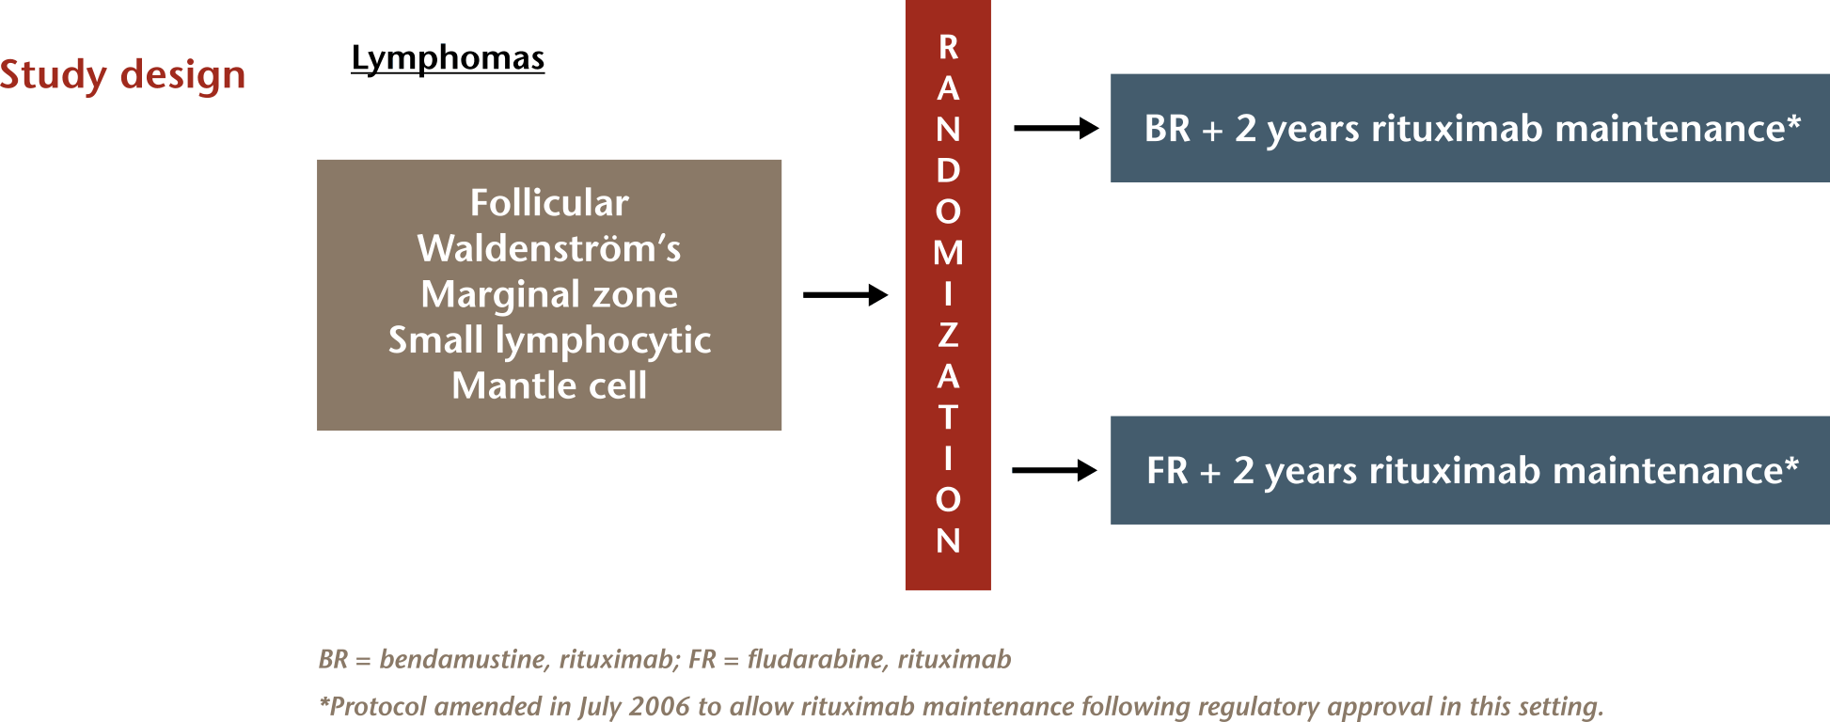
R-bendamustine for relapsed MCL
Rummel M et al. Lancet Oncology 2016;. 230 patients (47 with mantle cell lymphoma)

Slide 29
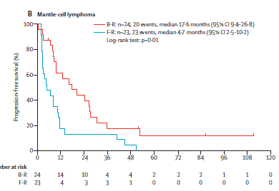
R-bendamustine for relapsed MCL
R-B superior to FR for CR (38 vs 13%), median PFS
(18 vs 5 months) and median survival (35 vs 21 months)
Rummel M et al. Lancet Oncology 2016;. 230 patients (47 with mantle cell lymphoma)

Slide 30
Lenalidomide for relapsed MCL (SPRINT)
Phase ll, randomised (SPRINT trial)
254 patients
2:1 randomisation
Arm A (84 patients)
Investigator’s choice chemotherapy (choice of rituximab, gemcitabine, fludarabine, chlorambucil, cytarabine)*
Arm B (170 patients)
Lenalidomide 25mg daily on days 1-21 of a 28 day cycle
Until PD or intolerability
Trněný et al, Lancet Oncology 2016. The investigator agent of choice was given as follows: rituximab 375 mg/m2 intravenously on days 1, 8, 15, and 22,
and then once every 56 days; gemcitabine 1000 mg/m2 intravenously on days 1, 8, and 15 every 28 days; fludarabine either 25 mg/m2 intravenously or 40
mg/m2 orally on days 1–5 every 28 days; oral chlorambucil 40 mg/m2 per month divided over 3–10 days; or cytarabine 1–2 g/m2 intravenously once or twice daily on days 1 and 2 every 28 days. Chlorambucil and rituximab were given until progressive disease, intolerance, or voluntary withdrawal; cytarabine, fludarabine, and gemcitabine were given for a maximum of six cycles.

Slide 31
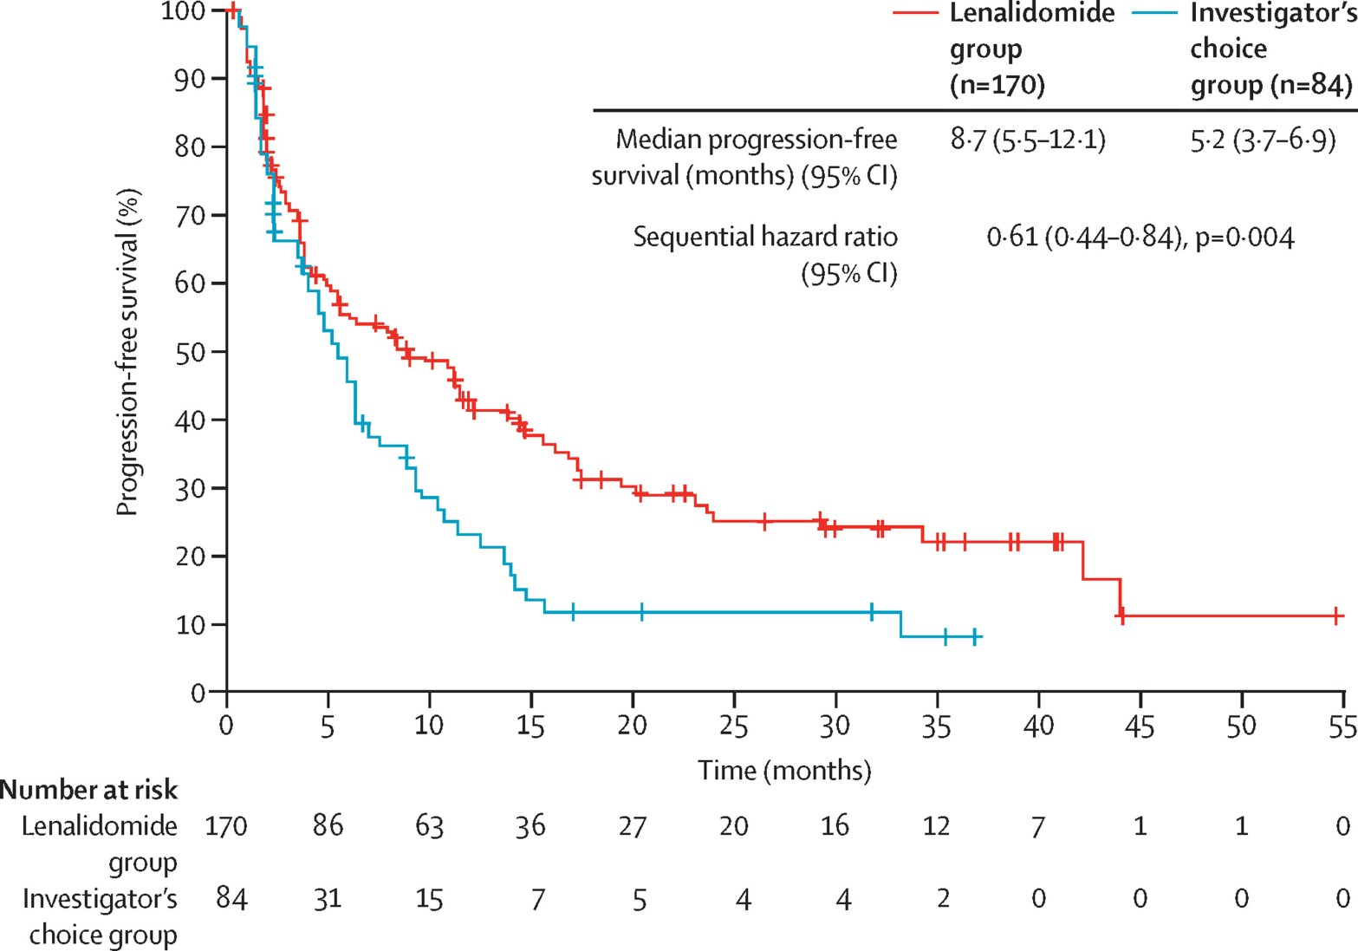
Lenalidomide for relapsed MCL (SPRINT)
Trněný et al, Lancet O
sly on days 1, 8, 15, and 22,
and then once every 56 days; gemcitabine 1000 mg/m2 intravenously on days 1, 8, and 15 every 28 days; fludarabine either 25 mg/m2 intravenously or 40
mg/m2 orally on days 1–5 every 28 days; oral chlorambucil 40 mg/m2 per month divided over 3–10 days; or cytarabine 1–2 g/m2 intravenously once or twice daily on days 1 and 2 every 28 days. Chlorambucil and rituximab were given until progressive disease, intolerance, or voluntary withdrawal; cytarabine, fludarabine, and gemcitabine were given for a maximum of six cycles.

Slide 32
Overview of Study Results of Ibritunib
 | RAY | 1104
Study Population | Relapsed/ Refractory | Relapsed/ Refractory
Ibrutinib | Monotherapy/ Temsirolimus | Monotherapy
N | 139 | 11
Median PFS | 14.6 months 57% reduction | 13 months -
PFS | 41% @ 24 months | 31% @ 24 months
Median OS | NR 24% reduction | 22.5 months -
OS | 68% @ 12 months | 47% @ 24 months
ORR | 71.9% | 67%
Discontinuation rate due to AEs | 6% | 9%
NR – not reached

Slide 33
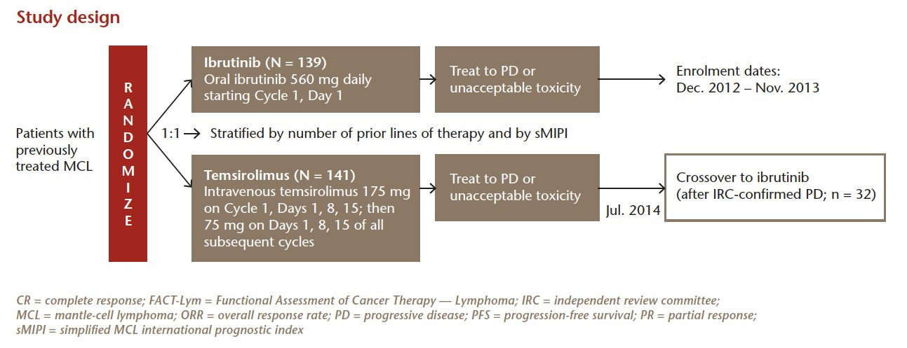
Ray trial
N=280
Ibrutinib versus Temsirolimus in Relapsed or Refractory Mantle Cell Lymphoma
Phase 3,
International, open-label, randomized,
multicenter study
Relapsed or refractory MCL; at least 1 prior rituximab-containing therapy
Dreyling et al, Lancet 2016

Slide 34
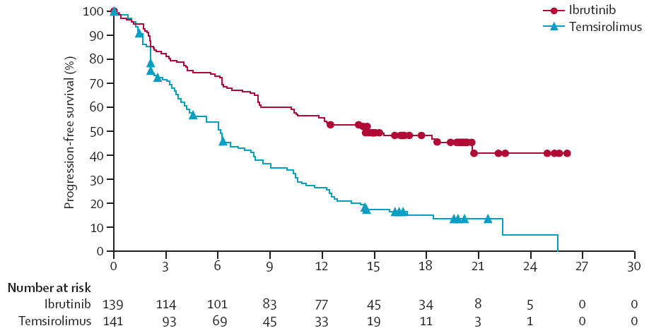
Ray trial
Ibrutinib Median: 14.6 months
Temsirolimus Median: 6.2 months
Two year PFS 41% vs 7%
ibrutinib reduced risk of disease progression compared with temsirolimus (p < 0.0001)
Dreyling et al, Lancet 2016

Slide 35
ORR Is Higher for Ibrutinib-Treated Patients
IRC Assessment
ORR: 71.9 vs 40.4% (p < 0.0001)
18.7
% of patients
53.2
1.4
39.0
30.5
10.8
10.8
16.3
CR
PR
CR
PR
Ibrutinib
(N = 139)
Temsirolimus
(N = 141)
Median duration of response: not reached (95% CI, 16.2-NE) with ibrutinib vs 7.0 months (95% CI, 4.2-9.9) for temsirolimus
Rule S et al. ASH 2015; Abstract 469 (Oral Presentation)

Slide 36
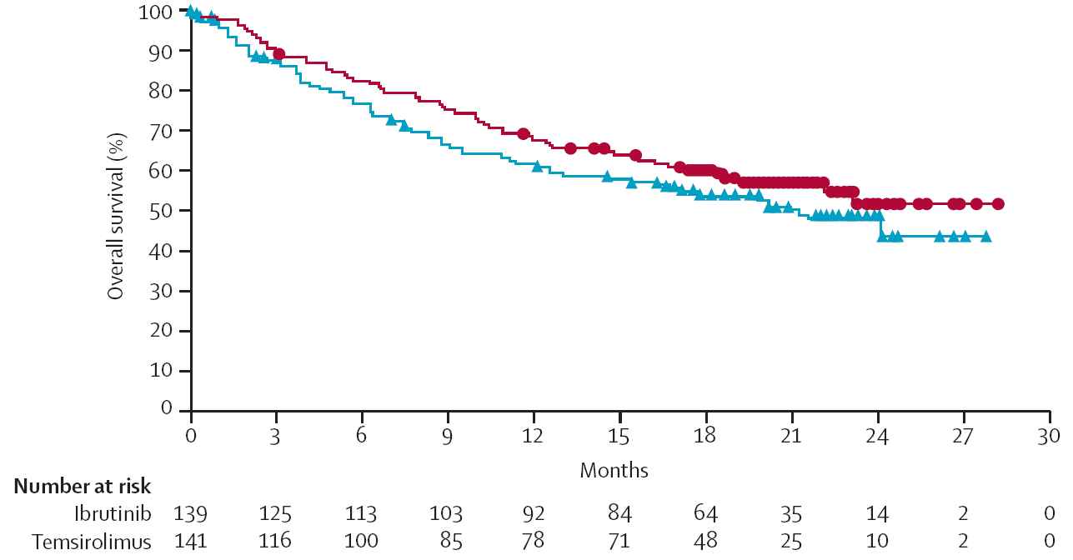

Overall Survival
Ibrutinib Median: Not yet reached
Temsirolimus Median: 21.3 months
No statistically significant difference in survival*
(1-year survival 68% for ibrutinib vs 61% for temsirolimus)
Dreyling M et al. Lancet 2016; 387(10020): 770-8
*Study was not powered to detect a statistically significant difference in OS

Slide 37
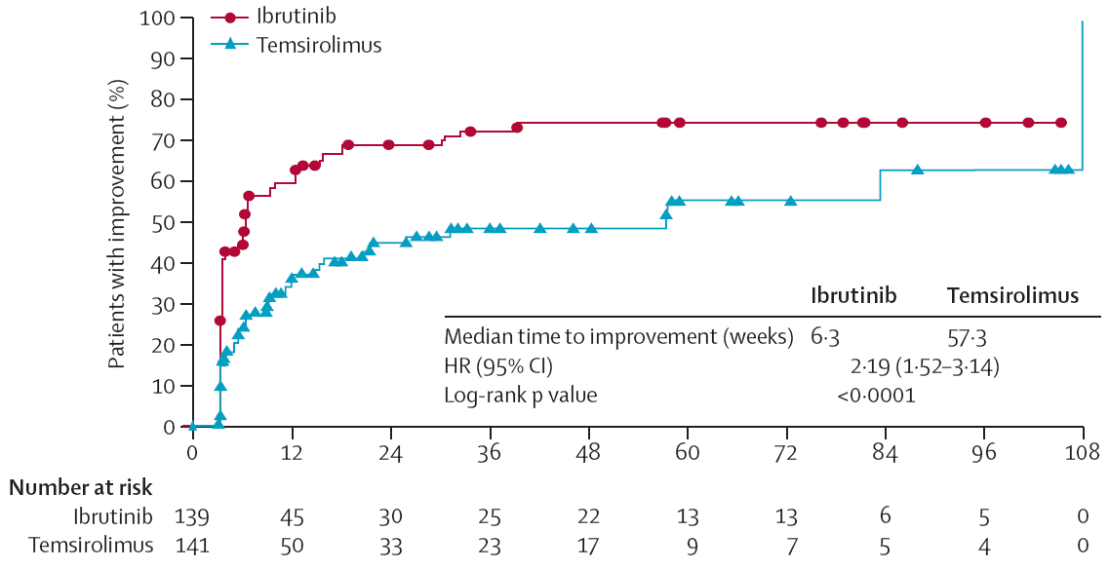
Time to Clinically Meaningful Improvement on the FACT-Lym Lymphoma Subscale
Clinically meaningful improvement was defined as a ≥ 5-point increase from baseline on the FACT-Lym lymphoma subscale score
A greater proportion of patients treated with ibrutinib had a clinically meaningful improvement in lymphoma symptoms vs. those treated with temsirolimus (86 [62%] vs. 50 [35%])
Improvement in symptoms occurred more quickly with ibrutinib vs. temsirolimus, with a median time to clinically meaningful improvement of 6.3 (IQR NE) weeks vs. 57.3 (101.4) weeks, respectively (p < 0.0001)
Dreyling M et al. Lancet 2016; 387(10020): 770-8

Slide 38
Common Treatment-Emergent Adverse Events (20% or More of Patients) in the Safety Population
 | Ibrutinib (n = 139) |  | Temsirolimus (n = 139)
AE, n (%) | Any Grade | Grade ≥ 3 | Any Grade | Grade ≥ 3
Hematological
Thrombocytopenia | 25 (18) | 13 (9) | 78 (56) | 59 (42)
Anemia | 25 (18) | 11 (8) | 60 (43) | 28 (20)
Neutropenia | 22 (16) | 18 (13) | 36 (26) | 23 (17)
Non-hematological
Diarrhea | 40 (29) | 4 (3) | 43 (31) | 6 (4)
Fatigue | 31 (22) | 6 (4) | 40 (29) | 10 (7)
Cough | 31 (22) | 0 | 31 (22) | 0
Pyrexia | 23 (17) | 1 (1) | 29 (21) | 3 (2)
Nausea | 20 (14) | 0 | 30 (22) | 0
Peripheral oedema | 18 (13) | 0 | 31 (22) | 3 (2)
Epistaxis | 12 (9) | 1 (1) | 33 (24) | 2 (1)
Stomatitis | 4 (3) | 0 | 29 (21) | 5 (4)
Rates shown are not adjusted for differences in exposure
Median treatment duration was four times longer for the ibrutinib group (14·4 months) vs. temsirolimus (3·0 months)
Despite the time difference in exposure, overall frequencies of most cumulative TEAEs were lower with ibrutinib
Dreyling M et al. Lancet 2016; 387(10020): 770-8

Slide 39
Conclusions
Ray trial
Results of this phase 3 trial confirm efficacy and favorable safety profile of ibrutinib
Results also confirm the positive benefit-risk ratio for ibrutinib as an effective targeted approach in R/R MCL
Demographic characteristics at baseline were reflective of target patient population, supporting the application of these results to the general MCL population
Future research should investigate ibrutinib-based combination approaches for patients with relapsed or refractory MCL and in front-line therapy
Dreyling M et al. Lancet 2016; 387(10020): 770-8

Slide 40
1104: LONG TERM FOLLOW UP
Study Design
Enrolled February 2011→March 2012
Cohort 1
560 mg/d ibrutinib
No prior treatment with bortezomib*
(n = 65)
*no prior bortezomib therapy or less than
2 complete cycles of bortezomib
Cohort 2
560 mg/d ibrutinib
Prior bortezomib treatment†
(n = 50)
†prior treatment with at least 2 cycles of bortezomib
Phase 2, open-label,
multicenter international study (18 sites)
Patients with relapsed or
refractory MCL (N = 115)
Patients received a daily dose of ibrutinib until disease progression or unacceptable levels of adverse events (AEs) occurred
Long-term follow-up of MCL patients treated with single-agent ibrutinib: updated safety and efficacy results of a Phase 2 Study (Median follow up: 26.7 m’s)
Wang ML et al. Blood 2015; 126(6): 739-745
Wang ML et al. N Engl J Med 2013; 369: 507-516
Notes:
Forty-eight patients (43%) who had received prior bortezomib demonstrated an ORR of 65% (95% CI: 49.5%, 77.8%), and 27 (24%) patients who had received prior lenalidomide demonstrated an ORR of 59% (95% CI: 38.8%, 77.6%).

Slide 41
Patient Characteristics (I)
 | No Prior Treatment with Bortezomib (n = 63) | Prior Treatment with Bortezomib (n = 48) | All Patients (N = 111)*
Age, years Median (range) | 66 (46-83) | 69 (40-84) | 68 (40-84)
Sex, n (%) Male Female | 46 (73) 17 (27) | 39 (81) 9 (19) | 85 (77) 26 (23)
ECOG performance status, n (%) 0-1 2 >2 | 53 (84) 9 (14) 1 (2) | 46 (96) 2 (4) 0 | 99 (89) 11 (10) 1 (1)
Prior regimens Median (range) ≥ 3 regimens, n (%) | 2 (1-5) 31 (49) | 3 (1-5) 30 (62) | 3 (1-5) 61 (55)
Refractory disease, n (%)† | 27 (43) | 23 (48) | 50 (45)
*Excludes 4 enrolled patients who did not receive ibrutinib treatment owing to the investigator’s decision.
†Refractory disease is defined as a lack of at least a PR to the last therapy before study entry.
Wang ML et al. Blood 2015; 126(6): 739-745
Wang ML et al. N Engl J Med 2013; 369: 507-516

Slide 42
Patient Characteristics (II)
 | No Prior Treatment with Bortezomib (n = 63) | Prior Treatment with Bortezomib (n = 48) | All Patients (N = 111)*
Type of prior therapy, n (%) Hyper-CVAD Stem cell transplant Lenalidomide Rituximab† | 18 (29) 8 (13) 9 (14) 56 (89) | 15 (31) 4 (8) 18 (38) 43 (90) | 33 (30) 12 (11) 27 (24) 99 (89)
Simplified MIPI, n (%) Low risk Intermediate risk High risk | 9 (14) 24 (38) 30 (48) | 6 (12) 18 (38) 24 (50) | 15 (14) 42 (38) 54 (49)
Bulky mass (diameter ≥ 10 cm), n (%) | 6 (10) | 3 (6) | 9 (8)
At least 1 node ≥ 5 cm, n (%) | 26 (41) | 17 (35) | 43 (39)
Advanced disease, n (%)‡ | 49 (78) | 31 (65) | 80 (72)
*Excludes 4 enrolled patients who did not receive ibrutinib treatment owing to the investigator’s decision.
†Includes rituximab alone or rituximab-containing regimens.
‡Advanced disease was defined as involvement of bone marrow, extranodal sites, or both.
Wang ML et al. Blood 2015; 126(6): 739-745
Wang ML et al. N Engl J Med 2013; 369: 507-516

Slide 43
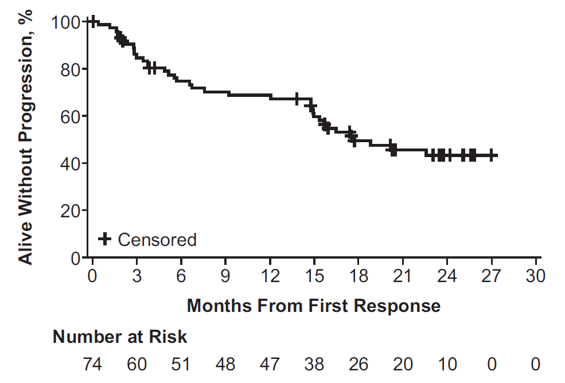
ORR and Duration of Response
 | Median DOR
All patients | 17.5 months
Patients with CR | Not reached
Patients with PR | 14.9 months
Patients (%)
CR
67%
PR
23%
44%
44%
Wang ML et al. Blood 2015; 126(6): 739-745
Wang ML et al. N Engl J Med 2013; 369: 507-516
Notes:
Forty-eight patients (43%) who had received prior bortezomib demonstrated an ORR of 65% (95% CI: 49.5%, 77.8%), and 27 (24%) patients who had received prior lenalidomide demonstrated an ORR of 59% (95% CI: 38.8%, 77.6%).

Slide 44
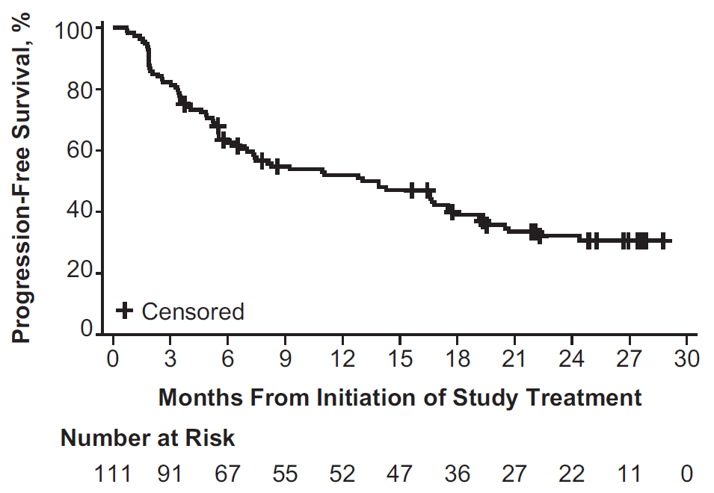
Progression Free Survival
PFS
Median PFS | 13 months
24 months PFS | 31%
Wang ML et al. Blood 2015; 126(6): 739-745

Slide 45
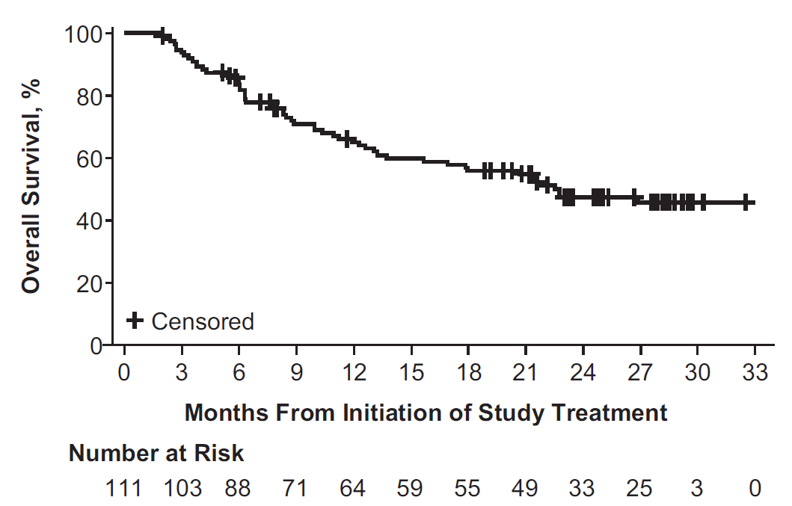
Overall Survival
OS
Median OS | 22.5 months
24 months OS | 47%
Wang ML et al. Blood 2015; 126(6): 739-745

Slide 46
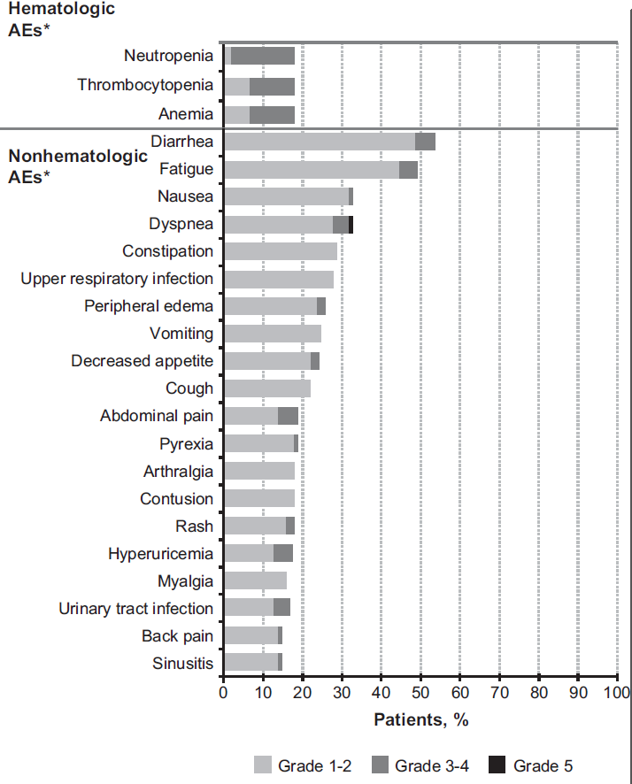
Adverse Events
Wang ML et al. Blood 2015; 126(6): 739-745

Slide 47
Conclusion
In a heavily treated patient population of R/R MCL at a median follow-up of 26.7 months
Single-agent oral ibrutinib produced rapid and durable responses
ORR of 67% and DOR of 17.5 months
(observed in study are the highest reported for a single-agent in R/R MCL)
Median PFS of 13 months and OS of 22.5 months
Additionally, the ORR did not differ across patients with respect to the number of prior therapies or presence of refractory disease, however, less tumour bulk and non-refractory disease were associated with longer PFS and OS Approximately one-third of patients remain progression-free at 24 months
Wang ML et al. Blood 2015; 126(6): 739-745
Wang ML et al. N Engl J Med 2013; 369: 507-516

Slide 48
Overall Conclusions
Ibrutinib single agent demonstrates robust efficacy and tolerability with continuous treatment
One phase 3 study and one phase 2 study with long term follow up have confirmed the PFS benefit for ibrutinib in relapsed/refractory MCL
Rapid and durable outcomes (PFS, OS, ORR & DOR) in a heavily pre-treated group of patients Improved outcomes when used in earlier lines of treatment
Long-term follow up data is available confirming durable responses with incidence of AEs declining over time , Low discontinuation rate due to AEs
Dreyling M et al. Lancet 2016; 387(10020): 770-8
Wang ML et al. Blood 2015; 126(6): 739-745
Wang ML et al. N Engl J Med 2013; 369: 507-516

Slide 49
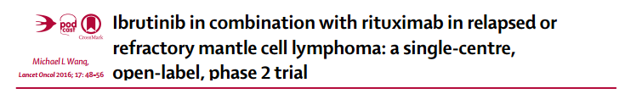
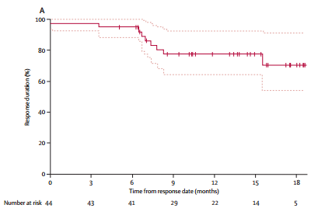
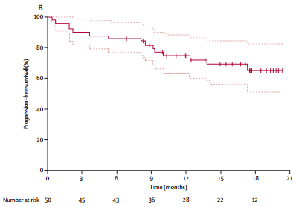
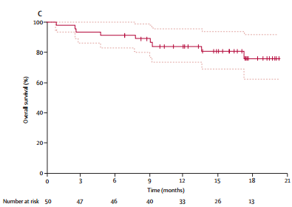
A phase II trial evaluated ibrutinib plus rituximab in 50 adults (median age 67 years)
with relapsed/refractory MCL a median of three prior therapies.
The overall response rate was 88 percent (44 percent complete) with a median time to response of 1.8 months
At a median follow-up of 17 months, the median PFS was not reached for the population as a whole.
Interpretation Ibrutinib combined with rituximab is active and well tolerated in patients with relapsed or refractory mantle cell lymphoma. Our results provide preliminary evidence for the activity of this combination in clinical practice. A phase 3 trial is warranted for more definitive data.
(A) Duration of response among patients who achieved an overall response (n=44). Overall survival of all patients enrolled in the study.
(B) Progression-free survival of all patients enrolled in the study. Dotted lines show 95% CIs.
Overall survival of all patients enrolled in the study. Dotted lines show 95% CIs.
The Lancet Oncology 2016 17, 48-56DOI: (10.1016/S1470-2045(15)00438-6)

Slide 50
Overall Conclusions
Ibrutinib is approved by the US Food and Drug Administration (FDA) and the European Medicine Agency (EMA) for the treatment of patients with MCL who have received at least one prior therapy.
The recommended dose and schedule is ibrutinib 560 mg (four 140 mg capsules) taken orally once daily.
Ibrutinib should not be administered with strong CYP3A inhibitors or inducers. Reduced doses are necessary if a moderate CYP3A inhibitor must be used. Ibrutinib should not be used in patients with baseline hepatic impairment.
Serious and potentially fatal renal toxicity has occurred in patients treated with ibrutinib. Creatinine levels should be periodically monitored during therapy, and patients should be encouraged to maintain hydration.

Slide 51

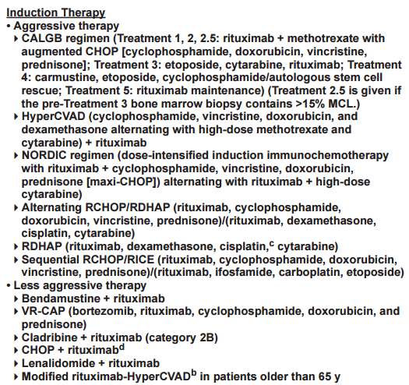
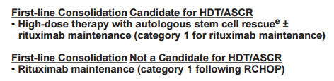
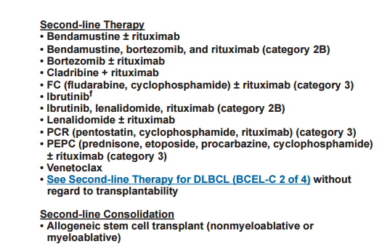

Slide 52
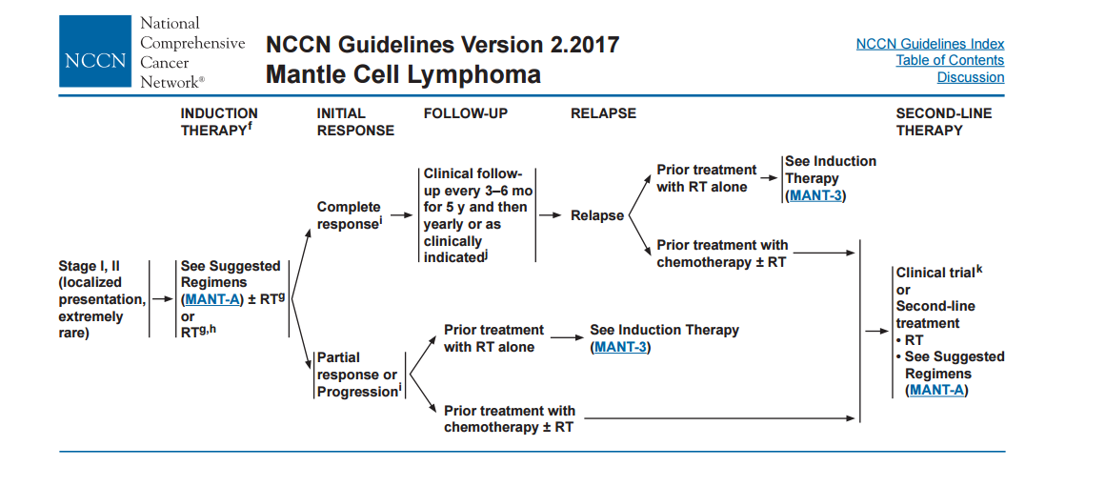

Slide 53


Slide 54


Slide 55
Summary
Mantle cell lymphoma is rare and remains incurable despite therapy advances
Most patients are unfit for intensive treatment
•
Emerging options for first line treatment of patients >65 include VR-CAP, RCHOP + maintenance rituximab, R-B, R-AraC
Treatment of relapsed disease is challenging; many effective treatments, including ibrutinib, lenalidomide and R-B but limited access in the UK
More needs to be done, especially to develop risk adapted therapy… every effort should be made to consider all patients for treatment on clinical trial

Slide 56

Thank you for your attention

