Slide 1
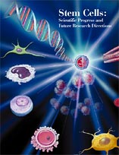
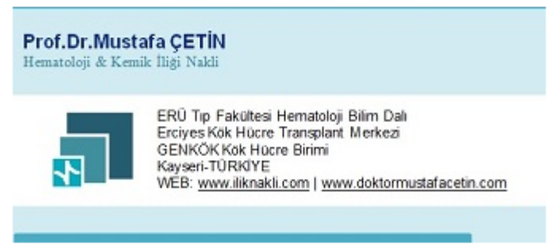
Kök hücre “Stem Cell”

Slide 2
Gündem
Kök hücre “Stem Cell” nedir?
Kök Hücre Gelişim Basamakları…
Kök hücre çeşitleri
Embriyogenezin Evreleri
İnvitro Embryonik Kök Hücre Dizilerinin Oluşumu
Kök hücre yüzey işaretçileri
Embriyonik kök hücre
Ergin kök hücre
Kök Hücre ile tedavi edilen hastalıklar
Hematopoetik Kök Hücre Nakli

Slide 3
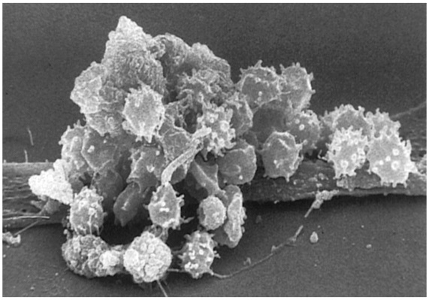
Kök hücre “Stem Cell” nedir?
Sonsuz bölünme ve farklılaşma yeteneğine sahip tek hücreli genomik yapıdan fenotipik olarak farklı hücrelere dönüşebilen hücrelerden oluşur.
Self Renewal: Devamlı bölünürken, kendi yedeğini verebilmesi
Puliripotent: Farklı hücrelere gelişebilme ve değişebilme (differansiasyon) yeteneği (potency)

Slide 4
Kök Hücre Gelişim Basamakları…
Totipotent kök hücre
Puliripotent kök hücre
Multipotent kök hücre
Unipotent kök hücre Hemostasis ve doku replasmanından sorumlu

Slide 5
Kök hücre çeşitleri
Tanımlar
Örnekler
Erken Embriyonik hücreler
(1-3 günlük)
Her bir hücre yeni bir bireyi geliştirebilir.
Totipotent
Her bir hücre 200’den fazla somatik hücreye dönüşebilir.
Blastosit hücreleri
(5-14 günlük)
Puliripotent
Plastisite kabiliyeti korunmuştur, maturasyon eğilimli
Multipotent
Adult kök hc
Kord kanı
Fetal doku
Doku hemaostasis
ve Tamir [Repair]

Slide 6



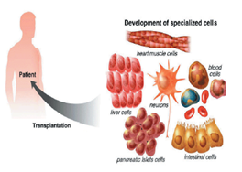
Embryonic Kök Hücre Dizileri; Oluşumu ve kullanılması
İç çeperden izole edilen hücreler
(IVF: bozulmuş embriyo)
Dış Çeper hücreleri
(plasentayı oluşturur)
5-6.Gün
Blastocyst
İç Çeper Hücreleri
(fetusu oluşturur)
Kültüre
Hücreler
Kalp kası
“Özel Kültür
Ortamı”
Böbrek
Notes:
6
The inner cell mass (the part that would form the fetus) of the embryo is isolated and disrupted to form embryonic cell lines. This process destroys the embryo. Under special culture conditions, the cells of the embryonic lines can be coaxed to form certain kinds of differentiated cell types. In theory, these differentiated cells could be used to repair or replace defective cells or tissues.

Slide 7
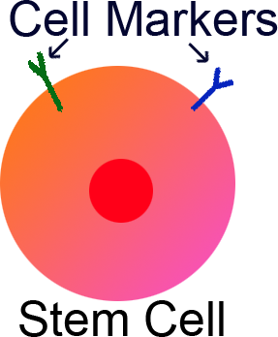
Kök Hücre Yüzey İşaretçileri
Yüzey işaretçileri
c-Kit
Oct4
CD34
CD38
Cd44
CD133
Nestin
Kök Hücre

Slide 8
Temelde Kök hücreler
Embriyonik kök hücre
Ergin (adult) kök hücre

Slide 9
Embriyonik kök hücre
Fertilize embriyodan elde edilir.
“Harvest” zamanı fertilizasyonun 3-5 günü.
‘’Pre-blastosist’’ aşaması
Sonsuz yenilenme yeteneği vardır (totipotent).
Tüm oganizmayı ve postembriyonik doku ve organları oluşturabilme kapasitesindedir.

Slide 10
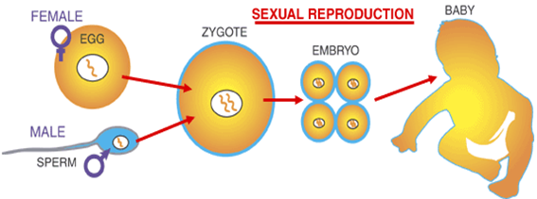
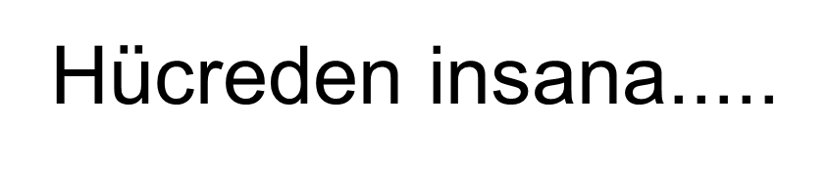
Embriyogenezin Evreleri
2 .Gün
2 hücreli embryo
1.Gün
Fertilize Yumurta
3-4.Gün
Çoklu hücreli embryo
11-14.Gün
Doku farklılaşması
5-6.Gün
Blastocyst
Notes:
10
The early stages of embryogenesis are the point at which embryonic stem cell lines are derived. The fertilized egg (day 1) undergoes cell division to form a 2-cell embryo, followed by 4-cell, etc. until a ball of cells is formed by the fourth day. The ball becomes hollow, forming the blastocyst. This is the stage at which pluripotent embryonic stem cell lines are generated. Following the blastocyst stage, the tissues of the embryo start to form and the cells become multipotent.

Slide 11
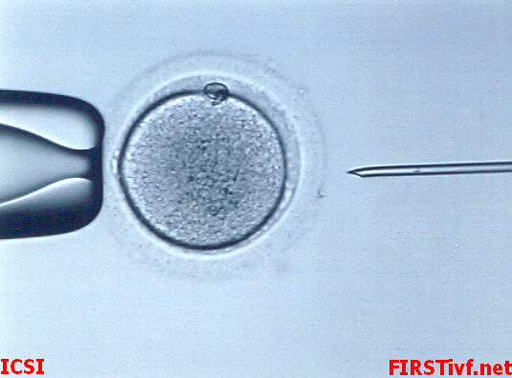
İntrastoplazmik Sperm İnjeksiyonu
Notes:
Intracytoplasmic Sperm Injection places a sperm right inside the egg nucleus so there is a better chance of insemination. Here’s how this procedure works.
After ovarian stimulation using hormones, between 10 and 30 eggs are removed from the woman’s ovaries.
Sperm is collected, and one sperm is sucked up. (point to right side of picture)
On the left, a holding pipette secures the egg in place.
Do you see how much bigger the egg is than the sperm? What’s amazing is they both contribute the same amount of genetic material to the developing organism.
11

Slide 12
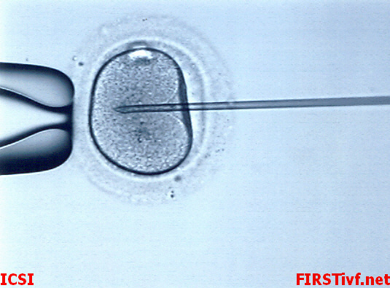
İntrastoplazmik Sperm İnjeksiyonu
Notes:
The sperm, containing the man’s half of the genetic contribution, is injected into the egg, containing the woman’s half of the genes. This is day 1 of fertilization.
12

Slide 13
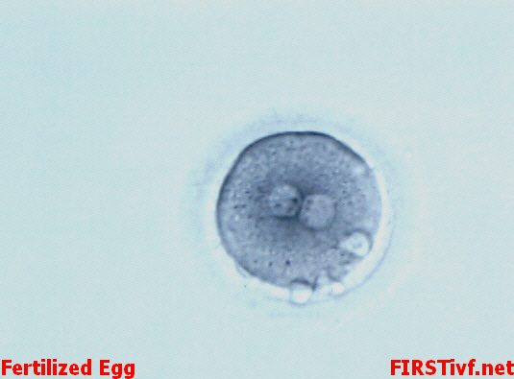
İntrastoplazmik Sperm İnjeksiyonu
Day 1
Notes:
At 12 hours after fertilization you can see the two bundles of genetic material. These contain the DNA from each parent. By 18-20 hours after fertilization, these bundles fuse and combine genetic material from mom and dad.
What starts out as two cells becomes one cell, called the fertilized egg.
13

Slide 14
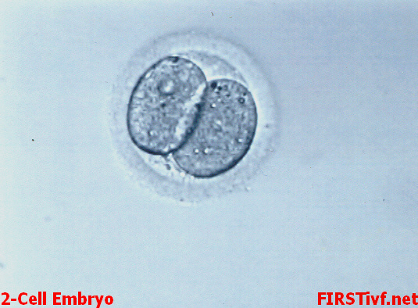
İntrastoplazmik Sperm İnjeksiyonu
Day 2
Notes:
On day 2, that one cell has divided into two cells. How do you guys think these cells are related? (wait for answers) That one cell made a copy of itself, so they are identical.
14

Slide 15
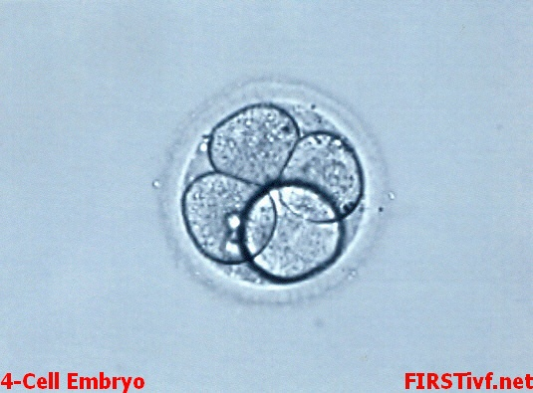
İntrastoplazmik Sperm İnjeksiyonu
Day 2
Notes:
Later on day 2, each of those two cells divides, making four identical cells.
15

Slide 16
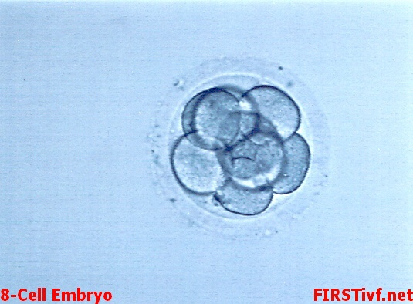
İntrastoplazmik Sperm İnjeksiyonu
Day 3
Notes:
By day 3, each of those four cells divides, making eight identical cells. Each cell is one-eighth the size of the original fertilized egg.
Some fertility doctors choose to put the embryos back into the uterus at this stage, and some wait until the embryo is more developed.
16

Slide 17
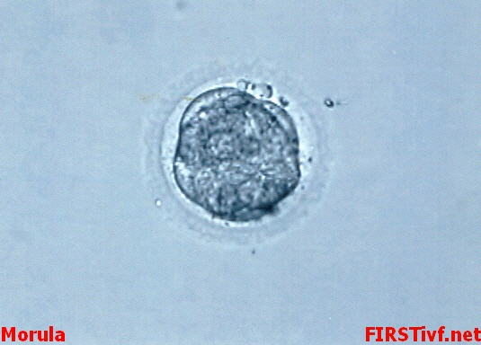
İntrastoplazmik Sperm İnjeksiyonu
Day 4
Notes:
On day 4, the cells have divided several times more and you can’t tell one cell from another cell. How do you think these cells relate to each other? (wait for answers) They’re still identical.
17

Slide 18
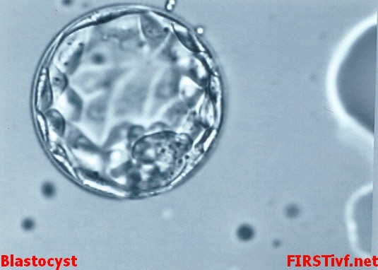
İntrastoplazmik Sperm İnjeksiyonu
Day 5
Embryonic
Stem
Cells
Notes:
Day 5 is a big day. Now, fluid builds up inside the ball of cells, making it look hollow like a soccer ball. This structure is called a blastocyst. Are the cells here still identical? (Wait for answers) No, they are not. The outer layer has cells that will become the placenta. There is a clump of cells sitting inside, CLICK! that will become the fetus. However, this is definitely not a fetus yet.
So now, the doctor chooses a few, usually 2-3, healthy-looking 5-day-old blastocysts. He implants those into the woman’s uterus. Hopefully one, and preferably only one of those will successfully burrow into the uterus and develop into a pregnancy.
So where are the embryonic stem cells? (wait for answers) EMBRYONIC STEM CELLS MAKE UP THE LITTLE CLUMP INSIDE THE BLASTOCYST.
So the doctor starts with 10-30 fertilized eggs, and they usually fertilize all of them. But to actually make a baby, they only use 2-3. So this means there are a large number of leftover embryos. After the doctor has chosen a few blastocysts to implant, what do you think happens to them? (wait for answers) The leftover embryos are frozen.
USE AGAIN: These can later be used by the couple to have more kids.
ADOPTION: They can be donated to another couple for adoption, and these successful pregnancies are called “snowflake babies.”
STEM CELL RESEARCH: They can also be used to make stem cells. In the US right now, there are about 400,000 embryos leftover from this procedure. Some of these could be used for research. A scientist would harvest the clump of embryonic stem cells and plate it onto a petri dish to make an embryonic stem cell line. But many people have a problem with this because you need to destroy these embryos and any chance they had to grow into babies.
DISCARDED: This is very commonly done if the couple doesn’t want their embryos to be used or stored. They would be thawed and discarded as medical waste.
18

Slide 19
İNSAN EMBRYONİK HÜCRELERİNİN
İN VİTRO KÜLTÜR İÇİN AYRIŞTIRILMASI
Notes:
19

Slide 20
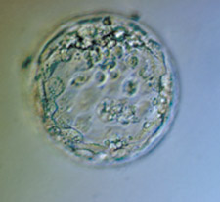
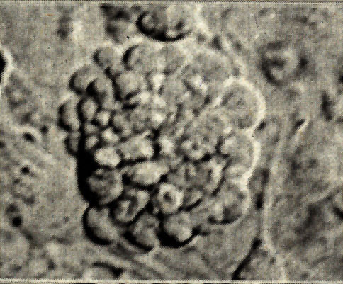
Blastosit
İç kitlesinden
Embrİyonik kök
Hücrelerin
İzolasyonu
Notes:
20

Slide 21
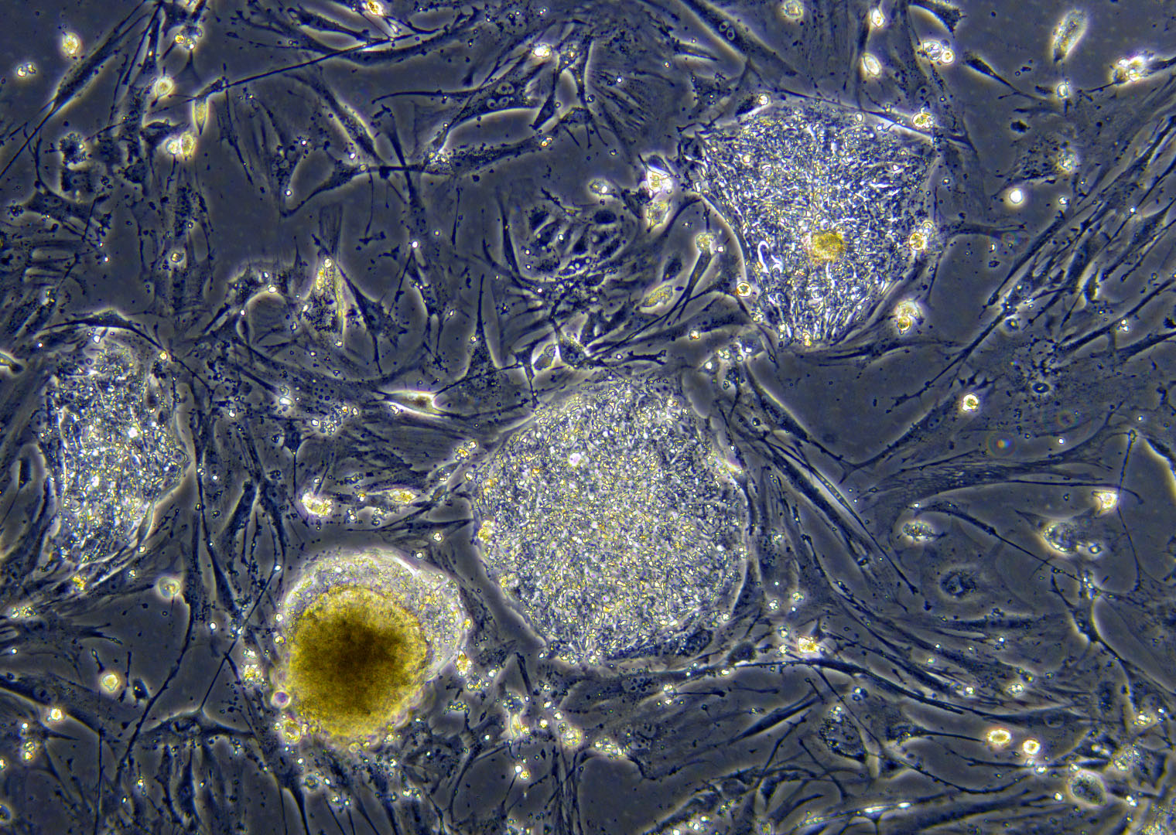
Embryonik kök hücre kolonileri
Notes:
21

Slide 22
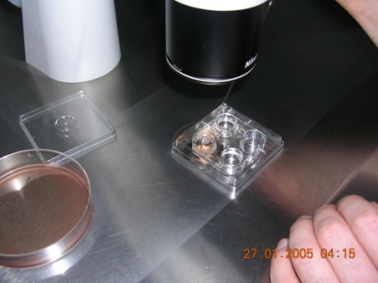
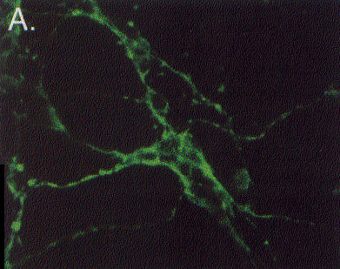
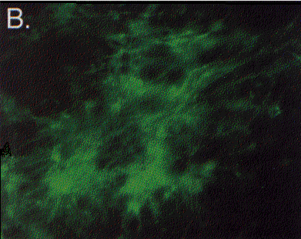
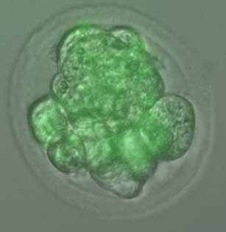
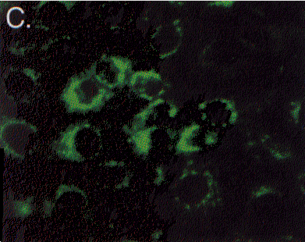
İnsan embriyonik kök hücrelerinin in-vitro farklılaşması
NÖRONLAR
Tubulin+
CARDİOMYOSİTLER
Troponin+
EMBRYONİK
KÖK HÜCRELER
ENDODERM
AFP +
Notes:
22

Slide 23
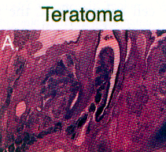
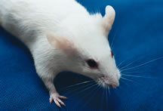
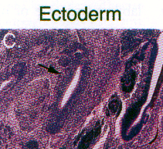
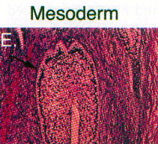
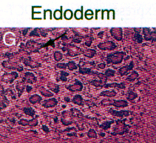
İnsan embriyonik kök hücrelerinin in-vivo farklılaşması
SCID/Fare
Notes:
23

Slide 24
Ergin kök hücre
Sınırlı yenilenebilme yeteneği
Doku replasmanı
Multi-Puliripotent
En iyi bilinen ‘’ kanyapıcı kök hücre-hematopoetik stem cell’’ dir.
Kaynak: kemik iliği, Kordon kanı, plasenta ve amniyotik sıvı gibi gebelik dokuları.
Beyin, kornea, diş pulpası, karaciger,pankreas. Deri, Kemik, kartilaj vs...... Doku replasman ve tamirinde kullanılmaktadır.

Slide 25
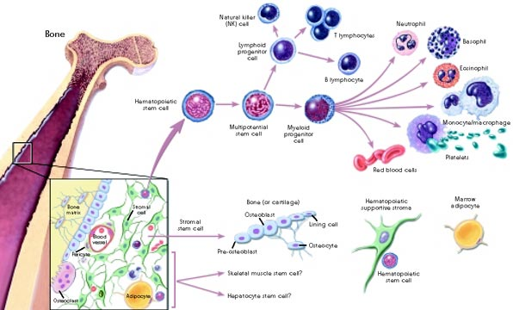
Ergin kök hücre
Doku Hemostasis>>>>maturasyon>>>>replasman

Slide 26
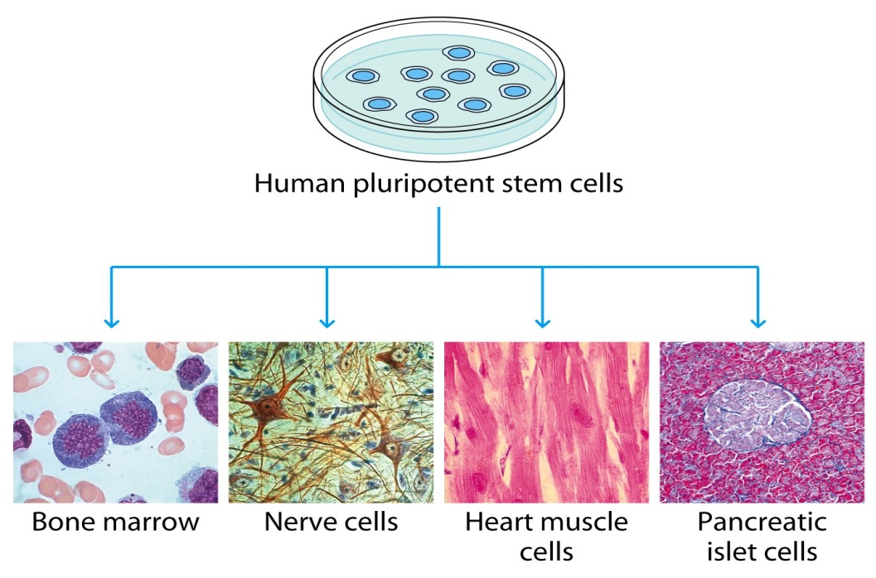
<<Plastisite>>
Ergin kök hücre
Farklı Orjin (generation)
Farklı doku (differantation)
Genetik program değişikliği (genetic re-programming)
Çevresel sinyaller kök hücrelerini spesifik hücreye yönlendirmektedir.
Hematopoez
Signaling
Kontraktilite
Sekresyon

Slide 27
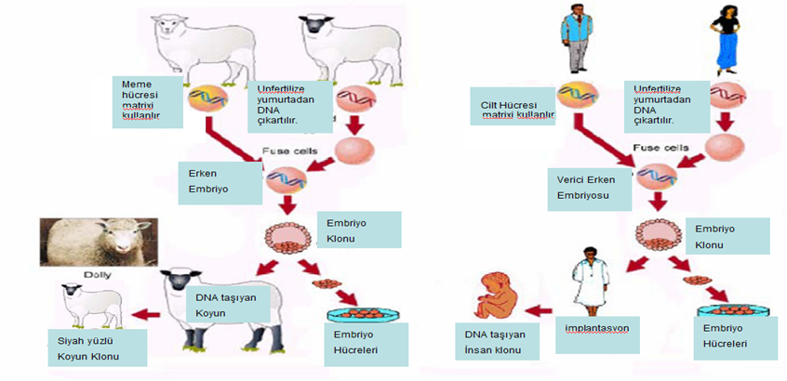
Ergin kök hücre
<<klonlama>>

Slide 28
Ergin kök hücre
<<Kullanım>>

Slide 29
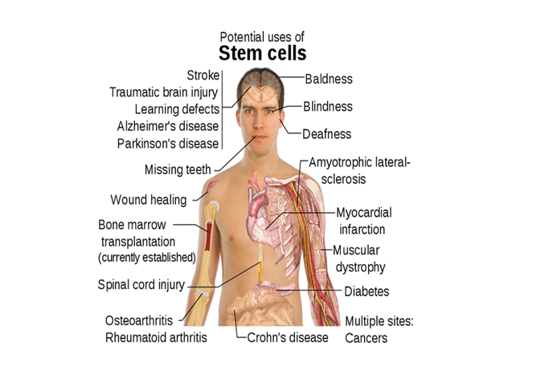


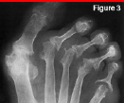
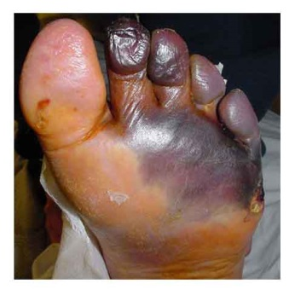
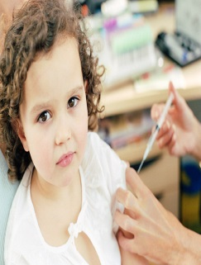
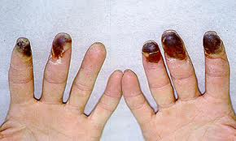


Doku tamiri ve replasman
Felçler
Kalp Krizi
Eklem hast
Diyabet
Burger
Parkinson
Alzheimer

Slide 30
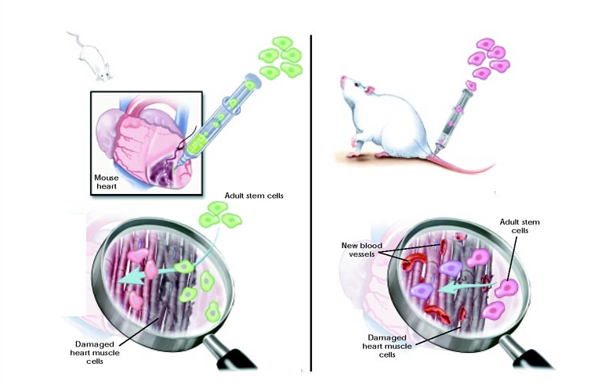
Kök Hücreyi nasıl uygulayalım…???

Slide 31
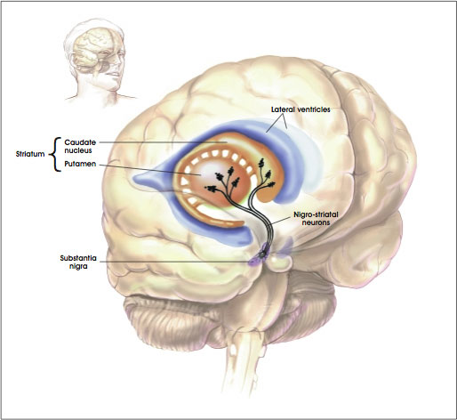
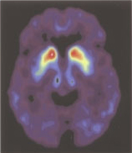
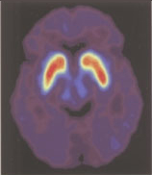
Dopamine-Neuron Transplantation
Before Surgery After Surgery
Beyin
Onarımı

Slide 32
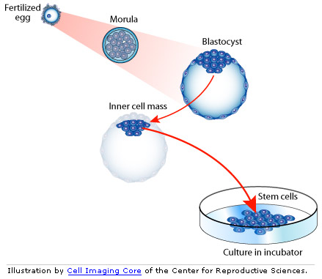
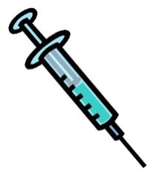
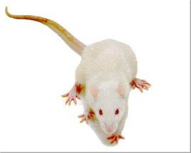
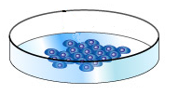
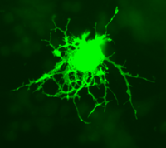
Spinal Kord Yaralanmalarında
Kök Hücre Tedavileri
Başlama
Hayvan modeli çalışmalarından sonra
Klinik çalışmalar başlatılmıştır.
Differentiate
(+ growth factors)
Zaman
Oligodendrocytes
Belirgin İyileşme
hasar
*Tedavi beklentisi kronik paralizi vakalarında daha düşük..
Notes:
Describe slide beginning with START
Oligodendrocytes--

Slide 33
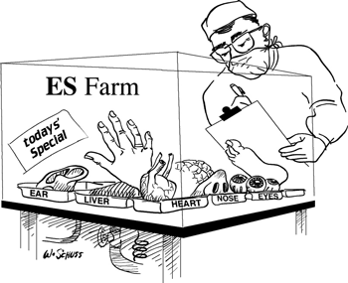
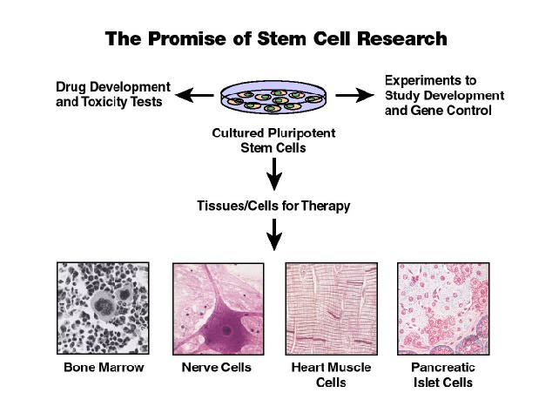
Kök Hücre Tedavilerini Geleceği
İlaç gelişimi
ve toksisite
çalışmaları
Deneysel
Araştırma ve
Denemeleri
( örn.gen kontrol)
Çalışmaları
Kök Hücre
Kültürleri
Hücre-doku tedavileri
Kemik İliği
Sinir Sistemi
Kalp Kası
Pankreas

Slide 34
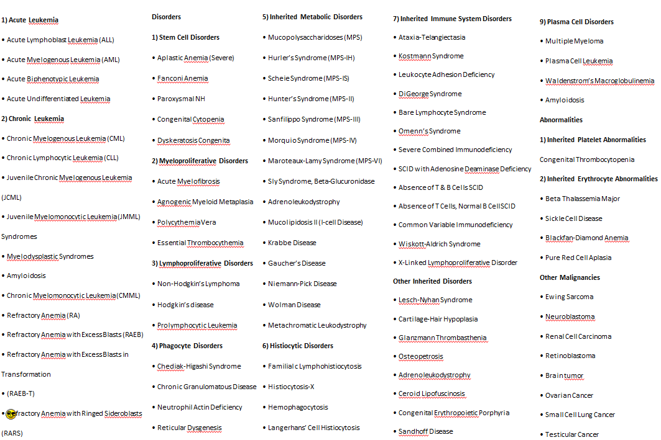
Kök Hücre ile tedavi edilen hastalıklar

Slide 35
Hematopoetik Kök Hücre nakli

Slide 36
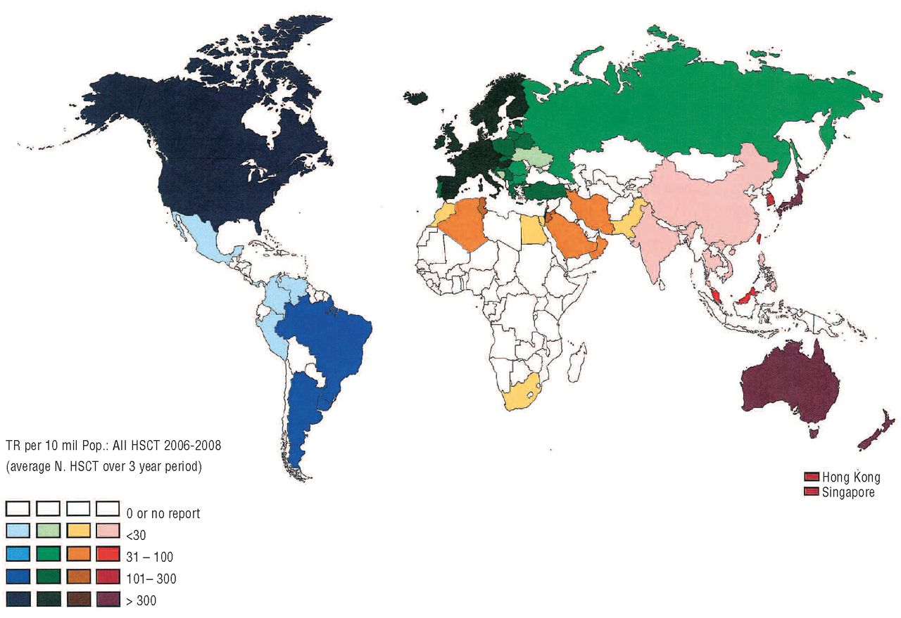
Dünya KIT aktivitesi

Slide 37
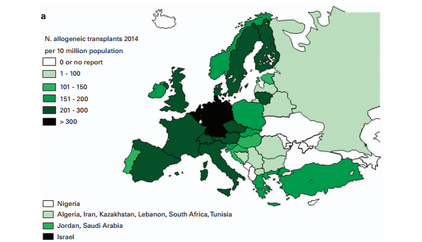

Avrupa KIT aktivitesi 2014

Slide 38
Kemik İliği: Fonksiyon
Notes:
38
38
THİS İS histological apperance of BONE MARROW TIISSUE STRUCTURE On average, bone marrow constitutes 4% of the total body mass of humans; in adults weighing 65 kg (143 lbs), bone marrow accounts for approximately 2.6 kg. MARROW TIISUUE CONSSIT OF PROCURSER AND PROGENITOR OF CIRCULATING BLOOD CELLS.

Slide 39
Kemik İliği: Fonksiyon
Notes:
39
ON THE CLOSER EXAMNATİON OF BONE MARROW REVEAL PROCURCER CELLS OF ERYTROID AND MYELOİD LİNEAGE SUCH AS erytroblast, normoblast,immatur forms granular cels promyelocyt, myelocyt etc
Bone marrow is not only important for blood fabrication also a vital element of the immune system, as it produces lymphocytes
The bone marrow hematopoietic compartment produces approximately 500 billion cells per day that use the bone marrow vasculature as a conduit to the systemic circulation.1
39

Slide 40

Kemik İliği: Fonksiyon
    Kan hücrelerinin üretimi,
      175 milyar kırmızı küre/gün
      70 milyar beyaz küre/gün (neutrophils, eosinophils, basophils)
      Üretim kapasitesini ihtiyaç halinde 10 katı artırabilir…
kemik iliğinde hücrelerin %1- 0.1’i
Kök hücre ve öncülleridir.

Slide 41


Hematopoez
Pluripotent kök hücre
CD34+/CD90+
CD34+/CD38-
Notes:
FROM THIS EARLY PROCURSOR CELLS DERİVES THEIR MATURE AND FUNCTİONALLY ACTIVE FORMS
As Eryrocytes are responsible from oxygen transport, granular cells and lyphocytes especially manage cellulary and humorally immuno-system.
On the ather hand platellets prevent life threating hemorhagies.

Slide 42




HKH’nin kimlik numarası : CD 34
CD43: 105-120 kDa ağırlığında membran glikoprotein
Erken hemapoetik kök hücre işaretleyicisi
CD34: Periferik MNH’lerin % 0.1
Kemik iliği MNH’lerinin % 1-4
CD 34+
Notes:
In 1985, a major advance was made with the discovery of a monoclonal antibody which bound a cell-surface moiety on all hematopoietic progenitors.
Subsequently designated as CD34, this molecule remains the only phenotypic marker that identifies early hematopoietic cells.
Approximately 0.1% of normal peripheral blood mononuclear cells and 1% to 4% of human bone marrow cells express the CD34 antigen.
The identification and characterization of CD34+ hematopoietic stem cells has opened new fields of research, and has become a major interest for both biological and clinical
research.
Interestingly, some CD34 monoclonal antibodies (such as Immu-133, see
below) can induce homotypic cell adhesion in CD34+ cell lines.

Slide 43

The Nobel Prize, 1990
E. Donnall Thomas
Akut lösemide ilk başarılı kök hücre nakli
Thomas ED, Lochte HL, Lu WC, Ferrebee JW. Intravenous infusion of bone marrow in patients receiving radiation and chemotherapy. N. Engl. J. Med. 1957; 257: 491.
Notes:
THOMAS' WORK SHOWED THAT BONE MARROW CELLS İNFUSED İNTRAVENOUSLY COULD REPOPULATE THE BONE MARROW AND PRODUCE NEW BLOOD CELLS.
Stem cell transplantation was pioneered using bone-marrow-derived stem cells by a team at the Fred Hutchinson Cancer Research Center from the 1950s through the 1970s led by E. Donnall Thomas, whose work was later recognized with a Nobel Prize in Physiology or Medicine. His work also reduced the likelihood of developing a life-threatening complication called graft-versus-host disease.10

Slide 44

Hematopoetik kök hücre toplama
CD34+ hücrelere nasıl ulaşırız..
Kemik iliğinden toplama
Çevre kanına hareketlendirlen hücrelerin toplanması

Slide 45

Kemik İliğinden toplama
Genel anestazi
İlik pelvik kemiklerden alınır
Artıklar filtre edilir
Donmuş veya taze ürün olarak hastaya uygulanır.
Notes:
A special needle is placed through the skin into the marrow cavity of the hipbone, where stem cells and blood are aspirated.
Two or three skin punctures are made on each rear hipbone.

Slide 46

Çevre kanı kök hücresi toplama
Kök hücre ilikten çevreye gönderilir
  G-CSF (sağlıklı verici)
  Cyclophosphamide + G-CSF in (hasta)
5.gün (sağlıklı verici)den, yaklaşık 10-132 günde hastadan toplanır
  İşlem 2- 3 saat kadar sürer
Taze ürün veya dondurulmuş olarak kullanılır…
Notes:
1986 with the discovery of GCSF, stem cell harvest new era. Along this perod GCSF mobilastion as safe as aspirtion and easier more acceptable, chemothrppy lso increase periphral blood CD34 levels 30 fold , with the gcsf 150-to 200 fold cd increase at the day of apheresis

Slide 47

İlik naklinin mantığı
Kök Hücre nakline hazırlık tedavisi ile bir taraftan ilik mesafesi boşaltılarak yuvalanmaya hazır hale getirilirken; diğer tarftan tümör kitlesi yok edilir.
Bu amacı myeablatif dozda kemoradyoterapi imkanı sağlar…

Slide 48


Kök hücre (ilik) naklinin tipleri….
Kök Hücre Ürünü
Allogenik
Otolog
Donör kaynaklı Hematopotik CD34+ Kök Hücreler alıcıda çoğalır
Notes:
Autologous HSCT requires the extraction (apheresis) of haematopoietic stem cells (HSC) from the patient and storage of the harvested cells in a freezer. The patient is then treated with high-dose chemotherapy with or without radiotherapy with the intention of eradicating the patient's malignant cell population at the cost of partial or complete bone marrow ablation (destruction of patient's bone marrow function to grow new blood cells). The patient's own stored stem cells are then returned to his/her body, where they replace destroyed tissue and resume the patient's normal blood cell production
Allogeneic HSCT involves two people: the (healthy) donor and the (patient) recipient. Allogeneic HSC donors must have a tissue (HLA) type that matches the recipient. Matching is performed on the basis of variability at three or more loci of the HLA gene, and a perfect match at these loci is preferred. Even if there is a good match at these critical alleles, the recipient will require immunosuppressive medications to mitigate graft-versus-host disease
Umbilical cord blood is obtained when a mother donates her infant's umbilical cord and placenta after birth. Cord blood has a higher concentration of HSC than is normally found in adult blood. However, the small quantity of blood obtained from an umbilical cord (typically about 50 mL) makes it more suitable for transplantation into small children than into adults. Newer techniques using ex-vivo expansion of cord blood units or the use of two cord blood units from different donors are being explored to allow cord blood transplants to be used in adults.

Slide 49
HKH tedavi endikasyonları
Leukemias (acute and chronic)
Lymphomas (Hodgkin’s and non-Hodgkin’s)
Multiple myeloma
Myelodysplastic and myeloproliferative disease
  (myelofibrosis, polycythemia vera, essential thrombocytosis)
Aplastic anemia
Metastatic breast cancer *
Some metabolic diseases
childhood cancers (neuroblastoma, sarcomas, high grade gliomas, Wilm’s tumor)
Congenital immunodeficiencies (CGD, SCID, Wiskott-Aldrich)
Rheumatologic/autoimmune diseases (RA, jRA, Lupus, AIHA)
Hemoglobinopathies
Metabolic diseases (osteopetrosis, Hurler’s, adrenaleukodystrophy)
Notes:
High dose chemotherapy has been tried and shown to be successful in a number of tumors. Mostly what we call liquid tumors such as lymphomas, leukemias and some conditions that are regarded as pre-leukemic. Some solid tumors have also been shown to be responsive to high dose chemotherapy, such as ovarian tumors, testicular tumors . Studies have shown that breast cancer treated with high dose chemotherapy did not show an advantage when compared with patients treated with regular chemotherapy. So the number of transplants for breast cancer has significantly decreased.
Some otherconditions for which bone marrow transplant is performed, includes some metabolic conditions for which BM cells can correct an metabolic condition, such as deficiency of an enzyme, or an error in the manufacture of hemoglobin, such as thalassemia and Sickle cell disease. Transplant is not routine in most of these cases, but only a last resort.

Slide 50







Erciyes University
Cappodoccia Transplant Center (EBMT: cic 623 & CIBMTR cic: 783)
Hematopoetic Stem cell Transplatation Activity Survey

Slide 51








Slide 52











Slide 53

















ERİŞKİN KİT MERKEZİ
PEDİATRİK KİT MERKEZİ
SORUMLU HEMŞİRELER
Dr. Mustafa ÇETİN
Dr. Ali ÜNAL
Dr. Bülent ESER
Dr. Leyla GÜL KAYNAR
Dr. Serdar ŞIVGIN
Dr. Çiğdem PALA
Dr. Musa KARAKÜKCÜ
Dr. Ekrem UNAL
Hmş. Aliye ÇELİKSOY
Hmş. Fatma VAROL
Hmş. Filiz KIZILKAYA
Hmş. Sibel ÇİFTÇİ
Hmş. Ayşe HEREK
Hmş. Eylem GENÇ
Hmş. Şerife ÖZASLAN
Hmş. Gülbahar CİLAVDAROĞLU
KİT MERKEZİ (UZMANLAR)
Dr. Elmas UZEL
Dr. Muzaffer KEKLİK
Dr. Gülşah AKYOL
Dr. Esra ERMİŞ
Dr. Koray DEMİR
Dr. Ayşe ÖZDAMAR
Dr. Esen KARAKUŞ
KİT AFEREZ ÜNİTESİ
Dr. Ayşe BİREKUL
Tek. Musa SOLMAZ
Tek. Mehmet ÖZTEKİN
Tek. Demet ÇAMLICA

