Slide 1
Early complications of high-dose therapy and stem cell transplantation
Mustafa CETIN
Notes:
Ten to the sixth power

Slide 2
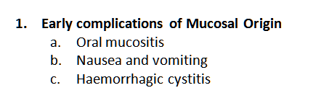
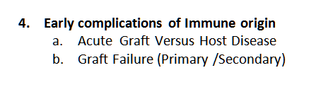
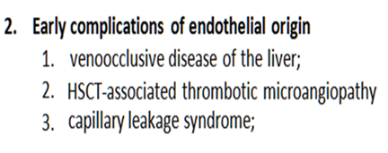
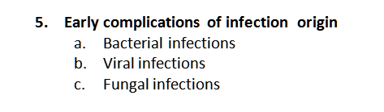
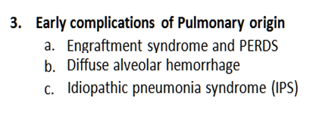
Early complications of high-dose therapy and stem cell transplantation
LATE EFFECTS …..

Slide 3

5. EARLY COMPLICATIONS OF IMMUN ORIGIN
Acute GRAFT VERSUS HOST DISEASE occuring after HSCT
GVHD occurs when immune cells transplanted from
a non-identical donor (the graft) recognize the transplant recipient (the host) as foreign, thereby initiating an immune reaction that causes disease in the transplant recipient

Slide 4
5. EARLY COMPLICATIONS OF IMMUN ORIGIN
Acute GRAFT VERSUS HOST DISEASE occuring after HSCT
Historically, it was divided based on the timing of occurrence
  Acute – within the first 100 days
  Chronic – after first 100 days
Notes:
Inflammatory condition affecting one or more of the skin, gastrointestinal tract and liver, and occurring within 100 days of allogeneic transplantation
Later acknowledgement of similar syndrome occurring beyond day 100, known as late onset acute GvHD (particularly after RICT and DLI)
Affects 35-45% of recipients of HLA matched, and
60-80% of one Ag mismatched transplants
Affects approximately 40% of recipients of DLI but incidence rises with increasing cell dose

Slide 5
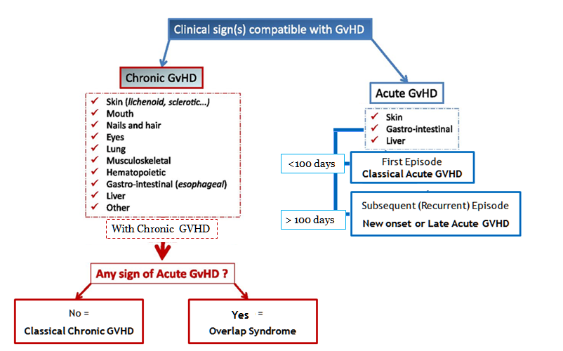
The NIH consensus;
recognized 2 main categories of GVHD, each with 2 subcategories.
similar syndrome occurs beyond day 100,
known as late onset acute GvHD
particularly after RICT and DLI
Notes:
The NIH consensus conference recognized 2 main categories of GVHD, each with 2 subcategories. The broad category of acute GVHD includes classic acute GVHD (maculopapular erythematous rash, gastrointestinal symptoms, or cholestatic hepatitis) and also includes persistent, recurrent, or late-onset acute GVHD occurring more than 100 days after transplantation. The broad category of chronic GVHD includes classic chronic GVHD, presenting with manifestations that can be ascribed only to chronic GVHD. Chronic GVHD also includes an overlap syndrome, which has diagnostic or distinctive chronic GVHD manifestations together with features typical of acute GVHD

Slide 6
5. EARLY COMPLICATIONS OF IMMUN ORIGIN
Acute GRAFT VERSUS HOST DISEASE occuring after HSCT
  Acute GVHD occurs
    in up to 40% of sibling donor recipients
    and up to 70% of unrelated donor recipients
  Chronic GVHD occurs in
    50% of 3-month survivors after allo HCT
  Recipients of DLI occurs in ( 40%) but incidence rises with increasing cell dose

Slide 7
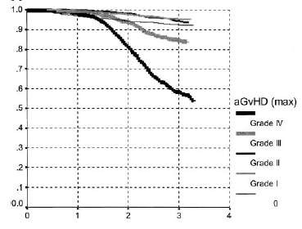
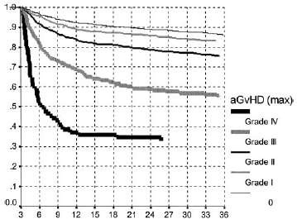
Impact of aGvHD on survival
Gratwohl et al, Blood, 2002

Slide 8
Today Topic
Acute GvHD
Definition
Incidence
Pathophysiology
Diagnosis
  Clinical
  Pathological
Prevention & treatment
  Pharmacological
  Immunomodulation
  Cellular

Slide 9
GVHD Pathogenetic Definiation
Remains poorly understood
Cellulary involvement, Cytokine storms and prolonged use of immune suppression:
  ➔ Increased infections
  ➔ Organ dysfunctions
  ➔ Increased morbidity
  ➔ Impaired QOL
Uncontrolled Immüne attack causes to the non-relapse mortality.

Slide 10
Basic for GVHD Understanding?
A donor origin cell mediated reaction against to the recipient tissues
It requires (prerequisites):
  .. a recipient expresses tissue antigens that are not present in the donor.
  .. a donor graft react against to the recipient antigens with immunologically competent cells
Recipient unable to overcome immune attack
Notes:
Graft must contain immunologically competent cells
Recipient must express tissue antigens not present in the donor

Slide 11
Basic Cellulary RESPONSE: Afferent PHASE
Degraded in peptides
Combined with HLA molecules
HLA Class I -
Displayed with HLA molecule
Exogenous substance

Slide 12
Basic Cellulary RESPONSE: Afferent PHASE
Viral or intracellular protein
Nucleus
HLA Class II -
Virus
Endogenous substance
Displayed with HLA molecule

Slide 13
Basic Cellulary RESPONSE: Afferent PHASE
HLA Class II - i.e. HLA - DR, DQ, DP
“Regulator”
“Trouble”
signal
CD4
APCs
Dendritic cell
B cell
Macrophage
“Submitted to the …
“Enforcer”
CD8
HLA Class I - i.e. HLA-A, B, C
Notes:
GVHD is a common complication and cause of mortality after allogeneic blood and marrow transplant (AlloBMT). T cells present in the donor stem cell graft can target antigens present on the leukemia, termed the graft-versus-leukemia (GVL) effect, resulting in clinical remissions and cures. Unfortunately T cells can also target host tissues that express minor histocompatibility antigens (mHAs) that are mismatched to the donor, leading to GVHD.
GVHD pathogenesis can be divided into distinct phases. Inflammation from the conditioning regimen activates antigen presenting cells (APCs) in the host expressing mHAs that are foreign to the donor prime and activate donor T cells. Cytokines stimulated by the inflammation, such as gamma interferon (IFNg), enhance this activation. Donor T cells proliferate in response to being exposed to foreign mHAs present on APCs, and attack host organs like liver, gut and skin.
The activated T cells can also produce further cytokines that exacerbate GVHD further. Because GVHD can be a life threatening complication, it is typically treated with immunosuppressant drugs for weeks to months. The paradox is that GVHD, and the current drugs used for treating GVHD, inhibit the function of the donor T cells – simultaneously abrogating GVL. Therefore while GVHD may be controlled, the leukemia relapses. If GVHD is not treated, T cells may be intact to cause GVL but GVHD eventually kills the patient. Thus clinicians often allow a small amount of GVHD to occur, to reap any concurrent GVL effect, but then treat GVHD as it worsens before it becomes uncontrollable and lethal.

Slide 14
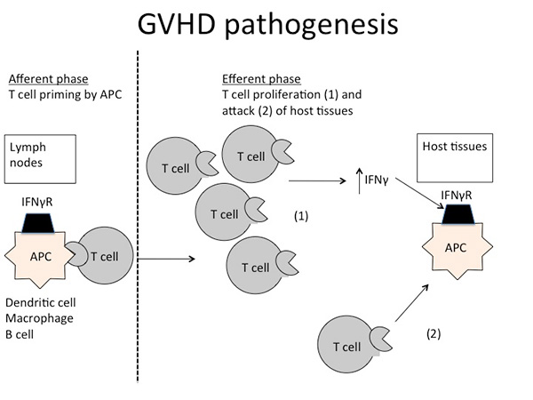
GVHD Pathogenetic Definiation

Slide 15
Why do we have to HLA match?
BMT = immune system transplant
HLA molecules act as T cell “superantigens”
All somatic tissues express HLA class I
Transferred T cell could “over-react” to recipient

Slide 16
If there is a “match”, why GVHD?
HLA molecules “show” what’s inside
We are all different inside
GVHD results from T cell reactivity toward polymorphisms between donor and host.
  This can be a good thing (GVL)
    or
  This can be a bad thing (GVHD)

Slide 17
Polymorphisms can help rid disease or cause GVHD
H -Y
  antigen from Y chromosome
  expressed ubiquitously
  target for CTL responses
  CTL response leads to less relapse, more GVHD
HA-1
  polymorphic
  unknown function
  expressed only on hematopoietic cells
  target for CTL responses
  CTL response leads to less relapse, no GVHD

Slide 18
Acute GvHD: Pathophysiology
Activation of antigen presenting cells (APCs) by tissue damage induced by conditioning regimen:
  Typically involves TNF alfa, IL1, IL6 and lipopolysaccharide (LPS)
Donor T-cells proliferate, differentiate and migrate:
  CD4 cells typically recognising Class II and CD8 recognising Class I antigens.
  Process modulated by NK, T-regs and MSCs,
  Production of IL2, IL-12, TNF alfa and IFN-gamma
Target tissue destruction through Fas-Fas ligand (liver) and perforin-granzyme pathway (GIT)

Slide 19
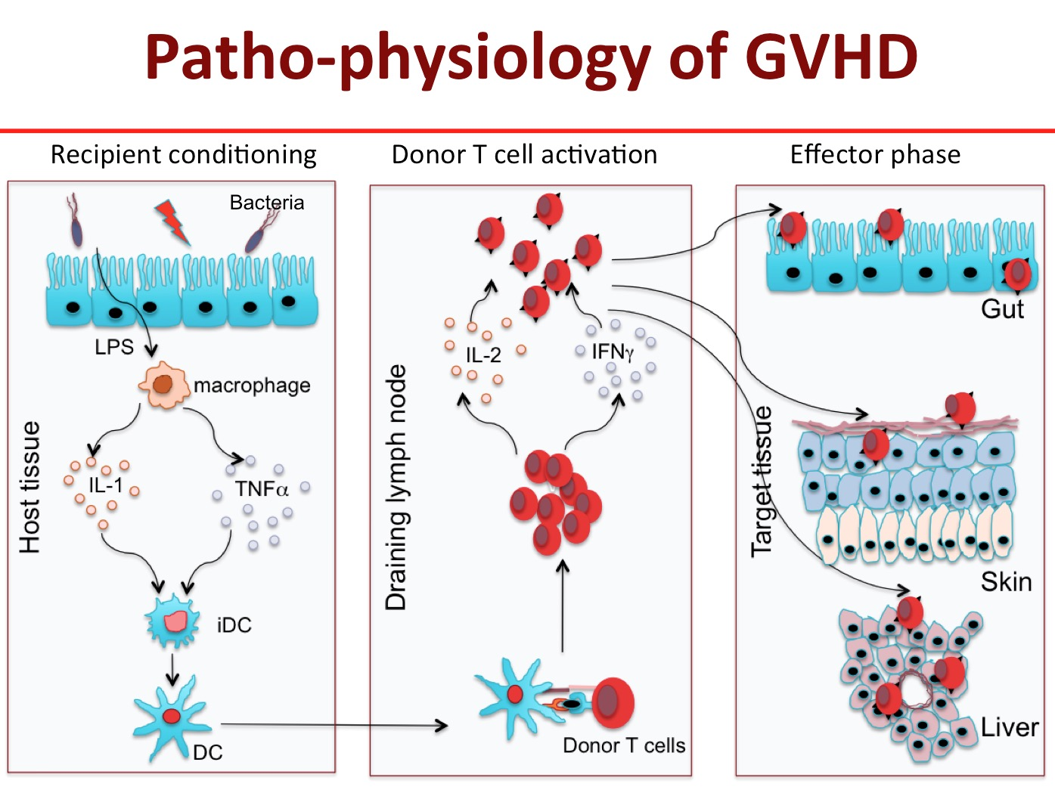
Notes:
HSCT without T cells results in poor engraftment and recurrent infections. Infused T cells also mediate anticancer effect against some lymphoma and leukemia. However, these donor T cells recognize the recipient’s cells as foreign and attack the epithelial cells in the skin, liver and gut causing acute graft versus host disease (GVHD) that accounts for significant morbidity and about 50% mortality associated with HSCT. Therefore, it is essential to identify the molecule(s) in donor T cells that are responsible for induction of GVHD.
I have been studying the cellular mechanism of GVHD and the interactions between subpopulations of T cells involved in induction or prevention of the disease. My research demonstrates that naive phenotype subset of T cells (memory phenotype) that cause acute GVHD while memory phenotype T cells do not. Memory phenotype T cells have these unique characteristics i) reduced proliferation and IL-2 production in response to recipient antigens (allo-antigens) and ii) havereduced ability to traffic to target to GVHD target organs. Therefore, I intend to identify transcription factors and cell signaling molecules that regulate their functions
Figure 1: Pathogenesis of acute GVHD. Conditioning by irradiation and/or chemotherapy causes tissue damage. Damaged tissues and cells release DAMPs (HMGB-1), PAMPs (LPS) from gut microbiota as well as inflammatory cytokines such as IL-1β, IL-6, and TNF-α, which contribute to the “cytokine storm.” These are the first danger signals that activate host APCs, which activate and polarized donor T-cells toward pathogenic T-cells (TH1 and TH17 for CD4 and TC1, TC17 for CD8). Activated pathogenic T-cells infiltrate target organs (i.e., GI tract, liver, skin) and amplify local tissue destruction. The presence of regulatory T-cells (Tregs) helps reduce GVHD severity through the inhibition of pathogenic cells activation and/or expansion at early or further phases of GVHD. Some of these DAMPs and PAMPs such as elafin (skin-specific), regenerating islet-derived 3-alpha (REG3α, gut-specific), and suppressor of tumorigenicity 2 (ST2, a member of the IL-1 receptor family, binding IL-33) have been shown to be biomarkers

Slide 20
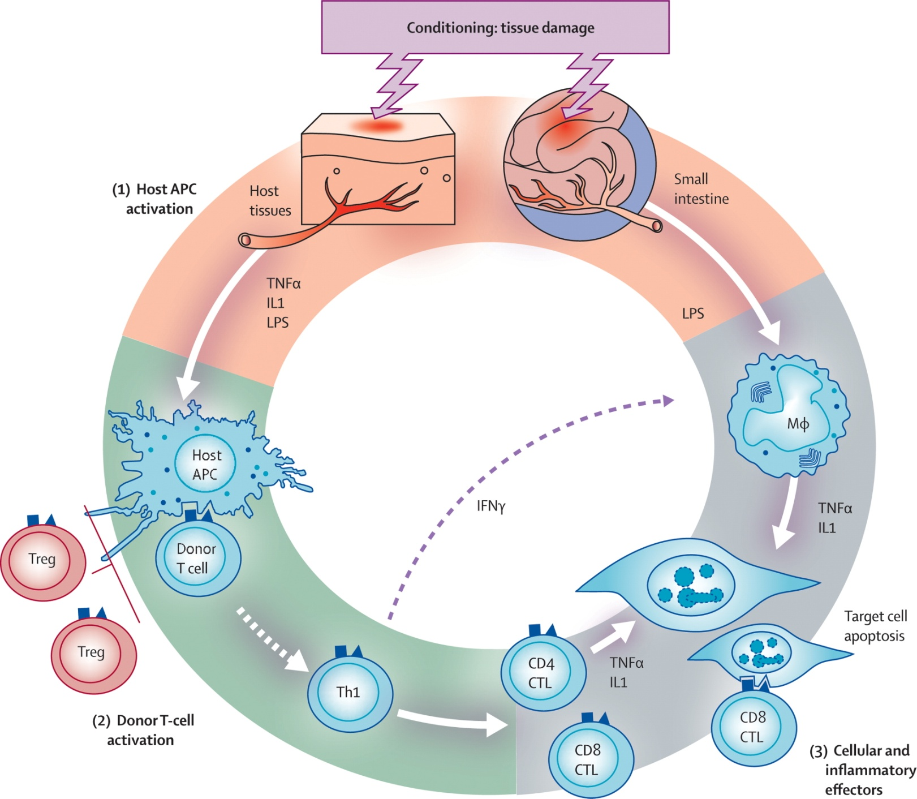

Acute GvHD:
Pathophysiology
The Lancet 2009 373, 1550-1561DOI: (10.1016/S0140-6736(09)60237-3)
Notes:
Pathophysiology of acute GVHD
IL 1=interleukin 1. IFN γ=interferon γ. LPS=lipopolysaccharide. Treg=regulatory T cell. Th1=T-helper 1 cell. CTL=cytotoxic T lymphocyte.

Slide 21
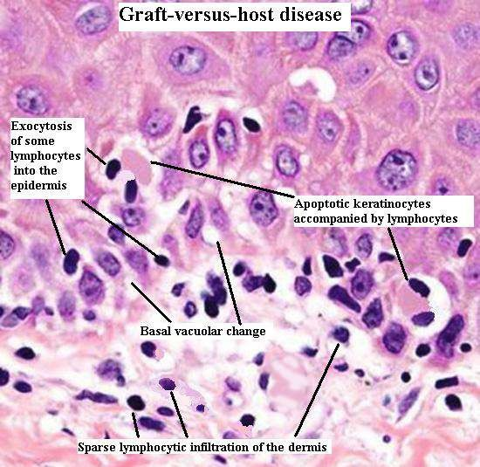
Acute GvHD: Pathophysiology

Slide 22
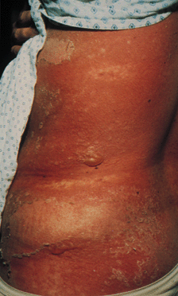
Clinical manifestations of Acute GvHD İnclude;
Graft Versus Host Disease of the Skin: Grade IV
A classic maculopapular rash;
Persistent nausea and/or emesis;
Abdominal cramps with diarrhea; and
A rising serum bilirubin concentration.
Notes:
Clinical manifestations of acute GVHD include a classic maculopapular rash; persistent nausea and/or emesis; abdominal cramps with diarrhea; and a rising serum bilirubin concentration. In contrast, patients with chronic GVHD commonly demonstrate skin involvement resembling lichen planus or the cutaneous manifestations of scleroderma; dry oral mucosa with ulcerations and sclerosis of the gastrointestinal tract; and a rising serum bilirubin concentration

Slide 23
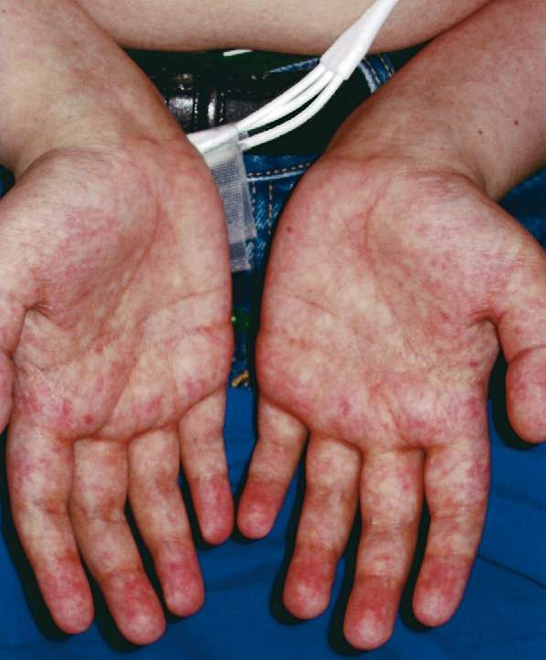
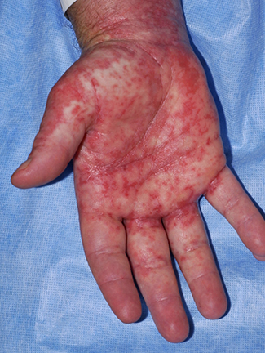
Acute GvHD: Skin
  Most common organ affected (>80% )
  Macular papular rash affecting any part of the body, typically palmar & plantar erythema and sparing the scalp
    Pt may complain of pain or itching to affected areas
    Rash becomes confluent as it progresses however, blisters may form.
    Severe cases resemble burn patients
    Usually correlates with engraftment;
    reduced intensity have delayed onset of GVHD
Differential diagnosis:
  Chemotherapy/radiation, drug, infection, engraftment

Slide 24
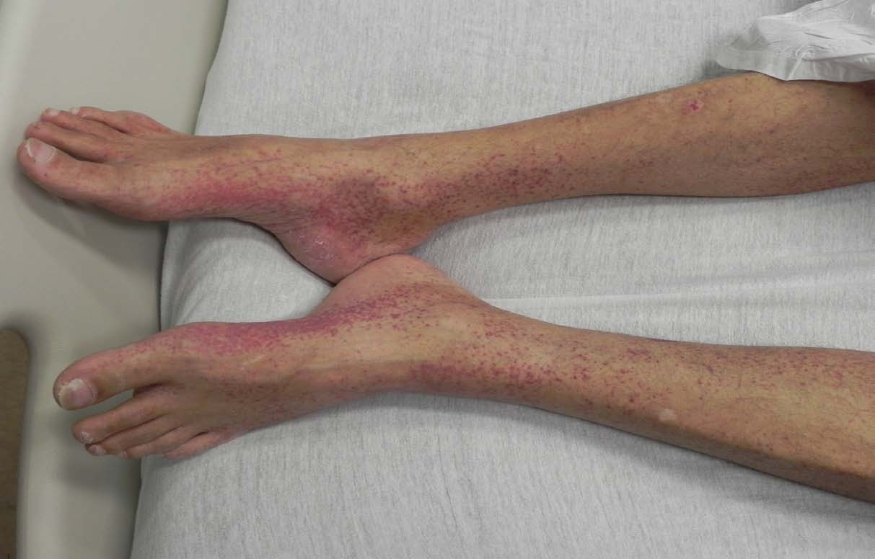
Skin

Slide 25
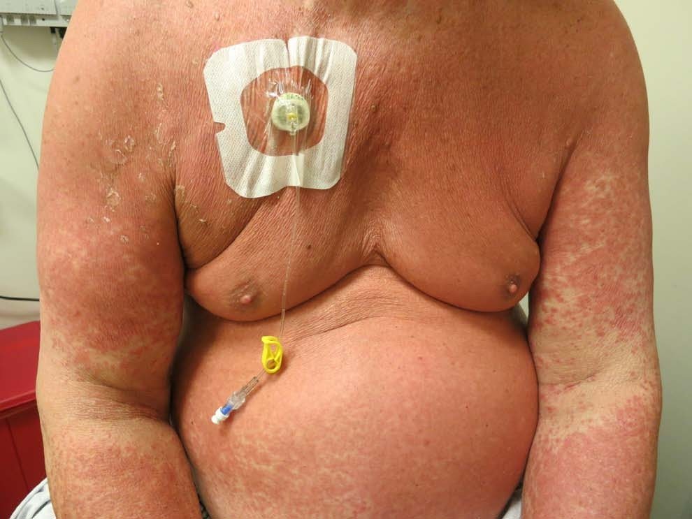
Skin

Slide 26
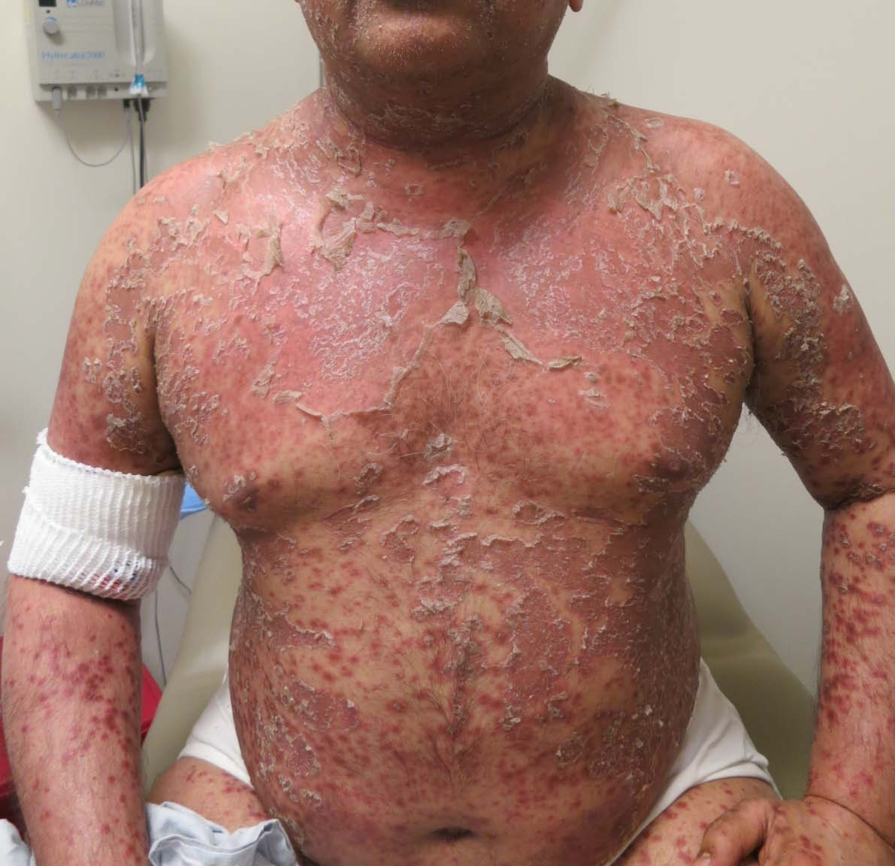
Skin
Multiple bullae and areas of denuded epidermis are present.

Slide 27
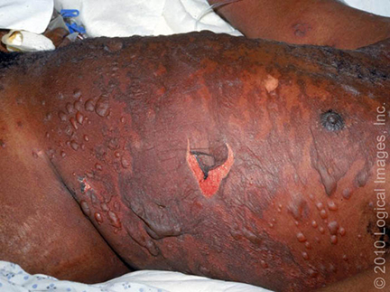
Skin
Toxic epidermal necrolysis
In severe GVHD, the maculopapular rash forms bullous lesions with toxic epidermal necrolysis mimicking Stevens-Johnson syndrome

Slide 28
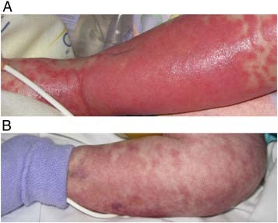
Skin

Slide 29
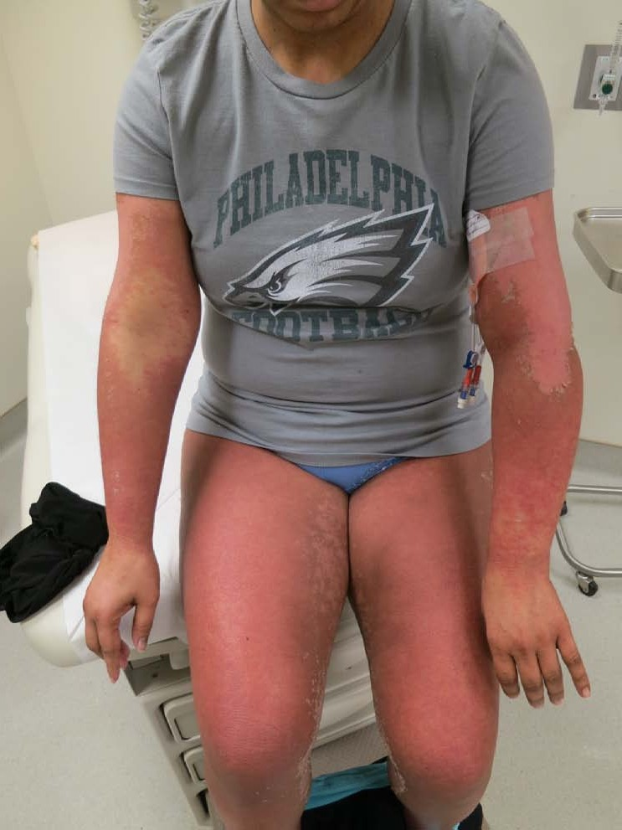
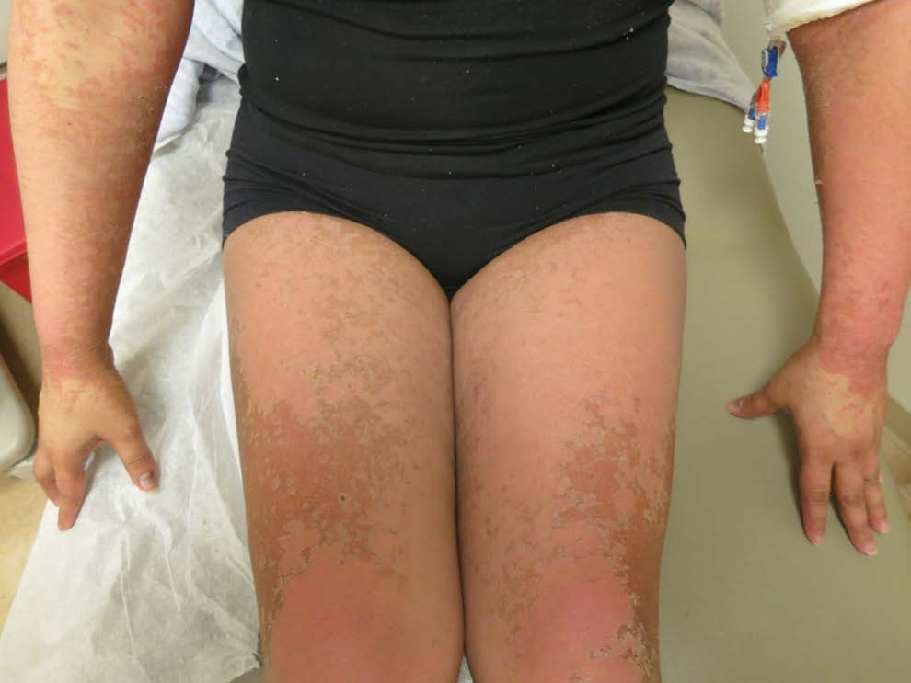
Skin

Slide 30
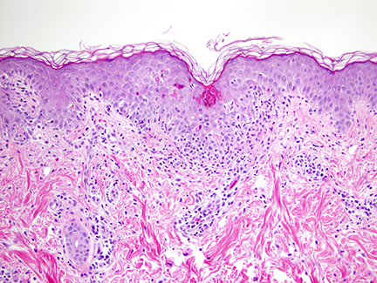
Histologic examination
Characteristic findings include exocytosed lymphocytes, dyskeratotic epidermal keratinocytes, follicular involvement, satellite lymphocytes adjacent to or surrounding dyskeratotic epidermal keratinocytes, and dermal perivascular lymphocytic infiltration
Apoptotic keratinocytes in the epidermis, vacuolization of the basal layer, and lymphocyte exocytosis are present in this specimen of histologic grade 2 acute graft-versus-host disease. A lymphocytic infiltrate at the dermal-epidermal junction and surrounding blood vessels is also present.
Notes:
Histologic examination of the skin reveals changes in the dermal and epidermal layers

Slide 31
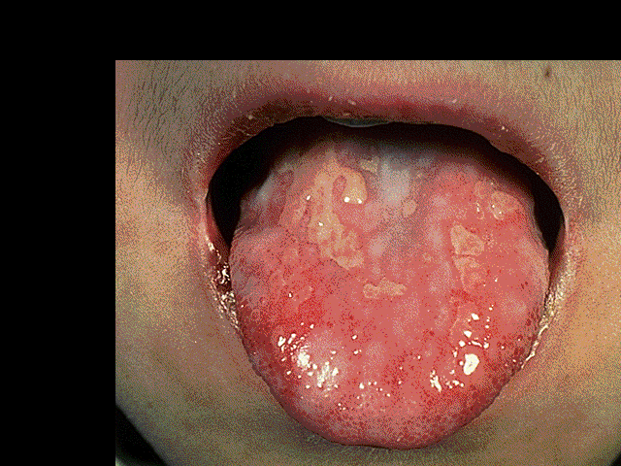
Acute GvHD: GIT
Approximately 50% of cases
Nausea, vomiting and anorexia
Watery diarrhoea (typically green) and
abdo cramps progressing to ileus and bloody diarrhoea
Differential diagnosis:
  Chemotherapy/radiation, medications, infections

Slide 32
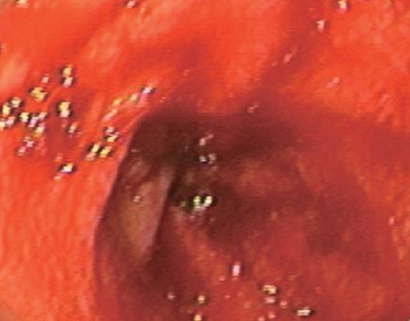
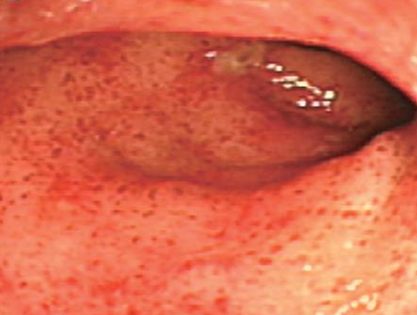
Acute GvHD: GIT
Endoscopy: patchy ulceration
CT scan: luminal dilatation with thickening of small bowel wall (ribbon sign), may have fluid levels

Slide 33
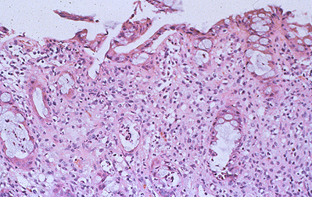
Histologic examination
Pathology: apoptotic bodies in base of crypts, crypt abscesses, loss and flattening of surface epithelium
Rectal biopsy in a patient with acute graft-versus-host disease (GVHD) shows crypt cell necrosis with the accumulation of degenerative material in the dead crypts.
Notes:
Apoptosis at base of
epidermal rete pegs
Dyskeratosis with adjacent satellite lymphocytes
Perivascular lymphocytic infiltration in the dermis.

Slide 34
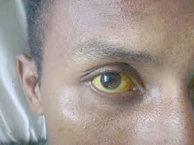
Acute GvHD: Liver
Approximately 50% of cases
Cholestatic hyperbilirubinaemia
  Increased bilirubin,
  alkaline phosphatase
  Transaminitis less common
Differential diagnosis:
Difficult to distinguish from other causes of hepatic toxicity i.e. veno-occlusive disease, drugs, viral infections, sepsis, iron overload

Slide 35
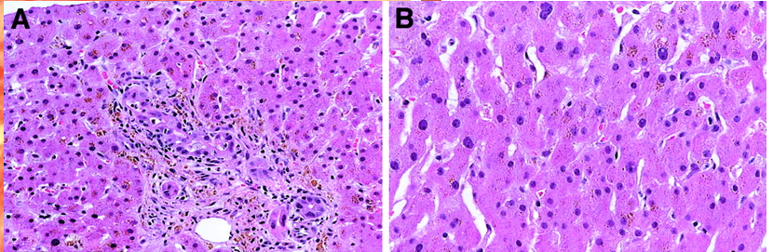
Acute GvHD: Liver
Biopsy often not performed because of concurrent thrombocytopenia
Pathology: endothelialitis, lymphocytic infiltrate of portal areas, pericholangitis, bile duct destruction
Characteristic histology of classical liver GVHD with bile duct lymphocytic infiltrates and injury. (A) Portal lymphocytic inflammation is also present. (B)

Slide 36
Grading of Acute Skin GVHD
Grade | Description
I | Rash <25% of body
II | Rash 25% – 50% of body
III | Generalized erythroderma or rash >50% of body
IV | Bullae formation and/or with desquamation

Slide 37
Grading of Acute Liver GVHD
Grade | Description
I | Bilirubin 2-3 mg/dL
II | Bilirubin 3.1-6 mg/dL
III | Bilirubin 6.1 – 15 mg/dL
IV | Bilirubin > 15 mg/dL

Slide 38
Grading of Acute Gut GVHD
Grade | Description
I | Diarrhea 500-1000 ml/day (or persistent nausea, vomiting or anorexia with biopsy proven upper GI involvement)
II | Diarrhea 1000 - 1500 ml/day
III | Diarrhea > 1500 mL/day
IV | Severe abdominal pain (w/o) ileus or stool with frank blood

Slide 39
Overall Grade (Stage) of Acute GVHD
Stage | Skin | Liver | Gut
I | I-II | None | None
II | III | I or | I
III |  | II-III or | II-IV
IV | IV | IV
5 year survival
O. Grade III: 40 %
O. Grade IV: 20 %

Slide 40
Acute GvHD: Risk Factors
Degree of (HLA) mismatch
  HLA-A, -B, -C, and –DRB
Gender disparity and donor parity
  Female to male
  Multiparity ➔ Maternal allo-immunization
Age of donor and recipient
Intensity of conditioning regimen
  Reduce intensity vs. myeloablative
Source of graft
      Peripheral blood vs. marrow vs. cord
CMV seropositivity

Slide 41
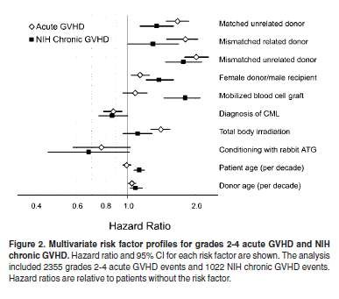
Risk factors for aGvHD
Flowers et al, Blood, 2011

Slide 42
Acute GvHD: Prevention and treatment
Prophylaxis REGIMENS:
  Calcineurin inhibitor (Cyclosporine/Tacrolimus) + MTX
  Tacrolimus + Sirolimus is another frequently used combination
    Randomized study showed comparable efficacy to Tacro/Siro
  Cellcept-based regimen
  Post-transplant Cytoxan
    Unique for haploidentical HCT
  The addition of mini-dose ATG & Velcade & MTX,
    Mismatch cases with lower likelihood of relapse
Notes:
Pharmacological
Immunosuppression
Corticosteroids
Methotrexate
Inhibition of cytoplasmic calcineurine (enzyme involved in T-cell
activation)
Cyclosporine
Tacrolimus (FK506)
Mycophenylate mofetil
Active compound, mycophenolic acid, Inhibits inosine monophosphate dehydrogenase (enzyme essential to de novo synthesis of guanosine nucleotides) and terminates DNA synthesis
Sirolimus (binds to FKBP12) can be used in combination with FK506
Vorinostat (histone deacetylase inhibitor)
Immunological and Cellular
Antithymocyte globulin (ATG, ALG)
Monoclonal antibodies
CD20: rituximab
CD52: alemtuzamab (Campath)
CD2: alefacept (Blocks CD3-LFA3 interaction)
CD3: OKT3, visilizumab
CD147: ABX-CBL
TNF: infliximab, etanercept, adalimumab, certolizumab
IL2/IL2R (CD25): dacluzamab, inolimomab, basiliximab, denileukin diftitox
Extracorporeal photophoresis
Cellular
T-cell depletion
Mesenchymal stem cells
T-regulatory cells
Suicide gene therapy of donor T-cells

Slide 43
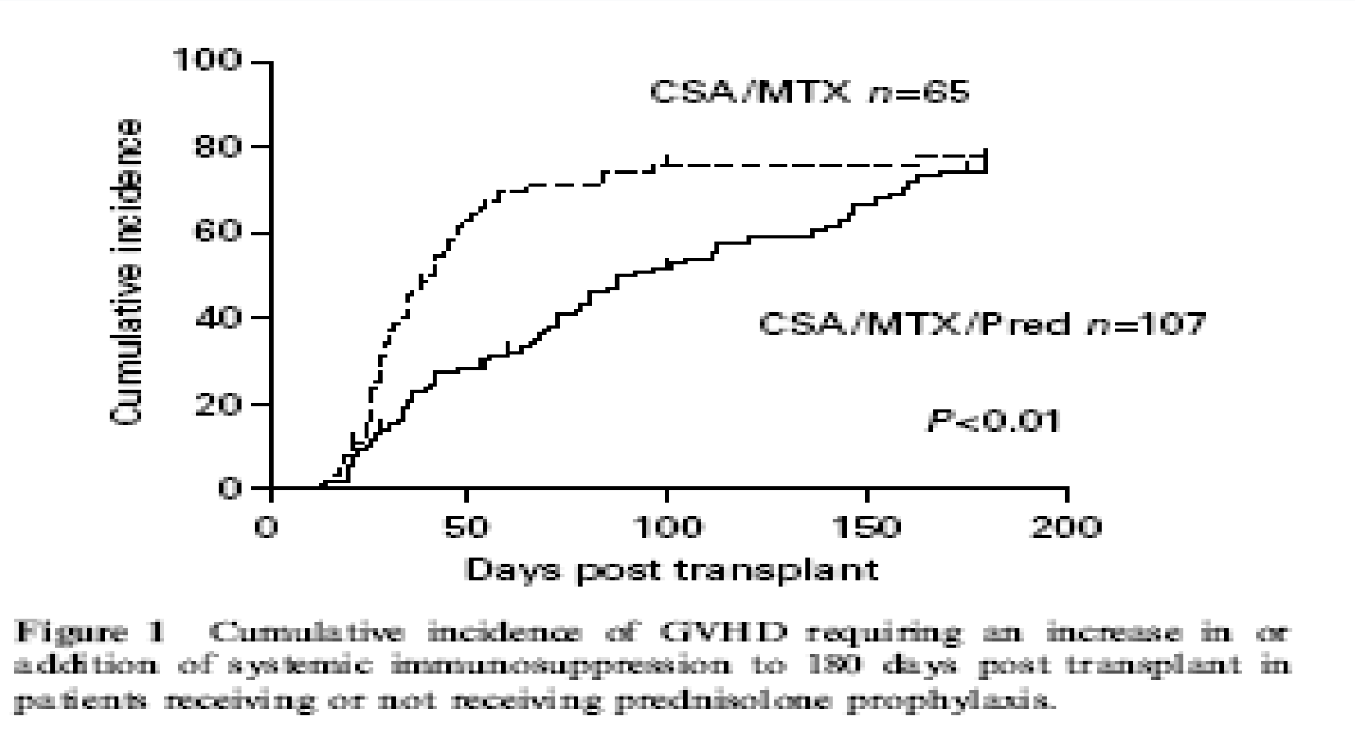
Acute GvHD: Prevention
Hoyt et al, BMT 2008

Slide 44
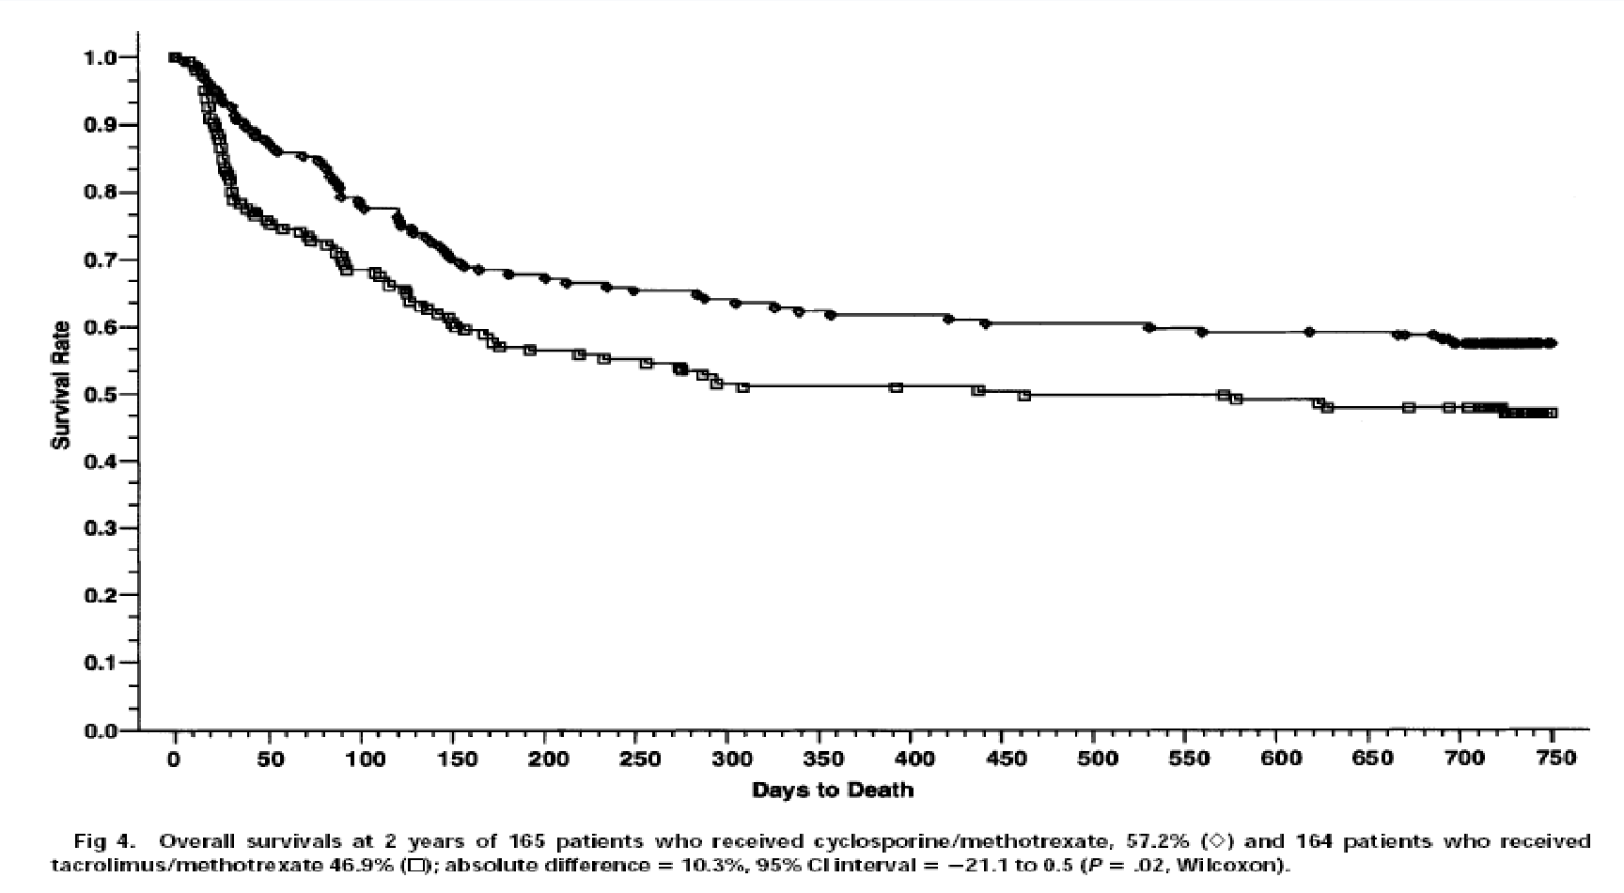
Acute GvHD: Prevention
Phase III trial CsA + MTX / FK506 + MTX in sibling transplants
Ratanatharathorn et al Blood 1998
CsA/MTX n=165 FK506/MTX n=164

Slide 45
Acute GvHD: Unrelated transplants
Parameter | CsA-MTX-ATG % N=103 | CsA-MTX % N-98 | P value
aGvHD > I | 33 | 51 | 0.01
aGvHD > II | 12 | 24.5 | 0.054
Any cGvHD | 31 | 59 | <0.0001
Ext CGvHD | 12 | 43 | <0.0001
100d TRM | 11 | 13 | NS
2yr TRM | 20 | 29 | NS
2yr relapse | 29 | 24 | NS
2yr DFS | 52 | 48 | NS
Finke et al, Lancet Oncology 2009 10: 855-864

Slide 46
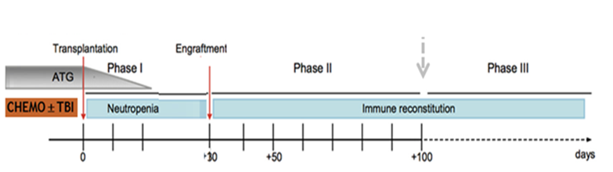
Acute GvHD: Prevention and treatment
DURATION:
  Started before day 0
  Continue for at least 3-6 months:
    Depends on donor source
      Risk of disease relapse
        Occurrence of GVHD
Notes:
Pharmacological
Immunosuppression
Corticosteroids
Methotrexate
Inhibition of cytoplasmic calcineurine (enzyme involved in T-cell
activation)
Cyclosporine
Tacrolimus (FK506)
Mycophenylate mofetil
Active compound, mycophenolic acid, Inhibits inosine monophosphate dehydrogenase (enzyme essential to de novo synthesis of guanosine nucleotides) and terminates DNA synthesis
Sirolimus (binds to FKBP12) can be used in combination with FK506
Vorinostat (histone deacetylase inhibitor)
Immunological and Cellular
Antithymocyte globulin (ATG, ALG)
Monoclonal antibodies
CD20: rituximab
CD52: alemtuzamab (Campath)
CD2: alefacept (Blocks CD3-LFA3 interaction)
CD3: OKT3, visilizumab
CD147: ABX-CBL
TNF: infliximab, etanercept, adalimumab, certolizumab
IL2/IL2R (CD25): dacluzamab, inolimomab, basiliximab, denileukin diftitox
Extracorporeal photophoresis
Cellular
T-cell depletion
Mesenchymal stem cells
T-regulatory cells
Suicide gene therapy of donor T-cells

Slide 47
Acute GVHD Treatment
Initiated once GVHD is suspected or confirmed
Corticosteroid remains the standard first line therapy
  Randomized studies failed to show benefit of combining other agents
  Starting M. Pred. dose 1-2mg/Kg
    10mg/kg was not superior to 2mg/kg
    1mg/kg might be enough for grade II disease
Notes:
Gold standard is cyclosporine and methotrexate
CsA/MTX and FK506/MTX better than CsA alone
No benefit in adding corticosteroid
FK506/MTX may be better than CsA/MTX
BMT-CTN completing a study on Sirolimus plus FK506 vs FK506/MTX
Decreased incidence with ATG

Slide 48
Acute GVHD Treatment
Grade I skin GVHD
  Managed with topical therapy + optimizing immunosuppression levels
Non-absorbable steroid are very useful adjuvant therapy in GI GVHD
Survival correlates directly with the response to initial therapy
Notes:
Gold standard is cyclosporine and methotrexate
CsA/MTX and FK506/MTX better than CsA alone
No benefit in adding corticosteroid
FK506/MTX may be better than CsA/MTX
BMT-CTN completing a study on Sirolimus plus FK506 vs FK506/MTX
Decreased incidence with ATG

Slide 49
Salvage Therapy for Steroid Resistant aGVHD
Cellcept (Mycofenelat Mofetil, MMF)
Extracorporeal photopheresis (ECP)
Anti-TNF antibodies-
  Infliximab, Etanercept
  Infliximab: Begin gtt within 3 hrs from preparation, and infuse at least over 2hrs. Risk of hypersensitivity rxn. Monitor vital signs closely
IL2 inhibitors-
  Basiliximab
  Hypersensitivity rxn, monitor vital sign
Nucleoside analogues- Pentostatin
  Infuse over 15 mins, and pre-infusion hydration is given usually
m-TOR inhibitor-
  Sirolimus
Rituximab
  Infused over 4 hrs, and associated with risk of hypersensitivity reaction

Slide 50
Topical Agents for Cutaneous GVHD
Topical Steroids
  Different potency
  Triamcinolone acetone 0.1% cream
    Apply twice daily
    Do not use on face
Calcineurin inhibitors:
  Tacrolimus cream 0.03% or 0.1%
    Apply twice daily

Slide 51
Refractory aGVHD
Steroid refractory defined as
  GVHD progression after 3 days of therapy
  No improvement in 1 week of therapy
  No resolution in 2 weeks of therapy
Second-line treatment characterized by
High failure rate
Significant toxicities
Poor survival
No standard of care for second or beyond therapy
  No data for efficacy for one regimen over another

Slide 52
Nursing Management :Acute GVHD
Skin
Skin cleansing
Moisturize skin/Avoid drying lotions
Topical antihistamines
Topical steroids
Analgesics
Maintain mobility with passive range of motion (ROM)
Educate patient to avoid sun exposure and dehydration

Slide 53
Nursing Management: Acute GVHD
Gut
Maintain fluid and electrolyte balance
Sitz baths for comfort
Prevent rectal fissures
Administer platelets as needed/ordered
Nutritional support
Protective barrier on rectal area

Slide 54
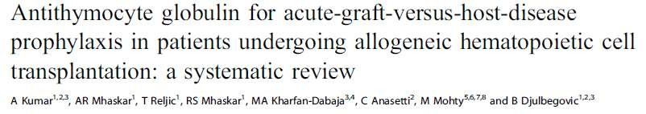
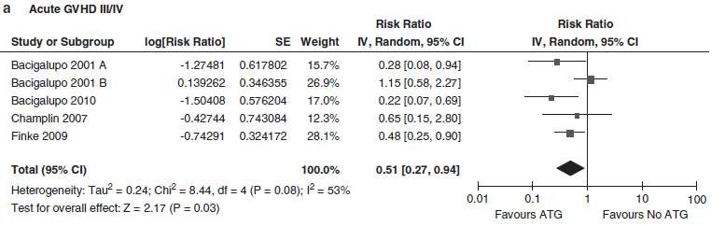
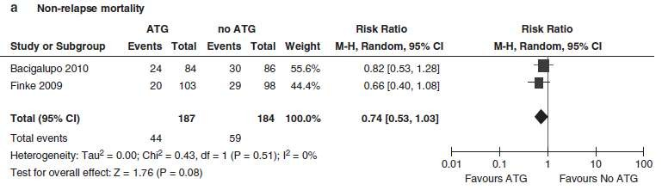
Kumar et al., Leukemia 2012

Slide 55
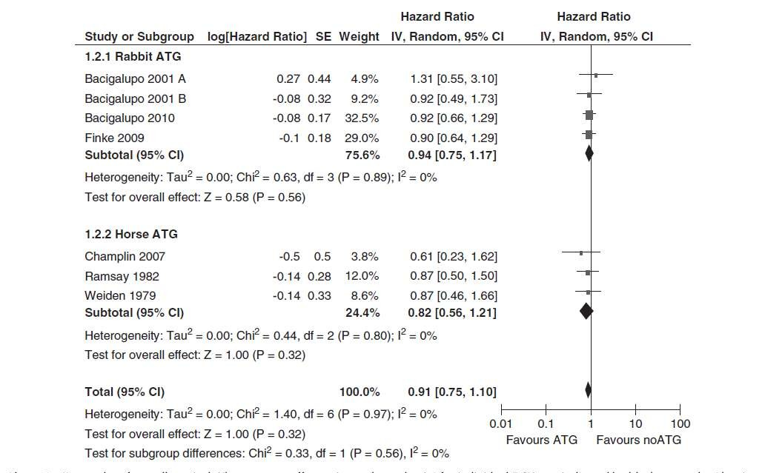
Overall survival
Kumar et al., Leukemia 2012

Slide 56
Acute GvHD: Prevention
SUMMARY
Gold standard is cyclosporine and methotrexate
  CsA/MTX and FK506/MTX better than CsA alone
  No benefit in adding corticosteroid
  CsA/MTX also may be better than FK506/MTX
  Decreased incidence with ATG but little or no change in outcome
Side effects
  Metabolic (low Mg, increased K, increased bilirubin)
  Hypertension, nephrotoxicity
  Neurological (altered mental state, seizures, classical signs on MRI)
  Transplant associated thrombotic thrombocytopenic purpura (TTP) – does not respond to plasmapheresis
Mandatory monitoring of drug levels

Slide 57
Acute GvHD: Treatment
SUMMARY
Grade I skin disease may be controlled with topical steroids alone
For GvHD > grade I, gold standard is corticosteroid
  2mg/kg methylprednisolone
  Several studies show no benefit in increasing dose
  One study of steroid plus etanercept showed 70% resolution in one month
Steroid refractory aGvHD
  ATG
  MoAbs
  MSC
  ECP
  Ruxolitinib
Supportive care is critical: antimicrobial prophylaxis, management of hyperglycaemia, antibody replacement, manage cytopenias

Slide 58
Acute GvHD: 2nd line treatment
Treatment | Response | Survival
ATG | 51% | 35%
Anti-IL2R | 40-70% | <30%
Anti-TNF | 67% | 38%
CsA to tacro | 10%
Tacro + ATG |  | 35%
MMF | 40% | 16% - 37%
Pentostatin | 50% | 26%
OKT3 | 50% | 45%

Slide 59
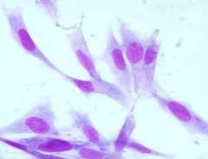




Acute GvHD: 3nd line treatment - MSC
Derived from bone
marrow stroma
Exhibit immunosuppressive properties
Non-HLA restricted
Progenitors
Bone
Chondrocytes
Adipocyte
Muscle

Slide 60
Acute GvHD: 3nd line treatment - MSC
Response rates | N = 55
Overall response | 71%
Complete response | 54%
Le Blanc et al, Lancet 2008
Response rates | N = 50
Overall response | 66%
Complete response | 34%
Resnick et al Am J Blood Res, 2013
Response rates | N = 37
Overall response | 78%
Complete response | 65%
Ball et al Brit J Haem, 2013
Response rates at 28 days | N = 40
Overall response | 67.5%
Complete response | 27.5%
Introna et al, BBMT2014

Slide 61

Thank you very much for your attention

Slide 62
Historically, acute GVHD defined as symtomps occuring within the first 100 days
True
False

Slide 63
Historically, acute GVHD defined as symtomps occuring within the first 100 days
True
False

Slide 64
Which of the following statements is untrue?
A In HSCT setting, not only hematopoetic system is transplated but also immune system is trarsferred to the recipient
B Transferred T cell could “over-react” to recipient
C Transferred T cells won’t tolerate if they can’t bind their own HLA molecule
D HLA match enought to prevent GVHD
Notes:
GvHD can only be diagnosed within the first 100 days of transplant
GvHD can only be diagnosed within the first 100 days of transplant
GvHD can only be diagnosed within the first 100 days of transplant

Slide 65
Which of the following statements is untrue?
A In HSCT setting, not only hematopoetic system is transplated but also immune system is trarsferred to the recipient
B Transferred T cell could “over-react” to recipient
C Transferred T cells won’t tolerate if they can’t bind their own HLA molecule
D HLA match enought to prevent GVHD
Notes:
GvHD can only be diagnosed within the first 100 days of transplant
GvHD can only be diagnosed within the first 100 days of transplant
GvHD can only be diagnosed within the first 100 days of transplant

Slide 66
Why do we have to match?
BMT = immune system transplant
HLA molecules act as T cell “superantigens”
All somatic tissues express HLA class I
Transferred T cell could “over-react” to recipient
Transferred T cells won’t tolerate if they can’t bind their own HLA molecule

Slide 67
Which of the following statements is untrue?
A The incidence and severity of GvHD increases with increasing HLA disparity
B One of the prerequisites for the occurrence of GvHD is lack of immunocompetence in the patient
C GvHD can only be diagnosed within the first 100 days of transplant
D Epithelial tissue damage is modulated through cytokines
Notes:
GvHD can only be diagnosed within the first 100 days of transplant
GvHD can only be diagnosed within the first 100 days of transplant
GvHD can only be diagnosed within the first 100 days of transplant

Slide 68
Which of the following statements is untrue?
A The incidence and severity of GvHD increases with increasing HLA disparity
B One of the prerequisites for the occurrence of GvHD is lack of immunocompetence in the patient
C GvHD can only be diagnosed within the first 100 days of transplant
D Epithelial tissue damage is modulated through cytokines
Notes:
GvHD can only be diagnosed within the first 100 days of transplant
GvHD can only be diagnosed within the first 100 days of transplant
GvHD can only be diagnosed within the first 100 days of transplant

Slide 69
The NIH consensus;
recognized 2 main categories of GVHD, each with 2 subcategories.
similar syndrome occurs beyond day 100,
known as late onset acute GvHD
particularly after RICT and DLI
Notes:
The NIH consensus conference recognized 2 main categories of GVHD, each with 2 subcategories. The broad category of acute GVHD includes classic acute GVHD (maculopapular erythematous rash, gastrointestinal symptoms, or cholestatic hepatitis) and also includes persistent, recurrent, or late-onset acute GVHD occurring more than 100 days after transplantation. The broad category of chronic GVHD includes classic chronic GVHD, presenting with manifestations that can be ascribed only to chronic GVHD. Chronic GVHD also includes an overlap syndrome, which has diagnostic or distinctive chronic GVHD manifestations together with features typical of acute GVHD

Slide 70
Which of the following is not a feature of acute GvHD?
A Nausea
B Raised serum bilirubin concentration
C Lichen planus
D Rash-Bullae

Slide 71
Which of the following is not a feature of acute GvHD?
A Nausea
B Raised serum bilirubin concentration
C Lichen planus
D Rash-Bullae

Slide 72
Clinical manifestations of Acute GvHD İnclude;
Graft Versus Host Disease of the Skin: Grade IV
A classic maculopapular rash;
Persistent nausea and/or emesis;
Abdominal cramps with diarrhea; and
A rising serum bilirubin concentration.
Notes:
Clinical manifestations of acute GVHD include a classic maculopapular rash; persistent nausea and/or emesis; abdominal cramps with diarrhea; and a rising serum bilirubin concentration. In contrast, patients with chronic GVHD commonly demonstrate skin involvement resembling lichen planus or the cutaneous manifestations of scleroderma; dry oral mucosa with ulcerations and sclerosis of the gastrointestinal tract; and a rising serum bilirubin concentration

Slide 73
Which of the following has not been reported as a risk factor for acute GvHD?
A Older patient age
B The use of fludarabine in the conditioning regimen
C CMV seropositivity
D Gender disparity between donor and recipient

Slide 74
Which of the following has not been reported as a risk factor for acute GvHD?
A Older patient age
B The use of fludarabine in the conditioning regimen
C CMV seropositivity
D Gender disparity between donor and recipient

Slide 75
Acute GvHD: Risk Factors
Degree of (HLA) mismatch
  HLA-A, -B, -C, and –DRB
Gender disparity and donor parity
  Female to male
  Multiparity ➔ Maternal allo-immunization
Age of donor and recipient
Intensity of conditioning regimen
  Reduce intensity vs. myeloablative
Source of graft
      Peripheral blood vs. marrow vs. cord
CMV seropositivity

Slide 76
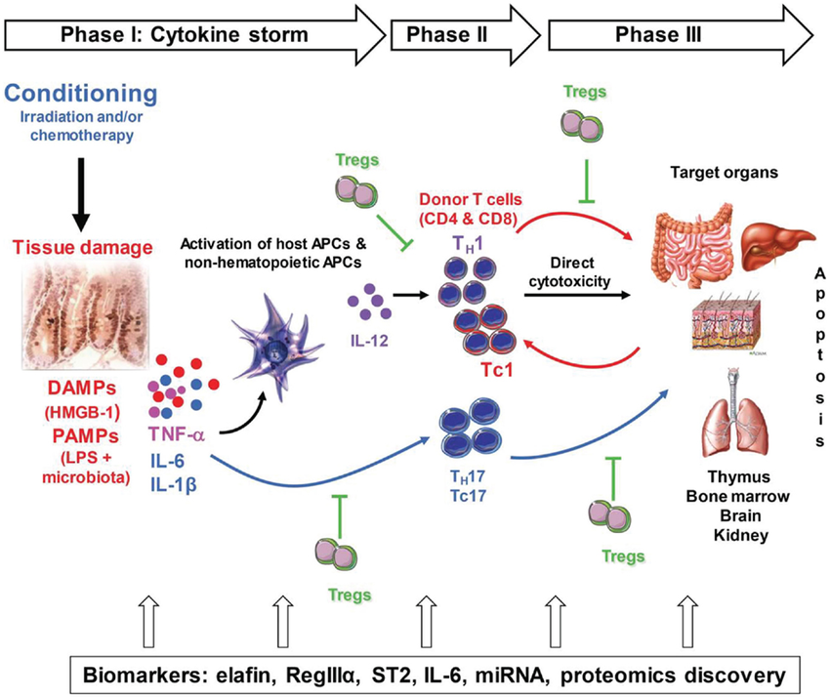
Notes:
Figure 1: Pathogenesis of acute GVHD. Conditioning by irradiation and/or chemotherapy causes tissue damage. Damaged tissues and cells release DAMPs (HMGB-1), PAMPs (LPS) from gut microbiota as well as inflammatory cytokines such as IL-1β, IL-6, and TNF-α, which contribute to the “cytokine storm.” These are the first danger signals that activate host APCs, which activate and polarized donor T-cells toward pathogenic T-cells (TH1 and TH17 for CD4 and TC1, TC17 for CD8). Activated pathogenic T-cells infiltrate target organs (i.e., GI tract, liver, skin) and amplify local tissue destruction. The presence of regulatory T-cells (Tregs) helps reduce GVHD severity through the inhibition of pathogenic cells activation and/or expansion at early or further phases of GVHD. Some of these DAMPs and PAMPs such as elafin (skin-specific), regenerating islet-derived 3-alpha (REG3α, gut-specific), and suppressor of tumorigenicity 2 (ST2, a member of the IL-1 receptor family, binding IL-33) have been shown to be biomarkers

