Slide 1
Early complications of high-dose therapy and stem cell transplantation
Mustafa CETIN
Notes:
Ten to the sixth power

Slide 2
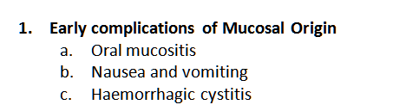
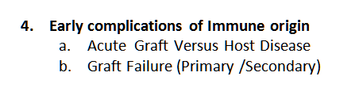
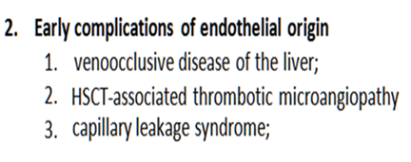
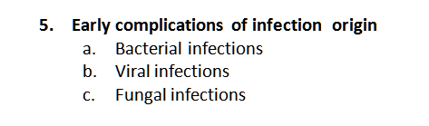
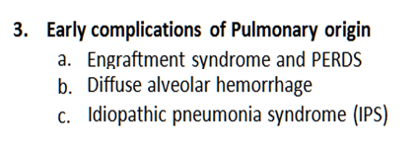
Early complications of high-dose therapy and stem cell transplantation
LATE EFFECTS …..

Slide 3
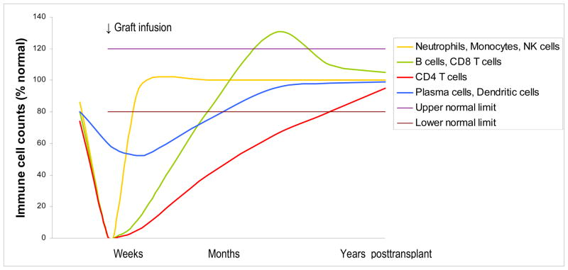
BACTERIALINFECTIONS occuring after HSCT
Immunological reconstitution after hematopoietic cell transplantation
Expert Opinion on Biological Therapy (Informa) 8(5):583–597, 2008
Notes:
Approximate immune cell counts (expressed as percentage of normal counts) peri– and post–myeloablative hematopoietic cell transplantation. Nadirs are higher and occur later after nonmyeloablative than myeloablative transplantation, as recipient cells persist after nonmyeloablative transplant for several weeks to months (in the presence of GVHD) or longer (in the absence of GVHD). The orange line represents the innate immune cells (e.g., neutrophils, monocytes, and natural killer [NK] cells), the recovery of which is influenced by the graft type (fastest with filgrastim-mobilized blood stem cells, intermediate with marrow, and slowest with umbilical cord blood). The green line represents the recovery of CD8+ T-cells and B-cells, the counts of which may transiently become supranormal. B-cell recovery is influenced by graft type (fastest after cord blood transplant) and is delayed by GVHD and/or its treatment. The blue line represents the recovery of relatively radiotherapy/chemotherapy-resistant cells such as plasma cells, tissue dendritic cells (e.g., Langerhans cells) and, perhaps, tissue macrophages/microglia. The nadir of these cells may be lower in patients with acute GVHD due to graft-versus–host-plasma cell/Langerhans cell effect. The red line represents CD4+ T-cells, the recovery of which is influenced primarily by T-cell content of the graft and patient age (faster in children than adults). From Storek J: Immunological reconstitution after hematopoietic cell transplantation – its relation to the contents of the graft..

Slide 4
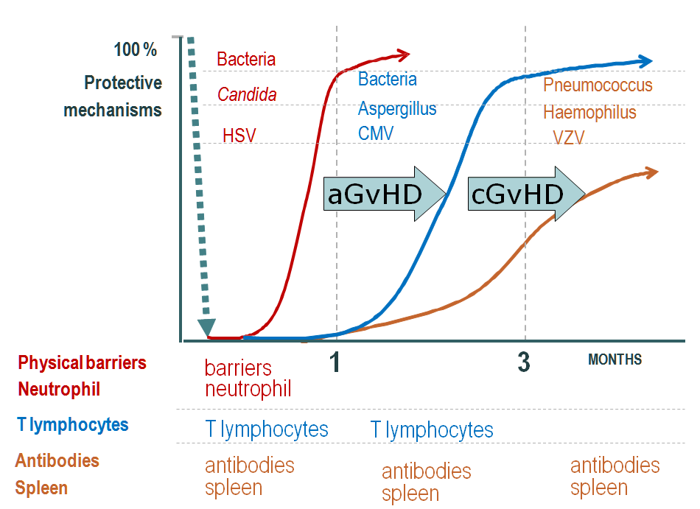
BACTERIALINFECTIONS occuring after HSCT
Immunological reconstitution & infections after hematopoietic cell transplantation

Slide 5
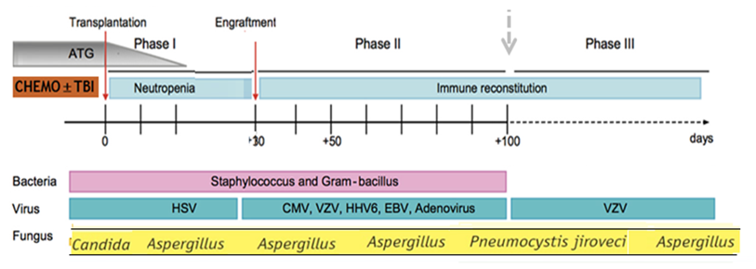
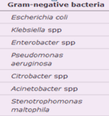
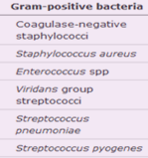
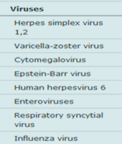
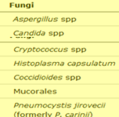
Early complications of high-dose therapy and stem cell transplantation
EARLY
LATE
Notes:
.

Slide 6
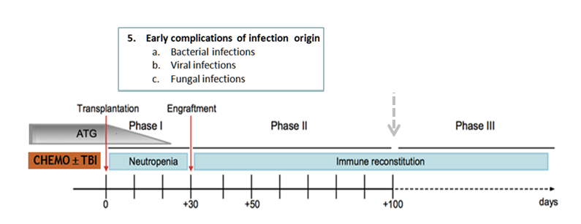
EARLY COMPLICATIONS OF INFECTION ORIGIN

Slide 7

EARLY COMPLICATIONS OF INFECTION ORIGIN
Fever in a neutropenic patient should be considered a medical emergency.
Broad-spectrum antibacterials should be given as soon as possible (within 60 minutes of triage) and at full doses, adjusted for renal and/or hepatic function.
In addition, the diagnostic evaluation should be obtained quickly.
Notes:
Golden rules

Slide 8
EARLY COMPLICATIONS OF INFECTION ORIGIN
Neutropenic Fever
The IDSA defines fever in neutropenic patients as a single oral temperature
of >38.3°C (101°F) or a temperature
of >38.0°C (100.4°F) sustained for >1h

Slide 9
EARLY COMPLICATIONS OF INFECTION ORIGIN
Neutropenia
Neutropenia is usually defined as an absolute neutrophil count (ANC) <1500 cells/microL, and
Severe neutropenia is usually defined as an ANC <500 cells/microL or an ANC that is expected to decrease to <500 cells/microL over the next 48 hours.
The risk of clinically important infection rises as the neutrophil count falls below 500 cells/microL and is higher in those with a prolonged duration of neutropenia (>7 days)

Slide 10
5. EARLY COMPLICATIONS OF INFECTION ORIGIN
High-risk patients
…… as those who are expected to be neutropenic (ANC <500 cells/microL) for >7 days.
…… with neutropenic fever who have ongoing comorbidities or evidence of significant hepatic or renal dysfunction are also considered to be high risk, regardless of the duration of neutropenia.
Notes:
Basic terms and def

Slide 11
5. EARLY COMPLICATIONS OF INFECTION ORIGIN
A persistent neutropenic fever syndrome;
.. is a febrile episode without defervescence after at least five days of initial empiric broad-spectrum antibacterial therapy in high-risk neutropenic patients.

Slide 12
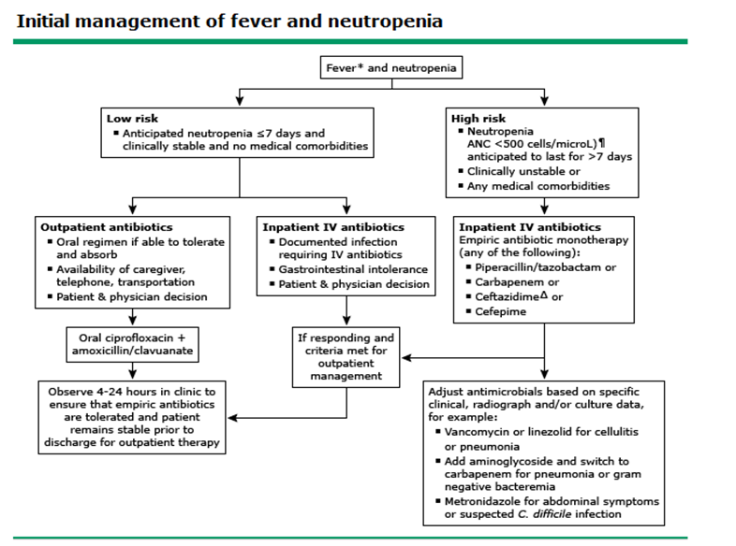
5. EARLY COMPLICATIONS OF INFECTION ORIGIN

Slide 13
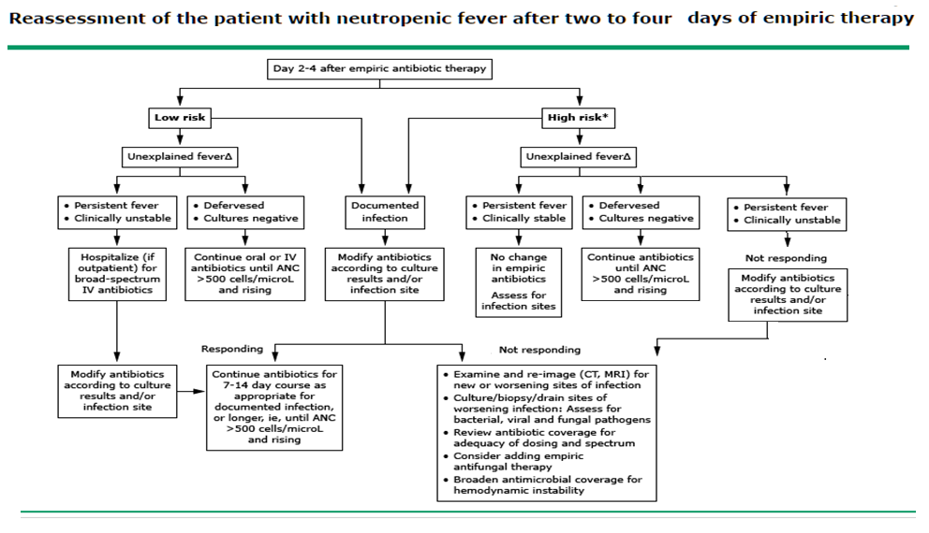
5. EARLY COMPLICATIONS OF INFECTION ORIGIN
Notes:
ANC: absolute neutrophil count; CT: computed tomography; IV: intravenous; MRI: magnetic resonance imaging.
* We consider patients to be high-risk if they have either of the following characteristics: neutropenia (ANC <500 cells/microL following cytotoxic chemotherapy) anticipated to last >7 days OR significant comorbid conditions. It should be noted that in the Infectious Diseases Society of America guidelines, an ANC ≤100 cells/microL is used as the cutoff for high-risk neutropenia.
Δ Fever in a neutropenic patient is defined as a single temperature >38.3°C (101°F) or a sustained temperature >38.0°C (100.4°F) for >1 hour.
Adapted with permission from: Freifeld AG, Bow EJ, Sepkowitz KA, et al. Clinical Practice Guideline for the Use of Antimicrobial Agents in Neutropenic Patients with Cancer: 2010 Update by the Infectious Diseases Society of America. Clin Infect Dis 2011; 52:e56. Copyright © 2011 Oxford University Press.
Graphic 74452 Version 13.0

Slide 14
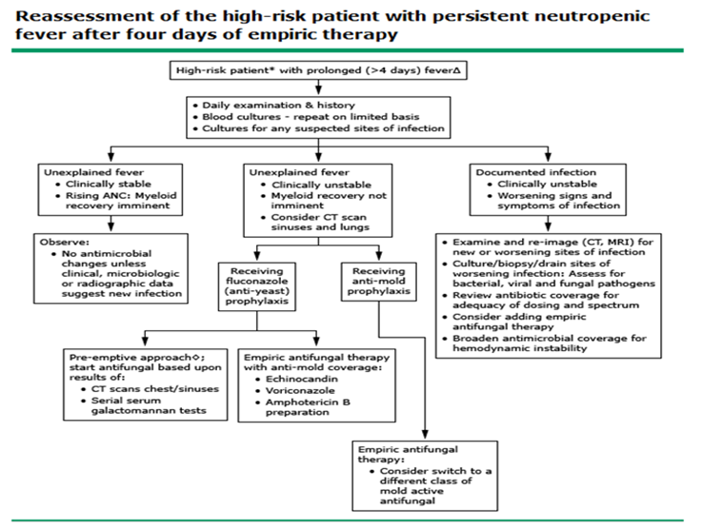
5. EARLY COMPLICATIONS OF INFECTION ORIGIN

Slide 15

5. EARLY COMPLICATIONS OF INFECTION ORIGIN
Evident Based Management of infections after HSCT
ECIL
ECIL grading scale for infections
Grade | Strength of Recommendations
A | Good evidence to support a recommendation for use
B | Moderate evidence to support a recommendation for use
C | Poor evidence to support a recommendation for use
Grade | Quality of Evidence
I | Evidence from ≥ 1 properly randomized, controlled trial
II | Evidence from ≥ 1 well-designed clinical trial, without randomization; from cohort or case-controlled analytical studies (preferably from >1 center); from multiple time-series; or from dramatic results from uncontrolled experiments
III | Evidence from opinions of respected authorities, based on clinical experience, descriptive studies, or reports of expert committees
ECIL-5

Slide 16
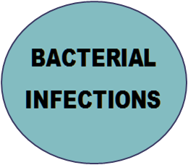
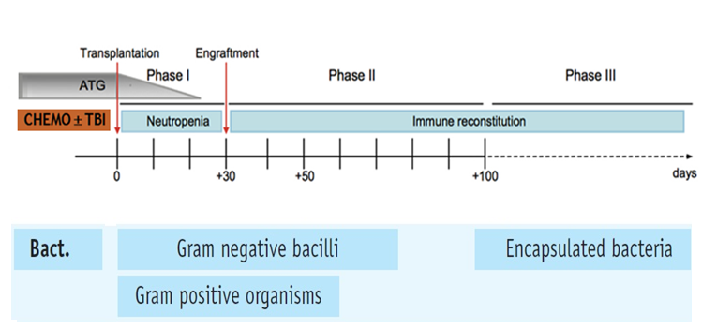
5. EARLY COMPLICATIONS OF INFECTION ORIGIN
BACTERIALINFECTIONS occuring after HSCT

Slide 17
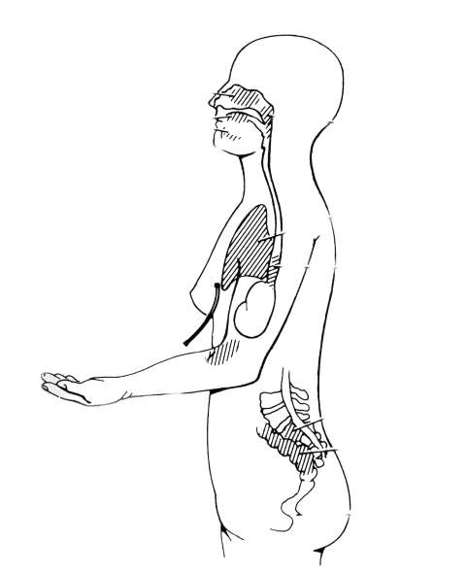
Main sources of infection in neutropenic patients
BACTERIALINFECTIONS occuring after HSCT
Vascular access Gram (+ve)
Gastro- intestinal tract Gram (-ve)

Slide 18
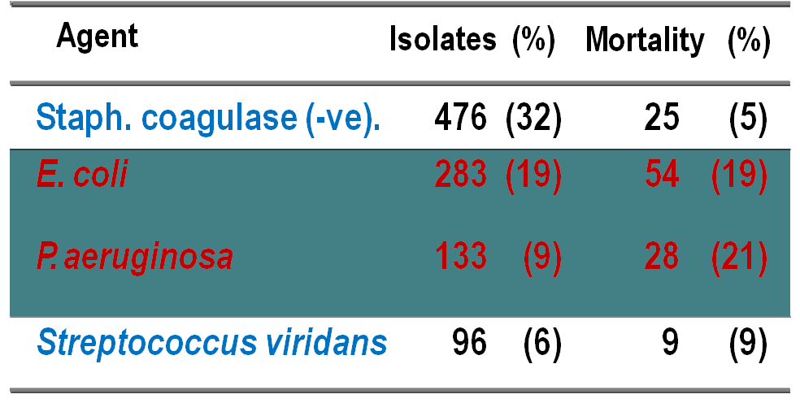
2540 episodes of bacteriemia in neutropenic patients (<500/mL) *
BACTERIALINFECTIONS occuring after HSCT
* Hospital Clínic. Barcelona 1991-2009

Slide 19

To prevent Bacterial infections
BACTERIAL INFECTIONS occuring after HSCT
Prophylaxis
Gastro-intestinal decontamination (GID)
+ low bacterial diets
Isolation (HEPA)

Slide 20
Profilaxis with non-absorbable antibiotics (GVN) + isolation measures in 95 consecutive severe neutropenic patients
BACTERIAL INFECTIONS occuring after HSCT
Hospital Clínic Barcelona
* p<0.01
Isolation +
GVN
without
measures
GVN:
Gentamicin, Vancomicin, Nistatin
Febrile episodes
40% ⬇
80%*
Clinically doc. Infect.
25% ⬇
55%*
Bacteriol. doc. Infect.
21% ⬇
53%*
Related deaths
8%
⬇
26%*
Ribas-Mundó et al. Cancer 1981

Slide 21
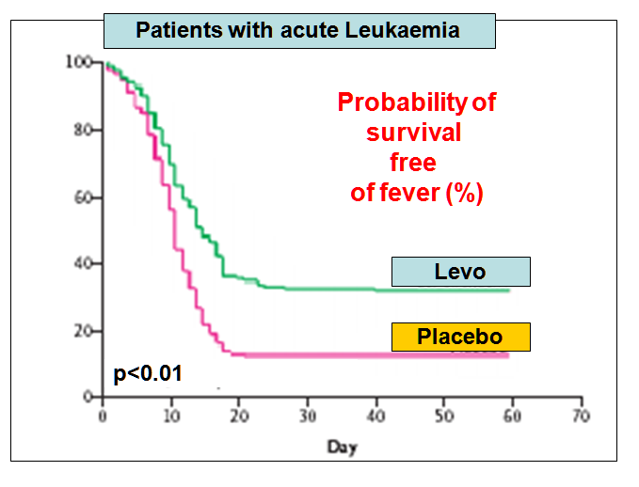
GID with levofloxacin
BACTERIAL INFECTIONS occuring after HSCT
Bucaneve et al, NEJM 2005

Slide 22
BACTERIAL INFECTIONS occuring after HSCT
Fluoroquinolone Prophylaxis,
ECIL
High risk patients (expected duration of neutropenia > 7 days)
Acute Leukemia and Auto-HSCT
Antibacterial prophylaxis with fluoroquinolones showed to be effective in reducing (Grade I) :
•Mortality
•Febrile episodes
•Bacterial infections and bacteremias
•Gram-negative infections and bacteremias
•Gram-positive infections but not bacteremias
•The use of empirical antibiotics
Allo-HSCT
Because the expected duration of neutropenia is more than seven days also in allo HSCT patients, this group is considered at high risk.
Also, Data on efficacy of quinolone prophylaxis are available for allo-HSCT patients.
ECIL-5
ECIL1 Guidelines. EJC supplement 2007: 5(2)
1st European Conference on Infections in Leukemia (ECIL)

Slide 23
BACTERIAL INFECTIONS occuring after HSCT
Fluoroquinolone Prophylaxis,
ECIL
Does fluoroquinolone prophylaxis prevent infections in patients with acute leukemia or in recipients of hematopoietic stem cell transplantation?
?
YES
Drug of Choice | Strength of Recommendation and level of evidence
Levofloxacin (500 mg once daily): Ciprofloxacin (500 mg bid): Ofloxacin (200 - 400 mg bid): Norfloxacin (400 mg bid): | AI AI BI BI
ECIL-5
ECIL1 Guidelines. EJC supplement 2007: 5(2)
Notes:
High-risk patients (patients anticipated to have an ANC <500 cells/microL for >7 days) include those undergoing allogeneic-HCT and those receiving induction chemotherapy for acute leukemia. Levofloxacin (500 mg orally once daily) and ciprofloxacin (500 mg orally twice daily) have been studied most extensively (Grade 2A). , and levofloxacin is favored in patients with increased risk for oral mucositis-related Streptococcus viridans infection
intermediate-risk patients whose treatment regimens generally result in 7 to 10 days of neutropenia (eg, autologous HCT recipients) Fluoroquinolone prophylaxis is sometimes used in selected

Slide 24
When should fluoroquinolone prophylaxis be started and how long should it be continued?
BACTERIAL INFECTIONS occuring after HSCT
Fluoroquinolone Prophylaxis,
ECIL
?
Start with chemotherapy and continue until
resolution of neutropenia or initiation of empirical antibacterial therapy for febrile neutropenia (AII)
ECIL-5
ECIL1 Guidelines. EJC supplement 2007: 5(2)
Notes:
Antibacterial prophylactic regimens target Pseudomonas aeruginosa and other gram-negative bacilli, since these pathogens are particularly virulent and may cause life-threatening infections
● Fluoroquinolone prophylaxis is sometimes used in selected intermediate-risk patients whose treatment regimens generally result in 7 to 10 days of neutropenia (eg, autologous HCT recipients; patients with lymphoma, chronic lymphocytic leukemia, or multiple myeloma; patients receiving a purine analog). The decision of whether to give antibacterial prophylaxis to intermediate-risk patients should be made on a case-by-case basis. (See 'Guidelines' above.)
●There are several potential downsides to using fluoroquinolone prophylaxis, including toxicities and the potential for promoting resistance. Practices regarding the use of antibacterial prophylaxis vary from center to center, with some centers avoiding the routine use of fluoroquinolone prophylaxis. At institutions that use fluoroquinolone prophylaxis, systematic monitoring of the prevalence of fluoroquinolone resistance among gram-negative bacilli should be performed. (See 'Indications' above.)
●For patients who are at risk for neutropenia, we recommend against the addition of a prophylactic antibacterial agent with specific activity against gram-positive organisms (Grade 1B). (See 'Guidelines' above.)
*n a 2012 meta-analysis of 109 randomized trials of afebrile neutropenic patients (most of whom had hematologic malignancies or had undergone HCT, with duration of neutropenia >7 days), antibiotic prophylaxis was associated with lower all-cause mortality when compared with placebo or no treatment (relative risk [RR] 0.66, 95% CI 0.55-0.79) [12]. Antibiotic prophylaxis was also associated with significantly reduced occurrence of fever, fewer clinically documented and microbiologically documented infections, fewer infections due to both gram-positive and gram-negative bacteria, fewer bacteremias, and lower risk of infection-related death
●For most patients with chemotherapy-induced neutropenia expected to be of short duration (which includes standard chemotherapy regimens for most solid tumors), we recommend against the use of antibacterial prophylaxis (Grade 1B). (See 'Indications' above.)

Slide 25
BACTERIAL INFECTIONS occuring after HSCT
Fluoroquinolone Prophylaxis,
ECIL
!
“Caveat”
Periodic monitoring for any marked increase in (AIII):
  Use of empirical antibacterial therapy
  Fluoroquinolone resistance among gram-negative
  Mortality rate
levofloxacin increased risk for oral mucositis-related Streptococcus viridans infection
ECIL-5
ECIL1 Guidelines. EJC supplement 2007: 5(2)
Notes:
High-risk patients (patients anticipated to have an ANC <500 cells/microL for >7 days) include those undergoing allogeneic-HCT and those receiving induction chemotherapy for acute leukemia. Levofloxacin (500 mg orally once daily) and ciprofloxacin (500 mg orally twice daily) have been studied most extensively (Grade 2A). , and levofloxacin is favored in patients with increased risk for oral mucositis-related Streptococcus viridans infection
intermediate-risk patients whose treatment regimens generally result in 7 to 10 days of neutropenia (eg, autologous HCT recipients) Fluoroquinolone prophylaxis is sometimes used in selected

Slide 26
A,B,C of treatment of febrile neutropenia
BACTERIAL INFECTIONS occuring after HSCT
ECIL
!
It must be:
Started immediately after onset of fever
Based in an empirical approach
Adapted to the flora usually observed in
each centre
!
Adapted to the type of disease
!
Adapted to the patient clinical condition
!
ECIL-5
ECIL1 Guidelines. EJC supplement 2007: 5(2)

Slide 27
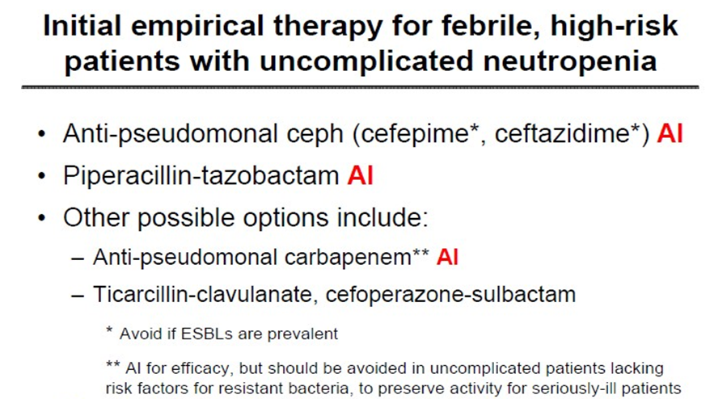
BACTERIAL INFECTIONS occuring after HSCT
ECIL
ECIL-5
ECIL1 Guidelines. EJC supplement 2007: 5(2)

Slide 28
BACTERIAL INFECTIONS occuring after HSCT
ECIL
Suggestions
Choice of appropriate beta-lactam for
monotherapy according to
local epidemiology and resistance data
recent beta-lactam use
available evidence (colonisation ?!)
ECIL-5
ECIL1 Guidelines. EJC supplement 2007: 5(2)

Slide 29
BACTERIAL INFECTIONS occuring after HSCT
To add an aminoglucoside?
ECIL
2 meta-analyses >4600 patients
(Furno et al. Lancet Infect Dis 2002; Paul et al. Cochrane 2003)+ 9 trials
AG in initial regime (empirical
or if G-ve documented)?
NO
(CIII)
Monotherapy = Betalactam + AG?
YES (AI)
Betalactam + AG more toxic?
YES (AI)
ECIL-5
ECIL1 Guidelines. EJC supplement 2007: 5(2)

Slide 30
BACTERIAL INFECTIONS occuring after HSCT
To add an aminoglucoside?
ECIL
Questions
Is there any evidence supporting the use of beta-
lactam + AG combination in neutropenic patients:
With high suspicion (i.e.: local epidemiology) of resistant gram- negative infections, including Ps. aeruginosa: YES (C III)
For severe sepsis and septic shock: YES (C III)
ECIL-5
ECIL1 Guidelines. EJC supplement 2007: 5(2)

Slide 31
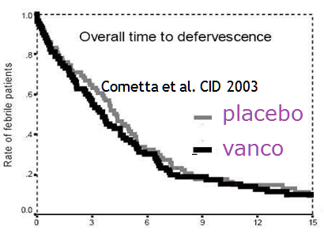
Studies
BACTERIAL INFECTIONS occuring after HSCT
To add a glycopeptide?
ECIL
1.- Upfront GP empirical therapy?
Vardakas et al. Lancet Infect Dis 2005 (meta-analysis)
Paul et al. JAC 2005 (meta-analysis)
2.- In case of persistent fever after initial broad spectrum empirical GP antibiotic therapy?
Cometta et al. CID 2003 (placebo controlled) Erjavec et al. JAC 2000 (placebo-controlled)
Note: No randomized controlled trial assessing the use of Daptomisin or Linezolid
ECIL-5
ECIL1 Guidelines. EJC supplement 2007: 5(2)

Slide 32
BACTERIAL INFECTIONS occuring after HSCT
ECIL
To add a glycopeptide?
Initial empirical glycopeptide in neutropenic patients
Development of hypotension or shock
Known colonisation with MRSA or Peni-R Pneumococcus
Positive results for G+ before identification
Clinically suspected serious cath-related infection (cellulitis)
(Institutions with high rate of infections due to MRSA or Peni-R viridans streptococci )
ECIL1 Guidelines. EJC supplement 2007: 5(2)

Slide 33
BACTERIAL INFECTIONS occuring after HSCT
ECIL
To add a glycopeptide?
(ECIL) Recommendations
 | Glycopeptide | CDC grading system
At onset of fever | Not recommended | I D
Persistent fever | Not recommended | I D
Known colonisation with MRSA | recommended | III C
Hypotension or shock | recommended | III C
Skin and soft tissue infections including cath-related infections | recommended | III C
ECIL1 Guidelines. EJC supplement 2007: 5(2)

Slide 34
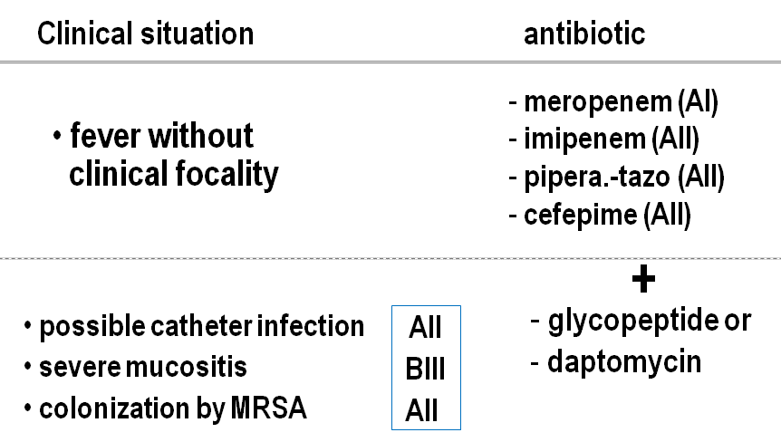
BACTERIAL INFECTIONS occuring after HSCT
Initial empirical antibiotherapy in neutropenic patients with fever
ECIL
JM
Notes:
Initiation of monotherapy with an antipseudomonal beta-lactam agent, such as cefepime, meropenem, imipenem-cilastatin, or piperacillin-tazobactam. Ceftazidime monotherapy has also been shown to be effective and continues to be used at some cancer centers. However, many experts avoid ceftazidime monotherapy because of rising resistance rates among gram-negative bacteria and its limited activity against gram-positive bacteria, such as streptococci, compared with newer alternatives. The dosing of these agents for patients with normal renal function are:
•Cefepime – 2 g IV every eight hours
•Meropenem – 1 g IV every eight hours
•Imipenem-cilastatin – 500 mg IV every six hours
•Piperacillin-tazobactam – 4.5 g IV every six to eight hours
•Ceftazidime – 2 g IV every eight hours
Vancomycin (or other agents that target gram-positive cocci) is not recommended as a standard part of the initial regimen but should be added in certain patients, such as those with suspected catheter-related infection, skin or soft tissue infection, pneumonia, or hemodynamic instabil

Slide 35
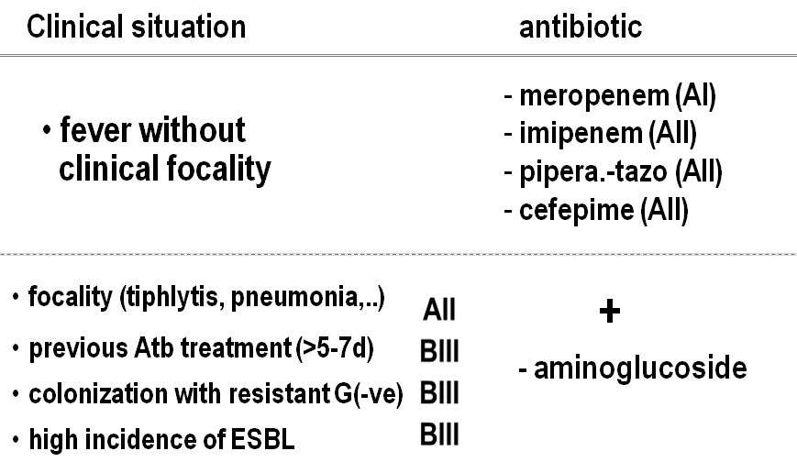
BACTERIAL INFECTIONS occuring after HSCT
Initial empirical antibiotherapy in neutropenic patients with fever
ECIL
JM

Slide 36
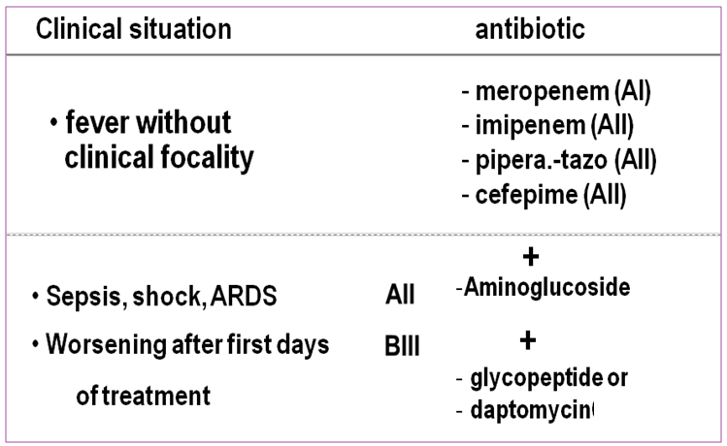
BACTERIAL INFECTIONS occuring after HSCT
Initial empirical antibiotherapy in neutropenic patients with fever
ECIL
JM
Notes:
Vancomycin (or other agents that target gram-positive cocci) is not recommended as a standard part of the initial regimen, but gram-positive coverage should be added in patients with any of the following findings [1]:
●Hemodynamic instability or other signs of severe sepsis
●Pneumonia
●Positive blood cultures for gram-positive bacteria while awaiting speciation and susceptibility results
●Suspected central venous catheter (CVC)-related infection (eg, chills or rigors during infusion through a CVC and/or cellulitis around the catheter entry site)
●Skin or soft tissue infection
●Severe mucositis in patients who were receiving prophylaxis with a fluoroquinolone lacking activity against streptococci and in whom ceftazidime is being used as empiric therapy. Addition of gram-positive coverage is recommended in this situation because of the increased risk of Streptococcus viridans infections, which can result in sepsis and the acute respiratory distress syndrome [1,41-44].

Slide 37

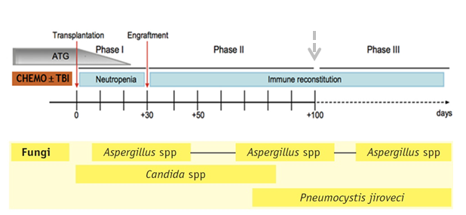
5. EARLY COMPLICATIONS OF INFECTION ORIGIN
FUNGAL INFECTIONS occuring after HSCT

Slide 38

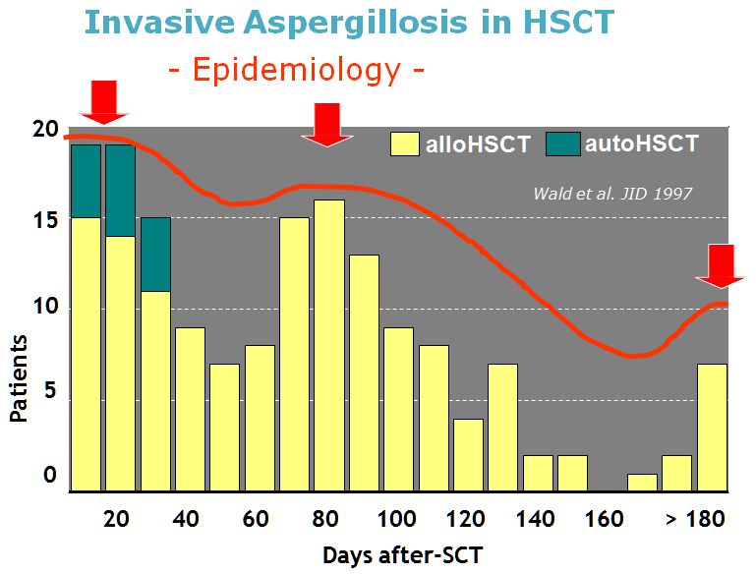
FUNGAL INFECTIONS occuring after HSCT

Slide 39
Invasive fungal infections;
FUNGAL INFECTIONS occuring after HSCT
… are common in selected hematopoietic cell transplant (HCT) recipients, such as allogeneic HCT recipients during the preengraftment period and in those with severe graft-versus-host disease, and cause substantial morbidity and mortality

Slide 40

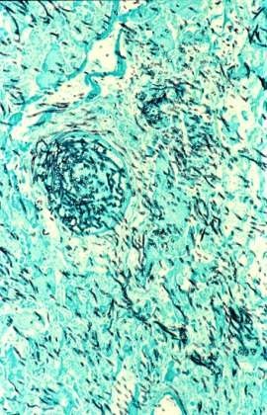
FUNGAL INFECTIONS occuring after HSCT
Invasive Fungal infections (diagnosis)
Histopathology
Imaging techniques
  Chest x-ray, CT, MRI
  Biopsy guided by TC
Microbiology
  Direct examination, fluorescence
  Culture
  Serological: Ag and Ab detection
  PCR techniques

Slide 41
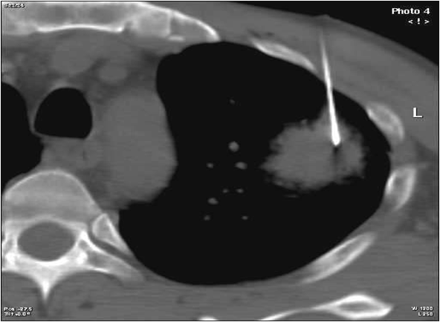
Biopsy guided by CT
FUNGAL INFECTIONS occuring after HSCT
Invasive Fungal infections (diagnosis)

Slide 42


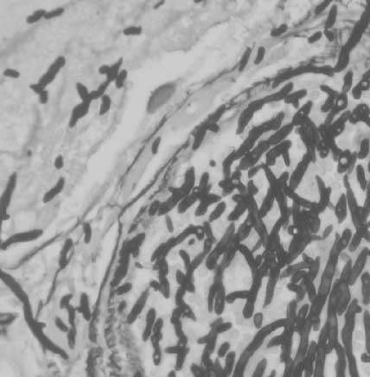
FUNGAL INFECTIONS occuring after HSCT
Invasive Fungal infections (diagnosis)
Histopathology
“Gold standard”

Slide 43
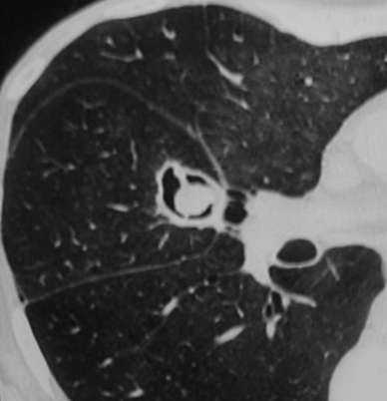
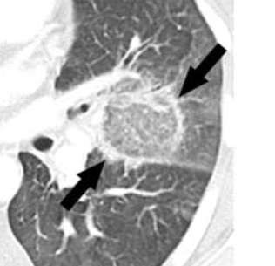

A “positive” chest x-ray is enough to establish the diagnosis.
FUNGAL INFECTIONS occuring after HSCT
Invasive Fungal infections (diagnosis)
An unremarkable chest x-ray should be followed by a CT scan to reliably detect or to accurately exclude early pulmonary infection in these patients.
invasive Pulmonary aspergillosis
Crescent sign
Halo sign

Slide 44
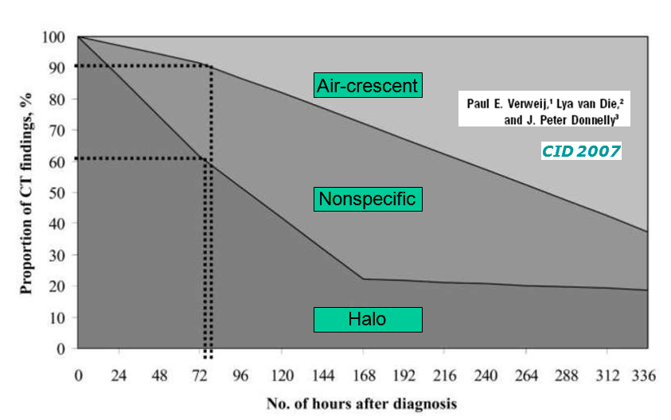
FUNGAL INFECTIONS occuring after HSCT
Invasive Fungal infections (diagnosis)

Slide 45
FUNGAL INFECTIONS occuring after HSCT
Invasive Fungal infections (diagnosis)
Histopathology
Imaging techniques
  Chest x-ray, CT, MRI
  Biopsy guided by TC
Microbiology
  Direct examination, fluorescence
  Culture
  Serological: Ag and Ab detection
  PCR techniques

Slide 46
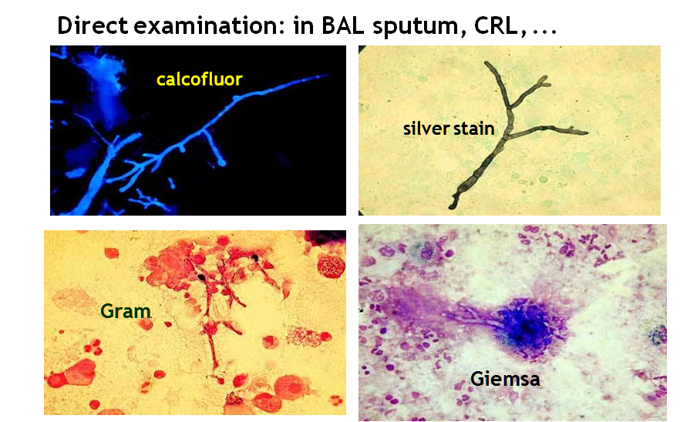
FUNGAL INFECTIONS occuring after HSCT
Invasive Fungal infections (diagnosis)

Slide 47
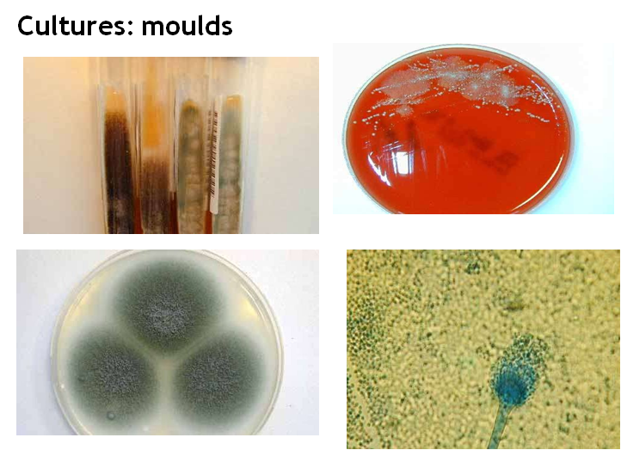
FUNGAL INFECTIONS occuring after HSCT
Invasive Fungal infections (diagnosis)

Slide 48
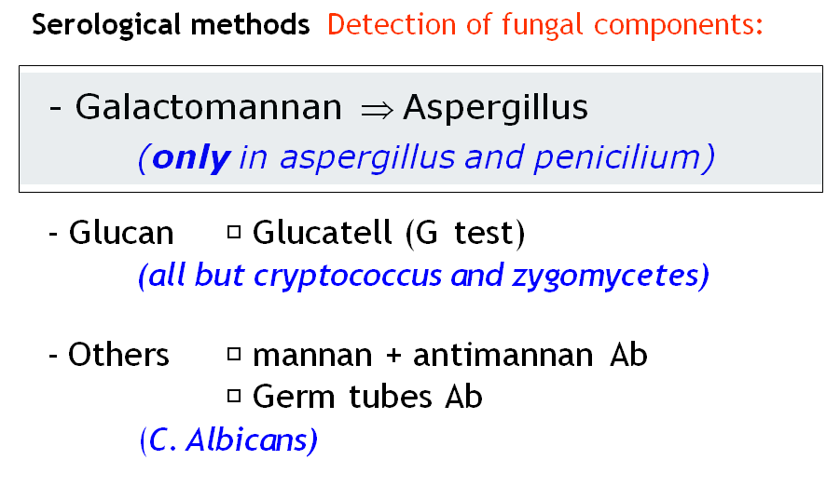
FUNGAL INFECTIONS occuring after HSCT
Invasive Fungal infections (diagnosis)

Slide 49
First GM+ and other events
FUNGAL INFECTIONS occuring after HSCT
Invasive Fungal infections (diagnosis)
“Cut off” 0.5 | GM first | Days before
X-ray thorax | 12/15 (80%) | 8
HRTC | 12/15 (80%) | 6
Cultures + | 16/18 (89%) | 9
Diagnostic | 16/18 (89%) | 14
Treatment | 16/18 (89%) | 6
Death | 17/18 (94%) | 14
0.5 cut-off approved by FDA in 2003
Maertens et al. J Infect Dis 2002

Slide 50
Galactomannan / false positive
FUNGAL INFECTIONS occuring after HSCT
Invasive Fungal infections (diagnosis)
Allo-HSCT | mucositis / food
Children | Bifidobacterium
Pollution cotton | glucopiranose
Other moulds | same galactomannan
Cyclophosphamide | crossed reaction
Antibiotics | Pipera-Tazob / Amoxi
Technical | contamination
Wheat. Transpl Infect Dis 2003
Notes:
Galactomannans are used in foods as stabilisers. Guar and Locust Bean Gum (LBG) are commonly used in ice cream to improve texture and reduce ice cream meltdown.
Bifidobacterium is a genus of gram-positive, nonmotile, often branched anaerobic bacteria. They are ubiquitous inhabitants of the gastrointestinal tract, vagina^{[1][2]} and mouth (B. dentium) of mammals, including humans. Bifidobacteria are one of the major genera of bacteria that make up the colon flora in mammals. Some bifidobacteria are used as probiotics.

Slide 51

IFI in HSCT
TRANSNET Study (2001-2006)
FUNGAL INFECTIONS occuring after HSCT
24 USA centres
16.390 HSCT
(Allo 41%, Auto 59%)
Median age: 50 y.
IFI: 998
Cumulative Incidence (1 y): Allo 8.6%; Auto 1.6%
Mortalidad global a los 90 días
Overal mortality at 90 days
100
80
60
40
20
0
58
52
Aspergilosis
Candidiasis
Kontoyiannis et al. CID 2010

Slide 52
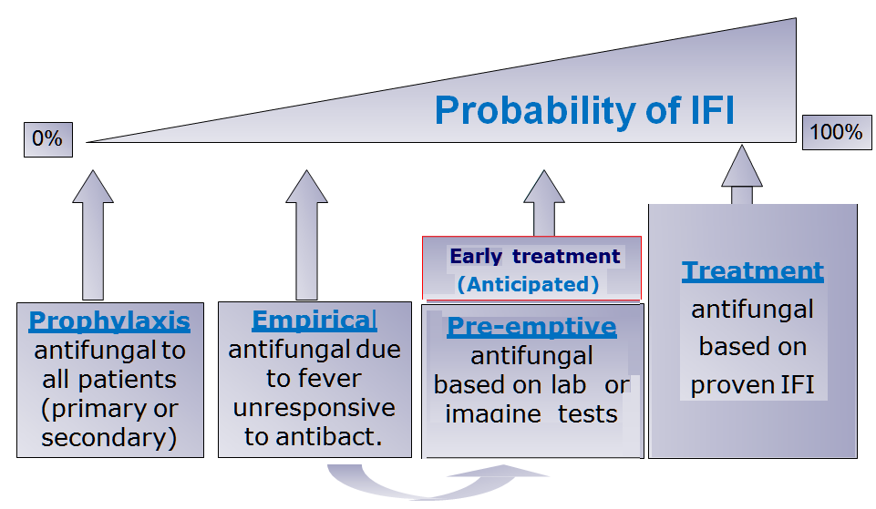
FUNGAL INFECTIONS occuring after HSCT
Fungal infections
(Therapeutic approaches in neutropenic patients)
P>
P>>
P3>>>
P>>>>
~ 75- 80% unnecessary treat. (IFI incidence <20-25 %)
E. Carreras
Notes:
Possible <probable

Slide 53
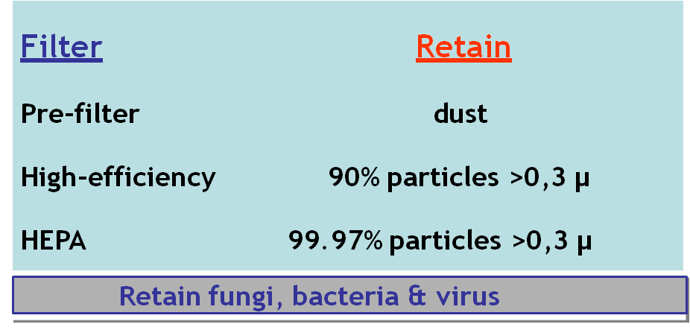
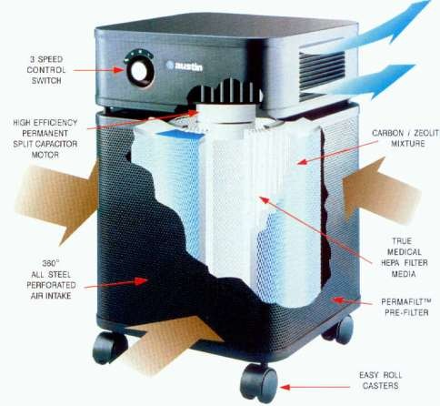
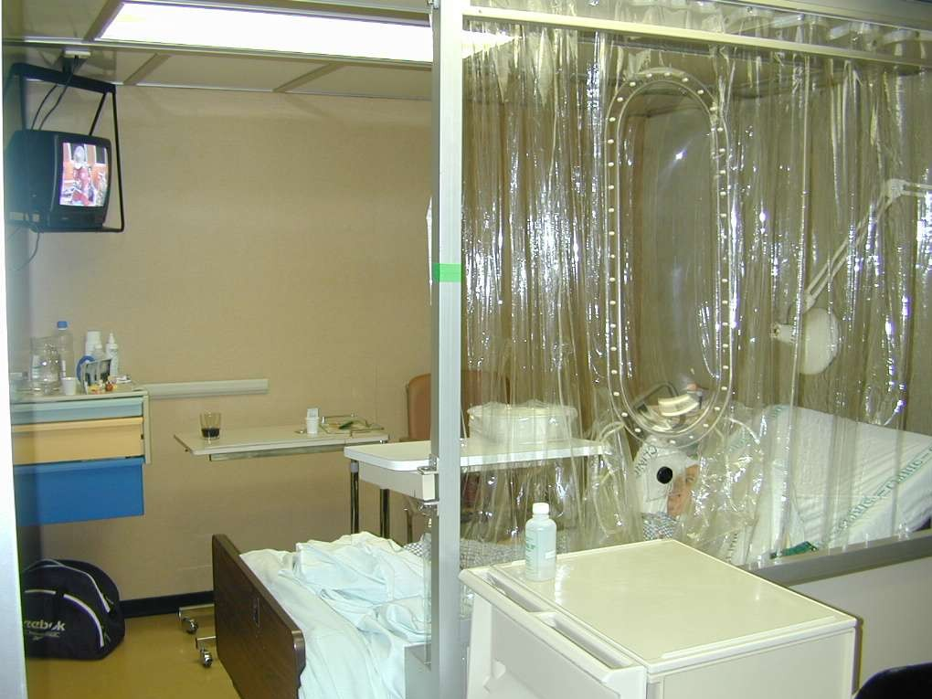
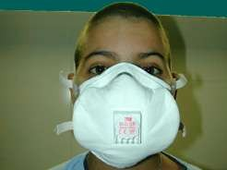
FUNGAL INFECTIONS occuring after HSCT
Mechanical prophylaxis
HEPA rooms
FFP3 (N95) masks
Portable HEPA

Slide 54
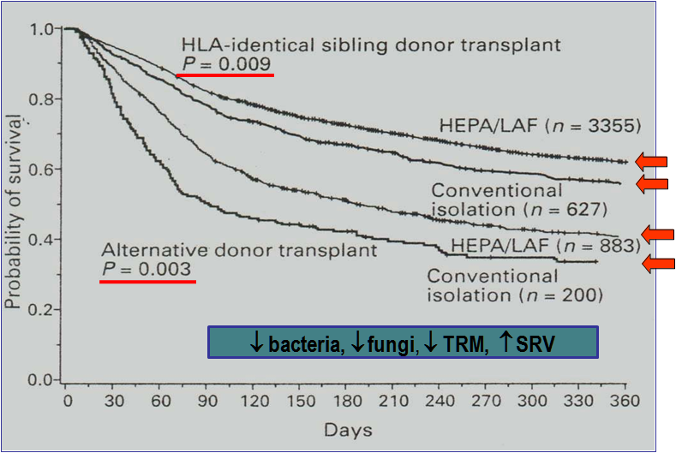
HEPA and LAF isolation and survival after HSCT
FUNGAL INFECTIONS occuring after HSCT
Mechanical prophylaxis
Passweg, et al. BMT 1998

Slide 55
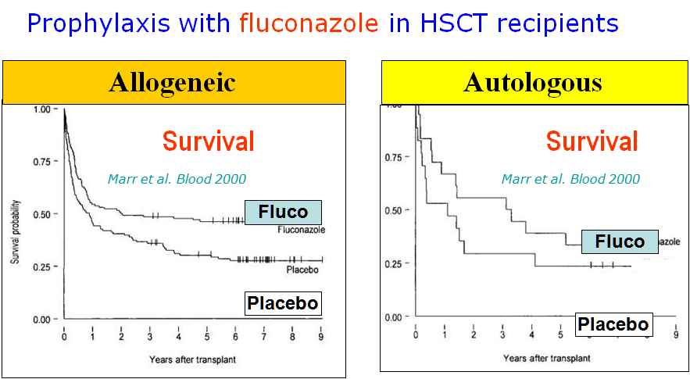
FUNGAL INFECTIONS occuring after HSCT
Pharmacological prophylaxis

Slide 56
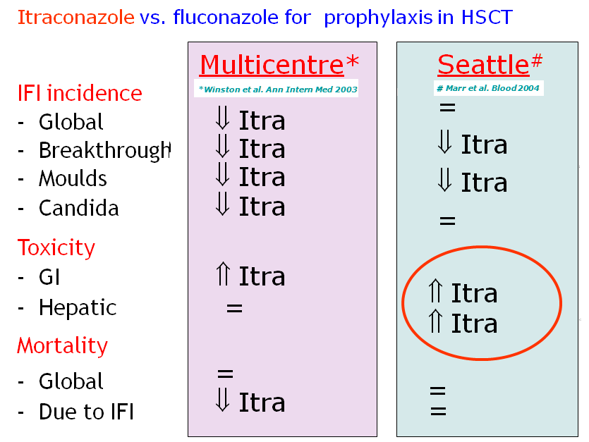
FUNGAL INFECTIONS occuring after HSCT
Pharmacological prophylaxis

Slide 57
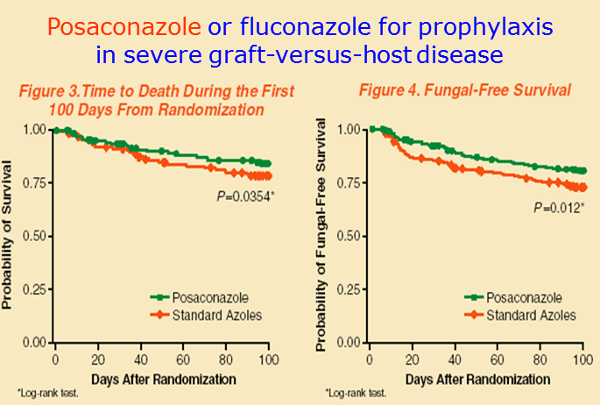
FUNGAL INFECTIONS occuring after HSCT
Pharmacological prophylaxis
Ullmann et al. NEJM 2007

Slide 58
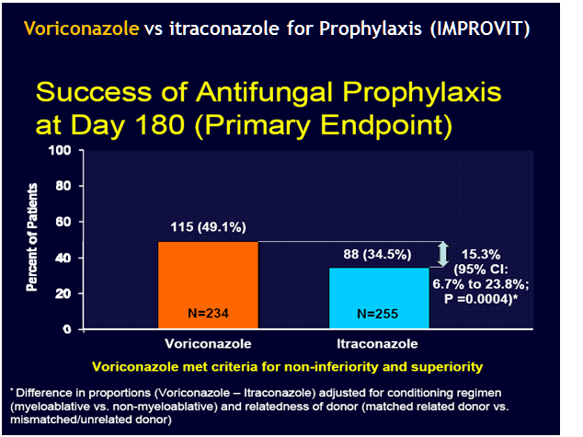
FUNGAL INFECTIONS occuring after HSCT
Pharmacological prophylaxis
Voriconazole was superior to itraconazole as antifungal prophylaxis after alloHCT, based on differences in the primary composite endpoint. Voriconazole could be given for significantly longer durations, with less need for other systemic antifungals.

Slide 59
Antifungal prophylaxis for HCT recipients
FUNGAL INFECTIONS occuring after HSCT
Both yeasts and molds cause serious invasive fungal infections in hematopoietic cell transplant (HCT) recipients.
Prior to the routine use of antifungal prophylaxis, Candida accounted for the majority of fungal infections that occurred during the preengraftment period of HCT, followed by Aspergillus spp.
More recently, Aspergillus has surpassed Candida as a cause of invasive fungal infections in HCT recipients, associated with the use of effective antifungal prophylaxis targeting Candida spp.
Both pathogens are associated with substantial risk for mortality.
Notes:
Interest in antifungal prophylaxis for high-risk HCT recipients has been prompted by the rising incidence of life-threatening invasive fungal infections in such patients, the difficulty in establishing the diagnosis early in the course of infection, and the recognition that treatment outcomes are poor if initiation of therapy is delayed.
Both yeasts and molds cause serious invasive fungal infections in hematopoietic cell transplant (HCT) recipients (figure 1). Prior to the routine use of antifungal prophylaxis, Candida spp accounted for the majority of fungal infections that occurred during the preengraftment period of HCT, followed by Aspergillus spp. More recently, Aspergillus has surpassed Candida as a cause of invasive fungal infections in HCT recipients, associated with the use of effective antifungal prophylaxis targeting Candida spp [1]. Both pathogens are associated with substantial risk for mortality.

Slide 60
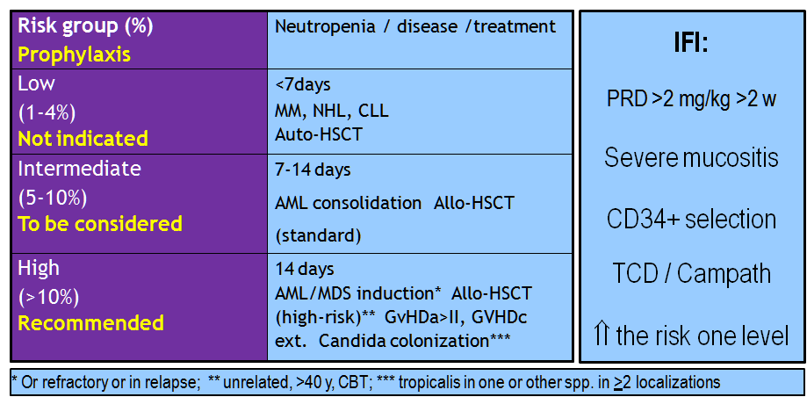
FUNGAL INFECTIONS occuring after HSCT
Pharmacological prophylaxis
Risk groups for IFI
SEQ/AEHH consensus, De la Cámara et al Med. Clin (Barc.) 2010
Notes:
Allogeneic HCT — After allogeneic HCT, there are two periods of elevated risk for invasive fungal infection (figure 1) [14,22,23]:
●During the neutropenic preengraftment phase
●During the early postengraftment period, especially in patients who develop graft-versus-host disease (GVHD) requiring glucocorticoids
Prior to engraftment, most fungal infections are due to Candida spp and the risk for invasive aspergillosis is low, except in patients with prior Aspergillus infections or in patients who have prolonged neutropenia due to delay in or failure of engraftment. Risk factors for invasive candidiasis during the preengraftment period include neutropenia, severe mucositis, and central venous catheter use [24]. Risk factors for aspergillosis before engraftment include prior multiple chemotherapy regimens, iron overload from multiple erythrocyte transfusions, prior history of invasive aspergillosis, failure to engraft after transplantation, and delayed engraftment such as is often seen with umbilical cord blood transplantation [14,25]. Patients with advanced or refractory acute myelogenous leukemia are at higher risk of invasive mold infections than other leukemia patients. (See "Prophylaxis of invasive fungal infections in adults with hematologic malignancies", section on 'Acute leukemia'.)
After engraftment, the risk for invasive aspergillosis is much greater. Risk factors for Aspergillus infection after engraftment are GVHD and prolonged courses of glucocorticoids at high doses (>1 mg/kg per day of methylprednisolone or the equivalent dose of another glucocorticoid) [14].
Autologous HCT — The risk for invasive fungal infections is lower in autologous HCT recipients than allogeneic HCT recipients, but invasive fungal infections do occur in such patients. Risk factors for Candida infections in autologous HCT recipients include intensive conditioning regimens that cause substantial mucosal injury (resulting in oral and/or gastrointestinal mucositis), as well as prolonged neutropenia [26]. Autologous HCT recipients at risk for prolonged neutropenia include those who received a suboptimal number of stem cells and those who did not receive myeloid growth factors following transplantation. Autologous HCT recipients are not usually at high risk for invasive aspergillosis or other mold infections, unless they have a prior history of such an infection.

Slide 61
FUNGAL INFECTIONS occuring after HSCT
Pharmacological prophylaxis
ECIL Risk factors for IFD in allogeneic HSCT
ECIL
Update 5, 2013
High risk-conditions during engraftment | High-risk conditions after engraftment *
Active acute leukaemia at transplant | Grade III-IV Acute-GVHD
Cord-blood transplant | Grade II acute GVHD in transplant from alternative donors, or unresponsive to standard steroid therapy
Multiple factors: alternative donor, iron overload, early CMV infection, acute GVHD | Secondary neutropenia
Prior fungal infection (secondary prophylaxis) | Multiple factors: alternative donor, early CMV infection, steroid therapy for more than 1 week.
Chronic GVHD is not by definition a high risk condition unless it is associated to other risk factors
Girmenia C et al. Biol Blood Marrow Transplant. 2014.

Slide 62
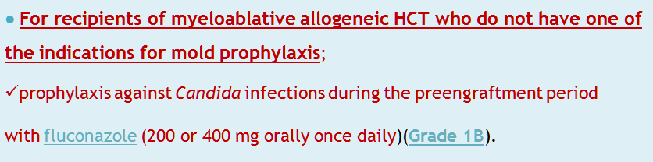
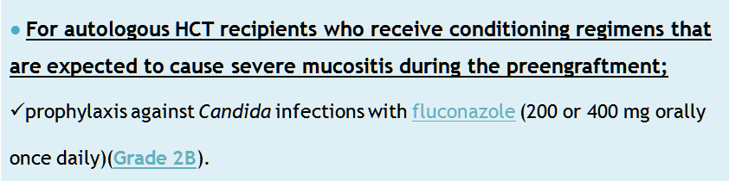
5. EARLY COMPLICATIONS OF INFECTION ORIGIN
Clinical Approaches for Fungal Infections in HSCT
Primary prophylaxis
Notes:
Approach to primary prophylaxis — The following recommendations represent our approach to antifungal prophylaxis in HCT recipients. These recommendations are generally in keeping with the 2010 Infectious Diseases Society of America (IDSA) guidelines for the use of antimicrobial agents in neutropenic patients with cancer [8], the 2016 IDSA guidelines for the diagnosis and management of aspergillosis [30], and the 2009 international guidelines for preventing infectious complications in HCT recipients [24]. It should be noted that there is ongoing controversy about the use of antifungal prophylaxis (see "Prophylaxis of invasive fungal infections in adults with hematologic malignancies", section on 'Risk-benefit assessment'). As a result, practices regarding antifungal prophylaxis differ widely at various cancer centers, and our approach may be different from the approach recommended at a specific institution.
We favor the following approach to primary antifungal prophylaxis in HCT recipients:
●For recipients of myeloablative allogeneic HCT who do not have one of the indications for mold prophylaxis discussed below, we recommend prophylaxis against Candida infections during the preengraftment period with fluconazole (200 or 400 mg orally once daily) [24]. (See "Prophylaxis of invasive fungal infections in adults with hematologic malignancies", section on 'Candida infection'.)
●For autologous HCT recipients who receive conditioning regimens that are expected to cause severe mucositis during the preengraftment period (eg, cyclophosphamide plus either ablative doses of busulfan or total body irradiation), we suggest prophylaxis against Candida infections with fluconazole (200 or 400 mg orally once daily) [8].
●For patients who undergo myeloablative allogeneic HCT for acute myelogenous leukemia, we suggest anti-mold prophylaxis [19,21]. When mold prophylaxis is indicated in an HCT recipient, we generally favor voriconazole (200 mg orally twice daily), but posaconazole is an appropriate alternative. When posaconazole is chosen, we prefer the delayed-release tablet (taken with food) rather than the oral suspension.
Patients who are unable to take medications orally or who are expected not to absorb oral medications should be given IV posaconazole. Posaconazole delayed-release tablets should be given as a loading dose of 300 mg (three 100 mg tablets) every 12 hours on the first day, followed by a maintenance dose of 300 mg (three 100 mg tablets) daily starting on the second day. The IV formulation of posaconazole should be given as a loading dose of 300 mg every 12 hours on the first day, followed by a maintenance dose of 300 mg daily starting on the second day. The dosing of the oral suspension of posaconazole is 200 mg three times daily. The delayed-release tablets, the IV formulation, and the oral suspension should not be used interchangeably due to differences in dosing. (See "Pharmacology of azoles", section on 'Posaconazole'.)
●Given the association between prolonged neutropenia and invasive aspergillosis, we also suggest prophylaxis during the preengraftment period with a mold-active agent in the subset of HCT recipients with a lengthy duration of neutropenia immediately prior to HCT (eg, patients with aplastic anemia) [8] and for those who are anticipated to have slow engraftment (>28 days; eg, umbilical cord blood transplant recipients) or who fail to engraft. In such patients, we generally favor voriconazole (200 mg orally twice daily), but posaconazole is an appropriate alternative.
●Given the potential for serious drug interactions, administration of extended-spectrum triazole-based (posaconazole, voriconazole, itraconazole) prophylaxis should be delayed until after completion of the transplant conditioning regimen; an echinocandin can be given safely during the conditioning regimen if a gap in antifungal coverage is unadvisable, such as in a patient with prior aspergillosis. Caution is advised for concomitant use of the extended-spectrum triazoles with chemotherapy drugs metabolized by the liver, especially those metabolized by cytochrome P450 isoenzymes. Recommendations about the timing of triazole administration in such patients are discussed below. Interactions between the anti-mold azoles and immunosuppressive drugs are substantial; reductions of cyclosporine and tacrolimus doses by approximately 50 percent are important and monitoring of levels of these drugs is necessary to avoid toxicity. Coadministration with sirolimus should be avoided due to extreme potentiation of sirolimus levels. (See 'Drug interactions' below.)
●For allogeneic HCT recipients with GVHD requiring methylprednisolone at a dose of ≥1 mg/kg per day (or the equivalent dose of another glucocorticoid) for longer than three weeks, we recommend anti-mold prophylaxis. We favor voriconazole in such patients, but posaconazole is an appropriate alternative. The same precautions regarding drug interactions that are discussed above must be considered.

Slide 63


5. EARLY COMPLICATIONS OF INFECTION ORIGIN
Clinical Approaches for Fungal Infections in HSCT
Primary prophylaxis
Notes:
Approach to primary prophylaxis — The following recommendations represent our approach to antifungal prophylaxis in HCT recipients. These recommendations are generally in keeping with the 2010 Infectious Diseases Society of America (IDSA) guidelines for the use of antimicrobial agents in neutropenic patients with cancer [8], the 2016 IDSA guidelines for the diagnosis and management of aspergillosis [30], and the 2009 international guidelines for preventing infectious complications in HCT recipients [24]. It should be noted that there is ongoing controversy about the use of antifungal prophylaxis (see "Prophylaxis of invasive fungal infections in adults with hematologic malignancies", section on 'Risk-benefit assessment'). As a result, practices regarding antifungal prophylaxis differ widely at various cancer centers, and our approach may be different from the approach recommended at a specific institution.
We favor the following approach to primary antifungal prophylaxis in HCT recipients:
●For recipients of myeloablative allogeneic HCT who do not have one of the indications for mold prophylaxis discussed below, we recommend prophylaxis against Candida infections during the preengraftment period with fluconazole (200 or 400 mg orally once daily) [24]. (See "Prophylaxis of invasive fungal infections in adults with hematologic malignancies", section on 'Candida infection'.)
●For autologous HCT recipients who receive conditioning regimens that are expected to cause severe mucositis during the preengraftment period (eg, cyclophosphamide plus either ablative doses of busulfan or total body irradiation), we suggest prophylaxis against Candida infections with fluconazole (200 or 400 mg orally once daily) [8].
●For patients who undergo myeloablative allogeneic HCT for acute myelogenous leukemia, we suggest anti-mold prophylaxis [19,21]. When mold prophylaxis is indicated in an HCT recipient, we generally favor voriconazole (200 mg orally twice daily), but posaconazole is an appropriate alternative. When posaconazole is chosen, we prefer the delayed-release tablet (taken with food) rather than the oral suspension.
Patients who are unable to take medications orally or who are expected not to absorb oral medications should be given IV posaconazole. Posaconazole delayed-release tablets should be given as a loading dose of 300 mg (three 100 mg tablets) every 12 hours on the first day, followed by a maintenance dose of 300 mg (three 100 mg tablets) daily starting on the second day. The IV formulation of posaconazole should be given as a loading dose of 300 mg every 12 hours on the first day, followed by a maintenance dose of 300 mg daily starting on the second day. The dosing of the oral suspension of posaconazole is 200 mg three times daily. The delayed-release tablets, the IV formulation, and the oral suspension should not be used interchangeably due to differences in dosing. (See "Pharmacology of azoles", section on 'Posaconazole'.)
●Given the association between prolonged neutropenia and invasive aspergillosis, we also suggest prophylaxis during the preengraftment period with a mold-active agent in the subset of HCT recipients with a lengthy duration of neutropenia immediately prior to HCT (eg, patients with aplastic anemia) [8] and for those who are anticipated to have slow engraftment (>28 days; eg, umbilical cord blood transplant recipients) or who fail to engraft. In such patients, we generally favor voriconazole (200 mg orally twice daily), but posaconazole is an appropriate alternative.
●Given the potential for serious drug interactions, administration of extended-spectrum triazole-based (posaconazole, voriconazole, itraconazole) prophylaxis should be delayed until after completion of the transplant conditioning regimen; an echinocandin can be given safely during the conditioning regimen if a gap in antifungal coverage is unadvisable, such as in a patient with prior aspergillosis. Caution is advised for concomitant use of the extended-spectrum triazoles with chemotherapy drugs metabolized by the liver, especially those metabolized by cytochrome P450 isoenzymes. Recommendations about the timing of triazole administration in such patients are discussed below. Interactions between the anti-mold azoles and immunosuppressive drugs are substantial; reductions of cyclosporine and tacrolimus doses by approximately 50 percent are important and monitoring of levels of these drugs is necessary to avoid toxicity. Coadministration with sirolimus should be avoided due to extreme potentiation of sirolimus levels. (See 'Drug interactions' below.)
●For allogeneic HCT recipients with GVHD requiring methylprednisolone at a dose of ≥1 mg/kg per day (or the equivalent dose of another glucocorticoid) for longer than three weeks, we recommend anti-mold prophylaxis. We favor voriconazole in such patients, but posaconazole is an appropriate alternative. The same precautions regarding drug interactions that are discussed above must be considered.

Slide 64


The duration of antifungal prophylaxis should be individualized based on the patient's clinical status and history of prior fungal infections.
The following general principles can be used to help determine the appropriate duration of prophylaxis
FUNGAL INFECTIONS occuring after HSCT
Clinical Approaches for Fungal Infections in HSCT

Slide 65


5. EARLY COMPLICATIONS OF INFECTION ORIGIN
Clinical Approaches for Fungal Infections in HSCT
Secondary prophylaxis
Notes:
Approach to primary prophylaxis — The following recommendations represent our approach to antifungal prophylaxis in HCT recipients. These recommendations are generally in keeping with the 2010 Infectious Diseases Society of America (IDSA) guidelines for the use of antimicrobial agents in neutropenic patients with cancer [8], the 2016 IDSA guidelines for the diagnosis and management of aspergillosis [30], and the 2009 international guidelines for preventing infectious complications in HCT recipients [24]. It should be noted that there is ongoing controversy about the use of antifungal prophylaxis (see "Prophylaxis of invasive fungal infections in adults with hematologic malignancies", section on 'Risk-benefit assessment'). As a result, practices regarding antifungal prophylaxis differ widely at various cancer centers, and our approach may be different from the approach recommended at a specific institution.
We favor the following approach to primary antifungal prophylaxis in HCT recipients:
●For recipients of myeloablative allogeneic HCT who do not have one of the indications for mold prophylaxis discussed below, we recommend prophylaxis against Candida infections during the preengraftment period with fluconazole (200 or 400 mg orally once daily) [24]. (See "Prophylaxis of invasive fungal infections in adults with hematologic malignancies", section on 'Candida infection'.)
●For autologous HCT recipients who receive conditioning regimens that are expected to cause severe mucositis during the preengraftment period (eg, cyclophosphamide plus either ablative doses of busulfan or total body irradiation), we suggest prophylaxis against Candida infections with fluconazole (200 or 400 mg orally once daily) [8].
●For patients who undergo myeloablative allogeneic HCT for acute myelogenous leukemia, we suggest anti-mold prophylaxis [19,21]. When mold prophylaxis is indicated in an HCT recipient, we generally favor voriconazole (200 mg orally twice daily), but posaconazole is an appropriate alternative. When posaconazole is chosen, we prefer the delayed-release tablet (taken with food) rather than the oral suspension.
Patients who are unable to take medications orally or who are expected not to absorb oral medications should be given IV posaconazole. Posaconazole delayed-release tablets should be given as a loading dose of 300 mg (three 100 mg tablets) every 12 hours on the first day, followed by a maintenance dose of 300 mg (three 100 mg tablets) daily starting on the second day. The IV formulation of posaconazole should be given as a loading dose of 300 mg every 12 hours on the first day, followed by a maintenance dose of 300 mg daily starting on the second day. The dosing of the oral suspension of posaconazole is 200 mg three times daily. The delayed-release tablets, the IV formulation, and the oral suspension should not be used interchangeably due to differences in dosing. (See "Pharmacology of azoles", section on 'Posaconazole'.)
●Given the association between prolonged neutropenia and invasive aspergillosis, we also suggest prophylaxis during the preengraftment period with a mold-active agent in the subset of HCT recipients with a lengthy duration of neutropenia immediately prior to HCT (eg, patients with aplastic anemia) [8] and for those who are anticipated to have slow engraftment (>28 days; eg, umbilical cord blood transplant recipients) or who fail to engraft. In such patients, we generally favor voriconazole (200 mg orally twice daily), but posaconazole is an appropriate alternative.
●Given the potential for serious drug interactions, administration of extended-spectrum triazole-based (posaconazole, voriconazole, itraconazole) prophylaxis should be delayed until after completion of the transplant conditioning regimen; an echinocandin can be given safely during the conditioning regimen if a gap in antifungal coverage is unadvisable, such as in a patient with prior aspergillosis. Caution is advised for concomitant use of the extended-spectrum triazoles with chemotherapy drugs metabolized by the liver, especially those metabolized by cytochrome P450 isoenzymes. Recommendations about the timing of triazole administration in such patients are discussed below. Interactions between the anti-mold azoles and immunosuppressive drugs are substantial; reductions of cyclosporine and tacrolimus doses by approximately 50 percent are important and monitoring of levels of these drugs is necessary to avoid toxicity. Coadministration with sirolimus should be avoided due to extreme potentiation of sirolimus levels. (See 'Drug interactions' below.)
●For allogeneic HCT recipients with GVHD requiring methylprednisolone at a dose of ≥1 mg/kg per day (or the equivalent dose of another glucocorticoid) for longer than three weeks, we recommend anti-mold prophylaxis. We favor voriconazole in such patients, but posaconazole is an appropriate alternative. The same precautions regarding drug interactions that are discussed above must be considered.

Slide 66
General requirements
FUNGAL INFECTIONS occuring after HSCT
Clinical Approaches for Fungal Infections in HSCT
ECIL
Update 5, 2013
All centers should know their local incidence and epidemiology of invasive fungal disease.
Centers should have an institutional protocol for diagnosing invasive FI
Mould-active azoles should not be used for treatment following failing prophylaxis with voriconazole or posaconazole
Of note: Environmental exposure to moulds may be altered by construction activity

Slide 67


Optimal management of antifungal therapy involves early diagnosis and early initiation
FUNGAL INFECTIONS occuring after HSCT
Notes:
Aspergillus species are ubiquitous, but invasive aspergillosis occurs primarily in immunocompromised hosts. Neutropenia and glucocorticoid use are the most common predisposing factors. Invasive aspergillosis is a major cause of death in immunosuppressed patients, particularly following hematopoietic cell transplantation (HCT). (See 'Introduction' above and 'Prognostic factors' above.)
●Optimal management involves early diagnosis and early initiation of antifungal therapy. Surgery and reduction of immunosuppression are important adjunctive components of management in selected patients. (See 'Approach to management' above and 'Role of surgery' above and 'Reduction of immunosuppression' above.)
●For initial therapy of patients with confirmed invasive aspergillosis (ie, diagnosed by culture, galactomannan antigen, or histopathology), we recommend a voriconazole-based regimen rather than an amphotericin B–based regimen (Grade 1A). We also suggest the addition of an echinocandin to voriconazole for the first one to two weeks of therapy, particularly in patients with severe disease (Grade 2B). However, some experts prefer monotherapy with voriconazole. Dosing is discussed above. (See 'Choice of regimen' above and 'Voriconazole' above and 'Voriconazole and an echinocandin' above and 'Dosing and drug effects' above.)
●In patients who are intolerant of voriconazole due to severe reactions, we suggest switching from voriconazole to either a lipid formulation of amphotericin B (AmBisome or Abelcet [ABLC]) (Grade 2B) or isavuconazole (Grade 2B). The decision of which agent to choose depends on organ dysfunction, toxicities, and tolerability. (See 'Initial therapy' above.)
●In patients receiving voriconazole and an echinocandin who are switched from voriconazole to a lipid formulation of amphotericin B or isavuconazole, we suggest continuing the echinocandin, although the efficacy of AmBisome or isavuconazole plus an echinocandin has not been proven (Grade 2C). (See 'Choice of regimen' above and 'Lipid formulations' above and 'Liposomal amphotericin B and an echinocandin' above.)
●For salvage therapy in patients who do not respond to monotherapy with voriconazole, isavuconazole, or a lipid formulation of amphotericin B, we suggest combination therapy with either voriconazole plus an echinocandin (Grade 2B) or isavuconazole plus an echinocandin (Grade 2C) or a lipid formulation of amphotericin B (AmBisome or Abelcet) plus an echinocandin (Grade 2C). There are no data to support the use of amphotericin B with a triazole for combination therapy. (See 'Salvage therapy' above and 'Echinocandins' above and 'Voriconazole and an echinocandin' above.)
●All patients receiving voriconazole for the treatment of invasive aspergillosis, particularly those receiving oral therapy, should undergo monitoring of serum voriconazole trough concentrations. We suggest checking a trough concentration five to seven days into therapy. A goal of achieving serum concentrations >1 mcg/mL and <5.5 mcg/mL has been suggested, but we prefer concentrations between 2 to 5.5 mcg/mL. (See 'Voriconazole' above.)
●If an invasive mold infection is suspected and the likelihood of mucormycosis is increased due to recent receipt of voriconazole, we use a lipid formulation of amphotericin B (AmBisome or Abelcet) rather than voriconazole in order to provide antifungal activity against both aspergillosis and mucormycosis. A definitive diagnosis should be pursued aggressively, and the regimen should be changed to voriconazole plus an echinocandin if the diagnosis of invasive aspergillosis is established. (See 'Choice of regimen' above.)
●The duration of antifungal therapy depends upon the location of the infection, the patient's underlying disease and need for further immunosuppression, and the response to therapy. For most immunosuppressed patients, antifungal therapy will continue for months or even years in some cases. (See 'Duration' above.)
●Antifungal resistance should be considered in patients with A. fumigatus who do not respond to voriconazole and in patients infected with certain Aspergillus species that have reduced antifungal susceptibility profiles (eg, A. terreus, A. calidoustus, A. lentulus, Neosartoria udagawae). (See 'Voriconazole' above and 'Antifungal resistance' above.)
●Patients who complete antifungal therapy are at risk for relapse of aspergillosis during periods of increased immunosuppression, particularly if neutropenia recurs. We recommend reinitiation of antifungal therapy if chemotherapy is reinitiated and the patient is expected to become neutropenic or if immunosuppression is intensified (Grade 1B). (See 'Secondary prophylaxis for prevention of relapse' above.)
●Strategies to prevent advanced disease include prophylactic therapy with a mold-active drug and antigen-based screening (eg, galactomannan) in high-risk patients. The most effective approach has not been determined and is likely to vary depending on patient characteristics and logistics (eg, ability to follow antigen assays

Slide 68



Optimal management of antifungal therapy involves early diagnosis and early initiation
FUNGAL INFECTIONS occuring after HSCT
Notes:
Aspergillus species are ubiquitous, but invasive aspergillosis occurs primarily in immunocompromised hosts. Neutropenia and glucocorticoid use are the most common predisposing factors. Invasive aspergillosis is a major cause of death in immunosuppressed patients, particularly following hematopoietic cell transplantation (HCT). (See 'Introduction' above and 'Prognostic factors' above.)
●Optimal management involves early diagnosis and early initiation of antifungal therapy. Surgery and reduction of immunosuppression are important adjunctive components of management in selected patients. (See 'Approach to management' above and 'Role of surgery' above and 'Reduction of immunosuppression' above.)
●For initial therapy of patients with confirmed invasive aspergillosis (ie, diagnosed by culture, galactomannan antigen, or histopathology), we recommend a voriconazole-based regimen rather than an amphotericin B–based regimen (Grade 1A). We also suggest the addition of an echinocandin to voriconazole for the first one to two weeks of therapy, particularly in patients with severe disease (Grade 2B). However, some experts prefer monotherapy with voriconazole. Dosing is discussed above. (See 'Choice of regimen' above and 'Voriconazole' above and 'Voriconazole and an echinocandin' above and 'Dosing and drug effects' above.)
●In patients who are intolerant of voriconazole due to severe reactions, we suggest switching from voriconazole to either a lipid formulation of amphotericin B (AmBisome or Abelcet [ABLC]) (Grade 2B) or isavuconazole (Grade 2B). The decision of which agent to choose depends on organ dysfunction, toxicities, and tolerability. (See 'Initial therapy' above.)
●In patients receiving voriconazole and an echinocandin who are switched from voriconazole to a lipid formulation of amphotericin B or isavuconazole, we suggest continuing the echinocandin, although the efficacy of AmBisome or isavuconazole plus an echinocandin has not been proven (Grade 2C). (See 'Choice of regimen' above and 'Lipid formulations' above and 'Liposomal amphotericin B and an echinocandin' above.)
●For salvage therapy in patients who do not respond to monotherapy with voriconazole, isavuconazole, or a lipid formulation of amphotericin B, we suggest combination therapy with either voriconazole plus an echinocandin (Grade 2B) or isavuconazole plus an echinocandin (Grade 2C) or a lipid formulation of amphotericin B (AmBisome or Abelcet) plus an echinocandin (Grade 2C). There are no data to support the use of amphotericin B with a triazole for combination therapy. (See 'Salvage therapy' above and 'Echinocandins' above and 'Voriconazole and an echinocandin' above.)
●All patients receiving voriconazole for the treatment of invasive aspergillosis, particularly those receiving oral therapy, should undergo monitoring of serum voriconazole trough concentrations. We suggest checking a trough concentration five to seven days into therapy. A goal of achieving serum concentrations >1 mcg/mL and <5.5 mcg/mL has been suggested, but we prefer concentrations between 2 to 5.5 mcg/mL. (See 'Voriconazole' above.)
●If an invasive mold infection is suspected and the likelihood of mucormycosis is increased due to recent receipt of voriconazole, we use a lipid formulation of amphotericin B (AmBisome or Abelcet) rather than voriconazole in order to provide antifungal activity against both aspergillosis and mucormycosis. A definitive diagnosis should be pursued aggressively, and the regimen should be changed to voriconazole plus an echinocandin if the diagnosis of invasive aspergillosis is established. (See 'Choice of regimen' above.)
●The duration of antifungal therapy depends upon the location of the infection, the patient's underlying disease and need for further immunosuppression, and the response to therapy. For most immunosuppressed patients, antifungal therapy will continue for months or even years in some cases. (See 'Duration' above.)
●Antifungal resistance should be considered in patients with A. fumigatus who do not respond to voriconazole and in patients infected with certain Aspergillus species that have reduced antifungal susceptibility profiles (eg, A. terreus, A. calidoustus, A. lentulus, Neosartoria udagawae). (See 'Voriconazole' above and 'Antifungal resistance' above.)
●Patients who complete antifungal therapy are at risk for relapse of aspergillosis during periods of increased immunosuppression, particularly if neutropenia recurs. We recommend reinitiation of antifungal therapy if chemotherapy is reinitiated and the patient is expected to become neutropenic or if immunosuppression is intensified (Grade 1B). (See 'Secondary prophylaxis for prevention of relapse' above.)
●Strategies to prevent advanced disease include prophylactic therapy with a mold-active drug and antigen-based screening (eg, galactomannan) in high-risk patients. The most effective approach has not been determined and is likely to vary depending on patient characteristics and logistics (eg, ability to follow antigen assays

Slide 69
Invasive aspergillosis: First-line
ECIL
Agent
Grade Comments
Update 5, 2013
Voriconazole Ambisome | A I B I | 2x6 mg/kg D1 then 2x4 mg/kg (initiation with oral: CIII) dose 3 mg/kg
ABLC | B II | dose 5 mg/kg
Caspofungin | C II
Itraconazole | C III
ABCD Combination voriconazole + anidulafungin | C I C I ¹
Other combinations | C III
_ AGAINST THE USE
Amphotericin B deoxycholate A I
¹ provisional
In the absence of data in 1st line, posaconazole has not been graded

Slide 70


5. EARLY COMPLICATIONS OF INFECTION ORIGIN
VIRAL INFECTIONS occuring after HSCT

Slide 71
Viral infections after allogeneic HSCT
VIRAL INFECTIONS occuring after HSCT
Community acquired respiratory infections
(CARVs)
RNA viruses (predominantl)
HRV Human rhinovirus
PIV Parainfluenza virus 1-3
RSV Respiratory syncytial virus A/B IFV Influenza virus A/B
HCoV Human coronavirus HMPV Human metapneumovirus HBoV Human bocavirus
HAdV Human adenovirus
„Classical“ infections
DNA viruses
HHV
Human herpes viruses 1-8
HHV1-HSV1 Herpes simplex virus 1 HHV2-HSV2 Herpes simplex virus 2 HHV3-VZV Varicella-zoster virus HHV4-EBV Epstein-Barr virus HHV5-CMV Cytomegalovirus
BKV/JCV Polyomaviruses I/II PVB19 Parvovirus B19
HAdV Human adenoviruses A-G/1-67
Virus Infection in hematopoietic cell transplant (HCT) recipients is associated with high morbidity and mortality. (HSV), (VZV), (CMV), (EBV), RVs, HHV-6, HBV, and HBC.

Slide 72

Community acquired respiratory infections (CARVs)
VIRAL INFECTIONS occuring after HSCT
Incidence in HSCT recipients
Shah DP et al. Am J Blood Res 2012, 2(4):203-2-18)
1-30%
≥50% in pediatric HSCT setting
median onset: +16 (range -7 to +100)
Verslyus AB et al. Biol Blood Marrow Transplant 2010, 16:783-791
Boelens JJ 2014 pers. comm.

Slide 73
Community acquired respiratory infections (CARVs)
Relative frequency in HSCT recipients
 |  |  | Choi JH J Korean Med Sci |  | Boelens JJ pers.comm.*
 |  |  | 2013 |  | 2014
 |  | HRV | 28% |  | 43%
 |  | PIV1-3 | 25% |  | 7%
 |  | RSVA/B | 26% |  | 3%
 |  | IFVA/B | 5% |  | 2%
 |  | HCoV | 11% |  | 5%
 |  | HMPV | 1% |  | 1%
 |  | HBoV | n.a. |  | 2%
 |  | HAdV | 13% |  | 5%
 |  | Multiple | 10% |  | 31%
55% detected by PCR in NPA/BAL prior to HSCT
* Data kindly provided by JJ Boelens, University Utrecht, Netherlands

Slide 74
Diagnosis and treatment of CARVs
Diagnostic approaches
Viral culture
Direct immunfluorescence AG testing Real-time PCR (multiplex assays)
too slow in immunocompromised setting rapid, inexpensive, but low sensitivity preferred method ( or pp65-antigen in CMV)
Treatment options for RNA viruses
Primarily supportive care, few antivirals with well documented effect
IFV
RSV PIV HMPV
Neuramidinase inhibitors (oseltamivir, zanamivir) and/or M2 protein inhibitors (amantadine, rimantadine)
Ribavirine (aerosolized)-preemptive therapy particularly in high-risk patients* Ribavirine?
Ribavirine?
*High risk: LRTI and lymphopenia <300/µl; GvHD≥3, treatment with steroids

Slide 75
DNA virus infection/reactivation after allo-SCT: Clinical manifestations
Virus | Manifestations | References (exemplary)
HHV1 (HSV1) | Mucocutaneous ulceration, pneumonitis, gastroenteritis, encephalitis | Nichols WG. J Inf Dis 2003; Styczynski J. BMT 2009
HHV3 (VZV) | Encephalitis, hepatitis, pneumonia | Breuer S. Mol Diagn Ther (MDT) 2012
HHV4 (EBV) | Post-transplantation lymphoproliferative disease (PTLD) | Ocheni S. Bone Marrow transplant (BMT) 2008
HHV5 (CMV) | Hepatitis, pneumonia, gastroenteritis, encephalitis, retinitis | Boeckh M. Blood 2012; Ljungman P. BMT 2008
HHV6A-B | Encephalitis, pneumonitis, hepatitis, thrombocytopenia | Bhanushali MJ, Neurology 2013
BKV | Hemorrhagic cystitits, meningitis, encephalitis, pneumonia, nephropathy | Hirsch H. Lancet Inf Dis 2003; Breuer S. MDT 2012
PVB19 | Refractory anemia, leukopenia, thrombocytopenia, (hepatitis, myocarditis, pneumonitis) | Eid AJ, CID 2006
HAdV | Enteritis, hepatitis, nephritis, encephalitis, myocarditis, hemorrh. cystitis | Lion T. Blood 2003; Lion T. Leukemia 2010
Causal relationship?

Slide 76
Broad molecular screening for DNA viruses in PB after allo-HSCT: Relative frequency of virus detection
1.
2.
3.
4.
5.
6.
7.
8.
9.
HHV6 EBV CMV
AdV HHV7 PVB19 BKV HSV1 VZV
BKV 4%
PVB19 7%
CMV 16%
AdV 11%
HHV 7
10%
EBV 23%
HSV 1
VZV ^{2%}
1%
HHV 6
26%
Herpes viruses: > 70%

Slide 77
Frequency of virus detection after allo-SCT
77% of patients positive for ≥ 1 virus
Up to 4 viruses present in PB
+ additional viruses at other sites
latent
active
Reliable assignment of clinical manifestations to specific virus? Restricted viral screening for specific virus cause?
only cause?

Slide 78

Approaches to antiviral treatment in the HSCT setting
Antiviral prophylaxis ( > HSV, VZV, CMV)
Preemptive treatment RQ-PCR monitoring of viral load in PB/serum
Critical thresholds of viral load for preemptive therapy
Threshold References
Kinetics of viral load
Virus
1,E+07
1,E+06
1,E+05
1,E+04
1,E+03
1,E+02
1,E+01
1,E+00
4,E+05
1,E+09
day 75
Virus particles / ml PB
4,E+04
Virusload per 1 ml PB
1,E+08
1,E+07
1,E+06
1,E+05
1,E+04
CMV
>10 virus copies/ml
>10³- 10³ virus copies/ml
Atkinson C. J Clin Virol 2011 Boeckh M. Blood 2009
2
5,E+03
6,E+03 Pneumonia
4,E+03
PTLD
EBV
cv
Coppoletta S. BBMT 2011 Omar H. Transpl Inf Dis 2009 Carpenter B. Transplant 2010
6,E+02
1,E+03
1,E+02
> 10³/10⁵ PBMCs
>10⁴ virus copies/ml 4x10⁴ virus copies/ml
42 46 50 54 58 62 66 70 74 78
Days after BMT
15 20 25 30 35 40 45 50
_{C}D_{M}ays after_{V}SCT
EBV
HHV6
>5.5x10 cp/ml (in SOT )
Le J. Gantt S. Am J Transpl 2013
5
1,E+07
1,E+06
1,E+05
1,E+04
1,E+03
1,E+02
1,E+01
1,E+00
1,E+07
1,E+06
1,E+05
1,E+04
1,E+03
AdV 10²-10⁴ virus copies/ml
Lindemans CA. Blood 2010 TeramuraT. BMT 2004
Lee YJ. BBMT 2013
Lion T. Leukemia 2010
Viruspartikel
4x10 virus copies/ml 10⁴ virus copies/ml
Plasma
MNCs
Viruspartikel
Plasma MNCs
3
1,E+02
1,E+01
1,E+00
19.01.2000
18.02.2000
19.03.2000
18.04.2000
18.05.2000
17.06.2000
17.07.2000
16.08.2000
15.03.2000
24.05.2000
25.03.2000
04.04.2000
14.04.2000
24.04.2000
04.05.2000
14.05.2000
03.06.2000
> 1x10⁶ copies/g stool
13.06.2000

Slide 79

Virus proliferation kinetics vs defined threshods of viral load for preemptive antiviral therapy
Boeckh M and Ljungman P. Blood 2009, 113(23):5711-19

Slide 80


Antiviral (chemo)therapy
Antiviral | Prophylactic Treatment | Preemptive Treatment | Symptomatic disease Treatment
Aciclovir | 3x10 mg/kg/d | 4x15 mg/kg/d | 4x15 mg/kg/d
Ganciclovir | 2x5mg/kg/d | 2x5mg/kg/d | 2x5mg/kg/d
Valganciclovir | 2 x 10 mg/kg/d | 2 x 10 mg/kg/d | No oral treatment
Cidofovir | 1x5 mg/kg/week or 3x1 mg/kg/week | 1x5 mg/kg/week or 3x1 mg/kg/week | 1x5 mg/kg/week or 3x1 mg/kg/week
Foscarnet | 2 x 40mg/kg/d | 2 x 90 mg/kg/d | 2 x 90-120 mg/kg/d
Ribavirin | 2 x 10 mg/kg | 2 x 10 mg/kg | 2 x 10 mg/kg
Brincidofovir |  | 100 mg 2x/week* or 200 mg 1x/week*
Maribavir |  | 100 mg/BID p.o.* or 400 mg/day or 400 mg BID*
Letermovir |  | 80 of 120 or 240 mg 1x/day*
Rituximab (anti CD20) |  | 375 mg/m² 1-4x
The indicated dosing reflects treatment in the pediatric setting
* Not approved for use in children> dose from adult studies
Genetic resistence in CMV to various antiviral agents (GCV, CDV, FOS, MBV)
UL 97: Protein kinase
UL 54: DNA polymerase
Analysis by genotypic analysis (sequencing) and functional analysis (recombinant phenotyping )
(James SH. Infect Disord Drug Targets 2011)

Slide 81
HAdV infections in immunosuppressed patients
Organ-Tropism of HAdV Species
Clinical Manifestations
A B
Intestinal tract; CNS
Respiratory tract; Eye; Intestinal tract; Genitourinary tract; CNS
Respiratory tract; Intestinal tract; Liver
Eye; Intestinal tract; CNS E Respiratory tract; Eye
F, G Intestinal tract
Gastro/enteritis Pneumonia Hämorrhagic cystitis Meningoencephalitis Hepatitis Keratoconjunctivits Respiratory infections
Multiorgan failure (MOF)

Slide 82
Preemptive treatment based on RQ-PCR screening in PB
Major risk factors for onset of HAdV viremia and disseminated disease
Allo-HSCT with unrelatated donor or cord blood graft Allo-HSCT with in-vivo or ex-vivo T-cell depletion Severe GvHD (grade III-IV)
Severe lymphopenia (<300 CD3-cells/µl PB)
Treatment with alemtuzumab
Reduction of immunosuppresion, if possible

Slide 83
Preemptive treatment based on RQ-PCR screening in PB
Cidofovir (± Ribavirin) at first HAdV positivity in PB
Treatment for ≥ 2 weeks
Adoptive transfer of donor-derived HAdV-specific T cells
(Feuchtinger T et al., BJH 134: 64-76, 2006)
Isolation of PBMC from donor by density gradient centrifugation
Stimulation ex vivo with HAdV antigen C
10⁸-10⁹ PBMC in RPMI for 16 h at 37°C
Magnetic enrichment of IFN-g secreting T-cells
(Cytokine Secretion System^{R} and CliniMACS^{R} device-Miltenyi)
Transfer of HAdV-reactive T-cells without further in vitro expansion
(1x10³-5x10⁴ T-cells/kg recipient body weight)

Slide 84


5. EARLY COMPLICATIONS OF INFECTION ORIGIN
Antiviral prophylaxis for HSCT For HCT recipients
who are HSV-seropositive (IgG) and VZV-seropositive (IgG)
.
Notes:
Infection in hematopoietic cell transplant (HCT) recipients is associated with high morbidity and mortality. Viruses of major importance in HCT recipients include herpes simplex virus (HSV), varicella-zoster virus (VZV), cytomegalovirus (CMV), Epstein-Barr virus (EBV), respiratory viruses (eg, influenza, parainfluenza, respiratory syncytial virus, adenovirus), human herpes virus 6, hepatitis B, and hepatitis C.
●For HCT recipients who are HSV-seropositive (HSV immunoglobulin G [IgG]-positive) and VZV-seropositive (VZV IgG-positive) we recommend antiviral prophylaxis (Grade 1A). Acceptable options for HSV prophylaxis include intravenous (IV) acyclovir (5 mg/kg IV every 12 hours or 250 mg/m² IV every 12 hours) or, if tolerated, Oral acyclovir (800 mg twice daily) or oral valacyclovir (500 mg twice daily). HSV prophylaxis should be given from conditioning until engraftment or until mucositis resolves, whichever is longer.
●For most CMV-seropositive recipients of allografts from CMV-seronegative donors (CMV D-/R+), CMV-seropositive recipients of allografts from CMV-seropositive donors (CMV D+/R+), and CMV-seronegative recipients of allografts from CMV-seropositive donors (CMV D+/R-), we recommend weekly quantitative CMV testing and preemptive therapy for patients with CMV viremia rather than giving antiviral prophylaxis (Grade 1B). For preemptive therapy, IV ganciclovir or oral valganciclovir can be given. In most patients, weekly monitoring should be performed from engraftment until day +100.
Varicella-zoster virus
●For VZV-seropositive (VZV IgG-positive) HCT recipients, we recommend antiviral prophylaxis for at least one year (Grade 1A). For patients requiring ongoing immunosuppression (eg, patients with graft-versus-host disease [GVHD]), we continue prophylaxis for six months after discontinuation of immunosuppressive therapy. Oral acyclovir (800 mg twice daily) or valacyclovir (500 mg twice daily) should be used for prophylaxis. (See 'Varicella-zoster virus' above.)
●For VZV-seronegative HCT recipients who were transplanted within the previous 24 months, as well as those transplanted >24 months earlier who require continued immunosuppression (eg, for chronic GVHD), and who were exposed to an individual with VZV infection (chickenpox, shingles, or a post-vaccine varicella-like rash) within the past 10 days, we recommend immunoprophylaxis with VariZIG (Grade 1B). When indicated, VariZIG should be administered as soon as possible. If VariZIG is not available, we give valacyclovir (1 g three times daily) from days 3 to 22 following exposure. (See 'VZV postexposure prophylaxis' above and "Post-exposure prophylaxis against varicella-zoster virus infection".)
Cytomegalovirus
For most CMV-seropositive recipients of allografts from CMV-seronegative donors (CMV D-/R+), CMV-seropositive recipients of allografts from CMV-seropositive donors (CMV D+/R+), and CMV-seronegative recipients of allografts from CMV-seropositive donors (CMV D+/R-), we recommend weekly quantitative CMV testing and preemptive therapy for patients with CMV viremia rather than giving antiviral prophylaxis (Grade 1B). For preemptive therapy, IV ganciclovir or oral valganciclovir can be given. In most patients, weekly monitoring should be performed from engraftment until day +100. (See 'Preemptive therapy' above.)
●An alternative approach for high-risk patients involves CMV prophylaxis and/or twice-weekly polymerase chain reaction (PCR) monitoring with initiation of preemptive therapy when CMV viremia is detected. High-risk patients include recipients of T cell-depleted allografts, human leukocyte antigen (HLA)-mismatched allografts, or umbilical cord blood allografts as well as patients who are receiving alemtuzumab. The decision of whether to give prophylactic or preemptive therapy should be made on a case-by-case basis, taking into account the risk profile of each patient. When we give prophylactic therapy, we favor ganciclovir from day -8 to day -2, followed by high-dose valacyclovir (2 g orally three times daily) with twice-weekly PCR monitoring starting at the time of HCT and continuing until engraftment or longer in patients receiving glucocorticoids. (See 'Primary prophylaxis' above.)
●CMV-seropositive autologous HCT patients usually do not require routine CMV monitoring because of a low risk for CMV disease. Monitoring, started around day +20 and continued until day +100, is recommended in patients who develop CMV infection during the first 60 days following transplantation or who are recipients of CD34-selected grafts. Other autologous HCT recipients who may benefit from a preemptive strategy include patients who received total body irradiation, patients who received T cell-depleted grafts, and patients who received alemtuzumab, fludarabine, or 2-chlorodeoxyadenosine within the previous six months. (See 'Monitoring for CMV reactivation' above.)
Epstein-Barr virus
●Patients at high risk for EBV reactivation, such as those who received anti-T cell antibodies or an umbilical cord blood or T cell-depleted graft, should undergo weekly monitoring of EBV DNA by quantitative PCR for at least three months after transplant. Preemptive strategies for EBV viremia with high viral loads to prevent the development of posttransplantation lymphoproliferative disorder (PTLD) should be considered. Such strategies include the reduction of immunosuppression, administration of the anti-CD20 monoclonal antibody (rituximab), and administration of EBV-specific cytotoxic T cells. (See 'Epstein-Barr virus' above and "Treatment and prevention of post-transplant lymphoproliferative disorders", section on 'Prevention'.)
Respiratory viruses
●Influenza vaccination remains the primary method for preventing influenza. The inactivated vaccine should be used in HCT recipients and it should be given annually lifelong. Generally, immunization should be done during influenza season beginning six months following transplantation or beginning four months following transplantation if there is a community influenza outbreak (table 3). (See 'Influenza' above.)
●Although vaccination remains the cornerstone of protection against influenza virus, preexposure or postexposure antiviral prophylaxis of HCT recipients is sometimes used during local influenza outbreaks. The decision of whom to offer chemoprophylaxis to should be made on a case-by-case basis and should be based on the patient's individual risk for influenza complications, the risk of influenza acquisition, recommendations from local or public health authorities, and clinical judgment. We consider preexposure prophylaxis for patients admitted to an inpatient unit in which multiple cases of influenza are occurring concurrently and for vulnerable patients presenting to a clinic where multiple patients with influenza infection are being seen. (See 'Chemoprophylaxis' above.)
●Strict hand hygiene and isolation precautions should be implemented to minimize spread of respiratory viruses among HCT patients. (See 'Infection control' above.)
Hepatitis B virus
●Hepatitis B virus (HBV) reactivation and transmission can result in severe hepatitis following HCT; all HCT candidates and donors should undergo testing for HBV, including HBV surface antigen (HBsAg), antibodies to HBV surface antigen (HBsAb), and antibodies to HBV core antigen (HBcAb). All HBcAb-positive and HBsAg-positive HCT donors and recipients should also undergo HBV DNA (viral load) testing. When planning to transplant an HBV-infected patient (HBsAg-positive and/or detectable HBV viral load), the recipient should undergo noninvasive serologic and radiographic testing for fibrosis (eg, FibroSure test and ultrasound-based elastography) because the presence of chronic liver disease can increase transplant-related morbidity and mortality. (See 'Hepatitis B virus' above.)
●Use of HBsAg-positive and/or HBV viral load positive donors for HBV-naïve recipients should be avoided if a suitable donor without hepatitis B is available. HBV vaccination is especially important in HCT candidates who will be receiving an allograft from a HBsAg-positive donor. (See 'Hepatitis B virus' above.)
●For HCT recipients at substantial risk of a HBV flare (patients who are HBsAg-positive or HBV DNA positive) or acquisition from the donor (recipients of allografts from a donor who is DNA positive [or cells that are DNA positive]), we suggest administration of an antiviral agent such as entecavir, tenofovir, or lamivudine (Grade 2C). This regimen should be continued for at least six months after autologous HCT and until six months after cessation of immunosuppression in allogeneic HCT recipients. Specific recommendations regarding the choice of agent are provided above. (See 'Hepatitis B virus' above.)
●The approach to HCT recipients who have been exposed to HBV in the past (HBcAb-positive, HBsAg-negative, and HBsAb-negative; HBcAb-positive and HBsAb-positive) is discussed above. (See 'Hepatitis B virus' above.)
Hepatitis C virus
●Both HCT candidates and donors should be screened for hepatitis C virus (HCV) antibodies prior to transplantation. Antibody positive individuals should be tested for HCV RNA. Hepatitis C-infected HCT candidates should undergo noninvasive serologic and radiographic testing for fibrosis. (See 'Hepatitis C virus' above.)
●Although it is preferable to use an HCT donor who is not infected with HCV, when there is no alternative donor, transplantation may proceed. We suggest treating HCV-seropositive donors prior to stem cell collection in an effort to prevent transmission to the recipient (Grade 2C). (See 'Hepatitis C virus' above.)
●HCV-infected HCT candidates and donors should be treated prior to transplant, if feasible. New antiviral therapies are becoming available but have not yet been evaluated for this indication. An HCV expert should be consulted for assistance with determining the most appropriate timing for initiating therapy and selection of a HCV regimen. (S

Slide 85



5. EARLY COMPLICATIONS OF INFECTION ORIGIN
Antiviral prophylaxis for HSCT For HCT recipients
Who are CMV condition …. (CMV D-/R+), (CMV D+/R+), and (CMV D+/R-):
CMV-seropositive auto- HCT patients usually do not require routine CMV monitoring because of a low risk for CMV disease
Notes:
Infection in hematopoietic cell transplant (HCT) recipients is associated with high morbidity and mortality. Viruses of major importance in HCT recipients include herpes simplex virus (HSV), varicella-zoster virus (VZV), cytomegalovirus (CMV), Epstein-Barr virus (EBV), respiratory viruses (eg, influenza, parainfluenza, respiratory syncytial virus, adenovirus), human herpes virus 6, hepatitis B, and hepatitis C.
●For HCT recipients who are HSV-seropositive (HSV immunoglobulin G [IgG]-positive) and VZV-seropositive (VZV IgG-positive) we recommend antiviral prophylaxis (Grade 1A). Acceptable options for HSV prophylaxis include intravenous (IV) acyclovir (5 mg/kg IV every 12 hours or 250 mg/m² IV every 12 hours) or, if tolerated, Oral acyclovir (800 mg twice daily) or oral valacyclovir (500 mg twice daily). HSV prophylaxis should be given from conditioning until engraftment or until mucositis resolves, whichever is longer.
●For most CMV-seropositive recipients of allografts from CMV-seronegative donors (CMV D-/R+), CMV-seropositive recipients of allografts from CMV-seropositive donors (CMV D+/R+), and CMV-seronegative recipients of allografts from CMV-seropositive donors (CMV D+/R-), we recommend weekly quantitative CMV testing and preemptive therapy for patients with CMV viremia rather than giving antiviral prophylaxis (Grade 1B). For preemptive therapy, IV ganciclovir or oral valganciclovir can be given. In most patients, weekly monitoring should be performed from engraftment until day +100.
Varicella-zoster virus
●For VZV-seropositive (VZV IgG-positive) HCT recipients, we recommend antiviral prophylaxis for at least one year (Grade 1A). For patients requiring ongoing immunosuppression (eg, patients with graft-versus-host disease [GVHD]), we continue prophylaxis for six months after discontinuation of immunosuppressive therapy. Oral acyclovir (800 mg twice daily) or valacyclovir (500 mg twice daily) should be used for prophylaxis. (See 'Varicella-zoster virus' above.)
●For VZV-seronegative HCT recipients who were transplanted within the previous 24 months, as well as those transplanted >24 months earlier who require continued immunosuppression (eg, for chronic GVHD), and who were exposed to an individual with VZV infection (chickenpox, shingles, or a post-vaccine varicella-like rash) within the past 10 days, we recommend immunoprophylaxis with VariZIG (Grade 1B). When indicated, VariZIG should be administered as soon as possible. If VariZIG is not available, we give valacyclovir (1 g three times daily) from days 3 to 22 following exposure. (See 'VZV postexposure prophylaxis' above and "Post-exposure prophylaxis against varicella-zoster virus infection".)
Cytomegalovirus
For most CMV-seropositive recipients of allografts from CMV-seronegative donors (CMV D-/R+), CMV-seropositive recipients of allografts from CMV-seropositive donors (CMV D+/R+), and CMV-seronegative recipients of allografts from CMV-seropositive donors (CMV D+/R-), we recommend weekly quantitative CMV testing and preemptive therapy for patients with CMV viremia rather than giving antiviral prophylaxis (Grade 1B). For preemptive therapy, IV ganciclovir or oral valganciclovir can be given. In most patients, weekly monitoring should be performed from engraftment until day +100. (See 'Preemptive therapy' above.)
●An alternative approach for high-risk patients involves CMV prophylaxis and/or twice-weekly polymerase chain reaction (PCR) monitoring with initiation of preemptive therapy when CMV viremia is detected. High-risk patients include recipients of T cell-depleted allografts, human leukocyte antigen (HLA)-mismatched allografts, or umbilical cord blood allografts as well as patients who are receiving alemtuzumab. The decision of whether to give prophylactic or preemptive therapy should be made on a case-by-case basis, taking into account the risk profile of each patient. When we give prophylactic therapy, we favor ganciclovir from day -8 to day -2, followed by high-dose valacyclovir (2 g orally three times daily) with twice-weekly PCR monitoring starting at the time of HCT and continuing until engraftment or longer in patients receiving glucocorticoids. (See 'Primary prophylaxis' above.)
●CMV-seropositive autologous HCT patients usually do not require routine CMV monitoring because of a low risk for CMV disease. Monitoring, started around day +20 and continued until day +100, is recommended in patients who develop CMV infection during the first 60 days following transplantation or who are recipients of CD34-selected grafts. Other autologous HCT recipients who may benefit from a preemptive strategy include patients who received total body irradiation, patients who received T cell-depleted grafts, and patients who received alemtuzumab, fludarabine, or 2-chlorodeoxyadenosine within the previous six months. (See 'Monitoring for CMV reactivation' above.)
Epstein-Barr virus
●Patients at high risk for EBV reactivation, such as those who received anti-T cell antibodies or an umbilical cord blood or T cell-depleted graft, should undergo weekly monitoring of EBV DNA by quantitative PCR for at least three months after transplant. Preemptive strategies for EBV viremia with high viral loads to prevent the development of posttransplantation lymphoproliferative disorder (PTLD) should be considered. Such strategies include the reduction of immunosuppression, administration of the anti-CD20 monoclonal antibody (rituximab), and administration of EBV-specific cytotoxic T cells. (See 'Epstein-Barr virus' above and "Treatment and prevention of post-transplant lymphoproliferative disorders", section on 'Prevention'.)
Respiratory viruses
●Influenza vaccination remains the primary method for preventing influenza. The inactivated vaccine should be used in HCT recipients and it should be given annually lifelong. Generally, immunization should be done during influenza season beginning six months following transplantation or beginning four months following transplantation if there is a community influenza outbreak (table 3). (See 'Influenza' above.)
●Although vaccination remains the cornerstone of protection against influenza virus, preexposure or postexposure antiviral prophylaxis of HCT recipients is sometimes used during local influenza outbreaks. The decision of whom to offer chemoprophylaxis to should be made on a case-by-case basis and should be based on the patient's individual risk for influenza complications, the risk of influenza acquisition, recommendations from local or public health authorities, and clinical judgment. We consider preexposure prophylaxis for patients admitted to an inpatient unit in which multiple cases of influenza are occurring concurrently and for vulnerable patients presenting to a clinic where multiple patients with influenza infection are being seen. (See 'Chemoprophylaxis' above.)
●Strict hand hygiene and isolation precautions should be implemented to minimize spread of respiratory viruses among HCT patients. (See 'Infection control' above.)
Hepatitis B virus
●Hepatitis B virus (HBV) reactivation and transmission can result in severe hepatitis following HCT; all HCT candidates and donors should undergo testing for HBV, including HBV surface antigen (HBsAg), antibodies to HBV surface antigen (HBsAb), and antibodies to HBV core antigen (HBcAb). All HBcAb-positive and HBsAg-positive HCT donors and recipients should also undergo HBV DNA (viral load) testing. When planning to transplant an HBV-infected patient (HBsAg-positive and/or detectable HBV viral load), the recipient should undergo noninvasive serologic and radiographic testing for fibrosis (eg, FibroSure test and ultrasound-based elastography) because the presence of chronic liver disease can increase transplant-related morbidity and mortality. (See 'Hepatitis B virus' above.)
●Use of HBsAg-positive and/or HBV viral load positive donors for HBV-naïve recipients should be avoided if a suitable donor without hepatitis B is available. HBV vaccination is especially important in HCT candidates who will be receiving an allograft from a HBsAg-positive donor. (See 'Hepatitis B virus' above.)
●For HCT recipients at substantial risk of a HBV flare (patients who are HBsAg-positive or HBV DNA positive) or acquisition from the donor (recipients of allografts from a donor who is DNA positive [or cells that are DNA positive]), we suggest administration of an antiviral agent such as entecavir, tenofovir, or lamivudine (Grade 2C). This regimen should be continued for at least six months after autologous HCT and until six months after cessation of immunosuppression in allogeneic HCT recipients. Specific recommendations regarding the choice of agent are provided above. (See 'Hepatitis B virus' above.)
●The approach to HCT recipients who have been exposed to HBV in the past (HBcAb-positive, HBsAg-negative, and HBsAb-negative; HBcAb-positive and HBsAb-positive) is discussed above. (See 'Hepatitis B virus' above.)
Hepatitis C virus
●Both HCT candidates and donors should be screened for hepatitis C virus (HCV) antibodies prior to transplantation. Antibody positive individuals should be tested for HCV RNA. Hepatitis C-infected HCT candidates should undergo noninvasive serologic and radiographic testing for fibrosis. (See 'Hepatitis C virus' above.)
●Although it is preferable to use an HCT donor who is not infected with HCV, when there is no alternative donor, transplantation may proceed. We suggest treating HCV-seropositive donors prior to stem cell collection in an effort to prevent transmission to the recipient (Grade 2C). (See 'Hepatitis C virus' above.)
●HCV-infected HCT candidates and donors should be treated prior to transplant, if feasible. New antiviral therapies are becoming available but have not yet been evaluated for this indication. An HCV expert should be consulted for assistance with determining the most appropriate timing for initiating therapy and selection of a HCV regimen. (S

Slide 86



5. EARLY COMPLICATIONS OF INFECTION ORIGIN
Antiviral prophylaxis for HSCT For HCT recipients
Who are positive for Hepatic Viruses
Notes:
Infection in hematopoietic cell transplant (HCT) recipients is associated with high morbidity and mortality. Viruses of major importance in HCT recipients include herpes simplex virus (HSV), varicella-zoster virus (VZV), cytomegalovirus (CMV), Epstein-Barr virus (EBV), respiratory viruses (eg, influenza, parainfluenza, respiratory syncytial virus, adenovirus), human herpes virus 6, hepatitis B, and hepatitis C.
●For HCT recipients who are HSV-seropositive (HSV immunoglobulin G [IgG]-positive) and VZV-seropositive (VZV IgG-positive) we recommend antiviral prophylaxis (Grade 1A). Acceptable options for HSV prophylaxis include intravenous (IV) acyclovir (5 mg/kg IV every 12 hours or 250 mg/m² IV every 12 hours) or, if tolerated, Oral acyclovir (800 mg twice daily) or oral valacyclovir (500 mg twice daily). HSV prophylaxis should be given from conditioning until engraftment or until mucositis resolves, whichever is longer.
●For most CMV-seropositive recipients of allografts from CMV-seronegative donors (CMV D-/R+), CMV-seropositive recipients of allografts from CMV-seropositive donors (CMV D+/R+), and CMV-seronegative recipients of allografts from CMV-seropositive donors (CMV D+/R-), we recommend weekly quantitative CMV testing and preemptive therapy for patients with CMV viremia rather than giving antiviral prophylaxis (Grade 1B). For preemptive therapy, IV ganciclovir or oral valganciclovir can be given. In most patients, weekly monitoring should be performed from engraftment until day +100.
Varicella-zoster virus
●For VZV-seropositive (VZV IgG-positive) HCT recipients, we recommend antiviral prophylaxis for at least one year (Grade 1A). For patients requiring ongoing immunosuppression (eg, patients with graft-versus-host disease [GVHD]), we continue prophylaxis for six months after discontinuation of immunosuppressive therapy. Oral acyclovir (800 mg twice daily) or valacyclovir (500 mg twice daily) should be used for prophylaxis. (See 'Varicella-zoster virus' above.)
●For VZV-seronegative HCT recipients who were transplanted within the previous 24 months, as well as those transplanted >24 months earlier who require continued immunosuppression (eg, for chronic GVHD), and who were exposed to an individual with VZV infection (chickenpox, shingles, or a post-vaccine varicella-like rash) within the past 10 days, we recommend immunoprophylaxis with VariZIG (Grade 1B). When indicated, VariZIG should be administered as soon as possible. If VariZIG is not available, we give valacyclovir (1 g three times daily) from days 3 to 22 following exposure. (See 'VZV postexposure prophylaxis' above and "Post-exposure prophylaxis against varicella-zoster virus infection".)
Cytomegalovirus
For most CMV-seropositive recipients of allografts from CMV-seronegative donors (CMV D-/R+), CMV-seropositive recipients of allografts from CMV-seropositive donors (CMV D+/R+), and CMV-seronegative recipients of allografts from CMV-seropositive donors (CMV D+/R-), we recommend weekly quantitative CMV testing and preemptive therapy for patients with CMV viremia rather than giving antiviral prophylaxis (Grade 1B). For preemptive therapy, IV ganciclovir or oral valganciclovir can be given. In most patients, weekly monitoring should be performed from engraftment until day +100. (See 'Preemptive therapy' above.)
●An alternative approach for high-risk patients involves CMV prophylaxis and/or twice-weekly polymerase chain reaction (PCR) monitoring with initiation of preemptive therapy when CMV viremia is detected. High-risk patients include recipients of T cell-depleted allografts, human leukocyte antigen (HLA)-mismatched allografts, or umbilical cord blood allografts as well as patients who are receiving alemtuzumab. The decision of whether to give prophylactic or preemptive therapy should be made on a case-by-case basis, taking into account the risk profile of each patient. When we give prophylactic therapy, we favor ganciclovir from day -8 to day -2, followed by high-dose valacyclovir (2 g orally three times daily) with twice-weekly PCR monitoring starting at the time of HCT and continuing until engraftment or longer in patients receiving glucocorticoids. (See 'Primary prophylaxis' above.)
●CMV-seropositive autologous HCT patients usually do not require routine CMV monitoring because of a low risk for CMV disease. Monitoring, started around day +20 and continued until day +100, is recommended in patients who develop CMV infection during the first 60 days following transplantation or who are recipients of CD34-selected grafts. Other autologous HCT recipients who may benefit from a preemptive strategy include patients who received total body irradiation, patients who received T cell-depleted grafts, and patients who received alemtuzumab, fludarabine, or 2-chlorodeoxyadenosine within the previous six months. (See 'Monitoring for CMV reactivation' above.)
Epstein-Barr virus
●Patients at high risk for EBV reactivation, such as those who received anti-T cell antibodies or an umbilical cord blood or T cell-depleted graft, should undergo weekly monitoring of EBV DNA by quantitative PCR for at least three months after transplant. Preemptive strategies for EBV viremia with high viral loads to prevent the development of posttransplantation lymphoproliferative disorder (PTLD) should be considered. Such strategies include the reduction of immunosuppression, administration of the anti-CD20 monoclonal antibody (rituximab), and administration of EBV-specific cytotoxic T cells. (See 'Epstein-Barr virus' above and "Treatment and prevention of post-transplant lymphoproliferative disorders", section on 'Prevention'.)
Respiratory viruses
●Influenza vaccination remains the primary method for preventing influenza. The inactivated vaccine should be used in HCT recipients and it should be given annually lifelong. Generally, immunization should be done during influenza season beginning six months following transplantation or beginning four months following transplantation if there is a community influenza outbreak (table 3). (See 'Influenza' above.)
●Although vaccination remains the cornerstone of protection against influenza virus, preexposure or postexposure antiviral prophylaxis of HCT recipients is sometimes used during local influenza outbreaks. The decision of whom to offer chemoprophylaxis to should be made on a case-by-case basis and should be based on the patient's individual risk for influenza complications, the risk of influenza acquisition, recommendations from local or public health authorities, and clinical judgment. We consider preexposure prophylaxis for patients admitted to an inpatient unit in which multiple cases of influenza are occurring concurrently and for vulnerable patients presenting to a clinic where multiple patients with influenza infection are being seen. (See 'Chemoprophylaxis' above.)
●Strict hand hygiene and isolation precautions should be implemented to minimize spread of respiratory viruses among HCT patients. (See 'Infection control' above.)
Hepatitis B virus
●Hepatitis B virus (HBV) reactivation and transmission can result in severe hepatitis following HCT; all HCT candidates and donors should undergo testing for HBV, including HBV surface antigen (HBsAg), antibodies to HBV surface antigen (HBsAb), and antibodies to HBV core antigen (HBcAb). All HBcAb-positive and HBsAg-positive HCT donors and recipients should also undergo HBV DNA (viral load) testing. When planning to transplant an HBV-infected patient (HBsAg-positive and/or detectable HBV viral load), the recipient should undergo noninvasive serologic and radiographic testing for fibrosis (eg, FibroSure test and ultrasound-based elastography) because the presence of chronic liver disease can increase transplant-related morbidity and mortality. (See 'Hepatitis B virus' above.)
●Use of HBsAg-positive and/or HBV viral load positive donors for HBV-naïve recipients should be avoided if a suitable donor without hepatitis B is available. HBV vaccination is especially important in HCT candidates who will be receiving an allograft from a HBsAg-positive donor. (See 'Hepatitis B virus' above.)
●For HCT recipients at substantial risk of a HBV flare (patients who are HBsAg-positive or HBV DNA positive) or acquisition from the donor (recipients of allografts from a donor who is DNA positive [or cells that are DNA positive]), we suggest administration of an antiviral agent such as entecavir, tenofovir, or lamivudine (Grade 2C). This regimen should be continued for at least six months after autologous HCT and until six months after cessation of immunosuppression in allogeneic HCT recipients. Specific recommendations regarding the choice of agent are provided above. (See 'Hepatitis B virus' above.)
●The approach to HCT recipients who have been exposed to HBV in the past (HBcAb-positive, HBsAg-negative, and HBsAb-negative; HBcAb-positive and HBsAb-positive) is discussed above. (See 'Hepatitis B virus' above.)
Hepatitis C virus
●Both HCT candidates and donors should be screened for hepatitis C virus (HCV) antibodies prior to transplantation. Antibody positive individuals should be tested for HCV RNA. Hepatitis C-infected HCT candidates should undergo noninvasive serologic and radiographic testing for fibrosis. (See 'Hepatitis C virus' above.)
●Although it is preferable to use an HCT donor who is not infected with HCV, when there is no alternative donor, transplantation may proceed. We suggest treating HCV-seropositive donors prior to stem cell collection in an effort to prevent transmission to the recipient (Grade 2C). (See 'Hepatitis C virus' above.)
●HCV-infected HCT candidates and donors should be treated prior to transplant, if feasible. New antiviral therapies are becoming available but have not yet been evaluated for this indication. An HCV expert should be consulted for assistance with determining the most appropriate timing for initiating therapy and selection of a HCV regimen. (S

Slide 87

Thank you very much for your attention

Slide 88

Acute Graft versus Host Disease
J Apperley
18th ESH-EBMT Training Course
Vienna
May 8-10 2014

Slide 89
Acute GvHD
Definition
Incidence
Pathophysiology
Diagnosis
  Clinical
  Pathological
Prevention & treatment
  Pharmacological
  Immunomodulation
  Cellular

Slide 90
Acute GvHD
Inflammatory condition affecting one or more of the skin, gastrointestinal tract and liver, and occurring within 100 days of allogeneic transplantation
Later acknowledgement of similar syndrome occurring beyond day 100, known as late onset acute GvHD (particularly after RICT and DLI)
Affects 35-45% of recipients of HLA matched, and
60-80% of one Ag mismatched transplants
Affects approximately 40% of recipients of DLI but incidence rises with increasing cell dose

Slide 91

Acute GvHD: Skin
>80% of cases of aGvHD
Macular papular rash affecting any part of the body, typically palmar & plantar erythema and sparing the scalp
Apoptosis at base of
epidermal rete pegs
Dyskeratosis with adjacent satellite lymphocytes
Perivascular lymphocytic infiltration in the dermis.

Slide 92

Acute GvHD: Pathophysiology

Slide 93
Acute GvHD: GIT
Approximately 50% of cases
Nausea, vomiting and anorexia
Watery diarrhoea (typically green) and abdo cramps progressing to ileus and bloody diarrhoea
Endoscopy: patchy ulceration
CT scan: luminal dilatation with thickening of small bowel wall (ribbon sign), may have fluid levels
Pathology: apoptotic bodies in base of crypts, crypt
abscesses, loss and flattening of surface epithelium

Slide 94
Acute GvHD: Liver
Approximately 50% of cases
Cholestatic hyperbilirubinaemia
Difficult to distinguish from other causes of hepatic toxicity i.e. veno-occlusive disease, drugs, viral infections, sepsis, iron overload
Pathology: endothelialitis, lymphocytic infiltrate of portal areas, pericholangitis, bile duct destruction
Biopsy often not performed because of concurrent
thrombocytopenia

Slide 95
Acute GvHD: Staging
stage | skin | Liver (bil:µmol/l) | Gut diarrhoea
1 | <25% | 34-50 | >500 ml
2 | 25-50% | 51-102 | >1000
3 | >50% | 103-255 | >1500
4 | Bullous disease | >255 | pain++

Slide 96
Acute GvHD: Grading
grade | skin | liver | gut
I | 1-2 | 0 | 0
II | 3, or | 1, or | 1
III | 0-3 | 2-3, or | 2-4
IV | 4, or | 4 | 0-4
5 year survival
Grade III: 25%
Grade IV: 5%

Slide 97
Acute GvHD: Pathophysiology
First recognised in 1950s as ‘runt disease’ in mice
Graft must contain immunologically competent cells
Recipient must express tissue antigens not present in the donor
Recipient incapable of monitoring an effective response to reject transplanted cells
Billingham

Slide 98



Acute GvHD: Pathophysiology
Activation of antigen presenting cells (APCs) by tissue damage induced by conditioning regimen: typically involves TNF , IL1, IL6 and lipopolysaccharide (LPS)
Donor T-cells proliferate, differentiate and migrate: CD4 cells typically recognising Class II and CD8 recognising Class I antigens. Process modulated by NK, T-regs and MSCs, production of IL2, TNF and IFN
Target tissue destruction through Fas-Fas ligand
(liver) and perforin-granzyme pathway (GIT)

Slide 99

Acute GvHD: Pathophysiology

Slide 100


Impact of aGvHD on survival
Gratwohl et al, Blood, 2002

Slide 101
Acute GvHD: Risk Factors
Degree of HLA disparity
Recipient age
Conditioning regimen
R/D gender combination
Stem cell source
Disease phase
Viral infections
Ethnicity

Slide 102

Risk factors for aGvHD
Flowers et al, Blood, 2011

Slide 103

Future of predicting GvHD
Gene polymorphisms, IFN , TNF, IL6, IL10 etc
Plasma biomarkers, elafin, REG3
Gene expression profiling
Proteomic peptide profiling
Metabolomics
Harris et al, BJH, 2013

Slide 104
Acute GvHD: Prevention and treatment
Pharmacological
Immunosuppression
  Corticosteroids
  Methotrexate
Inhibition of cytoplasmic calcineurine (enzyme involved in T-cell
activation)
  Cyclosporine
  Tacrolimus (FK506)
Mycophenylate mofetil
  Active compound, mycophenolic acid, Inhibits inosine monophosphate dehydrogenase (enzyme essential to de novo synthesis of guanosine nucleotides) and terminates DNA synthesis
Sirolimus (binds to FKBP12) can be used in combination with FK506
Vorinostat (histone deacetylase inhibitor)

Slide 105
Acute GvHD: Prevention and treatment
Immunological and Cellular
Antithymocyte globulin (ATG, ALG)
Monoclonal antibodies
  CD20: rituximab
  CD52: alemtuzamab (Campath)
  CD2: alefacept (Blocks CD3-LFA3 interaction)
  CD3: OKT3, visilizumab
  CD147: ABX-CBL
  TNF: infliximab, etanercept, adalimumab, certolizumab
  IL2/IL2R (CD25): dacluzamab, inolimomab, basiliximab, denileukin diftitox
Extracorporeal photophoresis
Cellular
  T-cell depletion
  Mesenchymal stem cells
  T-regulatory cells
  Suicide gene therapy of donor T-cells

Slide 106
Acute GvHD: Prevention
Gold standard is cyclosporine and methotrexate
  CsA/MTX and FK506/MTX better than CsA alone
  No benefit in adding corticosteroid
  FK506/MTX may be better than CsA/MTX
  BMT-CTN completing a study on Sirolimus plus FK506 vs FK506/MTX
  Decreased incidence with ATG

Slide 107

Acute GvHD: Prevention
Hoyt et al, BMT 2008

Slide 108

Acute GvHD: Prevention
Phase III trial CsA + MTX / FK506 + MTX in sibling transplants
Ratanatharathorn et al Blood 1998
CsA/MTX n=165 FK506/MTX n=164

Slide 109
Sirolimus + Tacrolimus without MTX
2 prospective Phase II trials
City of Hope ( 85pts)
Dana Farber (83pts)
Donor type
MRD | 100% | 64%
MUD | 0% | 36%
Stem cell source
PBSC | 94% | 100%
BM | 6% | 0%
Conditioning
Flu/Mel | 54% | 0%
TBI-VP16 | 33% | 0%
BU/Cy | 13% | 0%
TBI-Cy | 0% | 100%
Engraftment
Neutrophils | 15 day | 14 days
Platelets |  | 12 days
Rodriguez R. Blood 2010;115:1098-1105
Cutler C. Blood 2007;109:3108-3117

Slide 110
Sirolimus + Tacrolimus without MTX
2 prospective Phase II trials
City of Hope ( 85pts)
Dana Farber (83pts)
aGVHD
Median onset | 19 days | 21 days
Grade II-IV | 43% | 20,5%
Grade III-IV | 15% | 4,8%
cGVHD
Total | 51% | 59,1%
Rodriguez R. Blood 2010;115:1098-1105
Cutler C. Blood 2007;109:3108-3117

Slide 111
Sirolimus + Tacrolimus without MTX
2 prospective Phase II trials
City of Hope ( 85pts) Dana Farber (83pts)
Outcome
Median FU
26 mos
33,5 mos
OS 2 year
66%
72,2%
DFS 2 year
58%
68,5%
Relapse 2 year
34%
16,2%
NRM 100 days
4,8%
4,8%
NRM 2 year
10,2%
Toxicity
DAH/IPS
2,4%
1,2%
TMA
19%
7%
VOD
2,4%
7%
Rodriguez R. Blood 2010;115:1098-1105
Cutler C. Blood 2007;109:3108-3117

Slide 112























Thymoglobulin: Target Antigens
T lymphocytes
CD3/TCR,
CD2, CD4, CD5, CD6, CD7, CD8, CD25,CD28, CD30, CD45, CD80, CD86, CD152, CD49/CD29,
CD11a/CD18, LPAM-1, CCR5, CCR7, CXCR4, HLA I, β2-M
NK Cells
Monoocytes Granulocytes
CD2, CD56
CD4, CD11a/CD18, CD32, CD50, CD86,
CD49/CD29, LPAM-1, MHC I
B Lymphocytes
Plasma Cells
Endothelium
CD19, CD20, CD25, CD28, CD30, CD32, CD38, CD40, CD86, CD95, HLA-ABC, HLA-DR
CD138
CD50, CD54, CD102

Slide 113







































Summary of Thymoglobuline® Mechanisms of Action
The polyclonal nature of
Thymoglobulin is reflected in its diverse effects on the immune system
  T-cell depletion in blood and peripheral lymphoid tissues
  Interference with leukocyte/endothelium interactions
  Apoptosis in all B-cell lineages
  Induction of Tregs/NKT
cells
➔ Thymoglobuline provides multifaceted immunomodulation
« foreign » cells
CD8
APC
Immature DC
CD4
Activated
mature DC
NKT
NKT
DC
CD8
Migration to lymph node
Treg
Treg
Lymph node
CD4
Mohty M, Leukemia 2007

Slide 114

Acute GvHD: Prevention
70
60
50
40
30
20
10
0
60
47
48
% of patients
43
44
40
31
no ATG
ATG
26
aGvHD II+ cGvHD
109 unrelated donor transplants
BBMT 2006 12: 560
survival 2 yy
long term 6
yy

Slide 115

Acute GvHD: Prevention

Slide 116

Acute GvHD: Prevention

Slide 117

Acute GvHD: Prevention
Basara N for the German study group BMT 2005: 155 unrelated donor transplants

Slide 118
Acute GvHD: Unrelated transplants
Parameter | CsA-MTX-ATG % N=103 | CsA-MTX % N-98 | P value
aGvHD > I | 33 | 51 | 0.01
aGvHD > II | 12 | 24.5 | 0.054
Any cGvHD | 31 | 59 | <0.0001
Ext CGvHD | 12 | 43 | <0.0001
100d TRM | 11 | 13 | NS
2yr TRM | 20 | 29 | NS
2yr relapse | 29 | 24 | NS
2yr DFS | 52 | 48 | NS
Finke et al, Lancet Oncology 2009 10: 855-864

Slide 119



Kumar et al., Leukemia 2012

Slide 120

Overall survival
Kumar et al., Leukemia 2012

Slide 121



LFS following BMT for CML with an IS donor :
100
effect of GVHD prophylaxis
Probability of LFS (%)
80
CSA/MTX (n=154)
60
40
41%
TCD (n=70)
20
14%
P<0.0001
0
0 1 2 3 4 5 6
Years post BMT
7 8 9 10
ICSM/HH March 2000

Slide 122
Acute GvHD: Prevention
Gold standard is cyclosporine and methotrexate
  CsA/MTX and FK506/MTX better than CsA alone
  No benefit in adding corticosteroid
  FK506/MTX may be better than CsA/MTX
  BMT-CTN : Sirolimus plus FK506 vs FK506/MTX
  Decreased incidence with ATG but little or no change in outcome
Side effects
  Metabolic (low Mg, increased K, increased bilirubin)
  Hypertension, nephrotoxicity
  Neurological (altered mental state, seizures, classical signs on
MRI)
  Transplant associated thrombotic thrombocytopenic purpura (TTP) – does not respond to plasmapheresis
Mandatory monitoring of drug levels

Slide 123
Acute GvHD: Treatment
Grade I skin disease may be controlled with topical steroids alone
For GvHD > grade I, gold standard is corticosteroid
  2mg/kg methylprednisolone
  Several studies show no benefit in increasing dose
  One study of steroid plus etanercept showed 70% resolution in one month
Steroid refractory aGvHD
  ATG
  MoAbs
  MSC
  ECP
  Ruxolitinib
Supportive care is critical: antimicrobial prophylaxis, management of hyperglycaemia, antibody replacement, manage cytopenias

Slide 124

Acute GvHD: Treatment
Van Lint et al (GITMO) Blood 1998: 95 pts with > grade I aGvHD

Slide 125

Acute GvHD: Treatment
Etanercept & MP as first line therapy
Levine et al Blood 2008

Slide 126
Acute GvHD: 2nd line treatment
Treatment | Response | Survival
ATG | 51% | 35%
Anti-IL2R | 40-70% | <30%
Anti-TNF | 67% | 38%
CsA to tacro | 10%
Tacro + ATG |  | 35%
MMF | 40% | 16% - 37%
Pentostatin | 50% | 26%
OKT3 | 50% | 45%

Slide 127





Acute GvHD: 3nd line treatment - MSC
Derived from bone
marrow stroma
Exhibit immunosuppressive properties
Non-HLA restricted
Progenitors
Bone
Chondrocytes
Adipocyte
Muscle

Slide 128
Acute GvHD: 3nd line treatment - MSC
Response rates | N = 55
Overall response | 71%
Complete response | 54%
Le Blanc et al, Lancet 2008
Response rates | N = 50
Overall response | 66%
Complete response | 34%
Resnick et al Am J Blood Res, 2013
Response rates | N = 37
Overall response | 78%
Complete response | 65%
Ball et al Brit J Haem, 2013
Response rates at 28 days | N = 40
Overall response | 67.5%
Complete response | 27.5%
Introna et al, BBMT2014

Slide 129
The Value of Global Outcome Registries : Pros and Cons
Not so good at answering important questions?
Alemtuzamab vs ATG/ALG vs T-replete
Prevention and management of GvHD: 421 studies on- going and registered at clinicaltrials.gov

Slide 130
The Value of Global Outcome Registries : Pros and Cons
Role of T-cell depletion in VUD for AML CR2
 | Numbers per centre |  |  | Number of centres | Number of cases
 | Min | Max | Med
Patient numbers | 1 | 16 | 3 | 81 | 356
No ex vivo & in vivo prophylaxis | 1 | 16 | 3 | 80 | 345
No drugs reported | 1 | 16 | 3 | 80 | 343
ATG/ALG | 1 | 7 | 2 | 60 | 146
Alemtuzamab | 1 | 5 | 2 | 12 | 65
Courtesy of Carmen Ruiz, EBMT , 2013

Slide 131


































































BMT-CTN approach to study design
Six strategies in aGvHD with “promising” results in single center trials
Major differences in disease status, graft source, conditioning intensity, donor type
25%
15% 17% 4% 12% 3%
N = 74
N = 66
N - 117
N = 291
N - 44
N = 33
All disease status
All
All
Early
Early
All
80% PBSC
80% BM
BM
PBSC
PBSC
PBSC
MA
MA
MA
MA
RIC
RIC
URD
URD
MRD/URD
MRD/URD
URD
URD

Slide 132
Benchmark Analysis using CIBMTR
Tacrolimus+MTX Data as Control
 | Control FK+ MTX | A | B | C | D | E | F
AGVHD 3-4 | 1.00 | 0.86 | 0.50* | 0.90 | 0.31* | 0.48 | 0.91
CGVHD | 1.00 | 1.50 | 0.60* | 0.24* | 0.10* | 0.73 | 0.29*
Survival | 1.00 | 0.85 | 0.69* | 1.07 | 0.68* | 0.53* | 0.80
GVHD- free surv | 1.00 | 1.01 | 0.73* | 1.07 | 0.29* | 0.68* | 0.65*
DFS | 1.00 | 0.92 | 0.65* | 1.21 | 0.66* | 0.67 | 1.20
Data courtesy of Mary Horowitz, CIBMTR

Slide 133
Acute GvHD: what does the future hold?
Natural killer cells
Invariant NKT cells
Mesenchymal stromal cells
T-regulatory cells
Dendritic cells
Engineering specific anti-leukemic T-cells

Slide 134




