Slide 1
Early complications of high-dose therapy and stem cell transplantation
Mustafa CETIN
6 Jan 2017 /KAYSERI

Slide 2
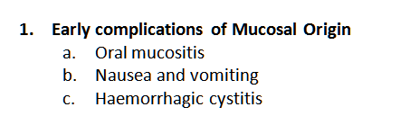
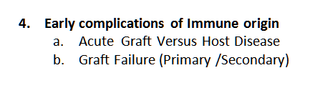
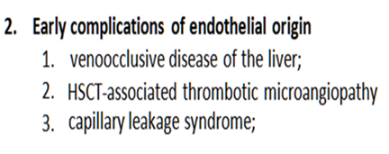
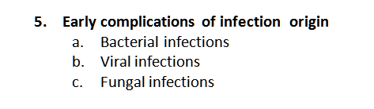
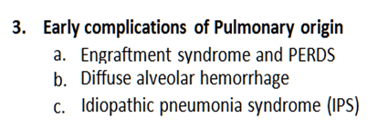
Early complications of high-dose therapy and stem cell transplantation
LATE EFFECTS …..

Slide 3
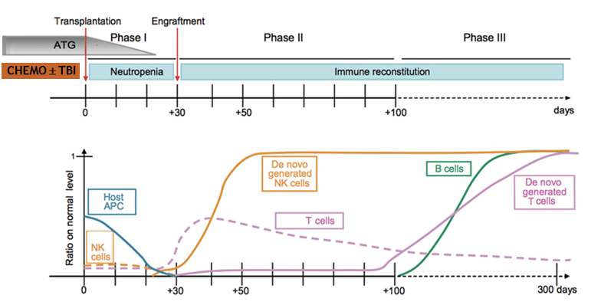
Early complications of high-dose therapy and stem cell transplantation
EARLY
LATE
Notes:
Before infusion of hematopoetic stem cells, bone marrow is conditioned by chemotherapty with without TBI
After transplantation 3 important stages are defined for trhe successful graft
First phase named as homing and proliration phase, this period repprsent neurtrophil and platelet recovery
Second phase still remains with immunulogical insuffciency. This two phase also known as early pahase, are very dangerous period for transplantation recipients. And the body is very vulnareable against immunlogic storms and pathogen attacks

Slide 4
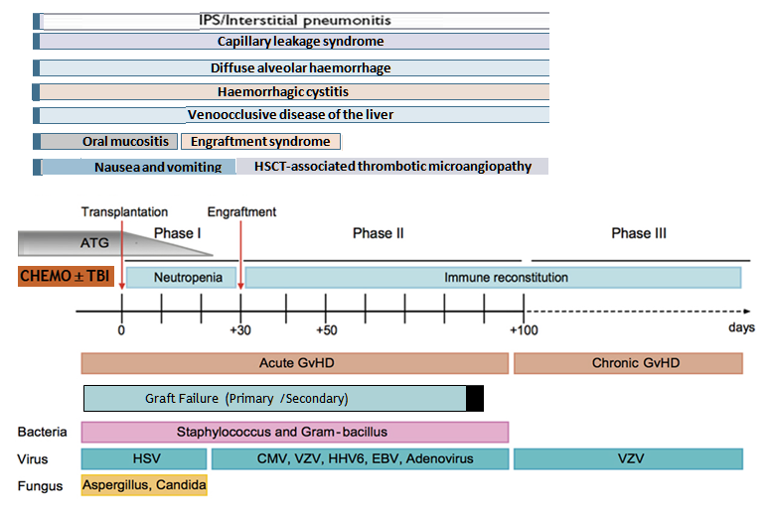
Early complications of high-dose therapy and stem cell transplantation
LATE
These have imprecise diagnostic criteria and overlapping clinical features and are observed within the first 30–60 days after HSCT.
Notes:
FRTUNATELY, THİS COMPLICATIONS ARE VERY RARE AND WITH THE CAREFULLY FOLLOW UP THE PATIENTS, MOST OF THEM ARE MANGABELE AND EASLY SOLVED BY APPROPTRAITE TREATMANT ….
There are a number of complications where injury to the vascular endothelium seems to be the most important initial event. These have imprecise diagnostic criteria and overlapping clinical features and are observed within the first 30–60 days after HSCT.

Slide 5
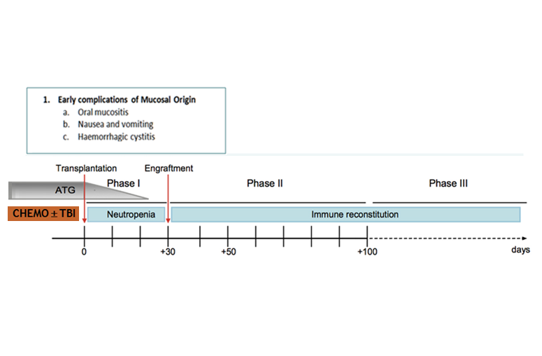
EARLY COMPLICATIONS OF MUCOSAL ORIGIN

Slide 6

NASUAE & VOMITING occuring after HSCT
Early complications of Mucosal Origin
The high dose chemo/radiotherapy used in standard conditioning
regimens has high emetic potential.

Slide 7
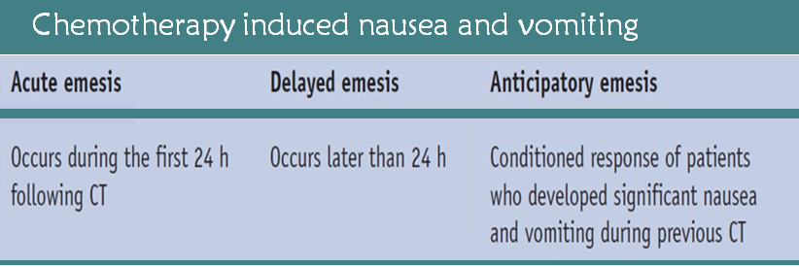
NASUAE & VOMITING occuring after HSCT
Early complications of Mucosal Origin
The main principles of emesis control are:
- Nausea and vomiting are far easier to prevent than to treat
- Antiemetic therapy should be adjusted for the drug with the highest emetic risk
- The risk for emesis following highly emetogenic CT lasts approximately 4 days

Slide 8
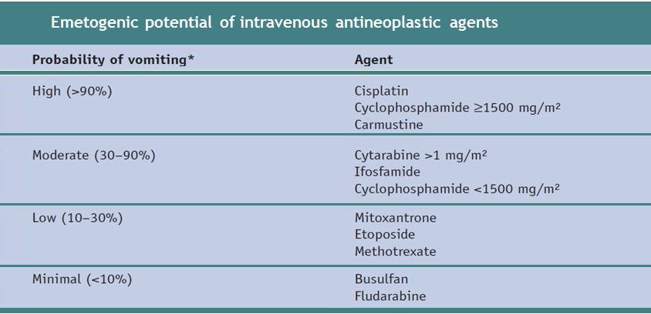
NASUAE & VOMITING occuring after HSCT
Early complications of Mucosal Origin
The high dose chemo/radiotherapy used in standard conditioning
regimens has high emetic potential.
✪
Notes:
In addition, there are several other factors that may further increase the risk of vomiting (consecutive day administration, prior cytotoxic treatment, and other medication, e.g. opiate analgesics).

Slide 9
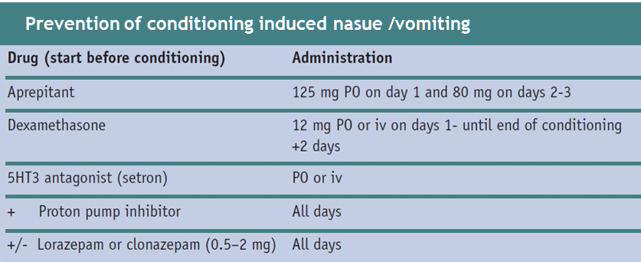
NASUAE & VOMITING occuring after HSCT
Early complications of Mucosal Origin
✪
A combination of a serotonin antagonist (setron) plus a neurokinin-1 antagonist (aprepitant) together with dexamethasone is considered to be the standard prophylaxis
Notes:
The conditioning regimens used in HSCT are known to have a high emetogenic risk. A com-bination of a serotonin antagonist (setron) plus a neurokinin-1 antagonist (aprepitant) together with dexamethasone is considered to be the standard prophylaxis.

Slide 10
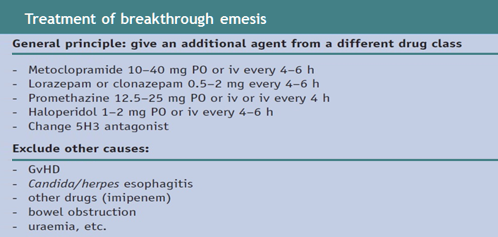
NASUAE & VOMITING occuring after HSCT
Early complications of Mucosal Origin
In case of failure of the prophylaxis :
the addition of further dexamethasone (max 20 mg/day) and/or a benzodiazepine (e.g. lorazepam max 4 mg iv) may help to counter increased patient anxiety and possible anticipatory emesis. . An alternative is to switch to a different serotonin antagonist, since there is an incomplete cross-resistance between agents

Slide 11
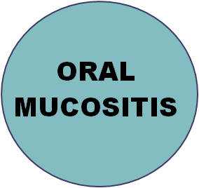
ORAL MUCOSITIS occuring after HSCT
Early complications of Mucosal Origin
It is characterized by mucosal damage ranging from mild inflammation to extensive ulceration, which may affect the oral cavity and other parts of the alimentary tract.
It has been associated with an increased need for total parenteral nutrition and
opioid analgesics, prolonged hospitalization, and increased risk of infection.

Slide 12
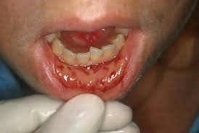
ORAL MUCOSITIS occuring after HSCT
Early complications of Mucosal Origin
Typically, oral mucositis peaks between day 6
and 12, and resolution coincides with engraftment.
✪
Mucositis is associated with an increased risk of systemic infection resulting from bacteraemia associated with the breakdown of mucosal barriers.
Mucositis-associated pain and infection cause significant morbidity and mortality.
Both the severity and the duration of oral mucositis are decreased RIC regimens compared to myeloablative HSCT..

Slide 13
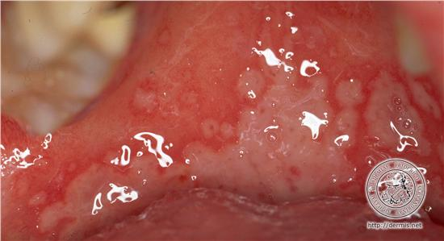
ORAL MUCOSITIS occuring after HSCT
Early complications of Mucosal Origin
Interventions for the prevention of mucositis
Management of oral mucositis requires a multidisciplinary approach.
Basic oral care consists of a pre-transplant oral/dental examination
  aimed at decreasing the oral infectious and inflammatory burden.
  It also minimise the need for invasive dental procedures in the immune reconstitution phase.

Slide 14
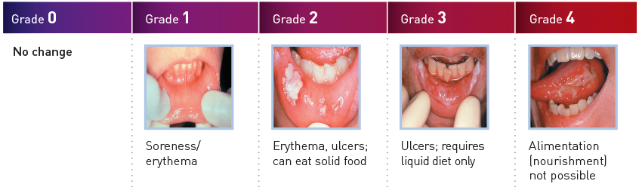
ORAL MUCOSITIS occuring after HSCT
Early complications of Mucosal Origin
Interventions for the prevention of mucositis ; Routine Care
Routine mouth care typically consists of daily assessments by trained nurses using standardized tools to evaluate oral mucositis, pain and other oral complaints.
Bland rinses (e.g. water, saline, sodium bicarbonate) are used routinely to remove debris and keep the oral tissues moist.
Patients should use a soft toothbrush or dental plaque accumulatioN

Slide 15
ORAL MUCOSITIS occuring after HSCT
Early complications of Mucosal Origin
Intervention for the treatment of mucositis: Pain management
Many patients require narcotics . Fentanyl is recommended as the opioid of choice.
Amifostine is a phosphorylated aminothiol, which has a protective effect on normal tissues against radiation and alkylating agent toxicity.
There is increasing evidence for the use cryotherapy (e.g. ice cubes)
A biological approach aimed to prevent mucositis is the use of recombinant keratinocyte growth factor (KGF, palifermin, Kepivance®). Its benefits were associated with significantly less use of opioid analgesics and less frequent requirement for TPN support.
Notes:
Topical agents are available with or without analgesics including diphenhydramine, corticosteroids, antacids, sodium hyaluronate gel, and mucoadhesive protectants. calcium phosphate .

Slide 16
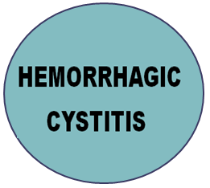
Early complications of Mucosal Origin
HEMORRHAGIC CYSTITIS occuring after HSCT
Haemorrhagic cystitis (HC) can be a serious complication of HSCT and causes significant morbidity, prolongation of hospitalisation, and, occasionally, death. Various additional complications have been described in patients with HC: obstructive uropathy, hydronephrosis, tubulointerstitial nephritis, acute renal failure and bladder perforation
Notes:
Haemorrhagic cystitis (HC) can be a serious complication of HSCT and causes significant morbidity, prolongation of hospitalisation, and, occasionally, death. Various additional complications have been described in patients with HC: obstructive uropathy, hydronephrosis, tubulointerstitial nephritis, acute renal failure and bladder perforation

Slide 17
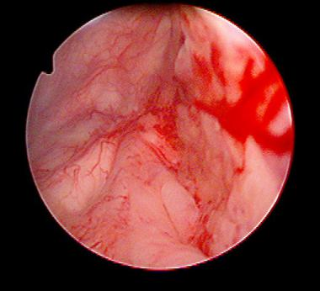
Early complications of Mucosal Origin
HEMORRHAGIC CYSTITIS occuring after HSCT
Incidence
HC secondary to Cy is seen in 5–25 % of cases,
Late HC was reported in a recent series as occurring in 7% of patients with RIC vs 17% of those undergoing MAC-HSCT
Clinical features
Haematuria, symptomatic or asymptomatic, is graded as follows:
  grade I, microscopic;
  grade II, macroscopic;
  grade III, with clots;
  grade IV, urinary retention
Notes:
And up to 58% in patients receiving MAC-HSCT from haplo or cord blood HSCT who had positive BK viruria

Slide 18
Early complications of Mucosal Origin
HEMORRHAGIC CYSTITIS occuring after HSCT
Causes of hemorrhagic cystitis in BMT recipients
Pre-engraftment | Post-engraftment
Chemotherapeutic agents Other Pelvic irradiation Severe thrombocytopenia Coagulopathy | Infections Polyomavirus (BK) Cytomegalovirus Adenovirus Other Severe thrombocytopenia Coagulopathy
Cyclophosphamide, Ifosfamide | Hemorrhagic cystitis
Busulfan | Hemorrhagic cystitis
Thiotepa | Irritation and rarely hemorrhagic cystitis
Doxorubicin | Reversible hemorrhagic cystitis in 20 to 30 percent
Mitomycin | Cystitis in 15 percent
Fludarabine | Rare hemorrhagic cystitis
Chlorambucil | Rare cases of sterile cystitis
Cabazitaxel | Hemorrhagic cystitis in 17 percent; severe (grade 3 or 4) in 2 to 3 percent

Slide 19
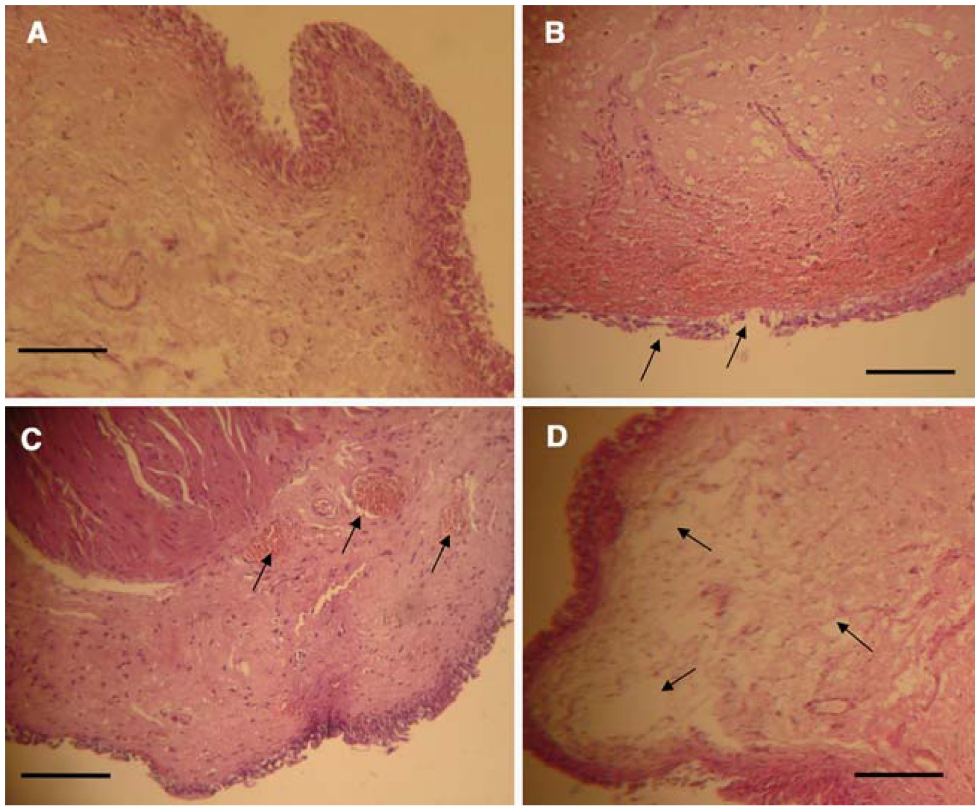
Histological Changes after Cy + Mesna
Early complications of Mucosal Origin
HEMORRHAGIC CYSTITIS occuring after HSCT
Lima et al. 2007, Canc Chem Pharm 59: 643
A
Normal
Before CY
B
Day+1, after
Cy plus 3x mesna
Erosion
C
Congestion
D Edema
Pathogenesis of early HC
Early bleeding (up to 72 hrs after CT agents) occurs almost exclusively when using conditioning therapies including Cy, whose metabolite acrolein produces direct toxicity to the urothelium.
The risk of developing HC after Cy is dose dependent. Occasionally, other agents such as ifosfamide, Bu (especially if associated with Cy), VP16 or TBI have been implicated.

Slide 20
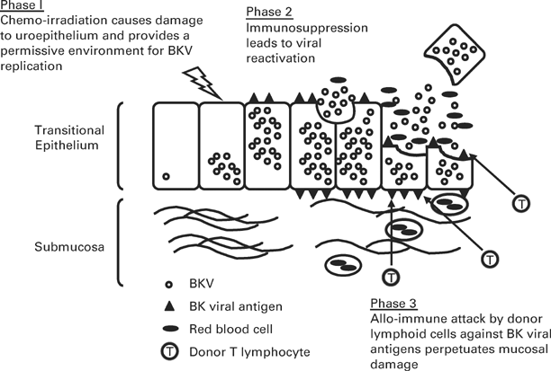
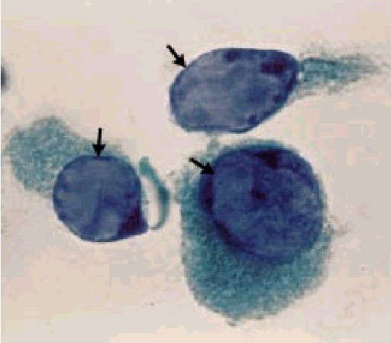
Proposed steps in the pathogenesis of BK virus-associated hemorrhagic cystitis
Early complications of Mucosal Origin
HEMORRHAGIC CYSTITIS occuring after HSCT
Decoy cells in urine
Sensitivity: 100%
Specificity :71%
Pathogenesis of late HC
The HC occurring late (usually more than 2 weeks after HSCT) are classically attributed to BK polyomavirus
infection (and exceptionally to infections with other polyomaviruses, adenovirus or CMV).
Notes:
2.2 Pathogenesis
Early bleeding (up to 72 hrs after CT agents) occurs when using conditioning therapies including Cy, ifosfamide, Bu (especially if associated with Cy), VP16 or TBI
Episodes of HC occurring late (usually more than 2 weeks after HSCT) are classically attributed to BK polyomavirus infection (and exceptionally to infections with other polyomaviruses, adenovirus or CMV). This fact, and the higher incidence of late-onset HC in allo-HSCT from alternative donors and in patients with advanced age, GvHD and thrombocytopenia, suggests that the pathogenesis of HC may be multifactorial.
Early bleeding (up to 72 hrs after CT agents) occurs almost exclusively when using conditioning therapies including Cy, whose metabolite acrolein produces direct toxicity to the urothelium. The risk of developing HC after Cy is dose dependent. Occasionally, other agents such as ifosfamide, Bu (especially if associated with Cy), VP16 or TBI have been implicated.

Slide 21
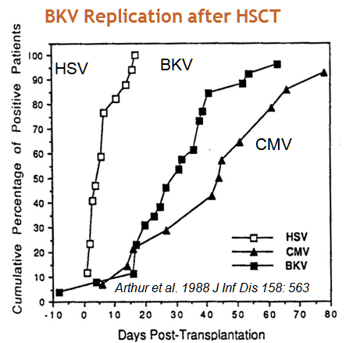
Early complications of Mucosal Origin
HEMORRHAGIC CYSTITIS occuring after HSCT
Diagnosis
High, peaking urine viral loads from baseline
(10⁹–10¹⁰ copies/ml or greater or ≥ 3 log increase)
High, plasma viremia ( > 10⁴ copies/ml)
Biopsy, (bladder epithelium and FISH)
Bone Marrow Transplant. Jan 2008; 41(1): 11–18

Slide 22
Potential risk factors for BK virus-associated hemorrhagic cystitis
Early complications of Mucosal Origin
HEMORRHAGIC CYSTITIS occuring after HSCT
Presence of pretransplant BK virus IgG antibody titer
High peak BK urine viral load or greater than 3 log increase in viral load
Type of conditioning regimen (full intensity >> reduced intensity)
Type of donor (unrelated >> related)
Allogeneic transplant and Acute GVHD
Leuhng et al Bone Marrow Transplant. 2002;29:509–513

Slide 23
Treatment of hemorrhagic cystitis
Early complications of Mucosal Origin
HEMORRHAGIC CYSTITIS occuring after HSCT
Treatment should be based on a three-step approach as follows:
Forced hydration plus intensive platelet support.
  bladder irrigation with saline, bladder instillation of formalin, alum, silver nitrate,
  sodium hyaluronate, PG-E2, GM-CSF or fibrin glue as well as with the administration of
  palifermin, hyperbaric oxygen, oestrogens, or recombinant FVIIa.
b. Intravesical or systemic cidofovir, or ribavirin , plus ciprofloxacin (reduces BK replication) have been reported as effective for cases of HC attributable to BK or adenovirus.
c. If the above measures do not alleviate HC, other salvage approaches can be considered: selective embolisation of bladder arteries; catheterisation of both ureters to rest the bladder or;, as a last resort, cystectomy.
Notes:
Forced hydration plus intensive platelet support. The use of procoagulant agents such as aminocaproic acid is contraindicated as they favour clot formation in the bladder.
Continuous bladder irrigation (via transurethral or suprapubic cystotomy) with saline. Some success has been reported with bladder instillation of formalin, alum, silver nitrate, sodium hyaluronate, prostaglandin E2, GM-CSF or fibrin glue as well as with the administration of palifermin, hyperbaric oxygen, oestrogens, or recombinant FVIIa. Similarly, systemic or intravesical cidofovir, ciprofloxacin (reduces BK replication) or ribavirin have been reported as effective for cases of HC attributable to BK or adenovirus.
If the above measures do not alleviate HC, other salvage approaches can be considered: selective embolisation of bladder arteries (one of the simplest and most effective measures in the hands of an expert angioradiologist); catheterisation of both ureters to rest the bladder; hypogastric bond (which can produce sexual impotence) or, as a last resort, cystectomy.

Slide 24
Prophylaxis & Treatment of hemorrhagic cystitis
Early complications of Mucosal Origin
HEMORRHAGIC CYSTITIS occuring after HSCT
Antiviral | Recommended Dose | Clinical experience
Hydration | The recommended daily dose for hydration is 3 L/m². | several randomised studies have shown that Mesa does not offer additional benefits if hydration and diuresis are adequate.
Mesna for Cy (If used) | As a continuous infusion (in 1 L of 0.9 % saline ) Mesna should be 1.0–1.5 × the daily dose of Cy,,over 12–24 hrs, beginning 4 h prior to the 1st dose of Cy; | several randomised studies have shown that Mesna does not offer additional benefits if hydration and diuresis are adequate.
Fluoroquinolones for BK virus | Ciprofloxacin 500 mg p.o. twice daily or 200 mg i.v. twice daily | BMT recipients had significantly lower peak urinary viral loads, likely more effective as prophylactic agent
Cidofovir | Standard dosing regimen: 5 mg/kg i.v. weekly for 2weeks, then 5 mg/kg with probenecid every otherweek Low-dose cidofovir: 1 mg/kg i.v. weekly without probenecid | ≥2: 80% with clinical response; 32% with resolution of viruria (qualitative PCR) clinical response 84%; virologic response 47% (at least 1 log decrease in urinary viral load)
Notes:
2.4 Prophylaxis for Cyclophosphamide
Although most centres use Mesna as a prophylaxis for Cy-based regimens, several randomised studies have shown that this drug does not offer additional benefits if hydration and diuresis are adequate.
The recommended daily dose for hydration is 3 L/m².
If used, the daily dose of Mesna should be 1.0–1.5 × the daily dose of Cy, administered iv using one of the following schedules:
a. As a continuous infusion in 1 L of 0.9% saline over 12–24 hrs, beginning 4 h prior to the 1st dose of Cy;
b. As bolus injections of 20% of the daily dose of Cy administered as a bolus ½–1 hr before Cy and the remaining daily dose divided into bolus injections q 2–3 hrs;
c. By combining continuous infusion with intermittent bolus injections.
Whichever regimen is used, the presence of acrolein in the bladder 24 hrs after Cy makes it advisable to prolong mesna administration for 24 hrs after the last Cy dose

Slide 25
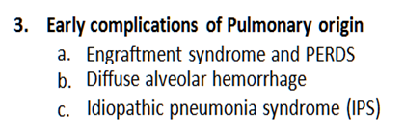

2. EARLY COMPLİCATİONS OF
VASCULAR (endothelial & pulmonary) ORİGİN
These have imprecise diagnostic criteria and overlapping clinical features and are observed within the first 30–60 days after HSCT.

Slide 26
2. Early complications of Vascular Origin
VASCULAR (Endothelial & Pulmonary) SYNDROMES
There are a number of complications where injury to the vascular endothelium seems to be the most important initial event. These have imprecise diagnostic criteria and overlapping clinical features and are observed within the first 30–60 days after HSCT.
The best-defined syndromes resulting from this endothelial injury are:
This endothelial injury seems also to have a relevant role in the pathogenesis of GvHD .
TMA
ES
DAH
CLS
VOD
  1. Venoocclusive disease of the liver;
  2. Capillary leakage syndrome;
  3. Engraftment syndrome;
  4. Diffuse alveolar haemorrhage;
  5. Thrombotic microangiopathy
  6. Idiopathic Pemnemonia Syndrome
?

Slide 27
2. Early complications of Vascular Origin
VASCULAR ENDOTHELIAL SYNDROMES
It is proposed that during HSCT, endothelial and pulmonay cells are activated by:
  The conditioning regimens
  Cytokines produced by injured tissues
  Microbial products translocated through mucosal barriers
  The process of engraftment
  Immunologic mediators
Intense and sustained activation of these cells leads to cellular damage
Alloreactivity also has been postulated to play a role in this damage and activation
  This explains the greater incidence of these complications after allogeneic transplantation
Carreras E & Diaz-Ricart M. Bone Marrow Transplant 2011;46:1495–1502

Slide 28
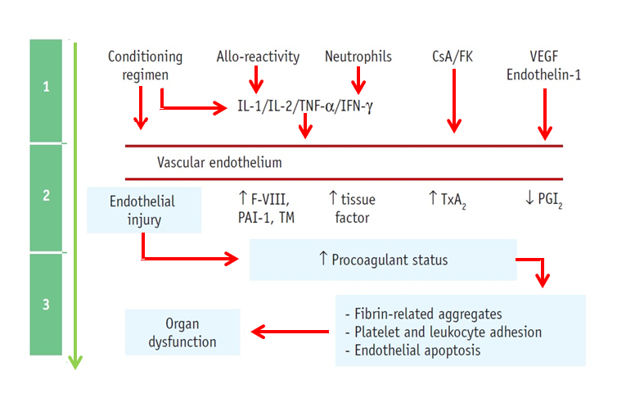
2. Early complications of Vascular Origin
VASCULAR ENDOTHELIAL SYNDROMES
Common pathogenesis of early complications of vascular origin after HSCT
Notes:
y the cytochrome P450 enzymatic system produces several toxic metabolites (e.g. acrolein). These toxic metabolites are converted into stable (non-toxic) metabolites by the glutathione (GSH) enzymatic system and eliminated. When this process occurs in patients with a reduced GSH activity caused by previous liver disease or by the action of agents such as Bu, BCNU or TBI, which consume GSH, toxic metabolites are not metabolised. Toxic metabolites are predominantly located in area 3 of the hepatic acinus (around the centrilobular veins) because this area is rich in P450 and poor in glutathione. Consequently, damage to hepatocytes and sinusoidal endothelium occurs predominantly in this zone. The remaining factors listed in Figure 1 can also contribute to endothelial injury.

Slide 29

2. Early complications of Vascular Origin
VASCULAR ENDOTHELIAL SYNDROMES
Multi-organ dysfunction syndrome
DAH
ES
IPS
CLS
ES
TMA
VOD
TMA
TMA
Organ
dysfunction
Endothelial
dysfunction
(pathologic)
Endothelial phenotype represents a net liability to the host
(capillary flow obstruction, fibrin-related aggregates,
platelet and leukocyte adhesion, endothelial apoptosis)
Endothelial
activation
(physiologic)
Increased
permeability
Pro-coagulant
status
Inflammatory
response
Vasoconstriction
Conditioning
G-CSF
CNI
LPS/infections
Engraftment
Alloreactivity
Haematopoietic stem cell transplantation
CNI, calcineurin inhibitors; CLS, capillary leak syndrome; DAH, diffuse alveolar haemorrhage; ES, engraftment syndrome; GCSF, granulocyte-colony stimulating factor; HSCT; haematopoietic stem cell transplantation; IPS, idiopathic pneumonia syndrome; LPS, lipopolysaccharide; TAM, transplant-associated microangiopathy; VOD, veno-occlusive disease Carreras E & Diaz-Ricart M. Bone Marrow Transplant 2011;46:1495–1502

Slide 30
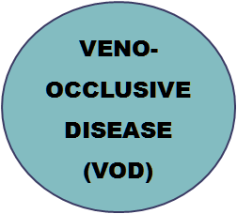
2. Early complications of Vascular Origin
VASCULAR ENDOTHELIAL SYNDROMES
Hepatic veno-occlusive disease (VOD) is the term used to designate the symptoms and signs that appear early after HSCT as a consequence of conditioning regimen related hepatic toxicity.

Slide 31
2. Early complications of Vascular Origin
VENOOCCLUSİVE DİSEASE occuring after HSCT
This syndrome is characterised by
  Jaundice,
  Fluid retention
  Tender hepatomegaly
appearing in the first 35–40 days after HSCT
VOD, also known as sinusoidal obstruction syndrome;
is a potentially life-threatening complication of HSCT
The conditioning regimens given before HSCT result in the production of toxic metabolites by the hepatocytes in the liver. These metabolites trigger the activation, damage and inflammation of the endothelial cells that line the sinusoids*
  Richardson PG et al. Expert Opin Drug Saf 2013;12:123–136
Notes:
Experimental models show that the first events after endothelial injury caused by toxic metabolites are loss of fenestrae in sinusoidal endothelial cells (SEC), formation of gaps within and between SEC and rounding up or swelling of SEC. Consequently, red blood cells penetrate into the space of Disse and dissect off the sinusoidal lining cells, which embolise downstream and block the sinusoids, reducing the hepatic venous outflow and producing post-sinusoidal hypertension. Based on all these observations, some authors have proposed the term of sinusoidal obstruction syndrome for this complication (8).

Slide 32
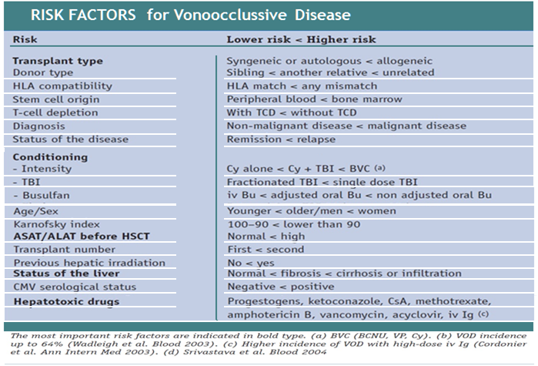
2. Early complications of Vascular Origin
VENOOCCLUSİVE DİSEASE occuring after HSCT

Slide 33
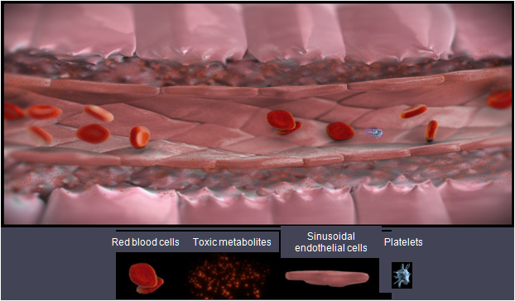
Cell toxicity resulting from chemotherapy damages the lining of the liver sinusoids
2. Early complications of Vascular Origin
VENOOCCLUSİVE DİSEASE occuring after HSCT
Endothelial cell and hepatocyte damage
Toxic metabolites resulting from the HSCT conditioning regimen damage and activate the sinusoidal endothelial cells, Activation and damage due to conditioning regimen-mediated injury. Damage is both directed and mediated by cytokines such as: TNF-α, IL-1b, IL-6
PAI-1,plasminogen activator inhibitor-1; TF, tissue factor Richardson PG et al. Expert Opin Drug Saf 2013;12:123–136
Notes:
The chemotherapy agents used as conditioning regimens for haematopoietic stem cell transplantation (HSCT) are metabolised in the liver.
Toxic metabolites are released by the hepatocytes, causing the damage and activation of the sinusoidal endothelial cells (SECs), which line the sinusoids.
These events can be triggered as soon as the conditioning regimen is administered.
The initial trigger for VOD is the activation and damage of the sinusoidal endothelial cells due to toxic metabolites resulting from the HSCT conditioning regimen¹
Inflammatory mediators such as cytokines and chemokines are released along with the enzyme heparanse, which breaks down the extracellular matrix¹
The rounding up of endothelial cells allows red blood cells, white blood cells and other debris accumulates in the space of Disse, leading to sinusoidal narrowing
Endothelial cells dissect off and embolise downstream, further contributing to this narrowing¹
A procoagulant and hypofibrinolytic state is also characteristic of VOD¹
This can lead to the complete obstruction of the hepatic sinusoids. In severe cases this can lead to multi-organ failure and death¹⁻³
References
Richardson PG et al. Expert Opin Drug Saf 2013;12:123–136
Bearman SI. Blood 1995;85:3005–3020
Coppell JA et al. Blood Rev 2003;17:63–70
References
Richardson PG et al. Expert Opin Drug Saf 2013;12:123–136

Slide 34
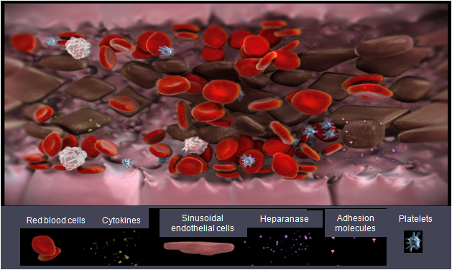
Activation of sinusoidal endothelial cells can trigger multiple pathways, resulting in inflammation and narrowing of the sinusoids
2. Early complications of Vascular Origin
VENOOCCLUSİVE DİSEASE occuring after HSCT
Sinusoidal narrowing
The accumulation of cells and debris in the space of Disse, the perisinusoidal space located between the endothelium and the hepatocyte, lead to narrowing of the sinusoids
PAI-1,plasminogen activator inhibitor-1; TF, tissue factor Richardson PG et al. Expert Opin Drug Saf 2013;12:123–136
Notes:
The activated sinusoidal epithelial cells release inflammatory cytokines, adhesions molecules and heparanase. Heparanese digests the extracellular matrix that supports the structure of the sinusoids. The action of these factors causes the endothelial cells to round up, and gaps to form between the cells. Red blood cells, white blood cells and other cellular debris exits through these gaps into the space of Disse, the perisinusoidal space that is located between the endothelium and the hepatocytes. This accumulation of cells and debris in this space causes narrowing of the sinusoids. Endothelial cells can dissect off and embolise further downstream.
References
Carreras E et al. Biol Blood Marrow Transplant 2011;17:1713–1720
Richardson PG et al. Expert Opin Drug Saf 2013;12:123–136

Slide 35
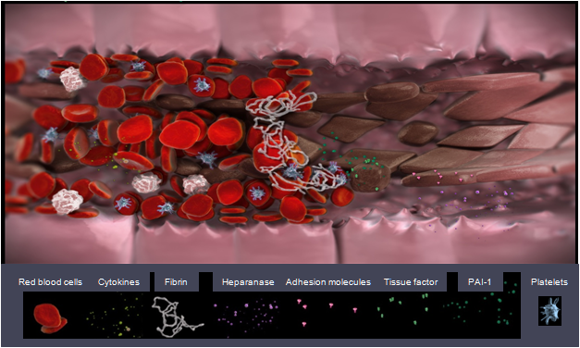
VOD is characterised by increased clot formation and reduced clot breakdown
2. Early complications of Vascular Origin
VENOOCCLUSİVE DİSEASE occuring after HSCT
Sinusoidal Obstruction Syndrome
The narrowing of the sinusoids, embolised endothelial cells and increased clot formation lead to the endpoint of VOD, namely obstruction of the sinusoids, Portal vein hypotension, Hepatic venous outflow obstruction
PAI-1,plasminogen activator inhibitor-1; TF, tissue factor Richardson PG et al. Expert Opin Drug Saf 2013;12:123–136
Notes:
An increase in the expression of tissue factor (TF) and plasminogen activator inhibitor-1 (PAI-1) causes an increase in clot formation and a decrease in the breakdown on clots.
This contributes to the deposition of fibrin, clot formation, and the narrowing of the sinusoids. This may ultimately lead to obstruction of the sinusoids.
This image shows the pathophysiology of VOD. The endothelial cells have rounded up, leading to gap formation, and some have dissected off into the bloodstream. The sinusoid has narrowed due to the accumulation of cells in the space of Disse. Clots forming at the sites of endothelial damage have caused the obstruction of the sinusoid.
References
Richardson PG et al. Expert Opin Drug Saf 2013;12:123–136

Slide 36
Diagnosis
2. Early complications of Vascular Origin
VENOOCCLUSİVE DİSEASE occuring after HSCT
As for any syndrome, the diagnosis of VOD must be established clinically. All teams employing HSCT use one of the following two sets of clinical criteria;
Seattle criteria.
In the first 20 days after HSCT, the presence of two or more of the following:
    Bilirubin >2 mg/dL (>34 mmol/L);
    hepatomegaly or pain in the right upper quadrant;
    weight gain (>2% basal weight).
Baltimore criteria.
In the first 21 days after HSCT, the presence of
    Bilirubin at >2 mg/dL (>34 mmol/L)
    Plus two or more of the following: a) painful hepatomegaly, b) Ascites, or c)weight gain (>5% basal weight).
Notes:
In both diagnostic criteria, other possible causes of these clinical features should be excluded before accepting a diagnosis of VOD (see differential diagnosis). Additionally, it is necessary to remember that some cases of VOD can appear late after HSCT.
This has ranged from 3% to 54% in the largest series. This variability is a consequence of the presence or absence of the well-known risk factors for this complication (see below). In the only prospective multi-centre study published, the incidence of VOD was 8% in cases of allo-HSCT and 3% in cases of auto-HSCT (5). In a large single-centre study, the cumulative incidences of VOD in cases of allo-HSCT in the last decade were 14% and 8% using Seattle or Baltimore criteria, respectively. The incidence in patients undergoing RIC-HSCT seems to be less than 2%

Slide 37
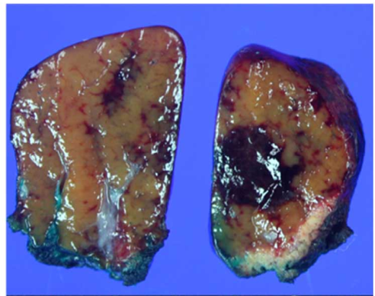
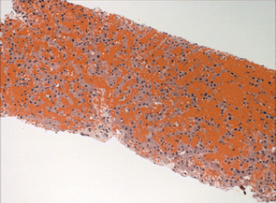
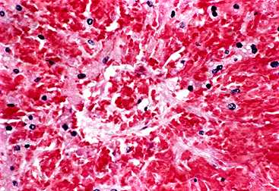
Diagnosis: Other studies that can complement the diagnosis are as follows.
2. Early complications of Vascular Origin
VENOOCCLUSİVE DİSEASE occuring after HSCT
HEMODYNAMIC STUDY: a hepatic venous gradient pressure (HVGP): of ≥10 mmHg, However, a normal HVGP does not exclude this syndromic diagnosis, (Prognostic Value !).
Liver biopsy. classical histological changes seen with VOD
  concentric narrowing of the lumen of small intrahepatic veins, (more specific )
  Because of the patchy nature of VOD, a normal biopsy does not exclude this syndromic diagnosis
Biological studies. plasminogen activator inhibitor (PAI)-1 (marker with the highest specificity and sensitivity for VOD), vWF, thrombomodulin, e.g.
Light micrograph of sinusoidal obstruction syndrome in which venular occlusion has led to widespread zonal liver disruption and centrilobular hemorrhagic necrosis
Notes:
In both diagnostic criteria, other possible causes of these clinical features should be excluded before accepting a diagnosis of VOD (see differential diagnosis). Additionally, it is necessary to remember that some cases of VOD can appear late after HSCT.
An hepatic venous gradient pressure (HVGP): of ≥10 mmHg in a patient without a previous liver disease allows a precise differential diagnosis with a high degree of specificity. However, a normal HVGP does not exclude this syndromic diagnosis.
Liver biopsy. classical histological changes seen with VOD
concentric non-thrombotic narrowing of the lumen of small intrahepatic veins, (more specific )
eccentric narrowing of the venular lumen; phlebosclerosis; sinusoidal fibrosis or hepatocyte necrosis (less specific ) Because of the patchy nature of VOD, a normal biopsy does not exclude this syndromic diagnosis
Ultrasonography. A variety of abnormalities can be observed, such as gallbladder wall thickening, ascites, hepatomegaly and attenuated or reversed portal flow, but they are all non-specific.
Biological studies. Although the serum of patients with VOD shows an increase in levels of plasminogen activator inhibitor (PAI)-1 (marker with the highest specificity and sensitivity for VOD), vWF, thrombomodulin, E-selectin, sICAM, aminopropeptides of type III collagen and hyaluronic acid, they are all of little utility in daily clinical practice

Slide 38
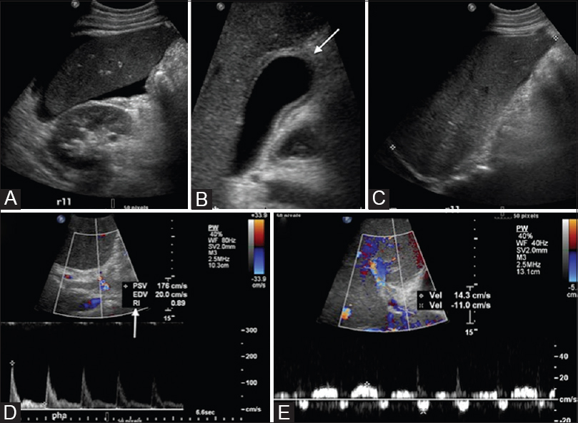
Diagnosis: IMAGING STUDIES : (Ultrasonography,).
2. Early complications of Vascular Origin
VENOOCCLUSİVE DİSEASE occuring after HSCT
US imaging is sensitive in detecting
Ascites,
Hepatosplenomegaly,
Portal vein enlargement,
Marked gallbladder wall edema (wall thickening > 6-8 mm),
Abnormal Doppler parameters
(portal venous pulsatility, hepatofugal portal venous
flow, increased hepatic artery resistive index >0.8, and
loss of triphasic flow pattern in the hepatic veins).
Figure ; Classic findings of hepatic veno-occlusive disease, day 18 post stem cell transplant: (A) perihepatic ascites (B) gallbladder wall thickening (arrow) (C) hepatomegaly (D) hepatic artery with increased resistive index (RI = 0.86) (arrow) (E) pulsatile and bidirectional portal vein
Notes:
ltrasonography may be abnormal in patients with hepatic sinusoidal obstruction syndrome (SOS), but is unlikely to be diagnostic for the disease. Ultrasonographic findings that are more common in SOS than other liver disorders occurring during hematopoietic cell transplantation (HCT) include the presence of ascites, an abnormal portal vein waveform, marked thickening of the gallbladder wall, and a hepatic artery resistance index greater than 0.75 [63]. Reversal of flow in the portal vein has been used to diagnose SOS, but the sensitivity is low [64,65].
However, ultrasonography is often abnormal in patients undergoing HCT in the absence of SOS. As an example, one study prospectively determined the prevalence of sonographic hepatobiliary abnormalities in 21 patients undergoing HCT [66]. Baseline scans were abnormal in 62 percent. Findings on serial examinations could not discriminate patients with SOS from those without the syndrome.
However, US findings are nonspecific and similar findings can be seen in patients with absence of SOS. Studies have shown that no US finding is strongly associated with veno-occlusive disease (VOD)

Slide 39
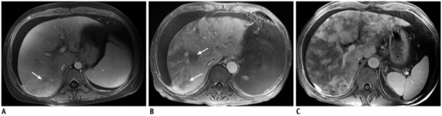
Diagnosis: IMAGING STUDIES : (MRI).
2. Early complications of Vascular Origin
VENOOCCLUSİVE DİSEASE occuring after HSCT
A variety of abnormalities can be observed, such as gallbladder wall thickening, ascites, periportal edema, narrowed right hepatic vein , hepatomegaly and attenuated or reversed portal flow, but they are all non-specific.
Post contrast-enhanced MR images show severity of patchy liver enhancement in hepatic sinusoidal obstruction syndrome.A. Grade 1. Arrow denotes mild patchy enhancement. B. Grade 2. Arrows denote moderate confluent patchy enhancement. C. Grade 3. Severe case with diffuse confluent patchy enhancement. Note all three cases demonstrate ascites.
Notes:
maging techniques have experienced major progress since the 1980s and the initial definition of the criteria for diagnosis of SOS/VOD,^{3, 4} raising the possibility that they may contribute to refining such diagnosis today. The role of ultrasound has been investigated in several studies, but most of them were published almost two decades ago, with conflicting results, as reviewed by Mahgerefteh et al.⁵³ The reported abnormalities in SOS/VOD are not specific, and included hepatomegaly, splenomegaly, gallbladder wall thickening, ascites and portal venous flow abnormalities.^{53, 54} The latter—decrease in velocity or reversal of the portal venous flow—are considered more specific for SOS/VOD, but usually occur late in the disease,^{53,54, 55} and their interest for SOS/VOD early diagnosis is limited.
Measurement of the hepatic venous gradient pressure through the jugular vein is the most accurate method to confirm the diagnosis of SOS/VOD.^{24, 56, 57} However, this technique is invasive, requires an expert hemodynamist, and is not routinely available in most centers. Therefore, doppler ultrasonography has been investigated to evaluate changes in portal circulation. Although the correlation between hepatic arterial resistive indices and portal hypertension is controversial, the hepatic arterial early acceleration index correlated directly with Hepatic venous pressure gradient.⁵⁸ Nevertheless, although non-invasive, this technique requires expert echographers, and is not available in most centers.
Few studies, mostly case reports, investigate the role of other imaging techniques.²³ Periportal edema, ascites and a narrow right hepatic vein on computerized tomography scans are suggestive of SOS/VOD.^{59, 60}Similarly, magnetic resonance imaging scans of patients with SOS/VOD have detected hepatomegaly, ascites, hepatic vein narrowing, gallbladder wall thickening, peri-portal cuffing or patchy signal enhancement of the liver.^{59, 61, 62, 63, 64} Of note, a high specificity of supramagnetic iron oxide-enhanced magnetic resonance imaging and gadoteric acid-enhanced magnetic resonance imaging for SOS/VOD diagnosis in patients with chemotherapy-treated colorectal liver metastases has been reported,^{65, 66} but these imaging modalities have not been evaluated in the setting of HCT.
At present, the role of imaging in SOS/VOD remains limited to ultrasound to assist in the exclusion of differential diagnoses. In addition, ultrasound may be helpful to confirm clinical findings such as hepatomegaly and ascites, which can be difficult to assess in particular in overweight patients. Baseline and serial ultrasound measurements may be useful for early detection of signs suggestive of SOS/VOD, although daily clinical examination and weight monitoring remain the gold standards. Prospective evaluation of hepatic arterial early acceleration index and of supramagnetic iron oxide- or gadoteric acid-enhanced magnetic resonance imaging for SOS/VOD monitoring/diagnosis seems indispensable before recommending their use and integration into the SOS/VOD diagnostic criteria.

Slide 40
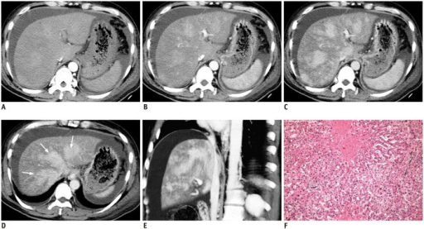
Diagnosis: IMAGING STUDIES : (C. Tomograhy).
2. Early complications of Vascular Origin
VENOOCCLUSİVE DİSEASE occuring after HSCT
49-year-old man diagnosed with hepatic sinusoidal obstruction syndrome
A-C. Arterial, portal and hepatic venous phase CT scans demonstrate patchy liver enhancement. D. Clover-like enhancement surrounding hepatic veins is well demonstrated at hepatic venous phase on slice through hepatic vein level (arrows). E. Multiple planar reconstruction CT angiogram F. sinusoidal congestion, centrilobular hepatocytes necrosis and slight fibrous hyperplasia in portal area.
Notes:
maging techniques have experienced major progress since the 1980s and the initial definition of the criteria for diagnosis of SOS/VOD,^{3, 4} raising the possibility that they may contribute to refining such diagnosis today. The role of ultrasound has been investigated in several studies, but most of them were published almost two decades ago, with conflicting results, as reviewed by Mahgerefteh et al.⁵³ The reported abnormalities in SOS/VOD are not specific, and included hepatomegaly, splenomegaly, gallbladder wall thickening, ascites and portal venous flow abnormalities.^{53, 54} The latter—decrease in velocity or reversal of the portal venous flow—are considered more specific for SOS/VOD, but usually occur late in the disease,^{53,54, 55} and their interest for SOS/VOD early diagnosis is limited.
Measurement of the hepatic venous gradient pressure through the jugular vein is the most accurate method to confirm the diagnosis of SOS/VOD.^{24, 56, 57} However, this technique is invasive, requires an expert hemodynamist, and is not routinely available in most centers. Therefore, doppler ultrasonography has been investigated to evaluate changes in portal circulation. Although the correlation between hepatic arterial resistive indices and portal hypertension is controversial, the hepatic arterial early acceleration index correlated directly with Hepatic venous pressure gradient.⁵⁸ Nevertheless, although non-invasive, this technique requires expert echographers, and is not available in most centers.
Few studies, mostly case reports, investigate the role of other imaging techniques.²³ Periportal edema, ascites and a narrow right hepatic vein on computerized tomography scans are suggestive of SOS/VOD.^{59, 60}Similarly, magnetic resonance imaging scans of patients with SOS/VOD have detected hepatomegaly, ascites, hepatic vein narrowing, gallbladder wall thickening, peri-portal cuffing or patchy signal enhancement of the liver.^{59, 61, 62, 63, 64} Of note, a high specificity of supramagnetic iron oxide-enhanced magnetic resonance imaging and gadoteric acid-enhanced magnetic resonance imaging for SOS/VOD diagnosis in patients with chemotherapy-treated colorectal liver metastases has been reported,^{65, 66} but these imaging modalities have not been evaluated in the setting of HCT.
At present, the role of imaging in SOS/VOD remains limited to ultrasound to assist in the exclusion of differential diagnoses. In addition, ultrasound may be helpful to confirm clinical findings such as hepatomegaly and ascites, which can be difficult to assess in particular in overweight patients. Baseline and serial ultrasound measurements may be useful for early detection of signs suggestive of SOS/VOD, although daily clinical examination and weight monitoring remain the gold standards. Prospective evaluation of hepatic arterial early acceleration index and of supramagnetic iron oxide- or gadoteric acid-enhanced magnetic resonance imaging for SOS/VOD monitoring/diagnosis seems indispensable before recommending their use and integration into the SOS/VOD diagnostic criteria.

Slide 41
2. Early complications of Vascular Origin
VENOOCCLUSİVE DİSEASE occuring after HSCT
Clinical features
Classical VOD.
  Several days after conditioning (from days –1 to +21)
  jaundice (in almost 100% of cases),
  Hepatomegaly and/or right upper quadrant pain and weight gain together with oedema and ascites
Late VOD.
  The same clinical manifestations as classical VOD but develops late
  Mainly observed after conditioning including several alkylating agents (e.g. busulfan, melphalan or thiotepa).
VOD with multi-organ failure.
  Clinical manifestations plus thrombocytopenia
  pleural effusion, pulmonary infiltrates, progressive renal, cardiac and pulmonary failure, confusion, encephalopathy, and coma
Notes:
3.1.3
Classical VOD. Several days after conditioning (from days –1 to +21) there is the presence of jaundice (in almost 100% of cases), hepatomegaly and/or right upper quadrant pain and weight gain (not attributable to an excessive fluid administration) together with oedema and ascites (4).
Late VOD. This shows the same clinical manifestations as classical VOD but develops late after HSCT (one-third of cases occur after patient discharge). It is mainly observed after conditioning including the use of one of several alkylating agents (e.g. busulfan, melphalan or thiotepa). One-third of cases show a biphasic course with an initial and transitory peak followed by a definitive late phase (9).
VOD with multi-organ failure. This shows the previously described clinical manifestations plus thrombocytopenia (refractoriness to platelet transfusions); pleural effusion, pulmonary infiltrates, progressive renal, cardiac and pulmonary failure, confusion, encephalopathy, and coma

Slide 42
2. Early complications of Vascular Origin
VENOOCCLUSİVE DİSEASE occuring after HSCT
Differential diagnosis
Infections. These include Cholangitis lenta (sepsis of the liver), fungal infections and viral hepatitis.
Immune dysfunction. This can lead to hepatic GvHD or autoimmune hepatitis.
Drug toxicity. CsA, azoles, MTX, progestogens, trimethoprimsulfamethoxazole and TPN, among others.
Reduction of venous outflow. This can lead to increased volume, constrictive pericarditis, congestive heart failure, fluid overload or renal failure.
Other causes. These include pancreatic ascites, chylous ascites or infiltration of the liver.
To accept a diagnosis of VOD, all of the following possible causes of similar clinical features should be excluded as far as possible.
Notes:
3.1.3
Classical VOD. Several days after conditioning (from days –1 to +21) there is the presence of jaundice (in almost 100% of cases), hepatomegaly and/or right upper quadrant pain and weight gain (not attributable to an excessive fluid administration) together with oedema and ascites (4).
Late VOD. This shows the same clinical manifestations as classical VOD but develops late after HSCT (one-third of cases occur after patient discharge). It is mainly observed after conditioning including the use of one of several alkylating agents (e.g. busulfan, melphalan or thiotepa). One-third of cases show a biphasic course with an initial and transitory peak followed by a definitive late phase (9).
VOD with multi-organ failure. This shows the previously described clinical manifestations plus thrombocytopenia (refractoriness to platelet transfusions); pleural effusion, pulmonary infiltrates, progressive renal, cardiac and pulmonary failure, confusion, encephalopathy, and coma

Slide 43
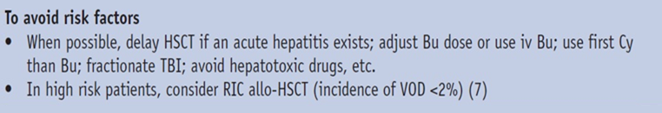
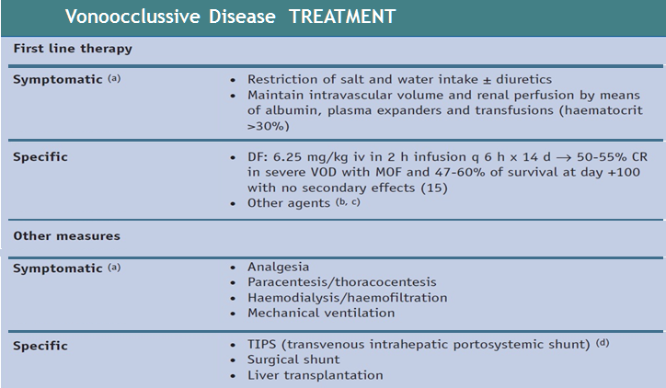
2. Early complications of Vascular Origin
VENOOCCLUSİVE DİSEASE occuring after HSCT

Slide 44
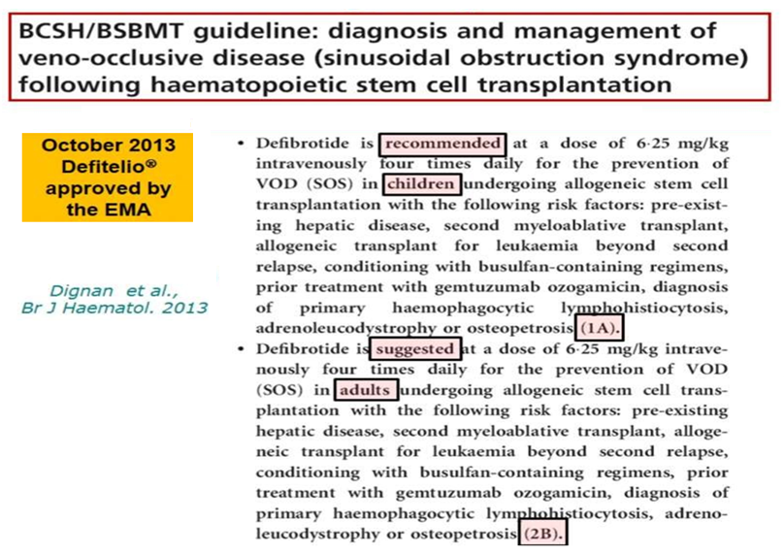
2. Early complications of Vascular Origin
VENOOCCLUSİVE DİSEASE occuring after HSCT
Treatment
Guidelines

Slide 45
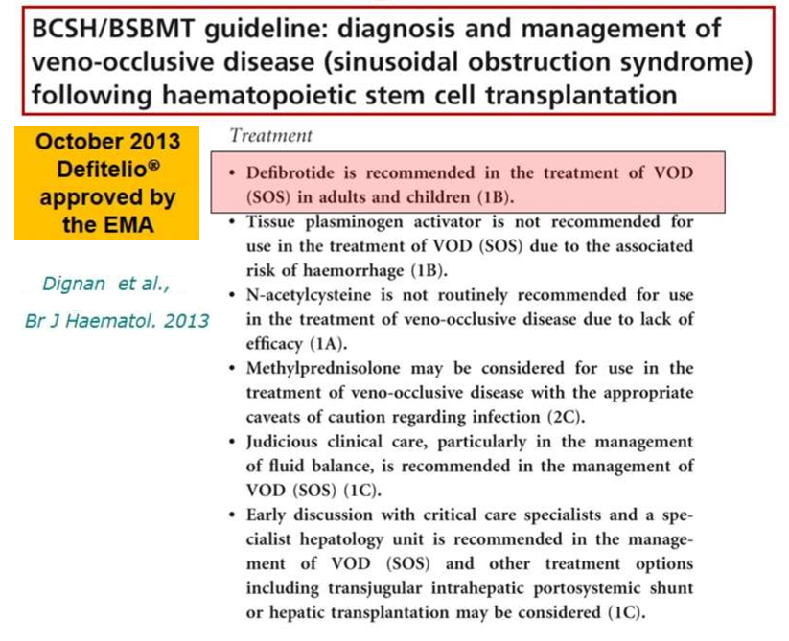
2. Early complications of Vascular Origin
VENOOCCLUSİVE DİSEASE occuring after HSCT
Treatment
Guidelines

Slide 46
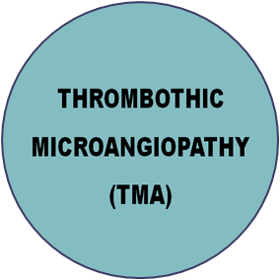
2. Early complications of Vascular Origin
THROMBOTHIC MICROANGIOPATHY occuring after HSCT
Especially, conditioning regimens produce a generalised endothelial dysfunction causing microangiopathic haemolytic anaemia and plt consumption, resulting in thrombosis and fibrin deposition in the microcirculation.
Unlike that seen in patients with classical TTP, ADAMTS13 activity in patients with TMA rarely decreases to below 10% of normal

Slide 47
2. Early complications of Vascular Origin
THROMBOTHIC MICROANGIOPATHY occuring after HSCT
TMA usually develops around day +60, but early (day +4) and late
(2 years) episodes have been described.
A higher incidence has been observed in patients receiving TBI, calcineurin inhibitors (CNI), sirolimus, unrelated or HLA-mismatched donor grafts, or developing GvHD or aspergillus, CMV or adenovirus infections. The intensity of conditioning does not seem to play a role in the development of TMA.
Notes:
This is less than 4% in cases of auto-HSCT but up to 15% in cases of allo-HSCT (7% in an EBMT survey). There is a similar incidence after RIC and MAC-HSCT

Slide 48
2. Early complications of Vascular Origin
THROMBOTHIC MICROANGIOPATHY occuring after HSCT
Diagnostic Criteria
Clinical features for HSCT associated TMA
Microangiopathic haemolytic anaemia ,
(Defined as anaemia with >2–4% schistocytes, together with raised LDH)
Thrombocytopenia or increased requirement for platelet transfusions.
Renal dysfunction and/or neurological abnormalities
(such as cortical blindness, seizures and typical images in CT scans of the CNS.)
In addition to these classical findings, experts insist on the relevance and high frequency of elevated blood pressure, diarrhea secondary to intestinal TMA and proteinuria, as well as in the possible absence of renal and neurological symptoms
It is characterised as follows.

Slide 49
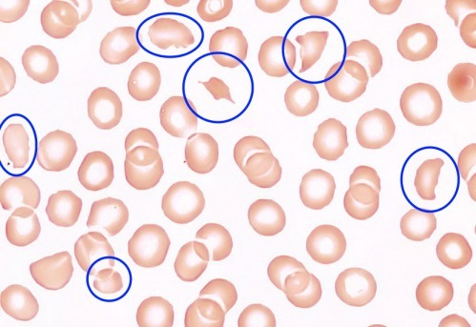
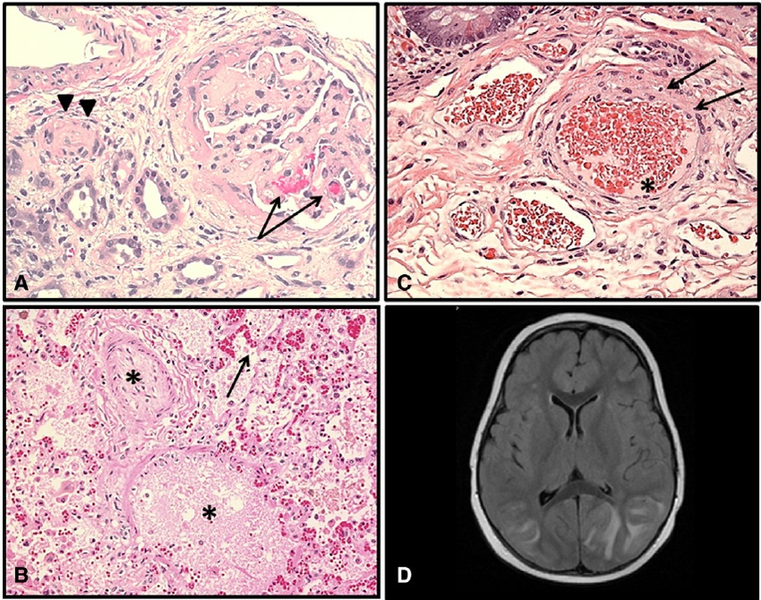


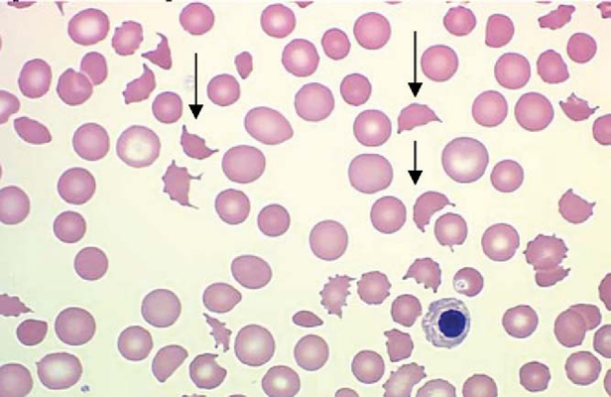


2. Early complications of Vascular Origin
THROMBOTHIC MICROANGIOPATHY occuring after HSCT
.Histologic examples of TA-TMA affecting various organs. (A) Renal cortex with glomeruli showing red blood cell fragments can be seen (arrows) (B) Lung arteriole showing debris nearly occluding vascular lumen (star) Red blood cell fragments extravagated into interstitial tissue (arrow) (C) Submucosal arterioles of the small bowel showing injured endothelial cells and red cell extravasation (arrows). Vessel lumen is occupied by schistocytes and fi brinoid debris (star) (D) Brain MRI: hyperintense FLAIR signal involving the bilateral (left N right) cortex and subcortical white matter. Effacement of sulci suggests associated swelling. Findings are suggestive of posterior reversible encephalopathy (PRES)
Notes:
Fig. 1. Histologic examples of TA-TMA affecting various organs. (A) Renal cortex with glomeruli showing thickened capillary walls and occluded vessel lumens. Red blood cell fragments can be seen (arrows) trapped in the mesangial matrix (H&E stain; magni fi cation ×200). Renal arteriole with separation of the endothelial cell layer and nearly occluded by endothelial debris (arrow heads) (H&E stain; magni fi cation ×200). (B) Lung arteriole showing denuded endothelial layer with large amount of debris nearly occluding vascular lumen (star) Red blood cell fragments extravagated into interstitial tissue (arrow) (H&E stain; magni fi cation ×200). (C) Submucosal arterioles of the small bowel showing injured endothelial cells and red cell extravasation (arrows). Vessel lumen is occupied by schistocytes and fi brinoid debris (star) (H&E stain; magni fi cation ×200). (D) Brain MRI: hyperintense FLAIR signal involving the bilateral (left N right) cortex and subcortical white matter. Effacement of sulci suggests associated swelling. Findings are suggestive of posterior reversible encephalopathy (PRES)

Slide 50
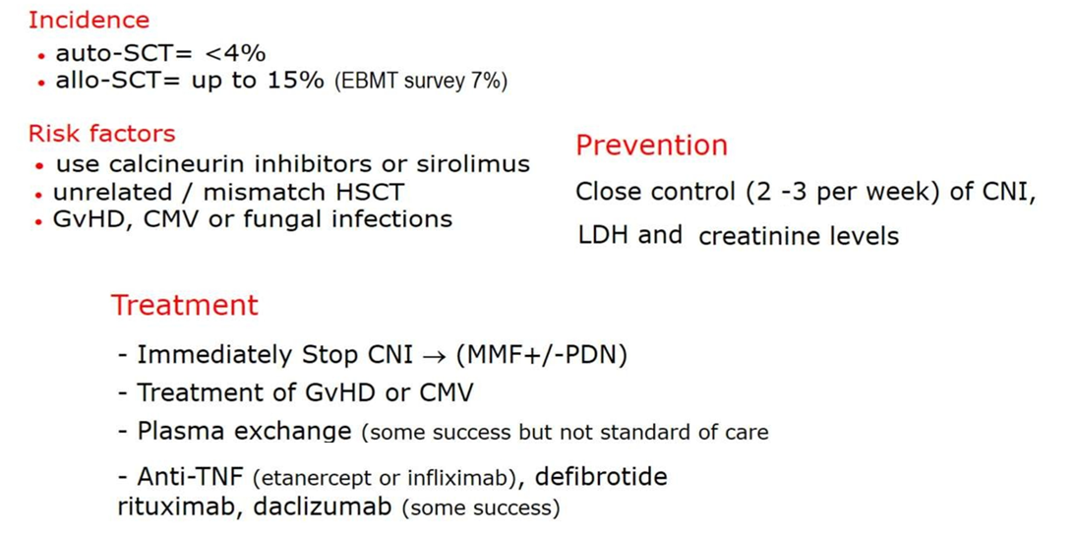
2. Early complications of Vascular Origin
THROMBOTHIC MICROANGIOPATHY occuring after HSCT
Notes:
3.5.7 Prevention
The only reasonable measure is to keep close observation (2–3 times per week) of the CNI, LDH and creatinine levels. If any of these markers increase, peripheral blood smears, haptoglobin levels and Coombs tests (direct and indirect antiglobulin tests) should be evaluated.
3.5.8 Treatment
The most effective measure is to stop CNI immediately (no dose reduction) by changing GvHD prophylaxis/treatment to another drug (corticosteroids, mycophenolate). Plasma exchange usually offers a poor response (median 35%; range 20–80%) probably because TMA is not associated with an absence or severe reduction of plasma ADAMTS13 activity and has a high associated mortality (80%). Some authors have reported successful results with defibrotide, rituximab, daclizumab and basiliximab therapies.

Slide 51
2. Early complications of Vascular Origin
CAPİLLARY LEAK SYNDROME (CLS) occuring after HSCT
CAPİLLARY LEAK SYNDROME (CLS)
Injury to the capillary endothelium (probably caused by Cytokines and VEGF) produces a loss of intravascular fluids to the interstitial space, which leads to the clinical manifestations of CLS

Slide 52
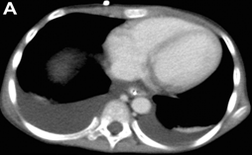
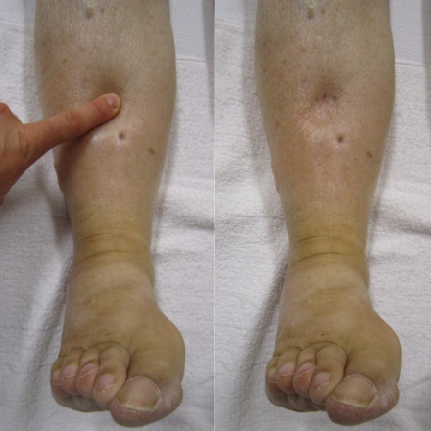
2. Early complications of Vascular Origin
CAPİLLARY LEAK SYNDROME (CLS) occuring after HSCT
Clinical features
The absence of well-established clinical criteria for the diagnosis of CLS precludes an adequate estimation of its incidence.
Weight gain (>3% within 24 hrs) and
Generalised oedematous syndromes (e.g. ascites, pleural
effusion or pericarditis) that characteristically do not respond to
furosemide treatment.
3. Other features occasionally observed are tachycardia, hypotension,
renal insufficiency of pre-renal origin and hypoalbuminaemia
This is characterised by the development in the first 15 days after HSCT of;
Notes:
Risk factors
The use of G-CSG, GM-CSF or K-CSF; high cumulative doses of CT in the pre-HSCT phase; unrelated or HLA-mismatched donor grafts.
Differential diagnosis;
From ES: its earlier development, the absence of skin rash and the poor response to corticosteroids.
From VOD : the absence of jaundice and painful hepatomegaly and the poor response to furosemide.
From DAH: generalised oedema.

Slide 53
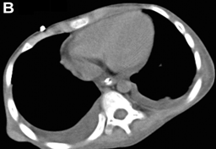
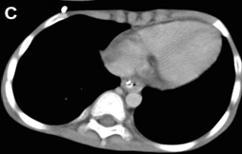
2. Early complications of Vascular Origin
CAPİLLARY LEAK SYNDROME (CLS) occuring after HSCT
Treatment
Withdraw any growth factors. Despite being used systematically, corticosteroids offer poor responses. iv Ig and bevacizumab (anti-VEGF) have been used successfully in some cases .
Evolution
There is a high mortality rate if CLS progresses to multi-organ failure
Administration of bevacizumab.
Hiromasa Yabe et al. Blood 2010;115:2723-2724
. Chest CT before
5 days after
20 days after

Slide 54
3 EARLY COMPLICATIONS OF
PULMONARY ORIGIN
These have imprecise diagnostic criteria and overlapping clinical features and are observed within the first 30–60 days after HSCT.

Slide 55
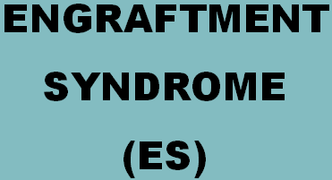
3. Early complications of Vasc. / Pulm. Origin
ENGRATMENT SYNDROME occuring after HSCT
This syndrome has received other names in the literature: capillary leak syndrome at engraftment; auto-aggression syndrome; peri-engraftment respiratory distress syndrome (PERDS); and aseptic shock syndrome
Notes:
This involves a massive release of pro-inflammatory cytokines (e.g. IL-2, TNF-α, IFN-γ and IL-6), M-GSF, EPO, products of degranulation and oxidative metabolism of neutrophils and systemic endothelial damage.
ES is almost exclusively diagnosed after auto-HSCT. In this setting, the incidence ranges from 5% to 25% (13% in the largest series). It is rarely seen after conventional allo-HSCT, but is occasionally described after RIC allo-HSCT and CB-HSCT.

Slide 56
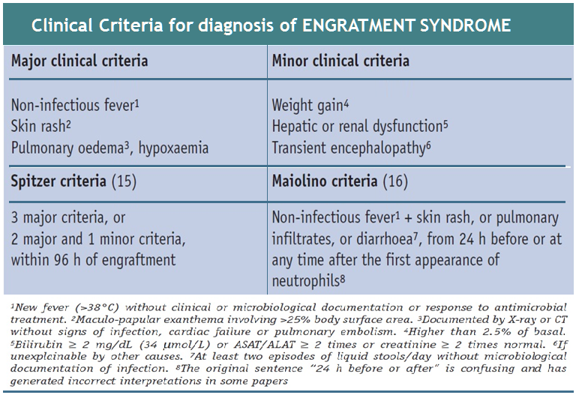
3. Early complications of Vasc. / Pulm. Origin
ENGRATMENT SYNDROME occuring after HSCT
Notes:
3.3.3 Clinical features and diagnostic criteria
The clinical manifestations and the Spitzer and Maiolino diagnostic criteria are listed in Table 5 (13, 16). A recent study showed that the Maiolino criteria - when correctly applied - are the best tool to establish an early diagnosis, despite being less specific than the Spitzer criteria. A sudden and significant increase in the level of C-reactive protein can help to establish the diagnosi

Slide 57





3. Early complications of Vasc. / Pulm. Origin
ENGRATMENT SYNDROME occuring after HSCT
(A) Day +8 PBSCT demonstrating relatively normal CXR despite fever and diarrhea.
Cutaneous rash
(B) Day +11 PBSCT (same patient) demonstrating increased heart size, diffuse interstitial infiltrates throughout both lungs with alveolar infiltrates in the lower lungs
The epidermis shows eosinophilic necrosis of epidermal keratinocytes and vacuolar change in the basal layer with perivascular lymphocytic infiltration
Notes:
3.3.3 Clinical features and diagnostic criteria
The clinical manifestations and the Spitzer and Maiolino diagnostic criteria are listed in Table 5 (13, 16). A recent study showed that the Maiolino criteria - when correctly applied - are the best tool to establish an early diagnosis, despite being less specific than the Spitzer criteria. A sudden and significant increase in the level of C-reactive protein can help to establish the diagnosi

Slide 58

3. Early complications of Vasc. / Pulm. Origin
ENGRATMENT SYNDROME occuring after HSCT
CRP levels …

Slide 59

3. Early complications of Vasc. / Pulm. Origin
ENGRATMENT SYNDROME occuring after HSCT
Risk factors
Notes:
Most cases of ES were described following the introduction of growth factors and PBSCT. Nowadays, ES is mainly observed in patients who have not received intensive chemotherapy before undergoing auto-HSCT or in those receiving less intensive conditioning, as occurs in cases of breast cancer, amyloidosis, myeloma, POEMS or autoimmune diseases

Slide 60

3. Early complications of Vasc. / Pulm. Origin
ENGRATMENT SYNDROME occuring after HSCT
Treatment
There is complete resolution in 1–5 days in >80% of the cases if steroids are introduced early. In some cases the symptoms reappear after stopping steroid therapy.
Notes:
3.3.5. Treatment
Methyl-PDN 1 mg/kg q 12 hrs (for 3 days) with progressive tapering off over 1 week. Because of the difficulty of excluding an infectious origin of the fever, this treatment should not be started until it has been confirmed that the fever does not respond to empirical antibiotic therapy and that cultures are negative.
3.3.6 Evolution
There is complete resolution in 1–5 days in >80% of the cases if steroids are introduced early. In some cases the symptoms reappear after stopping steroid therapy.

Slide 61

3 Early complications of Pulmonary Origin
DIFFUSE ALVEOLAR HEMAORRHAGE occuring after HSCT
The systematic use of bronchoscopy and bronchoalveolar lavage (BAL) to study these patients has permitted the recognition of DAH as a major entity after HSCT

Slide 62
3 Early complications of Pulmonary Origin
DIFFUSE ALVEOLAR HEMAORRHAGE occuring after HSCT
Pathogenesis
DAH is not related to low platelet counts.
DAH seems to originate from the disruption of the alveolar–capillary basement membrane by conditioning, immune-mediated events and the return of neutrophils with marrow recovery.
The pathological observations on small arteries are very similar to those observed in veins affected by VOD
Risk factors
Factors that favour this; complication are
Older age,
Previous thoracic radiation,
TBI and myeloablative conditioning.
The reported incidence ranges from;
1% to 21% in cases of auto-HSCT and from
2% to 17% in cases of allo-HSCT.

Slide 63


3 Early complications of Pulmonary Origin
DIFFUSE ALVEOLAR HEMAORRHAGE occuring after HSCT
Diagnosis
This is based on Chest X-ray /CT and exactly
BAL findings (progressively bloodier ) but not attributable to infection (absence of pathogens in BAL), on thrombocytopenia, fluid overload or heart failure.
Widespread alveolar filling representing diffuse alveolar hemorrhage following bone marrow transplantation.
Hemosiderin-laden macrophages in the lung.
Notes:
Successive aliquots of 20 mL, in at least three segmentary bronchi, become progressively more blood stained (indicating blood in the alveoli).

Slide 64
3 Early complications of Pulmonary Origin
DIFFUSE ALVEOLAR HEMAORRHAGE occuring after HSCT
Clinical features
The median times to onset in patients undergoing allo- and auto-HSCT are 19 and 12 days, but episodes after the first month are not uncommon. The main manifestations are as follows:
Shortness of breath and
Non-productive coughing ( haemoptysis is rare)
with or without fever;
Hypoxaemia (that can require oxygen therapy)
Chest X-ray or CT findings with
(focal or diffuse interstitial or alveolar infiltrates located in the middle and inferior lung fields)

Slide 65
3 Early complications of Pulmonary Origin
DIFFUSE ALVEOLAR HEMAORRHAGE occuring after HSCT
Treatment
After some small retrospective series, high-dose methyl-PDN (250–500 mg q 6 hrs, 4–5 days and tapering over 2–4 weeks) was considered the treatment of choice. However, many other authors have failed to observe any benefit of corticosteroids on the poor outcome associated with DAH. No other measures have proved to be effective.
Notes:
The overall mortality rate ranges from 60% to 100% (80–100% if patients require mechanical ventilation). With steroid therapy, many patients do not develop respiratory failure (85%) but most of them die from multi-organ dysfunction syndrome or sepsis.

Slide 66

3 Early complications of Pulmonary Origin
IDIOPATHIC PNEUMONIA SYNDROME occuring after HSCT
IPS is characterised by the development around day +20 of
Fever,
Non-productive cough,
Tachypnoea and hypoxaemia,
Diffuse alveolar or interstitial infiltrates
(X-rays or CT scans)
Notes:
IPS is the consequence of non-infectious lung injury after HSCT caused by the toxic effects of conditioning, immunological cell-mediated injury, inflammatory cytokines, flora-derived LPS and - probably - occult pulmonary infection

Slide 67

3 Early complications of Pulmonary Origin
Diagnosis
Today, this diagnosis is accepted when there is evidence of:
Widespread alveolar injury
(clinical, radiological and/or functional)
b. Absence of active lower respiratory tract infection (all cultures and tests in BAL or lung biopsies are negative)
c. Absence of cardiac dysfunction, acute renal failure or iatrogenic fluid overload.
IDIOPATHIC PNEUMONIA SYNDROME occuring after HSCT
Chest radiographs obtained on day 0 (A)

Slide 68
3 Early complications of Pulmonary Origin
IDIOPATHIC PNEUMONIA SYNDROME occuring after HSCT
1. Supportive care - IPS can rapidly progress to respiratory failure ventilatory support careful fluid balance including continuous veno-venous hemofiltration if required empiric and prophylactic (while on high-dose steroids) antimicrobials
Emergency Management
2. Corticosteroids (Low or high doses of methyl-PDN)
Seem to have limited efficacy (except in DAH forms of IPS).
The dose of corticosteroids is not well defined. One approach is to use 1-2 mg/kg/day. Another approach is higher doses at 1 gm/d of methylprednisolone for 3 days followed by a rapid taper to 1 mg/kg. Steroids can then be tapered over a 2- to 3month period.

Slide 69

3 Early complications of Pulmonary Origin
IDIOPATHIC PNEUMONIA SYNDROME occuring after HSCT
Emergency Management
3. TNFα blockade (Etanercept combination with systemic corticosteroids) Seems to be well tolerated and efficacious in 2-3. of patients and to improve survival ) Etanercept (Enbrel) 0.4 mg/kg (max 25mg) subcutaneously twice weekly for a maximum of 8 doses has shown some succes
Up to 60–80% of patients with IPS (95% if requiring mechanical ventilation) will die from progressive impairment of respiratory function.
Figure 1. Chest radiographs obtained on day 0 (A) and day 4 (B) of therapy with etanercept for patient 1.

Slide 70
2. Early complications of Vascular Origin
VASCULAR (ENDOTHELIAL) /PULMONARY SYNDROMES
TMA
ES
DAH
CLS
VOD
Jaundice,
Fluid retention
  Jaundice,
  Fluid retention
  Tender hepatomegaly
Weight gain
Generalised oedematous,(ascites)
Other ; tachycardia, hypotension,
renal insufficiency and hypoalbuminaemia
Weight gain, fever
Pulmonary oedematous,(Hypoxi)
Cutaneous Rashj
Diarrhoe
TRANSİENT ENCEPHALOPATHY
  1. Venoocclusive disease of the liver;
  2. Capillary leakage syndrome;
  3. Engraftment syndrome; CRP?
  4. Diffuse alveolar haemorrhage;
  5. Idiopathic Pulmonary Syndrome
  5. Thrombotic microangiopathy
Shortness of breath and
Non-productive coughing
( haemoptysis is rare)
Wth or without fever;
Hypoxaemia (requiring O2 therapy)
Focal or diffuse interstitial or alveolar infiltrates (CT)
?
Fever,
Non-productive cough,
Tachypnoea and hypoxaemia,
Diffuse alveolar or interstitial infiltrates (X-rays or CT scans)
Microangiopathic haemolytic anaemia ,
Thrombocytopenia
Renal dysfunction and/or neurological abnormalities
Diarrhoea secondary to intestinal TMA and proteinuria
Elevated blood pressure,

Slide 71
Self-assessment questions
Question
Late onset haemorrhagic cystitis usually is produced by:
A The direct action of cyclophosphamide on the bladder
B A polyomavirus infection
C A bacterial infection of the urinary tract
D The neutropenia
Notes:
VOD affects the liver

Slide 72
Self-assessment questions
Question
Which of the following complications could not be attributed to an endothelial dysfunction?
A Engraftment syndrome
B Veno-occlusive disease of the liver
C Haemorrhagic cystitis
D Thrombotic microangiopathy
Notes:
VOD affects the liver

Slide 73
Self-assessment questions
Question
Which of the following is not a clinical manifestation of VOD?
A Weight gain
B Ascites
C Platelet refractoriness
D Diarrhoea
Notes:
VOD affects the liver

Slide 74
Self-assessment questions
Question
All but one of the following are classical manifestations of engraftment syndrome
A Skin rash
B Back pain
C Fever
D Hypoxaemia
Notes:
VOD affects the liver

Slide 75
Self-assessment questions
Question
All but one of the following are classical manifestations of engraftment syndrome
Which is the main cause of thrombotic microangiopathy after HSCT?
A Bacterial infection
B Graft allo-reaction
C Cyclosporin toxicity
D Renal failure
Notes:
VOD affects the liver

Slide 76
Self-assessment questions
VOD affects which major organ?
Notes:
VOD affects the liver

Slide 77
Self-assessment questions
What by-product of HSCT conditioning causes damage to the sinusoidal endothelial cells and hepatocytes?
Notes:
Toxic metabolites resulting from HSCT conditioning regimens damage the sinusoidal endothelium and hepatocytes

Slide 78
Self-assessment questions
Which of the following is not a characteristic of
VOD pathophysiology?
  Increased clot formation
  Decreased clot breakdown
  Expansion of the sinusoids
  Inflammation
Notes:
Expansion of the sinusoids is not a characteristic of VOD; the sinusoids narrow in VOD

Slide 79
Self-assessment questions
What causes obstruction of the sinusoids?
Notes:
The narrowing of the sinusoids combined with clots and embolised endothelial cells obstruct the sinusoids

