Slide 1
Autologous Stem Cell Transplantation Present and Future
KHUH , Doctor Education Program
Mustafa CETIN, MD December, 2016
Erciyes University BMT Center

Slide 2
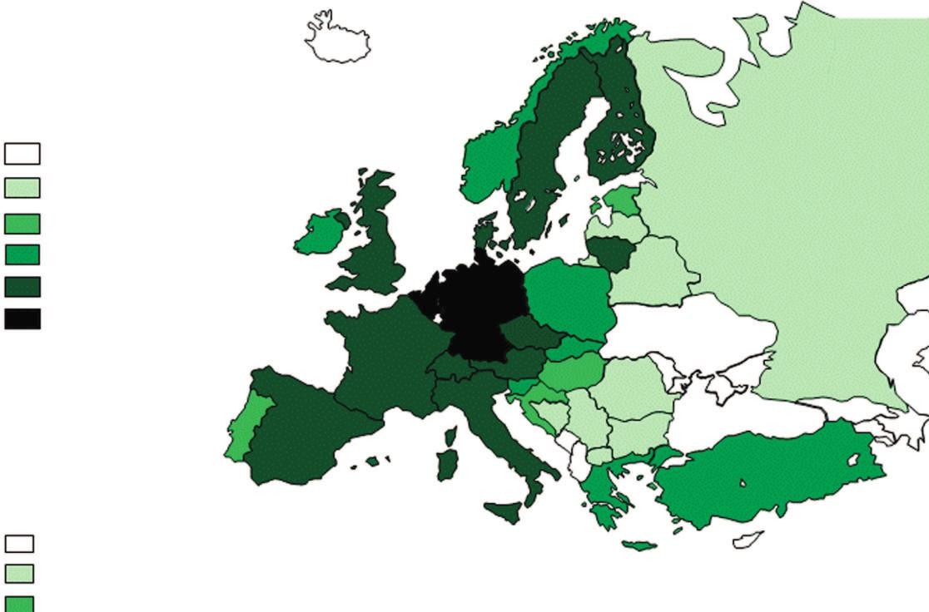
ASCT in Europe (2014 Survey)
Passweg et al. BMT Feb 2016

Slide 3
Main Indication ASCT
ASCT in Europe (2014 Survey)
12000
10000
PCD
8000
NHL,HD,CLL
H S C T
6000
ST
4000
Leukemia
2000
NMD
0
90 92 94 96 98 00 02 04 06 08 10 12

Slide 4
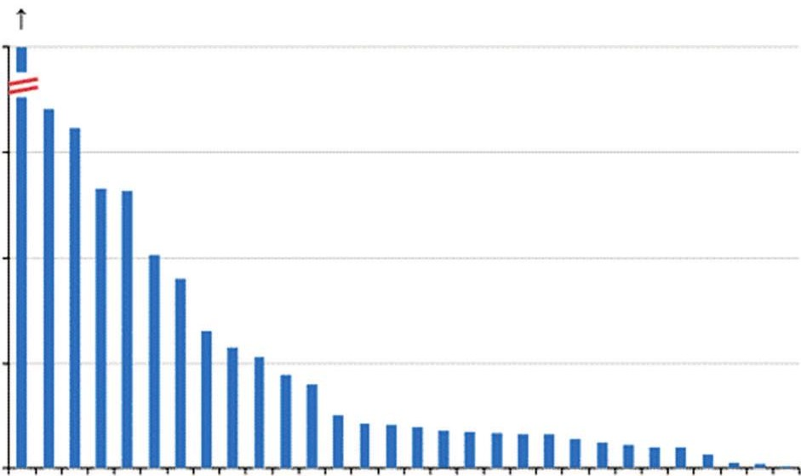



ASCT in Europe (2014 Survey)
Passweg et al. BMT Feb 2016

Slide 5
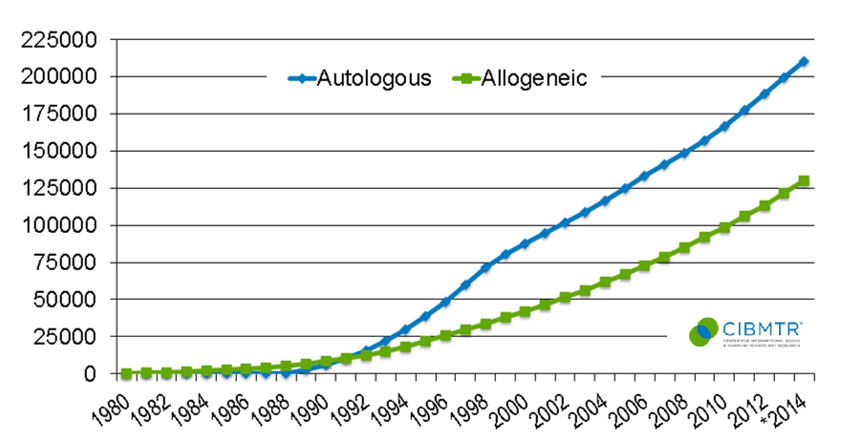
Cumulative Plot of Transplant Recipients in the US by Transplant Type
Cumulative plot of transplant recipies in
the US by transplant type
Notes:
Slide 5: Cumulative number of transplant recipients in the US reached 340,000 in 2014.

Slide 6
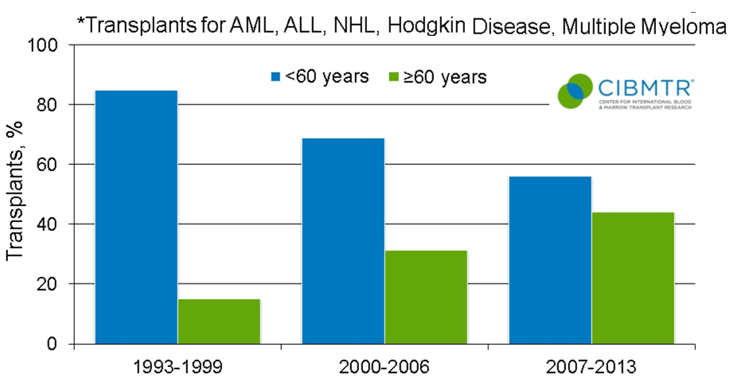
Trends in Autologous Transplants by Recipient Age*
Trends in Autologous Transplants
by Recipient Age
Notes:
Slides 10 & 11: The number of autologous and allogeneic transplants for treatment of malignant diseases in older patients continue to increase. Forty-four percent of autologous transplant recipients in 2007-2013 were older than 60.

Slide 7
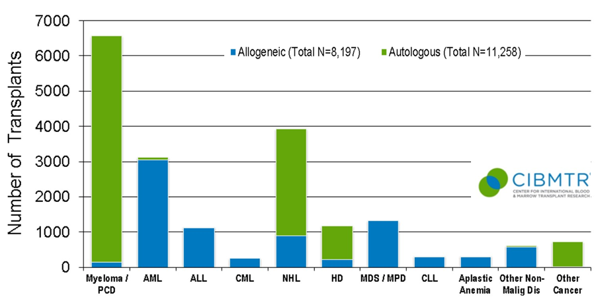
Indications for Hematopoietic Stem Cell Transplants in the US, 2013
Indications of Hematopoetic Stem Cell
Transplants İn the US, 2014
Notes:
Slide 12: The most common indications for HCT in the US in 2013 were multiple myeloma and lymphoma, accounting for 52% of all HCTs. AML and myelodysplasia are the most common indications for allogeneic transplants accounting for 53% of allogeneic HCTs.

Slide 8


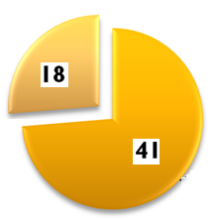
Hematopoetic Stem Cell Activity in TURKIYE, 2000-2012
Annual increase in HSCT, 2000-1012
Pediatric
Adult
Teams/Centers, 2012

Slide 9
Hematopoetic Stem Cell Activity in TURKIYE, 2008-2012
Pediatric
Adult
Totally

Slide 10
Today’s Topics
Autologous HSC Transplantation
  Evident based History for LLM
  Transplantation Procedures
  Pre-transplant assessment
  General eligibility criteria for Auto-HSCT
  Disease Related Indications & Outcomes
Improving outcomes of ASCT
  Pre-transplant induction therapies
  High-dose chemotherapy regimens
  Post-transplant maintenance treatments
Improving tolerability of ASCT
  Stem cell dose
  Growth factor support
  Prophylactic therapy
Expanding eligibility to ASCT
  Auto-Transplant in elderly patients

Slide 11
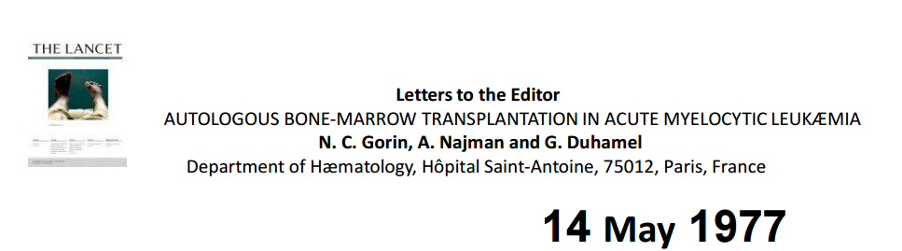
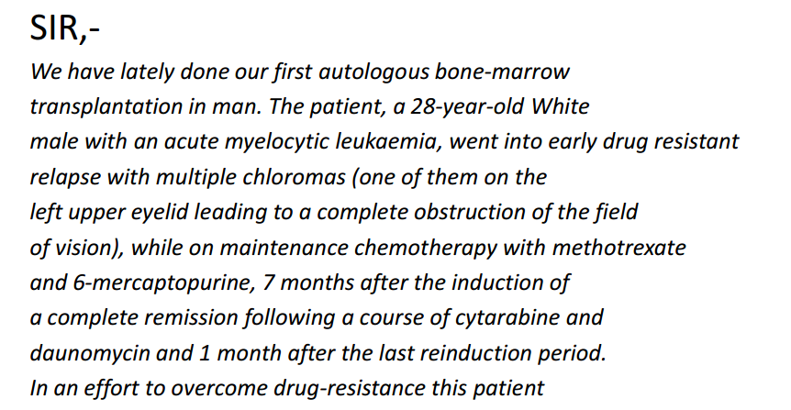
First Response to The Autologous-BMT

Slide 12
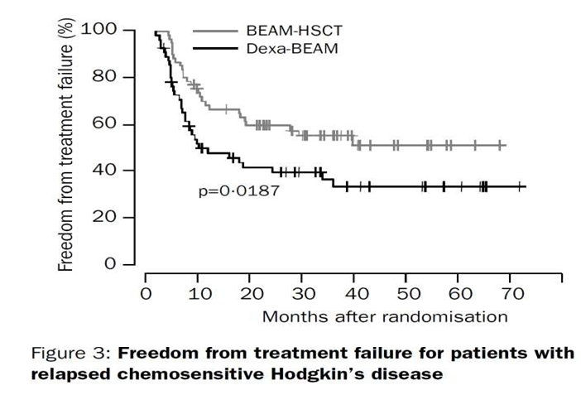

Hematopoietic Stem Cell Transplantation for Hodgkin Lymphomas:
Schmitz et al, Lancet 2002
TX

Slide 13
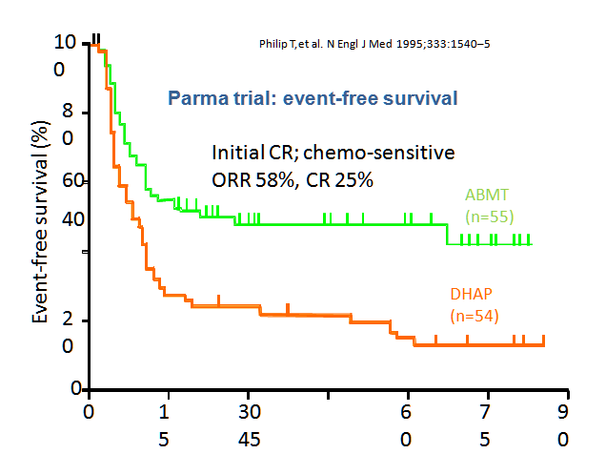
Hematopoietic Stem Cell Transplantation for Diffuse Large B Cell Lymphomas:
Relapsed DLBCL (n=109)
no previous bone marrow infiltration
TX
DHAP and if PR
Randomization
Auto-BMT
More DHAP

Slide 14

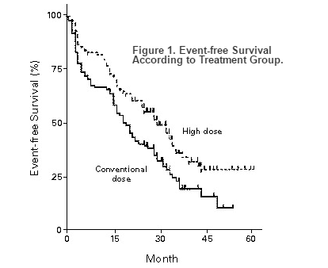
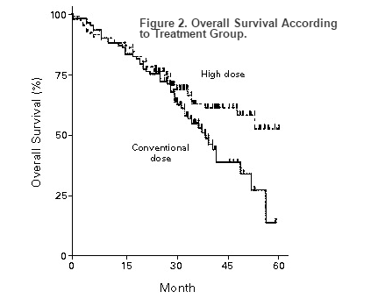
Hematopoietic Stem Cell Transplantation for Multiple Myeloma:
A significant survival advantage of high-dose chemotherapy (HDC) and auto-HCT over conventional chemotherapy was reported in the pivotal IFM trial in 1996
TX
As CONCLUSION:
High-dose therapy combined with transplantation improves the response rate, event-free survival, and overall survival in patients with myeloma.

Slide 15
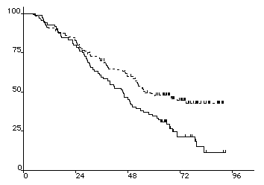
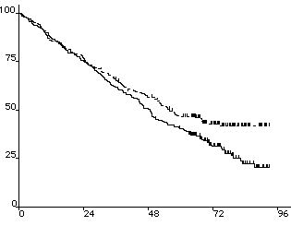
IFM 94 : Overall survival
Hematopoietic Stem Cell Transplantation for Multiple Myeloma:
Single versus Tandem Auto-SCT,
TX
P < 0.01
P < 0.001
Tandem
MM del(17p) and/or t(4;14) and not CR after
Single
Author
No. Pts
RR (%)
EFS mos.
OS mos.
Attal et al, NEJM 2003
42 vs 50* (p=NS)
48 vs 58 (p=0.01)
399
25 vs 30 (p=0.03)

Slide 16
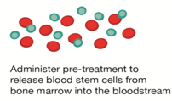




Autologous Haematopoietic Stem Cell Transplantation
Autologous HSC Transplant Procedure
General wiev to Auto-SCT
Mobilisation
Conditioning
Apheresis
HSC Infusion
Aplastic Phase
RECOVERY

Slide 17
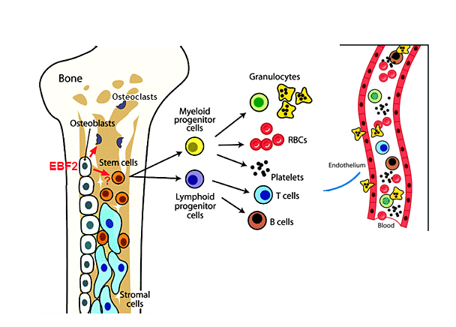
What are the Hematopoetic Stem Cells?
Autologous HSC Transplant Procedure
General wiev to HSCT

Slide 18
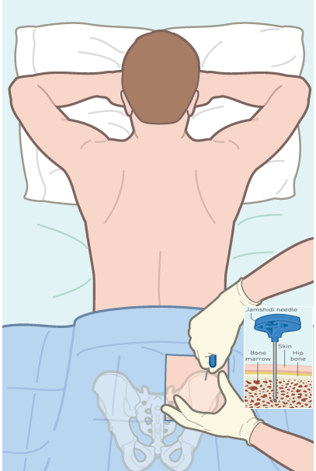
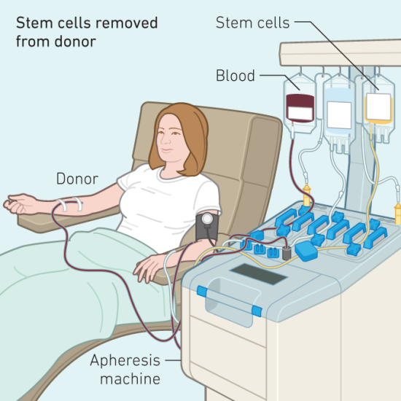
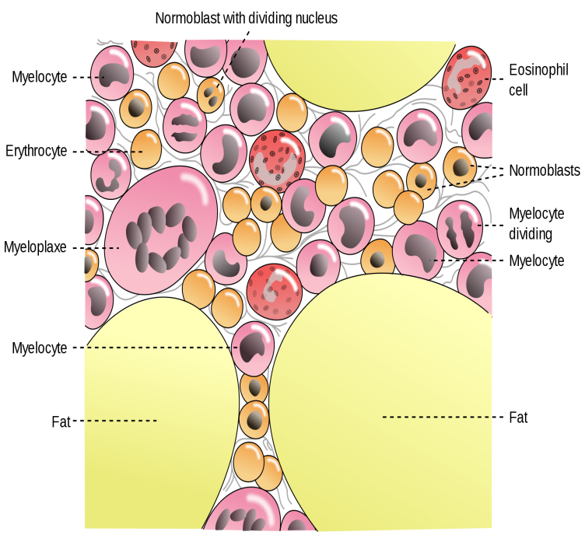
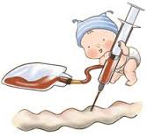
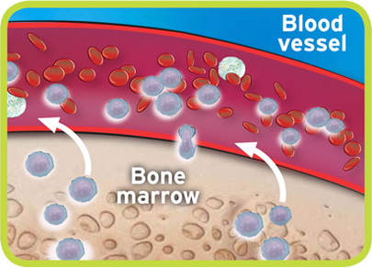
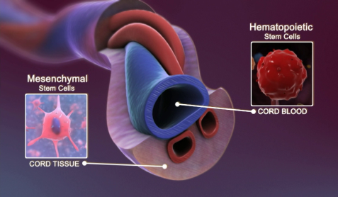
Sources of Stem Cells
Autologous HSC Transplant Procedure
General wiev to HSCT
Bone Marrow
Peripheral Blood
Cord Blood

Slide 19
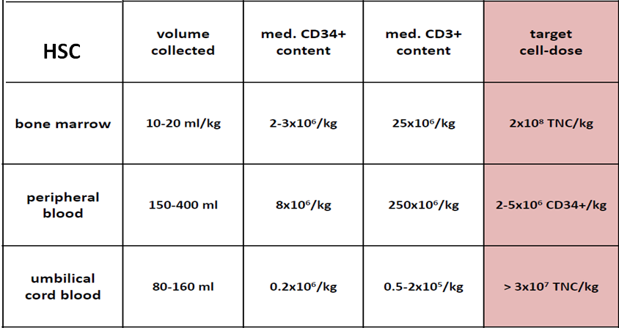
Autologous HSC Transplant Procedure
Stem Cell Sources

Slide 20


What do we need to consider pre Auto- HSCT?
Patient Issues
What does the patient want?
To make an informed
decision they need to be fully informed
Patient Issues
Comorbidities & Risks
EBMT risk score (Age,PS,etc)
Clinical Elgibility criterias
Comorbidity index HRCT-CI,
Disease issues
Indication status
Chemo-sensitivity Dis.
Alternative Treatments
Life Expectancy
Urgency
Patient Issues
Social Circumstances
What level of support do they have?
Dependents
Distance from Hospital Finance
Patient Issues
Stem Cell Source
Suitable BM (Remission?)
Source of Stem Cell(BM,PB,)
What is the CMV status?
Patient Issues
Other:
Smoking
Alcohol
Other recreational drugs
Notes:
All HCT donors who are either anti-HBc positive or HBsAg positive and all HCT candidates who are anti-HBc positive but negative for HBsAg and anti-HBs should undergo viral load testing for hepatitis B virus. Additional recommendations for the evaluation and management of HCT candidates in the setting of positive serologic or viral load testing results from the donor or recipient can be found in the 2009 international guidelines^{[1]}.
¶ In addition to serologic testing for hepatitis C, all HCT candidates should undergo a careful history and physical examination for risk factors, signs, and symptoms of hepatitis C, as well as serum alanine aminotransferase (ALT) testing. Hepatitis C viral load testing should be performed in all HCT donors as well as in HCT candidates at increased risk for hepatitis C infection, including those who have received a transfusion with blood not tested for hepatitis C (eg, before 1992 in developed countries), history of IV or inhaled drug use, tattoos, or unexplained elevation of serum ALT. Viral load testing should also be performed in HCT candidates with positive hepatitis C serologic testing. Additional recommendations for the evaluation and management of HCT candidates in the setting of positive serologic or viral load testing results from the donor or recipient can be found in the 2009 international guidelines^{[1]}.
Δ West Nile virus antibody testing and T. cruzi antibody testing of HCT donors is required in some states in the United States.
◊ Serum Aspergillus galactomannan antigen testing should be performed in HCT candidates who have a past history of invasive aspergillosis and in others who are high-risk for invasive aspergillosis.
§ Screening for TB includes obtaining a history of prior active TB or exposures to individuals likely to have TB, as well as results of previous tuberculin skin tests or interferon-gamma release assays.
¥ The southeastern United States is an endemic region; testing should therefore be performed in individuals who have resided in or traveled to this region. If Strongyloides antibody testing is not available or if active disease with strongyloidiasis is suspected in a seronegative HCT candidate, three stool samples should be sent for ova and parasites.
‡ Reactivation of endemic mycoses following HCT is very rare, even in endemic regions.
† Donors or recipients who were born, received a blood transfusion, or ever lived for six months or longer in a region that is endemic for Chagas disease (eg, parts of South and Central America and Mexico) should undergo serologic testing for T. cruzi IgG. Individuals who have lived for less than six months in an endemic are but who had high-risk living conditions (eg, lived in dwellings with mud walls, unmilled logs and sticks, or a thatched roof), should also undergo serologic testing. Individuals whose mother was born in an endemic region or who has a suggestive history (eg, cardiomegaly and dysrhythmias) should be screened due to the risk of congenital transmission. Since there is no gold standard for serologic testing, screening should be performed with at least two serologic tests (enzyme immunoassay, indirect hemagglutination, indirect fluorescent antibody, or radioimmunoprecipitation assay).
** Donors who have traveled to a malaria-endemic area should defer donation for one year following their return. Former or current residents of endemic areas should defer donation for three years. If this is not feasible, the donor should be treated empirically for malaria prior to donation. If the donor is diagnosed with active malaria, collection of stem cells should be delayed if possible until treatment has been completed and negative confirmatory testing obtained. If this is not feasible, preemptive treatment of the HCT recipient is reasonable, although there is no evidence regarding the safety or efficacy of this approach.

Slide 21
PRETRANSPLANT ASSESSMENT (Clinical)
Autologous HSC Transplant Procedure
A pretransplant assessment must establish the extent of disease and provide information about the individual's comorbidities that are likely to have an impact on outcomes,
General eligibility criteria for autologous hematopoietic cell transplantation
● Age —
The initial studies that demonstrated a benefit from auto-HCT were performed in younger adults (<65 years), subsequent studies suggest that the benefit from auto-HCT is also seen in older adults.
●Detailed history –
While all elements of the patient's history are pertinent, issues particularly relevant to potential complications include: performance status prior therapies, drug allergies (especially to antibiotics), and prior infections.
●Physical examination
with particular attention to the oral cavity, for example for abscesses or tooth decay (a potential source for infection to treat prior to auto-HCT), and central nervous system.
●Laboratory studies
include complete blood count with differential, chemistries with liver and renal function and electrolytes,
24-hour urine collection for the measurement of creatinine clearance (especially in patients with multiple myeloma),
● Electrocardiogram & ECHO or MUGA, Chest radiograph & Pulmonary function test, including DLCO

Slide 22
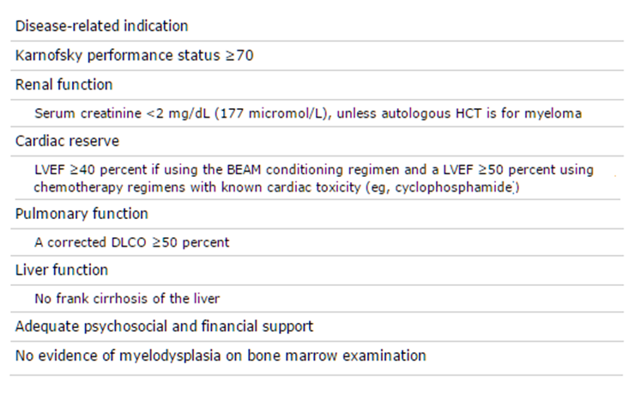
General eligibility criteria for autologous hematopoietic cell transplantation
Autologous HSC Transplant Procedure
PRETRANSPLANT ASSESSMENT (Laboratory)
DLCO: diffusing capacity of the lungs for carbon monoxide.
Seropositivity for HIV does not exclude patients from undergoing auto-HCT
Notes:
All of the factors described above are considered when making a decision as to who is the best candidate to undergo auto-HCT, who will get the best benefit from the transplant, and whether the risks are reasonable to assume. It is important to evaluate the overall clinical situation of the patient in parallel to assessing the disease state and indication for transplant, and the long term and short term benefits and risks of transplant. Despite the increasing availability of guidelines for the treatment of hematologic malignancies, there must remain room for individualization of treatment. In particular, patient preference must be considered with different treatment options (eg, standard chemotherapy versus high dose chemotherapy followed by auto-HCT), some of which result in a higher recurrence risk at the gain of less toxic initial therapy while others result in a higher risk of acute and/or late complications. Often, the final decision is based upon the transplant physician's clinical judgment based on their critical understanding of published data, their personal experience, and their understanding of the patient's preference.
— There are few strict rules about who is or is not an appropriate candidate for autologous hematopoietic cell transplantation (auto-HCT). Instead, clinical judgment should be used for the majority of patients as to whether the risks with the transplant outweigh the benefits. Risk factors include and are based on performance status, comorbidity, age, compliance, extent and status of disease, as well as the sensitivity of the tumor to standard therapy. All of these factors should be considered when determining appropriateness of auto-HCT for an individual. The final decision on transplant eligibility should be made based on a risk-benefit assessment, and the needs and wishes of the patient.
In general, patients are eligible for auto-HCT if they meet criteria for (table 4):
●A disease-related indication – An underlying hematologic disease at a stage likely to benefit from auto-HCT. (See 'Disease-related indications' above.)
●Functional capacity – An ECOG performance status ≤2 or Karnofsky performance status ≥70 (table 1).
●Renal function – Serum creatinine <2 mg/dL (177 micromol/L) or Cr CL >50, unless auto-HCT is for plasma cell dyscrasia. (See 'Renal dysfunction' above.)
●Cardiac reserve – Left ventricular ejection fraction (LVEF) ≥40 percent if using the BEAM conditioning regimen and a LVEF ≥50 percent using chemotherapy regimens with known cardiac toxicity (eg, cyclophosphamide-based regimens) or total body irradiation (TBI)-based conditioning regimens. (See 'Cardiac disease' above.)
●Pulmonary function – A corrected DLCO ≥50 percent. (See 'Pulmonary dysfunction' above.)
●Liver function – Both myeloma and lymphoma patients with frank cirrhosis of the liver are excluded from auto-HCT because of excessive mortality and morbidity. (See 'Liver dysfunction'above.)
●Support structure – Adequate psychosocial and financial support. (See 'Race, social, and economic issues' above.)
●Other factors – Seropositivity for HIV does not exclude patients from undergoing auto-HCT [23]. Patients with myelodysplasia do not benefit from auto-HCT because risk for developing secondary AML and doing poorly is too high. (See 'Risk of secondary cancers post-transplant' above and 'Infectious disease status' above.)

Slide 23
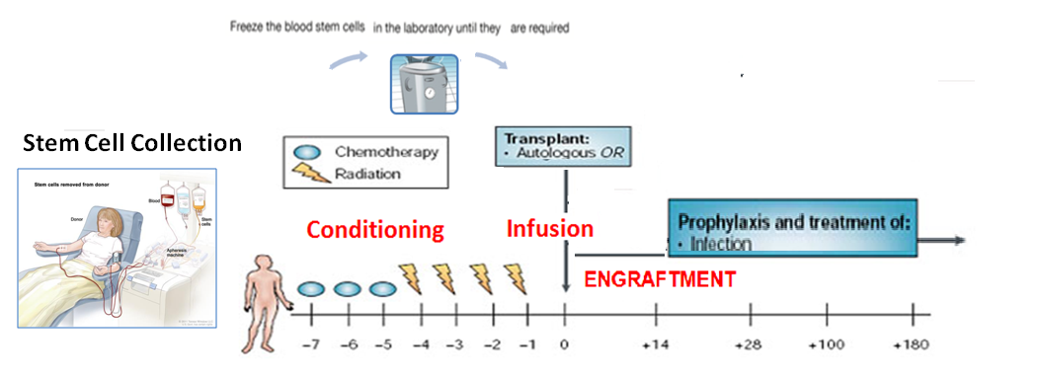
Autologous HSC Transplant Procedure
For treatment of hematologic malignancies,
Patient’s Bone marrow must be uninvolved by tumor cells
Patient must be able to tolerate high dose chemotherapy
autologous transplantation is only indicated if patient has chemotherapy sensitive disease
❖
⬥
◆

Notes:
While the dose used in ASCT completely destroys tumor cells, it removes bone marrow tissue irreversibly, we have support BM tissue after tümora-ablative conditioning therapy

Slide 24
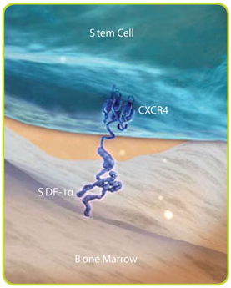
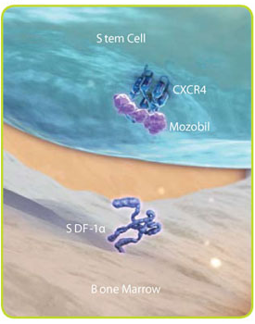

Autologous HSC Transplant Procedure
-Stem Cell Mobilization Agents & Mechanisms
GCSF
Prelifaxor
HSC mobilisation
G-CSF
adhesive interactions between HSC and BM:
cell adhesions molecules
PMN
HSC
AMD 100
CD44
CXCR4
HSC
CD62L
VLA-4
NE CG MMP9
CD44
CXCR4
Kit
CD62L
Kit
VLA-4
HA
SDF-1
HA
SDF-1
CD62
KL VCAM-1
CD62
KL VCAM-1
Extracellular matrix
Extracellular matrix
Extracellular matrix
osteoblast
osteoblast
osteoblast
osteoblast
Pruijt, Fibbe et al. 1999; Hattori et al. 2002
De Clercq E. The bicyclam AMD3100 story. Nat Rev Drug Discov 2003; 2: 581–587
MP Rettig, G Ansstas and JF DiPersio. Leukemia. 2011 Sep 2. doi: 10.1038/leu.2011.197

Slide 25
G-CSF
Filgrastim (G-CSF ) (Success rate: 70-95%)
Multi-step interactions in the marrow microenvironment lead to stem cell mobilization
.
Pain, headaches, arthralgias, malaise, fatigue, insomnia, and nause, Transient increase in ALP, ALT, LDH, Na and transient decrease in potasium, spontaneous splenic rupture
Increased spleen size in length (in 95% of pts) (mean increase,13%) but 10 days after G-CSF administration, spleen size returns to baseline.
CD-34+
Start leukaphaeresis on day 4,5
  Minimum number of CD34+ cells: 2 x 10⁶ /kg
G-CSF 10 -25 mcg/kg day , BID
circulating CD34 + cells
gradient> 20 / ϥL
1
2
11
3
4
5
6
7
8
9
10
12
13
14
Notes:
Models of HSPC mobilization by G-CSF and inhibitors of CXCR4 and VLA-4. (a) Bone marrow environment at baseline. HSPCs in the
endosteal niche are likely in close contact with osteoblasts and nestin? MSCs, both of which express numerous HSPC retention factors, including
CXCL12, VCAM-1 and SCF. The perivascular niche is more distant from the endosteum and includes both nestin? MSCs and CXCL12 abundant
reticular cells. Cells of the monocytic lineage support the maintenance of osteoblasts and MSCs. b-Adrenergic nerve cells of the sympathetic
nervous system regulate MSC proliferation and induce circadian oscillations of CXCL12 expression. (b) Model of G-CSF-induced HSPC
mobilization. Cells of the monocytic lineage express the receptor for G-CSF and provide factors that support the survival of MSCs and osteoblasts.
Upon 4–5 days of stimulation with G-CSF, the monocytes/macrophages disappear, leading to the loss of osteoblast lineage cells and reduced
expression of CXCL12, VCAM-1 and SCF on MSCs. Reduced expression of these important HSPC retention factors is also observed following
G-CSF signaling through b-adrenergic nerve cells. The net effect of these signaling cascades is the disruption of HSPC retention interactions and
mobilization of HSPCs into the peripheral blood. (c, d) Model of HSPC mobilization by inhibitors of CXCR4 or VLA-4. Targeted disruption of the
interaction of CXCR4 or VLA-4 with their ligands results in the rapid (within hours) and reversible mobilization of HSPCs into the peripheral
circulation. An additive or synergistic affect on HSPC mobilization is observed when a CXCR4 inhibitor is combined with a VLA-4 antagonist,
G-CSF or their combination. When used alone, inhibitors of CXCR4 and VLA-4 mobilize fewer HSPCs than G-CSF.
-- Stem cells may be induced to leave the bone marrow by administration of medications that are termed mobilizaiton agents. The most commonly used agent is filgrastim, also known as granulocyte colony stimulating factor. Filgrastim has a number of effects on the marrow environment including disruption of the CXCL4/CXCL12 axis, proliferation of HSC, and alterations in the adhesion factors VLA-4 and selectins as well as other effects. In total, its protean effects on the marrow microenvironment lead to stem cell mobilization after approximately 5 days of administration. The side effects are well known and include bone pain in approximately 100% of donors. Most donors experience flu-like symptoms most likely due to cytokine release. Filgrastim administration may be associated with significant leukocytosis which under the righ conditions can increase the risk of splenic rupture. This leukocytosis may also lead to a pro-thrombotic state where donors with underlying cardiac or cerebrovascular disease are more likely to experience thrombosis. Finally, there have been some reports of increased risk of development of acute myeloid leukemia in related donors who received filgrastim, however this risk may be explained by environmental or genetic susceiptibilities as well.
More recently, Plerixafor has been introduced for mobilizaiton of stem cells. Plerixafor is a reversible inhibitor of the CXCR4/CXCL12 axis that is usually administered in conjunction with filgrastim. This agent does not cause bone pain but is associated with abdominal discomfort in some patients as well as leukocytosis and potential for splenic rupture. The introduction of Plerixafor has decreased the number of patients who experience mobilization failure.
There are other agents in development for stem cell mobilization but are not currently FDA approved for this indication.

Slide 26
G-CSF & Chemo
(G-CSF & Chemo) (Success rate: 70-95%)
.
Mostly use in chemosensitive cancer patients
Not only mobilise HSC but also eradicate tumoral mass
Solid tumors, Lymphomas, Leukemias, and Myeloma
Cy Treatment may also treat Autoimmune Disease
CD-34
G-CSF
CY
(Cy+ G-CSF)
Cy: 4gr/m2 and GCSF : 10-25 mcg/kg
1
2
3
4
5
1
2
4
5
6
7
8
9
10
3
11
12
13
14
15
16
17
18
19
Notes:
Models of HSPC mobilization by G-CSF and inhibitors of CXCR4 and VLA-4. (a) Bone marrow environment at baseline. HSPCs in the
endosteal niche are likely in close contact with osteoblasts and nestin? MSCs, both of which express numerous HSPC retention factors, including
CXCL12, VCAM-1 and SCF. The perivascular niche is more distant from the endosteum and includes both nestin? MSCs and CXCL12 abundant
reticular cells. Cells of the monocytic lineage support the maintenance of osteoblasts and MSCs. b-Adrenergic nerve cells of the sympathetic
nervous system regulate MSC proliferation and induce circadian oscillations of CXCL12 expression. (b) Model of G-CSF-induced HSPC
mobilization. Cells of the monocytic lineage express the receptor for G-CSF and provide factors that support the survival of MSCs and osteoblasts.
Upon 4–5 days of stimulation with G-CSF, the monocytes/macrophages disappear, leading to the loss of osteoblast lineage cells and reduced
expression of CXCL12, VCAM-1 and SCF on MSCs. Reduced expression of these important HSPC retention factors is also observed following
G-CSF signaling through b-adrenergic nerve cells. The net effect of these signaling cascades is the disruption of HSPC retention interactions and
mobilization of HSPCs into the peripheral blood. (c, d) Model of HSPC mobilization by inhibitors of CXCR4 or VLA-4. Targeted disruption of the
interaction of CXCR4 or VLA-4 with their ligands results in the rapid (within hours) and reversible mobilization of HSPCs into the peripheral
circulation. An additive or synergistic affect on HSPC mobilization is observed when a CXCR4 inhibitor is combined with a VLA-4 antagonist,
G-CSF or their combination. When used alone, inhibitors of CXCR4 and VLA-4 mobilize fewer HSPCs than G-CSF.
-- Stem cells may be induced to leave the bone marrow by administration of medications that are termed mobilizaiton agents. The most commonly used agent is filgrastim, also known as granulocyte colony stimulating factor. Filgrastim has a number of effects on the marrow environment including disruption of the CXCL4/CXCL12 axis, proliferation of HSC, and alterations in the adhesion factors VLA-4 and selectins as well as other effects. In total, its protean effects on the marrow microenvironment lead to stem cell mobilization after approximately 5 days of administration. The side effects are well known and include bone pain in approximately 100% of donors. Most donors experience flu-like symptoms most likely due to cytokine release. Filgrastim administration may be associated with significant leukocytosis which under the righ conditions can increase the risk of splenic rupture. This leukocytosis may also lead to a pro-thrombotic state where donors with underlying cardiac or cerebrovascular disease are more likely to experience thrombosis. Finally, there have been some reports of increased risk of development of acute myeloid leukemia in related donors who received filgrastim, however this risk may be explained by environmental or genetic susceiptibilities as well.
More recently, Plerixafor has been introduced for mobilizaiton of stem cells. Plerixafor is a reversible inhibitor of the CXCR4/CXCL12 axis that is usually administered in conjunction with filgrastim. This agent does not cause bone pain but is associated with abdominal discomfort in some patients as well as leukocytosis and potential for splenic rupture. The introduction of Plerixafor has decreased the number of patients who experience mobilization failure.
There are other agents in development for stem cell mobilization but are not currently FDA approved for this indication.

Slide 27
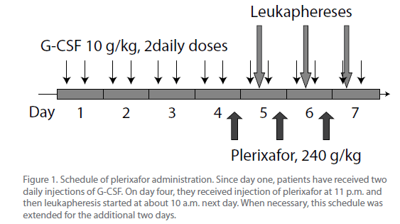
Prelixafor /AMD-100
Plerixafor (Success rate: 70-80%) after any failure
Reversible inhibitor of the CXCR4/CXCL12 axis
    A single subcutaneous dose of plerixafor at 160–240 μg/kg: 6- to 10-fold increase in CD34⁺ cell, Typically administered in conjunction with filgrastim
    Side effects include abdominal discomfort, leukocytosis, potential for splenic rupture (rare)
De Clercq E. The bicyclam AMD3100 story. Nat Rev Drug Discov 2003; 2: 581–587
MP Rettig, G Ansstas and JF DiPersio. Leukemia. 2011 Sep 2. doi: 10.1038/leu.2011.197
Notes:
Mozobil is an inhibitor of the CXCR4 chemokine receptor and blocks binding of its cognate ligand stromal cell derived factor-1 (SDF-1α). SDF-1α and CXCR4 are recognized to play a role in the trafficking and homing of hematopoietic stem cells (HSC) to the marrow compartment.
Accidental finding: leukocytosis after a single intravenous dose of plerixafor
Originally tested clinically as an agent for the treatment of HIV infection by blocking the HIV entry into CD4⁺ T cells

Slide 28
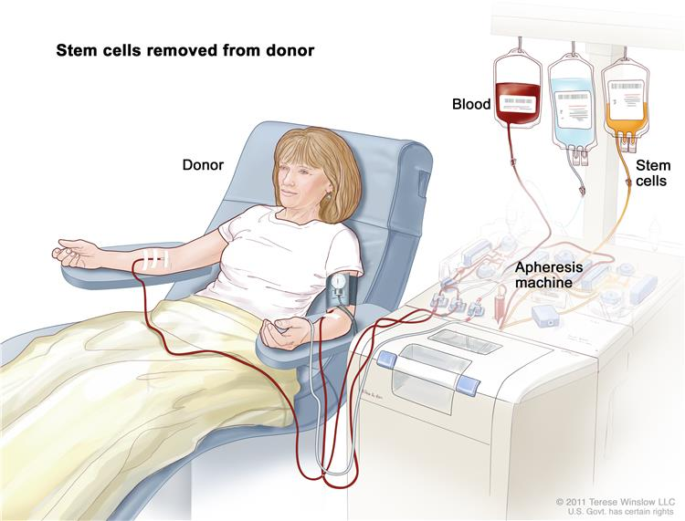
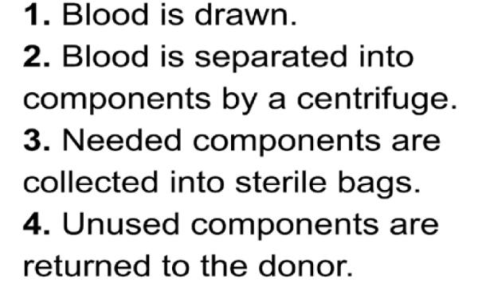
Apheresis Procedure
Autologous HSC Transplant Procedure
Stem Cell Mobilization and Collection
Mobilised Autologous Stem Cells
Removed from patients
FOR The autologous Graft
AT LEAST 2X106. CD34 /KG
OPTIMUM 5X106. CD34 /KG
patients
APHERESIS PROCESS
Notes:
Once it has been determined that a patient is circulating sufficient CD34+ cells to undergo apheresis, the collection procedure begins. Patients may donate autologous cells via peripheral IV’s or via central venous catheter with two lumens. Whole blood is removed from the patient and flows through the apheresis machine. During apheresis the stem cell layer is separated from the remainder of the blood and removed. The remainder of the blood is returned to the patient and the stem cells are stored using 10% DMSO to prevent cell damage during the thaw procedure. This is a cryopreserved stem cell product.

Slide 29
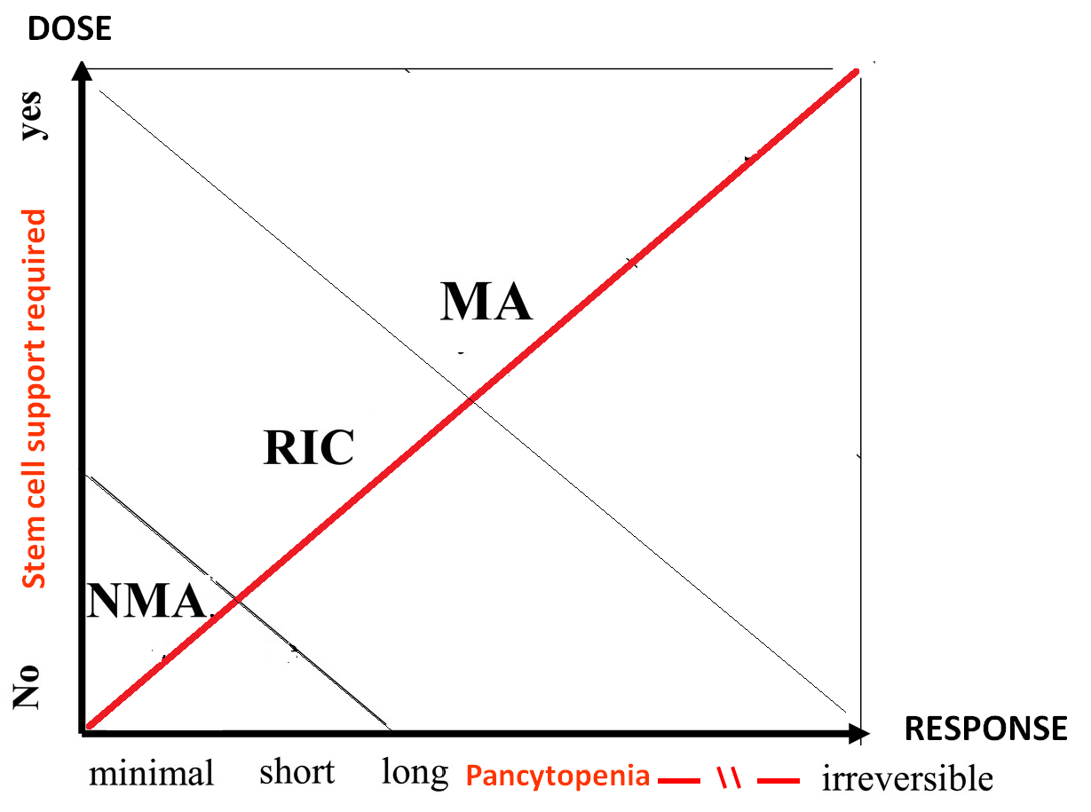

Autologous HSC Transplant Procedure
Conditioning Therapy
Dose & Response Curve with Cytotoxic Chemothrapy
MAC Auto for Tumoral Eradication
MAC Allo for BM Ablation
Cytotoxic Chemotherapy
RIC Allo for GVL
Bacigalupo,
Biol Blood Marrow Transplant.
2009 Dec; 15(12): 1628–1633.
Results in reversible myelosuppression (usually within 28 d) when given without stem cell support
TUMORAL CHEMOSENSITIVITY

Slide 30
Autologous HSC Transplant Procedure
❖ Conditioning Therapy
The first stage of the transplant.
May be given in one dose or over several days.
........................................................
Necessary for:
  Destroying remaining cancer cells
  Creating room in the bone marrow for the transplanted stem cells
  ......................................................................................
Conditioning regimen is dependent on the type of disease, the type of
transplant, co-morbidities and age.

Slide 31
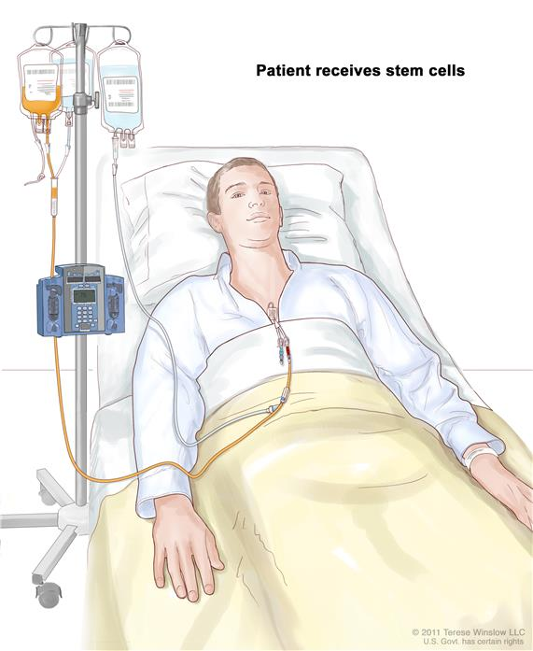
Autologous HSC Transplant Procedure
⬥ Stem Cell Re-infusion
At least 24 hour after the conditioning will be given on Day 0. These are generally given through a central line and takes approximately 30 minutes.
Stem cells are either cryopreserved or fresh.
Cryopreserved
  Usually for autologous transplants
  Most common side effects are reactions to DMSO
Fresh
  Usually for allogeneic transplants
  Administered much like a blood transfusion
  Generally better tolerated than frozen cells.

Slide 32
Stem cell transplantation
Autologous HSC Transplant Procedure
 ENGRAFTMENT
Definition of engraftment
The stem cells of the donor have been taken up by the patient´s bone marrow (”have engrafted”)
Neutrophils
Day, 12
0,5 x
10⁹/L
5
10
days
15
20
Conditioning
Infusion of graft
The first of three days with neutrophil count> 0.5 x 10⁹/L

Slide 33
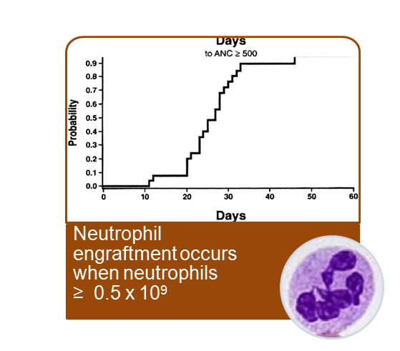
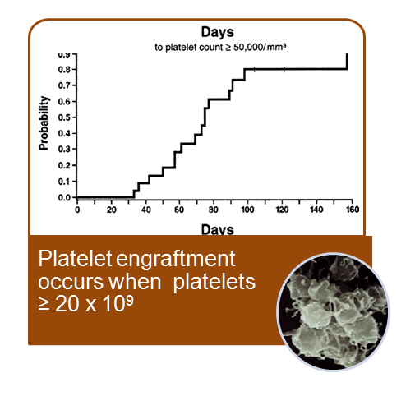
Autologous HSC Transplant Procedure
ENGRAFTMENT
Haematopoietic Reconstitution
First of three consecutive days with the indicated blood cell levels:
  Neutrophils > 0.5 x 10⁹/L
  Leucocytes > 1.0 x 10⁹/L
  Platelets (without transfusion) > 20 x 10⁹/L
  Platelets (without transfusion) > 50 x 10⁹/L
  Without transfusion: no transfusions for at least
  seven days before reconstitution is recorded
Thomson B G et al. Blood 2000;96:2703-2711

Slide 34
Autologous HSC Transplantation
DISEASE-RELATED INDICATIONS
Autologous hematopoietic cell transplantation (auto-HCT) is most commonly performed for the management of patients with
Hematologic Malignacies
  Multiple myeloma,
  Non-Hodgkin lymphoma,
  Hodgkin lymphoma.
Solid Tumors,
Autoimmune Diseases
There are no accepted guidelines regarding indications for auto-HCT and recommendations regarding indications for auto-HCT differ between transplant centers [1].

Slide 35
Autologous HSC Transplantation
DISEASE-RELATED INDICATIONS
In general, auto-HCT may be considered in the following settings:
● Acute myeloid /Lymphoid leukemia – As post-remission therapy in patients in first remission.
● Hodgkin lymphoma – Treatment of chemotherapy-sensitive relapsed disease.
● Diffuse large B cell lymphoma – Treatment of chemotherapy sensitive relapsed disease.
● Waldenström macroglobulinemia – Treatment of chemotherapy sensitive relapsed disease.
● Follicular lymphoma – Treatment of chemotherapy sensitive relapsed disease or clinically progressive /aggressive Ds
● Peripheral T cell lymphoma – As consolidation therapy in first CR or for the treatment of sensitive relaps
● Multiple myeloma – As consolidation therapy following initial response to CT or relapsed / refractory Ds
● Mantle cell Ly – As consolidation therapy in first CR or for the treatment of chemotherapy sensitive relapsed Ds
● AL amyloidosis – As consolidation of initial response to CT or for the treatment of relapsed Ds

Slide 36
Autologous HSC Transplantation
Complications of ASCT
Majority of complications are related to side effects of high dose chemotherapy
Early complications:
DMSO TOXİCİTY
  Myelosuppression
  Nausea, vomiting, diarrhea
  Melphalan-induced arrhythmias
  Febrile neutrpenia, sepsis
  Mucositis
Late complications:
  BCNU pneumonitis
  Myelodyspastic syndrome
  Infertility and other endocrine abnormalities
Notes:
With autologous transplantation, the majority of complications are directed related to the side effects of high dose chemotherapy. Early complications include myelosuppression with leukopenia and need for blood or platelet transfusions. Most patients develop febrile neutropenia necessitating antibiotic therapy. Most infections during this period are bacterial and result from disrupted mucosal barriers. Upon recovery of peripheral blood counts, termed “engraftment,” most of these toxicities improve and fevers resolve.
Late complications of autologous transplant include late pulmonary toxicity due to BCNU administration (if applicable) and potential for damage to the bone marrow causing development of myelodysplastic syndrome. Patients may also develop infertility and other endocrine abnormalities due to high dose chemotherapy.

Slide 37
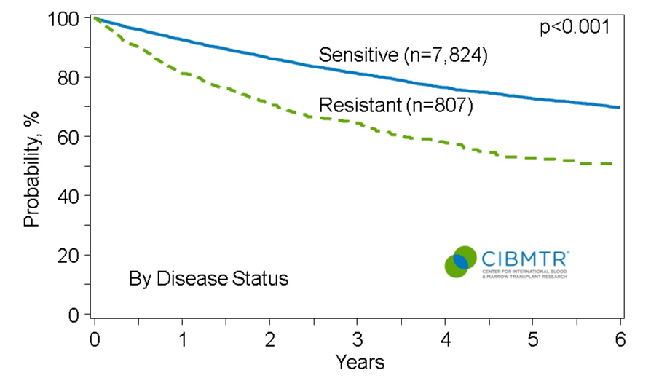
Survival after Autologous Transplants for Hodgkin Lymphoma, 2003-2013
Survival after Autologous Transplants
For Hodgkin Lymphoma, 2014
Treatment of chemotherapy-sensitive relapsed disease.
Notes:
Slide 32: Transplantation for Hodgkin Lymphoma (HL) is indicated in patients who have failed initial chemotherapy or radiation therapy. Survival after HCT for HL depends on disease response to previous salvage therapy. Among the 8,631 patients receiving autotransplants for HL between 2003 and 2013, the 3-year probabilities of survival were 81% ± 1% and 64% ± 2% for patients with chemosensitive and with chemoresistant disease, respectively.

Slide 38
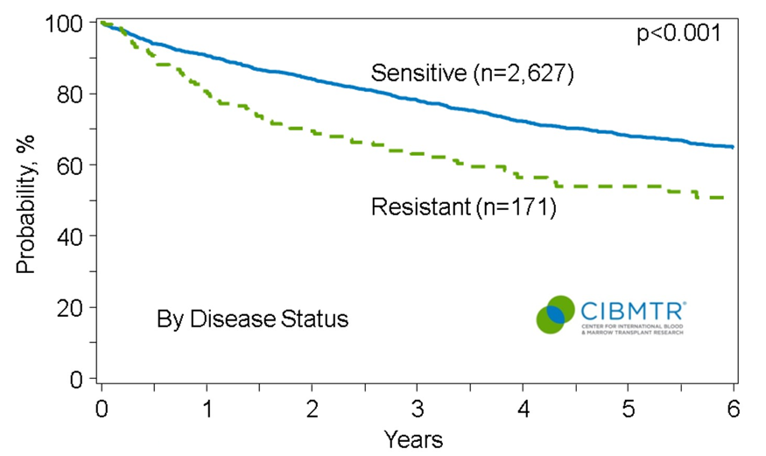
Survival after Autologous Transplants for Follicular Lymphoma, 2003-2013
Survival after Autologous Transplants
For Follicular Lymphoma, 2014
Treatment of Ch sensitive relapsed Dis. or Clinically progressive /aggressive Ds
Notes:
Slide 34: Transplantation for follicular lymphoma (FL) is generally reserved for patients with recurrent or aggressive disease. Autotransplantation is most commonly done in patients with chemosensitive disease. Among the 2,798 patients receiving an autotransplant for FL between 2003 and 2013. The 3-year probabilities of survival were 78% ± 1% and 62% ± 4% for patients with chemosensitive and chemoresistant disease, respectively.

Slide 39
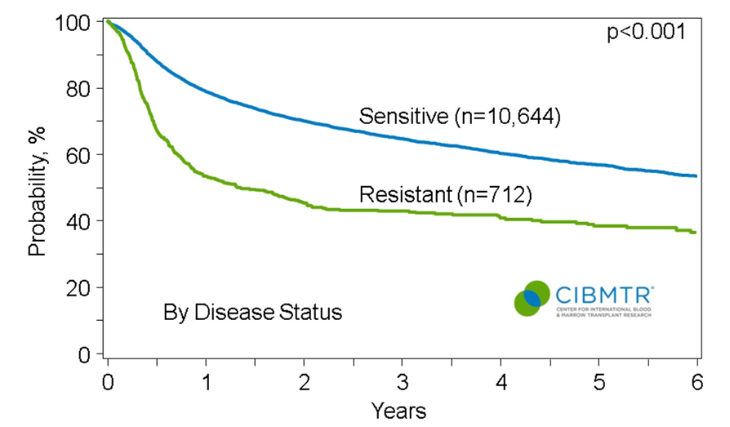
Survival after Autologous Transplants for Diffuse Large B-cell Lymphoma (DLBCL), 2003-2013
Survival after Autologous Transplants
For Diffuse Large B-Cell Lymphoma, 2014
Treatment of chemotherapy sensitive relapsed disease.
Notes:
Slides 36 & 37: Autotransplants are an accepted treatment indication for diffuse large B-cell lymphoma (DLBCL) and, similar to FL, most autotransplants are performed in patients with chemosensitive disease. Among the 11,356 patients who received an autotransplant for DLBCL between 2003 and 2013, the 3-year probabilities of survival were 64% ± 1% and 42% ± 2% for patients with chemosensitive and chemoresistant disease, respectively. Allogeneic HCT for treatment of DLBCL is performed less frequently than for FL and is generally used only in patients with aggressive disease that has been resistant to previous therapies, including autotransplants. Among the 1,040 patients who underwent an HLA-matched sibling HCT for DLBCL from 2003 to 2013, the 3-year probabilities of survival were 49% ± 2% and 25% ± 3% for patients with chemosensitive and chemoresistant disease, respectively.

Slide 40
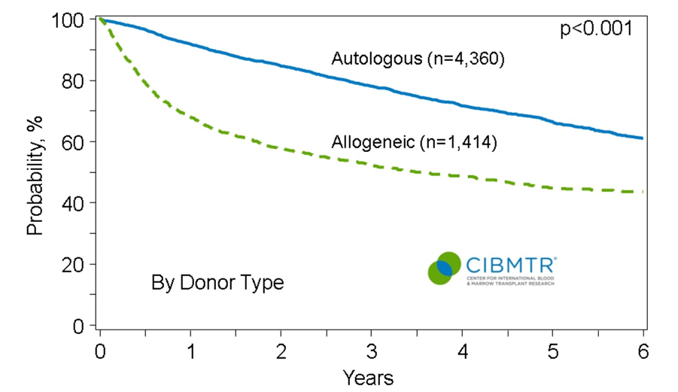
Survival after Transplants for Mantle Cell Lymphoma, 2003-2013
Survival After Transplants
For Mantle Cell Lymphoma, 2014
As consolidation therapy in first CR or for the treatment of chemotherapy sensitive relapsed Ds
Notes:
Slide 38: The optimal timing and type of HCT for mantle cell lymphoma (MCL) is not well defined. As with other mature B-cell lymphoproliferative disorders, autotransplantation is the most common transplant approach. Among the 4,360 patients who received an autotransplant for MCL between 2003 and 2013, the 3-year probability of survival was 78% ± 1%. Among 1,414 patients who underwent an allogeneic transplantation for MCL during the same period, the 3-year probabilities of survival was 52% ± 1% .

Slide 41
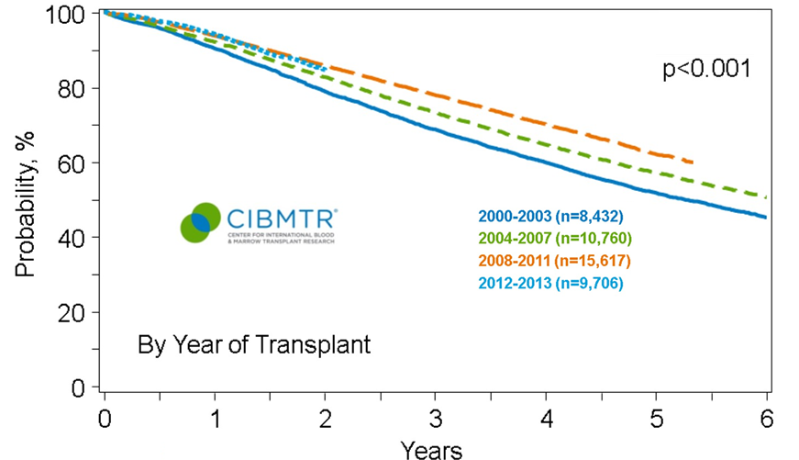
Survival after Autologous Transplants for Multiple Myeloma, 2000-2013
Survival after Autologous Transplants
For Multiple Myeloma, 2014
As consolidation therapy following initial response to CT or relapsed / refractory Ds
Notes:
Slide 40: Outcomes after autotransplants with the addition of novel agents and combinations for the treatment of multiple myeloma have significant impact survival in the last decade. The 3 year overall survival among autotransplant recipients for multiple myeloma were 68% ± 1%, 73% ± 1% and 77% ± 1% of the transplants were performed in 2000 to 2003, 2004 to 2007 and 2008 to 2011, respectively.

Slide 42
Today’s Topics
Autologous HSC Transplantation
  Transplantation Procedures
  Pre-transplant assessment
  General eligibility criteria for Auto-HSCT
  Disease Related Indications & Outcomes
Improving outcomes of ASCT
  Pre-transplant induction therapies
  High-dose chemotherapy regimens
  Post-transplant maintenance treatments
Improving tolerability of ASCT
  Stem cell dose
  Growth factor support
  Prophylactic therapy
Expanding eligibility to ASCT
  Auto-Transplant in elderly patients

Slide 43
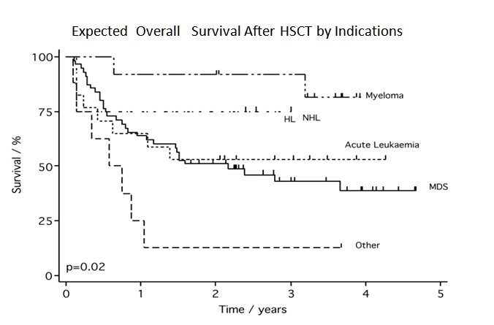
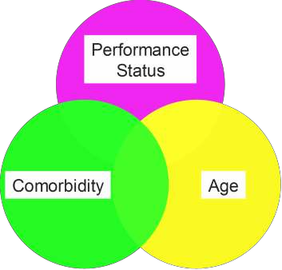
General Survival Of Hematopoietic Cancers
What is the major determinant of outcome?
Extermann M et al. Eur J Can 2000;36:453 Havlik R et al. Cancer 1994;74(s7):2101

Slide 44
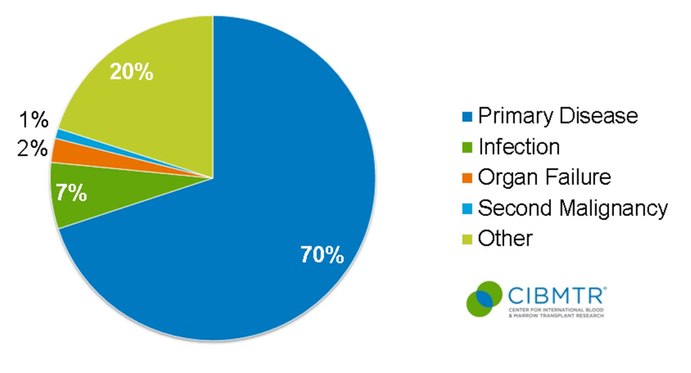
Causes of Death after Autologous Transplants done in 2012-2013
Causes of Death after Autologous
Transplantation done in 2012-2013
Notes:
Slides 13-15: After an autologous transplant, primary disease is the most commonly reported cause of death. Among allogeneic transplant recipients, unrelated donor transplants have fewer deaths related to the primary disease, however organ failure and infections are higher after unrelated donor transplants.

Slide 45
Improving outcomes of ASCT
Pre-transplant Therapies
ASCT outcomes are improved by induction with novel drugs
(proteasome inhibitors and immunomodulatory drugs).
  Adverse cytogenetic features such as t(4;14) and deletion 17p were overcome.
French 2005-01: VD produced higher CR/nCR, VGPR and ORR compared to VAD.
  These response rates remained higher post ASCT with a trend to a better 3-yr PFS in the VD arm (36 mo. vs 30 mo., p=0.064).
Spanish Myeloma Group: induction with VTD was superior to TD or
conventional chemotherapy with added bortezomib.
  CR rates favored VTD both post induction (35 vs 14 vs 21%) and post ASCT (46 vs 24 vs 38%), translating into:
  mPFS in the VTD arm of 56 vs. 36 vs. 28 mo. (p=0.01).
Pre-transplant induction therapies in Multiple Myeloma
Barlogie et al. Blood 2014;124:328

Slide 46
Improving outcomes of ASCT
Pre-transplant Therapies
Pre-transplant induction therapies in Multiple Myeloma
Intergroupe Francophone du Myélome (IFM): phase III VTD to VD.
  VTD induced higher VGPR rates (50% versus 36%, P = 0.047) but identical CR rates (14 versus 12%)
  This improvement persisted after HDT (VGPR or better: 66 versus 54%, P = 0.044)
HOVON- 65/GMMG-HD4: induction with
VAD followed by ASCT and T maintenance vs. PAD followed by ASCT and maintenance with B.
  CR rates were superior after PAD (31vs 15%; p<0.001) and B maintenance (49 vs. 34%; p<0.001).
  B during induction and maintenance abrogated the deleterious effect of del17p on both PFS and OS. Conversely, B may not always overcome the deleterious effect of deletion 17p in the non-transplant setting.

Slide 47
Improving outcomes of ASCT
Pre-transplant Therapies
Pre-transplant induction therapies in non-Hodgkin’s Lymphoma
ICE vs DHAP (CORAL): similar outcomes.
Gisselbrecht et al. 2012;30:4462
GDP vs DHAP (LY12): GDP is associated with:
  noninferior response rate
  similar transplantation rate, EFS, and OS
  less toxicity and hospitalization
  superior quality of life
Crump et al. JCO 2014;32:3490

Slide 48
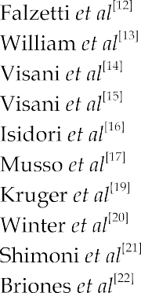


Improving outcomes of ASCT
High-dose Chemotherapy Regimens
: Non Hodgkin Lymphomas
Isidori et al. World J Stem Cells 2015;7:1039

Slide 49
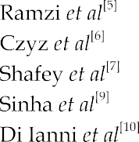

Improving outcomes of ASCT
High-dose Chemotherapy Regimens
High-dose chemotherapy regimens: Hodgkin’s
Isidori et al. World J Stem Cells 2015;7:1039

Slide 50
Improving outcomes of ASCT
Post-transplant Maintenance Treatment
: Multiple Myeloma
Consolidation and maintenance with novel drugs improves outcomes of ASCT.
GIMEMA: VTD vs TD administered pre- and post-tandem ASCT
  5-yr PFS favored VTD (62 vs. 49%; p=0.045).
  (n)CR rates favored VTD (73 vs. 61%; p=0.02)
The Nordic Myeloma group: bortezomib vs. placebo as consolidation for 5 cycles.
  PFS post ASCT 27 vs 20 mo. (p=0.05).
Thalidomide: 8 randomized studies, all showing improved PFS with
improved duration of disease control.
  In three 3 studies an OS benefit emerged.
  However, T induced peripheral neuropathy that adversely affected QoL.
Barlogie et al. Blood 2014;124:328

Slide 51
Improving outcomes of ASCT
Post-transplant Maintenance Treatment
: Multiple Myeloma
Consolidation and maintenance with novel drugs improves outcomes of ASCT.
IFM 2005-02 study: lenalidomide maintenance improved the VGPR rates from 76 to 84% (p=0.009) and improved mPFS from 23 mo. with placebo to 41 mo. with LEN (p=0.009), without difference in OS.
The CALGB 1001004 study randomized patients to lenalidomide or placebo post ASCT. LEN maintenance improved:
mTTP: 50 vs 27 mo. (p<0.001)
  OS: not reached with LEN vs 73 mo. with placebo (p=0.008).
Barlogie et al. Blood 2014;124:328

Slide 52
To improve outcomes of ASCT
:In our hands
Pre-transplant induction therapies: triplet including a novel drug (VCD x4).
High-dose chemotherapy regimens: No innovation yet (MEL200 for MM and BEAM for lymphoma)
Post-transplant consolidation and maintenance treatments in MM:
  High-risk and less than CR: second ASCT
  All other patients: 2x VCD, then LEN for 18 month if less than sCR:

Slide 53
Today’s Topics
Autologous HSC Transplantation
  Transplantation Procedures
  Pre-transplant assesment
  General eligibility criteria for Auto-HSCT
  Disease Related Endications & Outcomes
Improving outcomes of ASCT
  Pre-transplant induction therapies
  High-dose chemotherapy regimens
  Post-transplant maintenance treatments
Improving tolerability of ASCT
  Stem cell dose
  Growth factor support
  Prophylactic therapy
Expanding eligibility to ASCT
  Transplant in elderly Multiple Myeloma patients

Slide 54
Improving tolerability of ASCT
Stem Cell Dose
Doses >5x10⁶ CD34+ cells/kg are associated with:
  Faster neutrophil recovery.
  Higher median platelet counts or faster platelet recovery.
  Improved DFS and OS.
  Reduced resource utilization and cost of care.
>5x10⁶ CD34+/kg has been regarded as the ideal dose, while >2x10⁶
CD34+/kg represented the minimal cell dose.
A retrospective analysis of 2 randomized trials assessing Plerixafor confirmed better platelet engraftment dynamics and less platelet and red cell transfusions for the >5 million dose.
Duggan, et al. BMT. 2000;26:1299 - Siena JCO 2000;18:1360 - Sola et al. Hematology. 1999;4:195 - Kiss et al. BMT 1997;19:303- 310 - Schwella et al. JCO 1996;14:1114 - Blystad et al BJH 2004;125:605 - Toor et al. BJH 2004;124:769 - Limat et al. Eur J Cancer 2000;36:2360 - Schulman et al. JCO 1999;17:1227
Stiff et al. BBMT 2011;17:1146

Slide 55
Improving tolerability of ASCT
Growth factor support
Granulocyte colony-stimulating factor (G-CSF) is used after peripheral blood ASCT to further accelerate neutrophil engraftment.
The result is a small but significant reduction of:
  Number of febrile days
  I.V. antibiotic use
  Duration of hospitalization
  Costs.
Delaying the beginning of G-CSF from d1 to d5 or 7 post-ASCT, produce a small delay of neutrophil recovery that may not translate into a significant increase of duration of fever, i.v. antibiotic use, or days spent in hospital.
Pegfilgrastim is a slow clearance formulation of filgrastim administered as single dose.
Hornedo et al. BMT 2002;29:737 - Klumpp et al. JCO 1995;13:1323 - Lee et al. BJC 1998;77:1294 Linch et al. BJH 1997;99:933 - Schmitz et al. BMT 1995;15:26 - Valteau-Couanet et al. BMT 2005;36:547 - Bence-Bruckler et al. BMT 1998;22:965 - Bolwell et al. BMT 1998;21:369

Slide 56
Today’s Topics
Autologous HSC Transplantation
  Transplantation Procedures
  Pre-transplant assessment
  General eligibility criteria for Auto-HSCT
  Disease Related Indications & Outcomes
Improving outcomes of ASCT
  Pre-transplant induction therapies
  High-dose chemotherapy regimens
  Post-transplant maintenance treatments
Improving tolerability of ASCT
  Stem cell dose
  Growth factor support
  Prophylactic therapy
Expanding eligibility to ASCT
  Auto-Transplant in elderly patients

Slide 57




Expanding eligibility to ASCT
Transplant in elderly Multiple Myeloma patients
Ozaki et al. Biomed Res Int 2014

Slide 58
HDCT in the elderly with lymphoma
 | Day 100 Mortality
Finland (> 60 years) | 11 %
Mayo Clinic (≥ 60 years) | 5.4 %
MD Anderson (> 65 years) | 4 %
UCLA (> 70 years) | 17.7 %
Nebraska (> 60 years) | 5.2 %
Nice (>65 years) | 2.7 %
Memorial SKCC (≥ 60 years) | 4 %
Jantunen et al. BMT 2006;37:367 // Buadi et al. BMT 2006;37:1017 // Hosing et al. Ann Oncol 2008;19:1166 Andorsky et al. BMT 2011;46:1219 // Martin et al. Leuk Lymphoma 2015 Feb 20:1-9 // Dahi et al. BBMT 2014;20:2004-9
Notes:
The transplant age has gradually increased over the past decade

Slide 59
Improving outcomes of ASCT
Multidimensional geriatric assessment (MGA):
  MM limit age 70, extended to 75 after favorable MGA.
  Lymphoma limit age 65, extended to 70 after favorable MGA.

Slide 60
Hematopoietic SCT for Hematologic Malignancies in
Elderly: Geriatric Principles in the Transplant Clinic
Few studies exist evaluating ASCT in patients > 65 years.
No studies in patients > 75 years.
Most studies were confined to MM and lymphoma.
Elderly patients mobilize adequate numbers of stem cells.
Comorbidity risk factors associated with poor outcomes. in older adults
Elderly patients may display a modestly higher risk for specific toxicities and TRM, but older adults tolerate the procedure reasonably well.
ASCT displays a similar effectiveness in older and younger adults.
Prospective studies are needed.
Wildes et al. J Natl Compr Canc Netw 2014;12:128-36
51

Slide 61
General Survival Of Hematopoietic Cancers
What is the major determinant of outcome?
Extermann M et al. Eur J Can 2000;36:453 Havlik R et al. Cancer 1994;74(s7):2101

Slide 62
Thank you!
Any Questions?

Slide 63
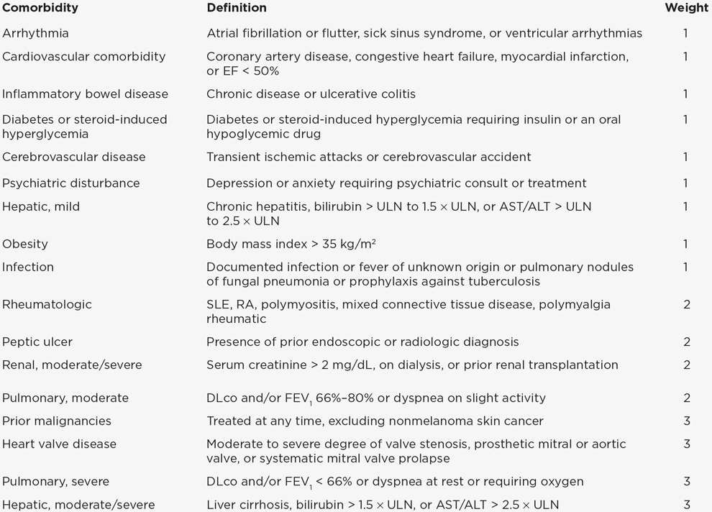
Hematopoietic cell transplantation-
Comorbidity index (HCT-CI) scoring systems
Sorror ML et al. Cancer 2008;112:1992 Sorror ML et al. J Clin Oncol 2008;26:4912
Notes:
To convert creatinine from milligrams per deciliter to micromoles per liter, multiply milligrams per deciliter by 88.4.
DLco: diffusion capacity of carbon monoxide; FEV₁: forced expiratory volume in one second; EF: ejection fraction; ULN: upper limit of normal; AST: aspartate aminotransferase; ALT: alanine aminotransferase; SLE: systemic lupus erythematosis; RA: rheumatoid arthritis; CTD: connective tissue disease.
* One or more vessel-coronary artery stenosis requiring medical treatment, stent, or bypass graft.
Data from: Sorror ML, Maris MB, Storb R, et al. Hematopoietic cell transplantation (HCT)-specific comorbidity index: a new tool for risk assessment before allogeneic HCT. Blood 2005; 106:2912.
Graphic 59272 Version 10.0

Slide 64
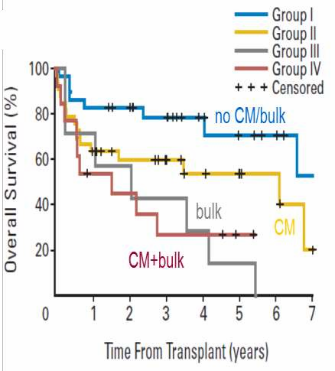
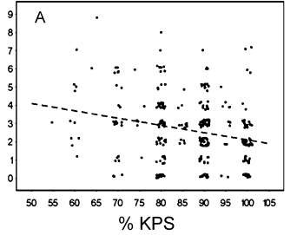

What is the major determinant of outcome?
Hematopoietic cell transplantation-
Comorbidity index (HCT-CI) scoring systems

