Slide 1

An Introduction to HSCT
Dr. Mustafa CETIN
25th November 2016.

Slide 2

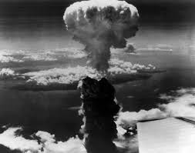
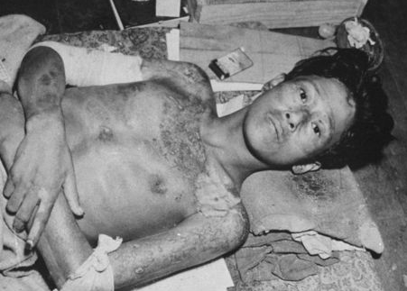
How haematopoietic stem cell transplant was born:
After the atomic bomb explosion in Japan, ending WW2, many scientists began to explore ways of protecting humans from irradiation.
Thomas ED, Blume KG. Historical markers in the development of allogeneic hematopoietic cell transplantation. Biol Blood and Marrow Transplant 1999; 5: 341–346.

Slide 3
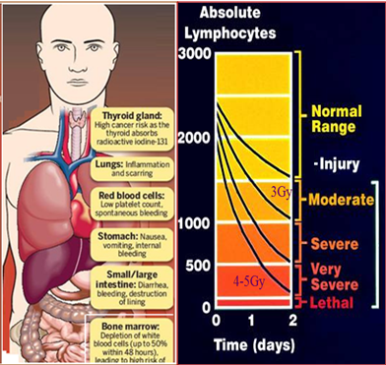
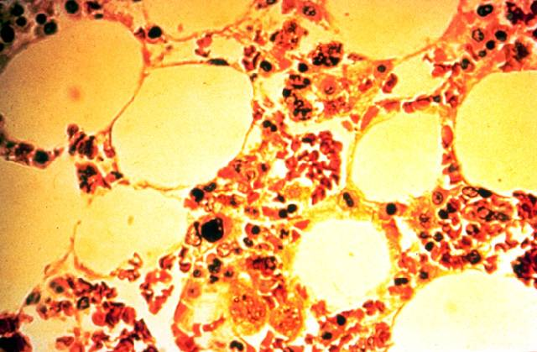

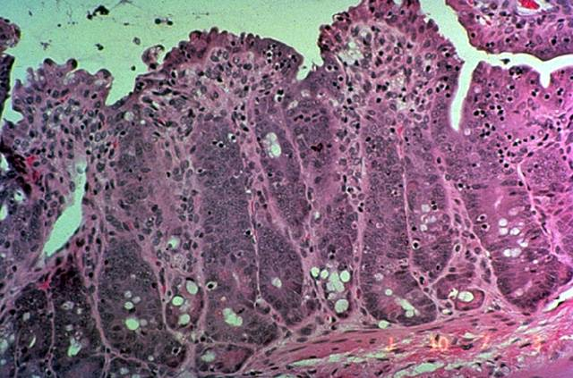

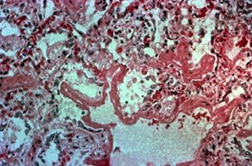
How haematopoietic stem cell transplant was born:
ACUTE RADIATION SYNDROME
  Haematological syndrome
ARS manifestations
Irradiated
Bone Marrow
  Gastrointestinal syndrome
Irradiated GI Mucosa
  Neurovascular syndrome
Irradiated lung tissue
Notes:
Combination of clinical syndromes occuring in stages hours to weeks after exposure as injury to various tissues and organs is expressed

Slide 4
How haematopoietic stem cell transplant was born:
ACUTE RADIATION SYNDROME
<0.1 Gy, whole body –
No detectable difference in exposed vs non-exposed patients
0.1-0.2 Gy, whole body –
Detectable increase in chromosome aberrations. No clinical symptoms
0.12 Gy, whole body –
Sperm count decreases to minimum about day 45
0.5 Gy, whole body –
Detectable bone marrow depression with lymphopenia

Slide 5
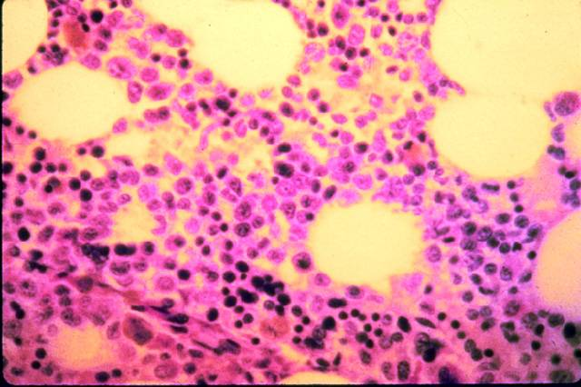
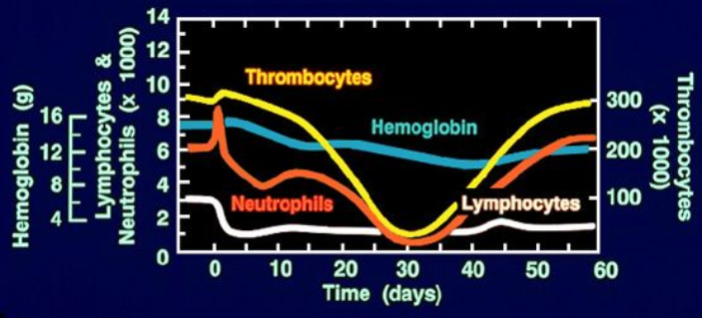
How haematopoietic stem cell transplant was born:
ACUTE RADIATION SYNDROME
Normal bone marrow cells
    If the lymphocyte count in first week below 100 cells/µL, consider treatment with growth factors and BMT
    Observe HLA compatibility at allogenic BMT. This therapy may be recommended for patients exposed to WB radiation doses exceeding 9 Gy
Bone marrow damaged by radiation injury
Haematological response to 3 Gy, exposure
Successfully used for radiation victims
after Goiânia, San Salvador, Israel and
Belarus and Istanbul accidents

Slide 6
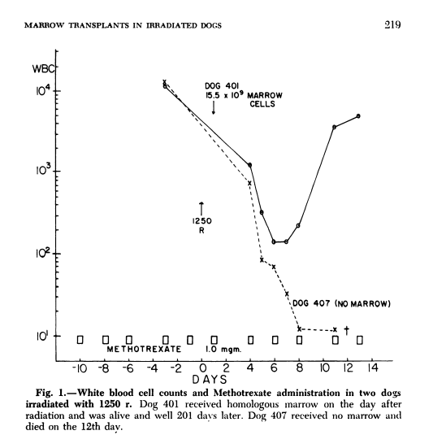
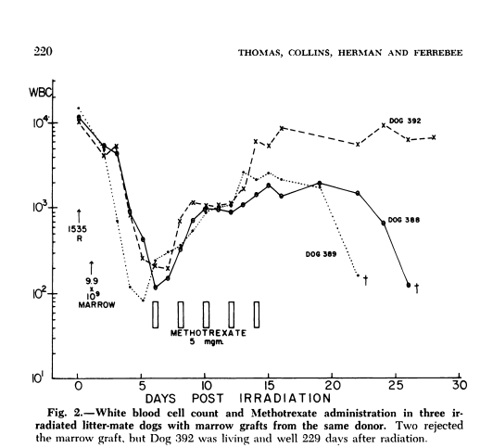
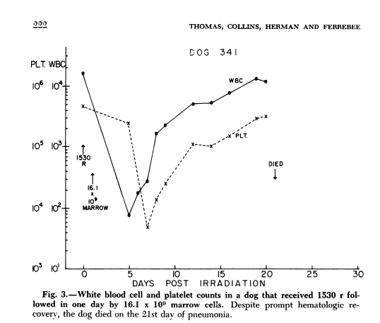



How haematopoietic stem cell transplant was born:
E.D. Thomas carried out the first transplants in dogs using high dose irradiation
Thomas ED, Collins JA, Herman EC, Ferrebee JW. Marrow transplants in lethally irradiated dogs given methotrexate. Blood 1952; 19: 217–228.
Notes:
The first experiments were performed in mice and later in dogs by E.D. Thomas.

Slide 7
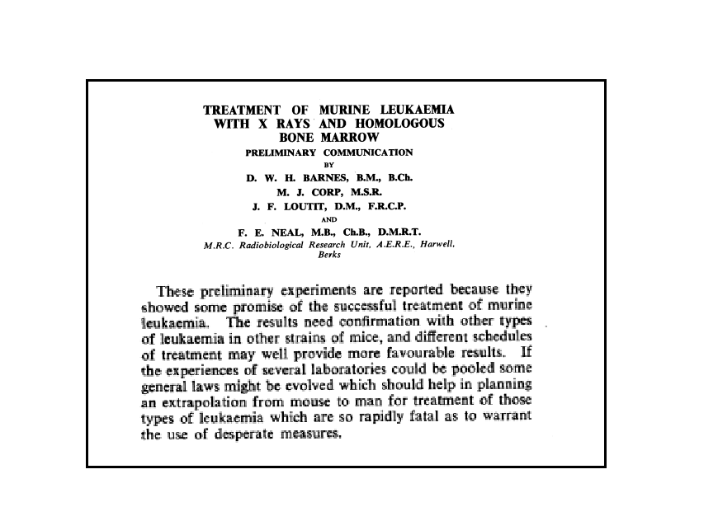
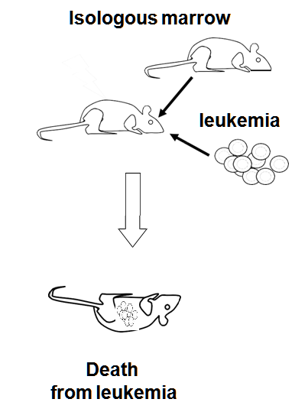
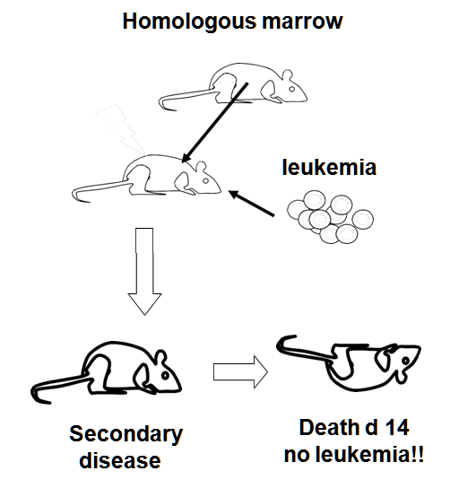






How haematopoietic stem cell transplant was born:
⬥
⬥
As early as 1956, the idea that bone marrow transplant might exert a therapeutic effect against malignancies was proposed by Barnes and Loutit who observed an anti-leukaemic effect of transplanted spleen cells in experimental murine models (2).
They also observed that animals that had been given allogeneic rather syngeneic marrow cells died of "wasting disease", which would now be recognised as being graft-versus-host disease (GvHD)
◆
❖
◆
❖

Slide 8
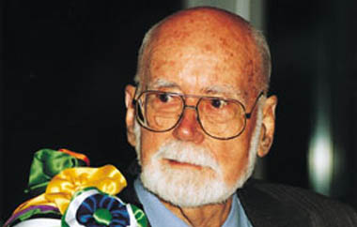
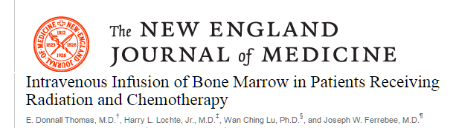
E. Donnall Thomas
Milestones of Stem Cell Transplantation
The Nobel Prize, 1990
In 1959, the first human bone marrow transplants gave a proof of concept that infusing bone marrow could provide haematological reconstitution in lethally irradiated patients with acute leukaemia

Slide 9
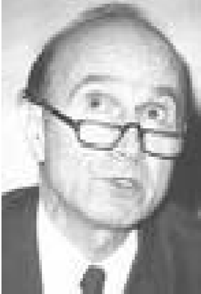
Milestones of Stem Cell Transplantation
G. Mathé
  G. Mathé gave allogeneic bone marrow for treatment of several patients who had suffered accidental irradiation exposure, most survived with hematopoetic reconstitution.
  In 1963, First successful complete engraftment and survival of over 1 year, description of acute and chronic GVHD in men
In 1965, Mathé was the first to describe long-term engraftment of a sibling bone marrow demonstrating chimerism, tolerance and an anti-leukaemic effect .

Slide 10
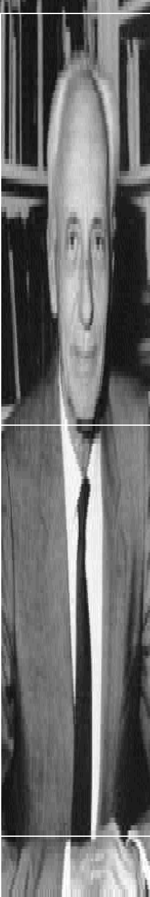
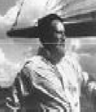
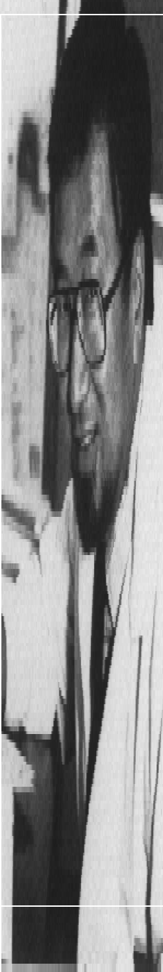
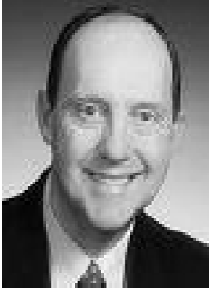
Milestones ofHLA typing
Most of succesful transplantation experiences had been carried out after learning about HLA and their important on tissue compatibility
1958-Dausset
  First HLA antigen described (A2)
1968-van Rood/Terasaki
  Modern HLA serologic typing available
  Secondary disease-runting syndrome-GVHD
1968-Good (Minneapolis) De Vries (Leiden)
  First successful HLA-matched sibling transplant for SCID

Slide 11
The 1970’s
Bone Marrow Transplantation takes off!!

Slide 12
One hundred patients with acute leukemia treated by chemotherapy, total body irradiation, and allogeneic marrow transplantation.
Thomas ED, Buckner CD, Banaji M, Clift RA, Fefer A, Flournoy N, Goodell BW, Hickman RO, Lerner KG, Neiman PE, Sale GE, Sanders JE, Singer J,
Blood. 1977 Apr;49(4):511-33.
94 patients were engrafted and only one patient rejected the graft. ……
Thirteen patients are alive with a marrow graft, on no maintenance antileukemic therapy, and without recurrent leukemia 4.5 yr after transplantation.
This observation, coupled with the observation that some patients may be cured of their disease, indicates that marrow transplantation should now be undertaken earlier in the management of patients with acute leukemia who have an HLA-matched sibling

Slide 13
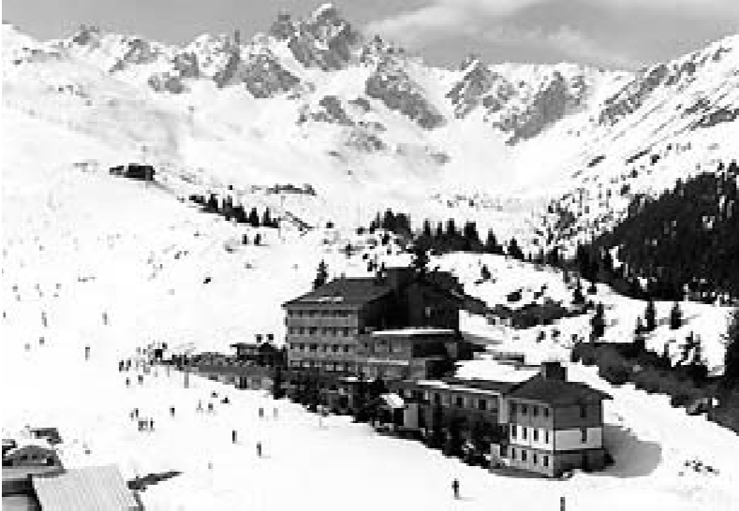
Tracking and documenting transplants in Europe
EBMT
Maastricht.
Three teams were present,
The Leiden group with J. Vossen and Rood,
The Basel group with B. Speck
The Paris group with E. Gluckman.
1974
EBMT (European Group for Blood and Marrow Transplantation) was born in 1974 when the number of bone marrow transplants was very small and results quite encouraging

Slide 14

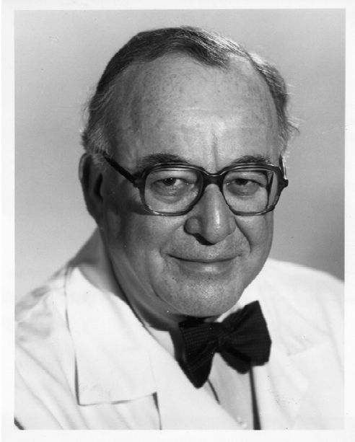
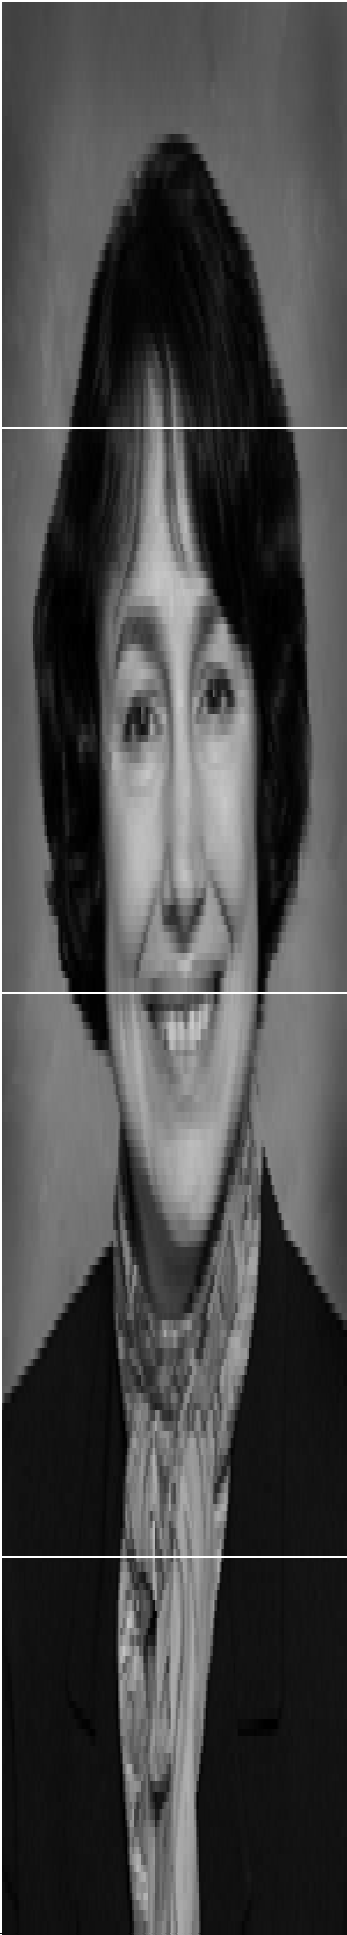
IBMTR - CIBMTR
Tracking transplants world-wide
Mortimer M. Bortin Scientific Director,
Mary M. Horowitz Scientific Director,
IBMTR 1972-1991
IBMTR 1991-
Dr. Mortimer M. Bortin and several colleagues established the IBMTR at the Medical College of Wisconsin to do just that. Physicians in the field agreed to voluntarily contribute their patient data to this outcomes registry.
At the time, there were only about 12 transplant centers and fewer than 50 patients per year worldwide receiving a transplant.
M. Horowitz the current director has developed the database and this worldwide database now includes data on 500,000 autologous, related and unrelated donor transplant recipients. CIBMTR is 35also performing both observational and prospective research

Slide 15
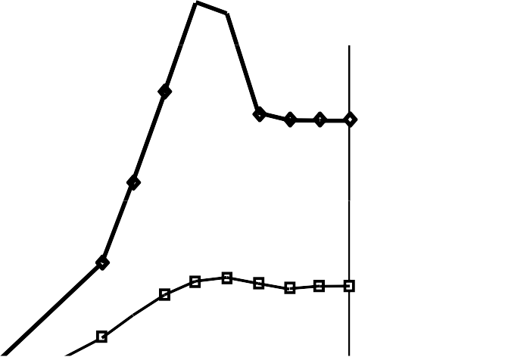

Annual Numbers of Hematopoietic Stem Cell Transplants Worldwide
IBMTR - CIBMTR
45,000
Number of Transplants
40,000
1970-2003
35,000
Autologous
30,000
25,000
IBMTR - CIBMTR
20,000
15,000
10,000
Allogeneic
5,000
0
1970
1975
1980
1985
1990
1995
2000
Year

Slide 16
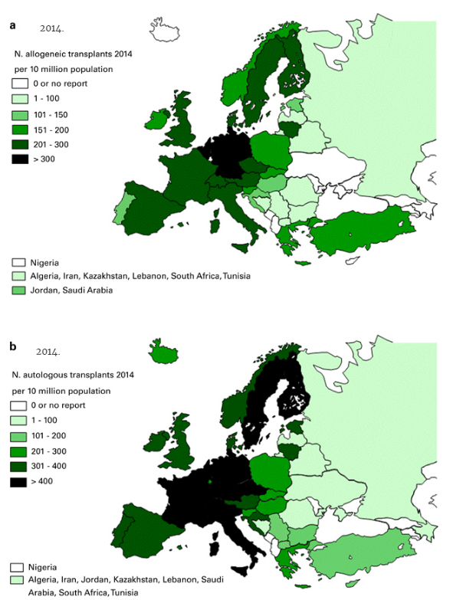
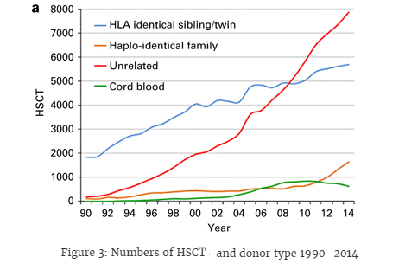
EBMT Transplantation Activity, 2014
A record number of 40 829 hematopoietic stem cell transplantation (HSCT) in 36 469 patients (15 765 allogeneic (43%), 20 704 autologous (57%)) were reported by 656 centers in 47 countries to the 2014 survey.

Slide 17
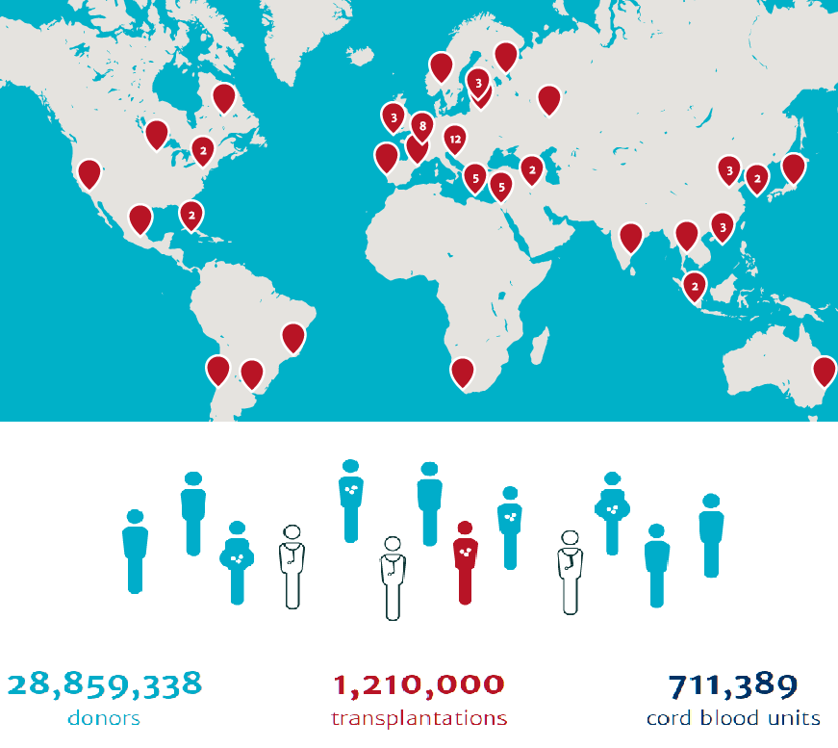
WMDA
(World Marrow Donor Association)
December 1987.
Notes:
NMDP (National Marrow Donor Program) was founded in 1986 and the first NMDP-facilitated transplant took place in December 1987. Today the registry is called Be the Match Registry and has grown to 9 million donors and nearly 145.000 umbilical cord blood units.
WMDA (World Marrow Donor Association). On March 10th 1988 an ad hoc committee was formed to discuss international collaboration for identification of matched unrelated donors, initially started as the Cooperative Marrow Donor Programme. The founders of this group were: Prof. J.J. van Rood, Prof. J. Goldman and Prof. E.D. Thomas. Prof. J. Goldman proposed a change in the name of the organisation from Cooperative Marrow Donor Programme to World Marrow Donor Association (WMDA).The WMDA is a voluntary organisation of representatives of bone marrow donor registries, cord blood banks, other organisations and individuals, with an interest in haematopoietic stem cell transplantation. It provides a forum for mutual discussion of all issues regarding the clinical use of haematopoietic stem cells from unrelated donors across international boundaries. These discussions, which take place in working groups, make it possible to formulate guidelines on logistics, quality control, accreditation, ethics, finances and registry accreditation. It works in close association with BMDW (Bone Marrow Donors Worldwide). BMDW is continuing the effort to collect the HLA phenotypes and other relevant data of volunteer stem cell donors and cord blood units. The current number of donors is 17,596,872 and cord blood units 482,451.
Eurocord is a registry of cord blood transplants which works in close collaboration with cord blood banks (members of Netcord) to analyse results of cord blood transplant and provide quality standards and accreditation to the unrelated cord blood banks. It has collected more than 7,000 cord blood transplant from 483 centres, 50 countries and 54 cord blood banks.

Slide 18
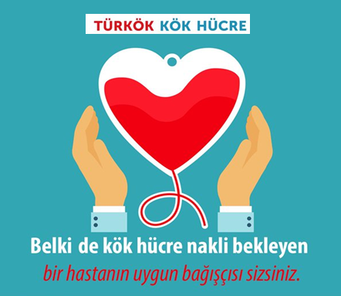
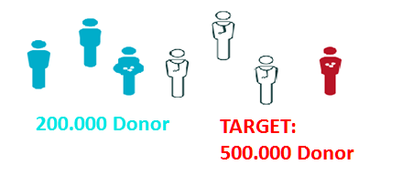
TURKOK
Turkish Donor Registry Program

Slide 19
Barriers for stem cell transplantation
The 1980’s: Extending the indications
The 1990’s: Older and debilitated patients
Extending the donor pool
The last decade: Safer transplants
The next decade: More cures

Slide 20
Extending the indications
The 1980’s
1970s
1980s
1990s
Acute leukemia
CML
CLL
Myeloma
Lymphoma
MDS
Solide Cancer
Aplastic anemia and immunodeficiency diseases
Hemoglobinopathies
Inborn errors

Slide 21
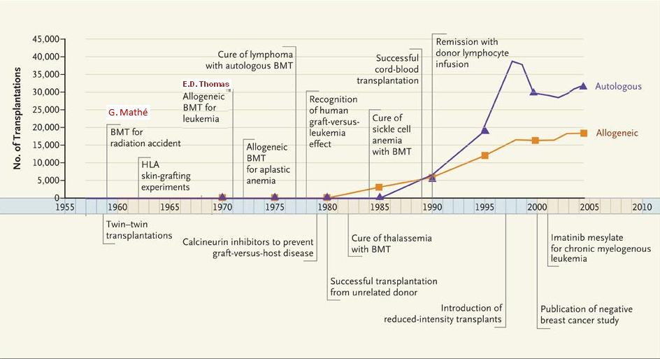
Timeline of Hematopoetic Stem Cell Transplantation
1955-2010

Slide 22
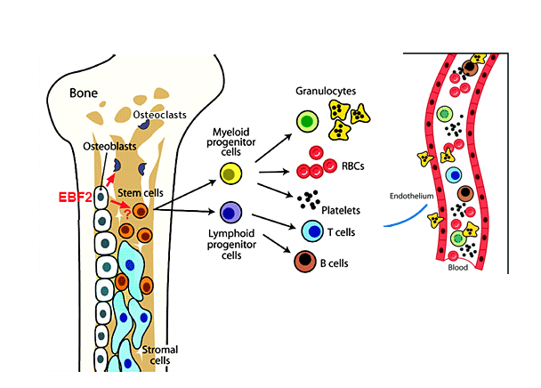
What are the Hematopoetic Stem Cells?
(HSCs)

Slide 23
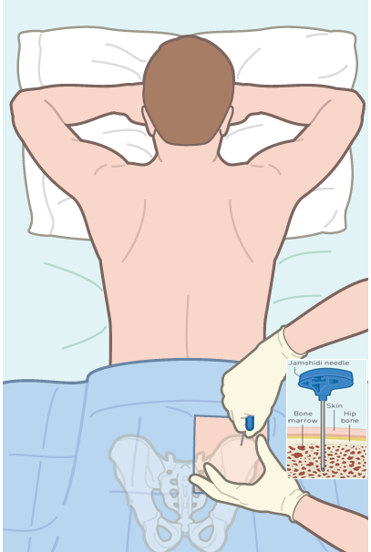
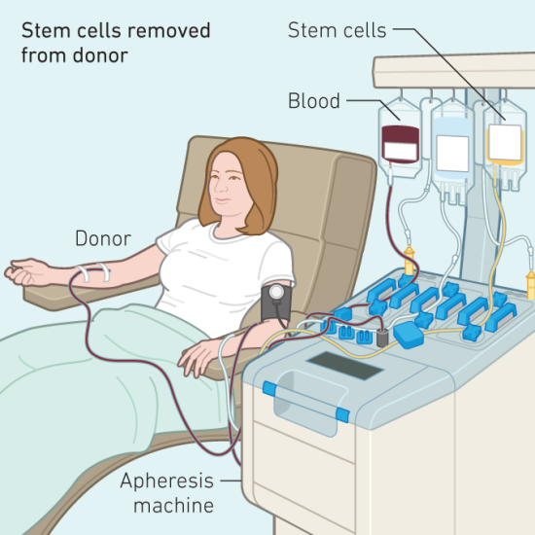
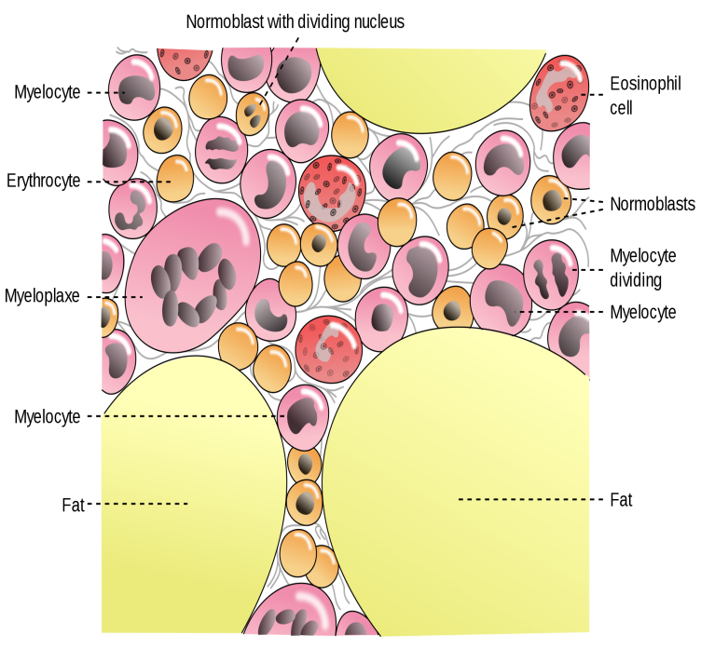
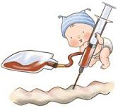
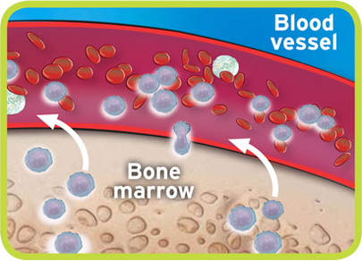
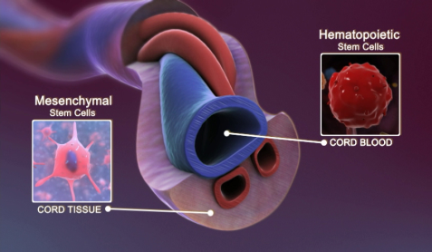
Sources of Stem Cells
(HSCs)
Bone Marrow
Peripheral Blood
Cord Blood

Slide 24
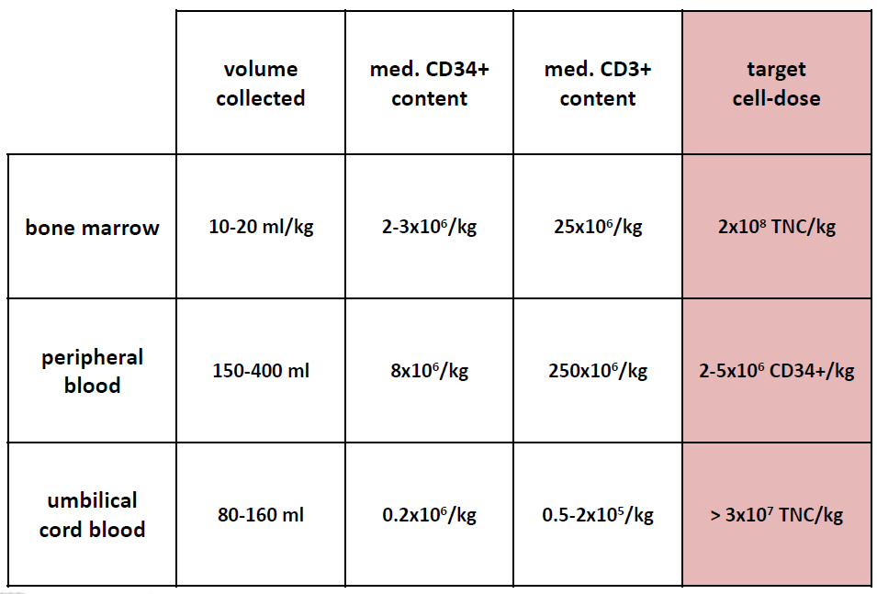
Stem Cell Sources

Slide 25
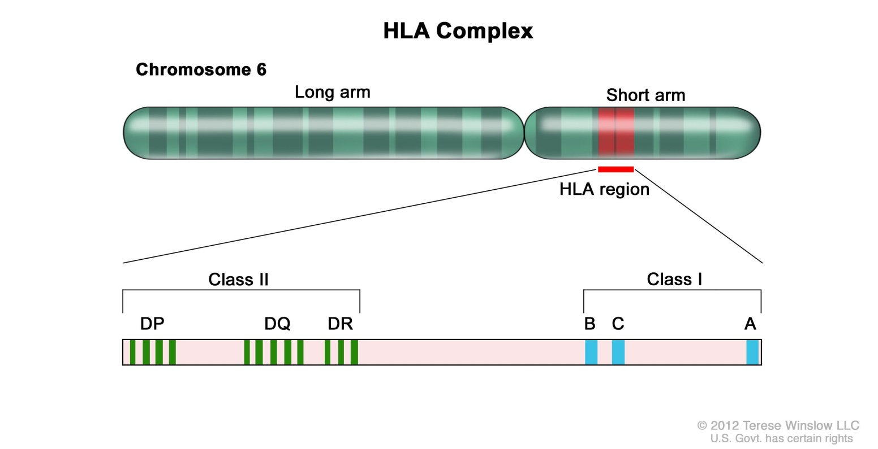
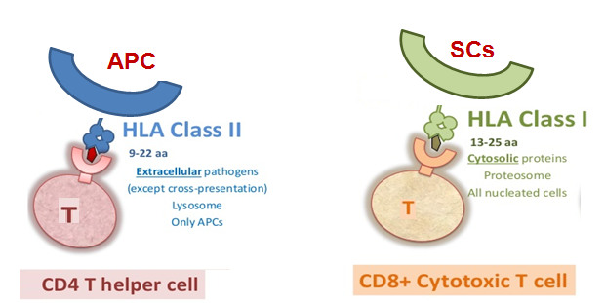
The Major Histocompatibility Complex
MHC
  HLA is a protein – or marker – found on most cells in your body. Your immune system uses HLA markers to know which cells belong in your body and which do not.
.

Slide 26
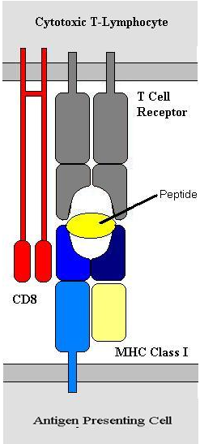
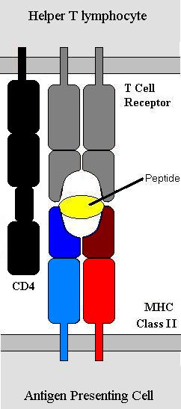
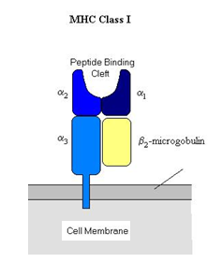
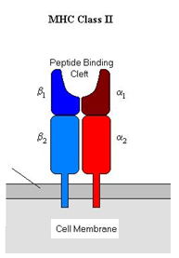
The Major Histocompatibility Complex
MHC
  HLA is a protein – or marker – found on most cells in your body. Your immune system uses HLA markers to know which cells belong in your body and which do not.
.

Slide 27
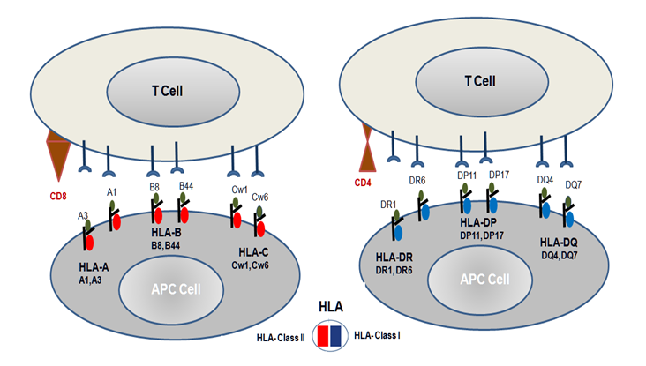
The Major Histocompatibility Complex & Antigen recognition
MHC
Donor Selection
  Immune system uses HLA markers to know which cells belong in your body and which do not.
Notes:
Allogeneic transplants are the most common type of transplant used to treat certain forms of leukemia. The best chance for the closest match is often a sibling. Unfortunately, there is only a 25-percent chance of a sibling match

Slide 28
HLA matches (SIBLINGS)
Mother
Father
Patient
Sibling 1
Sibling 2
Sibling 3
Sibling 4
HLA matched
Half of your HLA markers are inherited from your mother and half from your father. Each brother and sister has a 25%, or 1 in 4, chance of matching you, if you have the same mother and father.
Notes:
Half of your HLA markers are inherited from your mother and half from your father. Each brother and sister has a 25%, or 1 in 4, chance of matching you, if you have the same mother and father. It is highly unlikely that other family members will match you. Under very rare circumstances, family members other than siblings may be tested.

Slide 29
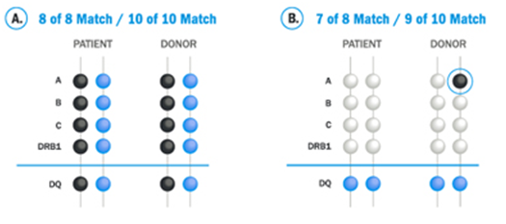
HLA matching (UNRELATED)
Example A shows that the patient's markers match the donor's. When HLA markers A, B, C, and DRB1 from the patient and the donor match, it is called an 8 of 8 match. When A, B, C, DRB1, and DQ markers all match, it’s called a 10 of 10 match.
Example B shows that one of the patient's A markers does not match one of the donor's A markers. Therefore, this is a 7 of 8 match or, if the DQ marker matches, a 9 of 10 match.
Notes:
There are many HLA markers. Each HLA marker has a name. The names are letters or combinations of letters and numbers. Doctors review at least 8 HLA markers for these minimum requirements: two A markers, two B markers, two C markers, and two DRB1 markers. Some doctors look for an additional marker, called DQ, to match.
An adult donor must match at least 6 of these 8 HLA markers. Many transplant centers require at least a 7 of 8 match. Because cord blood cells are less mature than adult donor cells they have less strict matching criteria. A cord blood unit must match at least 4 of 6 markers at HLA-A, -B, and -DRB1. These guidelines are based on scientific studies of transplant results.

Slide 30
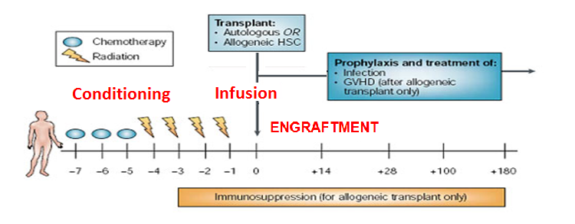
Transplant Procedure

Slide 31
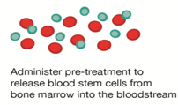




Autologous Haematopoietic Stem Cell Transplantation
(Auto-SCT)
Mobilisation
Conditioning
Apheresis
HSC Infusion
Aplastic Phase
RECOVERY

Slide 32
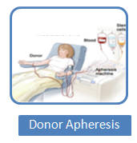
Allogenic Haematopoietic Stem Cell Transplantation
(Allo-SCT)
Allogeneic – from another person
  Sibling donor – HLA matched brother or sister
  Syngeneic – from an identical twin
  Unrelated donor – found using a donor registry
  Haploidentical – half-matched family member
Patient
Transplantation
ENGRAFTMANT
Conditioning CT

Slide 33
Conditioning Therapy
The first stage of the transplant.
May be given in one dose or over several days.
Necessary for:
  Supressing the patients immune system to lessen the chance of graft rejection
  Destroying remaining cancer cells
  Creating room in the bone marrow for the transplanted stem cells
Conditioning regimen is dependent on the type of disease, the type of
transplant, co-morbidities and age.

Slide 34
Regimen Intensity
Conditioning Therapy
Low Intensity
High Intensity
Flu / Cy BEAM Cy / TBI
Less regimen related toxicity
Rely on later graft versus
disease effect
Increase in regimen related toxicities
Increased level of
disease control

Slide 35
Regimen Intensity
Conditioning Therapy
Myeolablative conditioning
  Irreversibly destroys the haemopoietic function of the bone marrow with high doses of chemotherapy +/- TBI.
  Higher level of disease control
  Younger patients with a good performance status
  Quicker engraftment of donor cells
  Higher toxicities associated with higher transplant related mortality
Reduced intensity conditioning
  Regimens that have been developed to reduce the morbidity and mortality of allogeneic transplant.
  It aims to use enough immunosuppression to allow donor cells to engraft without completely eradicating the recipients bone marrow.
  Can be given to older patients
  Less regimen related toxicities
  Reduction in morbidity and transplant related mortality

Slide 36

Stem Cell Re-infusion
At least 24 hour after the conditioning will be given on Day 0. These are generally given through a central line and takes approximately 30 minutes.
Stem cells are either cryopreserved or fresh.
Cryopreserved
  Usually for autologous transplants
  Most common side effects are reactions to DMSO
Fresh
  Usually for allogeneic transplants
  Administered much like a blood transfusion
  Generally better tolerated than frozen cells.

Slide 37


Slide 38




Blood Count Recovery
ENGRAFTMENT
Neutrophil engraftment occurs when neutrophils
≥ 0.5 x 10⁹
Platelet engraftment occurs when platelets ≥ 20 x 10⁹
Thomson B G et al. Blood 2000;96:2703-2711

Slide 39
Early Complications of HSCT
Early Complications (Major cause of morbidity and mortality)
Infections: | Haemorrhagic cystitis
Bacterial | Hepatic veno-occlusive disease
Viral | Capillary leak syndrome
Fungal | Diffuse alveolar haemorrhage
Acute GvHD | Idiopathic pneumonia syndrome
 | Multi-organ dysfuntion syndrome

Slide 40


Graft versus Host Disease
Acute
  Usually occurs before D100
  Organs affected – skin, gut, liver
Chronic
  Usually develops after D100
  Can involve skin, gut, liver, eyes, lungs, connective tissues
  More prone to opportunistic infections
  Quality of Life
Risk Factors
  Prior history of Acute GvHD
  Unrelated donor
  Mismatched transplants
  Male recipients of female donors
  Older age of recipient or donor

Slide 41

Graft versus Host Disease
Prevention
  HLA matching
  Reduced intensity conditioning regimens
  Drugs – Ciclosporin, Methotrexate, Mycophenolate mofetil
  T-cell depletion (i.e. Campath)
Treatment
  Steroids with ciclosporin
  ATG
  Extracorporeal photopheresis (ECP)

Slide 42
Late Effects
Late Effects
Chronic GvHD | Back to work issues
Late infection and immune defects | Secondary MDS / leukaemia / malignancy
Pulmonary late effects including restrictive lung diseases and COPD | Late graft failure
Late liver complications (i.e. Hepatitis B,C and iron overload) | Relapsed disease
Late ocular effects including cataracts | Infertility / sexual dysfunction
QoL and neuropsychological functioning including intellectual and / or concentration issues | Endocrine abnormalities e.g. hypothyroidism
Emotional issues | Cardiac failure
Fatigue | Dental late effects

Slide 43
Patient Outcomes
Disease status after HSCT
Best response and at last contact?, Relapse or progression?
Patient outcome?
  D100 TRM
  1, 2 and 5 year TRM
  Most transplant related deaths occur within the first year of transplant
TRM is likely to increase with
  Allogeneic transplant
  Advanced disease status at time of transplant
  Type of donor
  Intensity of conditioning regimen
  Patient age

Slide 44
The MED-A form

Slide 45


First report – 100 days after HSCT
MED-A:

Slide 46
Introduction
MED-A:
Minimum Essential Data
Completion of the MED-A form is a requirement for all EBMT members.
JACIE requirement
  B 9.1 - The clinical programme shall collect all the data necessary to complete the Transplant Essential Data forms of the CIBMTR or the Minimum Essential data-A forms of the EBMT
First report should be submitted as soon as possible after D100
Follow up report should be submitted annually
Patient must give consent for data submission

Slide 47
Thank you!
Any Questions?

