Slide 1





Graft Versus Host Hastalığında Mezenkimal Kök Hücre Uygulamaları
http//www.iliknakli.com.tr http//www.hematoloji-onkoloji.com

Slide 2
Gündem
Mezenkimal Kök Hücreler
• İmmünosüpresif etki mekanizmaları?
PRE-KLİNİK MODELLERDEN KLİNİK UYGULAMALARA GEÇİŞ
HEMATOLOJİ KLNİKLERİNDE MKH UYGULAMALARI
Graft Versus Host Hastalığı

Slide 3
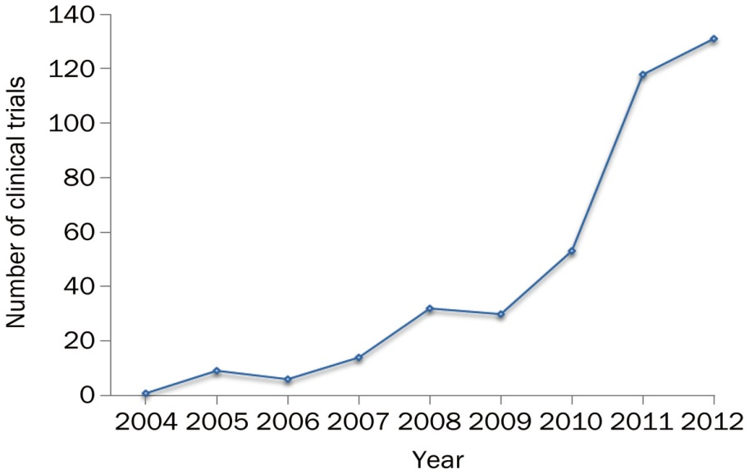
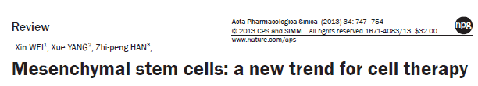


Dünyada MKH Uygulamaları
MKH çalışmaları 2004 yılından itibaren katlayarak artış göstermiştir.
2010 yılından itibaren hızı artan yarışın parçası olmak isteyenlerin adeta ‘’Gold rush’’ aktivitesine ’’ Çin başta olmak üzere Avrupa ve Birleşik Devletleri ön sırada yer almaktadır.
Xin Wei et al. Acta Pharmacol Sin 2013; 34: 747–754;
doi: 10.1038/aps.2013.50
© 2013 CPS and SIMM

Slide 4


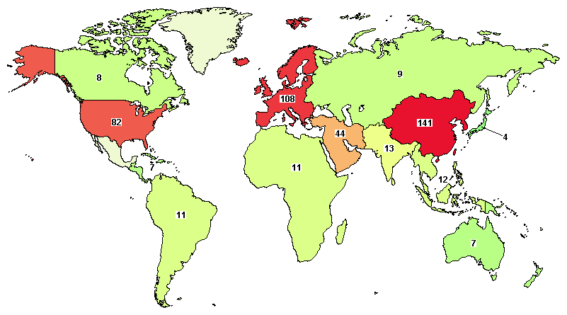
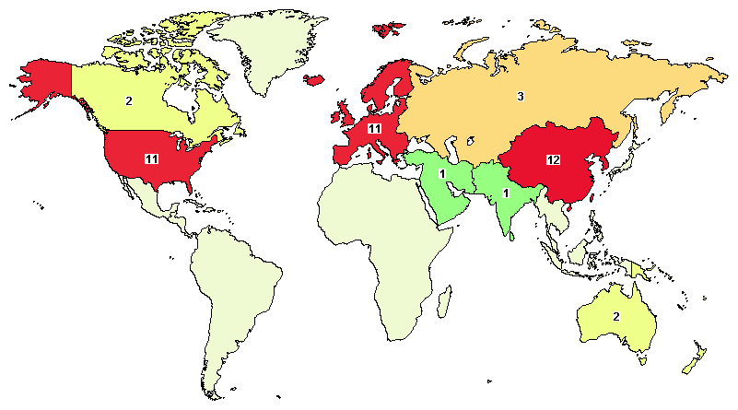
Dünyada MKH Uygulamaları
2010 yılına kadar; 14 farklı endikasyonda yaklaşık100 klinik çalışmada, 5400’den hasta üzerinde çalışılmıştır.
2011 yılından itibaren 200’den fazla klinik çalışma 44 endikasyonda 10.000’den fazla hasta üzerinde MKH test edilmektedir.
2012 yılı itibarı ile ‘’clinical trials’’ kayıtlı değişik fazlarda 344 çalışma
Aralık 2014 itibarı ile 448 Çalışma (39 çalışma GVHD)
3

Slide 5
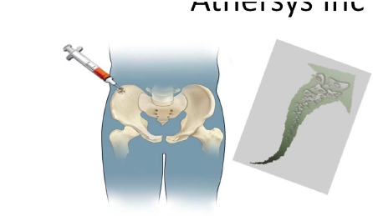
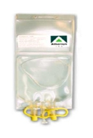
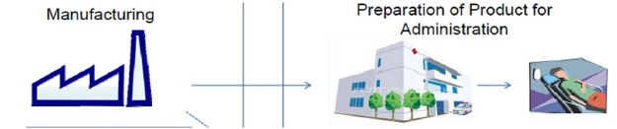
Laboratuvardan Kliniğe MKH Çalışmaları Faz I, II, III
Proplemler
Üretim (GMP) merkezlerinin tecrübesi
Ticari preparatların küresel hareketliliği
3. Parti (Raf ) MKH kullanımı
ACİL yapılması gerekenler
Randomize kontrollü çalışmalar
Çözümler
GMP Üretim standartları: kalite-saflık-canlılık-etiketleme-pazarlama
İKU standarları: toksisite- endikasyon-etkinlik(kapasite)-yaşam
23

Slide 6
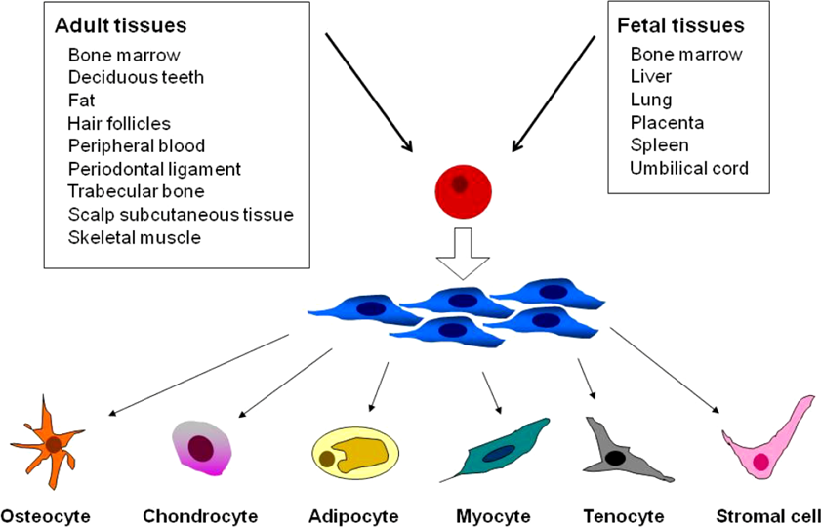
Mezenkimal Kök Hücre Kaynakları ve Plastisite
Bone
Chondrocytes
Adipocyte
Muscle
Kolay izolasyon, hızlı çoğalma ve kendini yenileyebilme ve yüksek plastisite ….
Baksh, Yao, & Tuan, 2007; Da Silva Meirelles, Chagastelles, & Nardi, 2006).
Notes:
MSCs have now been isolated from both bone marrow and many other tissue sources, including adipose tissue, synovial membrane, skeletal muscle, dermis, pericytes, trabecular bone, human umbilical cord, lung, dental pulp, amniotic fluid, fetal liver, and even peripheral blood, suggesting that MSCs are diversely distributed in vivo
The multilineage differentiation potential is the hallmark of MSCs. One of the criteria a cell has to satisfy before being regarded as an MSC would be its ability to differentiate into bone, cartilage, and fat cells [37]. However, studies have shown that MSCs can be differentiated into other cells such as skeletal cells, cardiomyocytes, endothelial, smoothmuscle,and neural cells [40].
There have also been several studies on the transdifferentiation of MSCs into pancreatic beta cells [6, 41].However, the ability of MSCs to differentiate into cells of all three germ layers must be carefully examined as they have been reported to spontaneously express neural markers even in the undifferentiated state

Slide 7
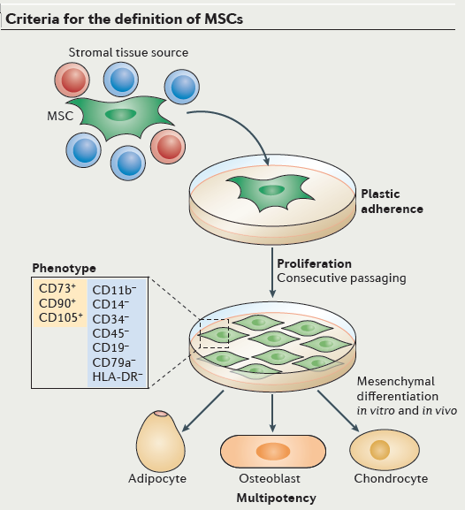
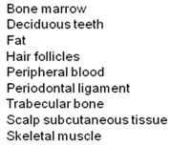
Uluslararası Hücresel Tedavi Derneğinin kriterlerine göre MKH’ler standart kültür ortamındaen azından aşağıdaki 3 kriteri taşımalıdır
Mezenkimal Kök Hücreyi Tanımlama
(1) Plastik yüzeylere yapışabilmeli (plastic-adherens);
(2) Yüzeylerinde C105, CD73 ve CD90 eksprese etmeli ancak CD45, CD34, CD14, CD11b, CD79 veya CD19 ve HLA-DR taşımamaları
(3) osteoblasts, adipocytes and chondroblasta değişebilme kapasitesi göstermeleri…
GEREKİRKEN; yanı sıra;
CD44, CD71, Stro-1 belirteçlerini taşımaları ve CD 106, CD166, CD29 gibi adezyon moleküllerine sahip olmaları beklenir
M. Dominici, K. Le Blanc, I. Mueller et al., “Minimal criteria for definingmultipotentmesenchymal stromal cells: the International Society for Cellular Therapy,” Cytotherapy, vol. 8, no. 4, pp. 315–317, 2006.
Notes:
Multipotent mesenchymal stromal cells (MSCs) constitute a heterogeneous population of precursor cells. They are found in situ within all mammalian supportive stromal tissue compartments, but bone marrow, adipose tissue and the umbilical cord are most commonly used as the cell source. In culture, MSCs can be isolated from other cell types by their adherence to plastic culture dishes and consecutive passaging (see the figure). They proliferate to form a heterogeneous population of fibroblast-like cells (colony-forming-unit fibroblasts) that are at varying stages of commitment to differentiation. These cells can retain their multipotency for 30–40 cell divisions. However, their growth rate and replicative lifespan decline with somatic age, and their spindle-type morphology is gradually lost over time in culture. Whereas in vitro or in vivo differentiation of MSCs into mesenchymal tissue cells (osteoblasts, chondrocytes and adipocytes) has become the standard for demonstrating their multipotency, (trans)differentiation into non-mesenchymal tissue cells (such as hepatocytes or cardiomyocytes) remains controversial30. MSCs do not express known unique phenotypic markers, but the International Society for Cellular Therapy has proposed minimal criteria6 for defining the cells based on their plastic adherence, phenotype and trilineage multipotency. The phenotype definition requires expression of CD73, CD90 and CD105, together with a lack of expression of monocyte and macrophage markers (CD11b or CD14), a haematopoietic progenitor and endothelial cell marker (CD34), a leukocyte marker (CD45), B cell markers (CD19 or CD79a) and HLA-DR (see the figure).

Slide 8
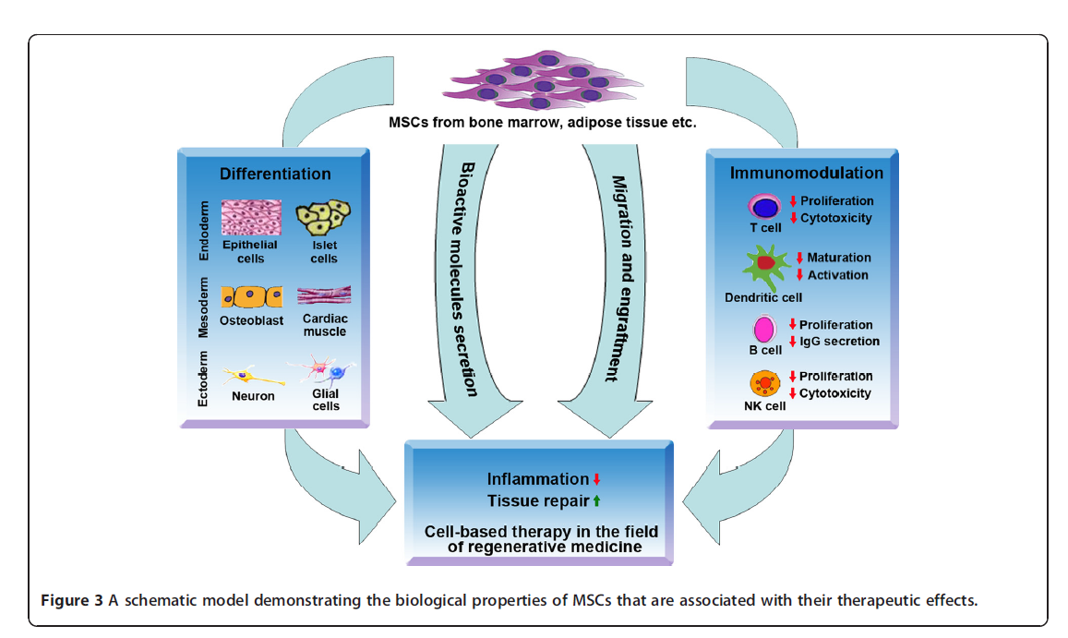
Mezenkimal Kök Hücreleri Biyolojik Karakteristiği
MKH’lerin tedavi edici etkileri biyolojik karekterlerinden kaynaklanır….
Notes:
MSCs are immune privileged cells. The fact that MSCs from children can persist in mothers for decades suggests that these cells can escape immune surveillance for a long period of time [43].
The immune phenotype of MSCs is generally described as major histocompatibility (MHC) I positive and MHC II negative.
THEY ALSO LACK THE COSTİMULATORY MOLECULES CD40, CD80, and CD86. Although expressing low levels of MHC I antigens can activate T cells, the absence of costimulatory molecules cannot initiate secondary signals, thus leaving the T cells anergic [44].
BESİDES, THE EXPRESSİON OF LOW LEVELS OF MHC I İS İMPORTANT İN PROTECTİNG MSCS FROM NATURAL KİLLER CELL-MEDİATED CYTOTOXİCİTY.
The use of MSCs in clinical applications requires understanding of their biological characteristics that contribute to the therapeutic effects.
Currently, the following four properties are considered the most important (Figure 3):
(1) the ability to home to sites of inflammation following tissue injury when injected intravenously
2) the ability to differentiate into various cell types
(3) the ability to secrete multiple bioactive molecules capable of stimulating recovery of injured cells and inhibiting inflammation
(4) the lack of immunogenicity and the ability to perform immunomodulatory functions. Although we divide the effects of MSCs into these four aspects for better description in this review, in fact, these four aspects are combined and overlapped. Their exact roles in the therapeutic effects of MSCs remain to be further elucidated.

Slide 9
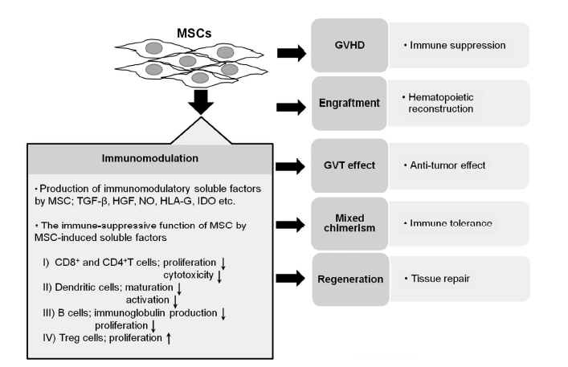

MKH’leri kemik iliği naklinde potansiyel kullanım alanları
Notes:
Figure 1 MSC-mediated therapies targeting for hematopoietic stem cell transplantation. The potential uses of MSCs include treatment of
GVHD, facilitation of hematopcietic engraftment, induction of mixed chimerism and induction of the GVT effect. MSCs possess unique
properties of immune modulation and tissue regeneration. k : suppression; m: promotion. GVHD, graft-versus-host disease; GVT, graftversus-
tumor; HLA, human leukocyte antigen; IDO, indoleamine 2,3-dioxygenase; MSCs, mesenchymal stem cells; TGF-b, transforming
growth factor-b.

Slide 10
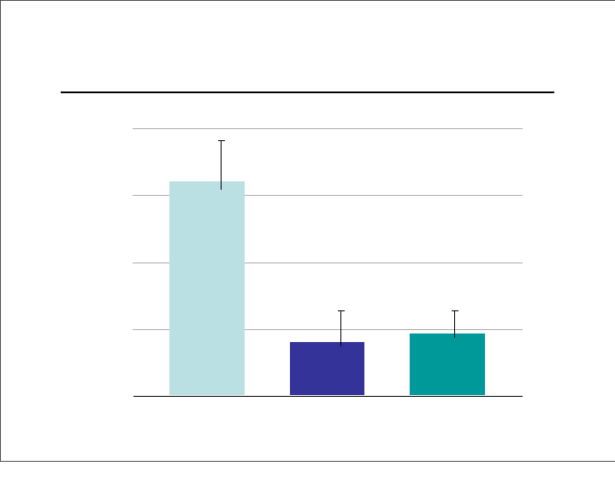

MKH’lerin T hücre inhibisyonu
HY karşı proliferasyon cevabı (cpm)
*T hücre antiproliferatif etkisi
*
Kontrol
MSC
3T3-F442A
Krampera et al, Blood 2003
Notes:
Mesenchymal stem cells (MSCs) have been recently shown to inhibit T-cell proliferation to polyclonal stimuli.
MSCs have been recently shown to inhibit T-cell proliferation to polyclonal stimuli.
We characterized the effect of MSCs of bone marrow origin on the T-cell response of naive and memory T cells to their cognate antigenic epitopes.
The immune response to murine male transplantation antigens, HY, was selected because the peptide identity and major histocompatibility complex (MHC) restriction of the immunodominant epitopes are known.
C57BL/6 FEMALE MİCE İMMUNİZED WİTH MALE CELLS WERE THE SOURCE OF MEMORY T CELLS, WHEREAS C6 MİCE TRANSGENİC FOR HY-SPECİFİC T-CELL RECEPTOR PROVİDED NAİVE T CELLS.
Responder cells were stimulated in vitro with male spleen cells or HY peptides in the presence or absence of MSCs.
MSC inhibitory effect did not selectively targetantigen-reactive T cells. When MSCs were added to the T-cell cultures in a Transwell system or MSCs were replaced by MSC culture supernatant, the inhibitory activity was abrogated. T-CELL REACTİVİTY WAS ALSO RESTORED İF MSCS WERE REMOVED FROM THE CULTURES. The expression of MHC molecules and the presence in culture of antigen-presenting cells (APCs) or of CD4/CD25 regulatory T cells were not required for MSCs to inhibit. We conclude that MSCs inhibit naive and memory Tcell responses to their cognate antigens. Overall our data suggest that MSCs physically hinder T cells from the contact with APCs in a noncognate fashion. (Blood. 2003;101:3722-3729)© 2003 by The American Society of Hematology

Slide 11
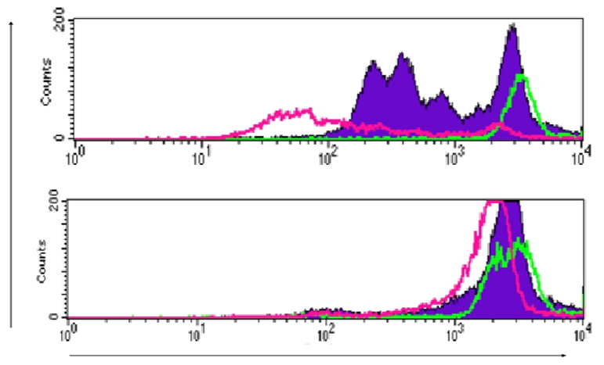
T hücre bölünmesini MKH’lerin inhibisyonu
24 saat
48 saat
72 saat
MSC
KONTROL
NoofCD8+cells
Krampera et al, Blood 2003

Slide 12
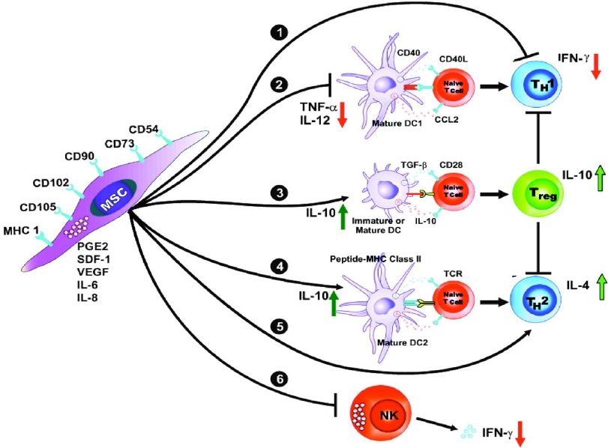
MKH’lerin immün sistem hücreleri ile etkileşimleri ve bu hücreler üzerine etkileri..
Efektör hücreleri inhibe ederken Regülatör hücreleri aktive etmekte...
Th1 hücreleri tarafından salınan IFN-γ GVHH patogenezindeki rolu MKH’ler tarafından aktif olarak inhibe edilir.
IFN- γ, TNF- α, IL-12 inhibisyonu ve IL-10 ve IL-4 aktivasyonu ile etkilidir.
Aggarwal & Pittenger Blood 2005;105:1815
Notes:
IFN-γ is a cytokine secreted by Th1 cells that are involved in GVHD development. MSCs can inhibit secretion of IFN-γ that is beneficial for GVHD treatment
Accordingly, experimental data suggests that MSC therapy might ameliorate disease by promoting the conversion from a Th1 humoral response to a Th2 cellular immune response through modulation of IL-4 and IFN-γ levels in effector T cells
MSCs have also been shown to induce the generation of functional Tregs both in vitro and in vivo (González et al., 2009; Prevosto et al., 2007; Gonzalez-Rey et al., 2010).
hMSCs promote Th2 responses by inhibiting IFN- γ and TNF- α and increasing IL-10.
Also hMSCs alter antigen-presenting cell maturation and induce T-cell unresponsiveness
The Th1 response is characterized by the production of Interferon-gamma, which activates the bactericidal activities of macrophages, and induces B cells to make opsonizing (coating) and complement-fixing antibodies, and leads to "cell-mediated immunity".^{[2]} The Th2 response is characterized by the release of Interleukin 4, which results in the activation of B cells to make neutralizing non-cytolytic antibodies, leading to "humoral immunity"and antiinflammotory effect .^{[2]} In general, Th1 responses are more effective against intracellular pathogens (viruses and bacteria that are inside host cells), whereas Th2 responses are more effective against extracellular bacteria, parasites including helminths and toxins.^{[2]} Like cytotoxic T cells, most of the CD4+ helper cells will die upon resolution of infection, with a few remaining as CD4+ memory cells

Slide 13
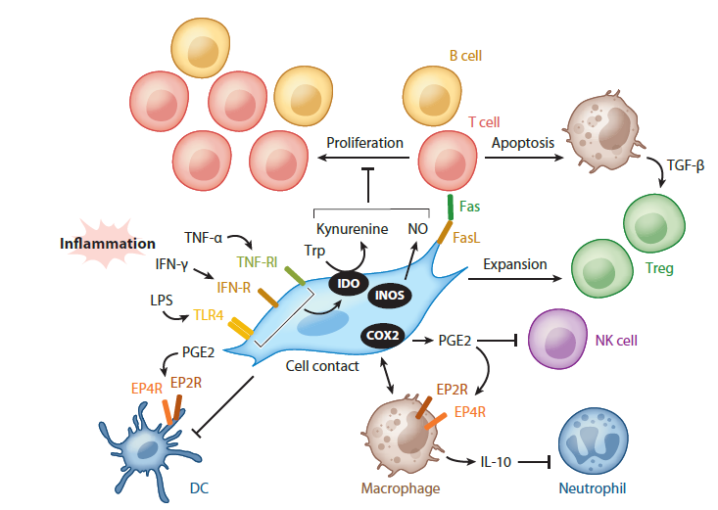





MKH’lerin immün sistem hücreleri ile etkileşimleri ve bu hücreler üzerine etkileri..
MKH’leri tarafından yapılan immün-modülasyon.
Notes:
MSPCs exert immunomodulatory functions in an inflamed environment where IFN-γ and other proinflammatory cytokines such as TNF-α as well as lipopolysaccharides (LPS) can act on their cognate receptors expressed by MSPCs.
(1) In human MSPCs, the ensuing intracellular signaling events induce the upregulation of indoleamine 2,3-dioxygenase (IDO) and the production of the tryptophan metabolite kynurenine, which suppresses the proliferation of T and B lymphocytes.
(2) In murine MSPCs, cytokine-induced signaling promotes the expression of inducible nitric oxide synthase (iNOS), which produces similar antiproliferative effects on T and B cells.
(3) MSPCs can indirectly induce the expansion of regulatory T cells (Tregs) in vivo,
(4) most likely via TGF-β released by macrophages, which is triggered by FAS-ligand-/FAS-mediated apoptosis of T cells.
(5) Anti-inflammatory properties of MSPCs on dendritic cells (DCs) and macrophages are mediated via the enzyme cyclooxygenase 2 (COX2) and its effector molecule prostaglandin E2 (PGE2). PGE2 binds to E prostanoid receptors (EP2R and EP4R) on DCs and macrophages, which induces a tolerogenic state in DCs and
(6) promotes the release of IL-10 by macrophages,inhibiting neutrophil infiltration to tissues.
(7) Released PGE2 is also a potent inhibitor of NK cell function.

Slide 14
MKH’lerin immün sistem hücreleri ile etkileşimleri ve bu hücreler üzerine etkileri..
Marker | Justification for marker selection
Prostaglandin E2 (PGE₂) | PGE₂ suppresses immune response. MSCs produce PGE₂, and PGE₂ mediates MSC-induced immunosuppressive and anti-inflammatory effects in vitro.
Indoleamine 2,3-dioxygenase (IDO) enzyme activity | IDO is an enzyme inducible by pro-inflammatory cytokines such as IFN-γ and TNF-α. IDO inhibits immune response via depletion of tryptophan, an amino acid that is essential for immune cell activation. IDO enzyme mediates MSC-induced immunosuppression in vitro.
Tumor Necrosis Factor-α ( TNF-α) | TNF-α is a pro-inflammatory cytokine playing an important role in GVHD. MSCs inhibit TNF-α secretion by immune cells in vitro.
Interferon-γ (IFN-γ) | IFN-γ is a cytokine secreted by Th1 cells that are involved in GVHD development. MSCs can inhibit secretion of IFN-γ that is beneficial for GVHD treatment
Tumor Necrosis Factor-α Receptor (TNFR ) | TNFR is expressed on MSCs. TNFα is present in organs targeted by GVHD. TNF-α via TNFR up-regulates secretion of PGE₂, induces expression of IDO and stimulates MSC migration in vitro. TNFR is a mediator of MSC biological activities.
MKH’leri tarafından yapılan immün-modülasyon.
Notes:
MSPCs exert immunomodulatory functions in an inflamed environment where IFN-γ and other proinflammatory cytokines such as TNF-α as well as lipopolysaccharides (LPS) can act on their cognate receptors expressed by MSPCs.
(1) In human MSPCs, the ensuing intracellular signaling events induce the upregulation of indoleamine 2,3-dioxygenase (IDO) and the production of the tryptophan metabolite kynurenine, which suppresses the proliferation of T and B lymphocytes.
(2) In murine MSPCs, cytokine-induced signaling promotes the expression of inducible nitric oxide synthase (iNOS), which produces similar antiproliferative effects on T and B cells.
(3) MSPCs can indirectly induce the expansion of regulatory T cells (Tregs) in vivo,
(4) most likely via TGF-β released by macrophages, which is triggered by FAS-ligand-/FAS-mediated apoptosis of T cells.
(5) Anti-inflammatory properties of MSPCs on dendritic cells (DCs) and macrophages are mediated via the enzyme cyclooxygenase 2 (COX2) and its effector molecule prostaglandin E2 (PGE2). PGE2 binds to E prostanoid receptors (EP2R and EP4R) on DCs and macrophages, which induces a tolerogenic state in DCs and
(6) promotes the release of IL-10 by macrophages,inhibiting neutrophil infiltration to tissues.
(7) Released PGE2 is also a potent inhibitor of NK cell function.

Slide 15
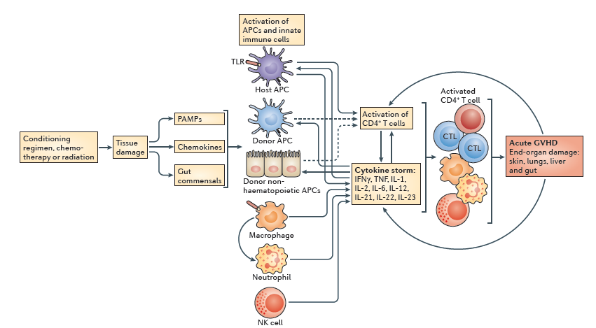
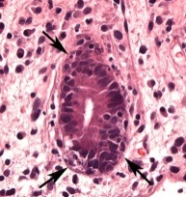
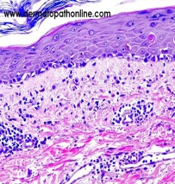
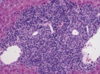
Akut graft-versus-host hastalığı patogenezi
Notes:
. Figure 1 | The overall acute GVHD cascade. The initiation and maintenance of acute graft-versus-host disease (GVHD) has been conceptualized into four phases with positive feedback loops that perpetuate the process. Although the conditioning phase is not absolutely necessary for the induction of acute GVHD, in many of the models it activates antigen-presenting cells (APCs), via tissue destruction, and increases APC function. Through the release of gut bacteria, pathogen-associated molecular patterns (PAMPs) and chemokines, the conditioning phase can also lead to the activation of innate immune cells that participate in direct tissue damage and contribute to the cytokine storm. Host haematopoietic APCs probably have the most important role in the initiation of GVHD, but this may depend on the model; the potential role of donor APCs and host non-haematopoietic APCs should not be ignored. Following the presentation of antigens to T cells, a strong cytokine response is initiated. These cytokines further promote antigen presentation and the recruitment of effector T cells and innate immune cells, which further augment the pro-inflammatory cytokine milieu. Finally, the effector T cells, natural killer (NK) cells, macrophages and pro-inflammatory cytokines (such as tumour necrosis factor (TNF)) result in end-organ damage, which is clinically recognized as acute GVHD in the skin, lungs, gut and liver. The resulting tissue damage, if not treated, will further amplify the process to more severe stages of GVHD pathology, which are extremely difficult to control. CTL, cytotoxic T lymphocyte; IFNγ, interferon-γ; TLR, Toll-like receptor.
Over the past decade, the immunomodulatory functions of MSCs have triggered great interests in their application for GVHD. Le Blanc K et al were the first to transplant haploidentical MSCs in a 9 year old boy withsevere treatment-resistant grade IV aGVHD of the gut and liver. They found the clinical response was strikingand the patient was well after 1 year [9].

Slide 16
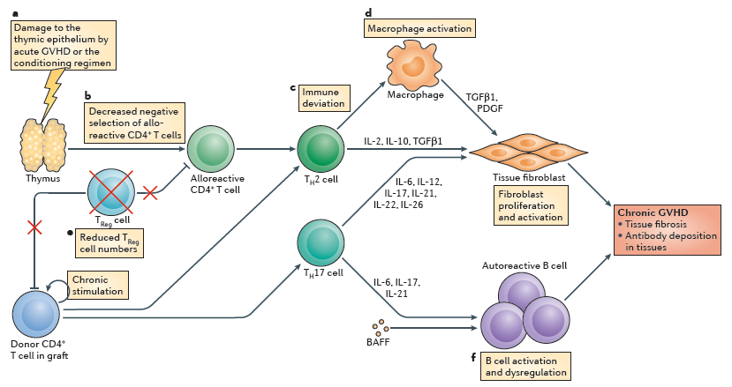
Kronik graft-versus-host hastalığı patogenezi
Notes:
Figure 2 | Crucial factors in the development of chronic GVHD. The pathophysiology of chronic graft-versus-host disease (GVHD) mainly depends on the polarization of CD4+ T cells into T helper 2 (TH2) cells, but there are six hallmarks that are unique to this syndrome. The first feature is damage to the thymus (a), which can be caused by the conditioning regimen or, more importantly, by prior occurrence of acute GVHD. This damage results in decreased negative selection of alloreactive CD4+ T cells (b). There is immune deviation to a TH2‑type cytokine response (c), which includes the production of interleukin‑4 (IL‑4), IL‑5 and IL‑11. This response leads to the release of fibrogenic cytokines — such as IL‑2, IL‑10 and transforming growth factor‑β1 (TGFβ1) — and the activation of macrophages that produce platelet-derived growth factor (PDGF) and TGFβ1 (d). These molecules induce the proliferation and activation of tissue fibroblasts. Low numbers of regulatory T (TReg) cells are the fifth hallmark (e), and finally there is B cell dysregulation (f), which leads to the emergence of autoreactive B cells and the production of autoreactive antibodies. It has been suggested that autoreactive B cell activation may be due to the presence of high levels of B cell-activating factor (BAFF) in the lymphoid microenvironment. All these events contribute to an autoimmune-like systemic syndrome that is associated with fibroproliferative changes. These changes can occur in almost any organ of the body but mainly affect oral and ocular mucosal surfaces and the skin, lungs, kidneys, liver and gut.

Slide 17
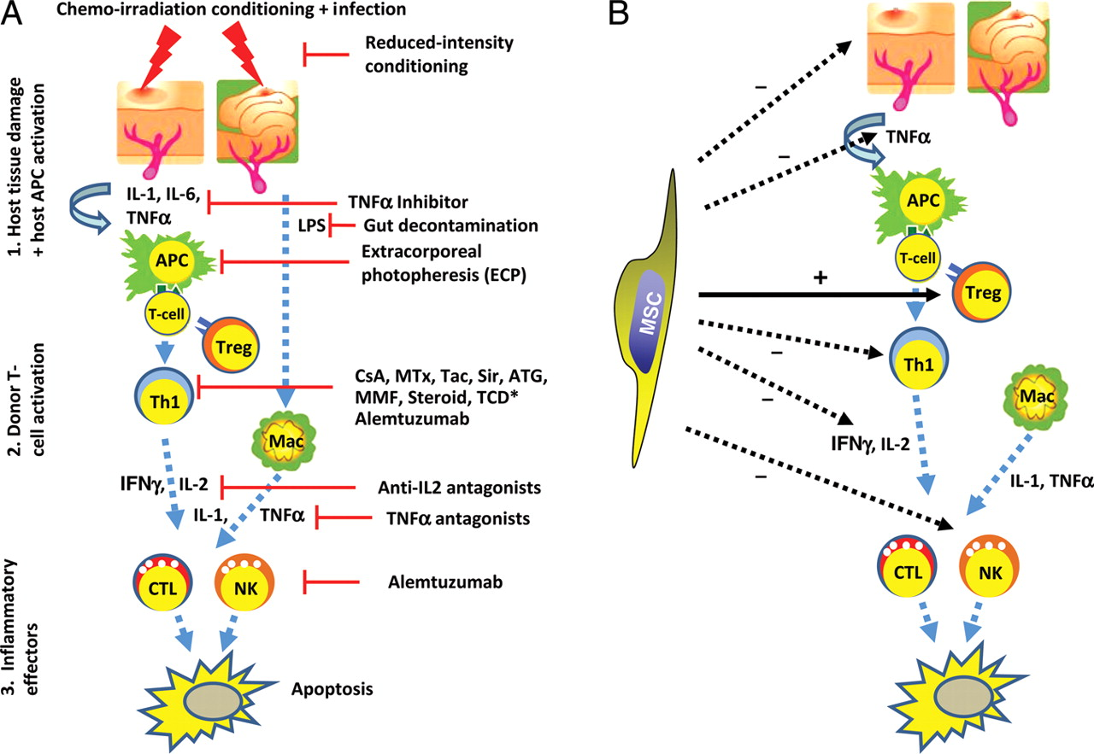
Graft-versus-host hastalığında hedefe yönelen tedaviler
Notes:
. Over the past decade, the immunomodulatory functions of MSCs have triggered great interests in their application for GVHD. Le Blanc K et al were the first to transplant haploidentical MSCs in a 9 year old boy withsevere treatment-resistant grade IV aGVHD of the gut and liver. They found the clinical response was strikingand the patient was well after 1 year [9].

Slide 18

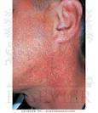
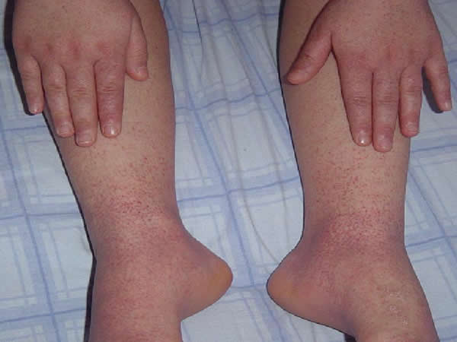
Graft-Versus-Host Hastalığı
Allojenik HKHN sonrası verici kaynaklıT lenfositlerin alıcı dokularda oluşturduğu GVHH yüksek oranda morbidite ve mortaliteye neden olmaktadır. Altın standart tedavisi kortikosteroidlere dirençli vakalarda halen etkin bir tedavi modalitesi bildirilmemiştir.

Slide 19
Steroide dirençli GVHH tedavisinde MKH Deneyimleri
İlk başarılı tedavi Le Blanc ve tarafından haploidentik nakil sonrası steroide dirençli akut GVHH (barsak-karaciğer) pediatrik olguda ex-vivo çoğaltılmış MKH kullanılması sonucu semptomlarda hızlı iyileşme rapor edilmiştir.
Bir süre sonra nüks eden olguda MKH’leri yeniden kullanımı sonucu tam ve kalıcı cevap elde edilebilmiştir.
(Le Blanc et al., 2004)

Slide 20
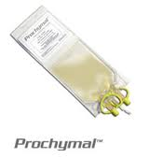
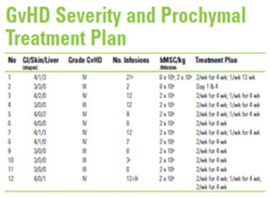
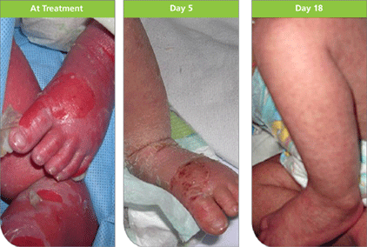
Compassionate use: (5/2006) USA geri ödeme 2012
Steroide dirençli GVHH tedavisinde MKH Deneyimleri
12 pediatrik hasta [yaş: 5 ay-15 yıl ]
Steroide dirençli ağır GVHH
The results of the Phase-II trial were presented at the 2006 ASH conference.
PROCHYMAL

Slide 21
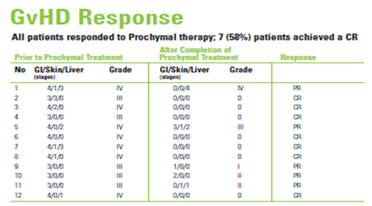
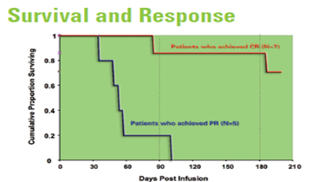
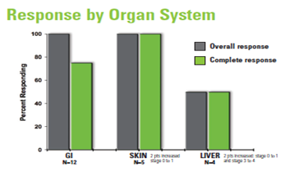
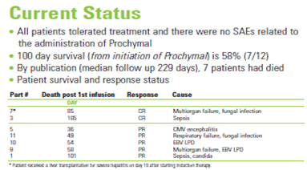
Compassionate use: (5/2006) USA geri ödeme 2012
Steroide dirençli GVHH tedavisinde MKH Deneyimleri
The results of the Phase-II trial were presented at the 2006 ASH conference.
PROCHYMAL

Slide 22
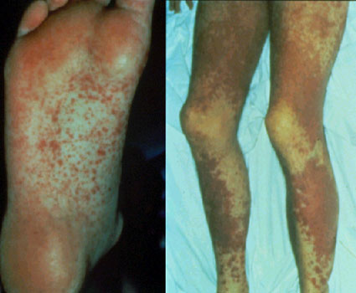
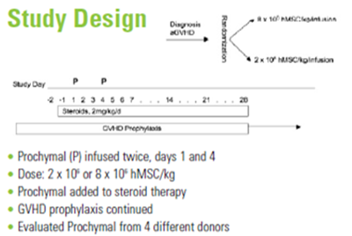
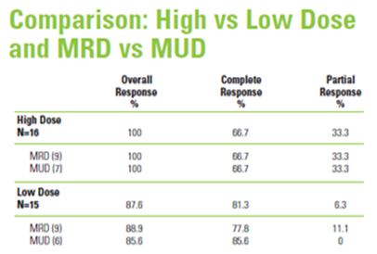
Compassionate use: (5/2006) USA geri ödeme 2012
Akut GVHH tedavisinde steroid + MKH tedavisi
A randomized, prospective, çok merkezli (16) grade II-IV GVHD. 32 erişkin hasta
The results of the Phase-II trial were presented at the 2006 ASH conference.
PROCHYMAL

Slide 23
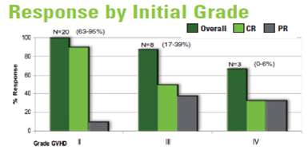
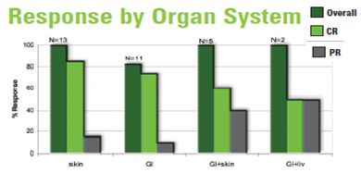
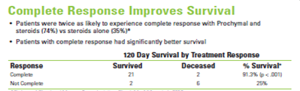
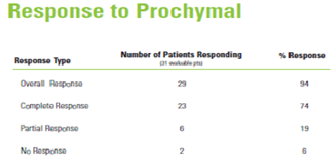

Compassionate use: (5/2006) USA geri ödeme 2012
Akut GVHH tedavisinde steroid + MKH tedavisi
The results of the Phase-II trial were presented at the 2006 ASH conference.
PROCHYMAL

Slide 24
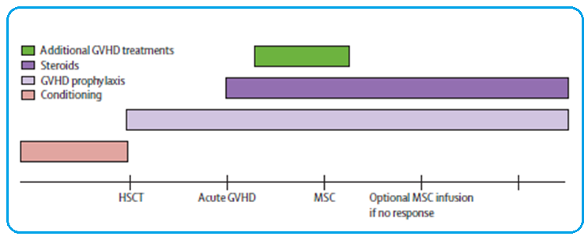

Steroide dirençli akutGVHH tedavisinde MKH Tedavisi: faz II çalışma
Karaciğer ve barsak fonksiyonlarında çarpıcı klinik cevap
55 steroide dirençli akut GVHH
25 çocuk ve 30 erişkin hasta
Mesenchymal Stem Cell Expansion EBMT Consortium,
Le Blanc et al, 2008

Slide 25
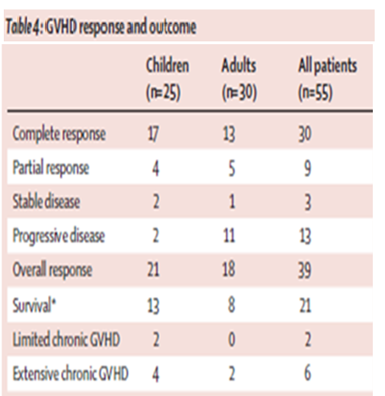
Steroide dirençli akutGVHH tedavisinde MKH Tedavisi: faz II çalışma
Grade II-IV akut GVHH
medyan 1 4×10⁶ hücre/kg
  % 55 Tam cevap
  % 71 Toplam cevap
MKH kaynağı aile içi verici (kardeş-haplo), akraba dışı ve 3. parti uygunsuz MKH vericisi
Mesenchymal Stem Cell Expansion EBMT Consortium,
Le Blanc et al, 2008

Slide 26
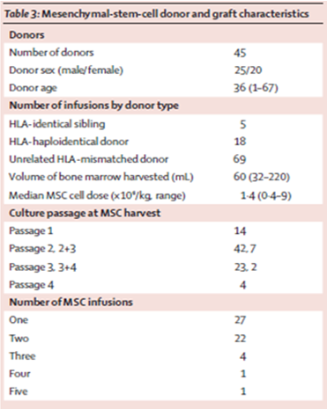
Steroide dirençli akutGVHH tedavisinde MKH Tedavisi: faz II çalışma
HLA uygun olma ile klinik cevap oranı bakımından MK hücre kaynaklarının farkı yoktu.
Hiçbir hastada MKH ilişkili yan etki bildirilmedi
Mesenchymal Stem Cell Expansion EBMT Consortium,
Le Blanc et al, 2008

Slide 27
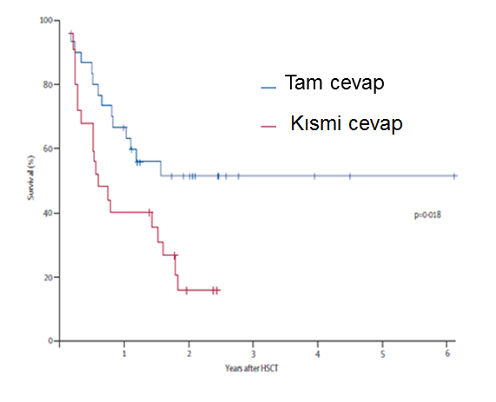
Steroide dirençli akutGVHH tedavisinde MKH Tedavisi: faz II çalışma
Kemik iliği kaynaklı MKH’ler kortikosteroid ve diğer immünosupresif tedavilere cevap vermeyen ağır GVHH tedavisinde yeni ve etkin bir tedavi seçeneği sunmaktadır.
2 yılın sonunda Tam cevap veren hastaların yarısında fazlası yaşamakta idi.
Mesenchymal Stem Cell Expansion EBMT Consortium,
Le Blanc et al, 2008

Slide 28
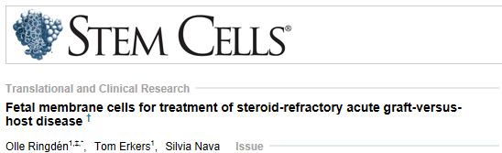
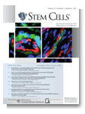
Steroid dirençli Akut GVHH’da Fetal Membran Hücreleri
Fetal (plasental) Membran Hücreleri kullanıldı
Ağır akut GVHH 9 hasta (medyan yaş:57)
0,9-2,8x106 FMH (CD29, CD44, CD73, CD90, CD105, CD49d pozitif, endotelyal ve epitelyal işaretleyiciler negatif
3 hasta tam cevap, 4 hasta kısmi cevap (toplam %75)
2013 Jan. [Epub ahead of print]

Slide 29
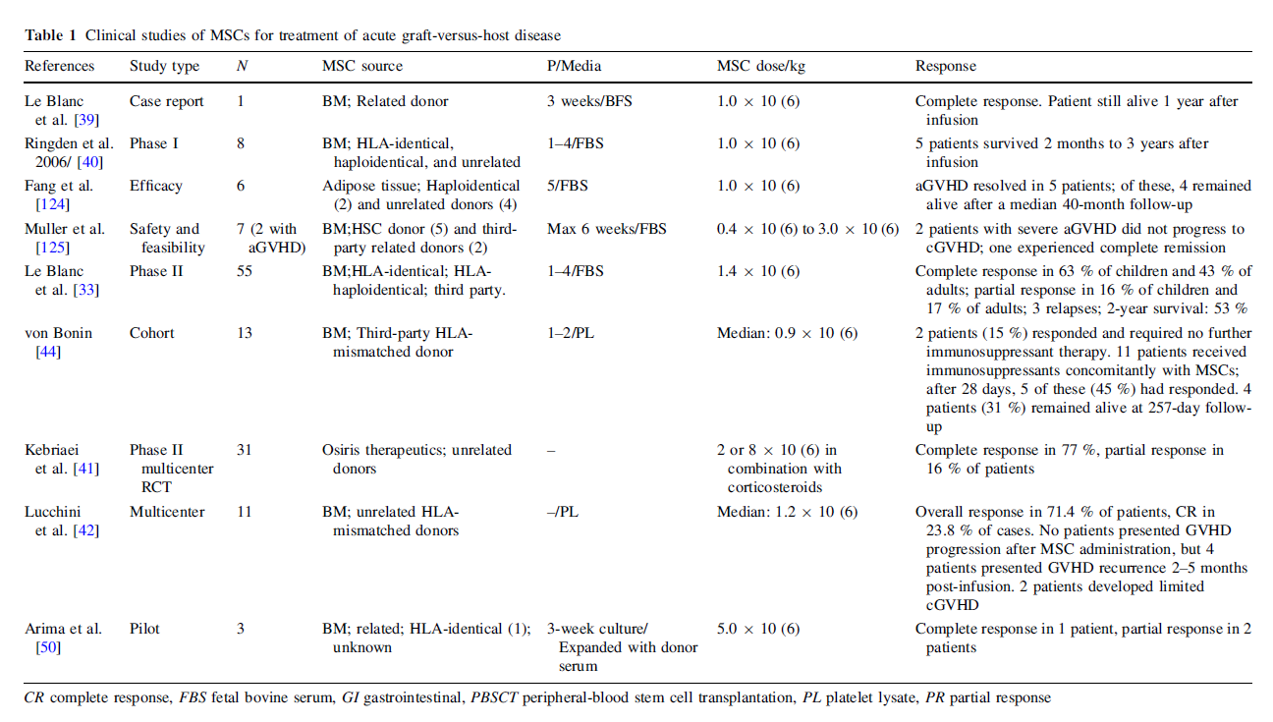
Faz II klinik çalışmalar; Steroide dirençli akut GVHH tedavisinde 3. parti MKH tedavisi

Slide 30
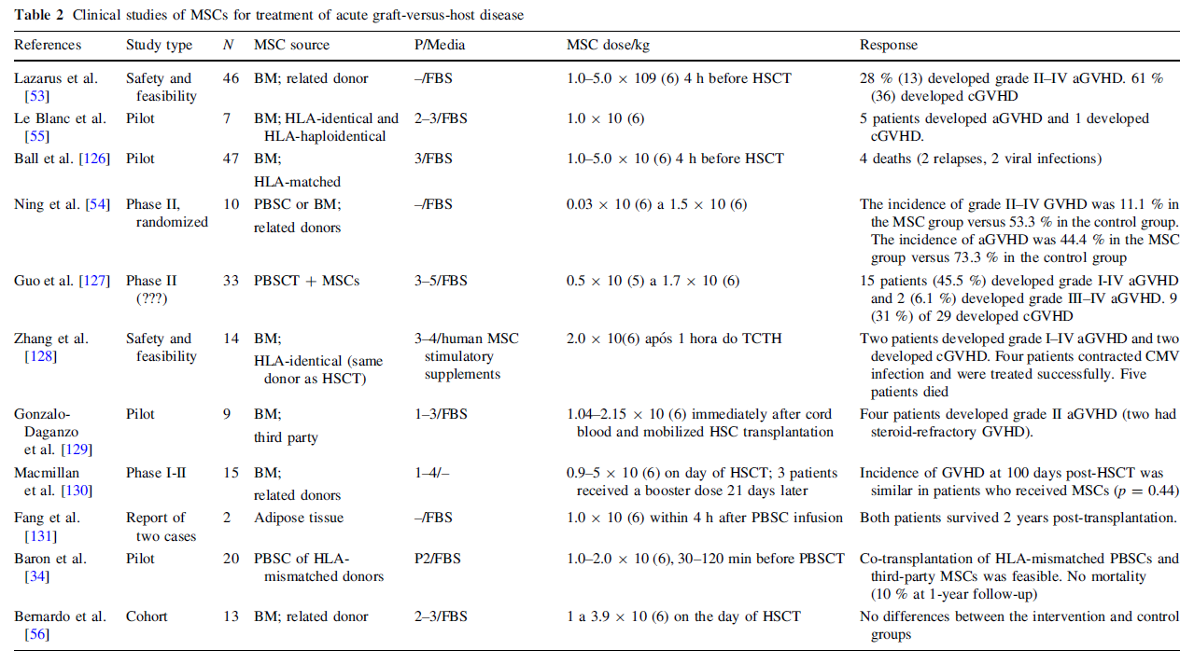
Faz klinik çalışmalar; Steroide dirençli akut GVHH tedavisinde 3. parti MKH tedavisi

Slide 31
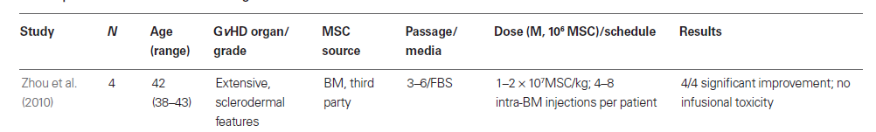
Kronik GVHH hücresel tedavisinde MKH Deneyimi
Sklerodermal tip kronik GVHH tedavisinde kayda değer iyileşme .......
Kemik iliği injeksiyonu ile 1–2 × 10⁷ hücre/kg verilen MKH’ler yaygın deri lezyonları ve ülserleri olan hastaların hastalık skorunda önemli oranda iyileşmeye yol açmıştır.
Th2 lenfosit oranında artış ve Th1 lenfositlerde azalma dikkati çekerken, lenfosit oranlarında Th1’den Th2’ye kayma cevap skoru ile ilişkilendirilmiştir
(Zhou et al., 2010).

Slide 32
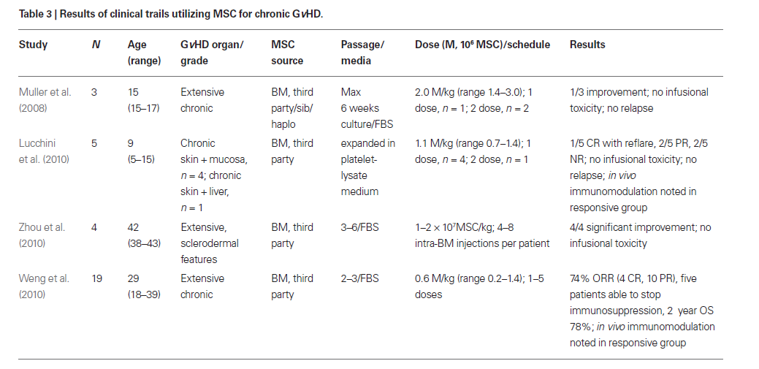
Faz II klinik çalışmalar; Steroide dirençli kronik GVHH tedavisinde 3. parti MKH tedavisi

Slide 33

Summary of clinical studies using adherent stem cells for GvHD prophylaxis.
Study | HSCT specifics | Stromal cell therapy | Stromal cell dosing | Observations
Maziarz et al. (2012) | URD, MRD, BM/PB, Adults CSA+MTX, Tac+MTX | Third party, universal donor, GHVD prophylaxis | 1, 5, or 10million/kg, single dose day 2 after HSCT, or 1 or 5million/kg repeat dose on day 2, 9, and 16, or days 2, 9, 16, 23, and 30 after HSCT | Grade II–IV and III–IV GVHD at Day 100 was 37 and 14%, resp. (n=36). 11% II–IV GVHD and no grade III–IV GVHD and in 10million/kg group single dose (n=9). Anticipated rates in this population; 47% II–IV and 15% III–IV
Kuzmina et al. (2012) | RD, HSCT, adults CSA, MTX, prednisolone | HSC donor-derived MSC, GVHD treatment | 0.9–1.3million/kg, 19–54days after HSCT | Grade II–IV aGVHD in 33.3% of control patients and 5.3% in MSC prophylaxis group
Bernardo et al. (2011) | URD, RD, UCB, pediatricCSA+steroids, CSA+MTX | Paternal derived MSC, GVHD prophylaxis | 1–3.9million/kg, single dose at day of HSCT | Reduced grade III–IV GVHD (0%, compared to historic controls 18/8%)
Baron et al. (2010) | URD, PB, adults MMF+Tac | Unrelated MSC, safety of MSC co-transplantation | 1–2million/kg at day of HSCT | Day 100 incidence of grade II–IV was 35%. Cumulative incidence of grade II–IV GVHD was 45%, compared with 56% in historic group
Macmillan et al. (2009) | URD, UCB, pediatric CSA+steroids | Parental MSC, promote engraftment | 0.9–5million/kg at day of HSCT; three patients second dose at day 21 | At day 100, cumulative incidence of grade II–IV similar between MSC and historic control (38 versus 22%, p=0.44)
Ning et al. (2008) | RD, BM/PB, adult CSA+MTX | Sibling derived MSC, MSC prophylaxis | 0.03–1.53million/kg at day of HSCT | Grade II–IV was 11.1% in MSC group and 53.3% in non-MSC group. Overall aGVHD incidence was 44.4% in MSC and 73.3% in non-MSC group
Ball et al. (2007) | MRD, PB, pediatric | HSC donor-derived MSC, graft failure | 1–5million/kg single dose at day of HSCT | No graft rejection in patients receiving MSC, 14.8% failure in control group (p=0.14)
Lazarus et al. (2005) | RD, PB/BM, adults CSA+MTX | HSC donor-derived MSC, GVHD prophylaxis | 1, 2.5, or 5million/kg single dose at day of HSCT | Overall, 50% of patients developed aGVHD, at least grade II in 28% of patients. 11 and 4% developed grade III and IV respectively

Slide 34
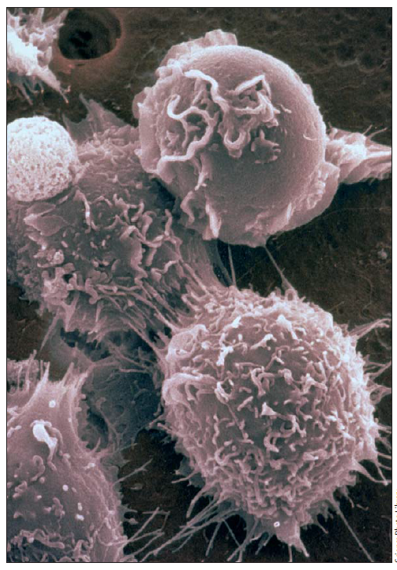
Mezenkimal Kök Hücreler: Yeni Hücresel immunosupresif biyolojik ilaçlar olarak
Dendritik hücreler (DC) akut GVHH patogenezinde rol alan naive T hücrelerin antijen sunucusudur. (Shlomchik, 2007).
MKH’ler monositlerin DC ‘ye farklılaşması, aktivasyonu ve fonksiyonları üzerine inhibe edici etkisi vardır. (Uccelli et al., 2008).
MKH’ler NK hücre proliferasyonu ve sitokin üretimini inhibe etmek suretiyle fonksiyonlarını kontrol eder. (Spaggiari et al., 2006).
T hücre, B hücre, NK ve DC üzerine etkilerin toplamı GVHH’da host’a karşı oluşan alloreaktiviteyi module eder.
MKH’LER BU DURUMDA ADETA HÜCRESEL BİR İMMÜNOSUPRESAN ROLU OYNAMKADIR:
Editorial: Dominik Wolf,Vol 371 May 10, 2008

Slide 35
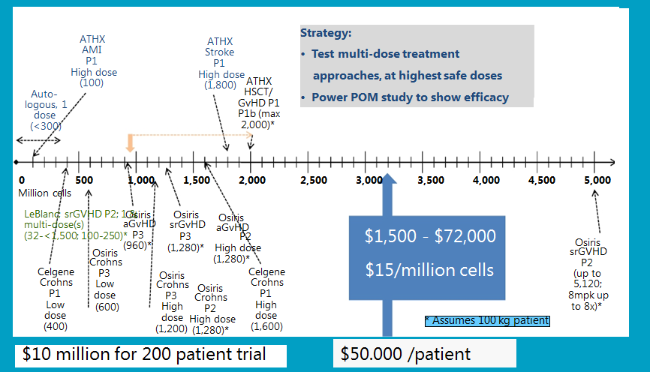
Cumulative Dose per Patient – Selected Clinical Studies
Wide Range for Treatment COGS: Reimburseable?

Slide 36
MKH’lerin ‘’Bench to bedsite’’ translasyonel geçişinde cevaplanmayı bekleyen sorular
Gerçek MKH ‘’ True MSC ‘’ işaretleyicileri
Standart MKH tanımlanması (homojenizasyonu) hala sorun… !?
(b) Kullanılan biyoaktif ürünleri klinik etkinliği, biyodağılımı, (Pharmacokinetic / pharmacodynamic ) profilleri..!?
(c) Hücresel komponentin yaşı ve biyoaktif molekül içeriği (sekrotom)
(d) MKH uygulama zamanı ve dozu.. Kime hangi-dozda-ne zaman?
(e) Raf’tan veya bireye özgü ürünlerin standardizasyonu
(f) Geri ödeme kapsamının genişletilmesi ve yatırım maliyetleri…!?
(g) Dünyada ve Türkiye de hukuki düzenlemeleri yetersizliği

Slide 37














CAPPADOCCIA BONE MARROW TRANSPLANT CENTER

